Slide 1
Autonomous car with the FRDM-KL25Z board
Germán Rivera
(jgrivera67@gmail.com)

Slide 2
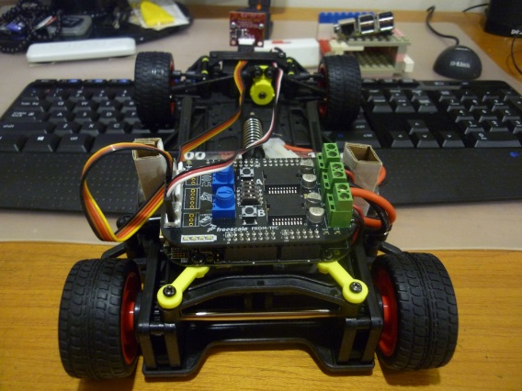
Overview
Hardware Platform for the autonomous car project
TFC-KIT: The NXP Cup Intelligent Car Development System
FRDM-KL25Z board
TFC-shield board
Line scan camera board
Wheel DC motors
Steering servo

Slide 3
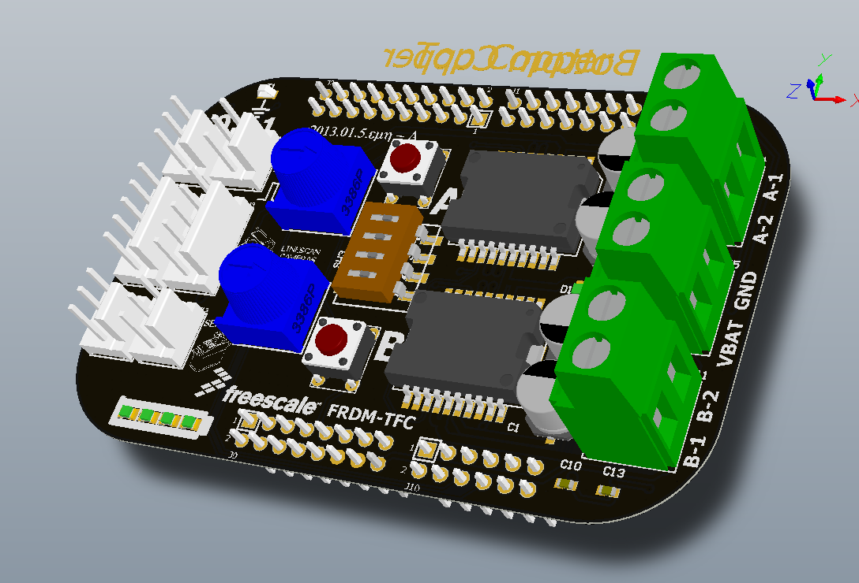
Overview (2)
TFC Shield User Interface Elements
trimpot1
push button A
trimpot2
push button B
DIP switches (4)
Battery LEDs

Slide 4
Process Control Problem Formulation
feedback control
loop

Slide 5
Software Context Diagram

Slide 6
Hardware Context Diagram

Slide 7
Control Software High-level Architecture

