Slide 1

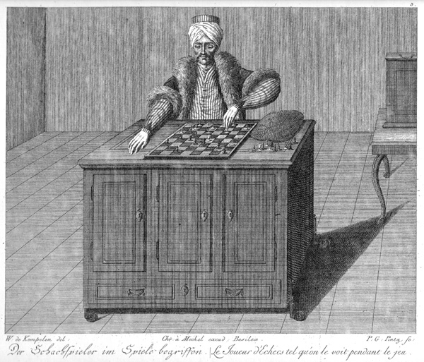
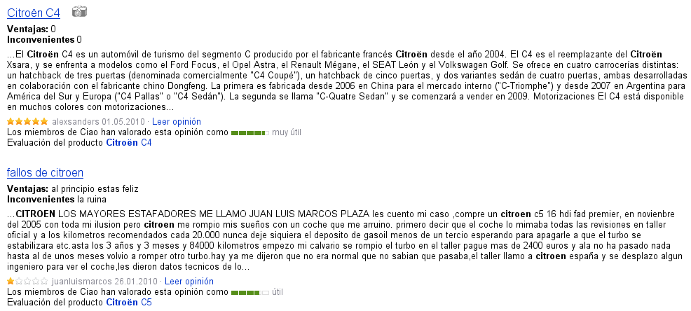
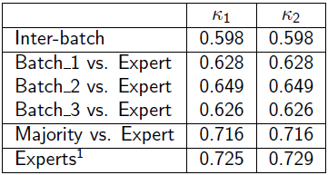
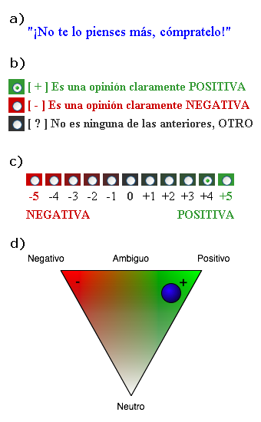
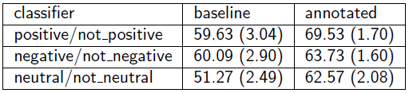
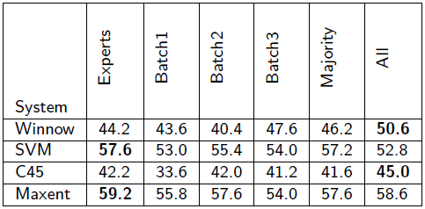
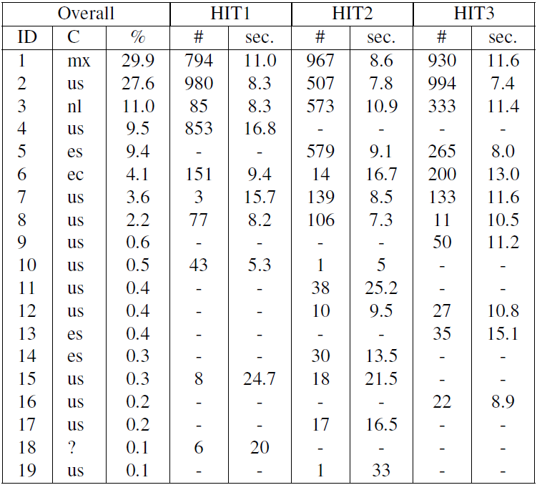
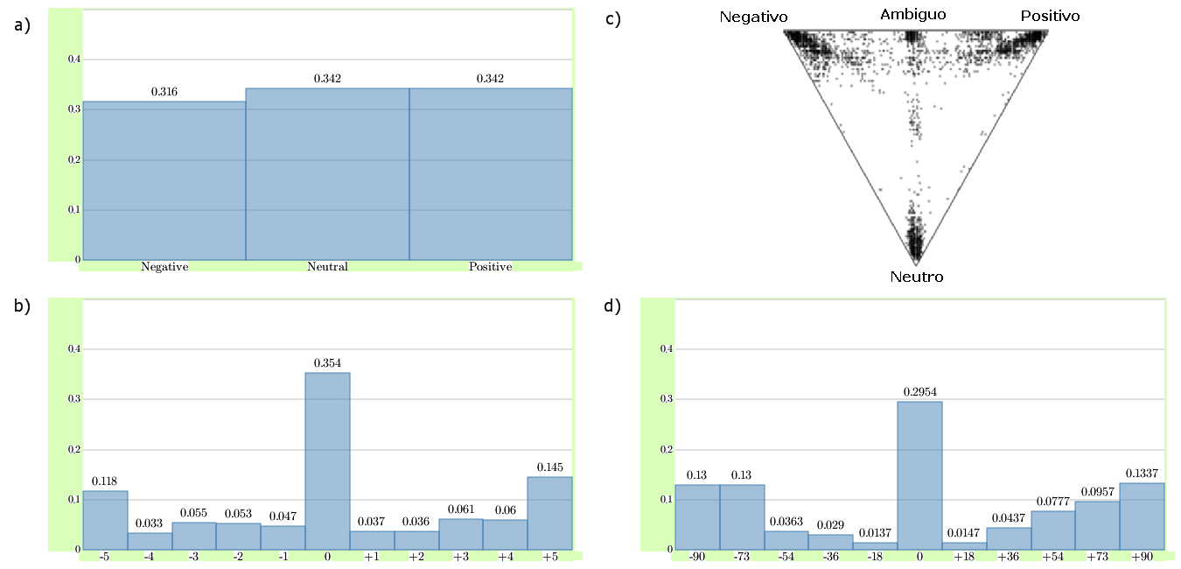
Opinion Mining of Spanish Customer Comments
with Non-Expert Annotations on Mechanical Turk
Summary:
We compare different HIT design strategies by evaluating the usefulness of resulting MechTurk annotations to train an Opinion Mining System on Spanish Consumer data.
Four Research Questions:
    What is the quality of the MechTurk annotations?
    What is the performance of classifiers trained on the data?
    Language Barriers: is there a large enough worker pool for Spanish?
    Is it cheaper to use Mturk than Expert annotations, and, if so, how much?
Conclusions:
    High Inter-Annotator Agreement between MechTurk and Experts.
    MechTurk annotations outperform initial noisy data and produce results on par with Expert annotations.
    After introducing a competence test, getting results for Spanish was easy and rapid.
    For the task at hand, we saved 65% of an Expert Annotator
Bart Mellebeek, Francesc Benavent, Jens Grivolla, Joan Codina, Marta R. Costa-Jussà* and Rafael E. Banchs
Barcelona Media Innovation Center
Av. Diagonal 177, planta 9
08018 Barcelona, Spain
{bart.mellebeek|francesc.benavent|jens.grivolla|
joan.codina|marta.ruiz|rafael.banchs}@barcelonamedia.org
Raw Data
MechTurk
Training Data
1000 Spanish user reviews on cars. Source = www.ciao.es
Opinion
Mining
Inter-Annotator Agreement
Only training data from HIT 1 were used in the experiments. Results on training data from HITS 2 and 3 are forthcoming.
Three different HIT designs
Experiment 1
Experiment 2
Inter-Annotator Agreement as a measure of quality of the annotations in HIT1. κ1 = Fixed Margin Kappa. κ2 = Free Margin Kappa.
HIT Statistics
HIT Correlation
Binary classification. Mean accuracy over 20 independent simulations (standard deviation in parenthesis) for each classification subtask trained with either the baseline or the annotated data set.
Multiclass classification. Accuracy figures of four different classifiers (Winnow, SVM, C45 and Maxent) trained on six different data sets.
Some more information about us:
www.barcelonamedia.org
Barcelona Media is
    An R&D Center in Barcelona, Spain.
    Interested in Applied Research and Commercial Projects.
    Currently focusing on Opinion Mining.
*This Researcher has been partially funded by a Juan de la Cierva Research Grant from the Spanish Ministry of Science and Innovation, co-funded by the European Social Fund.
Example sentence.
HIT1 – discrete categorization
HIT2 – discrete graded cat.
HIT3 – continuous categorization
Statistics on Mturk workers for all three HIT designs: (fictional) worker ID, country code, % of total number of HITs completed, number of HITs completed per design and average completion time.
Overview of HIT results; a) distribution of the three categories used in HIT1, b) distribution of results in the scaled format of HIT2, c) heat map of the distribution of results in the HITs triangle, d) distribution of projection of triangle data points onto the X-axis.

