Slide 1
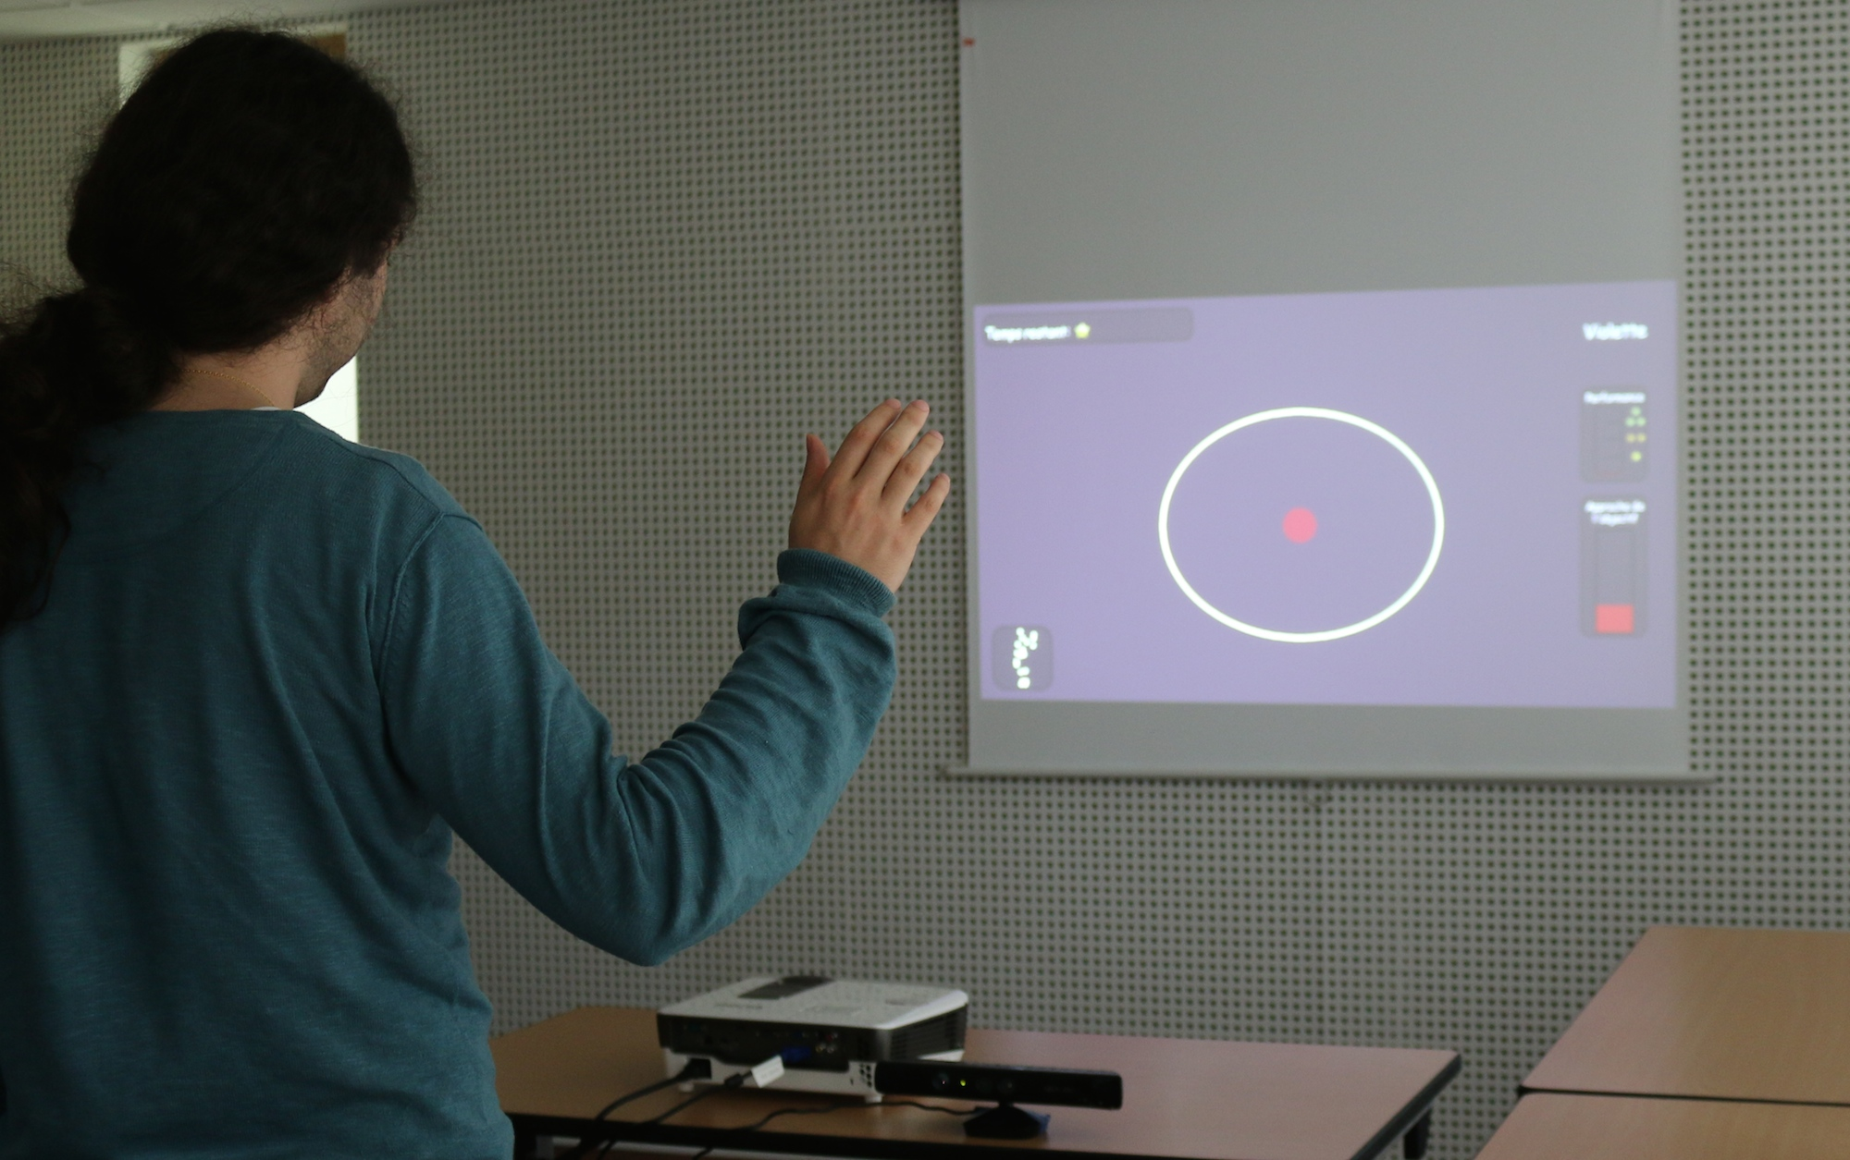
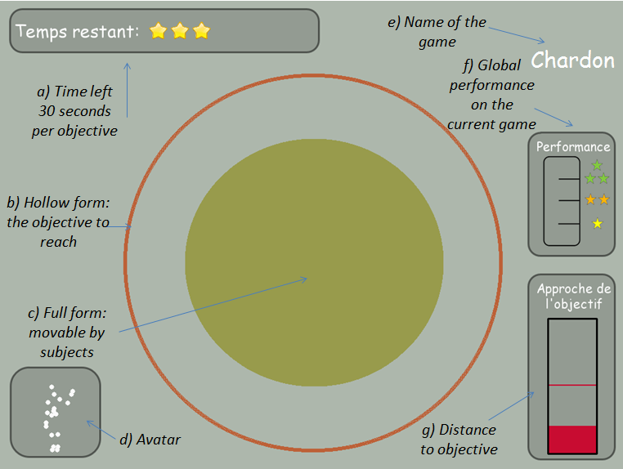
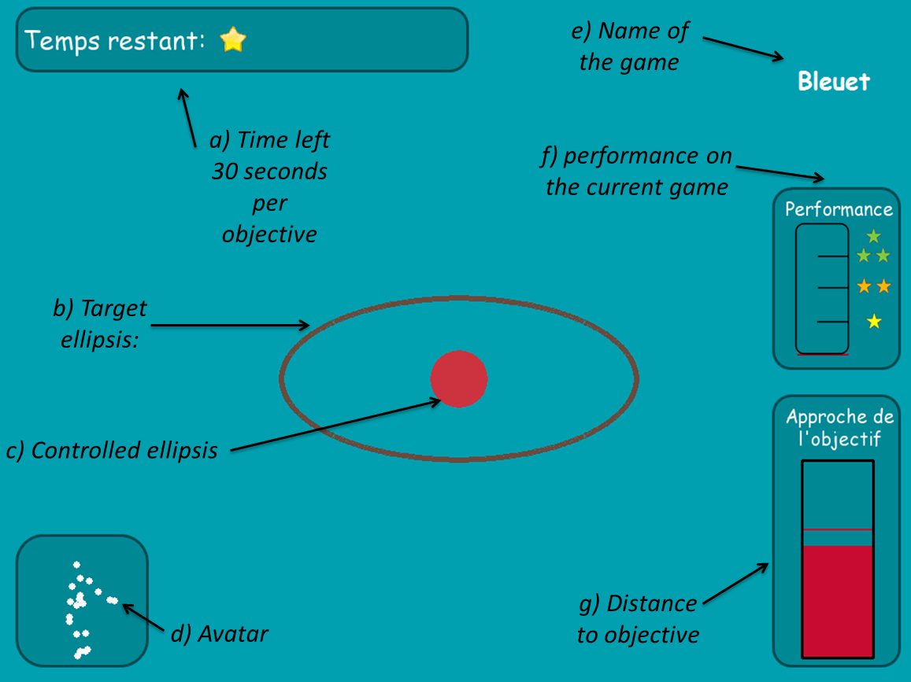
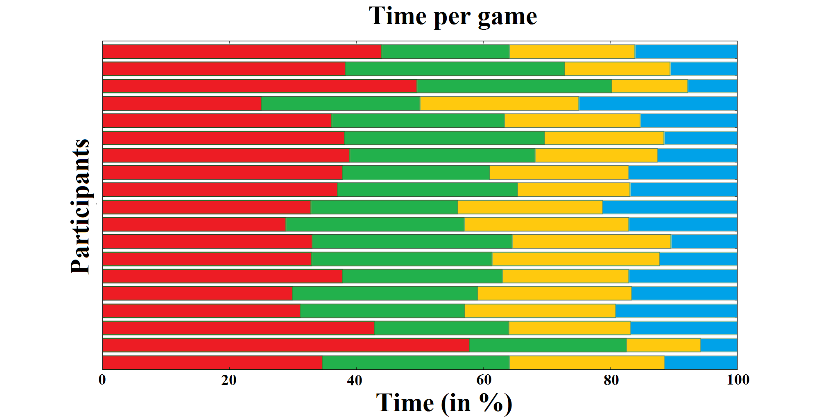
A New Experimental Setup to Study the Structure of Curiosity-Driven Exploration in Humans
Brice Miard, Pierre Rouanet, Jonathan Grizou, Pierre-Yves Oudeyer, Manuel Lopes, Adrien Baranes, Jacqueline Gottlieb
Study how they allocate time among the 4 games.

