Slide 1

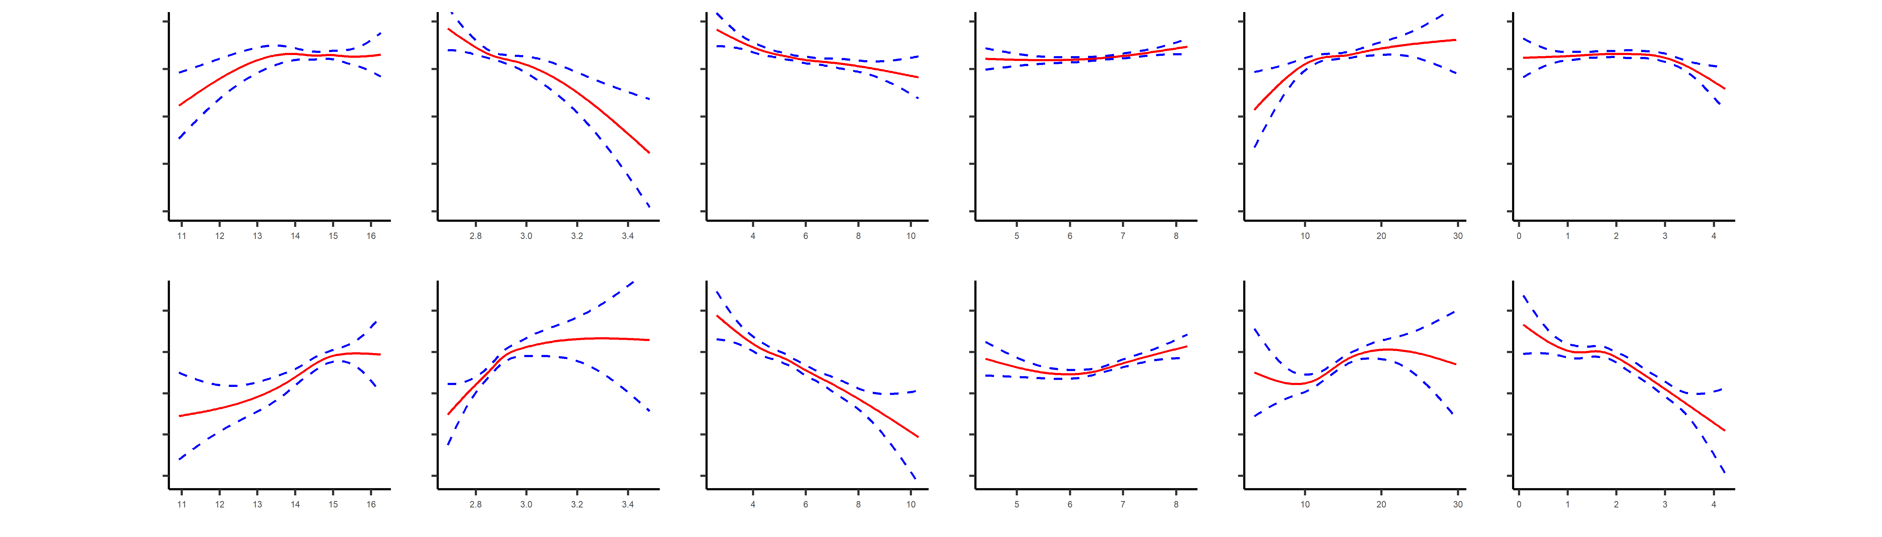
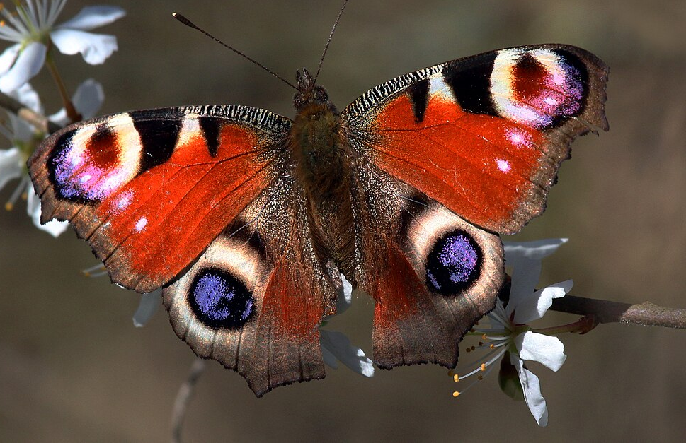
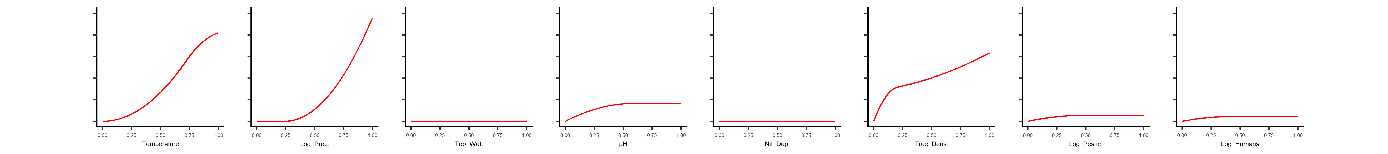
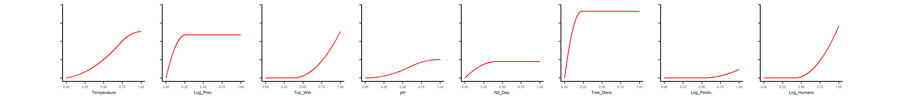
Anthropogenic influences on British butterfly diversity: species richness and turnover
Add logos
Add logos
Add new improved title here
James Rodger, Rob Cooke, Nick Isaac, Guillaume Latombe, David Roy, Ben Woodcock, and Cang Hui
Influence of environment on butterfly diversity
For habitat generalists, climate variables have larger effects
For habitat specialists, climate and habitat variables have similarly sized effects
Overall, environmental variables have larger effects for habitat specialists than generalists
Without mitigation, a declines in butterfly diversity is expected via both within and between site diversity declines, arising from local extinctions of habitat specialists due to climate and habitat change
Put into colourblind simulator
rodgerjg@gmail.com
Within-Site Diversity
Habitat Generalists
Climate
Habitat
Scan for orcid
Habitat Specialists
Species richness against environmental variables
Butterfly diversity data from UKBMS transects in Great Britain, aggregated 2015-2019; Environmental variable data from diverse datasets for 1km grid cells matching butterfly transects. Analysis with GAMM
Ask Andrew for Large Blues
Between-Site Diversity
Asked Andrew for Large Blues
Climate
Habitat
Habitat Generalists
Habitat Specialists
Turnover against environmental variables
Data sources as for Fig 1.. Analysis with MSGDM, zeta = 4 Try MSGDM splines like Fig 1, if bars include some measure of diversity
Background
Evidence is accumulating for the declines of some insect groups in some regions, but our understanding of how anthropogenic change is driving changes in insects is limited
Regional diversity may decline both due to reductions in within-site diversity due to local extinctions (reduced richness) and homogenisation of species composition across sites (reduced turnover).
To understand anthropogenic influences on butterfly diversity at large spatial scales, we must assess the importance of the multiple natural and anthropogenic drivers for both within- and between-site diversity.

