Slide 1
Recommendations for standardized data exchange in photoacoustic imaging Working Group 4
Presented by Janek Gröhl
on behalf of all working group members

Slide 2
Working Group 5 - members
Janek Gröhl (Group lead)
Hisham Assi
Jeff Bamber
Richard Bouchard
Joanna Brunker
Lucia Cavigli
Bryan Clingman
Germany
Canada
UK
USA
UK
Italy
USA
Ben Cox
Lina Hacker
Drew Heinmiller
Stefan Morscher
Yoko Okamura
Ruiqing Ni
Maximillian Waldner
UK
UK
Canada
Germany
Japan
Switzerland
Germany

Slide 3
Working Group 4 Mission
Understand the format of PA data available from commercial and custom-built PA imaging instruments
Define a list of accompanying metadata
Identify the metadata that would be required to enable open access and open use of data
Focus near term on commercial imaging instruments

Slide 4
Motivation: Current state of PA data formats
Systems use proprietary file formats
Viewable with vendor specific software
Interfaces to access data:
Python
MATLAB

Slide 5
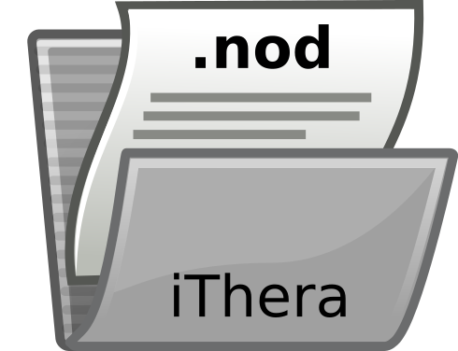
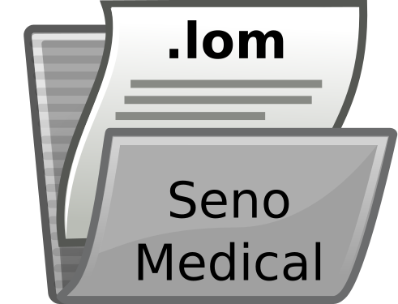
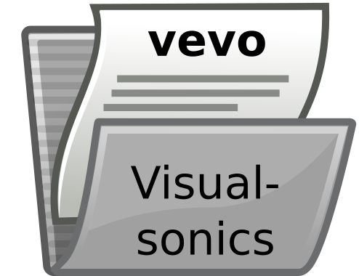
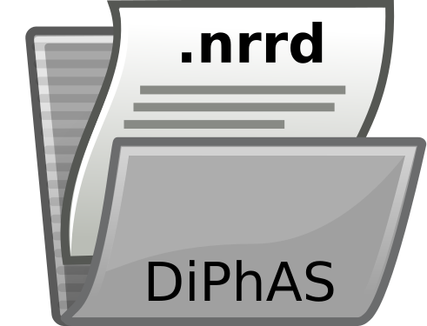
PAI data format landscape (examples)
iThera Medical, MSOT / RSOM
Proprietary .nod file format
Seno Medical
Proprietary .lom file format
Visualsonics
Proprietary file format
Fraunhofer DiPhAS MITK integration
NRRD file format

Slide 6
Metadata Parameters
Essential parameters to be able to read the raw data
Dimensionality + sizes
Data type
Encoding
Parameters required for reasonable image reconstruction and processing
US transducer design
Illumination geometry
Time domain information
sampling frequency
index of sample which corresponds to zero time
For quantitative image processing
the angle and frequency-dependent response of the detectors
Pulse to pulse laser energy
Notes:
For quantitative image processing:

Slide 7
Standardised data format: Requirements
Binary data container with lossless compression
Raw element data needs to be streamable and saveable as a stream
Binary data + metadata in the same file

Slide 8
Good candidate: HDF5
Fulfils all requirements:
(1) scalable, open and enables fast access times
(2) contains the metadata within the data file → metadata cannot get lost when exchanging files
(3) easily accessible without being limited to a specific programming language. → provides interfaces for e.g. C++, Python, MATLAB, and Java.

Slide 9
Recommendation
(1) To initially only include raw time series data into the standardization
(2) To use HDF5 as the standardized file format
(3) To create a standardized list of metadata parameters

Slide 10
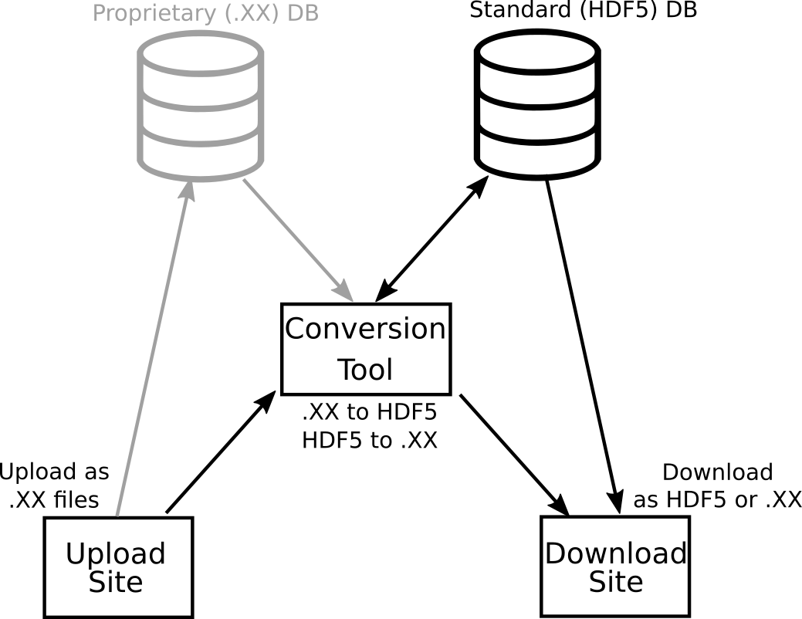
Next steps

Slide 11


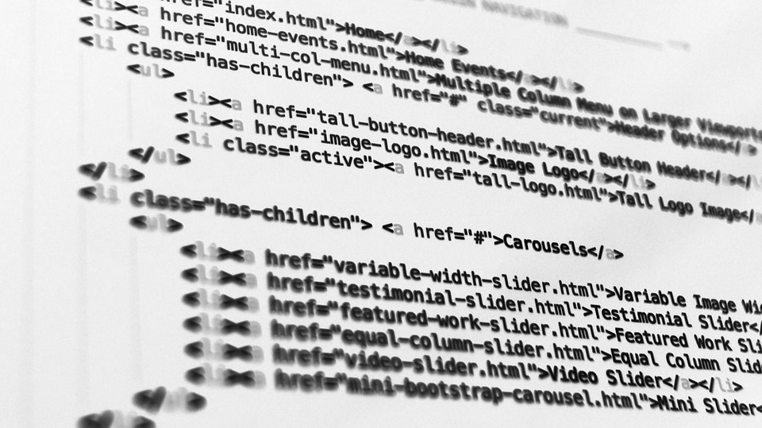
Next steps

Slide 12
Acknowledgements
Working Group Leads
Joanna Brunker UK
James Joseph UK
Lina Hacker UK
Janek Gröhl Germany
William Vogt USA
Chair - Sarah Bohndiek UK Co-Chair - William Vogt USA
Academic Members
Paolo Armanetti Italy
Hisham Assi Canada
Jeff Bamber UK
Paul Beard UK
Thomas Berer Austria
Richard Bouchard USA
Kimberly Briggman USA
Lucia Cavigli Italy
Ben Cox UK
Adrien Desjardins UK
Jeeseong Hwang USA
Eno Hysi Canada
Aoife Ivory UK
Academic Members
Thomas Kirchner Germany
Jan Klohs Switzerland
Lena Maier-Hein Germany
Efthymios Maneas UK
Julia Mannheim Germany
Srirang Manohar Netherlands
Lacey McNally USA
Luca Menichetti Italy
Ruiqing Ni Switzerland
Malini Olivo Singapore
Marty Pagel USA
Geoff Parker UK
Anna Pelagotti Belgium
Academic Members
Antonio Pifferi Italy
Srinath Rajagopal UK
Daniel Razansky Germany
Avihai Ron Germany
Maximillian Waldner
Germany
Kun Wang China
Lihong Wang USA
Wenfeng Xia UK
Bajram Zeqiri UK
Industrial Members
Bryan Clingman USA
Drew Heinmiller Canada
Jithin Jose Netherlands
Steven Miller USA
Stefan Morscher Germany
Yoko Okamura Japan
Lisa Richards USA
Mithun Singh Japan
www.ipasc.science
Notes:
Personally, I want to acknowledge my funding from the ERC starting grant

