Slide 1
Current Progress of the
Data Acquisition and Management
Theme
Lina Hacker & Janek Gröhl
Notes:
Lina intro -> Janek first part -> Lina part 2-3-4

Slide 2
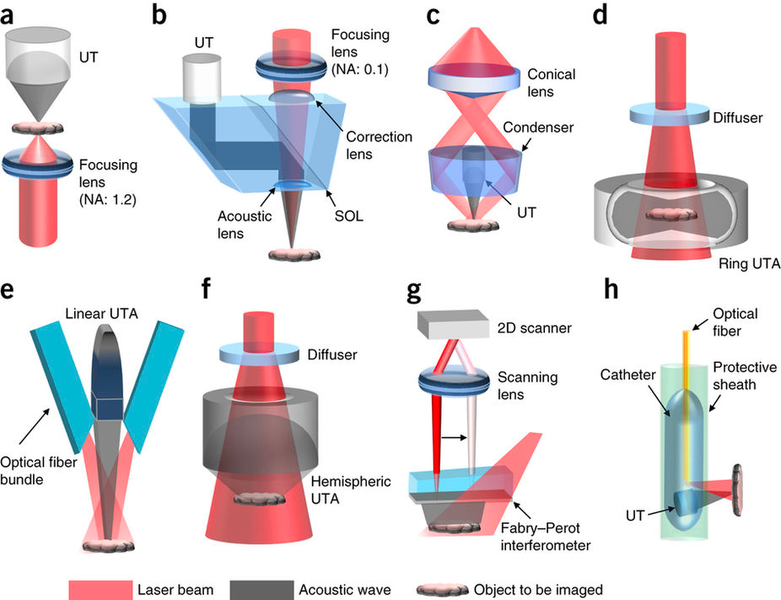


Goals of the DAM theme
4 open-access platform for PA data
3 consortium-wide PAI instrument library
2 open source tool for data conversion
A
B
C
1 standardised PA data format

Slide 3
Goal 1: IPASC-DAM Consensus Document
4 open-access platform for PA data
3 consortium-wide PAI instrument library
2 open source tool for data conversion
A
B
C
1 standardised PA data format

Slide 4
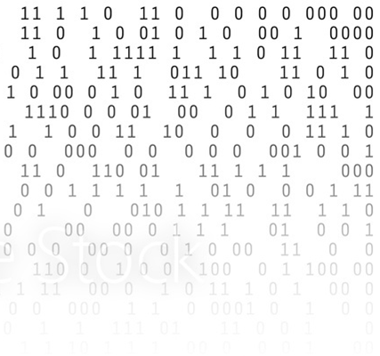
Goal 1: IPASC-DAM Consensus Document
Document divided into two parts:
(1) Model representation of the PA device
(2) Holistic collection of
PA image metadata
Z axis
X axis

Slide 5
Part 1: Representation of PAI device
Goal: Building a first basis for modelling device-specific PAI data acquisition.
Illumination geometry
Number, position, orientation and shape of elements
Specialized element properties (e.g. laser energy profile, pulse duration / width)
Detection geometry
Number, position, orientation and shape of elements
Specialized element properties (e.g. detector frequency response, angular response)

Slide 6
Part 1: Representation of PAI device
Representation in a coordinate system which is relative to the detector field of view.
Allows definition of arbitrary geometries
Z axis
Detection Element
Detector
Field of view
Illumination Element
Y axis
origin=(0, 0, 0)
X axis

Slide 7
Part 2: Raw time series data metadata
Goal: Description of a universal metadata format for PA raw time series data.
File container format:
Encoding, compression, UID
Binary data metadata:
Data type, dimensionality, sizes
Acquisition metadata:
E.g. frame acquisition timestamps, acquisition optical wavelengths, gain, sampling rate

Slide 8
Goal 2: Open source PAI toolbox
4 open-access platform for PA data
3 consortium-wide PAI instrument library
2 open source tool for data conversion
A
B
C
1 standardised PA data format
Notes:
Thank you J, I will continue now wih the remaining goals
So apart from creating standardized PA data format, we would of course also require an open source tool to converting the data aquired from different systems into the established stad data fromat

Slide 9
Goal 2: Open source PAI toolbox
Step 1: Development of an initial prototype of the IPASC data format (HDF 5)
Step 2: Field testing of data acquisition and exchange with the format
goal-specific task force was built during last DAM call
Notes:
We are aiming to do that in wo steps:
In the first step we would need of course develop an initial prototype of the theoretaical data format established in goal 1
HDF5 as a suitable format to use
(1) scalable, open and enables fast access times
(2) contains the metadata within the data file → metadata cannot get lost when exchanging files
(3) easily accessible without being limited to a specific programming language. → provides interfaces for e.g. C++, Python, MATLAB, and Java.
After step 1, the second step would include …
Both steps are necessary to prove wthether our theoretical concept developed in gial 1 is feasible or if changes have to be made
To tackle both of these goasl a taskforce … which will specifically focus on creating the data prototype and a firt framework of the conversion toll

Slide 10
Goal 3: PAI instrument library
4 open-access platform for PA data
3 consortium-wide PAI instrument library
2 open source tool for data conversion
A
B
C
1 standardised PA data format
Notes:
The third goal of the DAM theme is the collection of Pa instrument information within the consortium.

Slide 11
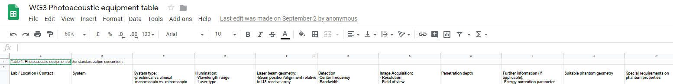
Goal 3: PAI instrument library
Goal: Collection of instruments that could be made available for phantom measurements and overview of phantom geometries needed.
So far 15 different systems
Information on system type and configuration, illumination and detection geometry, image acquisition details, etc..
Notes:
The aim of this consortium wide instrument library is to have a collection of instruments that could be made available to …
Most of you have probably already seen the equipment table which is shown here on the front. Every member of the consortium has been kindly asked to..
The collection encompasses so far 15 different types systems, including both commercial and custom-built systes and , covering macroscopic, mesoscopic, and microscopic devices.
Information on.. has been gathered and
Thereby we could identify the wide range of phantom geometires needed, going from half-spherical over planar to cylindrical architectures of different sizes.
This information is constantly fed back to the PD theme, which is working on optimizng the material properties to adjust them for the device -specfic requirements needed.

Slide 12
Goal 4: Open-access platform
4 open-access platform for PA data
3 consortium-wide PAI instrument library
2 open source tool for data conversion
A
B
C
1 standardised PA data format
Notes:
Moving on, we come to the 4th and last goal of the DAM theme, which is establishing an open access photoacoustic data platform. This platform aims to contain well-annotated sample data which can be used for example for testing and comparing processing algorithms and device performance.
Here work would still need to be done to specify the exact scope, application and hosting mechanism, but this would be one the aspects we would like to discuss in the afternoon.

Slide 13
Long term goals
Clinical integration of standardised PAI data:
Digital Imaging and Communications in Medicine (DICOM) format
New DAM sub-group on clinical integration
Notes:
While we were focussing so far on unprocessed PA raw data for simplification, our long term goal would be to integrate clinical standardisd PAI data into the DICOM format. The DICOM format is the international standard to transmit, store, retrieve and process medical imaging information. It integrates PACS, workstations and image-acquisition devices from diff vendors, and is actively developed and maintained and free to download and use
One of our consortium members, Stefan Morscher was so kind to explore the possibility of integrating PAI data into DICOM by establishing contact with the relavant DICOM authorities. We are aware now of the steps necessary to achieve this aim and might form soon a new thematic WG on this topic. But this would be also one point for our discussion group in the afternoon and hopefully Stefan can then share more details with you about that aspect.

Slide 14
DAM theme discussion in the afternoon
What are your requirements to be able to work with the IPASC data format and a respective conversion tool?
What are your applications and goals for a reference PA database?
Are there further ideas that should be considered in the DAM theme?
Feedback round.
Notes:
With this I am coming to an end with our presentation
We hope that we could clarify the exact aims of DAM theme and show you good progress we have been made during the last year.
If you are interested to dig deeper into PAI DAM, please join us in the afternoon discussion.
Here we would like to here your feedback on the general discussion of the DAM
will speifically focus on goal 2 and goal 4, open source conversion tool and open access and open access data platform

Slide 15

To everyone who actively participated in the DAM theme
Notes:
And at last I would like to say on behalf of Janek myself and a huge thank you to…
Without you all the great process in the last year would not have been possible
We are looking forward to continue our work with you. Thank you!

