Slide 1
Progress Report on the Study Design theme
William Vogt, Ph.D.
U.S. Food and Drug Administration
DISCLAIMER: The mention of commercial products, their sources, or their use in connection with material reported herein is not to be construed as either an actual or implied endorsement of such products by the Department of Health and Human Services. The opinions described herein are solely those of the author and should not be considered FDA policy or recommendations.

Slide 2

Overview of Standards
What is a “Standard”?
Test object (phantom)
Test method (image quality testing)
Data format (DICOM)
Documented set of technical definitions, guidelines
Specific to a type of device, system, process
Based on stakeholder consensus
What does a standard do?
Define performance characteristics
Describe performance test methods
Specify performance thresholds, safety requirements

Slide 3
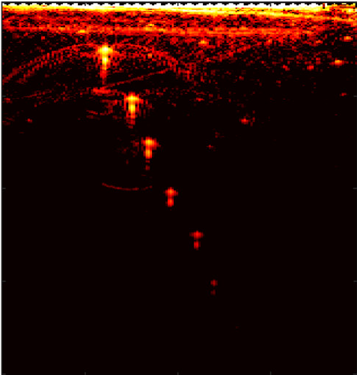
Levels of Standardization
Test Methodology Research

Slide 4

Levels of Standardization
Test Methodology Research
Collaboration, Consensus Documents

Slide 5


Levels of Standardization
Test Methodology Research
Standards Development Orgs.
Collaboration, Consensus Documents

Slide 6


Levels of Standardization
Test Methodology Research
Standards Development Orgs.
Collaboration, Consensus Documents
Accreditation (ACR,MQSA)

Slide 7
Why Develop Standards for PAI?
Nascent technology with wide variety of designs, applications
Standardized test methods are needed to support:
Objective, quantitative performance evaluation
Design evaluation and optimization
Interdevice comparison (benchmarking)
Regulatory decision-making
QA/QC, marketing, promotion
Indication of technological maturity
FDA Medical Device Development Tools (MDDT) Program
FDA can review and qualify tools, methods as suitable for regulatory purposes
Qualified for specific “context of use”, e.g., photoacoustic image quality assessment
Can be led/submitted by internal or external tool developers
Reviewed by team of FDA experts

Slide 8
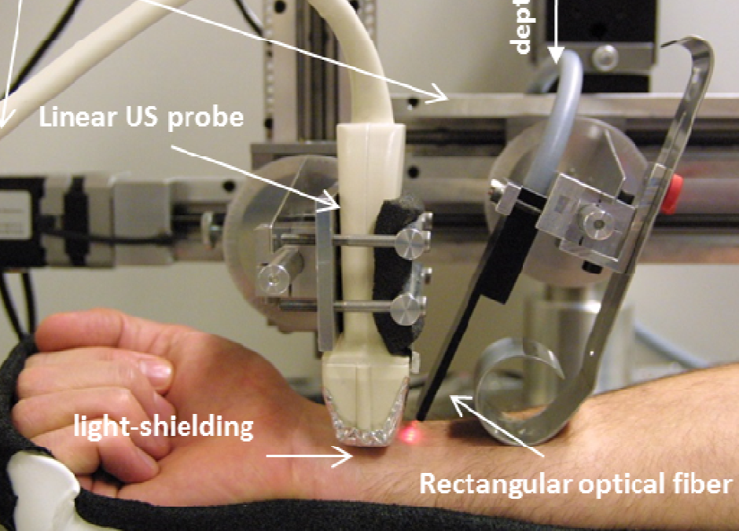
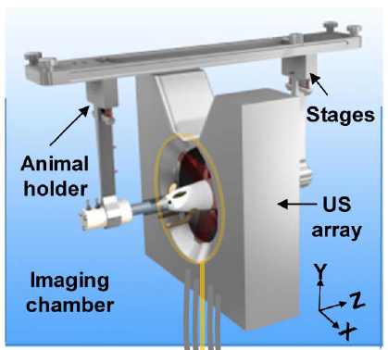
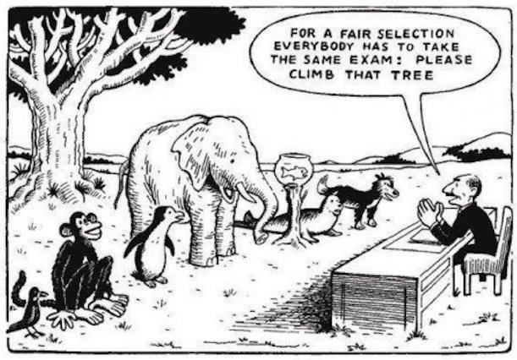
Elements of Medical Device Standards
Scope
As broad as possible…
Without sacrificing rigor, utility
Example: Which types of PAI devices?
Handheld vs. annular vs. hemispherical
Clinical devices vs. preclinical research tools
A generalized set of recommendations
May be established based on current type(s)…
But readily adapted to other or future types

Slide 9
Study Design Theme
Overall goal: Design multi-centre studies and resolve logistical challenges.
Aims:
Develop pre-specified study protocol for PAI system characterization
Resolve multi-site logistics (shipping, phantom calibration/constancy testing, etc.)
Why do a multi-site phantom study?
Reduce phantom-based test methods to practice
Identify topics where consensus must be reached
Produce peer-reviewed publications referenced during standard development

Slide 10
Previous Activity
Initial teleconferences held in mid/late 2018
Summary of initial recommendations
Identification of new consensus challenges

Slide 11

Previous Activity
Multi-site phantom study: how will phantom stability be evaluated?
Fabrication by a single source site
Measure optical + acoustic properties, mass
Maintain reference phantom, plugs
Cambridge group
“Test-ship-test” protocol
Source site characterizes phantom before shipment
Test site performs imaging
Source site reevaluates phantom
Ship to next test site
Test Site
Test Site
Source Site
Test Site
Test Site

Slide 12
Previous Activity
Initial consensus challenge: to what degree should standard prescribe measurement techniques?
Devices may have conflicting instructions for optimal use
Lack of controlled guidelines lowers reproducibility, consistency of the test method
Establish general guidelines
“Lock in” acquisition and display settings for entire test barrage
Protocol prescribes acoustic couplants (water, gel)
Positioning control
Stages: specify scan spacing (e.g., < half acoustic wavelength for elevational resolution testing)
Handheld devices: alignment procedure to produce “best-case scenario”
User training on phantom handling, packaging

Slide 13
Previous Activity
Image quality analysis should be pre-specified
Which performance characteristics, definitions?
Statistical measurements (multiple phantom locations)?
ROI analysis (ROI size, number of targets within FOV)
Image quality metrics
Axial, lateral, elevational resolution
Penetration depth, sensitivity
Intensity uniformity
Spatial measurement accuracy
Low-contrast detectability
Spectral measurement accuracy (SO_{2,} contrast agent conc.)
Artifacts
Feedback into phantom design (Phantom Theme)

Slide 14
Ongoing Activity
How should study results be reported to source site?
Standardize a written report with specified structure/sections
Device design parameters (wavelength, frequency, beam geometry)
Alignment procedure
General descriptions of processing (reconstruction, spectral unmixing, averaging, filtering)
Display settings (dynamic range, TGC, color map)
Quantitative test results
How will data be shared between sites? (DAM Theme)

Slide 15
Ongoing Activity
We want to develop a robust, consensus-based study protocol
Several identified challenges to address first
A consensus list of terms and definitions is needed
Improve clarity of communication in IPASC activities
Identify and resolve potential points of ambiguity
Harmonize compliance with existing IEC/ISO standards
May 2019: Initial draft circulated for comment
July: Collated comments, prepared revised document
August: Follow-up t-con with commenters
November: Final draft circulated for adoption

Slide 16
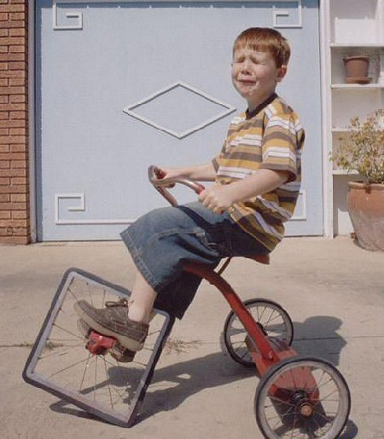
Consensus List of Terms and Definitions
List of normative references (other standards)
ANSI Z136.1:2014: American National Standard for Safe Use of Lasers
IEC 61391-1:2006: Ultrasonics – Pulse-echo scanners – Part 1: Techniques for calibrating spatial measurement systems and measurement of system point-spread function response
IEC 61391-2:2006: Ultrasonics – Pulse-echo scanners – Part 2: Measurement of maximum depth of penetration and local dynamic range
ISO 80000-7:2008: Quantities and units – part 7: Light
Avoid re-inventing the wheel

Slide 17
Consensus List of Terms and Definitions
Radiometry terms
Spectral bandwidth, pulse duration, pulse repetition rate
Harmonization with existing standardized terminology
Exception: PRR, not PRF (“frequency” used in acoustic terms)
An early issue: what does everybody mean by “fluence”?
Fluence = energy incident from all directions on a small point
Fluence is used to describe subsurface distribution of energy
Many papers use fluence = incident energy / beam area on tissue
Incident energy per area is to be called “radiant exposure”
Sliney, Photochemistry and Photobiology 83, 2007

Slide 18
Consensus List of Terms and Definitions
Why should we care about clarifying this distinction?
Consistent with ANSI, ISO, and IUPAC usage
ANSI laser safety limits are defined based on radiant exposure
Fluence is tissue-dependent, hard to measure
Fluence can exceed radiant exposure by ~5x
In PAI, we work with both incident and subsurface quantities
“incident fluence” could be R.E. or fluence in shallow tissue voxel
IPASC plans to adopt use of “radiant exposure” for the quantity “incident pulse energy per beam area on tissue”
“Radiant exposure” (correct)
“Incident fluence” (ambiguous)
“Fluence” (incorrect)
Sliney, Photochemistry and Photobiology 83, 2007

Slide 19
Consensus List of Terms and Definitions
Transducer parameters
Spatial coordinates (axial, lateral, elevational axes)
Element/array properties (e.g., pitch, element sensitivity)
Frequency response (center frequency, fractional bandwidth)
Tissue properties
What does it mean for a phantom material to be “tissue-mimicking material”?
Definition defines general characteristics, level of description of an acceptable TMM
Material whose optical/acoustic properties are similar to those of a declared tissue type over specified optical wavelength and acoustic frequency ranges
List of characterized properties “including but not limited to…”
Image quality metrics
Not necessarily a final recommended set of metrics to use

Slide 20
Consensus List of Terms and Definitions
One key new concept: minimum detectable optical absorption coefficient (“MDOAC”)
Independent of specific chromophore concentration (generalize across systems, applications)
Strongly dependent on target size, depth, absorption strength, tissue attenuation
MDOAC may be a foundation metric that supports several image quality tests
Contrast, sensitivity, max visualization depth
Contrast-detail analysis
Multispectral biomarker measurement accuracy limitations, e.g., SO₂

Slide 21
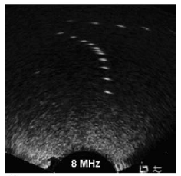
Consensus Set of Image Quality Metrics
IPASC should establish a set of image quality metrics supporting test methods
Extensive literature, standards available for mature imaging modalities
Many potentially valid approaches for each performance characteristic
Qualitative resolution test (CT)
Quantitative resolution test (US)

Slide 22
Consensus List of Terms and Definitions
Spatial measurement accuracy (1D, 2D, or 3D)
MRI (ACR)
Ultrasound (IEC 69391-2)

Slide 23
Image Quality Metrics
 | Ultrasound | CT | MRI
Sharpness / Spatial Resolution | X | X | X
Section Thickness | X | X | X
Spatial Measurement Accuracy | X | X | X
Distortion | X |  | X
Uniformity | X | X | X
Visualization Depth | X
Contrast: low contrast resolution, contrast-detail analysis | X | X | X
Artifacts | X |  | X
Material Property Meas. Accuracy | X | X
Sensitivity/Noise/SNR | X | X | X
Dynamic Range | X
Linearity | X

Slide 24
Summary and Next Steps
A comprehensive list of IPASC terms and definitions has been developed
Hold consensus vote to adopt IPASC terms and definitions document
Establish consensus set of image quality metrics to support/guide all theme group activities
Provide literature review of medical image quality test methods and standards
Survey IPASC members to prioritize/rank candidate metrics
Hold discussions to identify, rank utility of image quality metrics
Develop draft multi-site study protocol/SOP

Slide 25
Afternoon discussion
Which image quality metrics do you think are valuable for PAI system characterization?
Which metrics do you use to evaluate or compare PAI or other imaging devices? How do you measure/compute these metrics?
Are there other metrics that should be considered?
Do you see other challenges that should be addressed?

Slide 26
Thanks for your attention!

