Slide 1
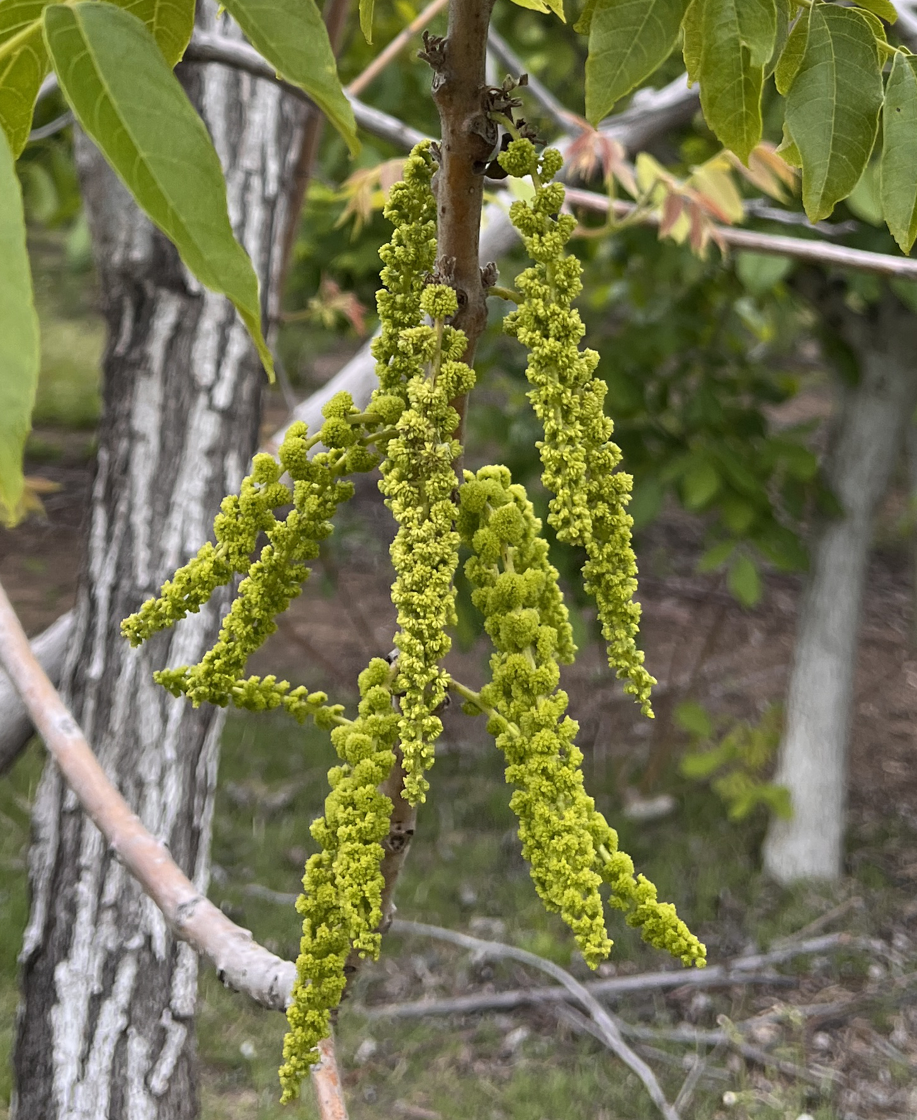
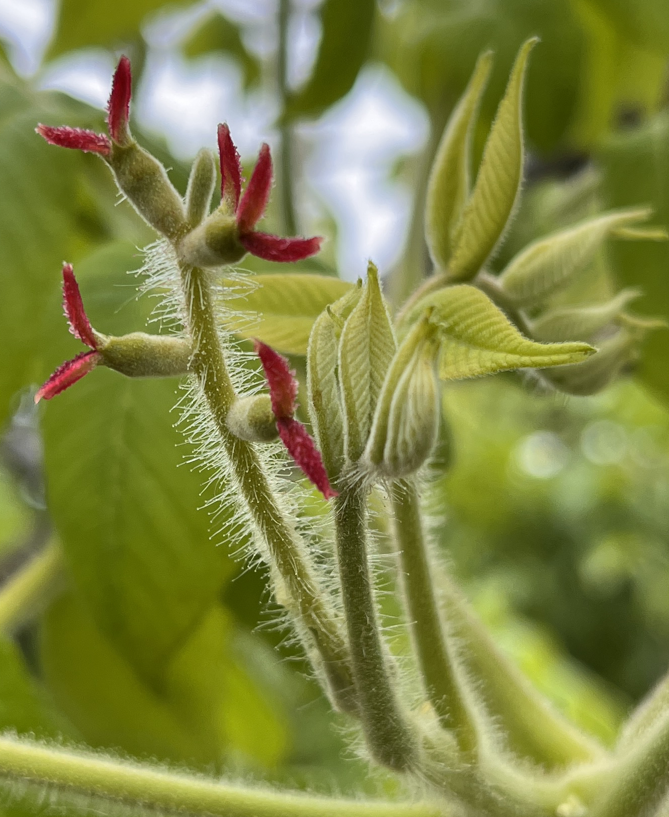
G
g
♂︎︎
♀︎
G
g
gg
pollination
Gg
♀︎
♂︎︎
Time in flowering season
Juglans
Carya
G
G
g
g
1
0

Slide 2
♂︎︎
♀︎
Type1
pollination
Type2
♀︎
♂︎︎
Time in flowering season

Slide 3
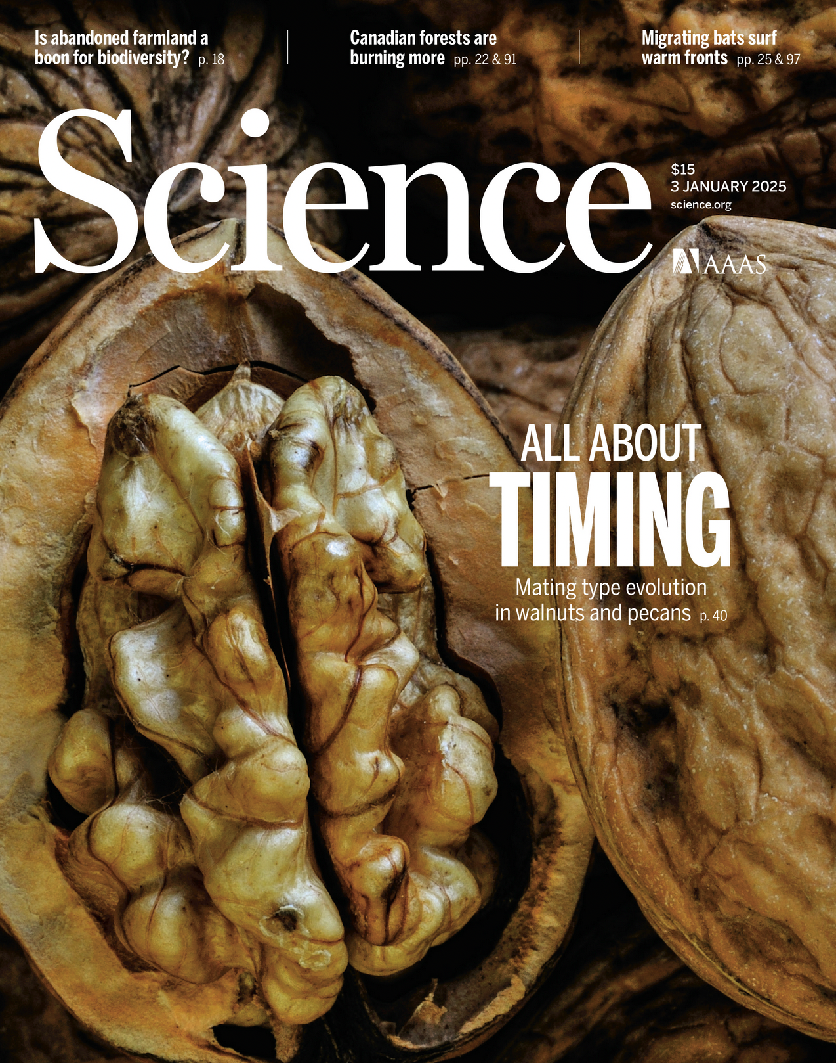
♂︎︎
♀︎
Type1
pollination
Type2
♀︎
♂︎︎
Time in flowering season

Slide 4

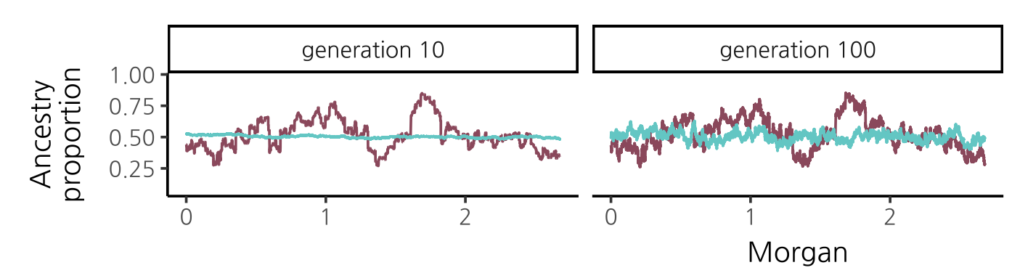

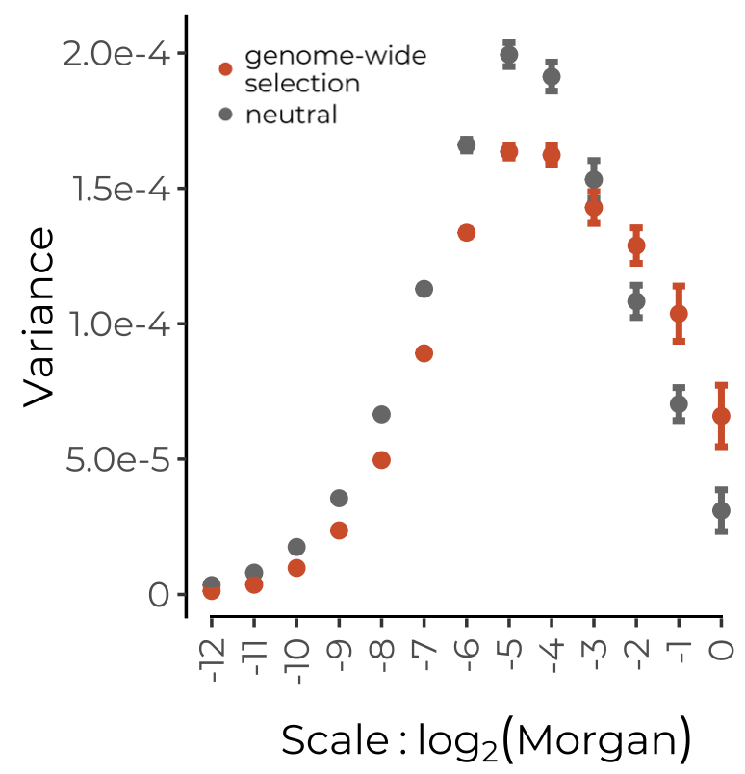
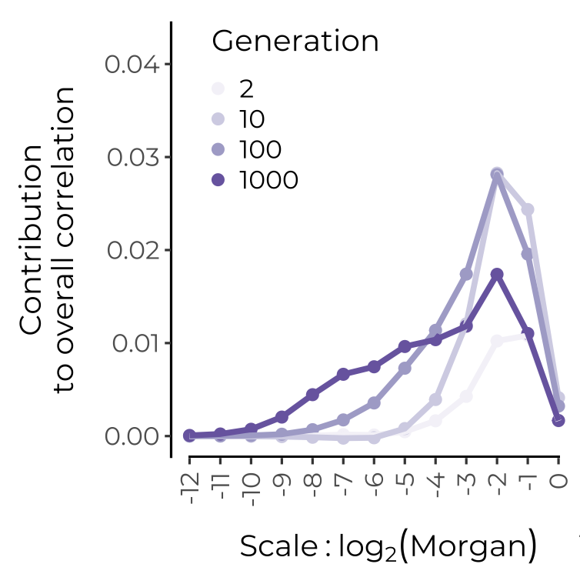
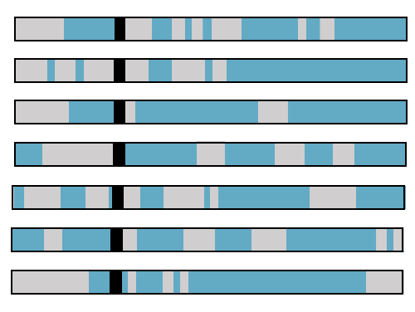
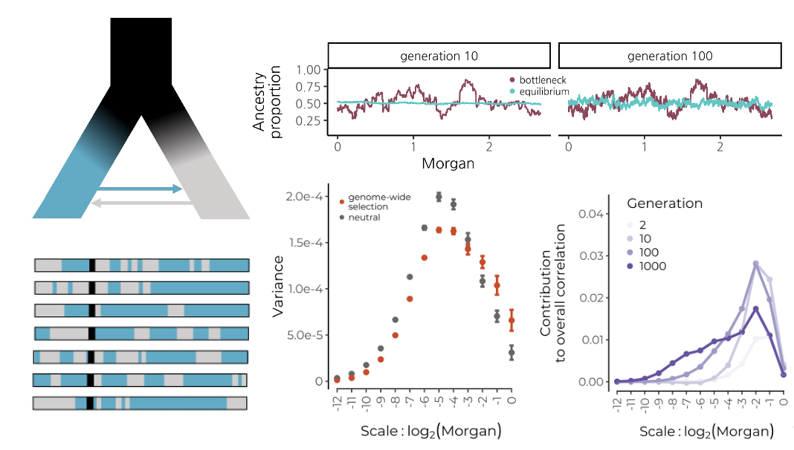

Slide 6
Position on chromosome (Morgans)

