Slide 1
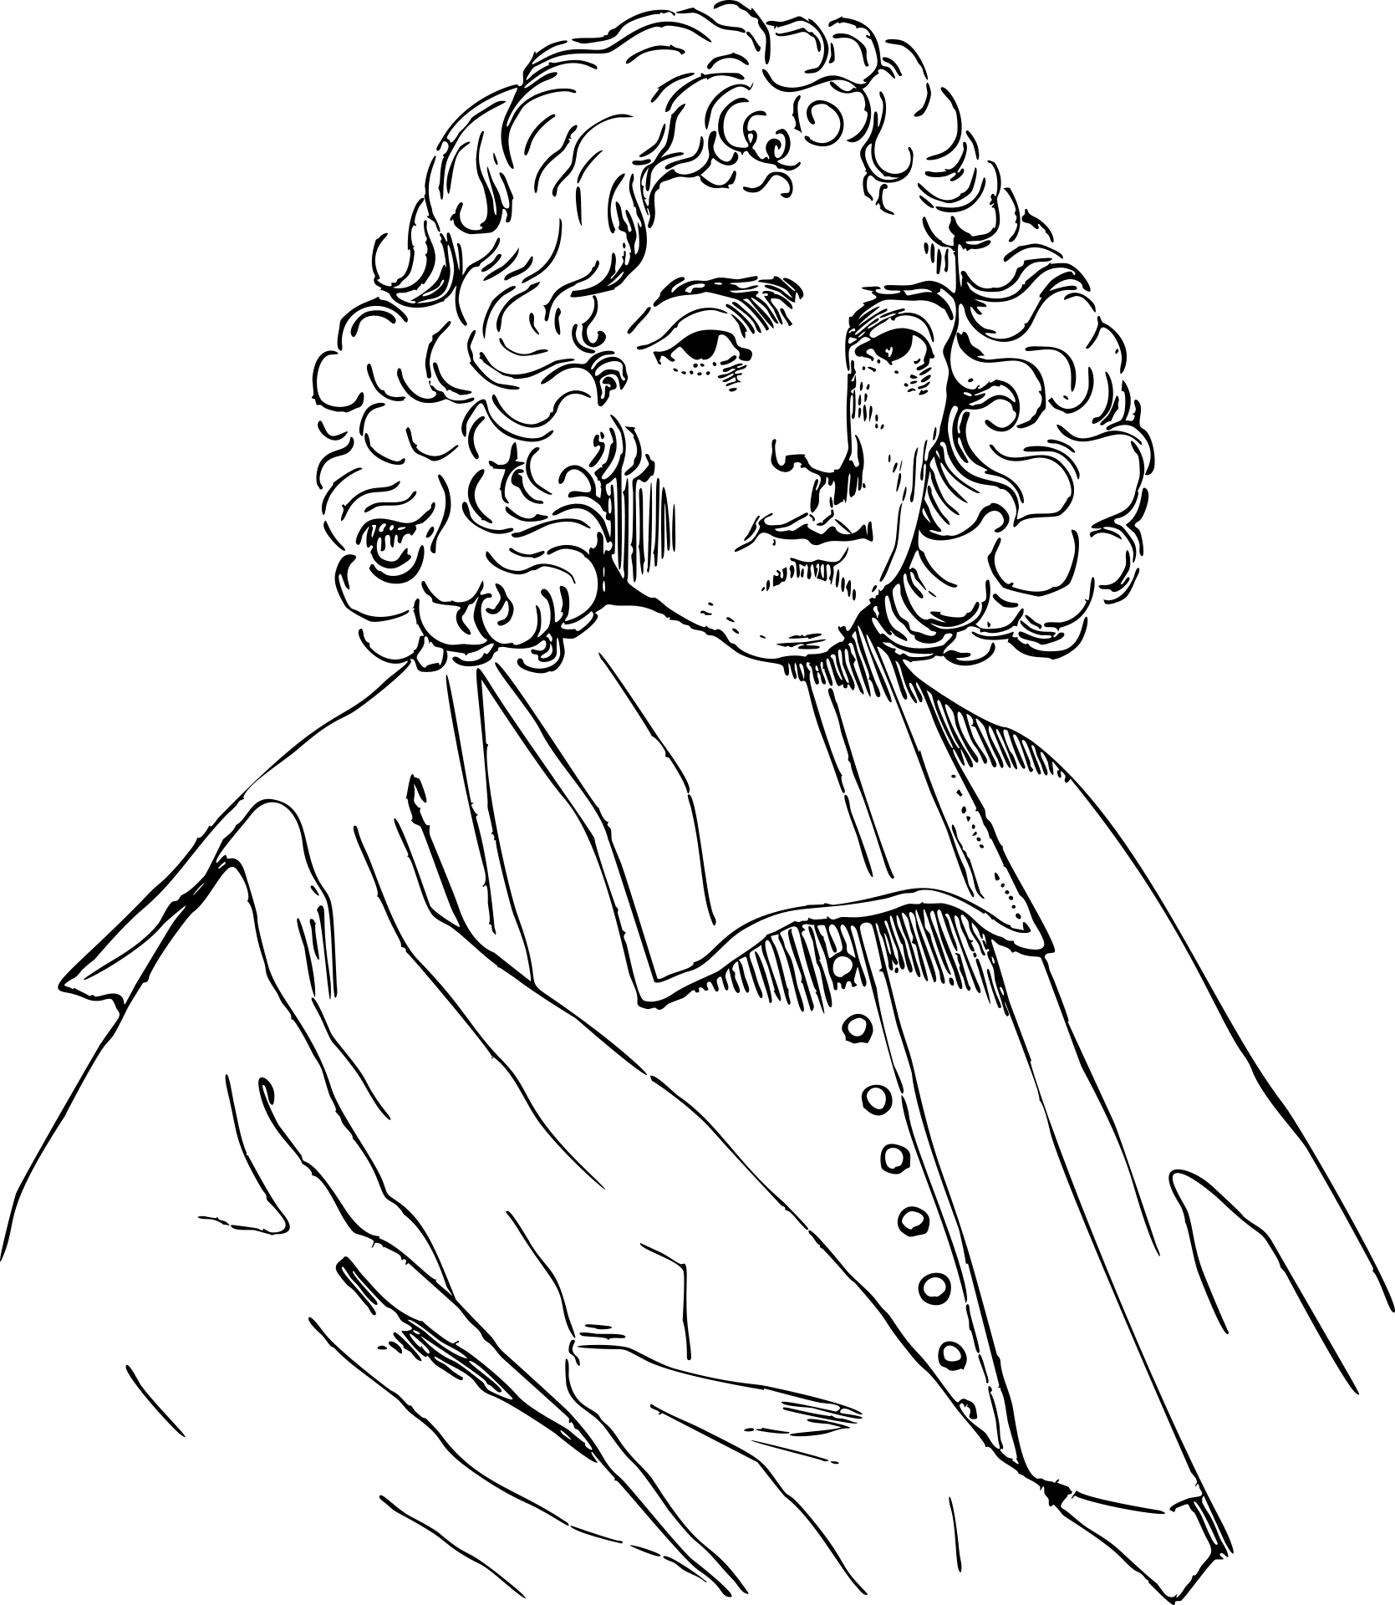
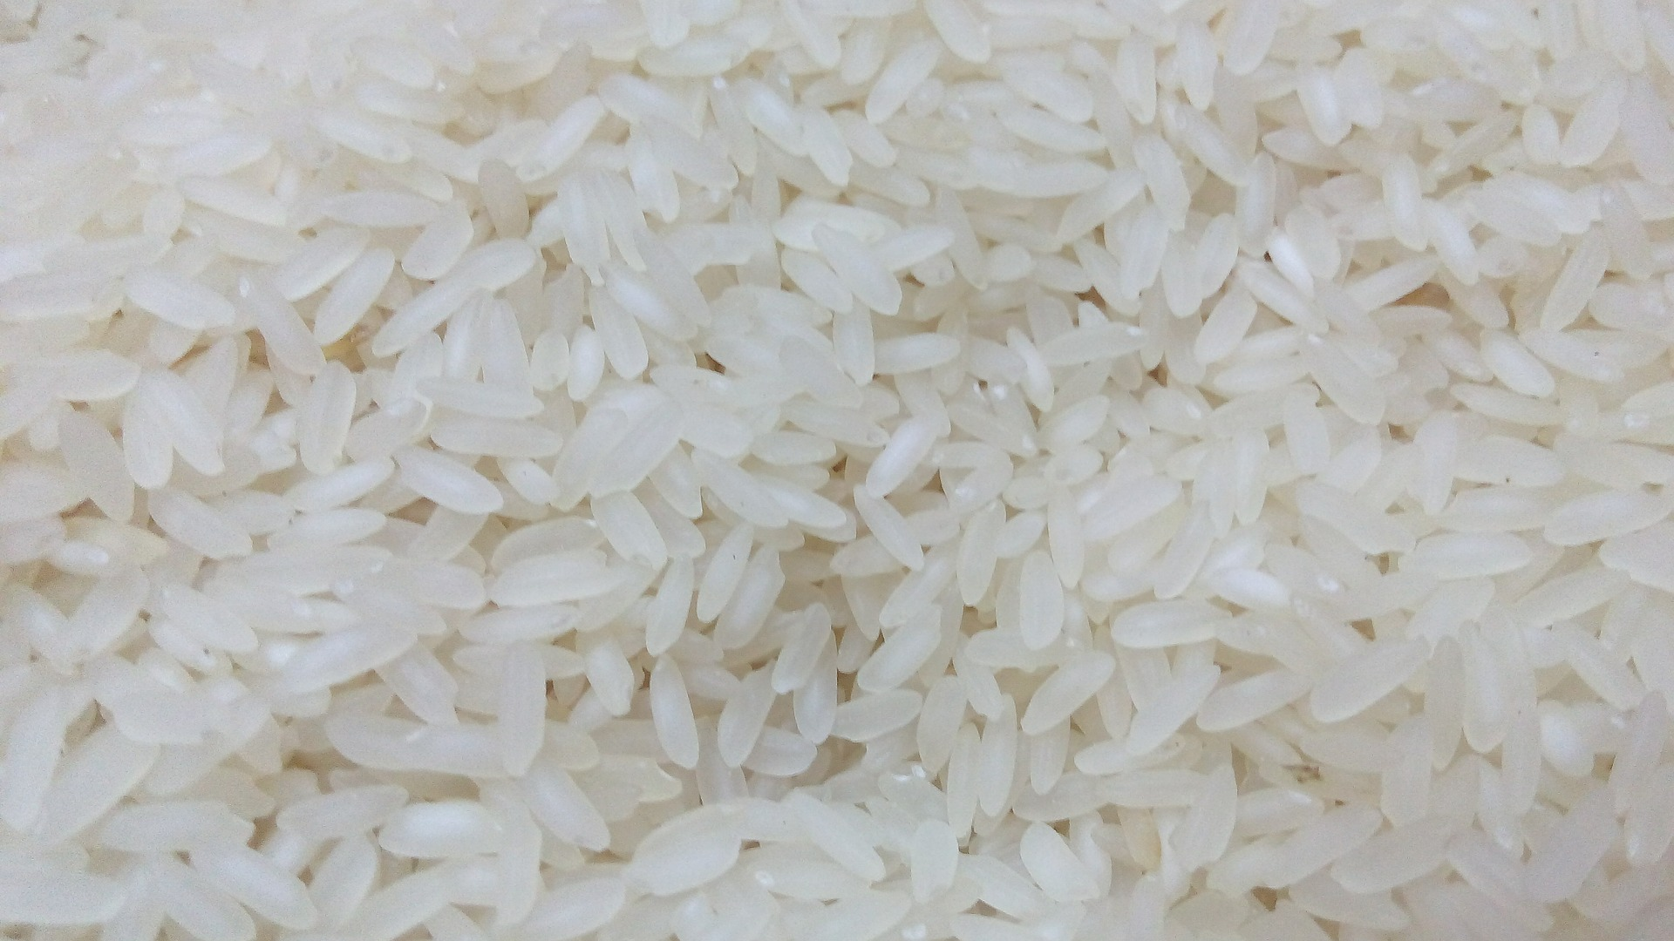

Dining Philosophers
Jaden Bathon and Jacob Grosse
Notes:
Jake
Welcome to not the best, not the longest, but the most thematically relevant presentation on the dining philosophers problem for this years CS-410 class!

Slide 2
Project Description
The Dining Philosophers problem is a classic problem in the world of computer science and, in a broader sense, logic. The task is to seat a certain number of philosophers at a dinner table with a corresponding number of chopsticks so that each may have only one chopstick. These philosophers must share chopsticks when they become hungry; however, no two of them can pick up the same chopstick at the same time. We were tasked with coding a solution to this problem which allowed independent threads to act as philosophers and effectively share chopsticks amongst themselves to eat rice from the table when they became hungry.
Notes:
Jake
The Dining Philosophers problem is a classic problem in the world of computer science and, in a broader sense, logic. The task is to seat a certain number of philosophers at a dinner table with a corresponding number of chopsticks so that each may have only one chopstick. These philosophers must share chopsticks when they become hungry; however, no two of them can pick up the same chopstick at the same time. We were tasked with coding a solution to this problem which allowed independent threads to act as philosophers and effectively share chopsticks amongst themselves to eat rice from the table when they became hungry.

Slide 3
Project Requirements
Uploaded to GitHub
Runs with ANT
Solution to the Problem
Solution is Documented
Effective Presentation
Notes:
Jaden
Uploaded to GitHub: https://github.com/jgrosse01/CS410_Dining_Philosophers_Bathon_Grosse
Runs with ANT
Solution to the Problem
Solution is Documented
Effective Presentation

Slide 4
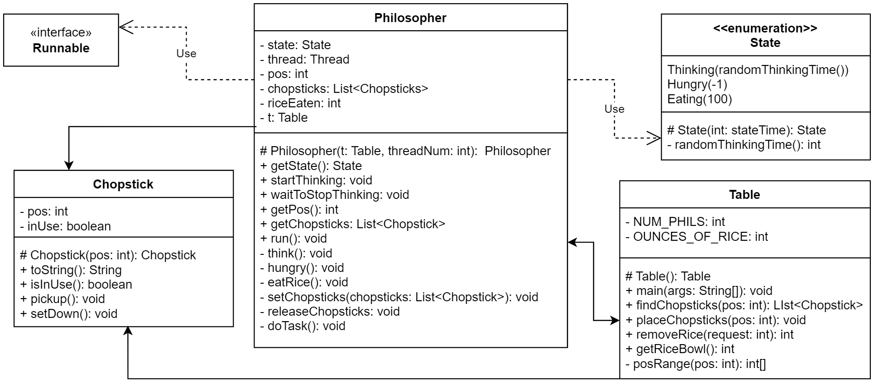
Project UML Diagram
.
.
.
.
.
.
.
.
.
.
Notes:
Jaden
Philosopher Uses State, Chopstick and Table. It also implements Runnable.
The Table Uses Chopstick and Philosopher.
Then Chopstick is a strong independent java class and it don’t need nobody else.

Slide 5
Code Solution
Notes:
Jake
So now we have our coding solution overview and problems with line by line viewing later to come.

Slide 6
Table.java
Manages the Rice Bowl.
Creates and Houses Philosophers and Chopsticks
Helps Philosophers find Chopsticks
Notes:
Jaden: The Table class host the main main method which create a Table, Philosophers, and Chopsticks.
The Philosopher ask the table for chopstick when they are hungry and the table either gives then an unused set of chopsticks to the hungry philosopher or has them wait for the next available set of chopsticks.

Slide 7
Philosopher.java
Runs on a Thread
Sits at a Table
Knows Where it Sits
Can Think, Be Hungry, or Eat
May Be Given Chopsticks
May Return Chopsticks
Notes:
Jaden: Philosopher are thread that are either Thinking, Hungry, or Eating rice. They are assigned a position at the table and use that position when asking the table give them a set of chopsticks. When Think the philosopher sleep for a random amount of time. After think they become Hungry and then wait until the table gives them a set of chopsticks. After acquiring chopsticks they eat until they are either full again or the table runs out of rice. Once done the Philosopher place the chopsticks back in their original position.

Slide 8
Chopstick.java
Knows Where it Rests
Knows if it is Being Used
Can Be Picked Up
Yells at you if it already has been picked up…
They’re very loud.
So much so that the philosopher will put the chopstick back down…
Can Be Placed Back On the Table
Notes:
Jake
A chopstick knows where on the table it is supposed to be as well as if it is being used.
Philosophers can pick up a chopstick; however, this strong independent chopstick knows when multiple people are getting involved so it will yell at any philosopher who tries to pick it up when it’s already being used.
That philosopher then puts the chopsticks they are holding back onto the table and waits patiently for their turn.
The chopstick is also capable of being placed back on the table.

Slide 9
Code Necessary for Each Philosopher Being a Thread
Synchronization Any Time A Chopstick is Interacted With
Synchronization On the Bowl of Rice On the Table
Sleeping Threads to Do Work
Utilization of wait() & notifyAll() to Schedule Interactions
Notes:
Jake
In order for a Philosopher to run on a thread. Any interactions with an instance of the strong, independent chopstick must be synchronized so that a philosopher cannot grab a chopstick that has already been grabbed and is no longer on the table.
We also had to synchronize interactions with the rice bowl so that we didn’t encounter any race conditions.
The threads sleep to do their work so that the program does not execute near instantaneously.
Wait and NotifyAll are used to prevent busy-loop waiting for a strong, independent chopstick to be placed with dignity back on the table.

Slide 10
Challenge Numero Uno
The first challenge was to ensure the philosophers would not pick up a chopstick which was already being used. We managed to overcome this with the Chopstick class which throws an exception if someone attempts to pick up the chopstick while it is in use. This error is handled in the Table class.
Notes:
Jake
The first challenge was to ensure the philosophers would not pick up a chopstick which was already being used. We managed to overcome this with the Chopstick class which throws an exception if someone attempts to pick up the chopstick while it is in use. This error is handled in the Table class.

Slide 11
Challenge 2 — Educational Haikubaru
Our next challenge was ensuring that philosophers would wait to pick up the chopsticks until one was placed down on the table after being used. This momentary lapse in memory was resolved by telling a philosopher with no valid chopsticks to grab to wait along with the table notifying all philosophers when a chopstick is placed back down on the table.
Notes:
Jaden:
Our next challenge was ensuring that philosophers would wait to pick up the chopsticks until one was placed down on the table after being used. This momentary lapse in memory was resolved by telling a philosopher with no valid chopsticks to grab to wait along with the table notifying all philosophers when a chopstick is placed back down on the table.

Slide 12
Challenge 3
Our last challenge was an unnecessary one. We could not get the program to exit when our rice bowl was empty. This was resolved with another frustratingly simple fix. We simply changed the condition on our Philosopher run loop to check the amount of rice remaining in the rice bowl.
Notes:
Jake
Our last challenge was an unnecessary one. We could not get the program to exit when our rice bowl was empty. This was resolved with another frustratingly simple fix. We simply changed the condition on our Philosopher run loop to check the amount of rice remaining in the rice bowl.

Slide 13
Line by Line Code Time! Yay!
Notes:
Jaden
THEN:
Chopstick(Jaden) -> Philosopher(Jake) -> Table (Jaden)

Slide 14
Summary
Notes:
Jake
Through the code shown on the screen and the process of overcoming the challenges faced, we have a working solution to the Dining Philosophers problem that is multithreaded without race conditions or deadlocks.

Slide 15
Questions?
Notes:
Jake
Are there any questions, comments, or otherwise directed statements?

