Slide 1

DS-SF-23 | Final Project Kobe Bryant Shot Prediction
Joshua Grossman 7/12/16

Slide 2
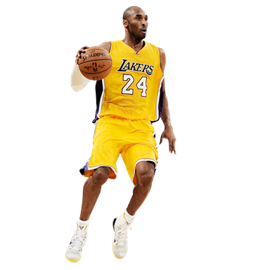
Agenda
Summary & Background
Exploratory Data Analysis
Dimensionality Reduction
KNN
Logistic Regression
Conclusions/Next Steps

Slide 3
Problem Statement
Using 20 years of data on Kobe's swishes and misses, can you predict which shots will find the bottom of the net?

Slide 4
BACKGROUND
Kaggle Dataset (via stats.nba.com)
Contains data for every shot Kobe took over his career
30,697 observations
Y = ‘shot_made_flag’, binary variable for shot made
X features: shot distance, loc_x, loc_y, shot type, playoffs, game date opponent etc. (24 total)
5,000 ‘shot_made_flag’ entries removed (reserved for Kaggle entries)

Slide 5
DATASET FEATURES
shot_made_flag
Numerical Values:
Categorical Values:
lat
lon
loc_x
loc_y
minutes_remaining
seconds_remaining
shot_distance
playoffs (2)
shot_type (2)
shot_zone_area (6)
shot_zone_range (5)
combined_shot_type (6)
shot_zone_basic (7)
period (7)
season (20)
opponent (33)
action_type (55)
matchup (74)
IDs:
game_event_id
game_id
team_id
shot_id
team_name
Date:
game_date
Notes:
224+ features
Action Type:
Alley Oop Dunk Shot
Alley Oop Layup shot
Cutting Layup Shot
Driving Bank shot
Driving Dunk Shot
Driving Finger Roll Layup Shot
Driving Finger Roll Shot
Driving Floating Bank Jump Shot
Driving Floating Jump Shot
Driving Hook Shot
Driving Jump shot
Driving Layup Shot
Driving Reverse Layup Shot
Driving Slam Dunk Shot
Dunk Shot
Fadeaway Bank shot
Fadeaway Jump Shot
Finger Roll Layup Shot
Finger Roll Shot
Floating Jump shot
Follow Up Dunk Shot
Hook Bank Shot
Hook Shot
Jump Bank Shot
Jump Hook Shot
Jump Shot
Layup Shot
Pullup Bank shot
Pullup Jump shot
Putback Dunk Shot
Putback Layup Shot
Putback Slam Dunk Shot
Reverse Dunk Shot
Reverse Layup Shot
Reverse Slam Dunk Shot
Running Bank shot
Running Dunk Shot
Running Finger Roll Layup Shot
Running Finger Roll Shot
Running Hook Shot
Running Jump Shot
Running Layup Shot
Running Pull-Up Jump Shot
Running Reverse Layup Shot
Running Slam Dunk Shot
Running Tip Shot
Slam Dunk Shot
Step Back Jump shot
Tip Layup Shot
Tip Shot
Turnaround Bank shot
Turnaround Fadeaway shot
Turnaround Finger Roll Shot
Turnaround Hook Shot
Turnaround Jump Shot
Grand Total

Slide 6
DATASET FEATURES
shot_made_flag
Numerical Values:
Categorical Values:
lat
lon
loc_x
loc_y
minutes_remaining
seconds_remaining
shot_distance
playoffs (2)
shot_type (2)
shot_zone_area (6)
shot_zone_range (5)
combined_shot_type (6)
shot_zone_basic (7)
period (7)
season (20)
opponent (33)
action_type (55)
matchup (74)
IDs:
game_event_id
game_id
team_id
shot_id
team_name
Date:
game_date
Notes:
224+ features
Action Type:
Alley Oop Dunk Shot
Alley Oop Layup shot
Cutting Layup Shot
Driving Bank shot
Driving Dunk Shot
Driving Finger Roll Layup Shot
Driving Finger Roll Shot
Driving Floating Bank Jump Shot
Driving Floating Jump Shot
Driving Hook Shot
Driving Jump shot
Driving Layup Shot
Driving Reverse Layup Shot
Driving Slam Dunk Shot
Dunk Shot
Fadeaway Bank shot
Fadeaway Jump Shot
Finger Roll Layup Shot
Finger Roll Shot
Floating Jump shot
Follow Up Dunk Shot
Hook Bank Shot
Hook Shot
Jump Bank Shot
Jump Hook Shot
Jump Shot
Layup Shot
Pullup Bank shot
Pullup Jump shot
Putback Dunk Shot
Putback Layup Shot
Putback Slam Dunk Shot
Reverse Dunk Shot
Reverse Layup Shot
Reverse Slam Dunk Shot
Running Bank shot
Running Dunk Shot
Running Finger Roll Layup Shot
Running Finger Roll Shot
Running Hook Shot
Running Jump Shot
Running Layup Shot
Running Pull-Up Jump Shot
Running Reverse Layup Shot
Running Slam Dunk Shot
Running Tip Shot
Slam Dunk Shot
Step Back Jump shot
Tip Layup Shot
Tip Shot
Turnaround Bank shot
Turnaround Fadeaway shot
Turnaround Finger Roll Shot
Turnaround Hook Shot
Turnaround Jump Shot
Grand Total

Slide 7
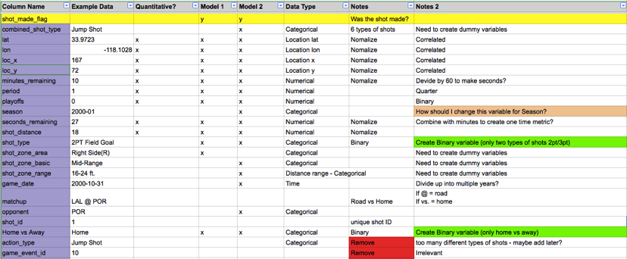
SIMPLE MODEL FIRST

Slide 8
Exploratory data analysis

Slide 9
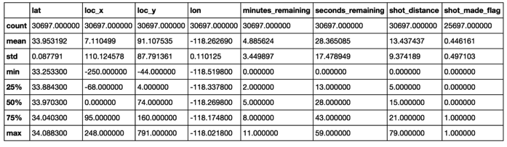
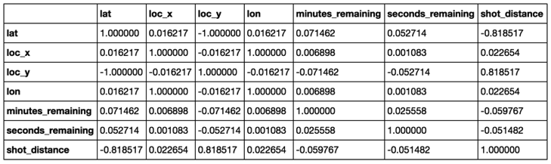
DF.Describe DF.corr

Slide 10
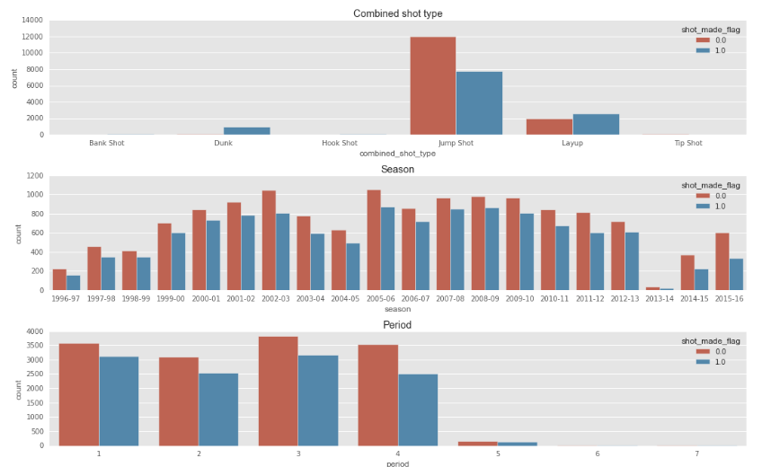
SHOT VOLUME

Slide 11
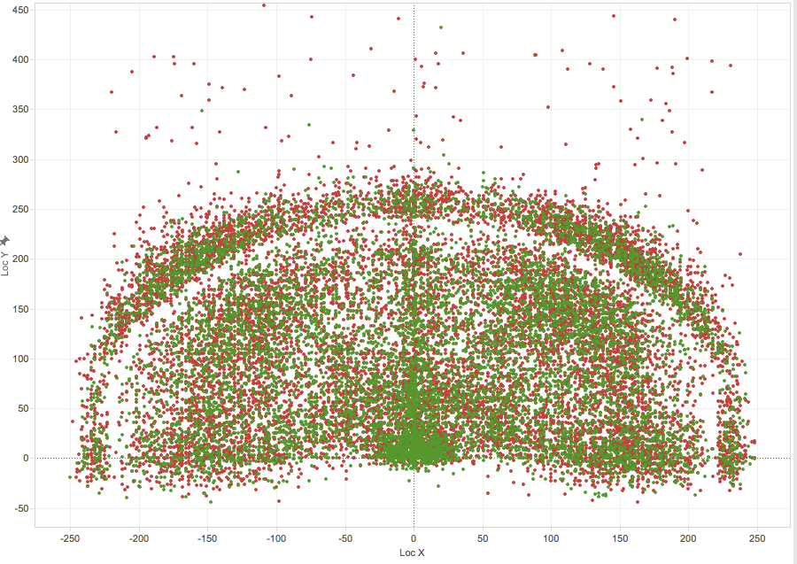
Shot location
20 NBA seasons
15 playoffs
30,697 Shots
FG%: 0.447
3P%: 0.329

Slide 12
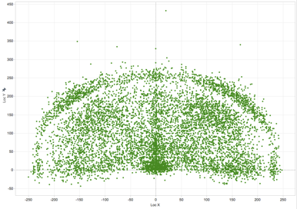
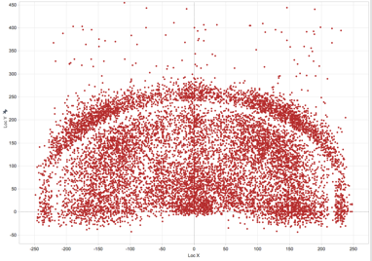
Shot LOCATION
Make
Miss

Slide 13
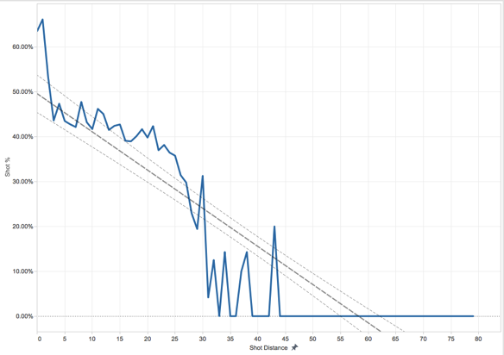
DISTANCE VS ACCURACY

Slide 14

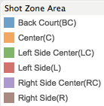
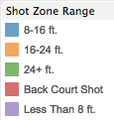
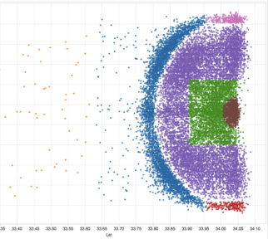
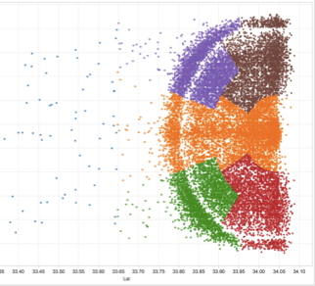
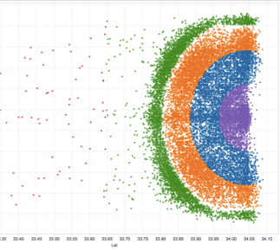
SHOT LOCATION DETAIL
shot_zone_basic
shot_zone_area
shot_zone_range
2%
1%
1%
33%
33%
33%
36%
38%
40%
45%
53%
44%
37%
41%
41%
40%
40%
62%
34%
57%

Slide 15
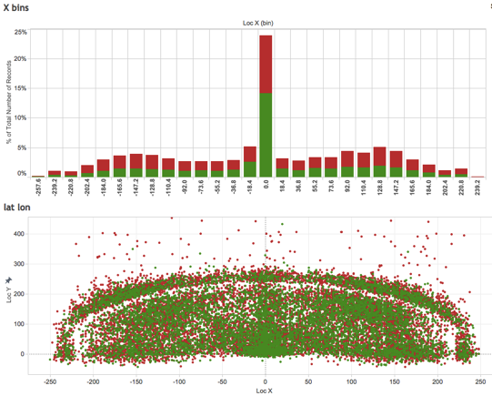
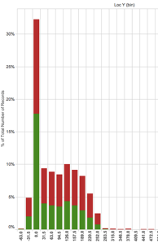
X/Y Location volume
Majority of shots took place at 0 X and Y axis (at or around the basket)
30% of shots occurred within 8ft
Notes:
Loc X – range: -250 to +250 from left to right (width of court)
Loc Y – range: -44 to +791 from bottom to top (length of court)

Slide 16
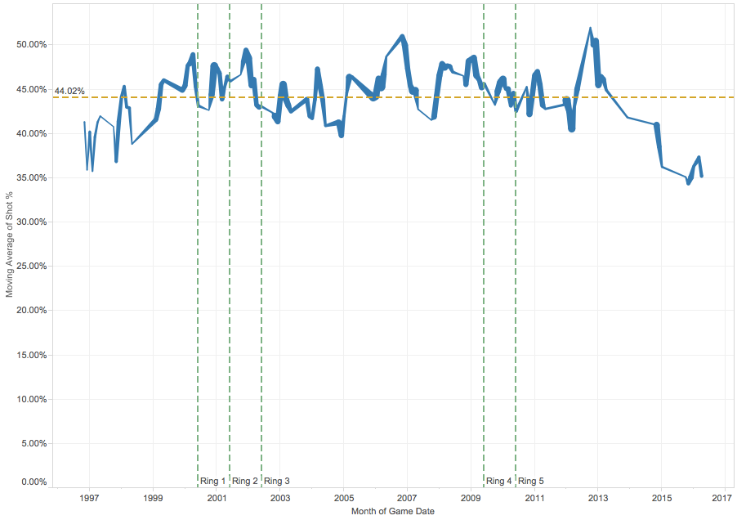
Shot% over time

Slide 17
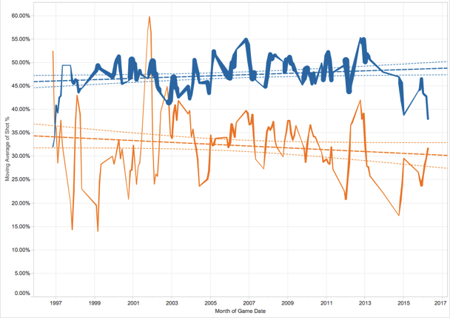

Shot% over time 2p/3p

Slide 18
WHAT DO We know?
Shot% over time stays relatively even
Shot% by day of week is virtually identical
Shots closer to the basket have higher %
Distance will certainly play a factor, but perhaps also location
Home vs Away: shot% marginally better at home
Playoffs vs. regular season essentially the same
Shot % higher against certain teams (NYK, VAN, SAC)
~20% of shots were 3 pointers

Slide 19
DATA Transformation

Slide 20
DATA Transformation
Created dummy variables for every categorical variable resulting in 160 features
Replaced 20 least common action types with ‘other’
Combined seconds remaining and minutes remaining
Normalized numerical values: time remaining, seconds_remaining, shot_distance, loc_y, loc_x
Reduced feature set with Random Forest and Variance Threshold methods

Slide 21
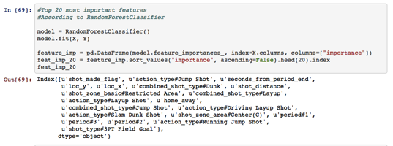
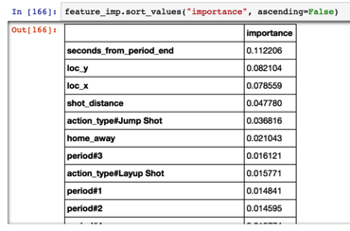
Feature Selection
Used Random Forest and Variance Threshold to reduce dimensions from ~160 to top 20

Slide 22
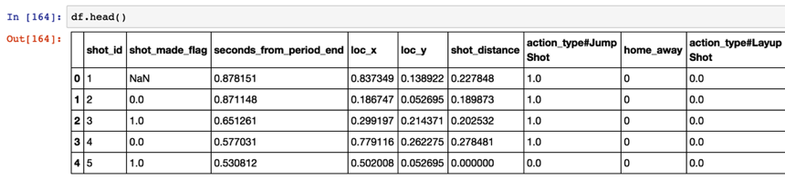
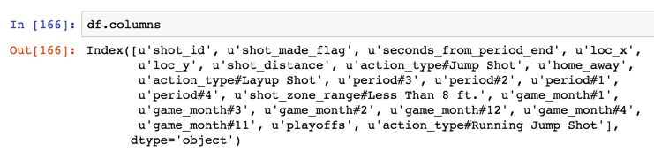
FINAL ‘CLEAN’ DATASET
20 Features

Slide 23
Algorithms & Predictions

Slide 24
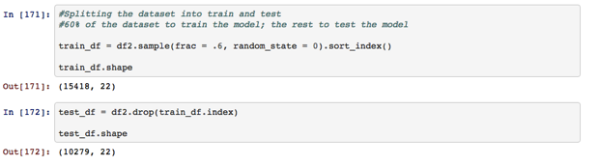
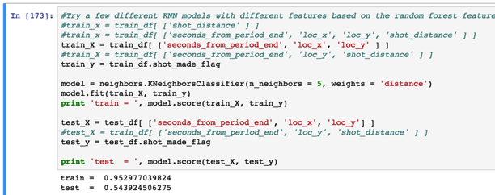
KNN

Slide 25
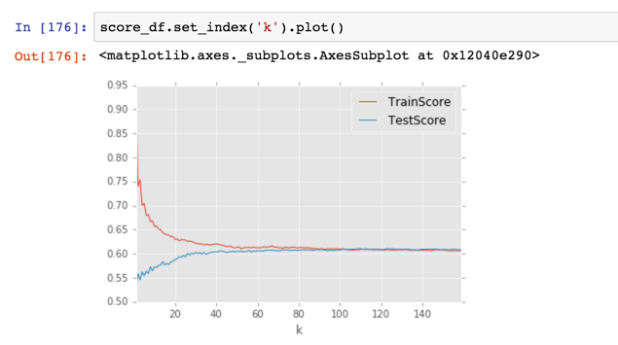
KNN

Slide 26
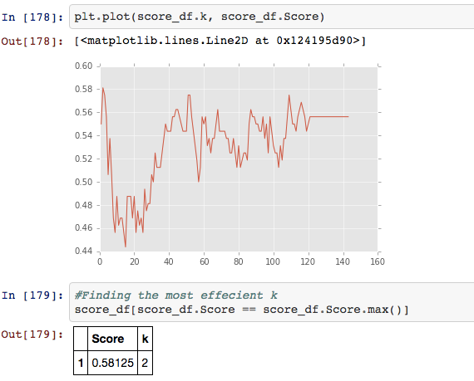
KNN

Slide 27
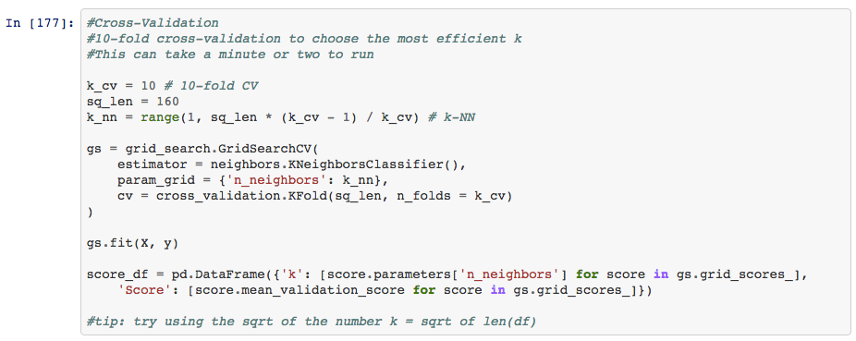

KNN

Slide 28
LOGISTIC REGRESSION

Slide 29
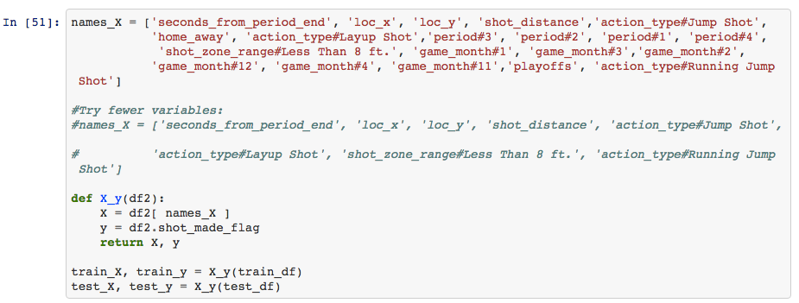
Logisitic Regression

Slide 30
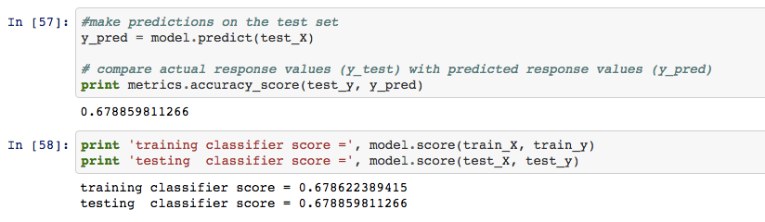
Logisitic Regression

Slide 31
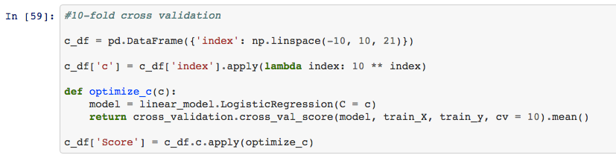
Logisitic Regression

Slide 32
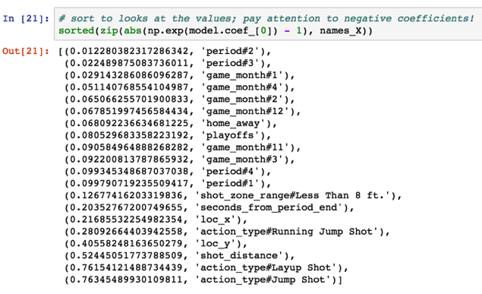
Logisitic Regression

Slide 33
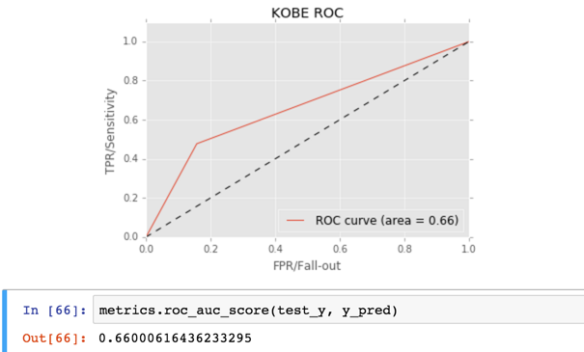
Logisitic Regression

Slide 34
Conclusion/NEXT STEPS
According to KNN and logistic regression models the most important features that predict if a shot is made or not are the following:
0.7634548993 action_type#Jump Shot
0.7615412149 action_type#Layup Shot
0.5244505177 shot_distance
0.4055824816 loc_y
0.280926644 action_type#Running Jump Shot
0.2168553225 loc_x
0.203527672 seconds_from_period_end
0.126774162 shot_zone_range#Less Than 8 ft.
Next Steps:
Remove outliers
Experiment with boosting and/or other techniques
Model threshold tuning
Explore ‘on fire’ phenomenon

Slide 35
Thank you
https://github.com/jgrossman1/DS-SF-23-work

