Slide 1
Beat The Streak NN
A Neural Network produced by Justin Grotton

Slide 2
Project Description
I’ve constructed a Neural Network that is intended to be used in MLB’s Beat the Streak contest
It takes identified hot vs. cold batter/pitcher matchups and determines each player’s chances of recording a hit
The goal of this project is to use machine learning to make accurate predictions

Slide 3
Project technologies
The language used was Python 3.5 in an Anaconda environment
The IDE was Spyder
Libraries include TensorFlow, Theano, Keras, pandas, NumPy, and BeautifulSoup
I setup a Conda environment by following the article below
Mandot, Pushkar. “Installing Tensorflow, Theano and Keras in Spyder.” Medium, Medium, 6 Aug. 2017, medium.com/@pushkarmandot/installing-tensorflow-theano-and-keras-in-spyder-84de7eb0f0df.

Slide 4
The data (matchups)
Scraped and cleaned daily
Used to train and test the nn
Acquired from Rotowire.com

Slide 5
The scraping & cleaning process
The BeautifulSoup library was used to search through the HTML of RotoWire.com and extract data from the Batter Vs. Pitcher Matchup tables.
The scraped data is then stored in a DataFrame using the pandas library.
The data is cleaned by eliminating missing values with Boolean indexing.
Irrelevant columns are dropped and the independent result column is added.
In addition to being used for daily predictions, this data was also used to train and test the network.
I used the blog below as a resource for developing this process.
Tjortjoglou, Savvas. “Learning Python: Part 1 - Scraping and Cleaning the NBA Draft.” Savvas Tjortjoglou, 1 July 2015, savvastjortjoglou.com/nba-draft-part01-scraping.html.

Slide 6
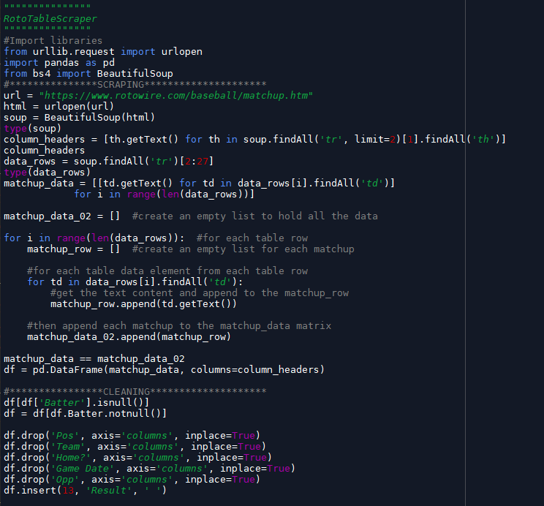
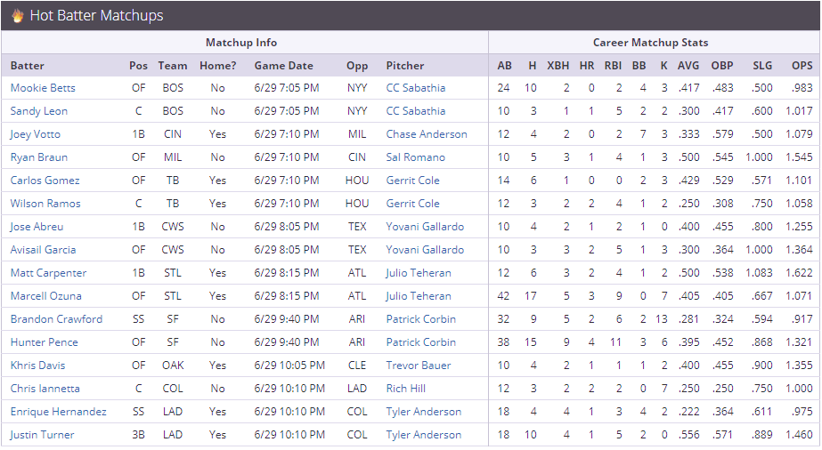
The matchups

Slide 7
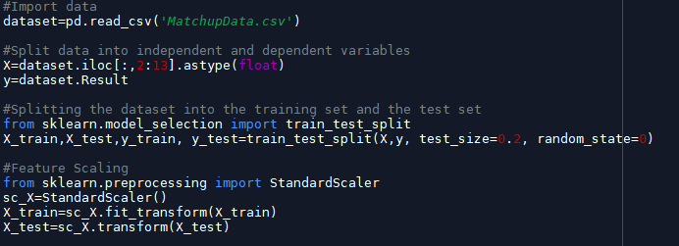
Training & testing data process
The imported data is split into inputs and outputs.
The data is then split into training and testing sets.
Feature scaling is applied to the input training and test data.

Slide 8
Nn infrastructure
Layers of the NN include an input layer, two hidden layers, and an output layer.
The NN is then compiled, trained, and tested.
I utilized the resources below to construct my neural network.
DeJesus, John. “Let's Classify Baseball Players Using Deep Learning!” J.D. Data, Squarespace, www.jddata22.com/home//lets-classify-baseball-players-using-deep-learning.
Brownlee, Jason. “Binary Classification Tutorial with the Keras Deep Learning Library.” Machine Learning Mastery, 7 June 2016, machinelearningmastery.com/binary-classification-tutorial-with-the-keras-deep-learning-library/.

Slide 9
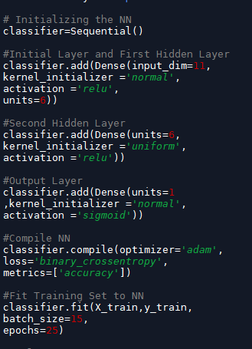
Infrastructure

Slide 10
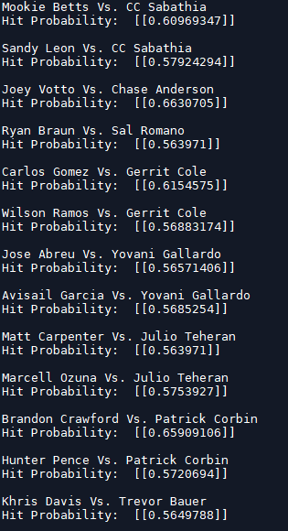
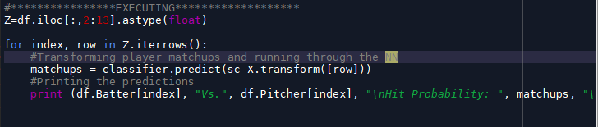
execution
The following code transforms the daily matchups and runs them through the NN. It then prints the results into the console.

Slide 11
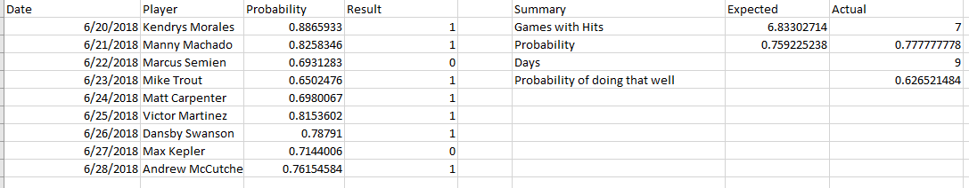
The results
In a short sample size, the project has been a success with ~78% hit rate. The expected probability is currently around ~76% and 7 out of 9 players have recorded hits.

Slide 12
Nn assessment
I performed a K-fold Cross-Validation to estimate the test-set performance of my NN.
I then performed a Grid-Search to determine the optimal parameters for the model.
I used the following reference as a guide to conduct these assessments.
DeJesus, John. “Let's Classify Baseball Players Using Deep Learning!” J.D. Data, Squarespace, www.jddata22.com/home//lets-classify-baseball-players-using-deep-learning.

Slide 13
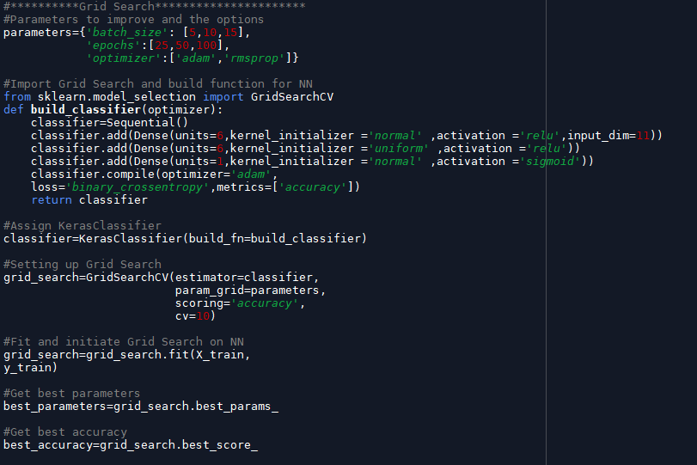
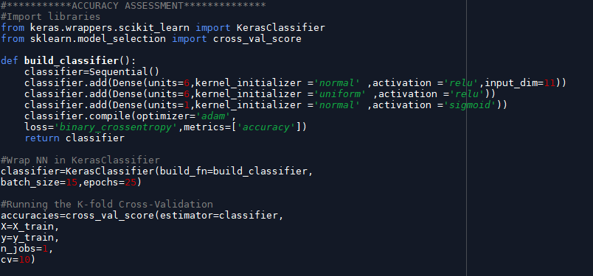
Cross-validation & grid-search

Slide 14
Works cited
Brownlee, Jason. “Binary Classification Tutorial with the Keras Deep Learning Library.” Machine Learning Mastery, 7 June 2016, machinelearningmastery.com/binary-classification-tutorial-with-the-keras-deep-learning-library/.
DeJesus, John. “Let's Classify Baseball Players Using Deep Learning!” J.D. Data, Squarespace, www.jddata22.com/home//lets-classify-baseball-players-using-deep-learning.
Mandot, Pushkar. “Installing Tensorflow, Theano and Keras in Spyder.” Medium, Medium, 6 Aug. 2017, medium.com/@pushkarmandot/installing-tensorflow-theano-and-keras-in-spyder-84de7eb0f0df.
RotoWire. “Batter Vs. Pitcher Matchup Stats.” RotoWire, RotoWire, www.rotowire.com/baseball/matchup.htm.
Tjortjoglou, Savvas. “Learning Python: Part 1 - Scraping and Cleaning the NBA Draft.” Savvas Tjortjoglou, 1 July 2015, savvastjortjoglou.com/nba-draft-part01-scraping.html.

