Slide 1
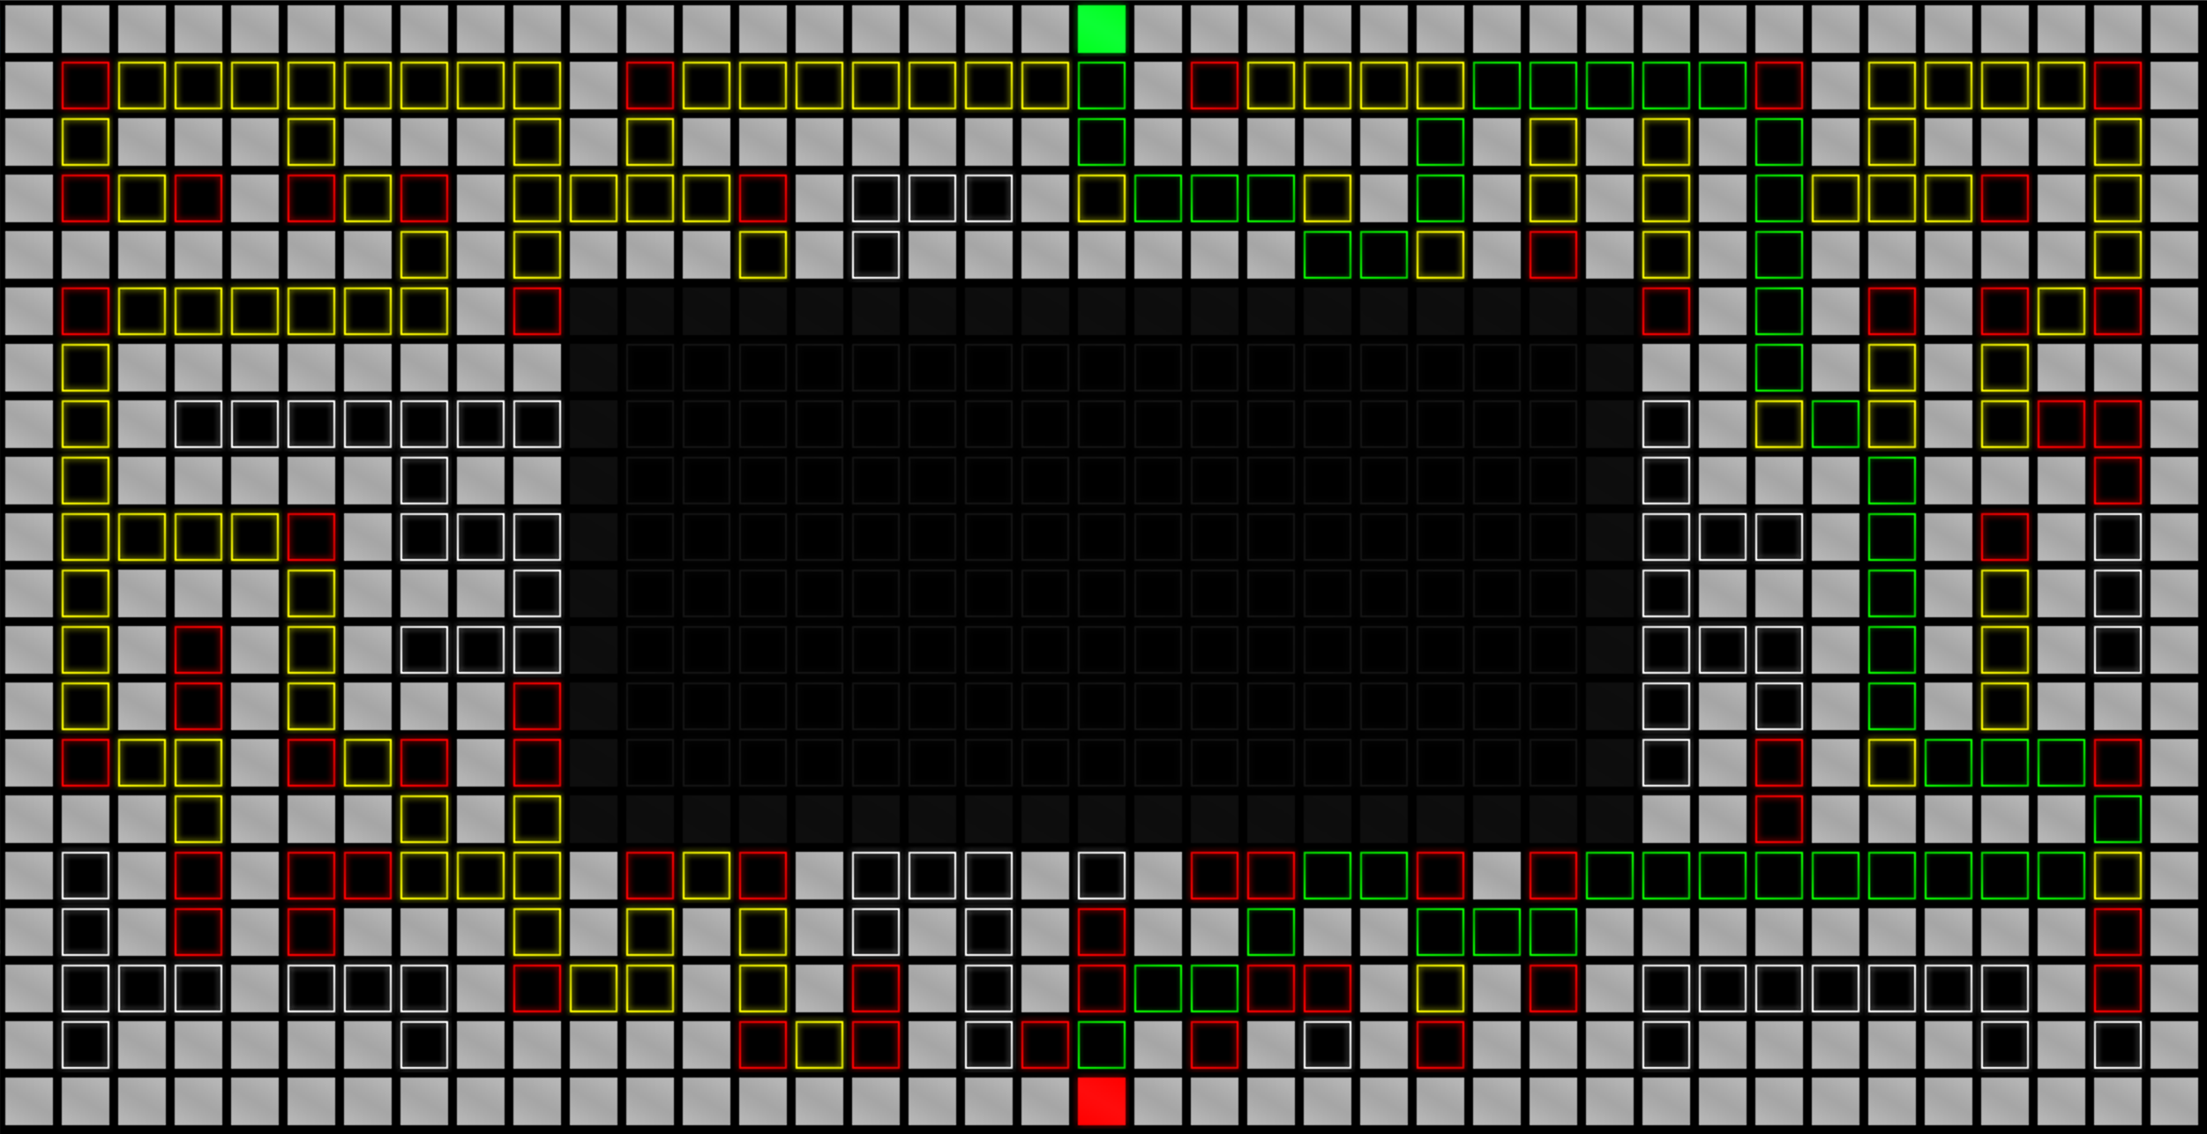
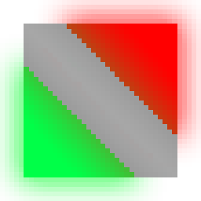
A* Algorithm
By Jared Grounds, Josh Jones, Susan Su, and Kenny Park

Slide 2
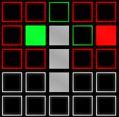
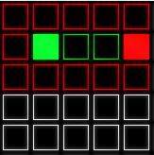
Problem Description
Pathfinding AI is becoming more prominent
Real-time navigation
Mathematics
Video games
It is necessary to visualize the logic behind such search algorithms
How can we determine the shortest path from one point to another while avoiding obstacles?

Slide 3
Problem Solution
A* Search Algorithm
Peter Hart, Bertram Raphael, Nils Nilsson (1968)
Highly popularized search algorithm
Finds the shortest path from a start point to a destination point while avoiding obstacles
Utilizes "heuristics" while searching for the shortest path
Programming a visualizer
Implements A* Search Algorithm
Visual C++ Forms

Slide 4
Data Structures – Tile Class
Derives from C++/CLI PictureBox component
Properties:
Integers for hCost, gCost, hCost, tile type, and XY positions on the tile grid
ArrayList of valid neighboring tiles
Parent tile that a given tile is selected from
Boolean for if the tile type can be changed
Methods:
Various get/set functions for tile properties
Click and hover Event-handlers for when a tile is interacted with on the UI

Slide 5

Data Structures - User Input
Void tileClick(){
If MouseButtons:: Left
Switch upon click
Case 0 set the tile Type to 1 (green, start)
Case 1 set the tile Type to 2 (red, end)
Case 2 set the tile Type to 0 (black, empty)
Default set the tile Type to 0 (black, empty)
Else If MouseButtons:: Right
If isDragging is true, set the hoveredTIle to Type 3 (grey, obstacle)
}

Slide 6


Data Structures – Exception Handling
Void loadButton_Click(){
Show load dialog
Try parsing the file into the grid
Catch any errors
}
Void saveButton_Click(){
Show save dialog
Try parsing the grid into a text file
Catch any errors
}

Slide 7
Data Structures – A* Algorithm
Void runAlgorithm(){
ArrayList^ openTiles
ArrayList^ closedTiles
Set the starting tile to the first index in openTiles
While openTiles is NOT empty
Set current tile to the tile in openTiles with lowest fCost
Change current tile from openTiles to closedTiles
Check if current tile is the end tile, if it is then a valid path has been found
If a given neighboring tile of the current tile is in closedTiles or is an obstacle, skip it
If the path to the neighboring tile is shorter or neighbor is in closedTiles, calculate its fCost and set the parent to the current tile
If the neighboring tile is not currently in openTiles, add it
}

Slide 8
A* Algorithm Demonstration

Slide 9
Notable Observations
Instantiating a new variable in every iteration of a for-loop
Reading an image from file while instantiating grid, rather than initializing an image variable.
Certain C++/CLI event-handlers conflict with each other.
Switched from Pythagorean theorem for hCost (distance from current tile to end tile)
Less resource intensive
Gave shorter distance path
Tile^ currentTile;
int tileCount = tiles->Count;
for(int i = 0; i < tileCount; i++){
currentTile = (Tile^)tiles[i];
}
for(int i = 0; i < tiles->Count; i++){
Tile^ currentTile = (Tile^)tiles[i];
}

Slide 10
Future Work
Allow option to configure grid size and heuristic cost formula
Convert to Unity3D C#, or a similar engine, for practical usage
Implement more algorithms
BFS can be faster in certain situations (poor heuristic)
Dijkstra's algorithm for weighted tiles/paths

