Slide 1

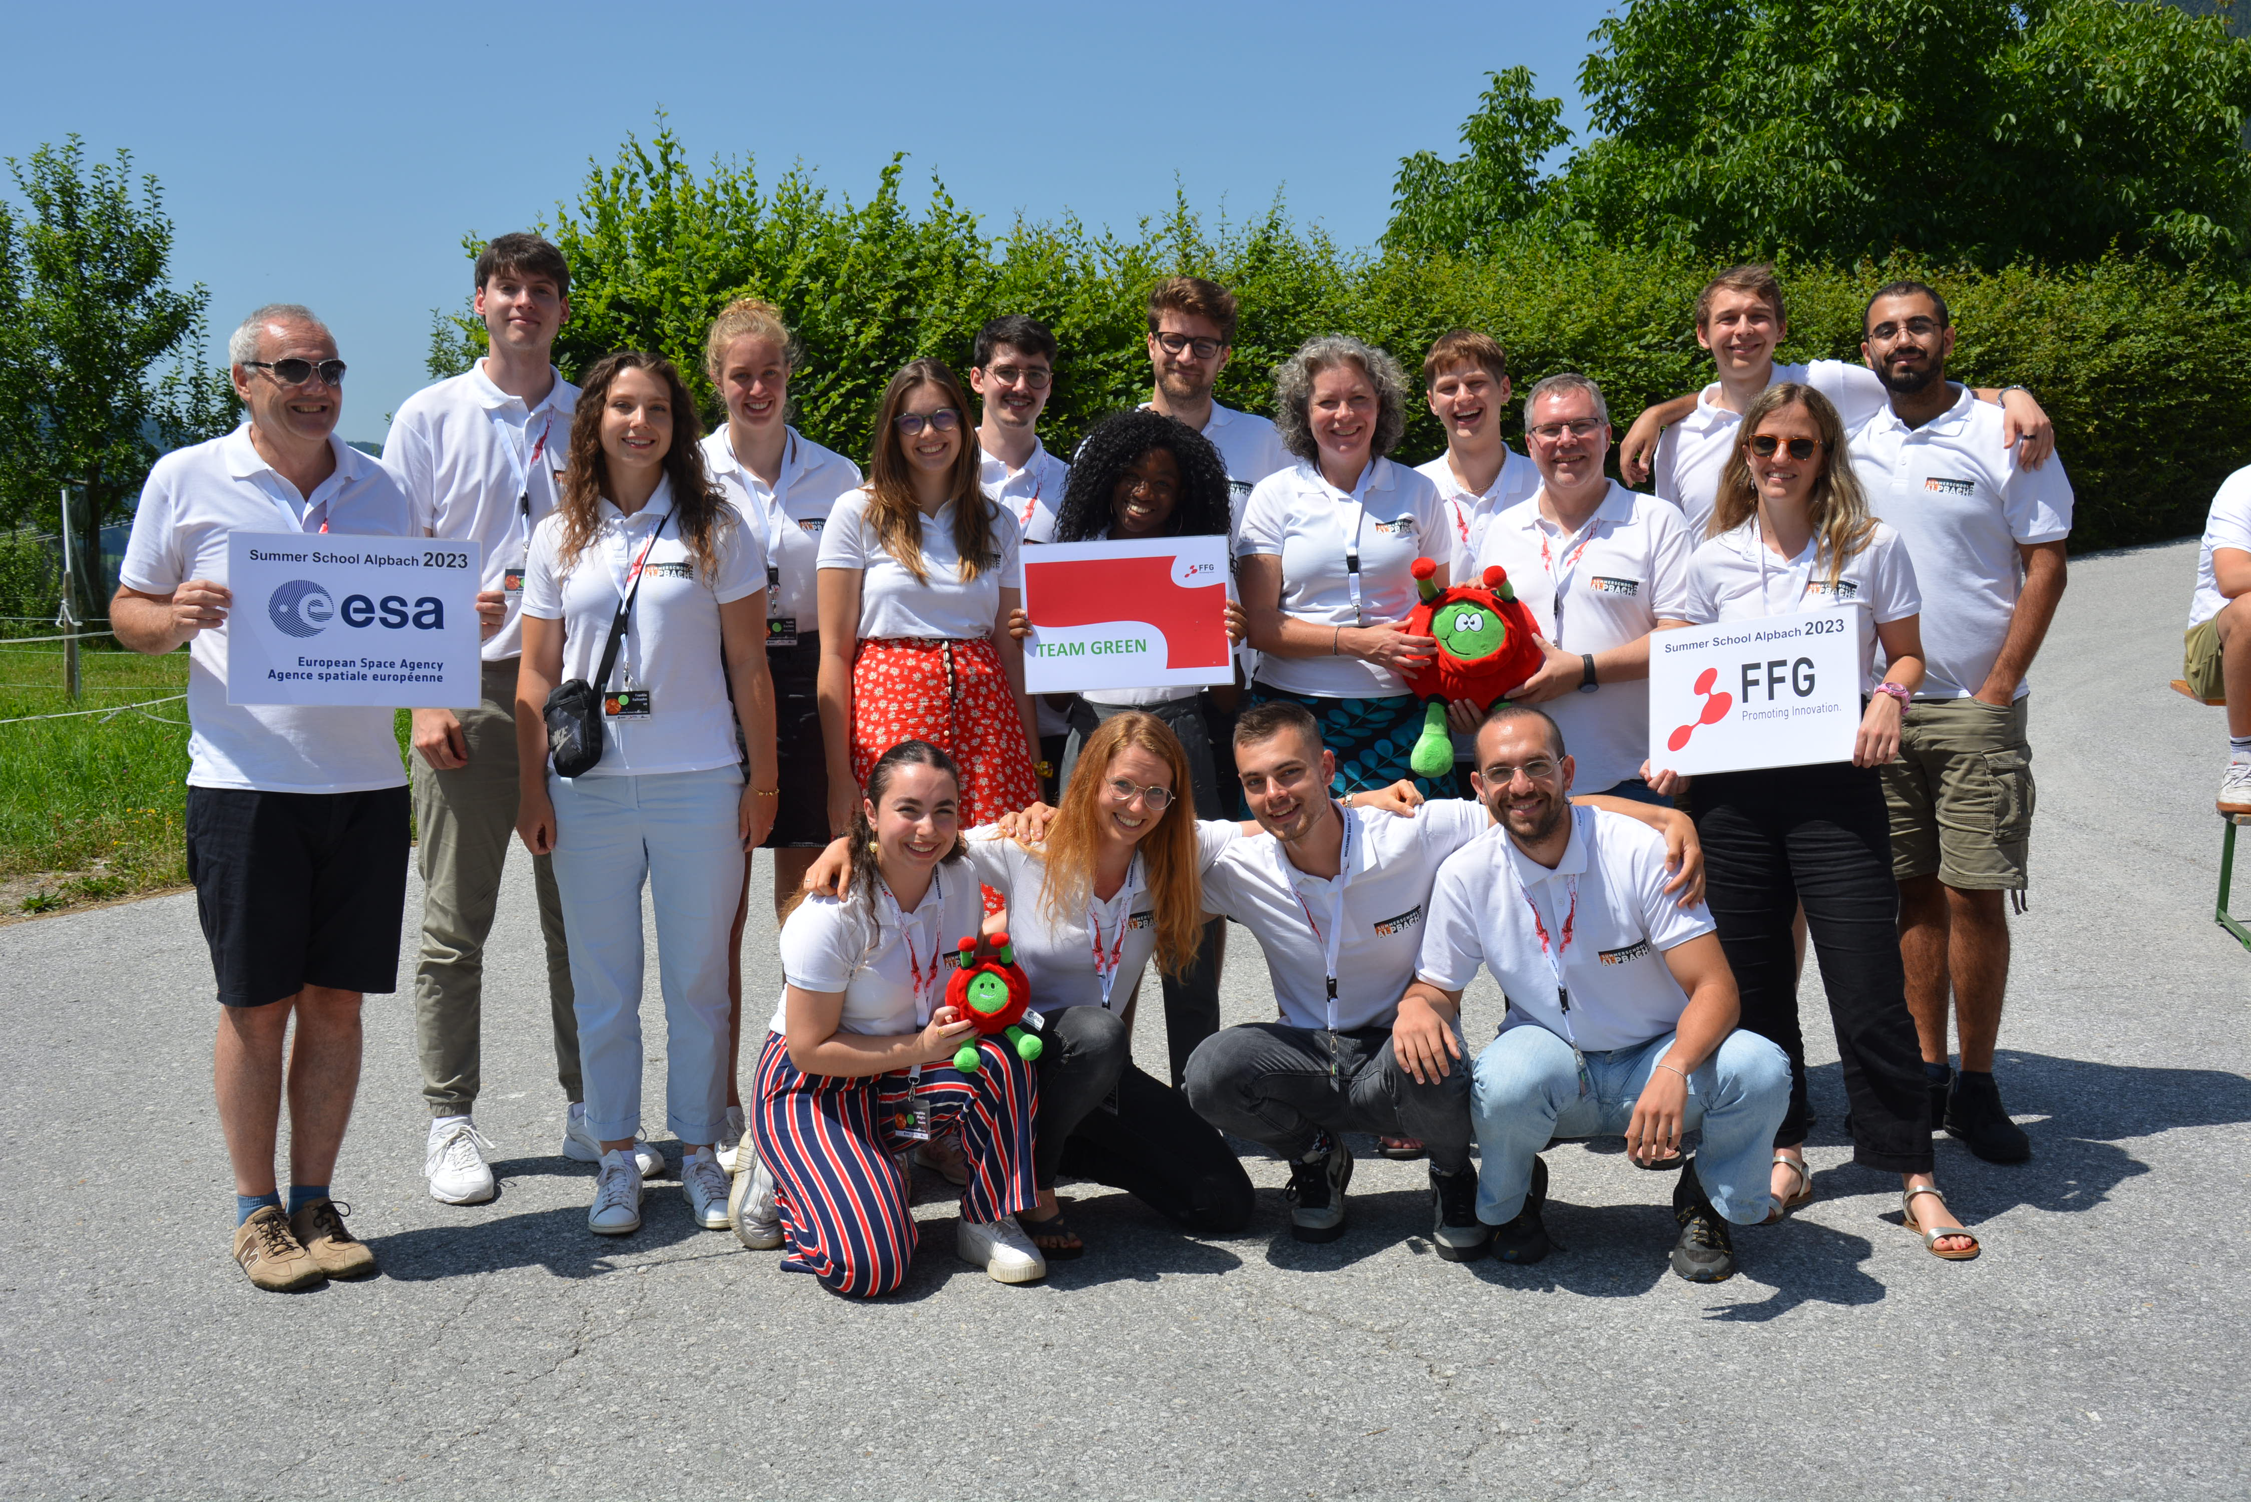












Members of Team Green:
Majdi Assaid, Frederik Dall'Omo, Cara Doumbe Kingue, Yoshi Eschen, Frankie Falksohn, Angelos Georgakis, Fabian Hauser, Adam Hlacik, Jonas Lunde, Josephine Maglio, Willeke Mulder, Jota Navarro Fernández,
Marie Puissant, Rick Röthlisberger and Einari Toivonen
Tutors: Gabby Aitink-Kroes and Christian Gritzner

Slide 2
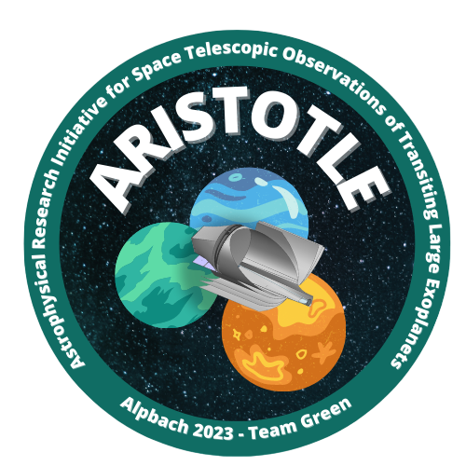
ARISTOTLE
- Astrophysical Research Initiative for Space Telescopic Observations of Transiting Large Exoplanets

Slide 3
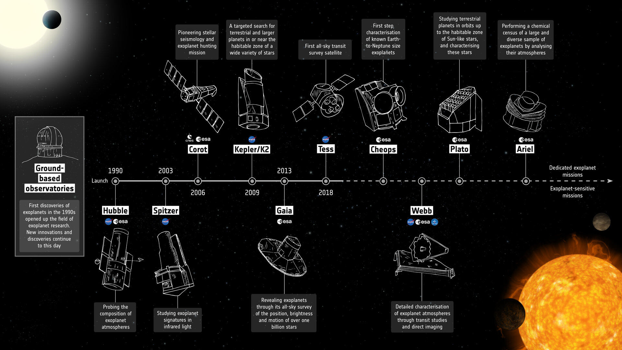
3

Slide 4
?
4

Slide 5

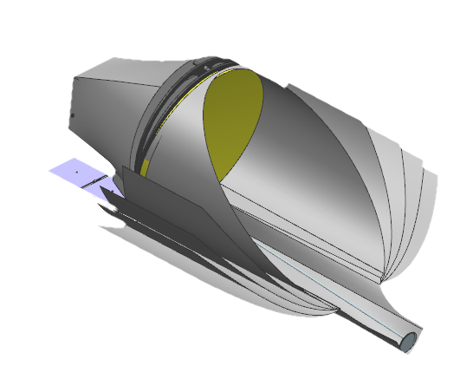
Notes:
Reduced background emission above the atmosphere: greater sensitivity to the 3+micron region: enabling survey studies of dust emission, water ice absorption, or (refractory) organic features that might otherwise take years to achieve from ground-based telescopes.
Additionally, it represents a dedicated mission, thus enabling it to achieve more in the field of exoplanet and search for life than JWST can, due to its schedule as a general purpose mission.

Slide 6
Mission Statement
The ARISTOTLE Mission shall push the envelope in the search of precursors for life in stellar systems.
6

Slide 7
Table of Content: Science Case
Science Case
Observatory
Spacecraft
Conclusion
7

Slide 8
Table of Content: Science Case
Science Case
Primary Science Case
Observatory
Secondary Science Cases
Science Breakdown
Spacecraft
Science Requirements
Conclusion
8

Slide 9
Mission Statement
The ARISTOTLE Mission shall push the envelope in the search of precursors for life in stellar systems.
9

Slide 10
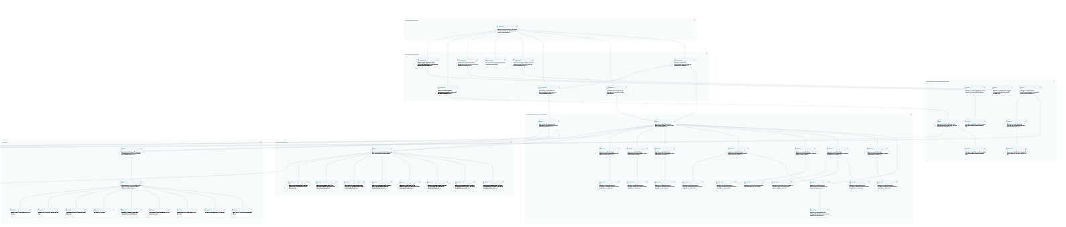
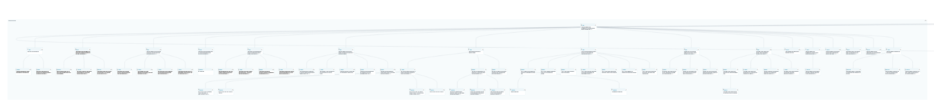
Requirements Breakdown

Slide 11
Requirements Breakdown
Science Objectives
Science Requirements
Observatory Requirements
Spacecraft Requirements

Slide 12
Science Questions
Primary
Secondary
Under what conditions are exoplanet atmospheres possible, and how does it shape their characteristics?
How do planetary systems form and evolve?
How does our solar system work, and does it compare to other stellar systems?
Is there life elsewhere in our solar system?
12

Slide 13
Primary Science
13
Notes:
PLATO follow up: we can use the knowledge existing: using wavelength information for alebedo and use the enthusiasm of existing consortiums ect.

Slide 14
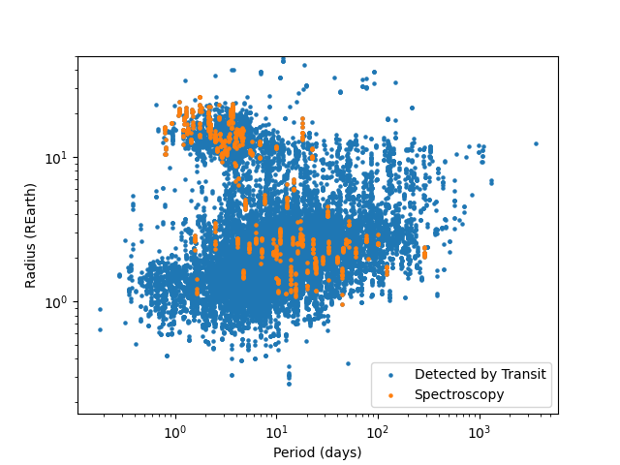
Primary Science: Analysis of Planetary Systems
Question: Exoplanet Atmospheres?
Derived Objectives:
Photochemistry in Exoplanets around Sun-Like stars. Breaking degeneracies of ARIEL. Probe host-star variability to reduce noise.
ARIEL
PLATO
ARISTOTLE
Notes:
1. Tracing and identifying photochemistry in exoplanetary atmospheres down to Super-Earths around Sun-likes.
2. Cross-correlate and break Ariel degeneracies, by going to higher wavelengths.
3. Probe M-star and Sun-like star systems over multiple transits to properly understand both the host star and the full phase curve in large detail.
The name ARISTOTLE is not on accident: Follow-up specifically on what Plato finds!
Benchmark: Super-Earths around Sun-like Stars
Mention that these are the transit detected planets !!

Slide 15
Primary Science: Analysis of Planetary Systems
Photochemistry & Geo-Thermal Activities
Sulfur Compounds (SO2, H2S)
Methane (CH₄)
Chemical Disequilibrium
Hydrocarbons (C_2H_4, ..)
Phosphine & Phyllosilicates
Ozone (O₃)
H₂O
Molecular Pre-cursors of Life
Carbon-Dioxide (CO₂)

Slide 16
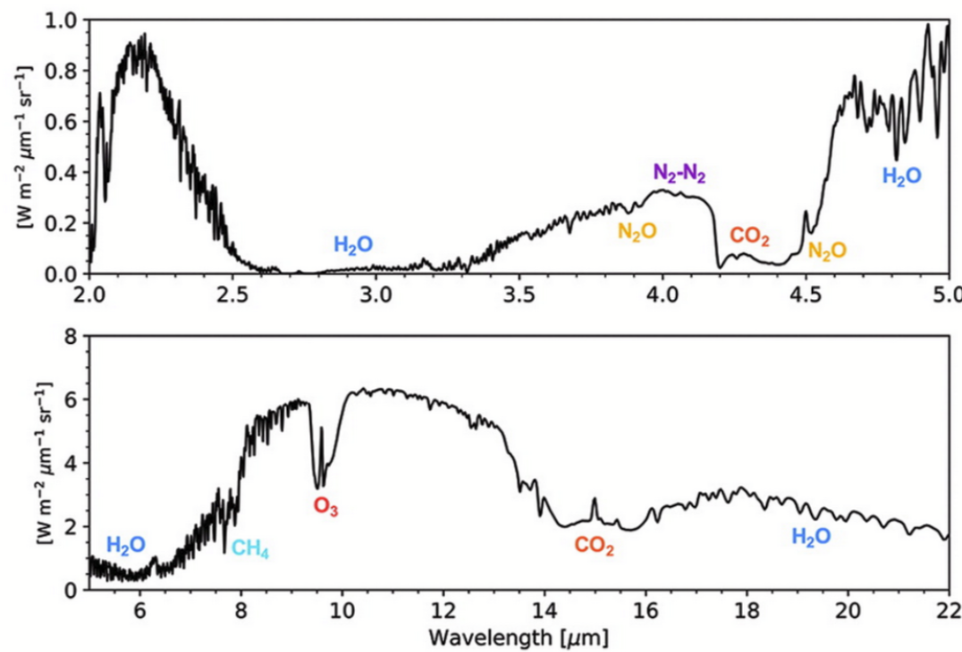
Primary Science: Analysis of Planetary Systems
Hydrocarbons (C₂H₄, ..)
H₂O
Illustration Spectrum
Sulfur Compounds (SO₂, H₂S)
Carbon-Dioxide (CO₂)
Ozone (O₃)
Methane (CH₄)
Phosphine & Phyllosilicates
Schwietermann et al. 2018
Notes:
Make Clear that its an example Spectrum (!!)

Slide 17
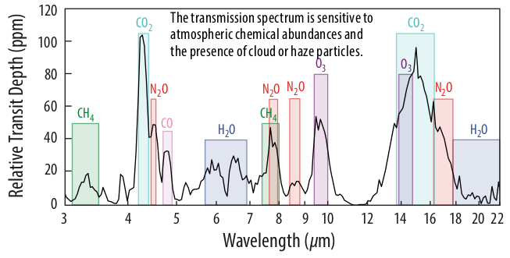
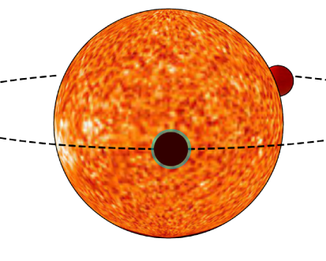
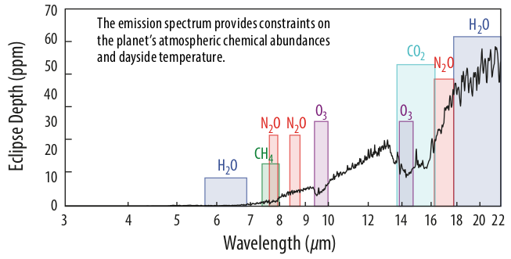
Primary Science: Analysis of Planetary Systems
M. Meixner et al. 2019 (ORIGINS Concept Study)
Notes:
Spectra from the ORIGINS Concept Study
“The transit and eclipse observations van be extended to observing the phase-curve of the planet through its entire orbit. While this is time-consuming, it allows for fitting and constraining anisotropies and rotational features of the planet. Through variations in these phase curves, clouds in the atmospheres of the exoplanets can be determined. “

Slide 18
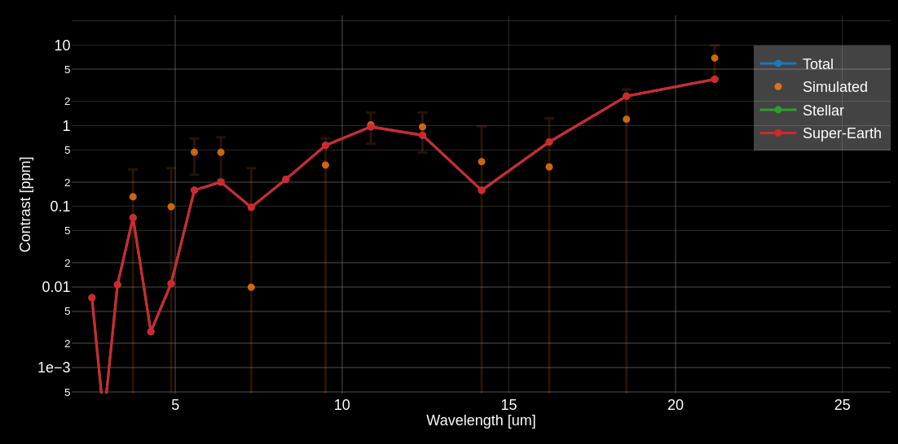
Characterize Super-Earths with Eclipses
Notes:
Preliminary simulation warm Super-Earth
Photon Noise Limite
Constrain BBR + CO_2 Line
~6 Transits

Slide 19

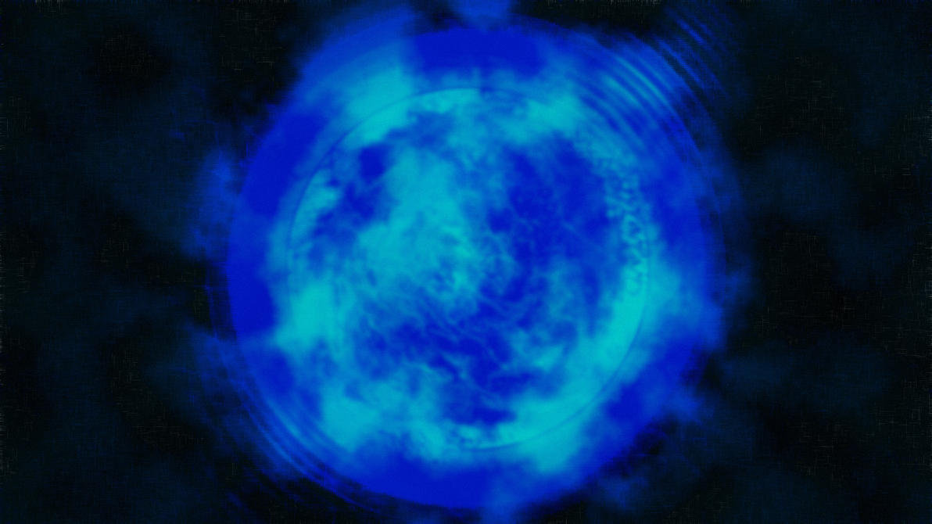
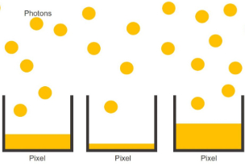
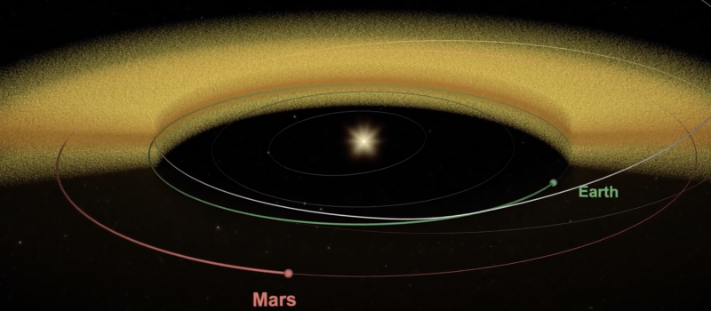



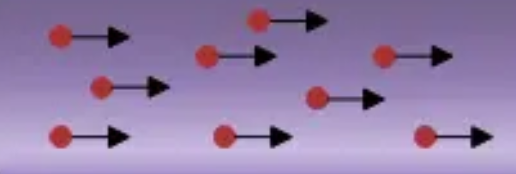
ARISTOTLE Noise and Systematics
Photon Noise
(0.8 - 6 ppm)
Dish thermal emission
(0 – 3 ppm)
Zodiacal background
(0 - 3 ppm)
Star instability
(~2 ppm)
Pointing jitter
(~1 ppm)
Dark current
(<1 ppm)
Read noise
(~0ppm)
Calibration errors & fringes
(target: < 5 ppm)
Notes:
Also have to consider the following noise sources
Did some back of the envelope calculations
At the maximum of the instrument capabilities this is inside the scope
Capabilities lead to hot Jupiters being characterized after 1-3 transits.

Slide 20
Secondary Science

Slide 21
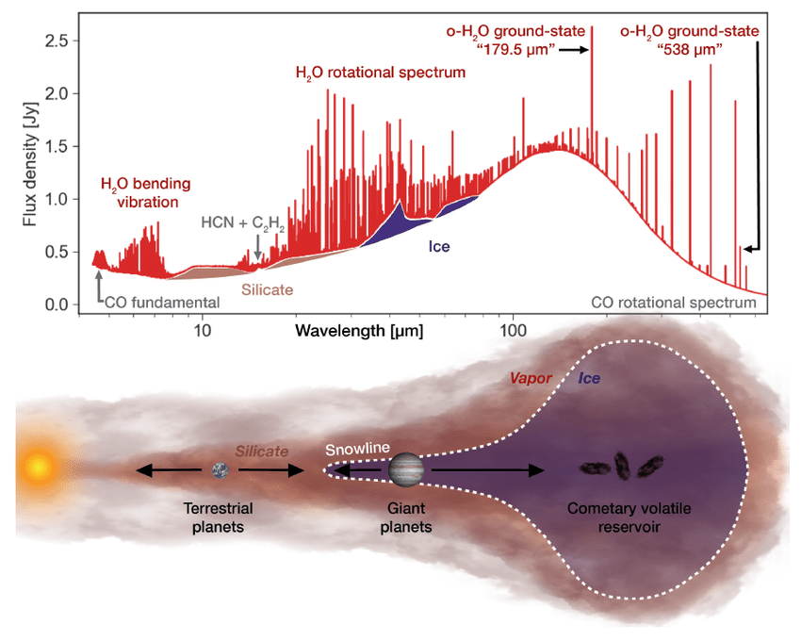
Planetary System(s) (formation)
Question: Evolution Planetary Systems?
Derived Objectives:
Constrain the SED of close protoplanetary disks. Find possible companions.
Linz et. al (2020)
Notes:
Mid-infrared (mid-IR) direct imaging traces dust of ~150K in the disk.
Disk is expected to re-emit a large fraction of the stellar flux in the infrared (Dullemontet. al (2010)).
Mid-IR imaging can thus further constrain disk properties, especially when combined with observations at other wavelengths. Especially if these companions still have circumplanetary disks (CPDs), which are expected to be bright in the mid-IR
Search for thermal emission from (planetary) companions*
Reference the NEAR mission
Are our planetary formation models correct?
How are elemental abundances distributed through the circumstellar disk?
When do Atmospheres start to form?
How do circumstellar gas dynamics change during the evolution of a system?

Slide 22
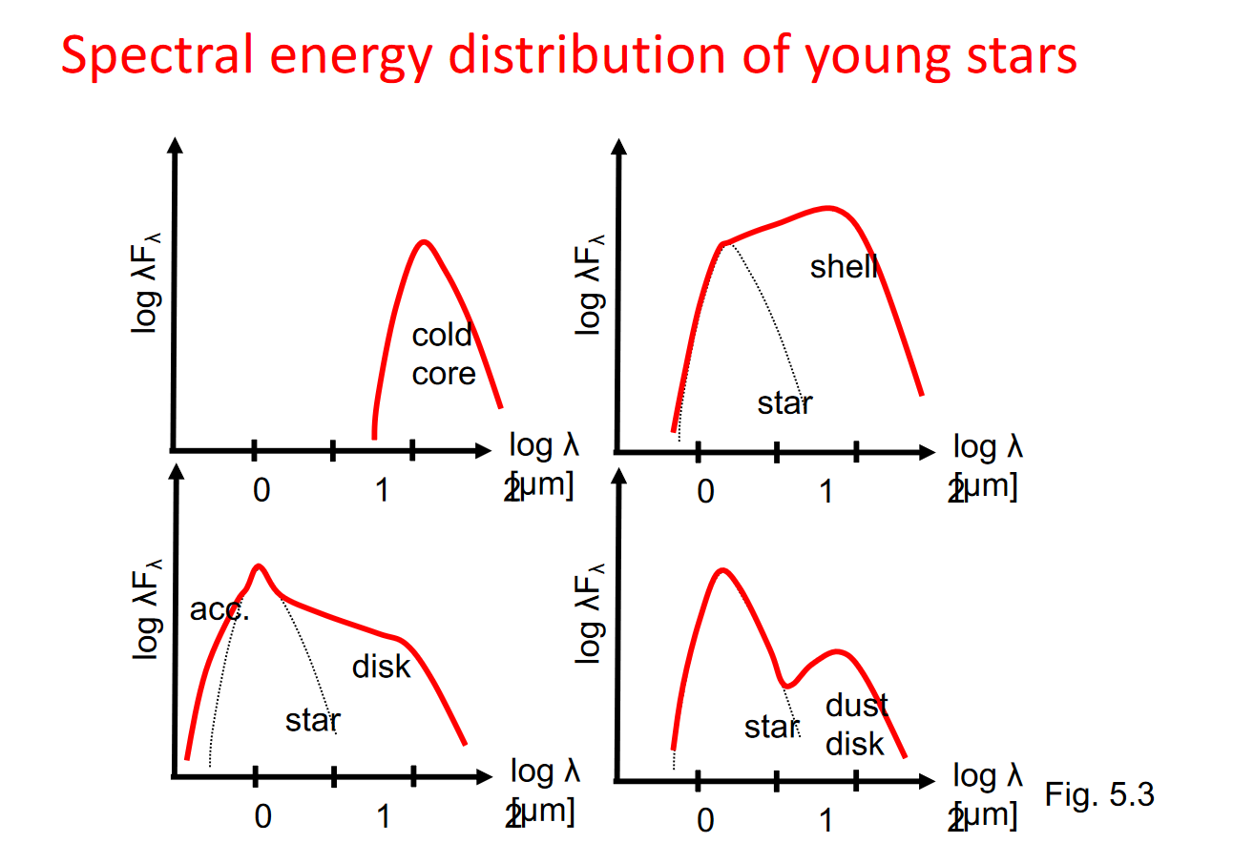
Coronagraph Direct Imaging of Disks
Constrain the SED, including its spatial component, of close protoplanetary disks by observing their thermal emission.
100 parsec
HD 100546
HD 163296
HD 169142
TW Hydra
~1000 AU
HD 100453
H.M. Schmid 2020
D.J. Petit de dit de la Roche et al. 2021
HD 36112
Science case
Payload
Spacecraft
Wrap-up
Notes:
Follow-ups to NEAR

Slide 23
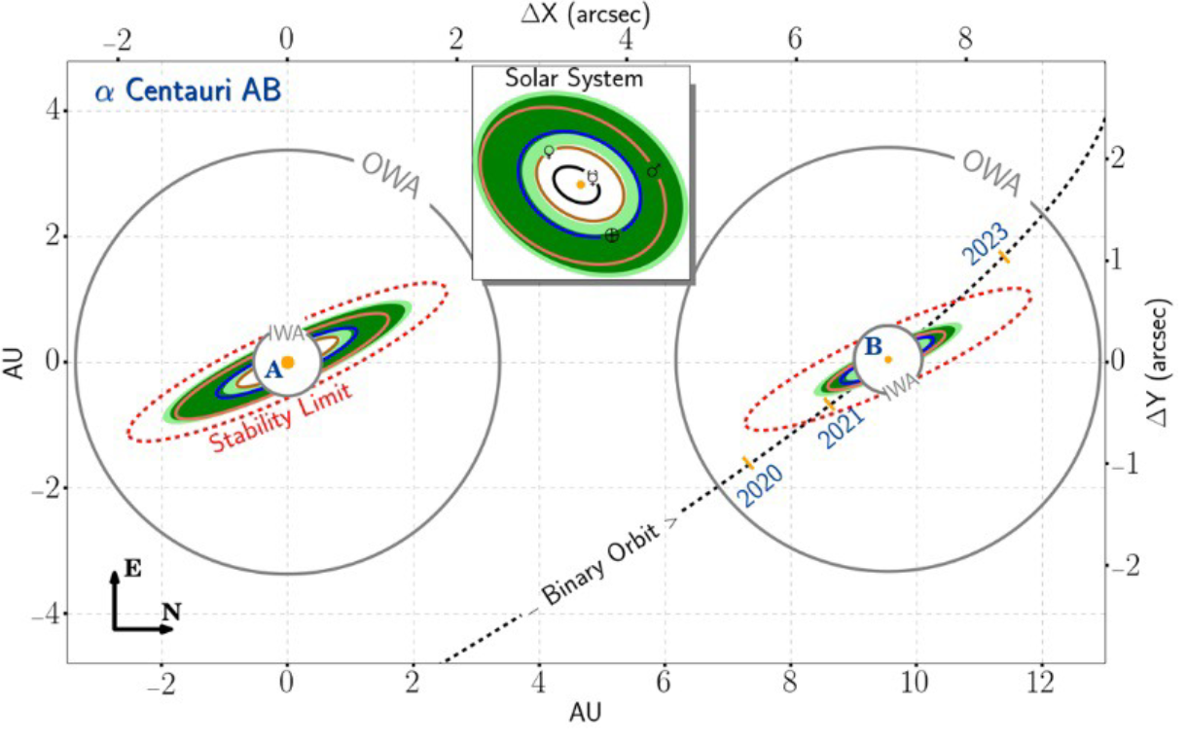
Coronagraph Direct Imaging of Nearby Exoplanets
2. Finding possible companions close-by.
Wolf 359
WISE 0855-0714
6 LIGHT YEARS
WISE 1049-5319
Bernard’s Star
Bernard’s Star
4 LIGHT YEARS
Alpha
Centauri
Proxima
Centauri
Beta
Centauri
2 LIGHT YEARS
R. Belikov et al. 2015
OORT CLOUD
Sun
Notes:
Not yet confirmed exoplanet candidate around WOLF 359
Possibly habitable around Alpha Centauri?
Direct Image in the MIR
Belikov et al: 30-45cm telescope in visible ➔ 4m dish more than enough

Slide 24
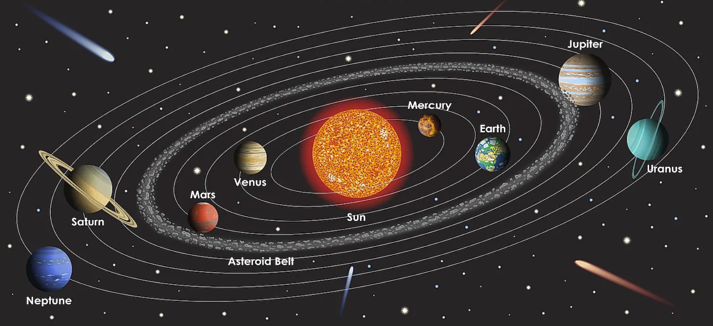
Understanding Universe by Looking
Far and At Home
https://www.worldatlas.com/space/the-hottest-and-coldest-planets-of-our-solar-system.html

Slide 25
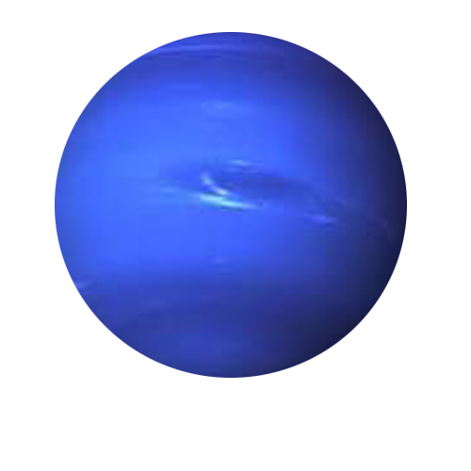
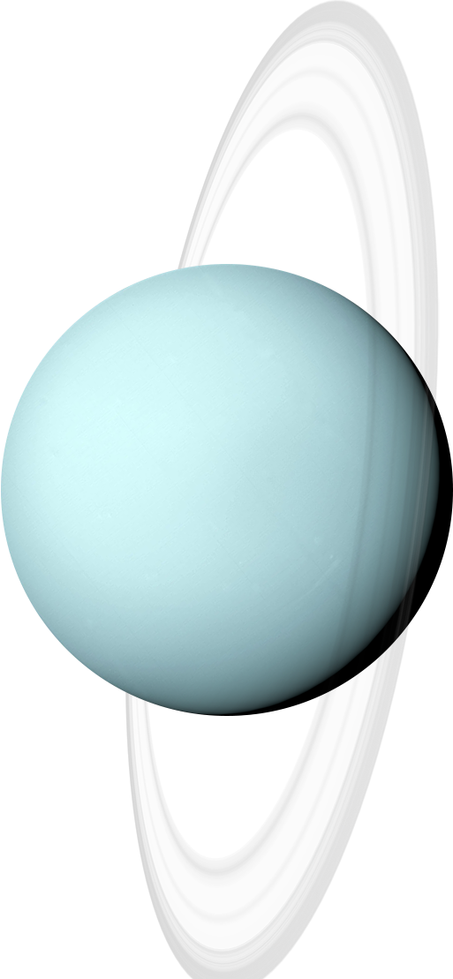

Solar System Science
Question: Evolution Solar System?
Derived Objectives:
Constrain energy budgets of gas planets. Constrain early composition by looking at pristine comets.
Science case
Payload
Spacecraft
Wrap-up

Slide 26
Understanding our Solar System:
Atmospheric dynamics and energy budget of solar system gas planets.
A longer wavelength peers into largely unexplored lower atmospheres of Neptune and Uranus
Mid-Infrared (MIR) observes composition and planetary flux
Energy Budget can be determined
Notes:
Current Models in disagreement with measured temperatures – WHY?

Slide 27
Understanding our Solar System
2. Constraining the elemental abundances during the formation of our solar system.
Comets consist of leftover building blocks from the solar system formation process
Complex organic molecules such as hydrocarbons can be measured at longer wavelengths
Comets can give us valuable insights into the formation of the Solar System and molecules of life

Slide 28
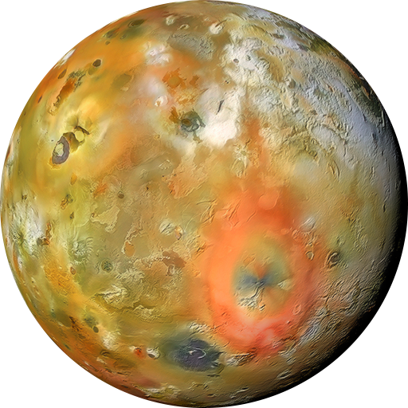
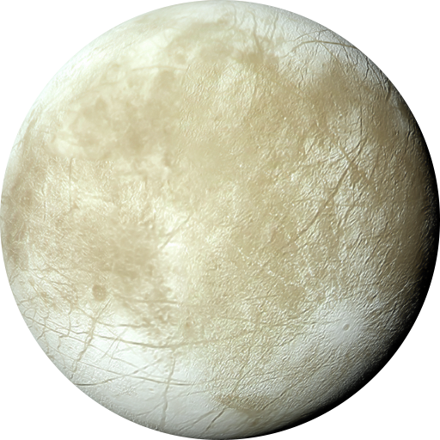
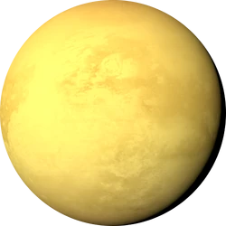
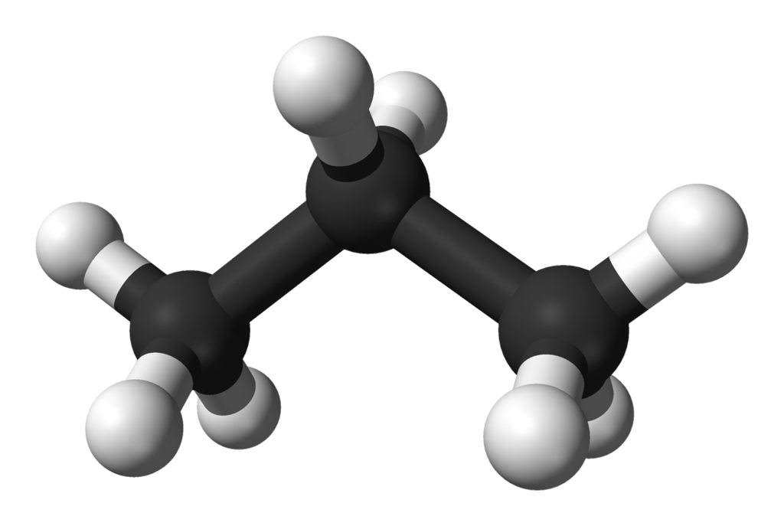
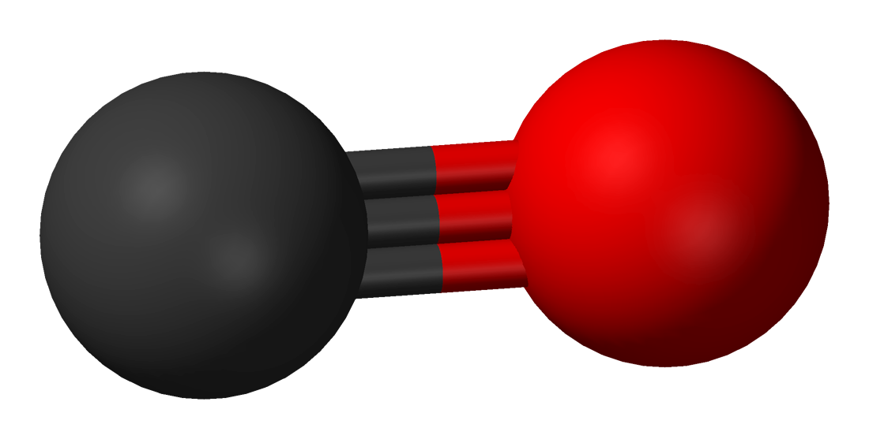
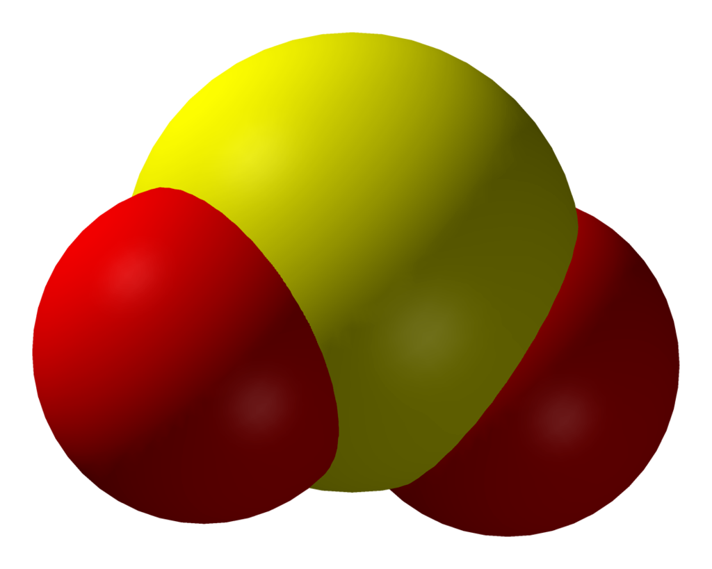
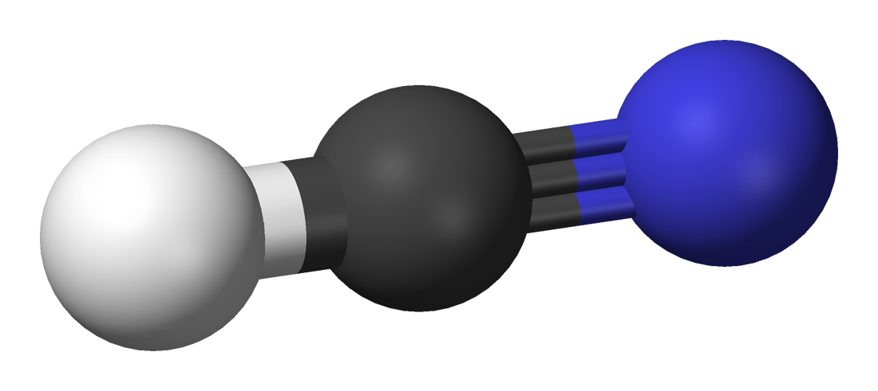
Solar System Science
Question: Life in the Solar System?
Derived Objectives:
Synergize with other mission, looking for biomarkers specifically in the mid-infrared (MIR).

Slide 29
Life in our Solar System?
Synergize with other mission by looking for biomarkers in solar system moons which are undiscovered so far.
Mid-IR opens new possibilities to study atmospheric compositions and dynamics on gas giants’ moons
Hydrocarbons could indicate the presence of life “precursors” i.e. some building blocks for more complex molecules
Sulfur dioxide (19μm) can give us wider information on geothermal (and especially volcanic) activities
Notes:
Comment: Will not be able to find all the Hydrocarbons – But there will be some Sweet Spots.

Slide 30
ARISTOTLE Science Breakdown

Slide 31
ARISTOTLE Science Breakdown
Target Priority – Characterization of Exoplanet Atmospheres
Warm Super-Earths and Sub-Neptunes around F and K stars.
Hot Jupiters
Hot Rockies, Super-Earths and Sub-Neptunes

Slide 32
ARISTOTLE Science Breakdown
Target Priority – Solar System Science
Energy budget Neptune & Uranus
Biosignatures on solar system moons
Pristine Comets and Interstellar Objects
Target Priority – Protoplanetary Disks
Follow up observations of NEAR PPDs
Search for (possible) habitable planet around alpha Centauri
Direct Imaging of far out, young Exoplanets (ask Frans for what targets)

Slide 33
Requirements Breakdown
Science Objectives
Science Requirements
Observatory Requirements
Spacecraft Requirements

Slide 34
Science Questions: A Refresher
Primary
Secondary
Under what conditions are exoplanet atmospheres possible, and how does it shape their characteristics?
How do planetary systems form and evolve?
How does our solar system work, and does it compare to other stellar systems?
Is there life elsewhere in our solar system?
34

Slide 35
Scientific Requirements
Primary Science Objectives
The mission shall do spectrography in the range of 2.5-23 μm.
The spectrograph shall have a resolution R=200 (2.5-10 μm) and R=100 (10-23 μm).
Secondary Science Objectives
The mission shall be able to observe continuously for up to 24 hours.
The mission shall be able to observe up to 5 transits of exoplanets in the habitable zone of sun-like stars.

Slide 36
Scientific Requirements
Primary Science Objectives
The Imager shall have a spatial resolution of 50AU at 100pc (R = 500mas).
The imager shall have a coronagraph.
Secondary Science Objectives
The mission shall be able to image in 10.65, 11.4, 15.5, 19, 22 μm bands.
The mission shall image with less than 50mas relative pointing error.

Slide 37
Requirements Breakdown
Science Objectives
Science Requirements
Observatory Requirements
Spacecraft Requirements

Slide 38
Table of Content: Observatory
Science Case
Mission Profile
Observatory
Orbit Determination
Payload concept
Spacecraft
Instruments
Conclusion
38

Slide 39
Mission Profile
39

Slide 40
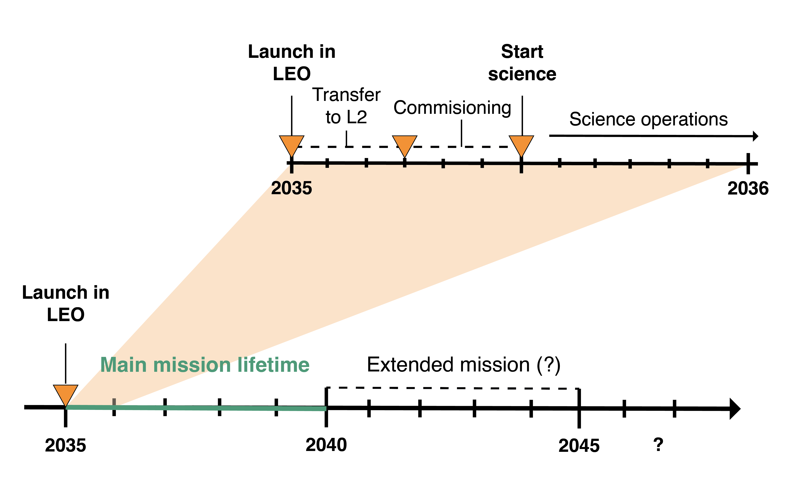
Concept of Operations
Notes:
Launch in LEO with Ariana 62 in 2035
Transfer to L2: 3 month
Comissioning: 3 month
Science Operations: 5 years -> Obersvation, Orbital Corrections, Data Transfer
Disposal: after end of liftime

Slide 41
Break-up of Time During Mission
Notes:
8% preperation for choosing filter and stuff

Slide 42
Orbit Determination
42

Slide 43
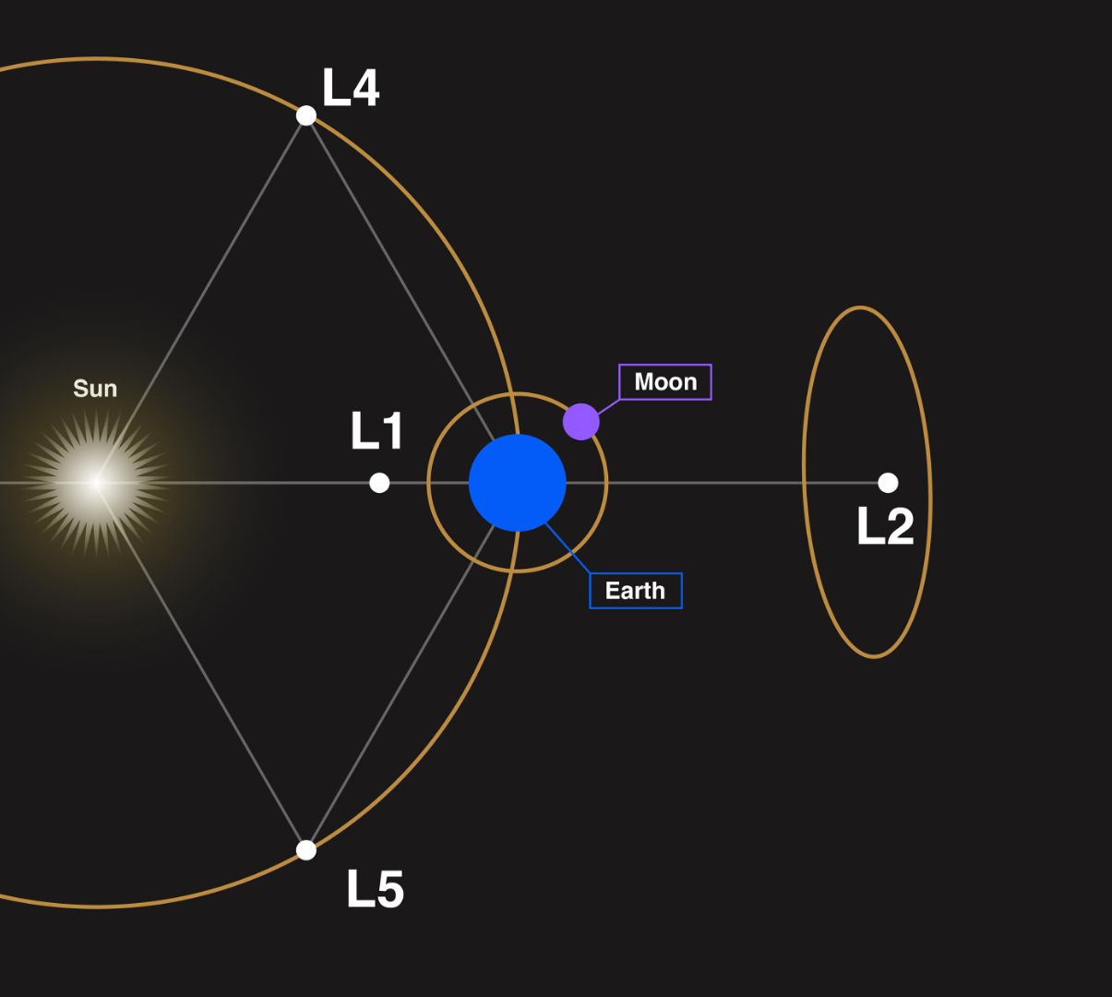
Target Orbit
Lagrange point 2
Thermal / radiation stability
Eclipses avoidance possible
Less geometric constraints
Notes:
Describe the figure
Sun light one side --> contrast to earth orbit: eclipses, albedo -> thermal conditions change frequently
Power: constant sun on solar arrays -> no eclipses from earth/moon
constant sun-earth-s/c-configuration due to L2 characteristics

Slide 44
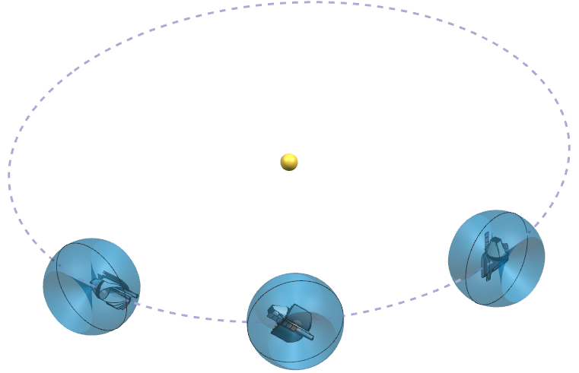
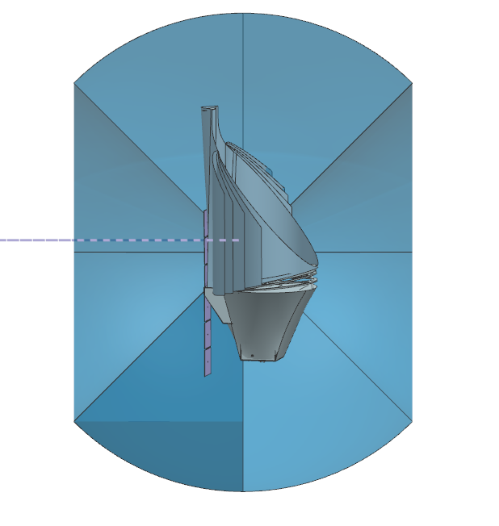
Observation angles
Lagrange point 2
Notes:
During one sun orbit -> cover everything

Slide 45
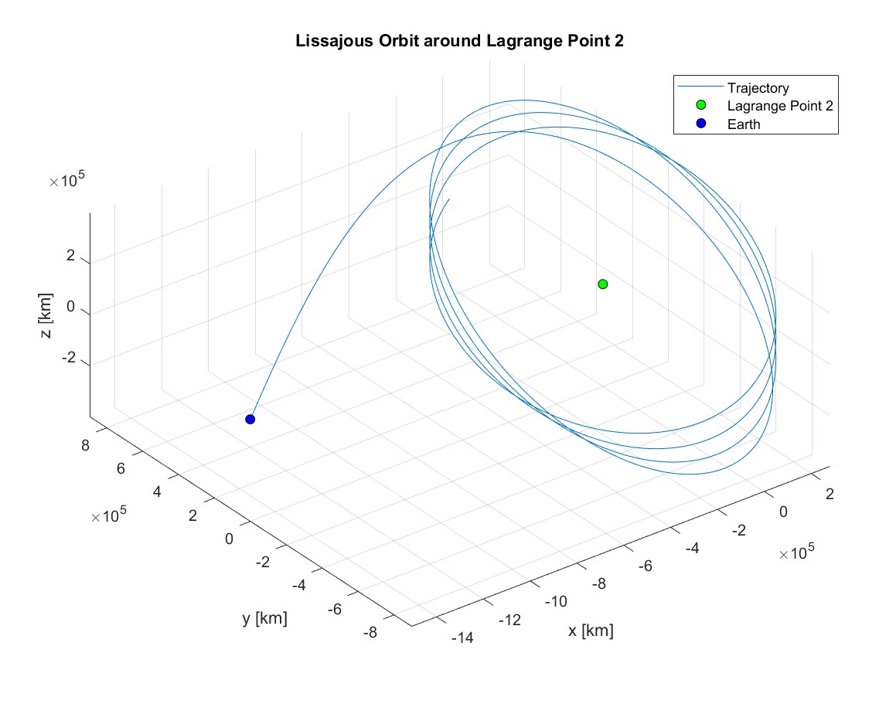
Target Orbit
Orbital Parameters
Amplitudes:
  Az: 400.000 km
  Ay: 800.000 km
One orbit/half year
Notes:
We are aiming for all of this!
Figure: matlab plot of orbit trajectory
Radius of orbit in z, y directions (show on the matlab plot)
One orbit around L2 point takes 0.5 years

Slide 46
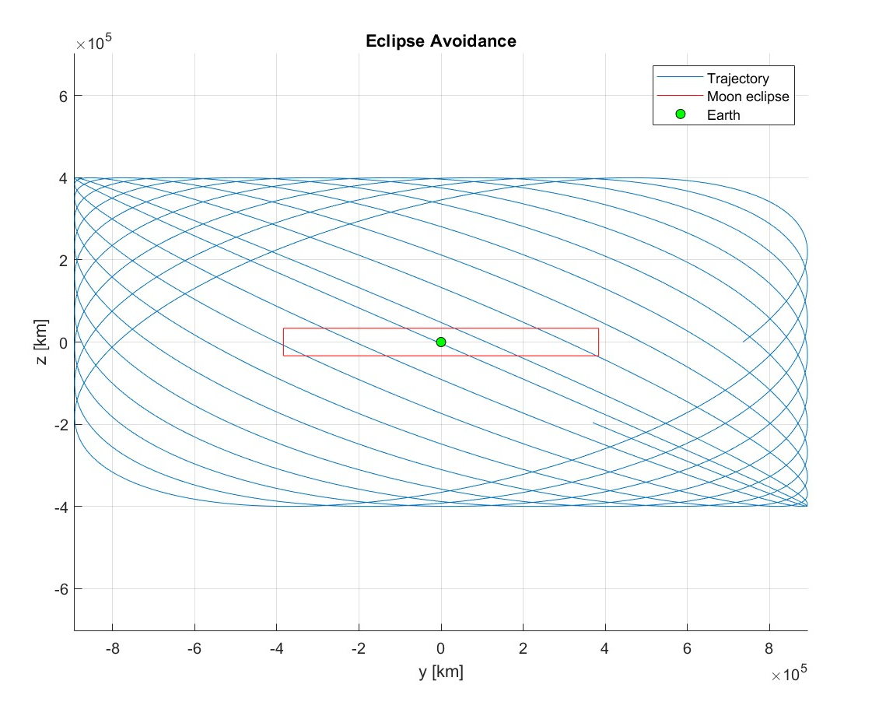
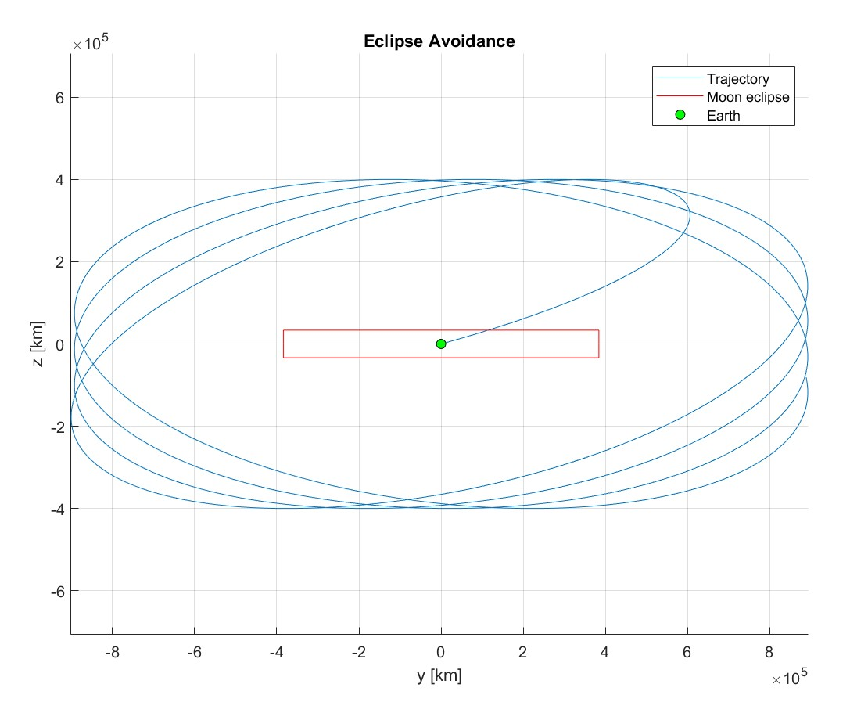
Orbit Eclipse Avoidance
Without eclipse avoidance manoeuvres
With eclipse avoidance manoeuvres
46
Notes:
As discussed on the previous slide: Eclipse avoidance: View from sun -> earth
red square: orbit area of moon (inclinated orbit)
Left: without eclipse manneuvers -> orbit crosses eclipse of moon/earth -> shadow -> power problems (solar arrays)
Right: orbit maneuevers to avoid eclipse

Slide 47
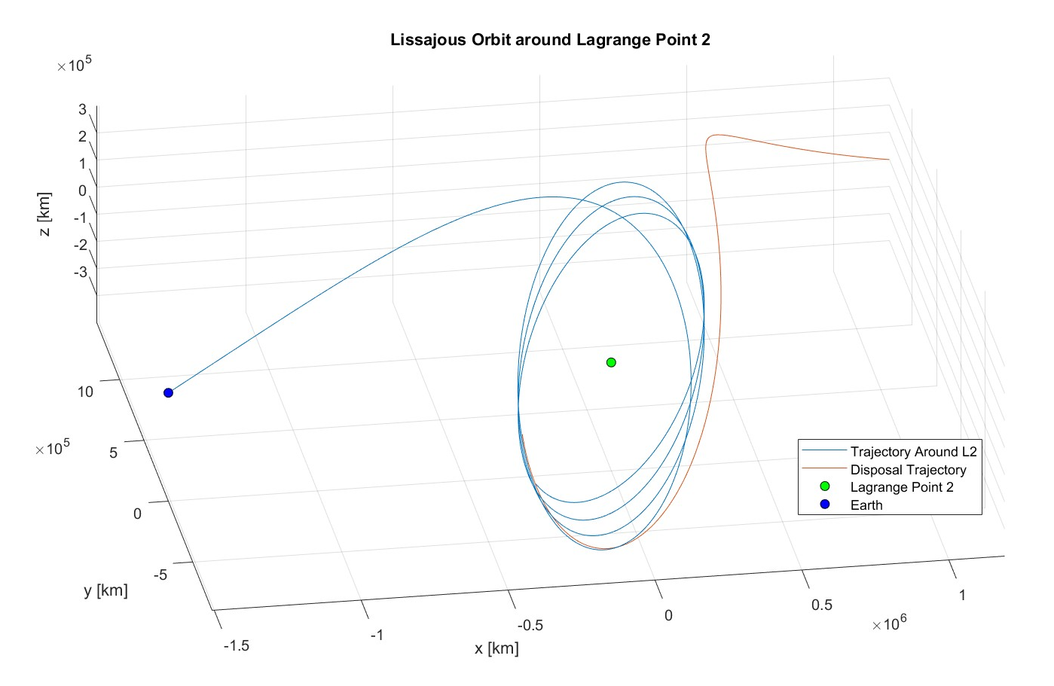
Spacecraft Disposal
Requirements
Disposal of spacecraft
ESA: Preven collision with Earth for 100 years
Notes:
ESA requirenment
Eblue line: same trajectory as previous slide + red trajectory -> disposal trajectory

Slide 48
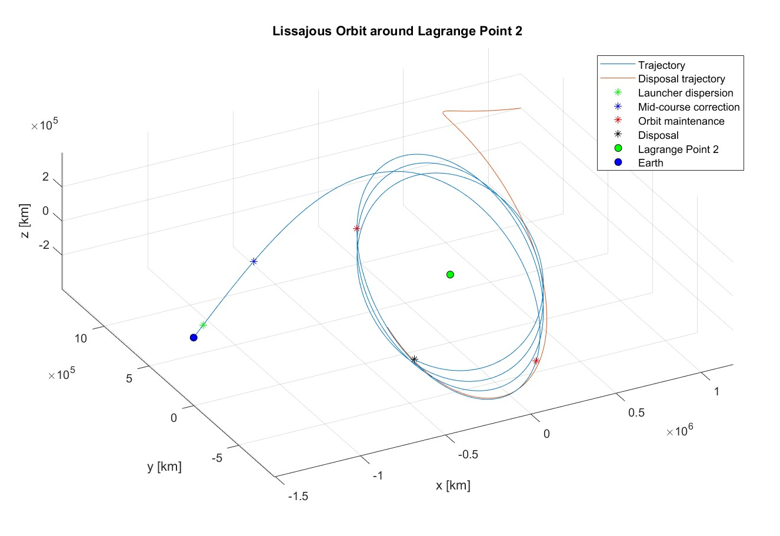
Delta-V Budget
# | Delta V Maneuvers | Delta V
1 | Removal launcher dispersion | 50 m/s
2 | Mid-course correction | 1 m/s
3 | Orbit maintenance (for 5 years) | 10 m/s
4 | Eclipse correction (for 5 years) | 10 m/s
5 | Disposal | 20 m/s
6 | Total | 91 m/s
48
Notes:
Picture: showing different maneuvers
Large delta v -> launcher not 100% precise -> deviation of planned trajectory
For correction
2) sun pressure, ect. -> deviation
3, 4) Point out: maintenace + eclipse correction are covered for 5 years
5) after end of life time

Slide 49
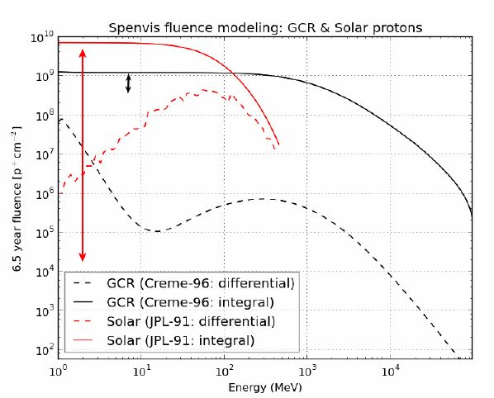
Environmental Conditions
Sources
Proton flux
Origin: Galactic cosmic rays, solar flares
Effects: displacement damage
Not determined in phase A study
Mitigation
Source: radiation effects on the GAIA CCDs after 30 months at L2
49
Notes:
Graph: GAIA -> for comparison: High Proton flux in L2 -> damage of solar panels or CCD
Phase A – study -> not enough information for Mitigation strategys -> we had it in mind

Slide 50
Observatory Concept
50

Slide 51
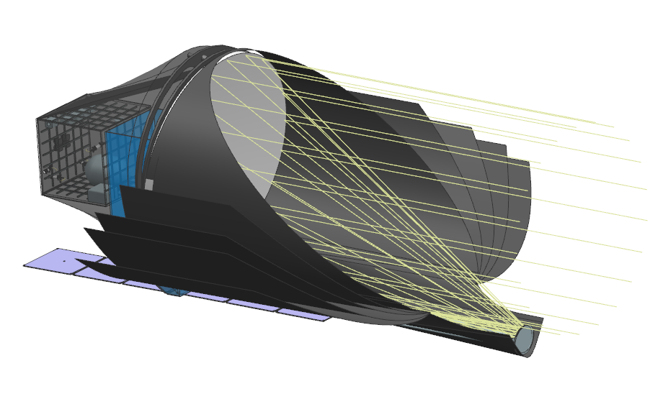
Observatory
PRIMARY
MIRROR
PAYLOAD
BAY
SECONDARY MIRROR
51
Notes:
Overview where we gonna head in the next slides:
Main & secondary mirror
Payload bay housing the instruments

Slide 52
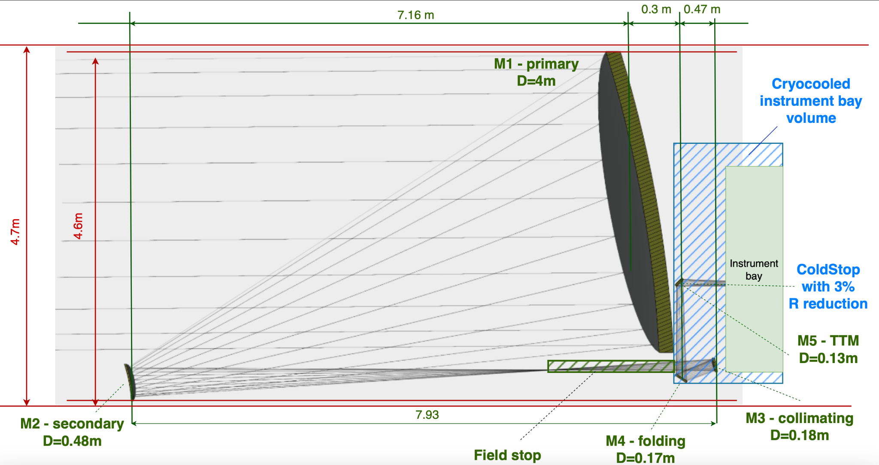
Telescope
52
Notes:
Monolothic mirror (4m) -> no folding needed -> cost effectiv
Off-axis configuration -> less radiative noise in the beam
driven by the amount of photons we need
Cooled instrument bay placed behind the mirror

Slide 53
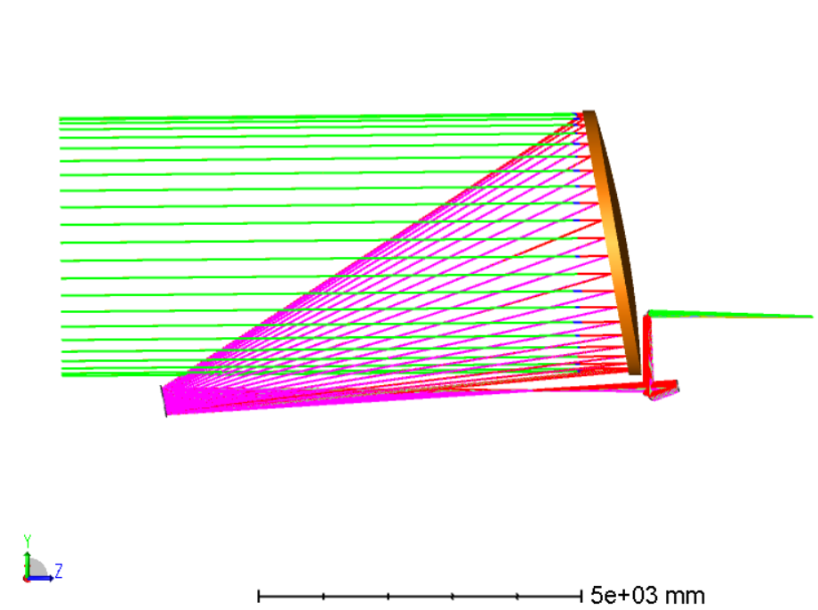
Telescope: Optical Design
# | Parameter | Value
1 | Primary mirror size | 4m
2 | Focal ratio | F/32
3 | FOV | 25 arcsec
4 | Wavelength | 2.5-23ym
5 | Mass (82% lightweighting) | 450-470 kg
6 | Coating | gold
7 | Substrate | Bonded Silicon Carbide
8 | TRL | 6
53
Notes:
Figure: light collection of the telescope with:
Unique Beam folding: allows to uses instruments behind the dish -> topology optimization
capable of using a 4 meter dish
TRL 6-7: based on previously developed mirrors (Herschel 3.5m with 80% lightweighting )

Slide 54
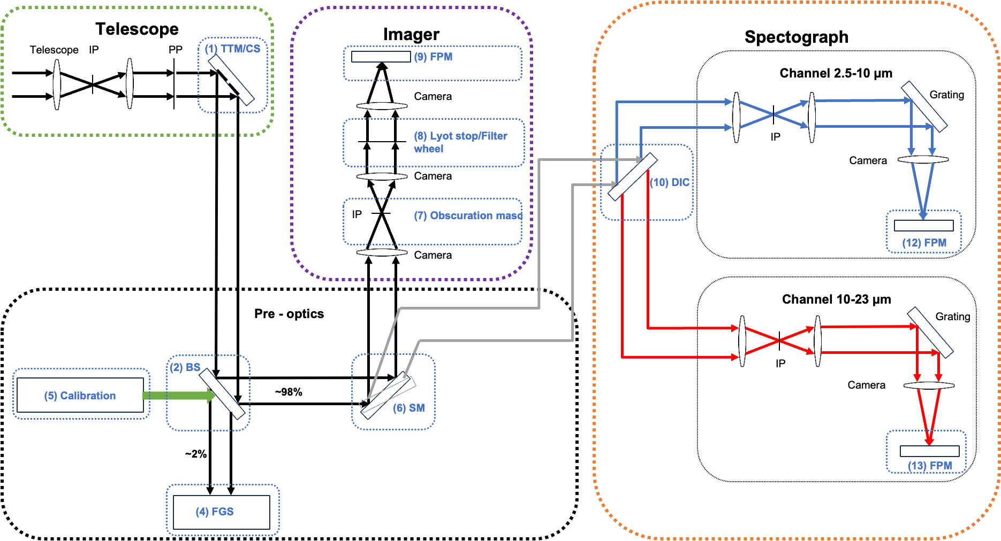
Observatory: Optical Path
54
Notes:
Lightpath: telescope -> pre-optics -> imager/spectograph
Telescope: collection the light
Pre-optics: calibration and light distribution
Imager:
Spectograph:

Slide 55
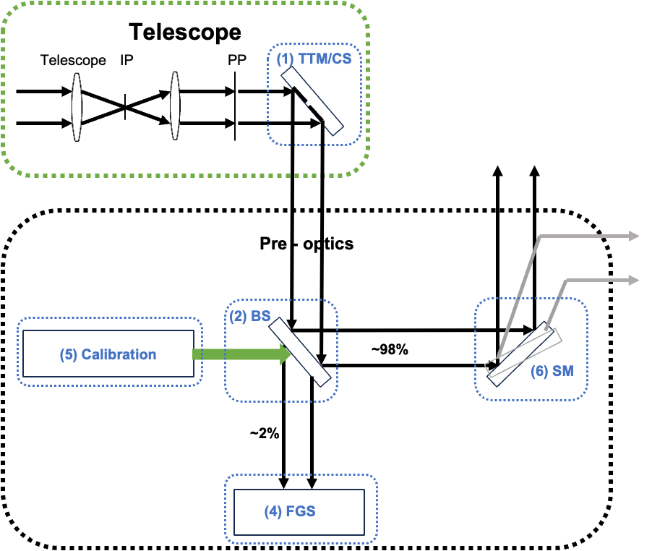
Instruments: Pre-optics
# | Critical Component | Function | Heritage | TRL
1 | Tip Tilting Mirror (TTM) Cold Stop (CS) | Beam stabilization Cooling | MITIS, GAIA | 6, 8
2 | Beam Splitter (BS) | 2 % FGS 98 % Science | MIRI | 8
4 | Fine Guiding Sensor (FGS) | fine pointing attitude stabilization | JWST | 8
5 | Calibration | Flux | JWST | 8
6 | Selection Mirror (SM) | Change of instrument | MIRI | 8
55
Notes:
List is not stating all the components
Only mention the most critical ones

Slide 56
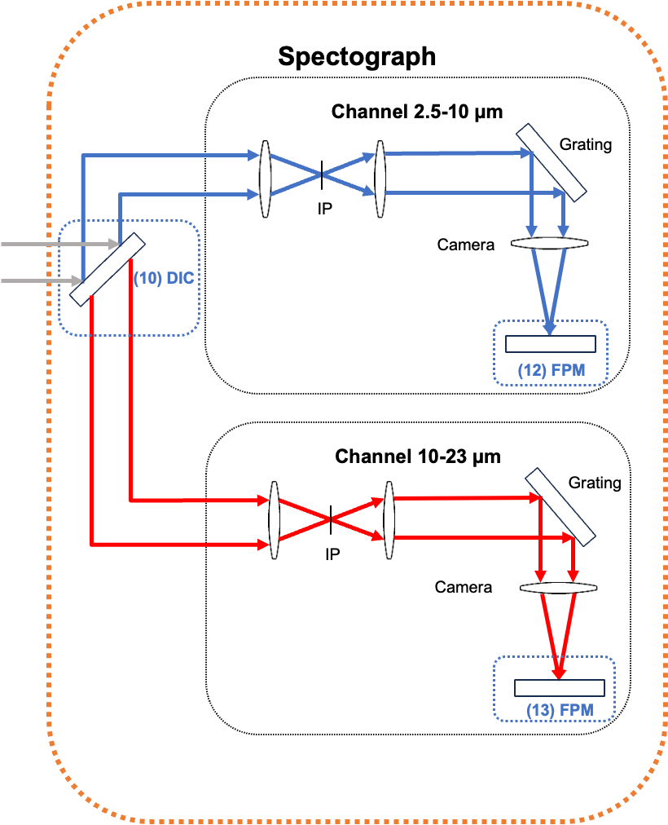
Instruments: Spectrograph
# | Critical Component | Function | Heritage | TRL
10 | Dichroic (DIC) | Wavelength splitting | MIRI | 8
11, 12 | Focal Plane Module (FPM) | Light detection | MIRI | 8
Galactic Astrobiology Broadband for Exoplanet Yields (GABBY) Infrared Spectrometer
56
Notes:
For atmospheric characterisation of all target planets

Slide 57
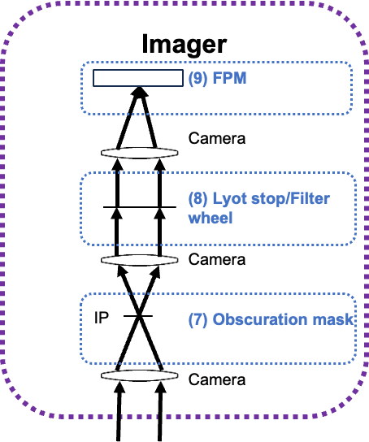
Instruments: Imager
# | Critical Component | Function | Heritage | TRL
7 | Obscuration Mask | Selection in/out | ISO | 8
8 | Lyot Stop Filter Wheel | Selection of stops and filters (12 TBD) | MIRI | 8
9 | Focal Plane Moduel (FPM) | Light detection | MIRI | 8
Coronographic High Resolution Imaging System (CHRIS)
57
Notes:
Direct imaging for far out planets, proto planetary discs
12: 2x 5 filters (obscuration masc in/out), 11: lyot stop, 12 open

Slide 58
Requirements Breakdown
Science Objectives
Science Requirements
Observatory Requirements
Spacecraft Requirements

Slide 59
Observatory Requirements
The mission shall do spectrography in the range of 2.5-23 μm.
Spectrograph is split by Dichroic into two channels
Channel 1: 2.5-10 μm, Channel 2: 10-22 μm
The mission shall be able to image in 10.65, 11.4, 15.5, 19, 22 μm bands.
Selection of filter throughout the filter wheel
Movable obscuration mask (in/out)
59

Slide 60
Table of Content: Spacecraft
Science Case
Observatory
Spacecraft Envelope
Spacecraft
Subsystems Decomposition
Operations & Launch
Conclusion
60
Notes:
THANKS ENGINEERING TEAM
PROPOSE ROUGH CONTENT

Slide 61
Design Drivers
Main design drivers
Primary mirror size (4m)
Observation wavelength range (2.5-23μm)
Instrument operational temperature (7-10K)
Mission lifetime (5+ years)
Launch vehicle constrains
Reuse of currently developed
technologies (high TRLs)
Secondary design drivers
61
Notes:
Scientifict requirements and mission reqs -> trasnleted to engineering language -> From that we can extract main design drivers for our spacecraft
But also we want to propose feasible solution, that why aditiaon design drivers were proposed. Reuse and updadate of predeveloped technologies, will significantli reduce costs copared to development from scratch solutiom, ourdesign sahllbe compatible we currently used space and. Ground infrastrucutre by ESA mission.

Slide 62
Spacecraft Envelope
62

Slide 63
Our Baby
Notes:
Our first idea for the spacecrafts name was Dyson but we were told that this would breech copyright infringement laws so we had to go with plan B (ARISTOTLE)

Slide 64
Our Baby
DEEP SPACE
Service & payload modules
Mechanical support
Primary
mirror
Solar panels
Primary
sunshield
Radiation shield
Secondary mirror
SUN
Notes:
MIRROR
SUN SHIELD
SUN and DEEP SPACE
PAYLOAD BAY
SERVICE BAY
Willeke: Describe the individual parts, quick remark why are they there, how is the light entering the space craft and where is the ’instrument’
Marie: “ Deployable shield in multiple layers. Shape designed to eject radiations”

Slide 65
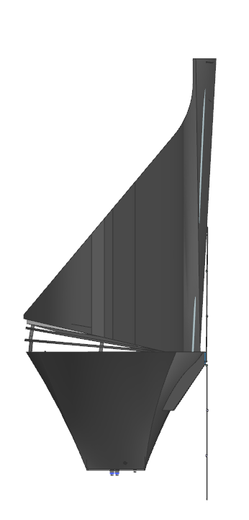
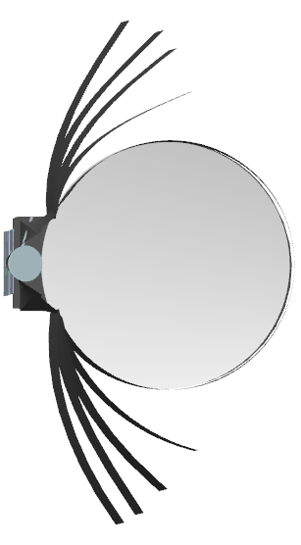
Spacecraft Envelope
max ±45°
Side
view
x
Front view
4.7 m
SUN
11.3 m
y
z
Notes:
ROUGH DIMENSSIONS
COMPATIBILITY WITH ARIANE FAIRING
Split into 2 slides with images and then the mass margin explanations. Otherwise, it is too small to read. Anyway, dimensions and masses should be on different slides. Maybe just a single mass estimation highlighted with the full explanation after. - DONE ?

Slide 66
Mass Budget
System |  | Value [kg]
Structure | Primary | 566
 | Payload support | 400
Telescope |  | 460
Instruments |  | 132
AOCS |  | 265
EPS |  | 144
COMMS |  | 40
Data Handling |  | 40
Propulsion System |  | 200
Total with 20% margin |  | 3030
Mass margins
TRL 1-5: 20%​
TRL 6-7: 15%​
TRL 8-9: 10%
System margin: 20%
Notes:
TOTAL MASS
MARGINS

Slide 67
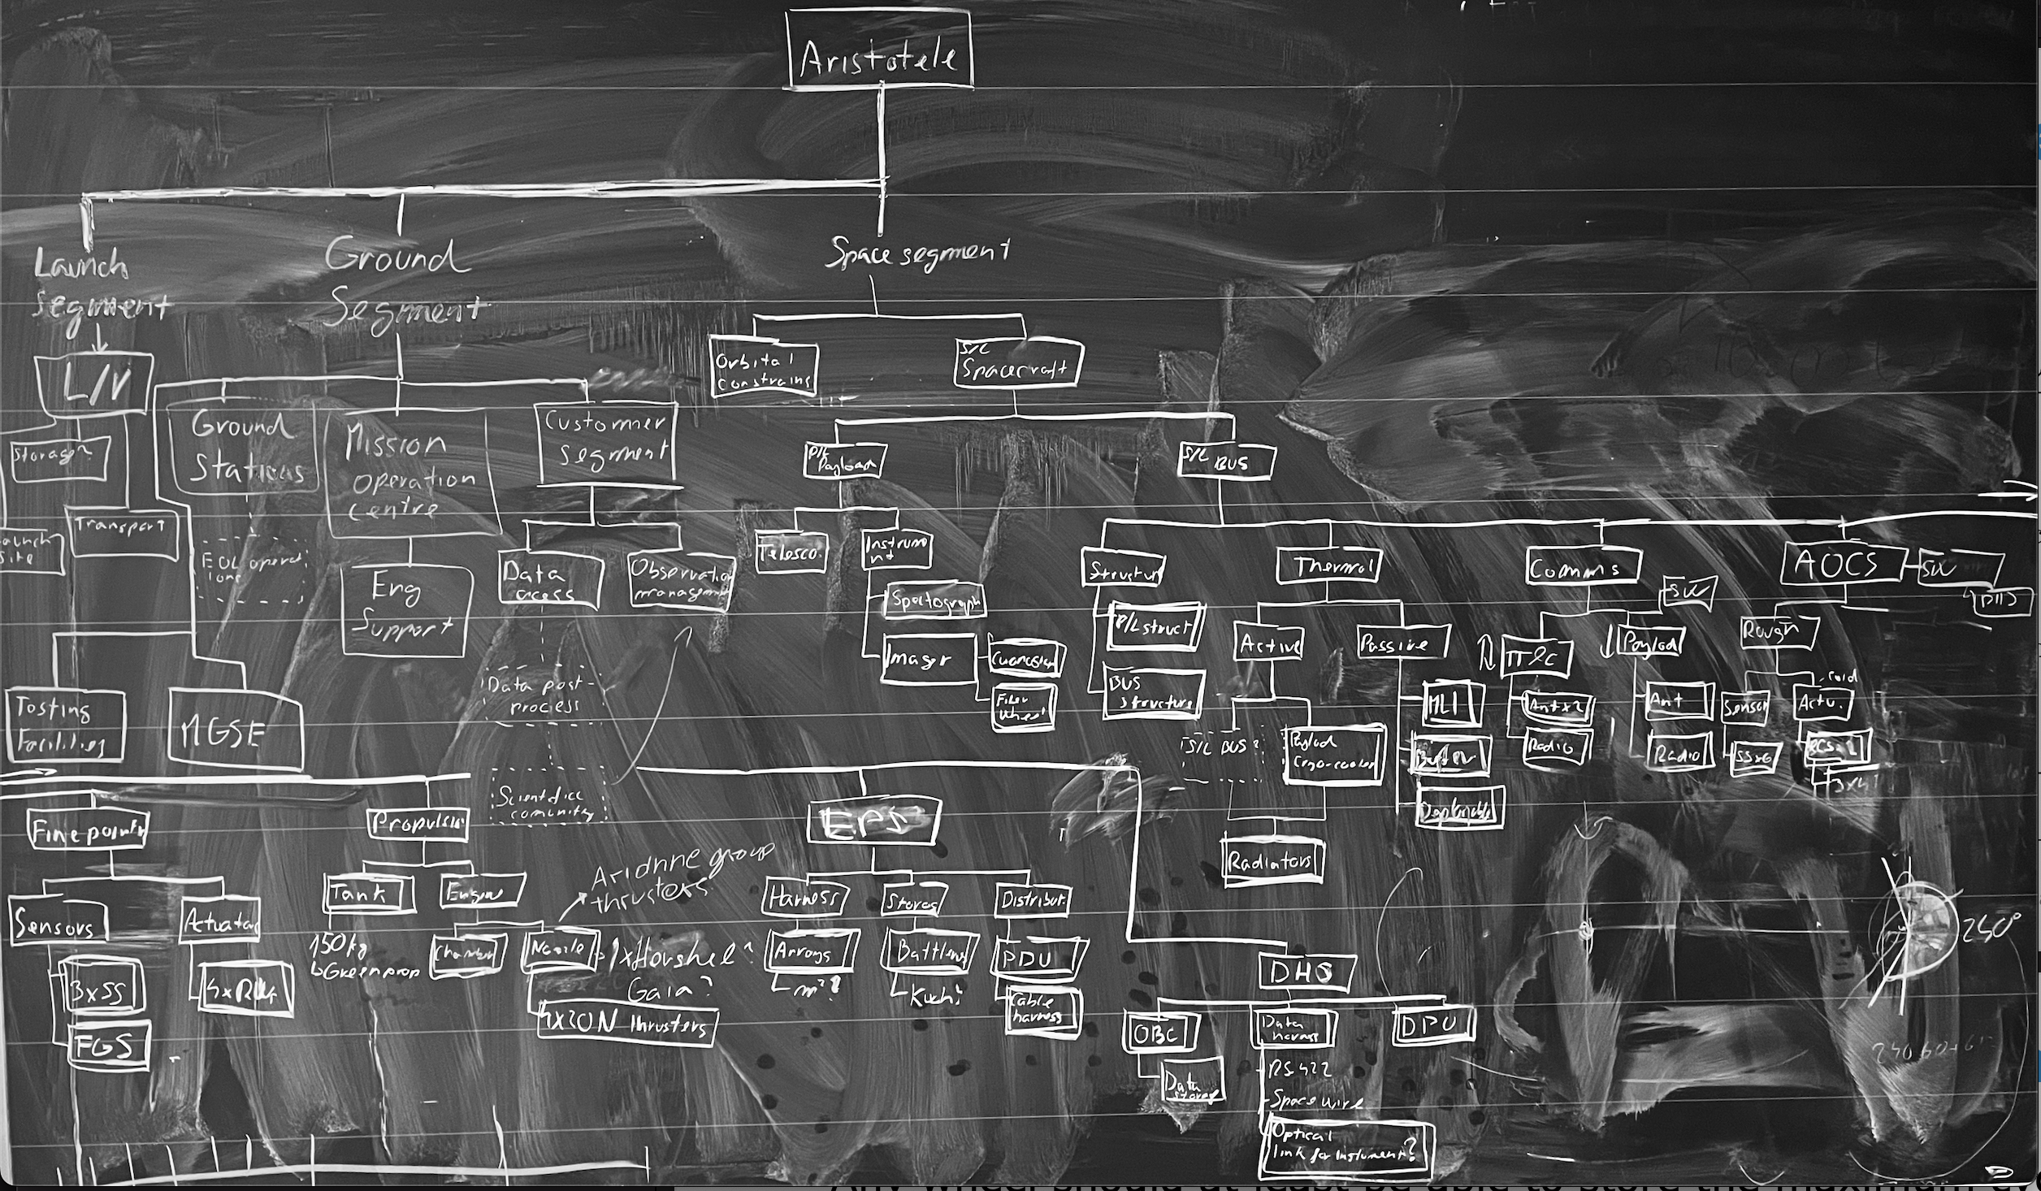
Spacecraft Systems Decomposition
Notes:
ILLUSTRATION OF THAT SPACECRAFT IS DECOMPOSED IN HIGH DETAIL, HIGHER THAN IS PRESNETED IN THIS PRESENTATION

Slide 68
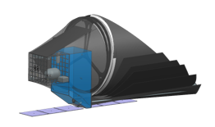

Spacecraft Service Module
Radiator Eps
Cryo-cooler
Batteries
Star tracker
Main thrusters
Tank
Sun sensor
Reaction wheels
Secondary thrusters
Notes:
SERVICE MODULE TOPOLOGY
FOLLOWING SLIDES CONFIGURATION: RUC REQS, LEFT DIAGRAM, REST PERFORMACC (WHEN NEEDED)
Marie: « The main subsystem éléments are represented in a box placed right behind the payload service module. Their locations are selected to eject heat to the deep space, keep the inertia center for the tank and finally, for the sensors, their are placed to point at their target direction. »

Slide 69

Support Structures
Primary support structure
payload structure & spacecraft BUS
​30% of spacecraft mass: 550-600kg
mirrors system & instruments​
50% of payload mass: 390-410kg
Payload support structure
Notes:
PRIMARY STRUCTURE (550-600) kg
SECONDARY (400kg)
COLOR BLUE PAYLOAD SUPPORT, GREY PRIMARY

Slide 70
Thermal Challenge
<150 K
250-320 K
7-10 K
Notes:
ONE OF MAIN ENGINEERIGN CHALANGES
HEATMAP

Slide 71
Thermal System Break-Down
Instrument bay < 8K
Telescope mirror <120K
Temperature requirements
Thermal System
Passive
Active 1
Active 2
Device | TRL Level | Heritage | Temp. [K] | Power max/nom [W]
CryoCooler - payload | 6/7 | MIRI | 8-6 | 350/80
Cooler - BUS | 7 | Airbus S&D mission | 250-300K | -
Sun-shield | 7 | JWST, SPICA | 150-100K | -
Sun Shield
Payload Cryocooler
Cooler - BUS
MLI
Plumbing
Radiators
Notes:
2 level system
PASSIVE
ACTIVE

Slide 72
Electric Power System (EPS)
EPS
EPS requirements
Positive power balance during nominal operations
S/C: own power storage 30 minutes after deployment
Power Harness
Power Distribution
Power Storage
Solar Array
PDU
Battery pack
Worst case: Instr. commissioning + AOCS high (20% margins)
Payload | 50 W
Thermal | 400 W
AOCS | 315 W
EPS | 20 W
Data handling | 20 W
COMMS | 80 W
Propulsion | 190 W
Total | 1075 W
Power Harness
BMU
Power harness (30° Beta Angle)
Solar Array Area | 6.6-6.7 m²
Power | 1200-1300
Power Storage
Batteries | 450-470 Whr
Notes:
WORST CASE DESIGN
BATTERIES SIZE

Slide 73
Attitude and Orbit Control System (AOCS)
Pointing requirements
Relative pointing error <0.050”
AOCS
Rough Pointing
Fine Pointing
AOCS parameters
Rough pointing | Sensors accuracy | 1.8 arcsec
 | Actuators accuracy | >3000 arcsec
Fine Pointing | Sensors accuracy | 30 marcsec
 | Actuators accuracy | 40 marcsec
Sensor
Actuator
Sensor
Actuator
Sun Sensor 6x (+6 spare)
MPS
Star Tracker3x
RWs 3+1
RCS 2x6 Thruster Unites
FGS
Heritage
N2 Tank
Hubble (0.010” accuracy)
Herschel (0.100” accuracy)
Notes:
MULTI LEVEL SYSTEM WITH DDEFINED PARAMEETERS
RCS FOR ROUGH
STAR TRACK FOR MEDIUM
FINE GUIDENCE

Slide 74


Attitude and Orbit Control
Fine Guidance
Micro Propulsion System (MPS)
Fuel Type: Nitrogen (TRL 9)
Fuel Tank: 66kg +50% margin =100kg
Thrusters: 12 N₂ cold gas thrusters
Spin rate management
Fine attitude pointing
RWs desaturation
4 reaction wheels (3 + 1 spare)
3 Star Trackers
Fine Guidance Sensor (FGS)
  Pointing accuracy 0.03”
Notes:
SYSTEMS IN MORE DETAIL

Slide 75
Propulsion System
Requirement
Total ΔV=90-100m/s
Propulsion
Chemical Mono-Propellant Propulsion System:
Thrust | 22N (ECAP's HPGP Thruster)
Propellant | Green Propellant (LPM-103S)
Fuel tank | 114kg + 50%margin = 171kg
Isp | 250sec.
Density Impulse (Ns/L) | 3030
Function | Station keeping Orbit correction Spacecraft disposal
Tank
Thrusters
Green Propellant
(171 kg)
4x22N Thrusters
Notes:
MAIN REASIN IS TO ADRESS ISSUE OF DELTA V
PROPOSED SOLUTION BASED ON EUROPEAN TECHNOL

Slide 76


Communications
Requirements
Communication window MDS < 7.5h/week
24/7 link Health Monitoring & Commanding
Comms
Medium Gain System (Payload Data, TX)
X-Band
Transmitter Power: 10 W
Data rate: 10 Mbits/s
2 Transmitter for redundancy
Parabolic antenna with 0.3 m diameter, 2 DOF
TT&C
Payload downlink
Low Gain System (TT&C, TX/RX)​
S-Band​
2 Transceivers for redundancy​
2 Omnidirectional antenna​
Data rate: 2 kbits/s
Ant x2
Ant
Transceiver x2
Transmitter x2
Pointing mechanism
Notes:
MAIN DESIGN DRIVER ARE REQS
TWO CHANNELS

Slide 77

Data Handling
Requirement
DHS
Scientific payload data shall not be corrupted by onboard processing
OBC
Data Storage
Data Harness
Data produced | Average (Gbits/day) | Maximum (Gbits/day)
Spectrograph | 2.7 | 9
Imager | 4 | 33
Housekeeping | 0.5 | -
Total | 3 | 33
  One instrument in use at a time
Max data rate: 10 Mbits/s
No on-board processing
Centralized OBC architecture
Notes:
NOT CORRUPT DATA
WWORST CASE SCENARIO
INPUT FOR PAYLOAD COMS CHANNEL DESIGN

Slide 78
Operations & Launch

Slide 79

Launch Segment
Requirements:
Total wet mass: 3100kg (incl. 20% margin)
Maximum diameter envelope: Ø4.7m
Proposed launcher : Ariane 62 - long fairing
Performance: 3300kg for L2 orbit
Max. usable diameter extension: Ø4.7m
Ariane 6 User’s Manual, Issue 2 revision 0, arianespace, arianegroup
Notes:
PROPOSED CHEAPER OPTIONS FROM TANDEM OF ARIANE LAUNCHER
COST REDUCTION
UPCOMING DEVELOPEMNT SSHOULD REDUCE PROPOSED WEIGHT DUE HIGH TRLs

Slide 80

Ground Segment
Operational Ground Segment (OGS)
Mission Operation Centre (MOC)
Science Ground Segment (SGS)
Ground Station Network
  ESA ESTRACK Deep Space Network
  35 m deep space antennas
    CEBREROS-1 (X / X Ka)
    MALARGÜE-1 (X Ka / X Ka)
    NEW NORCIA-1 (S X / S X)
Notes:
GROUND STATIONS NETWORK BY ESTRAC
360 coverage of earth
MISSION OPERATION CENTRE
SCIENCE GROUND SEGMENT

Slide 81

Data Pipeline
Notes:
Payload link
SCIENTIFIC GROUND SEGMENT
DATA PROCESSING
AVALAIBE ARCHIVE
OBSERVATION
CHOIEF OF OPERATIONS

Slide 82
Table of Content: Conclusion
Science Case
Testing and Qualification
Observatory
Risk Assessment
Spacecraft
Cost Assessment
Conclusion
Summary

Slide 83
Testing and Qualification

Slide 84
Testing and Qualification
Suppliers shall satisfy PA/QA certifications + sampling for statistics
Engineering model
Qualification model
Flight model
Functional and initial environmental testing
Extreme environment testing
Real mission conditions.
Notes:
Engineering model: prototype for components and assemblies. functional and some environmental tests. assure maximum TRL of the components and to test basic system integration.
Qualification model: larger system assemblies or prototype systems. placed under extensive functional and environmental tests that exceed their expected environment condition to demonstrate ability to withstand most challenging conditions.
Flight model: (New piece manufactured) tested against workmanship error, similar environmental testing to the expected experimental campaigns but less extreme than the qualification model.

Slide 85
Testing and Qualification
Functional
Vibration
Functional
Shock
Functional
TVAC + Functional
EMC
Functional
Acoustic
Testing facilities: TVAC Chamber, Vibration stand, EMC and Acoustic Chamber
Notes:
Functional tests covers a wide range of test. These can include: subsystem unit testing, optical verification, structural tests, electrical testing and performance verification are done in house.
After each mode of testing, functional testing needs to be repeated to check the functionality is preserved.
Shock, acoustic, ThermalVAC, electromagnetic compatability and radiation testing can be done in specialised labs within Europe.

Slide 86
Risk Assessment

Slide 87


Risk Assessment

Slide 88
Risk Assessment

Slide 89
Cost Assessment

Slide 90
Cost Estimation
Cost ARISTOTLE | % | [M€]
ESA space segment | 50 | 625
Mission / science operations | 15 | 187.5
ESA project team overhead | 12 | 150
Ariane 62 launcher | 8 | 100
Margin | 15 | 187.5
Sum ESA costs (L-mission limit 2023: 1,300 M€) | 100 | 1,250
Payload costs of member states (~30% of ESA costs) | 30 | 361.5
Overall mission costs |  | 1,611.5
 | Herschel | ARISTOTLE
Telescope diameter | 3.5m | 4.0m
Cold telescope | Yes | Yes
Cold instrument | Yes | Yes
Orbit | L2 Lissajous | L2 Lissajous
Mission duration | 3 years | 5 years (+5 years extension)
Launcher | Ariane 5 | Ariane 62
Launch date | 2009 | 2035
Cost correction factor | 1.00 (=2009) | 1.28 (=2023)
Overall costs | 1,100 M€ | 1,250 M€

Slide 91
Downscale options
Removing imager
Reduction of limit wavelength (15μm)
Downscaling dish size
Run instruments at higher temperature
Notes:
Run instruments at higher temperature
Increase of noise contributions

Slide 92
Summary
ARIEL + PLATO → ARISTOTLE → Later Missions
Transit & Eclipse spectroscopy in (2.5-23μm)
Imaging in 5 different wavelength bands and coronagraph
Technology employed in existing spacecraft
In line with current research
#AlienHunter
Notes:
Bridge gap: ARIEL + PLUTO → Habitable Worlds Observatory + LIFE
Emission spectroscopy and imaging in the infrared range
Under what conditions are exoplanetary atmospheres possible and how does this shape the characteristics?
How to planetary systems form and evolve?
How our solar system works and how it compares to other solar systems?
Is there life elsewhere in the solar system
Proposed systems are currently employed in existing spacecraft so this idea is a feasibile solution to follow up the ESA planet hunting endeavour. Proposed observation and strategy is in line with current research. The launch of ARISTOTLE will allow for a seamless transition from existing to future missions.
Outreach

Slide 93
"Extraordinary claims require extraordinary evidence.“
Carl Sagan/
- Pierre-Simon Laplace/
Marcello Truzzi/
etc…

Slide 94
Cost Estimation
Item | Percent | Cost
ESA Space Segment | 47
Mission/Science Operations | 15
ESA Project | 11.5
Launcher | 14 | 160 Mio.
Contingency | 12.5
Total | 100 | 1210 Mio.

Slide 95
Cost Estimation: ESA Missions Overview
Mission | Class | Costs
JUICE | L | ~1.6 billion
Athena | L | ~1.9 billion
LISA | L | ~1.5 billion
Solar Orbiter | M | ~1.5 billion
Euclid | M | ~606 mio
Plato | M | ~600 mio
Ariel | M | ~610 mio

