Slide 1
π- SERVER

Slide 2
Abstract
This project based on economic Web servers by using ultra-low-power micro-computing boards to serve Data to client.
Our premise is that low-power computing platforms can provide adequate performance for low-volume Websites run by small businesses while delivering a significantly higher request/Watt.
We use the popular Raspberry Pi platform as low-power computing platform.
Our Physical device show that this platform can provide comparable response times to more capable server-class machines.
We study the feasibility of using clusters of low-power systems to serve requests for larger Websites. We find that, by utilising low-power multi-server clusters.

Slide 3
INTRODUCTION
In todays cloud-dominated age, we still find that dedicated Web servers are widely used, especially in many small-scale to medium-scale enterprises.
Power consumption of such dedicated Web servers can be high. So we are opting this project for the development of a dedicated web server with low ratio of power consumption with the performance.
For instance, a typical server has a baseline power consumption of 325W, which amounts to approximately 50-80% of its power consumption at peak load. However, over 90% of the time, these servers are underutilised.

Slide 4
This project explores the feasibility of using ultra low-power systems to replace these high-power Web servers at small-to-medium scale enterprises, motivated by two observations.
1. First, new ARM-based ultra-low-power systems to replace x86 based Systems.
2. Second, many small-to-medium scale organisations (e.g. small offices)
Raspberry Pi cluster can serve, on average, 17-23x more requests per Watt than a typical server at high arrival rates.
We consider the feasibility of using clusters of low-power servers that can be adjusted based on the current workload such as to achieve a minimum desired response time.

Slide 5
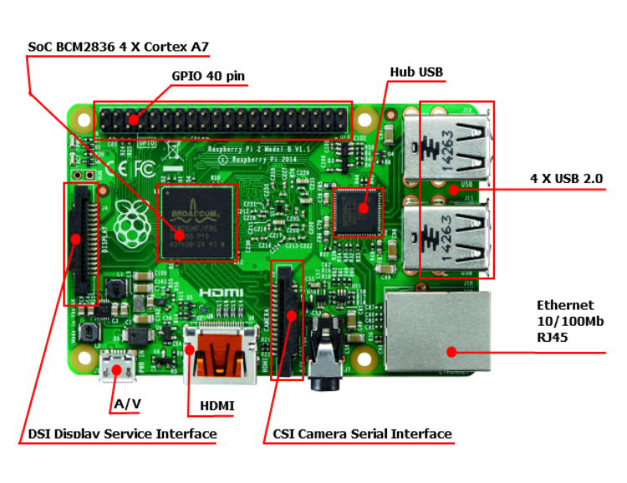
Benefits of using Raspberry pi

Slide 6
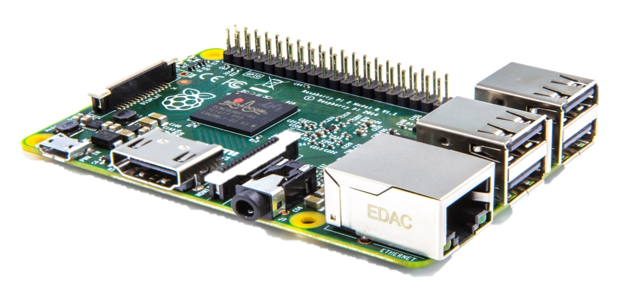
About Raspberry PI
Enhanced Quad Core Processor and 1GB RAM.
Larger Performance / Size Ratio of Raspberry Pi.
Required Low Power for Working.
Included all type Interfaces for Computing Purpose.

Slide 7
FEATURES OF π - server

Slide 8
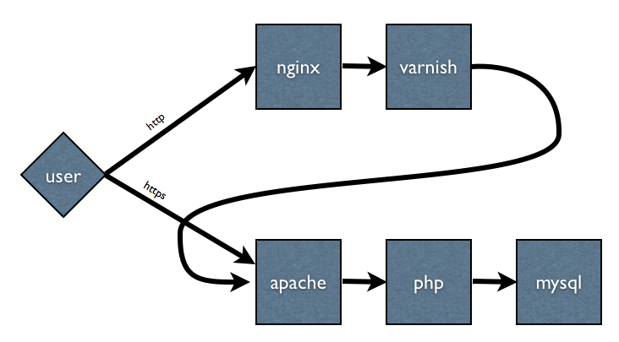
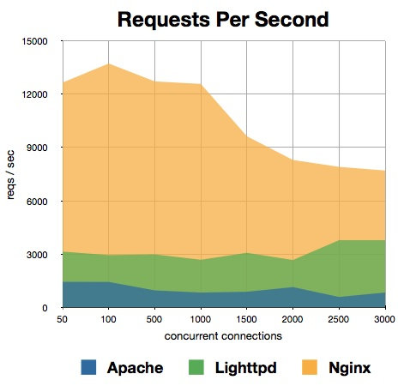
Full Featured Web Server:
For static content, Nginx Serve,
For dynamic content, for instance PHP files, Nginx will proxy the request to Apache, which can then process the results and return the rendered page.

Slide 9

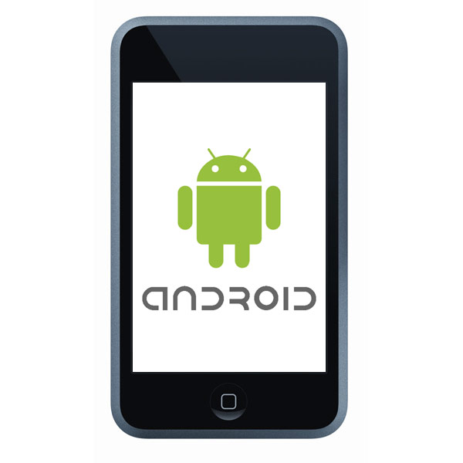
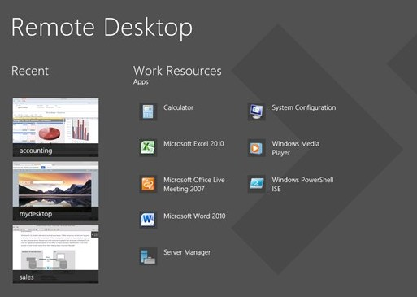
User Interfaces
No Monitor Required
Android App.
Desktop App.
Access GUI over Android and Desktop
Manage Server easily by App. Software.
Desktop and Android App. Freely available at AppStore.

Slide 10
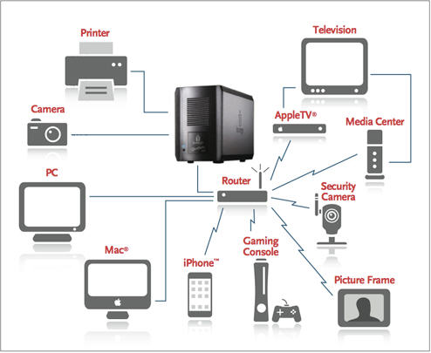
NAS( Network File System )
NAS is becoming a powerful and proven technology for storing and sharing data in network for any Supported Devices.

Slide 11
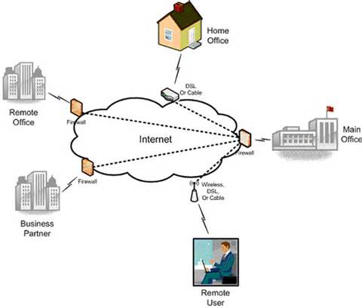
Remote Access via ( SSH , VNC, Web Interface, Internet)
Fully Encryption based Connectivity.
Cross-Platform Supported.
Fully Configurable on Remote Access
Android Based Application for Non-Technical User with Easy Interface.
Desktop Application for all OS ( Window, Linux and Mac ).

Slide 12
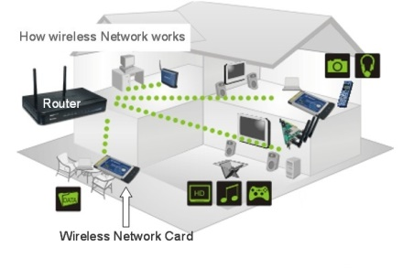
WLAN( Wireless LAN ) Wi-Fi Support
Fully supported all Wi-Fi Based Devices
Based on 2.4 GHz freq.
Supported All Wi-Fi Protocol
(Type: b/g/n/ac, WPA/2, WPS, Auto Channel etc.)
Can be used as Switch, Access Point, Router ( Wired and Wireless) in Network.

Slide 13

Power
20’800 mAh
Total Power: ~25W
Used Li-Ion Battery Cell
Capacity: 8x2600=20800 mAh
Longer Battery Life: 4+ Hrs
Perfect Silent Device, No any Noices
Two Type Battery Level Indicator

Slide 14
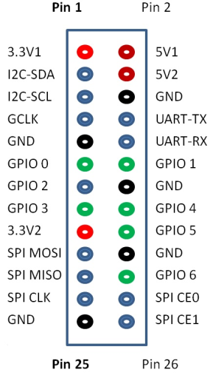
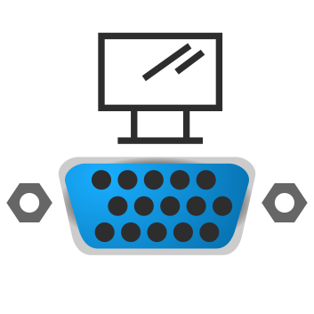
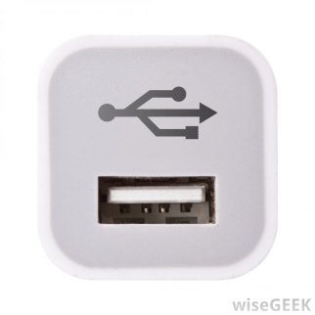
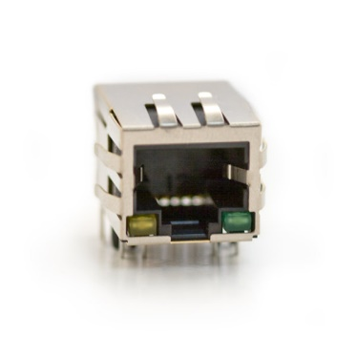
Supported H/W Interfaces:
5 x RJ45 Ports
40 GPIO Pins
VGA Port
8 x USB Port
Support Large no. of Devices Connection at a Time.

Slide 15
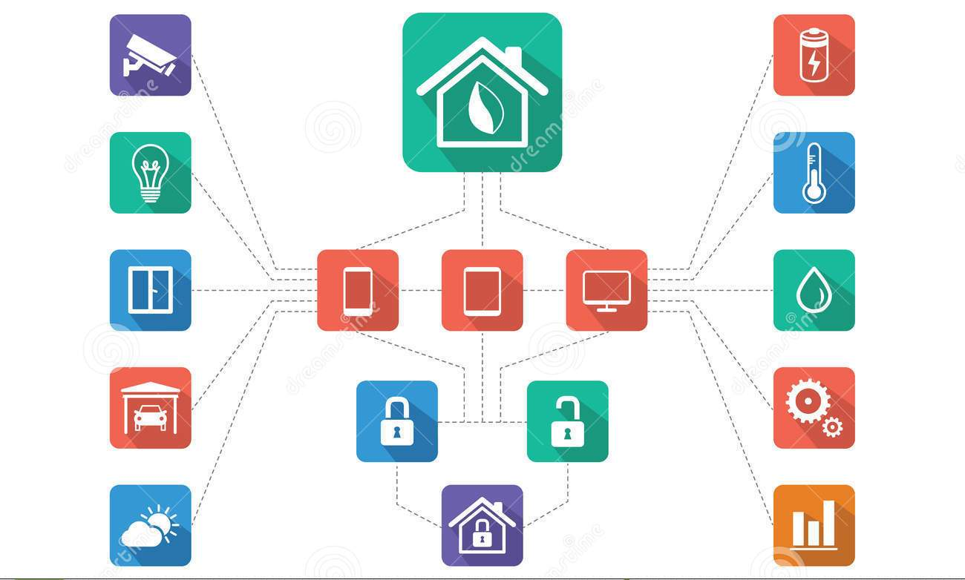
Home Automation
Control your Home appliances from anywhere
Surveillance your Home , offices
Remote Accessible

Slide 16
1. Dynamic Web Server( Nginx and apche2 with lampp );
2. FTP/SFTP Server;
3. NAS( Network File System ) support;
4. Remote Accessible via ( SSH , VNC, Web Interface, Over Internet);
5. Highly Secured Services via TOR network/Proxy ;
6. WLAN( Wireless LAN ) , Wi-Fi Support;
7. Connect upto Five Different Network At Same time ( 5x RJ45 port)
8. Can Be Use as (WLAN/LAN Router);
9. External HDD support/Flash Drives ;
10. VGA/AV Connectivity
11. Power Backup upto 3~4 hours
12. System/OS Independent Configurable via (Windows, Linux, Android );

Slide 17
13. Wireless Key-Board & Mouse Support;
14. 8x USB 2.0 Ports
15. Complete Support of Web Apps ( PHP5, MySQL , Python etc. );
16. 3 Android Managing Apps for unfamiliar user of server;
17. Perfectly Hack proof (MITM, DDOS,DOS);
18. Web Interface for System Administration ( Webmin, Usermin, phpMyAdmin );
19. Torrent Client
20. LDAP Server;
21. Fully Support SSL/HTTPS based Security;
22. Samba Server for Fast File Transfer over Network
23. Support VPN Server for Secure Networking with fully Encrypted Traffic

Slide 18
Comparison with our college server

Slide 19
PI SERVER | COLLEGE SERVER
Processor: Broadcom ARMv7 1Ghz@Quad-core 1GB DDR3 RAM OS: Raspbian (Ubuntu Modified) | Xenon Processor (Very High Performance) 32GB RAM OS: Windows Server, Redhat
The Pi Server is Perfectly Operate at Without Noise and A.C. | It Required A.C. and Proper maintenances.
The PI server can be Accessible over the LAN and Internet. | The College Server Is accessible only LAN.
Portable , can be carry anywhere and easy in Setup in all environments. And Provides Wi-Fi Facilities for Local Networks. | Not possible.
It’s Power Rating is <25W and Power Storages of 13000mAh upto 4 hrs. | It required Large no. of Equipment’s, Power and Hardwares and required Power Backup 24/7.

Slide 20
APPLICATIONS & benefits OF π - server

Slide 21
In Market , there is no mini-portable Server available for Small scale of use. We have to purchase a Server for that purpose. So the PI Server is the BEST OPTION for that.
The Dedicated Server or PC are Expensive to using in our Business or Home. For That PI server is the low cost <10000 Rs. Than other server or PC’s.
The PI server is Highly Dedicated for Server Operations. Because if we use our system as server , we have to add some Extra Software and Some kind of networking task are not possible in Windows, Linux operating System. There is need a dedicated OS and Applications for Networking.

Slide 22
There are many number of small offices , which contains very small no of computer system. So there is a need a dedicated server. For this The PI Server is better Option because it is low cost and low Maintenances.
The Pi Server use low Recourses than other PC or Servers.
The PI is Specially Designed of all kind of task and contains all Features in small devices.
The PI Server is Accessible over the Internet, So we can operate it around the World Wide.
The PI server is also usable for Home Use. Because It contains DLNA , Torrent Client ,NAS and VPN. So we can use it at home for Central Storage and VPN server for Home Internet System.

