Slide 1
RFID Counter and Reader
Jana Marie Gardon
Johanna Marisse Heramia
Jose Lorenzo Tadeo

Slide 2
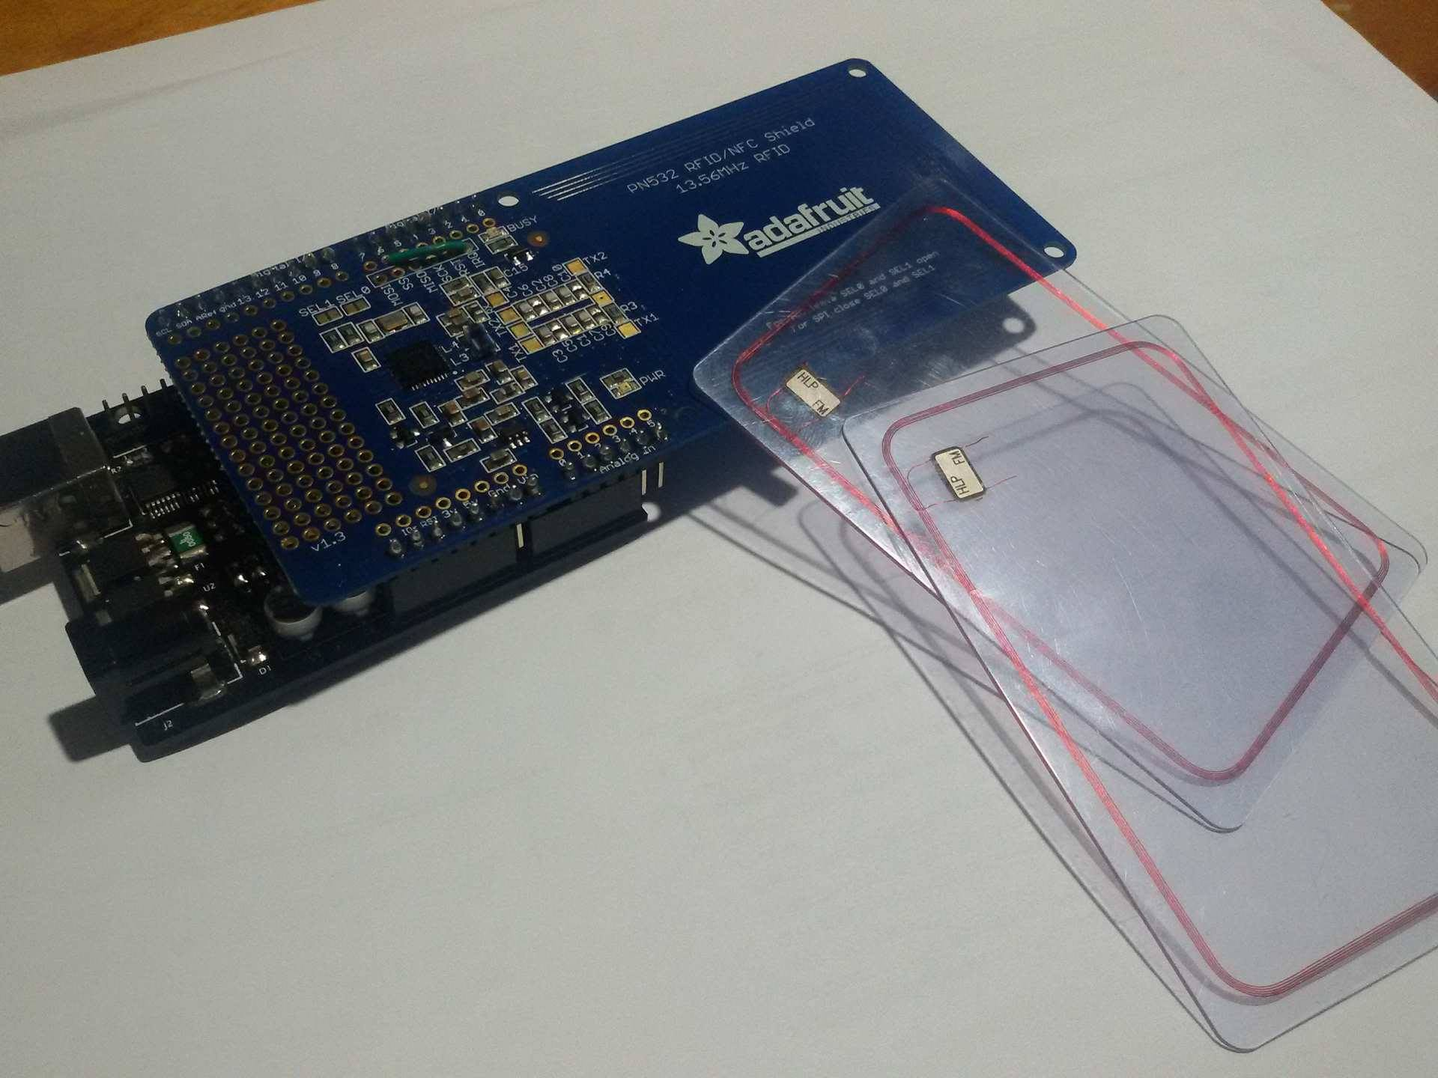
RFID Counter and reader
RFID – Radio Frequency Identification
RFID Reader/Writer
Identify tags attached in the RFID
Monitors number of users
Adds wireless tagging of RFID.
Updates the RFID tag

Slide 3
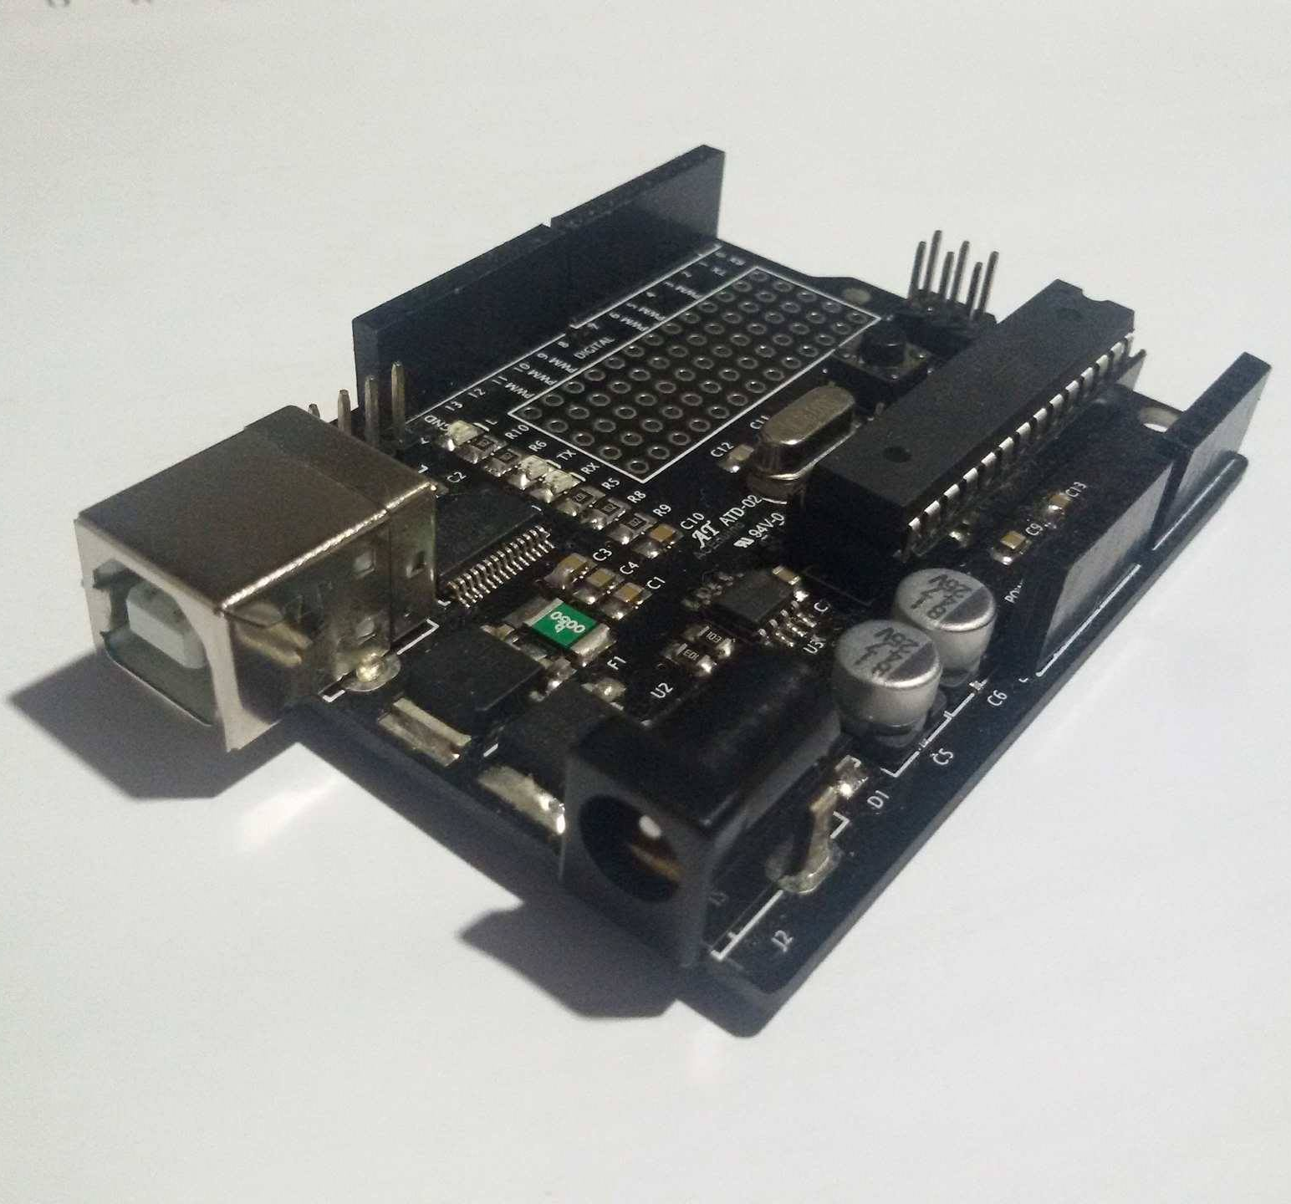
Materials:
Arduino 328 Board

Slide 4
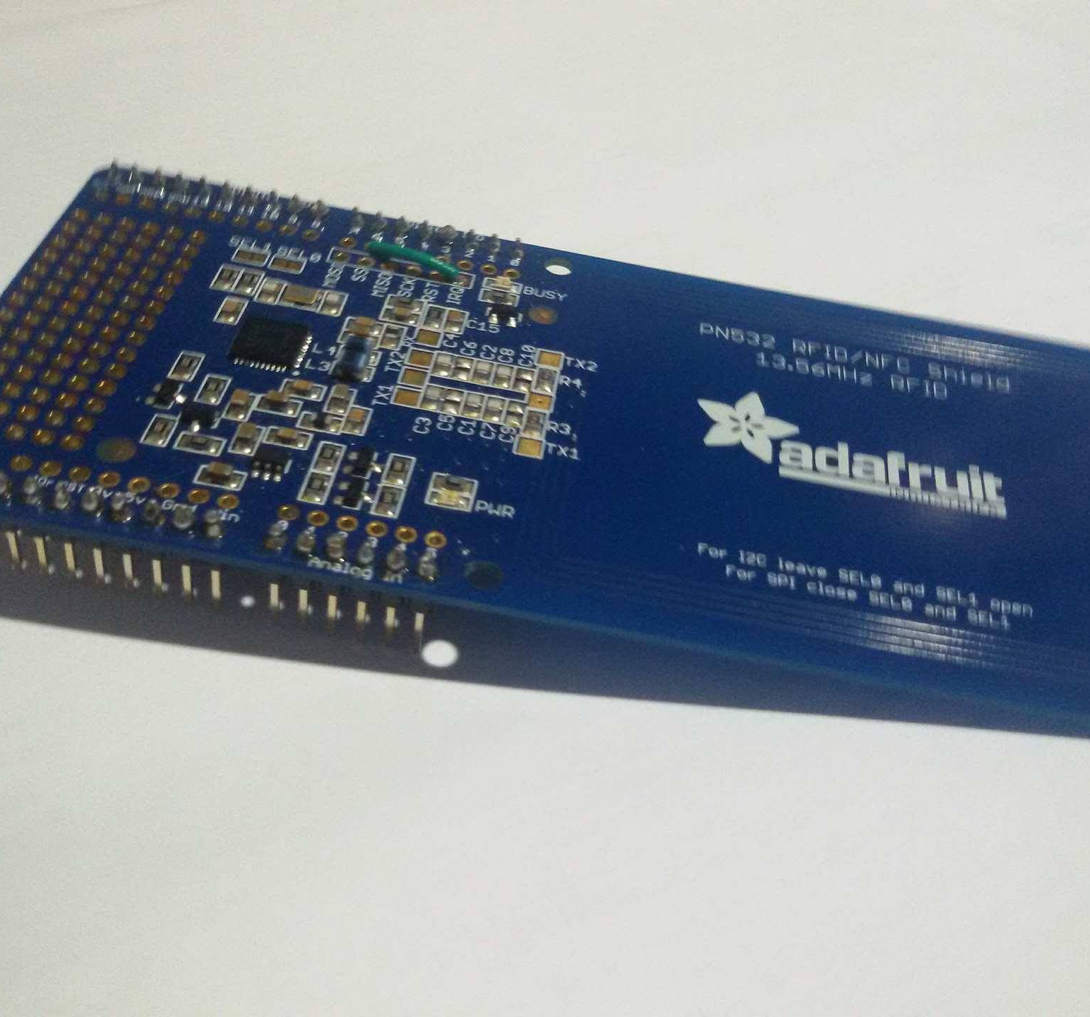
Materials:
PN532 RFID/NFC Shield
Acts as an access point for RFID
Sends data or command to the RFID

Slide 5
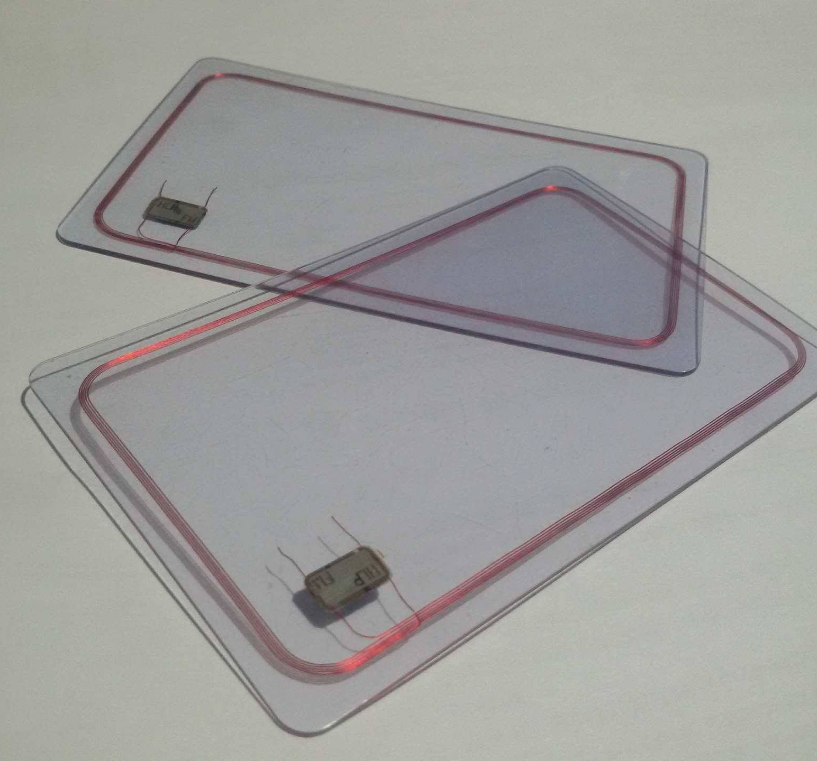
Materials:
RFID
Contains tag / Integrated circuit (IC)
Tag chips contains memory which stores code and information
Read and tracked by RFID readers

Slide 6
Objectives:
To be used as a visitor counter
01
To be used as a storage of names of people enters in a room
02
To track name or Id number of RFID
03

Slide 7
Purpose:
For easier checking of attendance
01
For monitoring number of people in a room
02
For security access
03

Slide 8

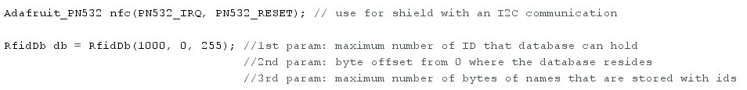

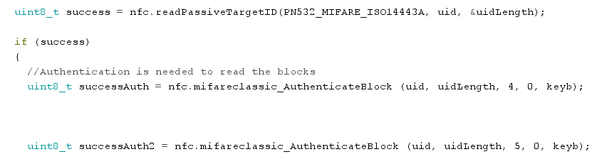
Codes (snippet)
ProjectRFID

Slide 9
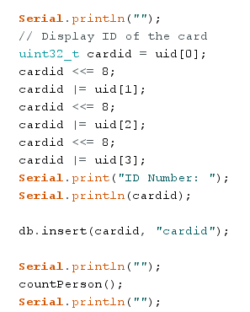
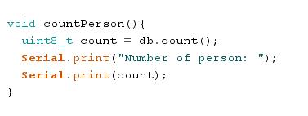
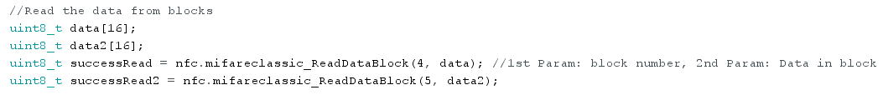
Codes (snippet)
ProjectRFID

Slide 10



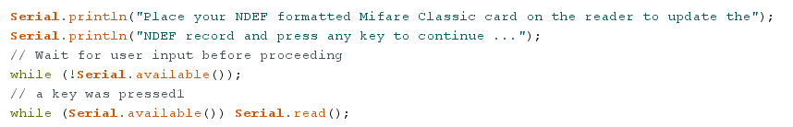
Codes (snippet)
updatendef

Slide 11
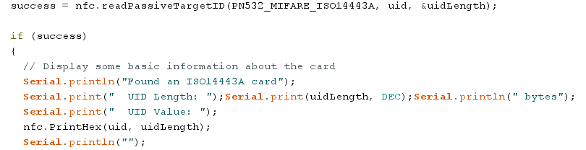
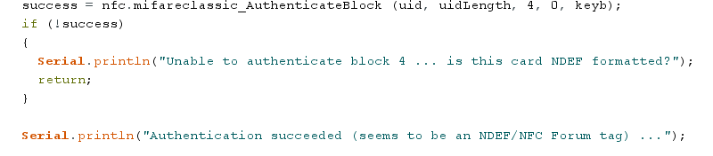
Codes (snippet)
updatendef

Slide 12
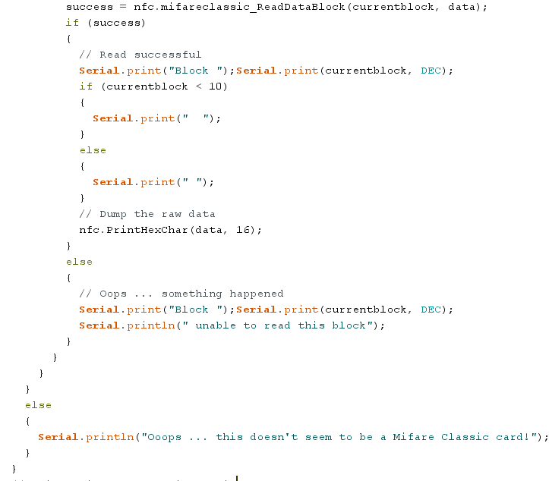
Codes (snippet)
memdump

Slide 13
Recommendation

Slide 14
References:
https://cdn-learn.adafruit.com/downloads/pdf/adafruit-pn532-rfid-nfc.pdf
http://fut-electronics.com/wp-content/plugins/fe_downloads/Uploads/How%20to%20use%20NFC%20Shield%20with%20Arduino%20and%20demo%20code.pdf
https://learn.adafruit.com/adafruit-pn532-rfid-nfc/arduino-library
https://github.com/gregington/RfidDb/blob/master/src/RfidDb.h

