Slide 1

Fellowship of the Heart
Getting Started — the Four Connects, walked around the table on alternating evenings
Evening Series 2026–27 · at the Tittle home · v1.5E DRAFT
All Scripture: ESV · The Companion lesson plans carry the full scripts — these slides carry the room
1
Notes:
DECK TITLE · pre-session · DIVIDER
On screen as the room assembles on night one. All Scripture ESV; the plans carry the scripts; these slides carry the room — and these notes carry you.

Slide 2

EVENING 8
Any Doubts?
Bringing the real question, and bringing it to God
The second movement: Connect with God
159
Notes:
E8 · pre-session · DIVIDER
On screen through dinner and as the circle forms. Greet at the door — the slide holds the room.

Slide 3




Where We Are — the Four Connects
Evening 8 stands in the third box — Connect with God. Each connection makes the next one real (Matt. 22:37–40).
160
Notes:
E8 · WELCOME · LEAD: CONTAINER HOLDER · GROUNDING — every session opens on this map
BEATS:
1. Locate tonight on the map, plainly: Evening 8 stands in the third box — Connect with God. Each connection makes the next one real (Matt. 22:37–40).
2. The four boxes are one journey — each connection makes the next one real — rooted in the two great commandments: love God, love neighbor (Matt 22:37–40).
3. This is also the 'where we are on the map' minute the welcome owes any newcomer.
CUES: Two minutes at most; then tonight's road.

Slide 4

Evening 8 — Tonight’s Road
1 Welcome and centering
2 The return — four weeks, and what I’m not sure was God
3 Mark 9:14–29 — the scripture ground
4 The Any Doubts? practice — teaching
5 Bridge to pairs
6 Any Doubts? in pairs within families
7 The silent place — bringing in the time you heard
8 Merge and surface
9 Homework and the Christmas break
10 Leader Feedback Round
11 Closing container
161
Notes:
E8 · 7:00–7:08 · LEAD: CONTAINER HOLDER
BEATS: 1. Evening 8 — the third evening of Connect with God (Heart Bible Study, Evening 9, closes the movement in January). Tonight is the first evening after four weeks apart (no evening over Thanksgiving): it opens with the return round, then picks up the Garden evening's thread: what I'm not sure was God. 2. Today: Any Doubts? — bringing the small quiet doubts we never say aloud, honestly, to God, in front of one other person. 3. With the Garden, one of the two highest-confidence practices in this whole body of work — treat it with care. 4. Frame it early and repeat it: doubt is not disbelief; this is the gap between what we say and what we actually trust. 5. The shape (John's word, 13 October): the four steps in pairs, then the silent place from the Four Connects deck — remember where God seemed silent, bring in the time you heard, invite Jesus in.
THE BREAKS (John's word, 28 October): the return round opens tonight; the Christmas send-off closes it. Heart Bible Study opens January; The Return follows it.

Slide 5
Opening Container — the Eight Steps
1 Welcome — five minutes to open the container
2 Phones silenced and put away
3 Stand in a circle
4 One-word check-in — how you actually are, right now
5 Put out / bring in — set something down; bring a blessing in
6 Spoken commitment: “I am here. I am paying attention. I am willing to be moved.”
7 Opening prayer — “Holy Spirit, you are welcome here. Speak. We are listening.”
8 Sit. Begin.
162
Notes:
E8 · 7:00–7:06 · LEAD: CONTAINER HOLDER
BEATS: 1. 'Welcome back. Settle.' Aaronic blessing. 2. Name the night: this goes against most of what we have been taught about how spiritual people should sound — we bring our actual doubts and bring them honestly to God. 3. Container: what is said in your pair stays in your pair; nothing is required; specificity is the practice, honesty is the goal.
PAIR LEAD: name the leading pair in the welcome — two leaders hold tonight, and the room will see the evening handed back and forth between them; that is the design. The pair practices the session together beforehand.

Slide 6

The Return — Four Weeks, and What I’m Not Sure Was God
• Which practices did you choose for weeks three and four — and why?
• What held? When it slipped, did you come back on your own?
• Which one would you keep?
• “One thing I’m not sure was God” — say it, or keep it for your pair
– “We hear that.” No comment; slips are data
163
Notes:
E8 · 7:06–7:18 · LEAD: CONTAINER HOLDER
BEATS: 1. Rebuild the room slowly: it has been four weeks. 2. Around the circle, one at a time, the leader first, then a parent: which practices did you choose for weeks three and four, and why; what held; when it slipped, did you come back to it on your own, because you wanted to; which one would you keep. A sentence on the garden weeks if they wish. 3. The preparation sentence from the Garden take-home, 'One thing I'm not sure was God': say it aloud, or keep it for your pair. 4. Receive each with 'We hear that'; no comment. Move on with: 'Good. The garden is still there. Tonight we bring the questions.'
GUARD: Cut the shame spiral off early, from the front: slips are data, and nobody owes an explanation for the gap. Receive 'No, not yet' as warmly as 'Yes.' If the gap was hard at home, that is a conversation with an adult tonight or this week, not a circle one.
TALLY: at the debrief, a quiet count for each practice: how many chose it, and how many would keep it. No names. This is the read on which practices people really want to do (John's word, 28 October); The Return runs it again for the Christmas choices.
CUES: Arranged parent opens after the leader; never cold-call a teen; pass-anytime holds.

Slide 7

Mark 9:14–29 — the Scripture Ground
• The whole scene, read slowly — the desperate father, the failed disciples, the boy in convulsions
• He does not pretend the unbelief is not there — he names both at once. And Jesus does not rebuke him; Jesus heals the boy
• The unbelief that is named and brought to Jesus is the unbelief that can be released; suppressed, it works as a quiet brake
• Tonight is not generating new doubts — it is bringing the ones already there into the open, and bringing them to Jesus
MARK 9:24
“Immediately the father of the child cried out and said, ‘I believe; help my unbelief!’”
164
Notes:
E8 · 7:18–7:23 · LEAD: CONTENT PRESENTER
BEATS: 1. Read Mark 9:14–29 IN FULL from the physical Bible, slowly, without stopping to comment — the verse lands differently inside the whole scene. 2. Teach the model: the father names belief and unbelief at once — 'I believe; help my unbelief' — and Jesus does not rebuke him; He heals the boy. 3. Most of us say the believing half loud and bury the unbelieving half, where it works as a quiet brake on faith. 4. Today is not generating new doubts — it is bringing the unbelief already there into the open, and bringing it to Jesus.

Slide 8

The Any Doubts? Practice — Four Steps
1 NAME — the scripture, then the doubt. Specific, not abstract: “I doubt He hears prayer about this specific thing”
2 EXAGGERATE — make the doubt bigger, not smaller. You are not endorsing it; you are exposing it
3 SIT — what does the doubt feel like in your body? Ten or fifteen seconds. Don’t fix it. Feel it
4 RE-READ — your partner reads the same scripture again, slowly. The Spirit does the work; you do the noticing
• Two kinds of doubt: what God has said — these four steps; whether I heard him — the How Did You Know? checks
• Watch the demo — specific, honest, brief, and unresolved-but-honest is the gift
165
Notes:
E8 · 7:23–7:30 · LEAD: CONTENT PRESENTER
BEATS: 1. Callback, 30s: journals open to the first-night question — naming a doubt takes the same courage. 2. The seat for the skeptic, named ALOUD: a doubt bigger than today's list is welcome and has its own standing door — any Companion, any week, for as long as it takes. 3. Name the two kinds of doubt: doubting what God has said — tonight's four steps; and doubting whether I heard him at all — that goes to the How Did You Know? checks from the Garden evening, tested in company, never settled alone. 4. Whiteboard walk: NAME (specific, not abstract) / EXAGGERATE (expose the brake, not endorse it) / SIT (feel it, 10–15s) / RE-READ (the Spirit works; you notice). 5. Demo with a Co-Companion, 3 min — real scripture, real small doubt; do NOT resolve it at the end. The pairs calibrate everything against this demo.
CUES: Keep the demo brief — do not let teaching eat the pair time.
SUB: Demo YOUR OWN real, small doubt — never fake one, never borrow the founder's. If you cannot bring one honestly, walk the four steps only and let the arranged parents' first turns carry the modeling.

Slide 9
Bridge to the Split — Parents First
• Take the practice card from your chair — Name · Exaggerate · Sit · Re-read. Pairs form within your own family, a parent with their own teen
• In every pair the parent goes first — arranged this week; nobody is being put on the spot tonight
– “Teens: you go second, and you choose your own depth. A small doubt is enough. Passing is enough.”
• No scripture in mind? Pick one with a flicker for you, not a hurricane
– Romans 8:28 · Jeremiah 29:11 · Psalm 139:13–16 · John 14:1–3 · Romans 8:38–39 · James 1:5
• Partners: read, listen, re-read. Not fix. Not theologize. “We are not arguing the doubt. We are bringing it.”
166
Notes:
E8 · 7:30–7:31 · LEAD: CONTENT PRESENTER · TRANSITION
BEATS: 1. Practice card H11.1 goes with them. Pairs are announced by the Lead Companion — pre-considered, within families, parent with own teen; never improvised on the night. 2. Say it plainly: in every pair the PARENT goes first — arranged this week; Mark 9:24 is a parent's sentence first. Teens go second and choose their own depth; a small doubt is enough; passing is enough. 3. Scripture choice: a flicker, not a hurricane — H11.3 has options. 4. Partners: read, listen, re-read — never fix, never theologize. Pray and send.
SMALL ROOM: the split is only necessary if the room is large enough to need it. With six or so, stay one circle — or quick pair work in place, knee to knee. Pair work is also the standing time-recovery lever: a full split-and-merge costs about five minutes.

Slide 10
Any Doubts? in Pairs, within Families
1 Pick a scripture; your partner reads it slowly — from the physical Bible if possible
2 “What I notice is ___. The doubt I am holding is ___.” — specific
3 Exaggerate it, then sit with the feeling for 10–20 seconds
4 “Read it again, please.” Then: “What I notice this time is ___.”
• The parent’s turn first, then switch — the teen at their own depth; pass-anytime holds
• Two agreements: you are not arguing or fixing the doubt — and nothing leaves your pair
167
Notes:
E8 · 7:31–7:53 · LEAD: CONTENT PRESENTER · PAIRS
BEATS: 1. Twenty-two minutes: one full cycle each direction, about 11 min per turn, parent's turn first. The silent place follows, so hold the clock. Companion calls switches at seven minutes; never interrupt a re-read. 2. The turn: partner reads; 'the doubt I am holding is ___'; gentle exaggerate; sit 10–20s; re-read; 'what I notice this time is ___'. 3. Interventions: apologetics — 'we're not arguing the doubt'; no doubt found — honest, run the partner's cycle; exaggeration won't come — don't push; distress — stop the exaggeration, re-read, sit with them.
GUARD: The practice never runs on a scripture the person actively rejects — flicker, not hurricane. A parent's doubt about the very teen across from them moves to a different doubt today and a 1:1 later. Anything bigger than the exercise: bless the naming, end the cycle gently, follow up within 48 hours.

Slide 11
The Silent Place — Bringing In the Time You Heard
1 Settle (1 min) — breathe; be present; he is here
2 Remember (2 min) — a time or place where God seemed silent: a dry spell, a prayer that met nothing. Get clear on it
3 Bring in the time you heard — the memory from the Garden evening: what it looked, sounded, felt like
4 Invite Jesus into the silent place (4 min) — give him permission to do or say anything he wishes; see what he does
5 Write (3 min) — what did he do? Is something blocking, or in the way? What might be the downside of a deeper connection?
6 Share (2 min) — optional, one circle, by invitation; received with “Thank you.”
• If nothing comes, that is honest. Silence is not a verdict on you
168
Notes:
E8 · 7:53–8:06 · LEAD: CONTENT PRESENTER
BEATS: 1. The reader reads the Silent Place Reading Card. Settle, 1 minute. 2. Remember, about 2 minutes: a time or place where God seemed silent — a dry spell, a prayer that met nothing. Get clear on it. 3. Bring in the anchor: the time you did hear, remembered at the Garden evening — what it looked, sounded and felt like — into the silent place. 4. Invite Jesus into the silent place; give him permission to do or say anything he wishes; then about three minutes of silence. See what he does. Return. 5. Write, 3 minutes: what did he do? Is something blocking, or in the way? What might be the downside of a deeper connection — what would change? 6. Share, 2 minutes, optional: one circle, by invitation; 'Thank you' is the whole response.
CUES: Sharing is optional — say so twice. No anchor from the Garden evening? Offer a time creation stopped you, or simply John 10:27.
GUARD: Silence is not a verdict on anyone. If a silent place opens something heavy, the Settle Protocol stands — for the person, not the circle; follow up within 48 hours.
FROM: the Four Connects deck (FotH, September 2025), 'Hearing God — The How' (remember a place where the Lord was not speaking; change with the anchor; invite in Jesus, give him permission; share optional) and 'Connect with God' (is something blocking; the downside to a deeper connection).

Slide 12
Merge and Surface
• What happened in your pair stays in your pair — no one will be asked to share a doubt or a scripture
• “One word about what the practice was like. Not the doubt — the practice.”
– “Surprising.” “Heavy.” “Quiet.” “Awkward.” “Honest.” “Lighter.” Pass anytime
• This practice fits in five minutes alone, or twenty with a friend — a way of bringing your real questions to God for the rest of your life
• “The resolution is the Spirit’s work. The naming is yours. We do the naming. He does what only He can.”
169
Notes:
E8 · 8:06–8:12 · LEAD: CONTAINER HOLDER
BEATS: 1. What happened in your pair stays in your pair — not back to the pair, not around the dinner table, unless the one who named it brings it up first. 2. One word about the practices, not the doubt or the silent place: 'surprising', 'heavy', 'honest', 'lighter'. Receive with a nod; no commentary. 3. Two closers: this practice takes five minutes alone, for the rest of your life; and the naming is ours — the resolution is the Spirit's work.
CUES: Pass-anytime holds. Watch faces — follow up offline within 48 hours on anything the night stirred.

Slide 13

Homework — Two Weeks, Then the Christmas Break
• Week one: the Personal Doubts Inventory — twenty minutes, once; no shame, just data, never turned in
• End of week one: the check-in with your partner
• Week two, two journal questions: Is there something I heard and did not obey? What is at risk for me to hear?
• Then each week of the break: one practice from The Practices So Far — Any Doubts? is on it now — written down, with why
• If it slips: begin again the next day. No streaks. You know who to reach
• The Return in January opens with: which did you choose? Did you come back on your own? Which would you keep?
170
Notes:
E8 · 8:12–8:21 · LEAD: CONTENT PRESENTER
BEATS: 1. Week one, the Personal Doubts Inventory (H11.2): twenty minutes once; list 5–10 scriptures you say you believe, rate your honest trust in each, write one specific sentence on the two or three lowest. No shame, just data; nobody ever sees it. 2. The check-in at the end of week one. 3. Week two, two journal questions from the Four Connects deck: 'Is there something I heard and did not obey?' and 'What is at risk for me to hear?' 4. The Christmas break: after the two weeks, each week one practice from The Practices So Far card, the one you would really like to do, written down with why. Read the list once, aloud; never steer. Before choosing, look back in your journal at what you actually did; the card reminds them of each evening and its homework. 5. The returning rule; name who to reach over the break.
GUARD: Name the break plainly: how long it is, and that The Return opens by asking which practices were chosen and how it went. The choices are made at home, freely.
FROM: the Four Connects deck (FotH, September 2025), 'Hearing God — What If?'.

Slide 14
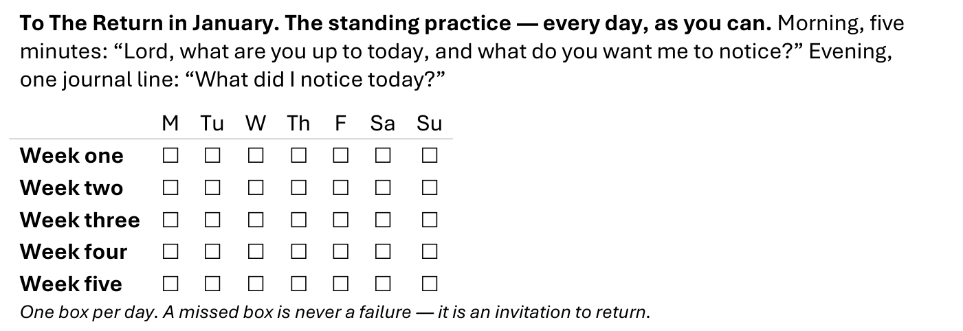
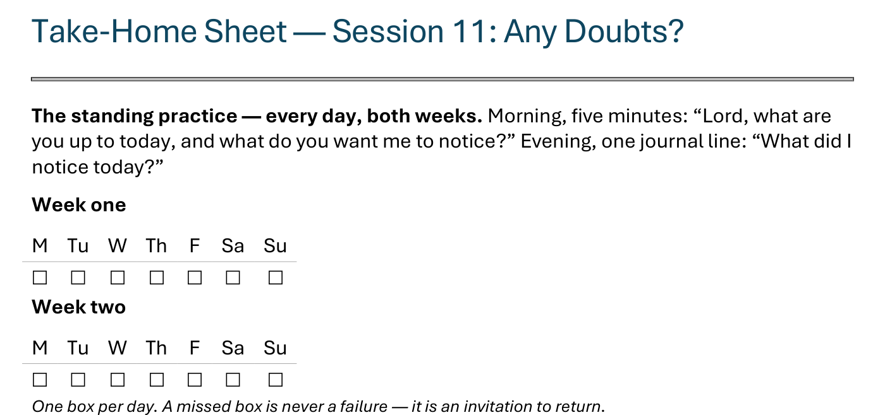
The Take-Home Sheet — the Daily Rhythm
Handed out now — this is the sheet in your hands.
171
Notes:
E8 · COMMISSIONING · LEAD: CONTENT PRESENTER
BEATS:
1. The sheet on the screen is the sheet in their hands — walk it, don't read it.
2. The standing rhythm first: the morning question, the evening journal line — one box per day, on one grid for the weeks to The Return.
3. A missed box is never a failure — it is an invitation to return.
CUES: The five parts are the next slide.

Slide 15
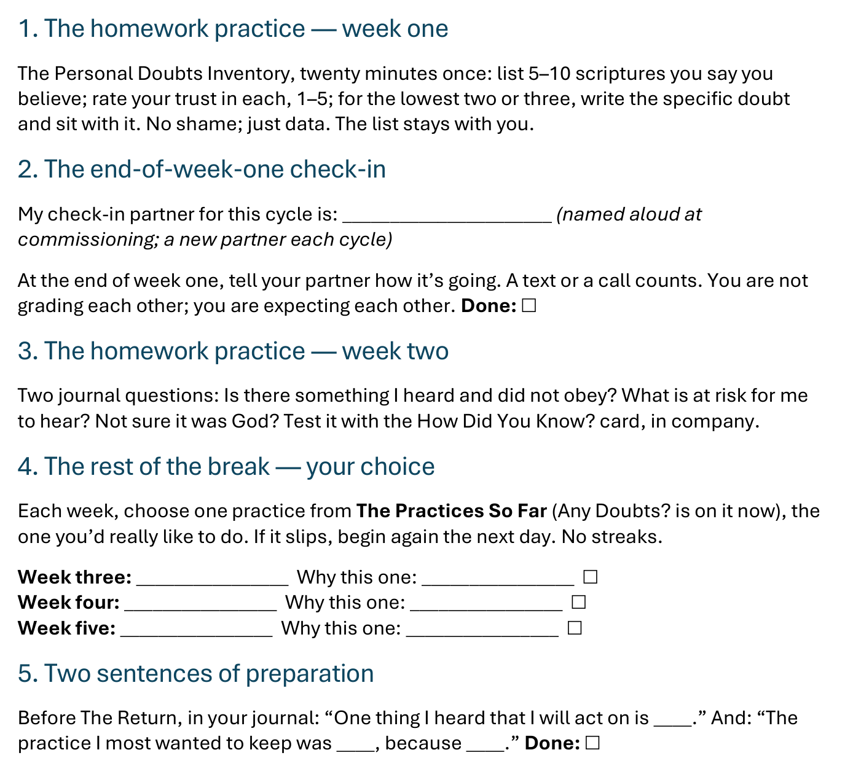
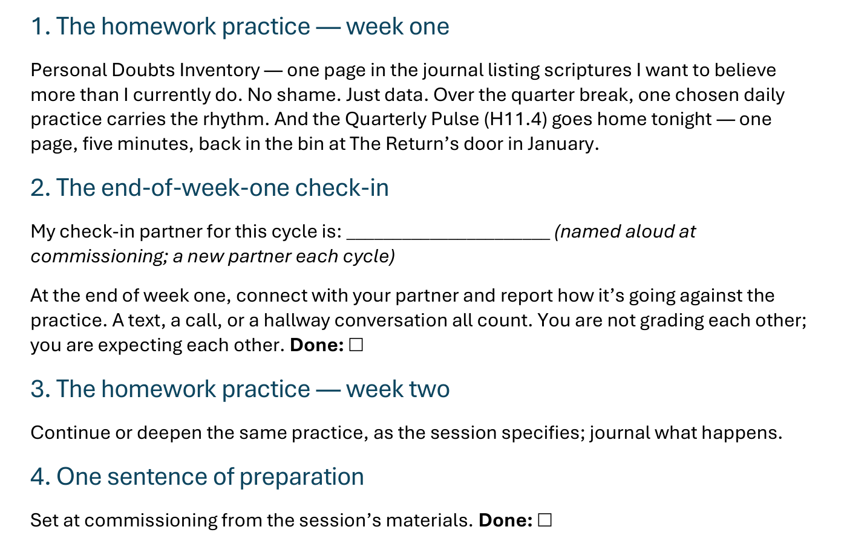
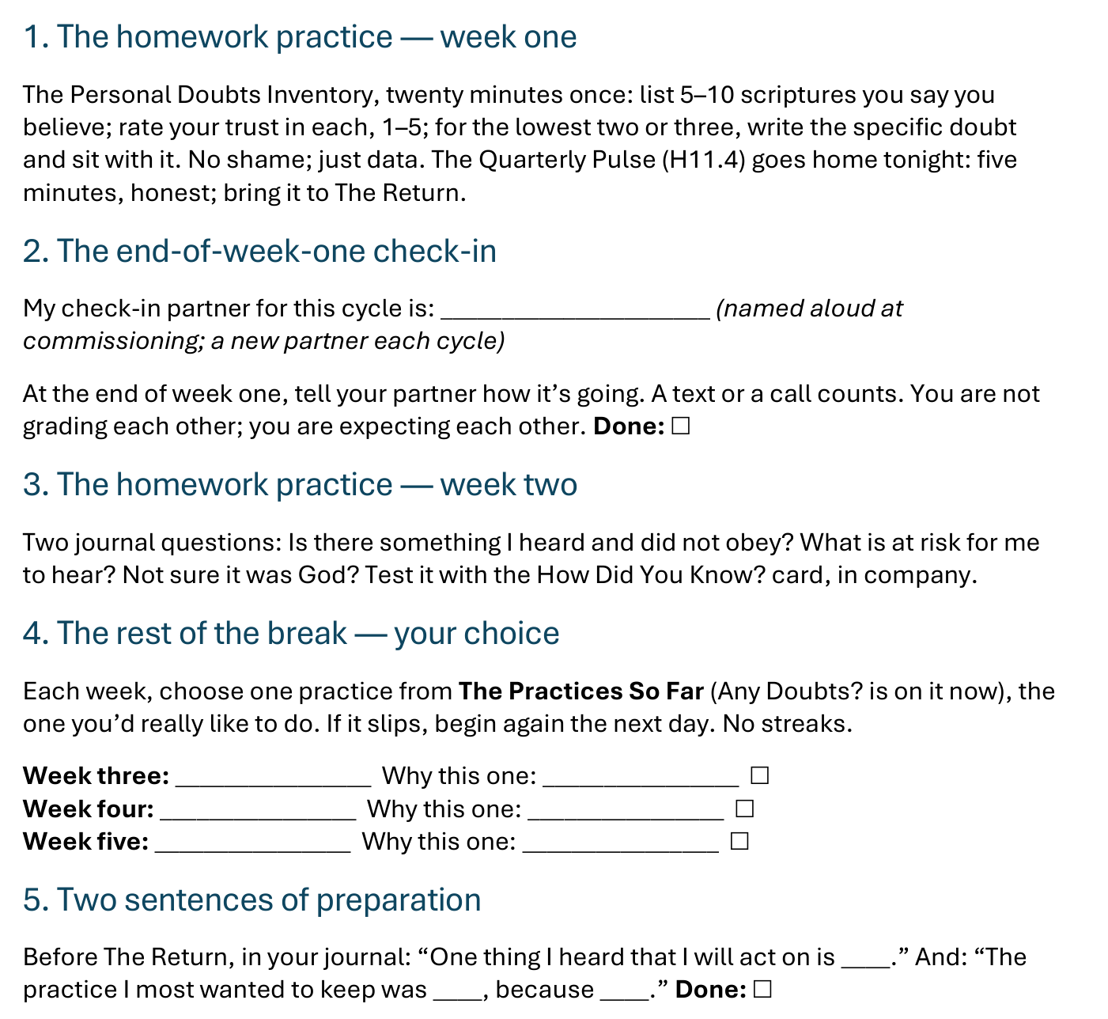
The Take-Home Sheet — the Five Parts
Two weeks as always, then the break you choose — and a partner expecting you at the end of week one.
172
Notes:
E8 · COMMISSIONING · LEAD: CONTENT PRESENTER
BEATS:
1. The five parts, in order: week one, the doubts inventory; the end-of-week-one check-in; week two, the two journal questions; the rest of the break, your choice from The Practices So Far; two sentences of preparation for The Return.
2. Check-in partners are named aloud before leaving this slide; the sheet has the line to write the name.
3. The Practices So Far card goes with the sheet, with Any Doubts? now on it.
GUARD: The sheet-walk, not a re-teach.

Slide 16

The Leader Feedback Round
• Two rounds, same as every session — the container holder first, then the content presenter: three things each
– “What I think went well tonight: ______”
– “What I’d do differently next time: ______”
– “If I were to teach tonight’s process to someone, I would tell them: ______”
• Then the room — the same two questions about tonight
• The leaders receive without defending — “thank you” is the whole response
173
Notes:
E8 · 8:21–8:25 · LEAD: BOTH LEADERS
BEATS: 1. Same round: leader's three answers first, then the room's two questions — two or three voices is plenty. 2. Receive without defending — 'thank you' is the whole response. 3. May be dropped if the room needs quiet; dropping it twice running goes to the team debrief.

Slide 17
Closing the Container + Aaronic Blessing
• We close the way we opened — the container, six steps:
1 Stand again — same circle, same posture as the open
2 One-word landing — compare it to your opening word
3 The one thing you are taking from tonight
4 The one practice — committed aloud, or modified to one you will actually keep
5 Blessings — eyes on the person, not the screen: say what is on your heart for them. Specific, witnessed, short
6 Closing prayer — and the Aaronic blessing, spoken over each other, face to face
THE AARONIC BLESSING — NUMBERS 6:24–26
“The Lord bless you and keep you;
the Lord make his face to shine upon you, and be gracious to you;
the Lord lift up his countenance upon you, and give you peace.”
174
Notes:
E8 · 8:25–8:30 · LEAD: CONTAINER HOLDER
BEATS: 1. What was named in your pair is yours — some doubts quietly resolve, some deepen before they release; both are normal. If anything is heavier than tonight could hold, reach out. 2. Name the Christmas break plainly and who to reach over it; Evening 9, Heart Bible Study, opens January; then Evening 10, The Return, asks which practices you chose. Merry Christmas to every house. 3. Aaronic blessing.
BLESSINGS: eyes on the person, not the screen — nothing to read; say what is on your heart for them, specific and short.

Slide 18
In January
Heart Bible Study
Evening 9 — hearing God together · the first evening back, and the last of Connect with God
175
Notes:
EVENING 9 · pre-session · DIVIDER
On screen as families arrive for the first evening back. Greet warmly at the door; welcome every walker home.

