Slide 1

WEEK 4
Telling Your Story II
The second running — the teens tell, the round is completed, and the room watches one of its own hold it
Quarter 1: Connect with Self & Others
47
Notes:
W4 · pre-session · DIVIDER
On screen as families arrive. Greet at the door — the slide holds the room.

Slide 2

Week 4 — Tonight’s Road
1 Welcome and centering
2 Joint Footprints check-in
3 Psalm 139 — being known, again
4 Bridge to the split
5 Stories in family clusters
6 Merge and one-word landing
7 Between-session practice
8 The Leader Feedback Round
9 Closing container
48
Notes:
W4 · 4:15–5:30 · SHARED
BEATS:
1. The teens tell today — same question, same clusters, nothing new taught; the completion is the point.
2. A Companion-in-Formation (senior teen) leads the open, the bridge, their own cluster, and the close — protocol card in hand, adult across the circle.
3. Same Section 6 preparation as Week 3: re-read within 48 hours; crisis card in pocket; backup on call.
GUARD: The bright line governs everything — the senior leads process; the adult holds care. If the FC1 gate has not cleared, adults lead exactly as Week 3.
CUES: If you are covering: the senior still leads their blocks — receive their leadership as the room does; do not hover, do not re-lead.

Slide 3
Opening Container — the Eight Steps
1 Welcome — five minutes to open the container
2 Phones silenced and put away
3 Stand in a circle
4 One-word check-in — how you actually are, right now
5 Put out / bring in — set something down; bring a blessing in
6 Spoken commitment: “I am here. I am paying attention. I am willing to be moved.”
7 Opening prayer — “Holy Spirit, you are welcome here. Speak. We are listening.”
8 Sit. Begin.
49
Notes:
W4 · 4:15–4:22 · SHARED
BEATS:
1. The Companion-in-Formation opens the night: blessing, container, Week 4 frame — the pieces are required, their own words are fine (card H4.1).
2. You sit in the circle as a participant and do not hover.
CUES: The room registers a teen leading within ten seconds. Let it — no introduction, no explanation, no applause. Receive the opening exactly as the room received it from the Lead Companion in Weeks 1–3.

Slide 4

Joint Footprints Check-In
• “Some of you got to it. Some of you didn’t. Both are fine — ‘we didn’t get to it’ is honest, and honest is what we do here.”
• One sentence about what it was like — “not what was said — that’s yours — just what it was like”
• An arranged parent starts; then it’s open, and optional
• “The work is happening, whether or not we name it tonight.”
50
Notes:
W4 · 4:22–4:26 · SHARED
BEATS:
1. Lead Companion takes this block. 'Some of you got to it, some didn't — both are fine; honest is what we do here.'
2. One sentence on what it was LIKE, not what was said. The arranged parent starts; then open, and optional.
3. Silence after the opener: wait ten seconds, move on — 'The work is happening, whether or not we name it today.'

Slide 5
Psalm 139 — Being Known, Again
• Same psalm as last week, on purpose — nothing new tonight; we’re completing the round
• One idea, repeated: the opposite of being hidden is not being exposed — it is being seen and being safe at the same time
• The parents practiced that last Wednesday. Tonight the teens do
• Put the comparison down — “Every story is its own. … The story you tell tonight is not in competition with any story told in this building last week. Tell yours.”
PSALM 139:23–24
“Search me, O God, and know my heart! Try me and know my thoughts! And see if there be any grievous way in me, and lead me in the way everlasting!”
51
Notes:
W4 · 4:26–4:31 · SHARED
BEATS:
1. Re-read Psalm 139:23–24 only. Nothing new taught — repetition is how it becomes ours: seen and safe at the same time.
2. Say the comparison word out loud: put down measuring your story against your mom's or dad's. Every story is its own; the parents went first so you would never have to guess, not so you would have a bar to clear.
3. If Week 3 flagged fixing: one gentle sentence — 'listening to receive is its own discipline.'

Slide 6
Bridge to the Split
1 “It’s one question — tell the story of how you got here, and what has shaped you.” The depth is yours to choose
2 “When you’re listening — don’t fix, don’t advise, don’t relate back. Receive, and after each story, bless.”
3 “Nothing leaves your cluster. Not a phrase, not a name, not a story.”
• Same clusters and same rooms as last week — your family stays with you
52
Notes:
W4 · 4:31–4:32 · TRANSITION
BEATS:
1. The senior takes the bridge from the card: one question; listeners receive and bless — no fixing, no advising, no relating back; nothing leaves the cluster.
2. The senior prays, then sends: same clusters, same rooms as last week, families together; back at 5:12.
CUES: Ten or fewer — 'We're staying right here, one circle, same rules,' and flow straight into the telling.

Slide 7
Stories in Family Clusters — the Teens Tell
• The teens tell — same clusters, same single question, same blessing. Second running
1 Story — 5–7 minutes. Nobody interrupts, even the silences
2 Silence — ten seconds
3 Blessing round — the arranged parent blesses first, then the circle: one or two sentences each
• Parents tonight: receive and bless — no correcting the record, no filling silences
• “What’s said in this circle stays in this circle. And when someone is telling, we’re looking at them. We’re receiving.”
53
Notes:
W4 · 4:32–5:12 · CLUSTERS
BEATS:
1. The teens tell — 5–7 minutes each, ten seconds of silence, then blessing; the arranged parent speaks the first blessing after every story.
2. In the senior's cluster: the senior tells FIRST (the adult steers their blessing round), then facilitates the rest, card in hand; the adult sits directly across, silent through mechanics, holding care.
3. Parents receive without correcting the record, filling silences, or bracing — the teen's telling stands today.
4. Out of time: compress blessings to one sentence each; every teen gets told.
GUARD: The handoff rule never bends — anything heavy, the senior says '[Adult's name], I'd like you to take this' and holds the container in silence; the adult takes it instantly and completely, then hands the process back. The senior never counts as one of the two adults; the adult runs any Settle Protocol.

Slide 8
Merge and One-Word Landing
• What happened in your cluster stays in your cluster
• One word, when you’re ready, about what tonight was like — an arranged parent starts. You can pass
• “The round is complete — every person in this room, parent and teen, has now told a piece of their story to a circle that blessed them for it.”
• “Rooms like this one are rare. They’re also the kind of room God shows up in.”
54
Notes:
W4 · 5:12–5:16 · SHARED
BEATS:
1. Lead Companion takes the merge. Let the room settle; do not break the texture with energy.
2. One word each; the arranged parent starts; pass allowed. Receive — eye contact, small nod, no comment.
3. Name the completion: every person in the room, parent and teen, has now told and been blessed. 'Rooms like this are rare. They're the kind of room God shows up in.'

Slide 9

Between-Session Practice
• Joint Footprints — for every family that hasn’t done it yet. Parent and teen, twenty minutes, sometime this week
• Not in the car, not in front of a screen. Phones away
• Five minutes telling, a follow-up question or two, and one sentence: “What I love about your footprints is...” Then swap
• “Families who already did it — you’re done; don’t force a repeat.”
• Everyone keeps the morning question and the evening journal note going — five minutes in the morning, two at night
55
Notes:
W4 · 5:16–5:19 · SHARED
BEATS:
1. Parent Co-Companion leads. Joint Footprints (H3.5) for every family that has not yet done it — twenty minutes, not the car, not a screen.
2. Families who already did it are done — do not force a repeat.
3. Everyone keeps the morning question and evening note going: 'that rhythm is quietly doing more than any single Wednesday.'

Slide 10
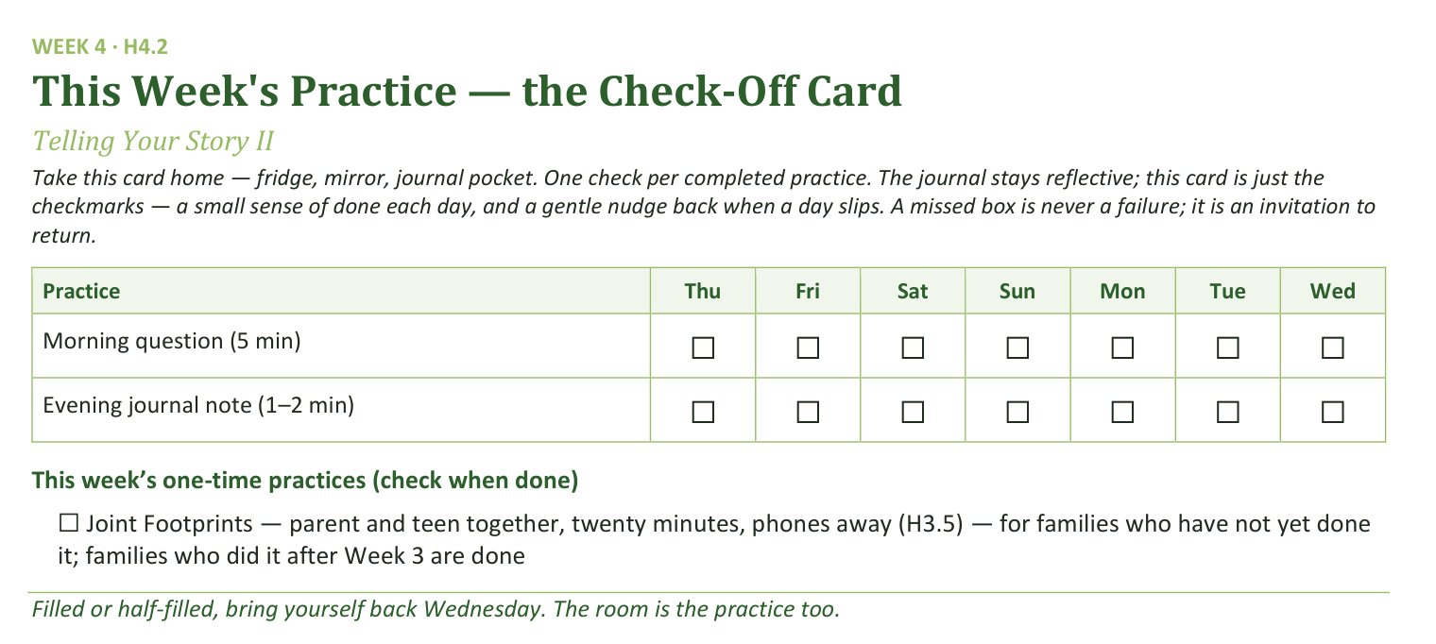
Your Take-Home Card — This Week’s Practice
Handed out now — fridge, mirror, journal pocket.
56
Notes:
W4 · 5:16–5:19 · SHARED
BEATS:
1. Check-off card (H4.2): daily morning question and evening note; the Joint Footprints box is only for families not yet done.
CUES: Rides inside the practice block.

Slide 11

The Leader Feedback Round
• The evening’s leader goes first — three things, same as every week
– “What I think went well tonight: ______”
– “What I’d do differently next time: ______”
– “If I were to teach tonight’s process to someone, I would tell them: ______”
• Then the room — the same two questions about tonight
• The leader receives without defending — “thank you” is the whole response
57
Notes:
W4 · 5:19–5:23 · SHARED
BEATS:
1. You frame it; the senior answers the three things FIRST, you answer the first two second; the room's feedback covers both.
2. Keep the room's words specific and for-you-shaped: 'the way you waited out the silence' is gold; 'you did great' is not.
3. Both leaders receive without defending — 'thank you.'
CUES: The team's one growth item was agreed in a ten-second sidebar during the merge — never improvised in front of the room; affirmations outweigh it in number and specificity. Think hard before dropping this round on a night a senior led — it is part of their formation.

Slide 12
Closing the Container + Aaronic Blessing
• We close the way we opened — the container, six steps:
1 Stand again — same circle, same posture as the open
2 One-word landing — compare it to your opening word
3 The one thing you are taking from tonight
4 The one practice — committed aloud, or modified to one you will actually keep
5 Blessings — specific, witnessed, short
6 Closing prayer — and the Aaronic blessing, spoken over each other, face to face
THE AARONIC BLESSING — NUMBERS 6:24–26
“The Lord bless you and keep you;
the Lord make his face to shine upon you, and be gracious to you;
the Lord lift up his countenance upon you, and give you peace.”
58
Notes:
W4 · 5:23–5:30 · SHARED
BEATS:
1. The senior closes from the card: your story goes home with you, nobody else's; help named; Aaronic blessing; 'Go gently this week.'
2. Adults stay accessible ten minutes after, as always.
CUES: Find the senior privately before they leave: one sentence of thanks, one question — 'How are you, after that?' — and a listen. No coaching today; that waits for the debrief and the Lab.

