Slide 1
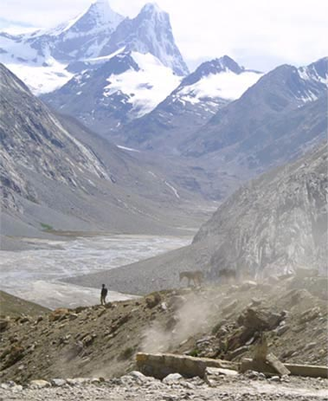
Fellowship of the Heart
Getting Started — the Four Connects, walked over twenty-two Wednesday afternoons
CCA Club Year 2026–27 · Session Slides · v1.5 DRAFT
All Scripture: ESV · The Companion lesson plans carry the full scripts — these slides carry the room
1
Notes:
DECK TITLE · pre-session · DIVIDER
On screen as the room assembles on night one. All Scripture ESV; the plans carry the scripts; these slides carry the room — and these notes carry you.

Slide 2
Quarter 1
Connect with Self & Others
Weeks 1–6 · Six Wednesdays · the container is built, the stories are told
2
Notes:
QUARTER 1 · pre-session · DIVIDER
On screen as families arrive. Greet at the door — the slide holds the room.

Slide 3

WEEK 1
Welcome to the Journey
Establishing the container; introducing the four Connects
Quarter 1: Connect with Self & Others
3
Notes:
W1 · pre-session · DIVIDER
On screen as families arrive. Greet at the door — the slide holds the room.

Slide 4
Week 1 — Tonight’s Road
1 Welcome — the very-first-time orientation
2 The door out — one name, said once
3 The Four Connects — kitchen-table teaching
4 Container introduction — the first full protocol
5 One True Sentence — why each of us is here
6 Scripture: John 10:10 — and the seed, stated plainly
7 What does it mean to be saved?
8 Between-week practice
9 The Leader Feedback Round (debut)
10 Closing container + Aaronic blessing
THIS YEAR, IN ONE LINE
Hearing and obeying God
4
Notes:
W1 · 4:15–5:30 · SHARED
BEATS:
1. Thirty-second walk of the night: welcome, Four Connects, first container, One True Sentence, John 10:10, the saved question, practice, close.
2. Start on time at 4:15. Whole night is one shared circle — family clusters begin Week 2.
3. Timing trap: the teaching is always cuttable; the experiential blocks are not.
CUES: Chairs in one circle, no table; Four Connects diagram pre-drawn on the whiteboard; leader sits in the circle, not at the head.

Slide 5
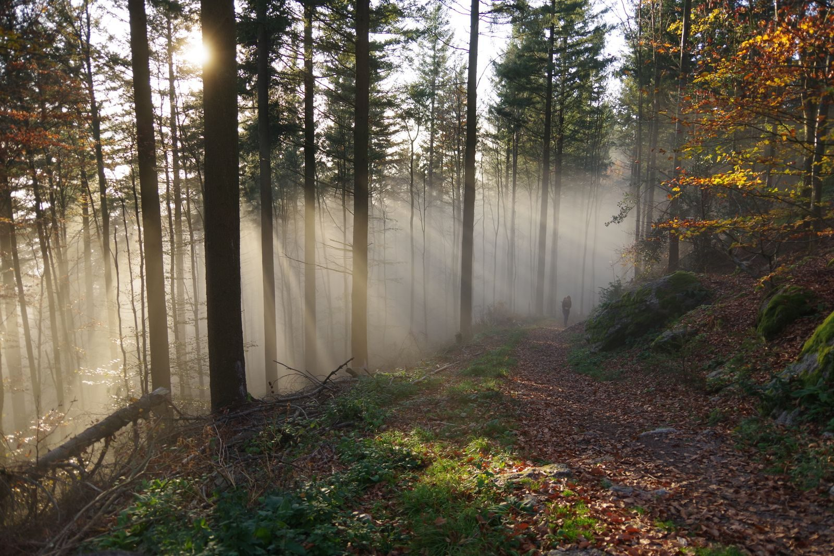
Welcome — the Very-First-Time Orientation
• “I came that they may have life and have it abundantly.” — John 10:10
• This is a journey of exploration
– Your heart
– This process — the plans, practices, and pages live at the Fellowship of the Heart website
– This group
• This is not a youth group
• It is family formation and growth in Christ
• An offer of leadership opportunity
5
Notes:
W1 · 4:15–4:22 · SHARED
BEATS:
1. Stand at the open of the circle; wait for full silence before a word.
2. Three things: today is the doorway, not the destination; no chaperones — every person is a participant; phones silenced and away (the ask is enough — no collecting, no policing).
3. At 4:19 shift to what-this-is framing: real interior work as families; not a Bible study, not youth group, not therapy — an invitation to the abundant life of John 10:10.
CUES: A parent sliding into chaperone mode gets 'Today we are all participants. Let me hold the space.'

Slide 6
One More Person You Should Know About
• Pastor Bobby Gore · (831) 277-9878 — not part of our team
• If something ever needs saying that you would rather not say to me, or to your Companion, or to your parents, you can go straight to him
• No reason needed, no permission needed, and nobody here will be told. It is on the page you take home tonight
6

Slide 7
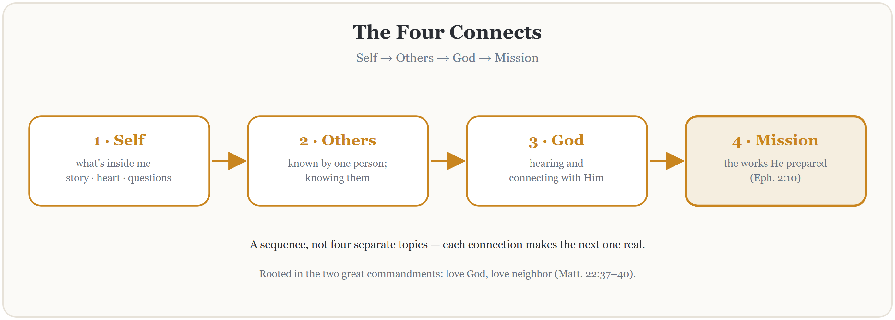
The Four Connects
THE SOWER — THREE WITNESSES: Mark 4:1–20 · Matthew 13:1–23 · Luke 8:4–15
7
Notes:
W1 · 4:22–4:30 · SHARED
BEATS:
1. Stand at the whiteboard; diagram already drawn. Matthew 22 origin: two commandments, four connections.
2. Walk the sequence: Self, then Others, then God, then Mission — a sequence, not four separate topics.
3. Sketch the year's map, then release it: 'Don't worry about memorizing it. These twenty-two weeks will teach it to you.'
GUARD: Ten minutes maximum — do not teach the whole framework today. Concrete language for teens: 'the person at your lunch table knowing what's actually going on inside you.'

Slide 8

Container Introduction
Safe
– What is shared in this room stays in this room — no judging, no fixing, no interrupting
– No shaming
Present
– Focused here — in this room, with these people
– Phones silent and put away
Clear
– Releasing any roadblocks to hearing — set them aside intentionally
Intentional
– “I’m leaning in. I’m looking for what God has for me in the next seventy-five minutes.”
8
Notes:
W1 · 4:30–4:42 · SHARED
BEATS:
1. Most important block of Week 1 — do not rush it.
2. Name the four conditions once: Safe, Present, Clear, Intentional.
3. Teach the commitment plus the honest alternative: 'I am here, and I am listening' is a full way to stand in the circle, not a lesser one. Nobody tracks who says which.
4. Everyone stands; walk the eight-step opening protocol (Handbook Section 5), holding each step.
CUES: The first one-word check-in is the key moment of Week 1 — if every single person says one word, that is your first win.

Slide 9
Opening Container — the Full Eight Steps
1 Welcome — five minutes to open the container
2 Phones silenced and put away
3 Stand in a circle
4 One-word check-in — how you actually are, right now
5 Put out / bring in — set something down; bring a blessing in
6 Spoken commitment: “I am here. I am paying attention. I am willing to be moved.”
7 Opening prayer — “Holy Spirit, you are welcome here. Speak. We are listening.”
8 Sit. Begin.
9
Notes:
W2 · 4:15–4:22 · SHARED
BEATS:
1. Full eight-step opening protocol — the cohort knows the form; hold the rhythm, do not over-explain.
2. Four conditions: name them once; nods or a quiet yes are enough. Re-teach only if Week 1 felt unsafe.
3. Close the opening with brief prayer naming the Holy Spirit — ask Him to teach us through Jesus' own words today.
CUES: At the one-word check-in, listen for heavy words ('angry', 'numb', 'scared') — note them; the diagnostic may pull from there.

Slide 10
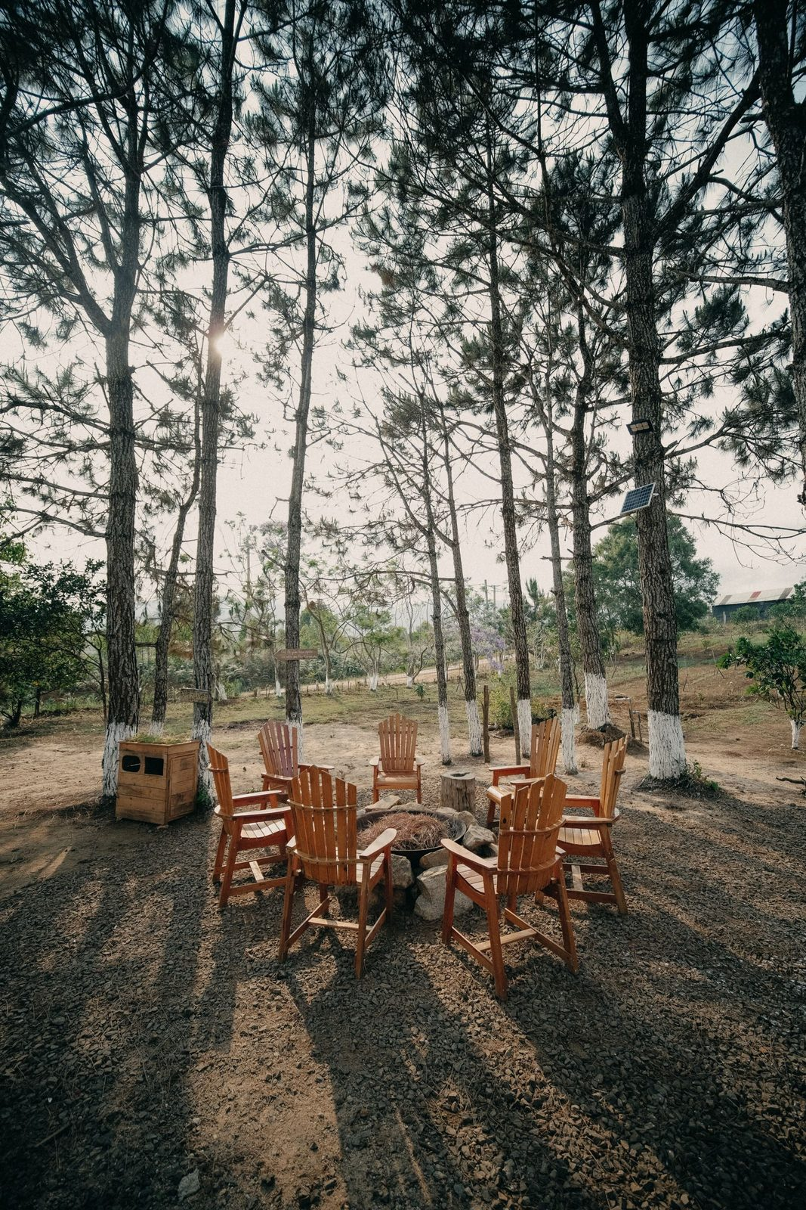
One True Sentence — Why Each of Us Is Here
• Around the circle: one true sentence about why you are here tonight
• One sentence — not a paragraph, not a story
• The word that matters is “true” — not what you think we want to hear
• “Because Mom said I had to be here” counts. “I don’t know yet” counts.
10
Notes:
W1 · 4:42–4:55 · SHARED
BEATS:
1. One true sentence each on why you are here. True beats polished; 'Mom made me come' counts, and so does 'I don't know yet.'
2. You go first — short and true; you set the depth and length.
3. 'I pass today' is allowed; receive with 'Thanks. We're glad you're here' and move on without ceremony.
CUES: The second speaker is a parent, arranged before the session — never a cold call, and never on a teen. Stem for a frozen teen: 'One reason I'm here today is ___.' Two gentle fingers for a parent giving a speech.
GUARD: If something heavy lands ('I'm here because I'm drowning'): 'Thank you for trusting us with that. We will hold that.' Never process it in the circle; follow up after.
SUB: The plan's example sentences are the founder's. Speak your OWN true sentence — pre-write three, pick one in the moment. Never perform someone else's.

Slide 11
Scripture: John 10:10 — and the Seed, Stated Plainly
JOHN 10:10
“The thief comes only to steal and kill and destroy. I came that they may have life and have it abundantly.”
THE QUESTION TO CARRY HOME — NOT TO ANSWER TONIGHT
“Where in my life am I living abundantly, and where am I living some thinner version of life that Jesus did not come to give me?”
11
Notes:
W1 · 4:55–5:04 · SHARED
BEATS:
1. 'Tonight's scripture. Listen for one word.' Read John 10:10 in full from the physical Bible — slowly, once. The screen holds the words; the Bible carries the reading.
2. Abundantly — the word the year hangs on. The thief's purpose against His purpose; the more is real and it cost Him everything (John 10:11). Point to the carry-home question on the slide: not to answer tonight — to carry.
3. Close the Bible. One beat of quiet. The seed, stated plainly (2–3 min) — full script in the plan, Block 6. The year's proclamation: do not rush it; do not decorate it.
ADVANCE CUE: next slide exactly at the seed's last line — 'which raises a question worth sitting with on our very first night —'

Slide 12
What does it mean to be saved?
12
Notes:
W1 · 5:04–5:07 · SHARED
ADVANCE CUE: this slide goes up exactly at the seed's last line — 'which raises a question worth sitting with on our very first night.'
BEATS:
1. 'What does it mean to be saved?' — the room answers first. Parents may start; popcorn, 2–3 minutes.
2. Receive every answer with a nod and a thank-you — no grading; the thief does the correcting (next slide).
GUARD: an honest 'I don't know' counts; no spotlight, ever.

Slide 13
What Does It Mean to Be Saved?
LUKE 23:42–43
“And he said, ‘Jesus, remember me when you come into your kingdom.’ And he said to him, ‘Truly, I say to you, today you will be with me in paradise.’”
ROMANS 10:9–10
“because, if you confess with your mouth that Jesus is Lord and believe in your heart that God raised him from the dead, you will be saved. For with the heart one believes and is justified, and with the mouth one confesses and is saved.”
Saved: the desire to be connected to Christ, acted on by turning to Him.
No baptism. No church attendance. No cleaned-up life. No time left — he had hours. He wanted Jesus, and he turned to Him — and Jesus said yes. Heart and mouth: believe, and say so. Not a certificate. A connection.
13
Notes:
W1 · 5:07–5:15 · SHARED
BEATS:
1. Read Luke 23:39–43 slowly, then show the response: no baptism, no cleaned-up life — desire aimed at Christ, and Christ's yes. Romans 10:9–10: heart and mouth.
2. Land the year's working definition: saved = the desire to be connected to Christ, acted on by turning to Him.
GUARD: No assurance or baptism debates today — 'the thief settles today's question; come find me.' Watch gently for the face that changes; no spotlight, ever.

Slide 14
As Far as the East Is from the West
PSALM 103:12
“as far as the east is from the west, so far does he remove our transgressions from us.”
N
W
E
S
It is all about which way you are pointing. Catch yourself pointing east, and turn.
14
Notes:
Week 1, inside the saved discussion, straight after the definition. Ask it as a real question: how far is the east from the west? Let two or three answers come. Get the compass out on your phone. Stand in the middle of the circle. "Okay. I am heading east. How far is west from here?" Then bring the room in. They have been sitting since the container opened, so ask for their feet. "Everybody up for a second. Turn and face east with me." Wait for the whole room to come around; let it be slightly awkward, and do not hurry them. "That is east. Now - turn west." Turn with them, slowly, and stop. Let the room stand there facing the other way for a beat before you say anything. "That is it. That is how far west is from east. It is all about which way you are pointing. And no matter when you catch yourself pointing east - no matter how long you have been walking that way - all you have to do is turn around and point west." "That is what the verse means when it says He removes our transgressions as far as the east is from the west. And it is the same word we just used for what saved is: turning." Then stop. Do not explain it further and do not open it for discussion. The turn lands in the body before it lands in the head, which is why the whole room turns rather than watching one person do it. It also gives them a picture for the definition they just heard: saved is the desire to be connected to Christ, acted on by turning to Him. If the compass will not settle indoors, pick a wall during setup and call it east. The demonstration needs the turn to be real, not the needle to be right.

Slide 15
The First Page
If you could ask God one question — and know that He would answer it for you this year — what would you ask Him?
• Open your journal to the very first page — write it in your own handwriting
• The question you actually have — not the one you’re supposed to have
• Date it. Nobody will ever read it — the journal is yours, never collected
• This room will come back to that page before the year is done
Two quiet minutes, no music. Companions write their own first page too.
15
Notes:
W1 · 5:04–5:15 · SHARED
BEATS:
1. Tail of the saved block. Journals open to the very first blank page.
2. The question: if you could ask God one question and know He would answer it this year, what would you ask? The real one, not the supposed-to one. Date it.
3. Two silent minutes — no music, no commentary. Companions write their own first page too, visibly.
GUARD: Nobody will ever read it; the journal is never collected. Say so — the privacy is the point, and the room comes back to this page before the year ends.

Slide 16

Between-Week Practice
• One practice this week — the simplest we will give you in all of Getting Started
• Each morning, before the phone: five quiet minutes
– Ask one question: “Father, what are you up to today, and what do you want me to notice?”
– Then sit. Listen. The asking is the practice.
• Each evening, sixty seconds: one specific sentence in the journal — what did I notice today?
• Parents are doing this too — we check in next Wednesday
16
Notes:
W1 · 5:15–5:18 · SHARED
BEATS:
1. One practice only. Each morning, before the phone: five minutes — 'Father, what are You up to today, and what do You want me to notice?' Then sit. The asking is the practice.
2. Evening: one specific sentence in the journal — what did I notice today?
3. 'Parents, you are doing this too. We'll check in next week.'
CUES: The Parent Co-Companion leads this block, not you — parents need to hear from a parent that they are doing it too.

Slide 17
Homework, If You Want It — Five Questions for Your Journal
These are the five questions we ask every family on the way into this work — some of you have met them already; some are meeting them tonight. They’re printed in your journal handout. If you want more than the one practice this week: give each one a page.
1 What do you sense the Spirit might be doing in you right now?
2 What’s drawing you toward something like this?
3 What are you a little afraid of?
4 What would you NOT want this to be?
5 Where would you say you are with Jesus — has there been a time you said yes to Him, or is that still an open question?
Your journal is never collected and never read. A page per question or a single sentence — whatever is true.
17
Notes:
W1 · 5:15–5:18 · SHARED
BEATS:
1. Thirty seconds, as the first-page pens settle. 'On the way into this work we ask every family five questions — some of you met them in a conversation with one of us; some of you are meeting them right now, and that is just as good a door. They're printed in your journal, right after the where-am-I-with-Jesus page. A page per question this week, or a single sentence — if you want more than the one practice.'
2. Say the privacy line again, even though they know it: the journal is never collected, never read; nobody will ever ask what you wrote.
GUARD: an offer, never an assignment — the week's only ask is the morning question (next slide). If the evening is running long, skip this slide without loss; the questions are in the journal either way.

Slide 18
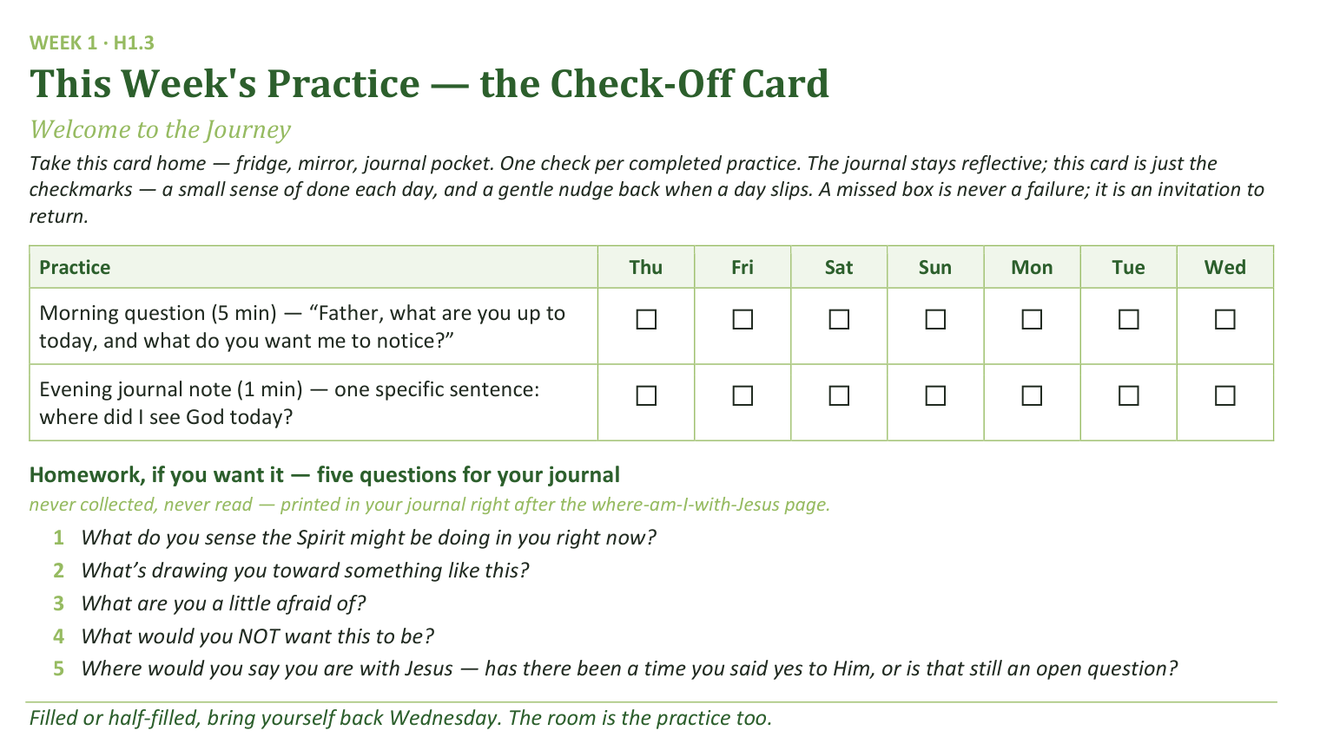
Your Take-Home Card — This Week’s Practice
Handed out now — fridge, mirror, journal pocket. Same card, new practices, every week of the year.
18
Notes:
W1 · 5:15–5:18 · SHARED
BEATS:
1. Hold up the check-off card (H1.3) — fridge, mirror, or journal pocket; one check per completed practice.
2. Say the card's grace note aloud: a missed box is never a failure; it is an invitation to return.
CUES: Rides inside the practice block — keep the two slides to four minutes together.

Slide 19
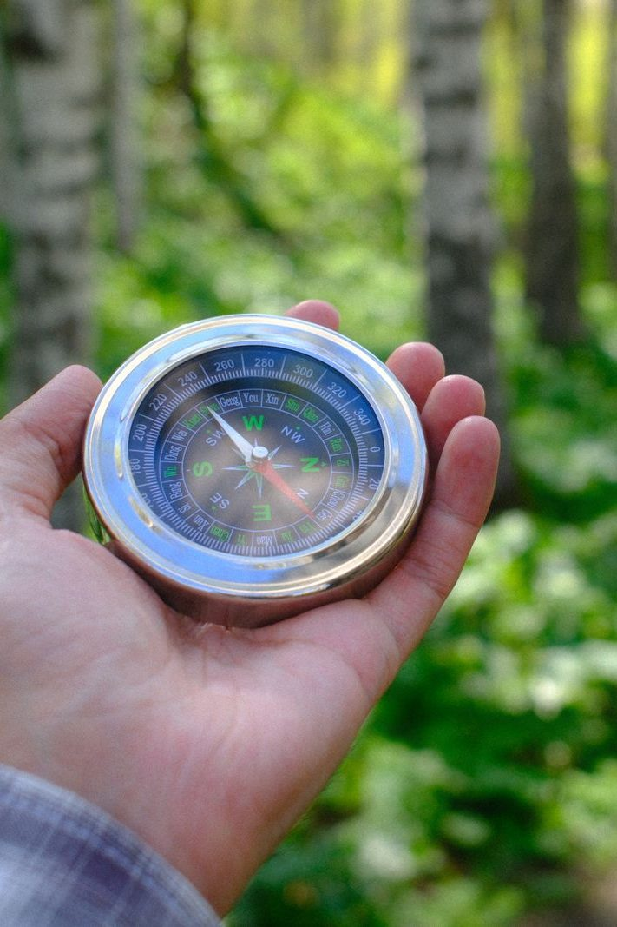
The Leader Feedback Round
• The evening’s leader goes first — three things, same as every week from here on
– “What I think went well tonight: ______”
– “What I’d do differently next time: ______”
– “If I were to teach tonight’s process to someone, I would tell them: ______”
• Then the room — the same two questions about tonight
• The leader receives without defending — “thank you” is the whole response
19
Notes:
W1 · 5:24–5:27 · SHARED
BEATS:
1. Debut today; you model it on yourself. Three things: what went well; what I'd do differently; what I'd tell someone teaching today's process.
2. Then the room, same two questions; two or three voices is plenty.
3. Receive without defending — 'thank you' is the whole response.
CUES: Week 1 order: the closing container runs at 5:18 BEFORE this round; the blessing follows it at 5:27. May be dropped if the room needs something else; twice running goes to the team debrief.

Slide 20
Closing the Container + Aaronic Blessing
• We close the way we opened — the container, six steps:
1 Stand again — same circle, same posture as the open
2 One-word landing — compare it to your opening word
3 The one thing you are taking from tonight
4 The one practice — said together: “Father, what are you up to today, and what do you want me to notice?”
5 Blessings — specific, witnessed, short
6 Closing prayer — then the Aaronic blessing, spoken over each other, face to face
THE AARONIC BLESSING — NUMBERS 6:24–26
“The Lord bless you and keep you;
the Lord make his face to shine upon you, and be gracious to you;
the Lord lift up his countenance upon you, and give you peace.”
20
Notes:
W1 · 5:18–5:30 · SHARED
BEATS:
1. Six-step closing (Handbook Section 5). One-word landing — any word, even 'tired'; do not push for depth today.
2. The one practice, said aloud together: 'Father, what are You up to today, and what do You want me to notice?'
3. Blessings: do not press in Week 1; honor any offered. Closing prayer 30 seconds, naming the Holy Spirit.
4. Aaronic blessing at 5:27: teens face parents, hand on shoulder if comfortable; read the card together, slowly. Pause. 'Take your blessing card with you.'
CUES: Week 1 order: closing 5:18, Leader Feedback Round 5:24, blessing 5:27 — the round sits inside this window.

Slide 21

WEEK 2
The Soil of Your Heart
The Heart Soil diagnostic from Mark 4; beginning Connecting with Self
Quarter 1: Connect with Self & Others
21
Notes:
W2 · pre-session · DIVIDER
On screen as families arrive. Greet at the door — the slide holds the room.

Slide 22
Week 2 — Tonight’s Road
1 Opening container — full eight-step protocol
2 Check-in on Week 1 practice
3 Teaching: the seed recalled; Mark 4, the soils, and Paul’s mixed ground
4 Family clusters: question zero, then the Heart Soil diagnostic
5 Re-merge — shared debrief; Mark 4:20 re-read
6 Between-week practice
7 The Leader Feedback Round
8 Closing container + Aaronic blessing
22
Notes:
W2 · 4:15–5:30 · SHARED
BEATS:
1. Shape: full eight-step open, practice check-in, Mark 4 teaching, first move into FAMILY CLUSTERS for the Heart Soil diagnostic, merge, practice, close.
2. First cluster night — frame it confidently: your family stays together, a parent goes first every time, you choose your own depth.
3. If the room is about ten or fewer, skip the clusters entirely — one circle all night.
CUES: Cluster spaces set before doors open; every Cluster Companion has done the diagnostic on themselves; the opening parent for each cluster is arranged in advance.

Slide 23
Opening Container — the Full Eight Steps
1 Welcome — five minutes to open the container
2 Phones silenced and put away
3 Stand in a circle
4 One-word check-in — how you actually are, right now
5 Put out / bring in — set something down; bring a blessing in
6 Spoken commitment: “I am here. I am paying attention. I am willing to be moved.”
7 Opening prayer — “Holy Spirit, you are welcome here. Speak. We are listening.”
8 Sit. Begin.
23
Notes:
W2 · 4:15–4:22 · SHARED
BEATS:
1. Full eight-step opening protocol — the cohort knows the form; hold the rhythm, do not over-explain.
2. Four conditions: name them once; nods or a quiet yes are enough. Re-teach only if Week 1 felt unsafe.
3. Close the opening with brief prayer naming the Holy Spirit — ask Him to teach us through Jesus' own words today.
CUES: At the one-word check-in, listen for heavy words ('angry', 'numb', 'scared') — note them; the diagnostic may pull from there.

Slide 24

Check-In on Week 1 Practice
• One quick round, one sentence each — a parent starts
– “One thing I noticed this week when I asked the morning question …”
– Or one thing about the practice itself — “I forgot it three days running” is a real answer
• No grades, no lectures — honesty over performance
• Missed it? “Thanks for the honesty. Pick it back up tomorrow.”
“When your children ask their fathers in times to come, ‘What do these stones mean?’”
— JOSHUA 4:21 (ESV)
24
Notes:
W2 · 4:22–4:27 · SHARED
BEATS:
1. Parent Co-Companion leads and models first with one true sentence ('I checked my phone before the question most days').
2. One quick sentence each around the circle — what I noticed, or what I noticed about the practice. Honor passes without ceremony.
3. Teach the anchor once, thirty seconds: Joshua 4 — twelve stones from the Jordan. Every week this check-in adds a stone.
GUARD: No grading, no lecture on consistency. 'I didn't do it' gets 'Thanks for the honesty. Pick it back up tomorrow.'

Slide 25
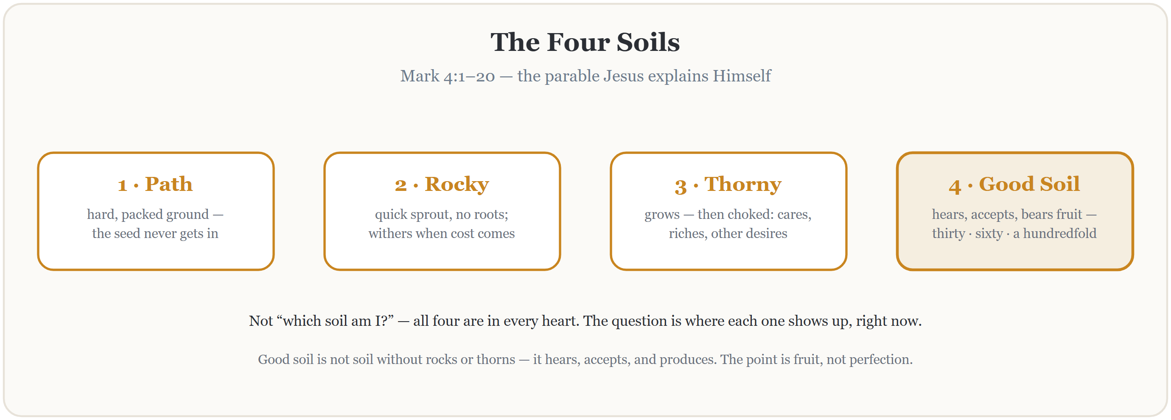
Teaching — Mark 4 and the Four Soils
Read Mark 4:1–20 in full, slowly — all twenty verses, no commentary. Then the seed, recalled — sixty seconds. Then the four soils — and Paul’s mixed ground, next slide.
25
Notes:
W2 · 4:27–4:40 · SHARED
BEATS:
1. Read Mark 4:1–20 in full from the physical Bible — slowly, all 20 verses, no stopping to comment.
2. Recall the seed, 60 seconds: 'the sower sows the word' — today is about the ground it lands on, yours and mine.
3. Walk the four soils in six minutes max: path (hard, taken), rocky (fast, rootless), thorny (choked, fruitless), good (hears, accepts, produces — fruit, not perfection).
GUARD: At path soil, name the enemy plainly — no dramatizing, no denying. Save the back of the block for Paul.

Slide 26
Paul’s Mixed Ground — Romans 7
ROMANS 7:15, 18–19
“For I do not understand my own actions. For I do not do what I want, but I do the very thing I hate… For I have the desire to do what is right, but not the ability to carry it out. For I do not do the good I want, but the evil I do not want is what I keep on doing.”
ROMANS 7:24–25
“Wretched man that I am! Who will deliver me from this body of death? Thanks be to God through Jesus Christ our Lord!”
Mixed soil, in the mouth of an apostle — and he lands on rescue, not despair. All four soils in one honest week is not failure. It is apostolic company.
26
Notes:
W2 · 4:27–4:40 · SHARED
BEATS:
1. Paul's mixed ground, 3 min: read Romans 7:15, 18–19 — an apostle with all four soils at once.
2. Land where Paul lands, 7:24–25: rescue, not despair. Finding rocks and thorns is apostolic company.
3. Pivot: the wrong question is 'which soil are you?' — the right one is 'where does each show up, specifically, this week?'
CUES: Bridge before the 4:40 move: restate the container for the clusters — what your family says today is a gift, not ammunition; it does not come up in the car. Wait for nods from each family before anyone moves.

Slide 27
Question Zero — Private, Journal Only
2 CORINTHIANS 13:5
“Examine yourselves, to see whether you are in the faith. Test yourselves.”
Has the seed itself ever gone into your ground? Has there been a time you actually said yes to Jesus — your yes, not your family’s?
Write your honest answer — yes, no, or I’m not sure. Nobody shares this one.
If it’s no, or not sure — the road is short. The thief walked it in one sentence. Any Companion, any Wednesday, quietly — or start with your parent, tonight, in the car.
27
Notes:
W2 · 4:41–5:09 · CLUSTERS
BEATS:
1. First three minutes of cluster time. Journals open to the Question Zero page; scripture asks it — 2 Corinthians 13:5.
2. Read it once: has the seed itself ever gone into your ground — your yes, not your family's? Write yes, no, or not sure. The road is short; the thief walked it in one sentence.
3. Three quiet minutes. Do not walk the circle; do not glance at pages.
GUARD: Question zero is PRIVATE and journal-only — never shared, never referenced again, today or ever. No 'anyone want to say anything about the first one.' The quiet seeker who finds a Companion afterward is the year's best outcome, not a crisis.

Slide 28
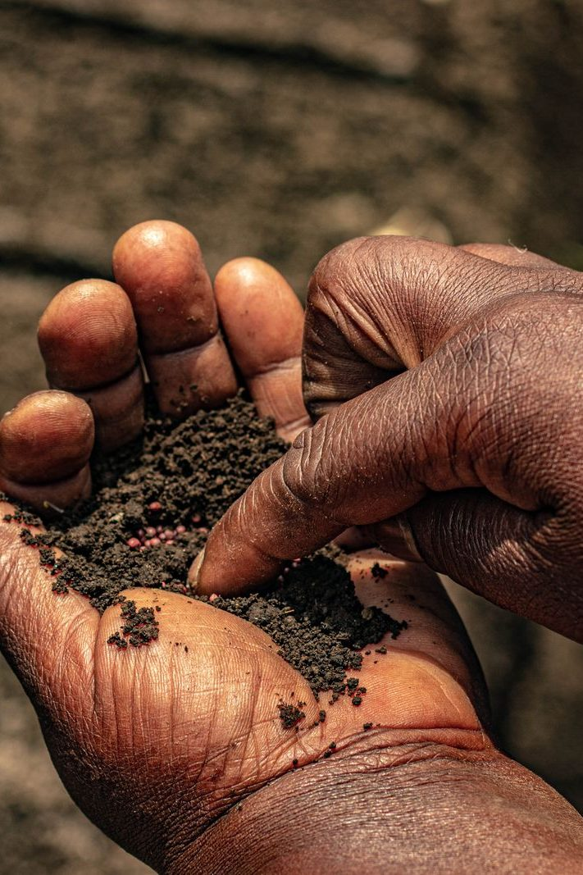
Family Clusters — the Heart Soil Diagnostic
• Not “which soil am I?” — where does each soil show up in my life right now? Specifically.
1 Path — where is the ground hard right now? One specific place, this week
2 Rocky — where has a season with God not lasted? What sun revealed the missing roots?
3 Thorny — what is choking me right now: cares, riches, other desires? Which is loudest?
4 Good — where has something God planted actually grown? Name one real piece of fruit
• Journal two minutes, then share — a parent answers first, every round
• “I’d rather not share that one” is a complete answer — a gift, not ammunition
28
Notes:
W2 · 4:41–5:09 · CLUSTERS
BEATS:
1. Four questions, one at a time: path, rocky, thorny, good. About two minutes journaling each, then share around — 'I'd rather not share that one' is a complete answer.
2. Push for one specific incident, not a category — 'my phone' becomes one moment this week.
3. Nobody fixes anybody across the family line: 'Just receive it. We're noticing today, not fixing.'
CUES: The arranged parent opens the first round — never a cold call, never on a teen. Watch the clock privately: question zero plus four questions in 28 minutes. Ten or fewer today — run it as one whole circle.
GUARD: Heavy material ('rocky is when we fight at home') — acknowledge, hold, move on; follow up per Handbook Section 6. Watch a teen's face while their parent shares.

Slide 29
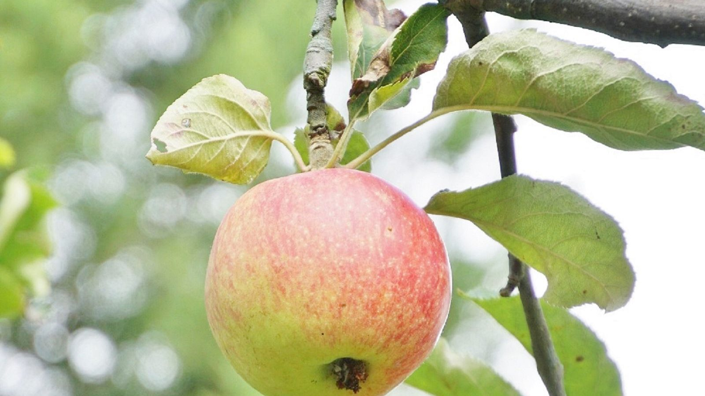
Re-Merge — One Word, Then the Verse
• What surfaced stays in your cluster — here, just one word from each of us
• Then the verse Jesus ends with, read slowly — listen for the word that lands
• Noticing rocks and thorns is not the opposite of good soil — it is what good soil does
MARK 4:20
“But those that were sown on the good soil are the ones who hear the word and accept it and bear fruit, thirtyfold and sixtyfold and a hundredfold.”
29
Notes:
W2 · 5:10–5:18 · SHARED
BEATS:
1. Re-merge starts at 5:09 — three minutes to move; let the circle settle.
2. One word each on what today surfaced — 'thorny', 'seen', 'tired'. Hold each word a beat.
3. Re-read Mark 4:20 slowly; land it: good soil is not soil without rocks — it hears, accepts, produces. The noticing IS what good soil does.
GUARD: No specifics from the clusters — the diagnostic stays in the cluster; the merge is for landing, not repeating.

Slide 30

Between-Week Practice
• The Soil Journal — three times this week, five minutes each. Not every day; three times.
– Today, where did the path show up? The rocky? The thorny? The good soil?
– One sentence per soil. Specific, not general.
• No fixing. We notice; the Spirit fixes.
• Keep the morning question going too: “Father, what are you up to today?” The practices stack.
30
Notes:
W2 · 5:18–5:21 · SHARED
BEATS:
1. Parent Co-Companion leads. Three times this week — not daily — five minutes: one sentence per soil, where did each show up today? Specific, not general.
2. Rule stands: no fixing. The Spirit fixes; our job is to pay attention.
3. Keep last week's morning question going — the two practices stack.

Slide 31
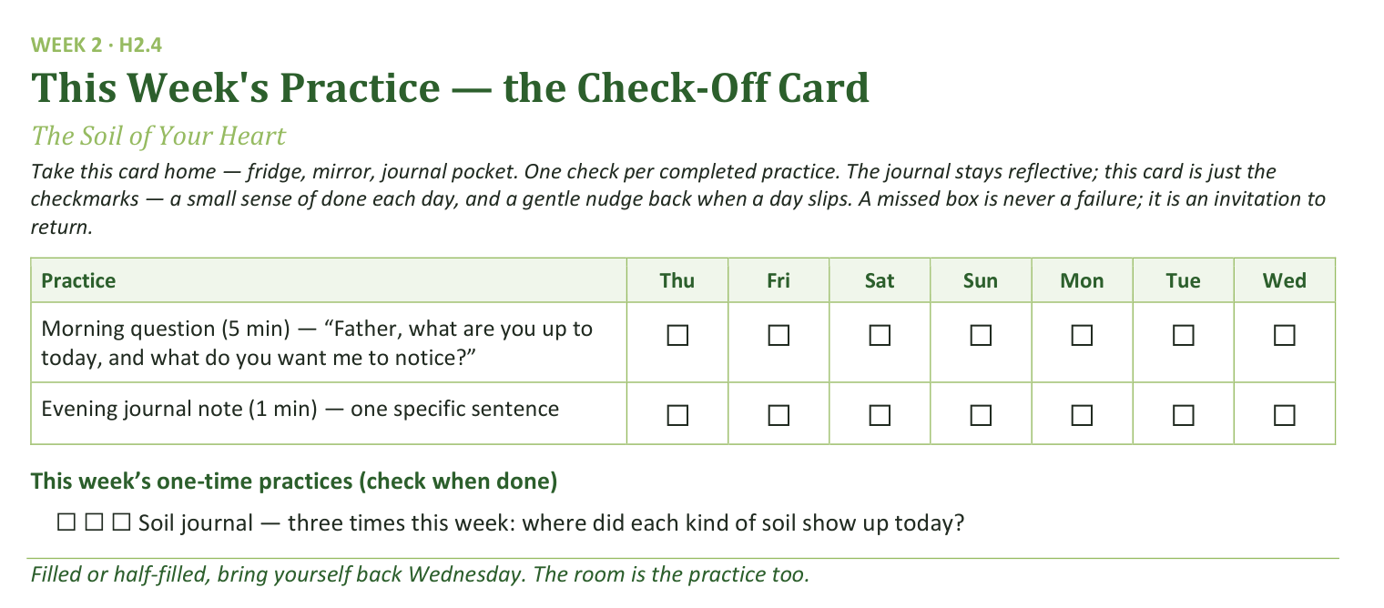
Your Take-Home Card — This Week’s Practice
Handed out now — fridge, mirror, journal pocket.
31
Notes:
W2 · 5:18–5:21 · SHARED
BEATS:
1. Hold up the check-off card (H2.4): daily morning question and evening sentence, plus three soil-journal boxes.
2. A missed box is never a failure — it is an invitation to return.
CUES: Rides inside the practice block — keep both slides to five minutes together.

Slide 32
The Leader Feedback Round
• The evening’s leader goes first — three things, same as every week
– “What I think went well tonight: ______”
– “What I’d do differently next time: ______”
– “If I were to teach tonight’s process to someone, I would tell them: ______”
• Then the room — the same two questions about tonight
• The leader receives without defending — “thank you” is the whole response
32
Notes:
W2 · 5:21–5:25 · SHARED
BEATS:
1. Your three things first: what went well; what I'd do differently; what I'd tell someone teaching today's process.
2. Room's two questions; two or three voices is plenty.
3. Receive without defending — 'thank you' is the whole response.
CUES: May be dropped if the room's energy needs something else; dropping it twice running goes to the team debrief.

Slide 33
Closing the Container + Aaronic Blessing
• We close the way we opened — the container, six steps:
1 Stand again — same circle, same posture as the open
2 One-word landing — compare it to your opening word
3 The one thing you are taking from tonight
4 The one practice — committed aloud, or modified to one you will actually keep
5 Blessings — specific, witnessed, short
6 Closing prayer — and the Aaronic blessing, spoken over each other, face to face
THE AARONIC BLESSING — NUMBERS 6:24–26
“The Lord bless you and keep you;
the Lord make his face to shine upon you, and be gracious to you;
the Lord lift up his countenance upon you, and give you peace.”
33
Notes:
W2 · 5:25–5:30 · SHARED
BEATS:
1. Abbreviated six-step close: one-word landing, one thing I'm taking, one practice (the three soil journals).
2. Aaronic blessing parent-to-teen, teen-to-parent — the cohort knows the form now.
3. Brief closing prayer naming, without details, what surfaced: 'Father, You saw the rocks and the thorns we named today.'
GUARD: If the merge ran heavy, give the prayer 60–90 seconds; do not lighten the room.

Slide 34

WEEK 3
Telling Your Story I
One question, one circle, and the practice of being known — the parents tell first; the teens’ night is Week 4
Quarter 1: Connect with Self & Others
34
Notes:
W3 · pre-session · DIVIDER
On screen as families arrive. Greet at the door — the slide holds the room.

Slide 35
Week 3 — Tonight’s Road
1 Welcome and centering
2 Week 2 check-in
3 Psalm 139 — being known
4 Companion demo story
5 Bridge to the clusters
6 Stories in family clusters
7 Merge and shared closing
8 Between-session practice
9 The Leader Feedback Round
10 Closing container
35
Notes:
W3 · 4:15–5:30 · SHARED
BEATS:
1. Highest-risk session of the series — Handbook Section 6 re-read within 48 hours before; crisis card in every Companion pocket; pastoral/clinical backup on call 6:30–11:00.
2. Shape: open, check-in, Psalm 139, YOUR five-minute demo story, bridge, 35-minute cluster storytelling (parents tell; teens witness and bless), merge, Joint Footprints, feedback, close.
3. The clock is a guide — if a block runs sixty seconds long because something true is being said, let it.
CUES: First-teller parent arranged per cluster. Any parent whose story carries news their teen has not been handed talked with the Lead Companion beforehand — hold that plan.

Slide 36
Opening Container — the Eight Steps
1 Welcome — five minutes to open the container
2 Phones silenced and put away
3 Stand in a circle
4 One-word check-in — how you actually are, right now
5 Put out / bring in — set something down; bring a blessing in
6 Spoken commitment: “I am here. I am paying attention. I am willing to be moved.”
7 Opening prayer — “Holy Spirit, you are welcome here. Speak. We are listening.”
8 Sit. Begin.
36
Notes:
W3 · 4:15–4:22 · SHARED
BEATS:
1. 'Find a seat. We'll start in ninety seconds.' The settling is part of the work.
2. Speak the Aaronic blessing over the room first.
3. Frame: today the parents tell; teens, your night is next week — your work today is listening and blessing, and that is not the small half.
4. Container reminders: Safe, Present, Clear, Intentional; nothing is required; we listen and bless, we do not fix.
CUES: Spot anyone who arrived heavy — eye contact, smile, no singling out. They will know you saw them.

Slide 37
Week 2 Check-In — Heart Soil
• “Some of you journaled this week. Some of you didn’t. Both are fine.”
• One sentence about what showed up — optional, no pressure
– “‘Path soil at school’ — just one sentence. Anyone?”
• “The work is happening, whether or not we name it tonight.”
37
Notes:
W3 · 4:22–4:26 · SHARED
BEATS:
1. Ninety seconds, optional: one sentence on what the soil journaling surfaced — 'path soil at school' is enough.
2. Take 3–4 voluntary contributions; call on no one.
3. If silence: wait ten seconds, then 'Good. The work is happening, whether or not we name it today.'

Slide 38
Psalm 139 — Being Known
• Psalm 139 is the psalm of being completely known by God — and the psalmist’s response is not panic. It is wonder
• Most of us have parts we hope nobody has noticed. The psalmist invites God to look further
• The opposite of being hidden is not being exposed — it is being seen and being safe at the same time. That is what the circle is
• Tonight is a small practice of Psalm 139 — parents answer one question, with what they are willing to say
PSALM 139:23–24
“Search me, O God, and know my heart! Try me and know my thoughts! And see if there be any grievous way in me, and lead me in the way everlasting!”
38
Notes:
W3 · 4:26–4:33 · SHARED
BEATS:
1. Read Psalm 139:1–6, then 23–24, from the physical Bible. Slowly. Do not preach over the reading.
2. The psalmist is completely known and not running — his response is wonder, and he invites more: 'Search me.'
3. Land the one idea: the opposite of hidden is not exposed — it is seen and safe at the same time. That is what the circle is.
4. Today is a small practice of it: parents answer one question at the depth they choose; the circle blesses, never fixes.

Slide 39
Companion Demo Story
• The Lead Companion tells their own story — five minutes, modeling the form
• The one question: “tell the story of how you got here — today, as you are. What has shaped you into who you are today?”
• Be specific — “I grew up in a house where we didn’t do anger, it wasn’t accepted”
• Not the hero, not the victim — what happened, and where you see God in it now, looking back
• “That is the form. Parents, you’ll do this in your cluster tonight. Teens, this is yours next week. Yours doesn’t have to look like mine.”
39
Notes:
W3 · 4:33–4:38 · SHARED
BEATS:
1. Tell your own five-minute story answering the one question: how you got here, and what has shaped you.
2. Be specific ('I learned to read a slammed cabinet door'), honest about one real hard place, neither hero nor victim; say where you see God in it now.
3. Close: 'That is the form. Parents, today in your cluster. Teens, yours is next week. Yours doesn't have to look like mine.'
GUARD: Time it — five minutes, practiced in advance. The whole room calibrates against this demo; vague gives permission to be evasive.
SUB: The printed kitchen-table story in the plan is the founder's own. Tell YOUR story, written out this week per the pre-work — never perform John's testimony.

Slide 40
Bridge to the Clusters
1 One question — how you got here, and what has shaped you. The depth is yours to choose
2 Listening — do not fix. Do not advise. Do not say “that happened to me too.” Receive, then bless
3 Nothing leaves your circle. “Not a phrase, not a name, not a story.”
• Teens — your own storytelling card goes home tonight; next Wednesday is your night
• Two or three families together, your own family stays with you — thirty-five minutes
40
Notes:
W3 · 4:38–4:39 · TRANSITION
BEATS:
1. Hold up the cards. Three things: one question, depth is the teller's; listeners receive and bless — no fixing, advising, or 'me too'; nothing leaves the circle.
2. Pray the bridge prayer: 'Make this circle a small place where we can be known and safe at the same time.'
3. Send: families stay together; back in the main room at 5:14.
CUES: Teen storytelling cards (H3.2) go home today for Week 4. Ten or fewer — stay one circle; the arranged parent tells after the Companion.

Slide 41
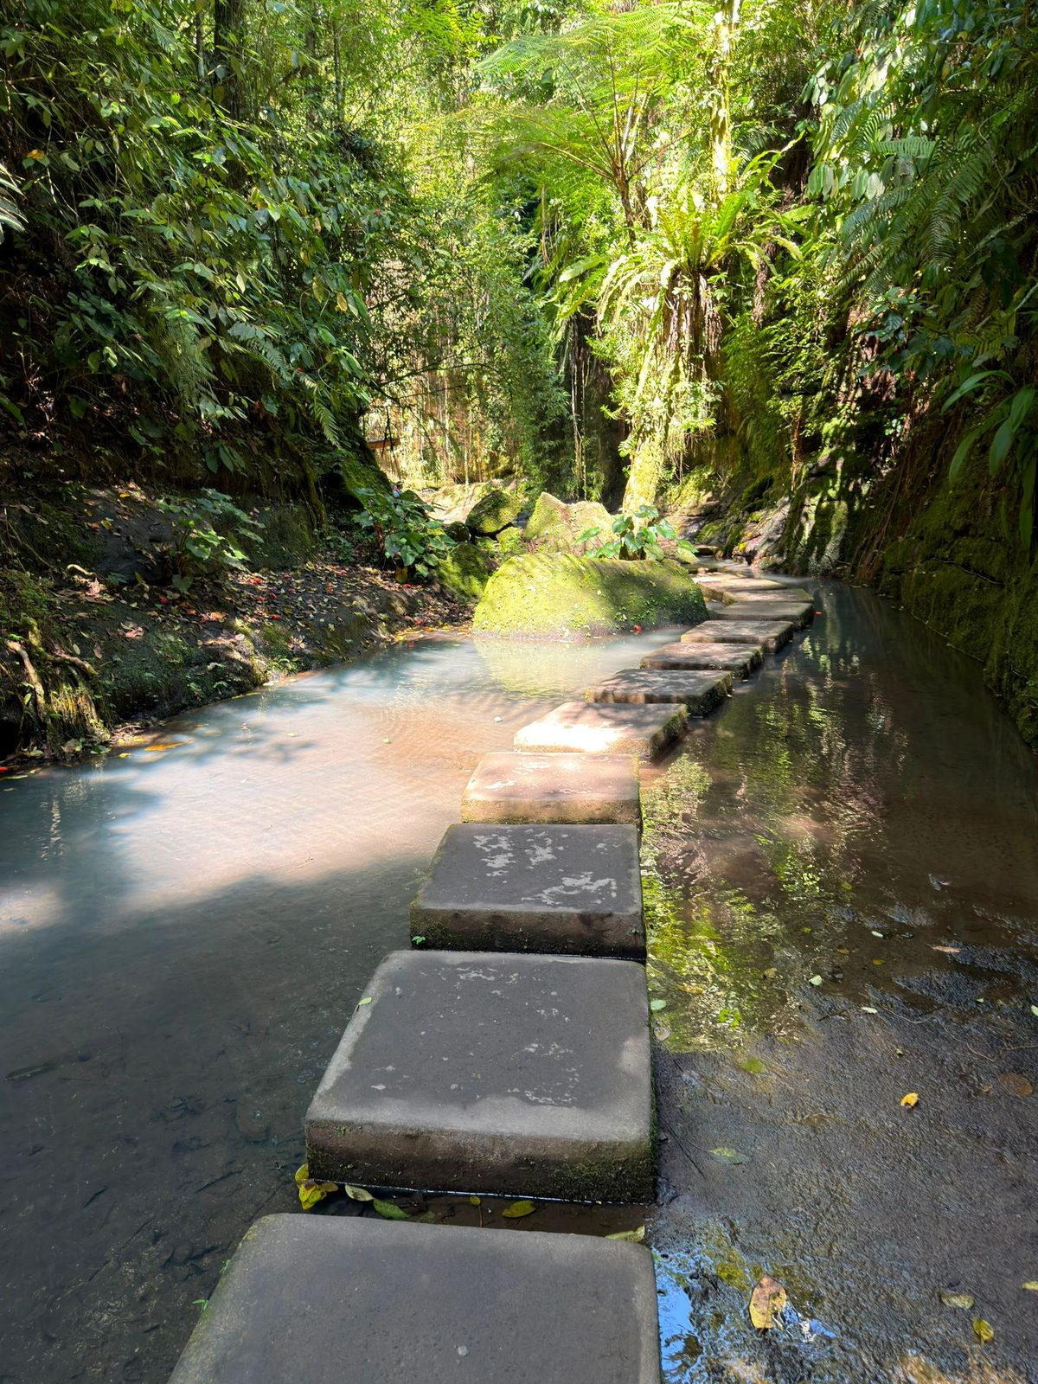
Stories in Family Clusters
• Tonight’s tellers: the parents — plus any Companion-in-Formation. The Cluster Companion goes first
1 Story — 5–7 minutes. The teller speaks; nobody interrupts, even the silences
2 Silence — ten seconds
3 Blessing round — one or two sentences each, teens included: “What I want to bless about your story is...”
• “Inside this cluster, what is said stays in this cluster. Not even back to the main room, and not back up in the car this week.”
• “When someone is telling their story... we are looking at them. We are receiving. That’s the practice.”
41
Notes:
W3 · 4:39–5:14 · CLUSTERS
BEATS:
1. In each cluster: the Companion tells first, then the arranged parent, then the remaining parents. 5–7 minutes per story, 10 seconds of silence, 1–2 minute blessing round.
2. Nobody interrupts a teller, even through silence. At six minutes, gentle eye contact; at seven, 'Let's land it together.'
3. Blessing starters are on the listener card; invite the teller's own teen to bless — invite, never force.
4. Short on time: compress blessings to one sentence each. Never send a parent home untold.
GUARD: Watch each teen's face during their parent's telling — weight received is a Settle Protocol matter (Handbook Section 6); quiet check-in at the next pause, and nobody leaves activated. Heavy disclosures: receive, bless, do not rush; two adults step aside after; Section 6 timelines apply.

Slide 42
Merge and Shared Closing
• What happened in your circle stays in your circle
• One word — just one — about what tonight was like for you. You can pass
– “Heavy.” “Seen.” “Surprising.” “Tender.” “Hard.” Whatever the true word is
• “Each of you brought something true into this room tonight, and each of you received something true. That’s rare. It’s also the kind of room God shows up in.”
42
Notes:
W3 · 5:14–5:18 · SHARED
BEATS:
1. Reconvene; the room's texture will be different than at 4:38 — honor it, do not break it with energy.
2. One word each on what today was like; pass allowed. Receive with eye contact and a small nod — no 'great', no commentary.
3. Close: 'Each of you brought something true and received something true. That's rare. It's also the kind of room God shows up in.'
GUARD: Do not ask anyone to share what was said — cluster content stays in the cluster.

Slide 43

Between-Session Practice — Joint Footprints
• Joint Footprints — each parent-and-teen pair sits together once this week. Twenty minutes total
• Not in the car, not at dinner, not while the TV is on. Phones away
1 Five minutes telling the footprints question — where you grew up, who shaped you, what places and people made you who you are
2 The listener asks one or two follow-ups, then one sentence: “What I love about your footprints is...”
3 Then swap — the other person tells, the first listens and blesses
• The morning question and evening journal note continue daily
43
Notes:
W3 · 5:18–5:21 · SHARED
BEATS:
1. Parent Co-Companion leads. One handout per family (H3.5).
2. The practice: parent and teen sit together twenty minutes this week — not the car, not the TV, phones away. Five minutes of footprints each way; listener asks one or two follow-ups, then one sentence: 'What I love about your footprints is...'
3. Two rules: the teen discloses only what they are ready to (their telling night is next week); the parent does not turn it into a lecture.

Slide 44
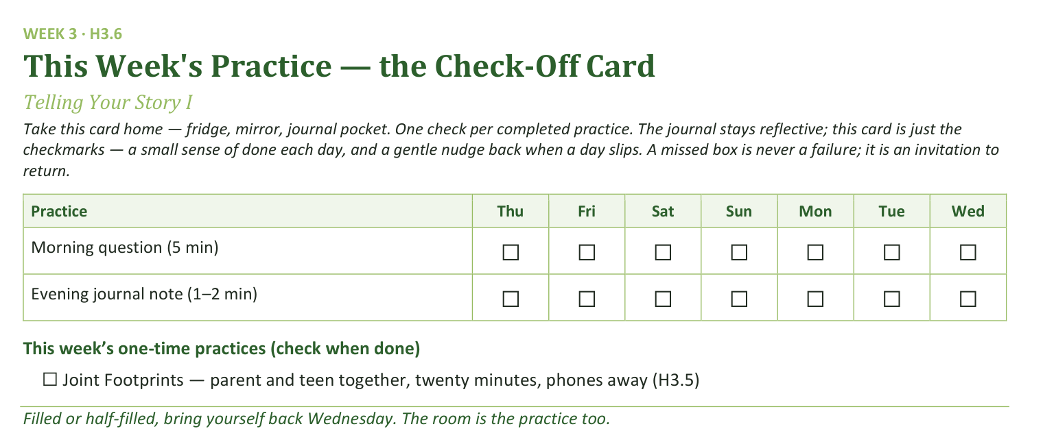
Your Take-Home Card — This Week’s Practice
Handed out now — fridge, mirror, journal pocket.
44
Notes:
W3 · 5:18–5:21 · SHARED
BEATS:
1. Check-off card (H3.6): morning question and evening note daily; Joint Footprints once.
2. Confirm every teen leaves with their storytelling card (H3.2) — the writing for next week starts today.
CUES: Rides inside the practice block.

Slide 45
The Leader Feedback Round
• The evening’s leader goes first — three things, same as every week
– “What I think went well tonight: ______”
– “What I’d do differently next time: ______”
– “If I were to teach tonight’s process to someone, I would tell them: ______”
• Then the room — the same two questions about tonight
• The leader receives without defending — “thank you” is the whole response
45
Notes:
W3 · 5:21–5:25 · SHARED
BEATS:
1. Your three things first: went well; do differently; what I'd tell someone teaching today's process.
2. Then the room's two questions; two or three voices is plenty.
3. Receive without defending — 'thank you' is the whole response.
CUES: May be dropped if the room's energy needs something else; twice running goes to the team debrief.

Slide 46
Closing the Container + Aaronic Blessing
• We close the way we opened — the container, six steps:
1 Stand again — same circle, same posture as the open
2 One-word landing — compare it to your opening word
3 The one thing you are taking from tonight
4 The one practice — committed aloud, or modified to one you will actually keep
5 Blessings — specific, witnessed, short
6 Closing prayer — and the Aaronic blessing, spoken over each other, face to face
THE AARONIC BLESSING — NUMBERS 6:24–26
“The Lord bless you and keep you;
the Lord make his face to shine upon you, and be gracious to you;
the Lord lift up his countenance upon you, and give you peace.”
46
Notes:
W3 · 5:25–5:30 · SHARED
BEATS:
1. Restate the container hard: your own story goes home with you; nobody else's does — not to a sibling, a friend, or a spouse not in this room.
2. Name the help: reach out if today sits heavy — email, text, knock; the Crisis Quick-Reference Card is real and someone is there.
3. Aaronic blessing. 'Go gently this week.'
CUES: Do not pack up — stay accessible ten minutes; the work after the closing is sometimes the work.

Slide 47
WEEK 4
Telling Your Story II
The second running — the teens tell, the round is completed, and the room watches one of its own hold it
Quarter 1: Connect with Self & Others
47
Notes:
W4 · pre-session · DIVIDER
On screen as families arrive. Greet at the door — the slide holds the room.

Slide 48
Week 4 — Tonight’s Road
1 Welcome and centering
2 Joint Footprints check-in
3 Psalm 139 — being known, again
4 Bridge to the split
5 Stories in family clusters
6 Merge and one-word landing
7 Between-session practice
8 The Leader Feedback Round
9 Closing container
48
Notes:
W4 · 4:15–5:30 · SHARED
BEATS:
1. The teens tell today — same question, same clusters, nothing new taught; the completion is the point.
2. A Companion-in-Formation (senior teen) leads the open, the bridge, their own cluster, and the close — protocol card in hand, adult across the circle.
3. Same Section 6 preparation as Week 3: re-read within 48 hours; crisis card in pocket; backup on call.
GUARD: The bright line governs everything — the senior leads process; the adult holds care. If the FC1 gate has not cleared, adults lead exactly as Week 3.
CUES: If you are covering: the senior still leads their blocks — receive their leadership as the room does; do not hover, do not re-lead.

Slide 49
Opening Container — the Eight Steps
1 Welcome — five minutes to open the container
2 Phones silenced and put away
3 Stand in a circle
4 One-word check-in — how you actually are, right now
5 Put out / bring in — set something down; bring a blessing in
6 Spoken commitment: “I am here. I am paying attention. I am willing to be moved.”
7 Opening prayer — “Holy Spirit, you are welcome here. Speak. We are listening.”
8 Sit. Begin.
49
Notes:
W4 · 4:15–4:22 · SHARED
BEATS:
1. The Companion-in-Formation opens the night: blessing, container, Week 4 frame — the pieces are required, their own words are fine (card H4.1).
2. You sit in the circle as a participant and do not hover.
CUES: The room registers a teen leading within ten seconds. Let it — no introduction, no explanation, no applause. Receive the opening exactly as the room received it from the Lead Companion in Weeks 1–3.

Slide 50
Joint Footprints Check-In
• “Some of you got to it. Some of you didn’t. Both are fine — ‘we didn’t get to it’ is honest, and honest is what we do here.”
• One sentence about what it was like — “not what was said — that’s yours — just what it was like”
• An arranged parent starts; then it’s open, and optional
• “The work is happening, whether or not we name it tonight.”
50
Notes:
W4 · 4:22–4:26 · SHARED
BEATS:
1. Lead Companion takes this block. 'Some of you got to it, some didn't — both are fine; honest is what we do here.'
2. One sentence on what it was LIKE, not what was said. The arranged parent starts; then open, and optional.
3. Silence after the opener: wait ten seconds, move on — 'The work is happening, whether or not we name it today.'

Slide 51
Psalm 139 — Being Known, Again
• Same psalm as last week, on purpose — nothing new tonight; we’re completing the round
• One idea, repeated: the opposite of being hidden is not being exposed — it is being seen and being safe at the same time
• The parents practiced that last Wednesday. Tonight the teens do
• Put the comparison down — “Every story is its own. … The story you tell tonight is not in competition with any story told in this building last week. Tell yours.”
PSALM 139:23–24
“Search me, O God, and know my heart! Try me and know my thoughts! And see if there be any grievous way in me, and lead me in the way everlasting!”
51
Notes:
W4 · 4:26–4:31 · SHARED
BEATS:
1. Re-read Psalm 139:23–24 only. Nothing new taught — repetition is how it becomes ours: seen and safe at the same time.
2. Say the comparison word out loud: put down measuring your story against your mom's or dad's. Every story is its own; the parents went first so you would never have to guess, not so you would have a bar to clear.
3. If Week 3 flagged fixing: one gentle sentence — 'listening to receive is its own discipline.'

Slide 52
Bridge to the Split
1 “It’s one question — tell the story of how you got here, and what has shaped you.” The depth is yours to choose
2 “When you’re listening — don’t fix, don’t advise, don’t relate back. Receive, and after each story, bless.”
3 “Nothing leaves your cluster. Not a phrase, not a name, not a story.”
• Same clusters and same rooms as last week — your family stays with you
52
Notes:
W4 · 4:31–4:32 · TRANSITION
BEATS:
1. The senior takes the bridge from the card: one question; listeners receive and bless — no fixing, no advising, no relating back; nothing leaves the cluster.
2. The senior prays, then sends: same clusters, same rooms as last week, families together; back at 5:12.
CUES: Ten or fewer — 'We're staying right here, one circle, same rules,' and flow straight into the telling.

Slide 53
Stories in Family Clusters — the Teens Tell
• The teens tell — same clusters, same single question, same blessing. Second running
1 Story — 5–7 minutes. Nobody interrupts, even the silences
2 Silence — ten seconds
3 Blessing round — the arranged parent blesses first, then the circle: one or two sentences each
• Parents tonight: receive and bless — no correcting the record, no filling silences
• “What’s said in this circle stays in this circle. And when someone is telling, we’re looking at them. We’re receiving.”
53
Notes:
W4 · 4:32–5:12 · CLUSTERS
BEATS:
1. The teens tell — 5–7 minutes each, ten seconds of silence, then blessing; the arranged parent speaks the first blessing after every story.
2. In the senior's cluster: the senior tells FIRST (the adult steers their blessing round), then facilitates the rest, card in hand; the adult sits directly across, silent through mechanics, holding care.
3. Parents receive without correcting the record, filling silences, or bracing — the teen's telling stands today.
4. Out of time: compress blessings to one sentence each; every teen gets told.
GUARD: The handoff rule never bends — anything heavy, the senior says '[Adult's name], I'd like you to take this' and holds the container in silence; the adult takes it instantly and completely, then hands the process back. The senior never counts as one of the two adults; the adult runs any Settle Protocol.

Slide 54
Merge and One-Word Landing
• What happened in your cluster stays in your cluster
• One word, when you’re ready, about what tonight was like — an arranged parent starts. You can pass
• “The round is complete — every person in this room, parent and teen, has now told a piece of their story to a circle that blessed them for it.”
• “Rooms like this one are rare. They’re also the kind of room God shows up in.”
54
Notes:
W4 · 5:12–5:16 · SHARED
BEATS:
1. Lead Companion takes the merge. Let the room settle; do not break the texture with energy.
2. One word each; the arranged parent starts; pass allowed. Receive — eye contact, small nod, no comment.
3. Name the completion: every person in the room, parent and teen, has now told and been blessed. 'Rooms like this are rare. They're the kind of room God shows up in.'

Slide 55
Between-Session Practice
• Joint Footprints — for every family that hasn’t done it yet. Parent and teen, twenty minutes, sometime this week
• Not in the car, not in front of a screen. Phones away
• Five minutes telling, a follow-up question or two, and one sentence: “What I love about your footprints is...” Then swap
• “Families who already did it — you’re done; don’t force a repeat.”
• Everyone keeps the morning question and the evening journal note going — five minutes in the morning, two at night
55
Notes:
W4 · 5:16–5:19 · SHARED
BEATS:
1. Parent Co-Companion leads. Joint Footprints (H3.5) for every family that has not yet done it — twenty minutes, not the car, not a screen.
2. Families who already did it are done — do not force a repeat.
3. Everyone keeps the morning question and evening note going: 'that rhythm is quietly doing more than any single Wednesday.'

Slide 56
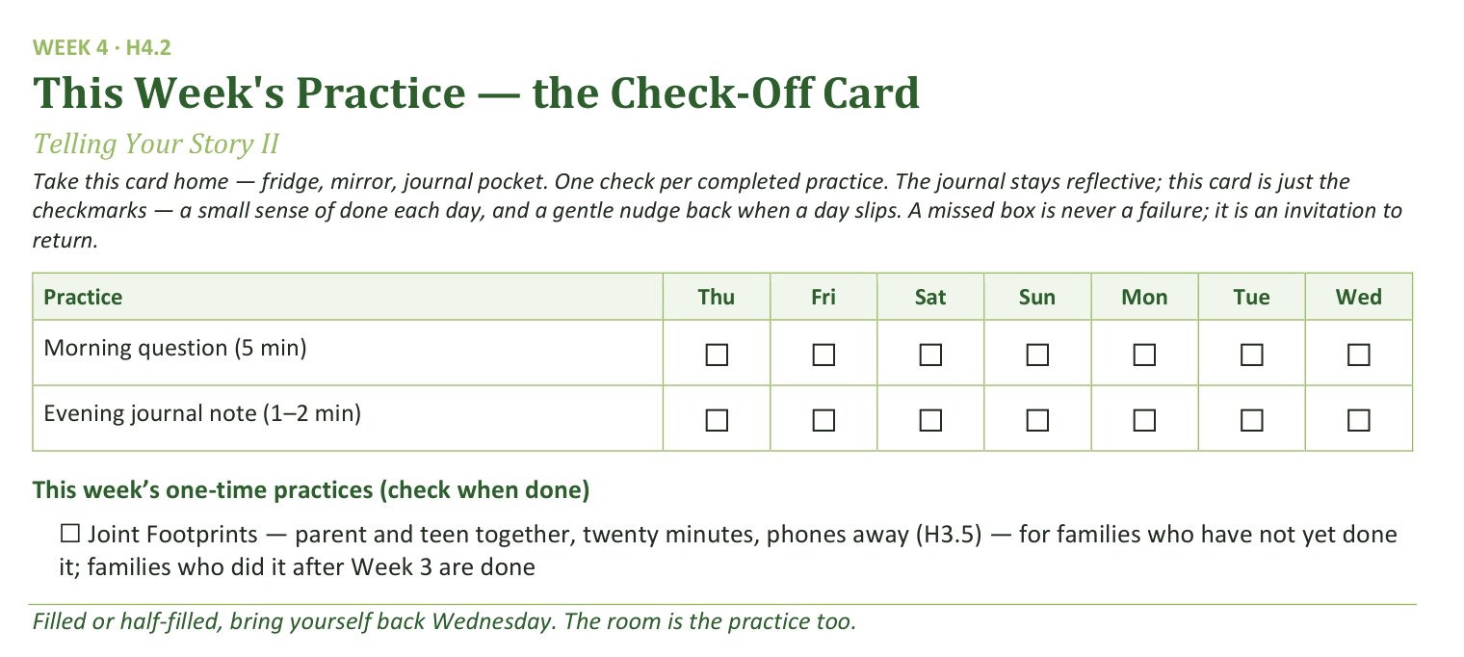
Your Take-Home Card — This Week’s Practice
Handed out now — fridge, mirror, journal pocket.
56
Notes:
W4 · 5:16–5:19 · SHARED
BEATS:
1. Check-off card (H4.2): daily morning question and evening note; the Joint Footprints box is only for families not yet done.
CUES: Rides inside the practice block.

Slide 57
The Leader Feedback Round
• The evening’s leader goes first — three things, same as every week
– “What I think went well tonight: ______”
– “What I’d do differently next time: ______”
– “If I were to teach tonight’s process to someone, I would tell them: ______”
• Then the room — the same two questions about tonight
• The leader receives without defending — “thank you” is the whole response
57
Notes:
W4 · 5:19–5:23 · SHARED
BEATS:
1. You frame it; the senior answers the three things FIRST, you answer the first two second; the room's feedback covers both.
2. Keep the room's words specific and for-you-shaped: 'the way you waited out the silence' is gold; 'you did great' is not.
3. Both leaders receive without defending — 'thank you.'
CUES: The team's one growth item was agreed in a ten-second sidebar during the merge — never improvised in front of the room; affirmations outweigh it in number and specificity. Think hard before dropping this round on a night a senior led — it is part of their formation.

Slide 58
Closing the Container + Aaronic Blessing
• We close the way we opened — the container, six steps:
1 Stand again — same circle, same posture as the open
2 One-word landing — compare it to your opening word
3 The one thing you are taking from tonight
4 The one practice — committed aloud, or modified to one you will actually keep
5 Blessings — specific, witnessed, short
6 Closing prayer — and the Aaronic blessing, spoken over each other, face to face
THE AARONIC BLESSING — NUMBERS 6:24–26
“The Lord bless you and keep you;
the Lord make his face to shine upon you, and be gracious to you;
the Lord lift up his countenance upon you, and give you peace.”
58
Notes:
W4 · 5:23–5:30 · SHARED
BEATS:
1. The senior closes from the card: your story goes home with you, nobody else's; help named; Aaronic blessing; 'Go gently this week.'
2. Adults stay accessible ten minutes after, as always.
CUES: Find the senior privately before they leave: one sentence of thanks, one question — 'How are you, after that?' — and a listen. No coaching today; that waits for the debrief and the Lab.

Slide 59

WEEK 5
Knowing and Being Known
The four conditions of a container, applied to your real friendships
Quarter 1: Connect with Self & Others
59
Notes:
W5 · pre-session · DIVIDER
On screen as families arrive. Greet at the door — the slide holds the room.

Slide 60
Week 5 — Tonight’s Road
1 Welcome and centering
2 Week 4 check-in
3 The four conditions — teaching
4 Bridge to split
5 Friendship-mapping exercise
6 Merge and surface common patterns
7 Between-session practice
8 The Leader Feedback Round
9 Closing container
60
Notes:
W5 · 4:15–5:30 · SHARED
BEATS:
1. Movement two begins: Connect with Others. Today names the four conditions that have been holding this room — Safe, Present, Clear, Intentional — then maps them onto real friendships in clusters.
2. Shape: open, check-in, 15-minute whiteboard teaching, bridge, 28-minute friendship-mapping, merge patterns, practice, feedback, close.
3. Risk profile is nearer Week 2 than Week 3 — but 'I don't have a single friend who knows me' from a teen is its own quiet emergency; receive it and follow up within 48 hours.
CUES: Whiteboard pre-written vertically: SAFE / PRESENT / CLEAR / INTENTIONAL. Opening parent arranged per cluster.

Slide 61
Opening Container — the Eight Steps
1 Welcome — five minutes to open the container
2 Phones silenced and put away
3 Stand in a circle
4 One-word check-in — how you actually are, right now
5 Put out / bring in — set something down; bring a blessing in
6 Spoken commitment: “I am here. I am paying attention. I am willing to be moved.”
7 Opening prayer — “Holy Spirit, you are welcome here. Speak. We are listening.”
8 Sit. Begin.
61
Notes:
W5 · 4:15–4:23 · SHARED
BEATS:
1. Blessing over the room; let it settle first.
2. Frame: the first four weeks were Connect with Self — the soil, then the story told all the way around, parents first. Today begins Others; two weeks here.
3. Today we make visible the four conditions that have been quietly holding our work — then ask where else each is present in our lives, and where missing.
4. Container reminders, briefly: what is said here stays here; nothing required; we listen to receive, not to fix.

Slide 62
Week 4 Check-In — Joint Footprints
• “Some of you got to it. Some didn’t. Both are fine.”
• “Anyone want to say one sentence about how that landed for you?” — an arranged parent starts
• Receive without commentary
• “Good. Some of that work continues whether or not we got to it this week.”
62
Notes:
W5 · 4:23–4:28 · SHARED
BEATS:
1. Brief check on Joint Footprints across both runnings: one sentence on how it landed; the arranged parent starts.
2. Take 3–4 voluntary contributions; receive without commentary.
3. Move on: 'Some of that work continues whether or not we got to it this week.'

Slide 63
The Four Conditions
• The threefold cord is stronger because the strands hold each other in tension — the strength is in the holding
• Four conditions have been quietly holding this room for four weeks. Tonight we name them
1 SAFE — the hearing condition. “I will not be judged as a person while I am doing my work” — Romans 14:3–4
2 PRESENT — the attention condition. “I am actually here” — aware that the Great I AM is also here — Revelation 1:8
3 CLEAR — the channel condition. Nothing unaddressed between God and me, or the circle and me — Matthew 7:5
4 INTENTIONAL — the obedience condition. On purpose, watching for what God is doing, willing to do it — John 5:19
ECCLESIASTES 4:9–12
“Two are better than one, because they have a good reward for their toil. For if they fall, one will lift up his fellow. … And though a man might prevail against one who is alone, two will withstand him—a threefold cord is not quickly broken.”
63
Notes:
W5 · 4:28–4:42 · SHARED
BEATS:
1. Read Ecclesiastes 4:9–12 — the threefold cord's strength is in the holding.
2. Walk each condition 2–3 minutes at the whiteboard: SAFE, the hearing condition (not judged while doing my work — Rom 14:3–4); PRESENT, the attention condition (actually here — Rev 1:8); CLEAR, the channel condition (nothing unaddressed — Matt 7:5); INTENTIONAL, the obedience condition (willing to do what He shows — John 5:19).
3. Teach lightly — the cluster exercise does the depth work.
GUARD: This is not friendship tips. Stay with the four conditions as defined, and do not run long — the mapping block needs its full 28 minutes.

Slide 64
Bridge to the Split
• Each cluster takes the four conditions and asks: “for each one, where in my actual friendships does this show up? And where is it missing?”
• “We are not naming names tonight. ‘One of my friends’ is fine.” — we map conditions, not people
• Your Companion goes first on every condition, then one of the parents opens the round
• Teens, you choose your own depth. Pass anytime
• Twenty-eight minutes — same rooms as the last two weeks
64
Notes:
W5 · 4:42–4:43 · TRANSITION
BEATS:
1. Frame the exercise: for each condition — where does it show up in my actual friendships, and where is it missing? Worksheets are on the chairs.
2. Name the language rule: no names — 'one of my friendships,' 'one adult relationship in my life.'
3. Pray and send: same rooms; back at 5:11. Ten or fewer — stay one circle.
CUES: In each cluster the Companion goes first on every condition, then the arranged parent opens; teens choose their own depth after; pass anytime.

Slide 65

Friendship-Mapping in Family Clusters
• Four conditions, about six minutes each — the Companion models first, the arranged parent opens the round
• Each turn 30–60 seconds — specific: one friendship where the condition is present, one where it is missing
• “No names of people who aren’t in this room — and for people who are, ‘one of my friendships’ or ‘one adult relationship in my life’ is the language. Nobody asks who you meant.”
• Parents map their own adult friendships — not their teens’
• If time remains, the quiet final question: “Of the four conditions, which one is the one I find hardest to offer to my friends?”
65
Notes:
W5 · 4:43–5:11 · CLUSTERS
BEATS:
1. About six minutes per condition: Companion models 30–60 seconds (one friendship where it is present, one where missing — specific), the arranged parent opens, then around; pass allowed.
2. After each round the Companion names one observation and moves on — no summarizing, no evaluating.
3. Finish early: the harder question, silent, two minutes — which condition am I hardest at OFFERING?
CUES: Minute four with three unspoken — compress: 'Two minutes left on this one, quick rounds.'
GUARD: Real names get gently re-framed. The relationship a teen maps may be the parent beside them — hold the anonymous frame both ways: nobody asks who was meant, in the circle or afterward. A teen with no friendship in any condition: receive, do not rescue, flag for the Lead Companion. Parents map their OWN friendships, not their teen's.

Slide 66
Merge — Surfacing Common Patterns
• What happened in your cluster stays in your cluster
• Patterns only — general, no names: “Many of us noticed Safety is the rarest condition in our friendships”
• Each Cluster Companion takes ninety seconds — one or two general patterns from their circle
• Then the Lead Companion names one observation across the clusters — “that is real, and it is the seed of the practice this week”
66
Notes:
W5 · 5:11–5:18 · SHARED
BEATS:
1. Patterns only, no people: each Cluster Companion takes ninety seconds — 'many of us noticed Safety is the rarest condition.'
2. You close with one true cross-cluster observation, briefly — the actual one, e.g. 'most of us name what is missing from our friendships faster than what we ourselves don't offer.'
GUARD: Pattern-level means pattern-level — nothing from any individual's mapping crosses cluster lines.

Slide 67
Between-Session Practice — One Friendship, One Condition
• “Pick one friendship in your life. Just one.” — you don’t have to tell anyone which one
• Pick one of the four conditions — the one most missing there, or the one you find hardest to offer
• Practice that one condition in that one friendship more intentionally than usual this week — practically
– Presence — your phone is in another room. Clear — name something you have been quietly carrying
• “One friendship. One condition. Practice. Journal what happens.” — the Week 5 journal pages carry the card
• The morning question and evening journal note continue daily
67
Notes:
W5 · 5:18–5:21 · SHARED
BEATS:
1. Pick one friendship — yours alone, told to no one. Pick one condition: the most missing, or the hardest to offer.
2. Practice it more intentionally than usual this week — give the concrete versions: phone in another room for Present; receive without judging for Safe; name a carried thing for Clear; come in watching for what God is doing for Intentional.
3. Journal what happens — the Week 5 pages have prompts; H5.5 has the practice in writing.

Slide 68
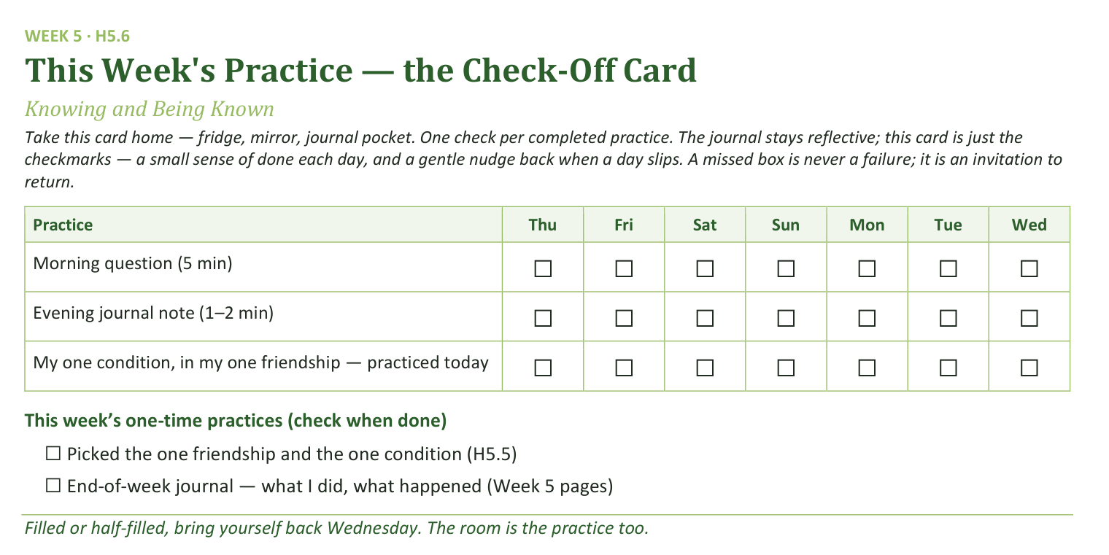
Your Take-Home Card — This Week’s Practice
Handed out now — fridge, mirror, journal pocket.
68
Notes:
W5 · 5:18–5:21 · SHARED
BEATS:
1. Check-off card (H5.6): daily morning question, evening note, and the one-condition practice; two one-time boxes.
2. A missed box is never a failure — it is an invitation to return.
CUES: Rides inside the practice block.

Slide 69
The Leader Feedback Round
• The evening’s leader goes first — three things, same as every week
– “What I think went well tonight: ______”
– “What I’d do differently next time: ______”
– “If I were to teach tonight’s process to someone, I would tell them: ______”
• Then the room — the same two questions about tonight
• The leader receives without defending — “thank you” is the whole response
69
Notes:
W5 · 5:21–5:25 · SHARED
BEATS:
1. Your three things first: went well; do differently; what I'd tell someone teaching today's process.
2. Then the room's two questions; two or three voices is plenty.
3. Receive without defending — 'thank you' is the whole response.
CUES: May be dropped if the room needs something else; twice running goes to the team debrief.

Slide 70
Closing the Container + Aaronic Blessing
• We close the way we opened — the container, six steps:
1 Stand again — same circle, same posture as the open
2 One-word landing — compare it to your opening word
3 The one thing you are taking from tonight
4 The one practice — committed aloud, or modified to one you will actually keep
5 Blessings — specific, witnessed, short
6 Closing prayer — and the Aaronic blessing, spoken over each other, face to face
THE AARONIC BLESSING — NUMBERS 6:24–26
“The Lord bless you and keep you;
the Lord make his face to shine upon you, and be gracious to you;
the Lord lift up his countenance upon you, and give you peace.”
70
Notes:
W5 · 5:25–5:30 · SHARED
BEATS:
1. 'What was named today is yours. The friendships you mapped are yours. Carry it gently this week.'
2. Name the open door: anyone who noticed they have no friendships with these conditions — reach out to the team; that is real, and not a problem to solve in five seconds.
3. Aaronic blessing. 'See you Wednesday.'

Slide 71
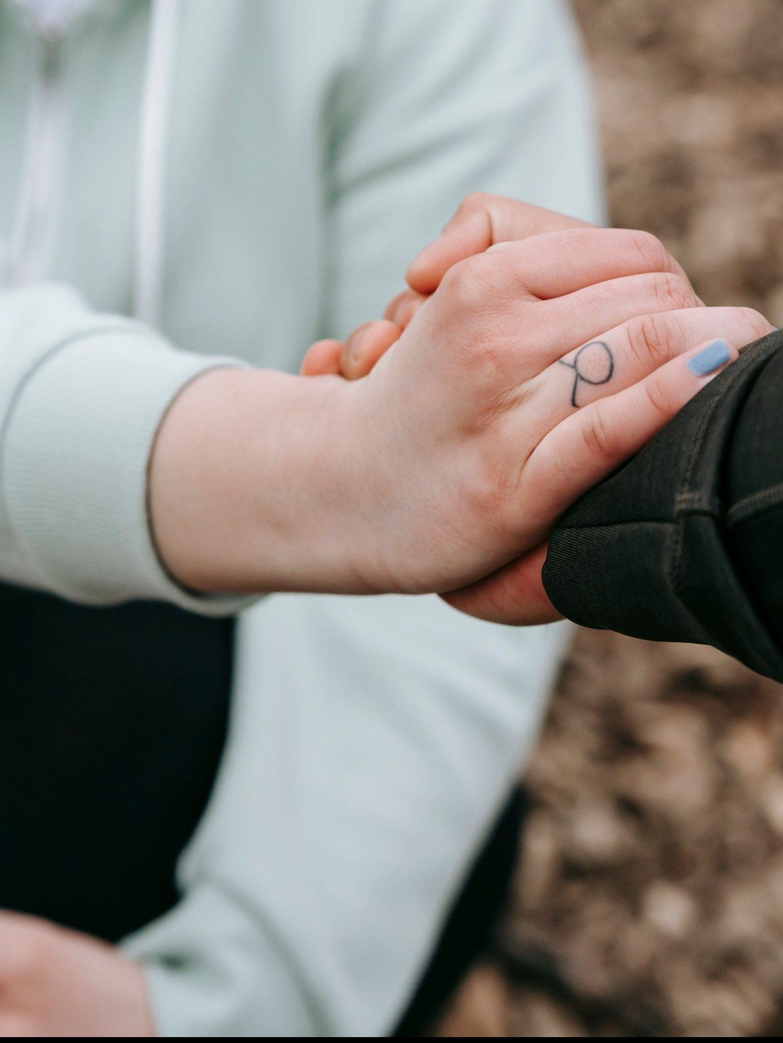
WEEK 6
Safe and Brave Together
Confession and restoration in an age-appropriate community
Quarter 1: Connect with Self & Others
71
Notes:
W6 · pre-session · DIVIDER
On screen as families arrive. Greet at the door — the slide holds the room.

Slide 72
Week 6 — Tonight’s Road
1 Welcome and centering
2 Wk 5 check-in
3 James 5:16 and 1 John 1:9 — confession as architecture
4 Companion demo
5 Bridge to the split
6 Confession-and-restoration in family clusters
7 Merge and shared blessing
8 Between-session practice + the room’s question
9 The Leader Feedback Round
10 Closing container
72
Notes:
W6 · 4:15–5:30 · SHARED
BEATS:
1. Confession-and-restoration night — second-highest-risk after Weeks 3–4. Section 6 re-read beforehand; backup on call 6:30–11:00; tissues in every space.
2. Shape: open, check-in, 13-minute teaching, YOUR demo, bridge, 33-minute cluster practice (Companion, then parents, then teens), merge and shared blessing, Examen plus Quarterly Pulse, feedback, close. Quarter 1 ends today.
3. Every parent was pre-briefed this week: own struggles, yes; the marriage's raw material, no; anything about the teen, never without asking the teen privately first.
GUARD: Frame it three times before the split: not specific sins — the place, the pattern, the pull.

Slide 73
Opening Container — the Eight Steps
1 Welcome — five minutes to open the container
2 Phones silenced and put away
3 Stand in a circle
4 One-word check-in — how you actually are, right now
5 Put out / bring in — set something down; bring a blessing in
6 Spoken commitment: “I am here. I am paying attention. I am willing to be moved.”
7 Opening prayer — “Holy Spirit, you are welcome here. Speak. We are listening.”
8 Sit. Begin.
73
Notes:
W6 · 4:15–4:21 · SHARED
BEATS:
1. Blessing; container reminder; nothing is required.
2. Say what today is NOT: we will not confess specific sins to each other in detail — scripture does not ask it, and neither do we.
3. Say what it IS: each of us names one place where we want to walk in greater honesty; the circle speaks a blessing of restoration; about three minutes per person; parents first, on purpose.
4. 'Teens, you choose your depth, and the pass is always real. The Spirit does the work; we hold the space.'

Slide 74
Week 5 Check-In
• “Last week we did the friendship audit and committed to one condition, one friendship, one week.”
• “One sentence about how that practice landed.” — an arranged parent starts
• Two or three voices is plenty — optional, no pressure
74
Notes:
W6 · 4:21–4:25 · SHARED
BEATS:
1. Ninety seconds: one sentence on how the one-friendship, one-condition practice landed; the arranged parent starts.
2. Take 2–3 voluntary contributions. Do not ask for more; move on.

Slide 75
Confession as Architecture
• Two verses, two angles — 1 John 1:9 is vertical: confession to God, with full assurance. James 5:16 is horizontal: confession to one another, for healing
• Most Christians live in 1 John 1:9 and never enter James 5:16. Tonight we enter it carefully and at age
• Patterns we hide from each other tend to keep their grip — bringing them into the light, in front of trusted people, is part of what breaks it
• Not detailed sin disclosure — each person names ONE place where they want to walk in greater honesty: the place, the pattern, the pull
• The parents go first in every cluster — the older generation owes the younger the demonstration
• After each naming, the circle speaks a specific blessing of restoration — about three minutes per person
JAMES 5:16 · 1 JOHN 1:9
“Therefore, confess your sins to one another and pray for one another, that you may be healed. The prayer of a righteous person has great power as it is working.”
“If we confess our sins, he is faithful and just to forgive us our sins and to cleanse us from all unrighteousness.”
75
Notes:
W6 · 4:25–4:32 · SHARED
BEATS:
1. Read James 5:16 and 1 John 1:9 aloud, slowly, from the physical Bible.
2. Two angles: 1 John is vertical, with full assurance — the cross secured it (1 John 1:7); James is horizontal, in community, for healing. Most Christians never enter James 5:16; today we do, carefully and at age.
3. Give the examples of a 'place': the fear-over-trust pattern, the way I treat my brother, the performed faith, the resentment I keep feeding.
4. Say the parents-first rationale plainly: the older generation owes the younger the demonstration — a teen should never be asked to be braver than their parents were three minutes earlier.
GUARD: Not Catholic-sacramental confession — a Protestant small group doing what James 5:16 says. 'The place, not the details' — this is one of the three required framings; keep count.

Slide 76
Companion Demo
• The Lead Companion does the practice in front of the whole room — this sets the depth and the form
• One sentence: “The place where I want to walk in greater honesty is ______.” Real but not graphic
• Pause. A pre-arranged Co-Companion speaks a brief blessing of restoration back
• Receive it — no deflecting, no joking, no minimizing. “Thank you.”
• “That is the practice. You will do it in your cluster — parents first, then teens. Yours doesn’t have to look like mine.”
76
Notes:
W6 · 4:32–4:37 · SHARED
BEATS:
1. Stand; eye contact across the room. 'The place where I want to walk in greater honesty is ___.' One place, specific, real but not graphic.
2. Pause; a PRE-ARRANGED Co-Companion speaks the three-sentence blessing back.
3. Receive it — no deflecting, no joking, no minimizing. 'Thank you.' Sit down.
4. Close: 'That is the practice. Parents first, then teens. Yours doesn't have to look like mine. Three minutes per person.'
SUB: The demo is the leader's own material. Name YOUR one real place, written and rehearsed this week — never borrow the founder's — and arrange your blessing-giver before the session.

Slide 77
Bridge to the Split
1 “Take what helps from the prompts. You don’t have to use any of them.”
2 The blessing card — specific, short, witnessed: “In the name of Jesus, we pray restoration over...”
3 “The container holds. Nothing leaves the cluster. Not even back to the main room. Especially this week.”
• The order holds too: your Companion first, then the parents, then the teens
• “Teens — your depth is yours, and pass is always allowed.”
77
Notes:
W6 · 4:37–4:38 · TRANSITION
BEATS:
1. Three things: the prompts are scaffolding — use or ignore; the blessing card has the form — specific, short, witnessed; the container holds — nothing leaves the cluster, especially this week.
2. Restate the order: Companion first, then the parents, then the teens — teens' depth is theirs; pass always allowed.
3. Pray and send. Ten or fewer: 'We're staying right here — one circle, same order, same rules.'

Slide 78
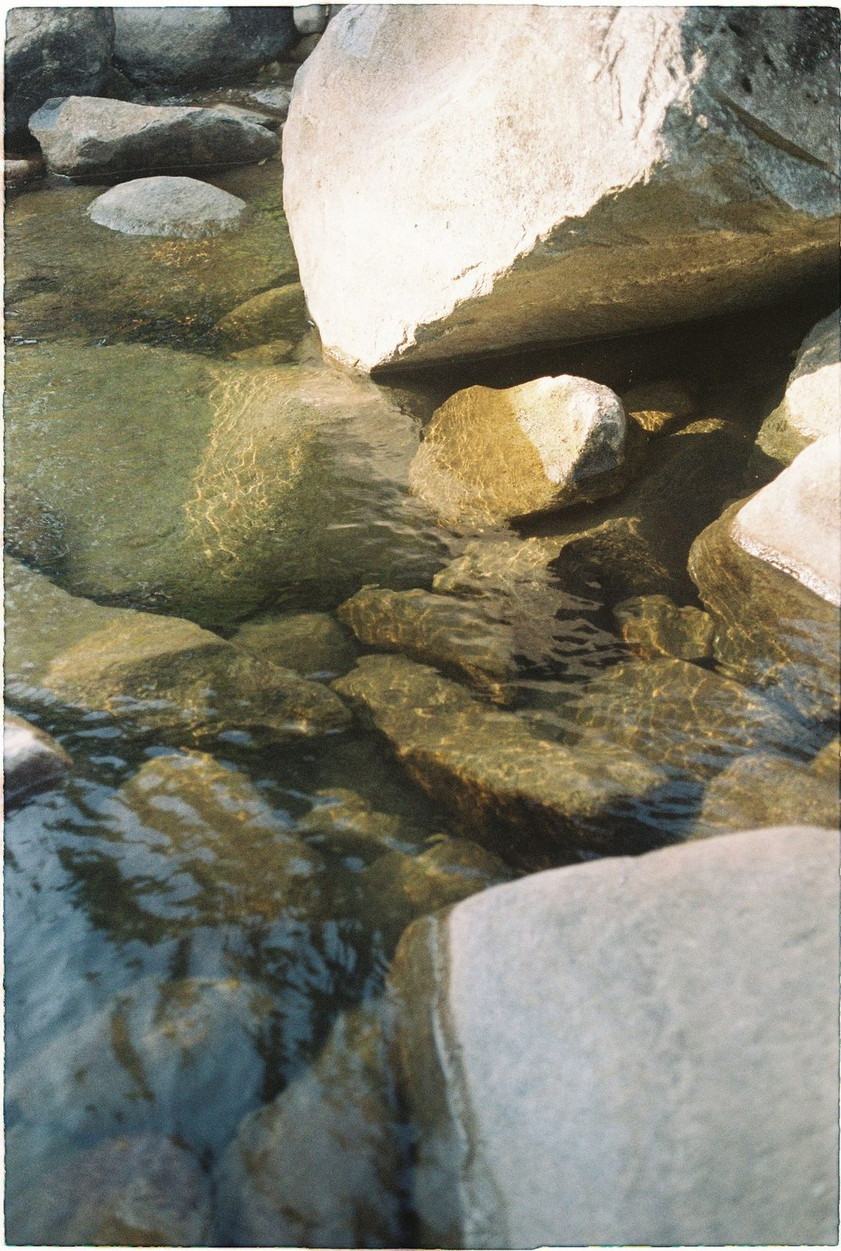
Confession and Restoration in Family Clusters
• Ninety seconds of silence to settle in — the silence is part of the practice
1 The Cluster Companion goes first — names one place, receives a blessing
2 The parents next — the arranged parent opens; own struggles only, within the rails
3 The teens — each names one place at whatever depth they choose. Pass is real, honored without a flicker
• The form: “The place where I want to walk in greater honesty before God is ______.”
• After each naming, a brief specific blessing — a teen blessing their own parent is one of the best things this night can produce
• Closing silence — “We have named real things tonight. Let’s sit with what was said.”
78
Notes:
W6 · 4:38–5:11 · CLUSTERS
BEATS:
1. The Companion opens with ninety seconds of silence, then goes first (3 min) and receives the pre-assigned blessing.
2. Parents next, arranged parent opening, within the rails; then the teens at their own depth — pass honored without a flicker. A teen blessing their own parent is one of the best things this night produces.
3. Pace: three minutes per person; a three-family cluster runs 2.5 from the start, not discovered at 5:03. Never skip anyone — compress before you cut.
4. Close with one to two minutes of held silence.
GUARD: Detailed sin disclosure gets the gentle redirect — 'the practice is the place, not the details.' A parent drifting past the rails: 'The rest belongs to the 1:1.' Watch the teens' faces during the parents' turns, not the confessing parent — weight received is a Settle Protocol matter; check in before anyone leaves the building.

Slide 79
Merge and Shared Blessing
• What happened in your cluster stays in your cluster
• “One word about what tonight was like in your body. ‘Heavy.’ ‘Lighter.’ ‘Held.’ ‘Tender.’ ‘Surprised.’” — an arranged parent starts
• Then one shared blessing of restoration over the whole room — “Hands up if you want”
• “We pray restoration into every place that was named... Holy Spirit, walk these brothers and sisters home.”
79
Notes:
W6 · 5:11–5:15 · SHARED
BEATS:
1. Settle the room. One word each on what today was like IN YOUR BODY — 'heavy', 'lighter', 'held', 'tender'; the arranged parent starts.
2. Speak the one corporate blessing of restoration over the whole room (script in the plan): real places named, restoration prayed into each, courage carried to Wednesday morning when the place will still be the place.
GUARD: Nothing from any cluster is asked for or repeated.

Slide 80
Between-Session Practice — the Five-Minute Examen
• The Five-Minute Examen — five minutes with God each evening, before bed, carried through the quarter break
1 Thank Him for one specific thing from the day
2 Notice one place where you saw God moving
3 Ask Him about one place where you walked in less honesty than you wanted to today — just notice. No fixing
• The Quarterly Pulse goes home tonight — three questions, five minutes, sign it or leave it anonymous
• It comes back to the bin at the door at Week 7
80
Notes:
W6 · 5:15–5:21 · SHARED
BEATS:
1. Parent Co-Companion leads. Five-Minute Examen each evening: thank Him for one specific thing; notice one place you saw God moving; ask Him about one place you walked in less honesty than you wanted today.
2. No fixing — just notice; the Spirit does the work. Carried through the quarter break.
3. Quarterly Pulse (H6.3) goes home today: three questions, five minutes, signed or anonymous — back in the bin at the Week 7 door.

Slide 81
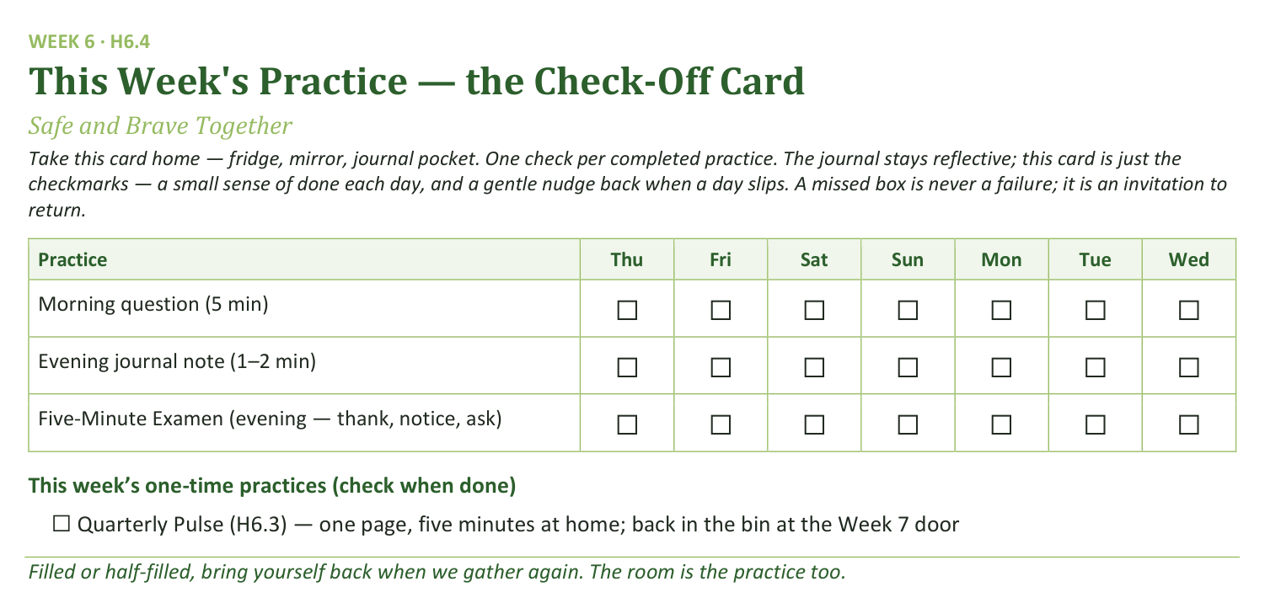
Your Take-Home Card — This Week’s Practice
Handed out now — fridge, mirror, journal pocket.
81
Notes:
W6 · 5:15–5:21 · SHARED
BEATS:
1. Check-off card (H6.4): morning question, evening note, nightly Examen; one-time box for the Pulse.
2. 'Filled or half-filled, bring yourself back when we gather again.'
CUES: Rides inside the practice block — make sure every family leaves with a Pulse page.

Slide 82
Three Questions, Carried Home
Every week we close the same way — the leader’s reflection, then the room’s. Tonight closes a whole quarter, so the same questions come home for all of us:
1 What’s working well that we ought to keep doing next quarter?
2 What could we do differently that would make things even better?
3 What would you tell somebody else about what this group is like?
No paper. Nothing to prepare. The group, never any one person. First night back, we talk.
82
Notes:
W6 · 5:15–5:21 · SHARED
BEATS:
1. After the Examen and the Pulse: 'three questions go home tonight — no paper, no deadline, nothing to prepare.' Frame it as the round the room already knows, grown one size: the leader's questions, asked of all of us.
2. Read the three slowly. Then the runway for the quiet ones: 'some of you think best in the quiet — that's why they go home two weeks early.'
GUARD: the group, never any one person — said warmly, once. An offer, never an assignment; the journal's Week 6 page carries the questions for anyone who wants to write toward them.
ADVANCE CUE: after 'first night back, we talk.'

Slide 83
The Leader Feedback Round
• The evening’s leader goes first — three things, same as every week
– “What I think went well tonight: ______”
– “What I’d do differently next time: ______”
– “If I were to teach tonight’s process to someone, I would tell them: ______”
• Then the room — the same two questions about tonight
• The leader receives without defending — “thank you” is the whole response
83
Notes:
W6 · 5:21–5:24 · SHARED
BEATS:
1. Your three things first; then the room's two questions; receive without defending — 'thank you.'
2. On a night this heavy, read the room — a quiet, brief running usually lands better than skipping: the leader asking 'what would you do differently?' minutes after everyone confessed is the same muscle the room just practiced.

Slide 84
Closing the Container + Aaronic Blessing
• We close the way we opened — the container, six steps:
1 Stand again — same circle, same posture as the open
2 One-word landing — compare it to your opening word
3 The one thing you are taking from tonight
4 The one practice — committed aloud, or modified to one you will actually keep
5 Blessings — specific, witnessed, short
6 Closing prayer — and the Aaronic blessing, spoken over each other, face to face
THE AARONIC BLESSING — NUMBERS 6:24–26
“The Lord bless you and keep you;
the Lord make his face to shine upon you, and be gracious to you;
the Lord lift up his countenance upon you, and give you peace.”
84
Notes:
W6 · 5:24–5:30 · SHARED
BEATS:
1. 'Today's container is heavier than usual. We hold it tighter than usual.' Nothing leaves the cluster.
2. Name the follow-up door: email, text, knock — the team is here.
3. Aaronic blessing. 'Go gently. Today closes the quarter — carry the Examen through the break; bring the Pulse back to the Week 7 door.'
CUES: Do not pack up — stay accessible at least ten minutes; this night produces door conversations more than any other.

Slide 85
Quarter 2
Connect with God
Weeks 7–11 · Five Wednesdays · PROAPT, the Garden, Any Doubts? · ends at the year’s midpoint
85
Notes:
QUARTER 2 · pre-session · DIVIDER
On screen as families arrive for the quarter's first Wednesday. Greet at the door — the slide holds the room.

Slide 86

WEEK 7
Hearing God in Scripture — PROAPT I
PROAPT — the systematic practice of hearing; the first walk-through, received before it is led
Quarter 2: Connect with God
86
Notes:
W7 · pre-session · DIVIDER
On screen as families arrive. Greet at the door — the slide holds the room.

Slide 87
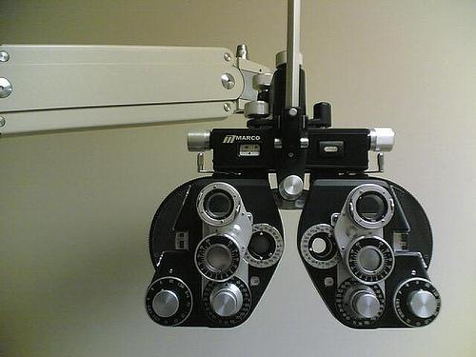

Week 7 — My Story: The Eye Test
“The more I obey what I have heard, the finer print I can read.”
— the founder’s story, told live
Hearing God is a practice that grows with obedience — tonight we learn the practice.
87
Notes:
W7 · 4:15–4:21 · SHARED
BEATS: 1. This is John's personal eye-test story — his own testimony of learning to hear God, framing today's turn from Self and Others toward God. 2. Keep it to about one minute; the story serves the practice, not the reverse. 3. Land it and move to Today's Road.
SUB: Never perform someone else's testimony. Tell your own hearing-growth story in one minute — or skip straight to the pull-quote on the slide, read it, and move.

Slide 88
Week 7 — Tonight’s Road
1 Welcome and centering
2 Re-entry — and the room reads itself
3 Romans 10:17 — the chain
4 PROAPT walked together
5 Bridge to the clusters and pair structure
6 PROAPT in family pairs in family clusters
7 Tell step — sharing in the cluster
8 Merge and between-session
9 The Leader Feedback Round
10 Closing container
88
Notes:
W7 · 4:15–4:21 · SHARED
BEATS: 1. Walk the road briefly: re-entry check-in, Romans 10:17, PROAPT walked together, then family pairs and the Tell step. 2. Frame the turn: six weeks of Self and Others behind us; today the channel goes vertical — hearing God in scripture. 3. Name it now: PROAPT is a hearing practice, not a Bible study technique.
CUES: First night back after the quarter break — Pulse 1 returns go in the bin at the door.

Slide 89
Opening Container — the Eight Steps
1 Welcome — five minutes to open the container
2 Phones silenced and put away
3 Stand in a circle
4 One-word check-in — how you actually are, right now
5 Put out / bring in — set something down; bring a blessing in
6 Spoken commitment: “I am here. I am paying attention. I am willing to be moved.”
7 Opening prayer — “Holy Spirit, you are welcome here. Speak. We are listening.”
8 Sit. Begin.
89
Notes:
W7 · 4:15–4:21 · SHARED
BEATS: 1. Aaronic blessing first. 2. Container restated SLOWLY — Safe, Present, Clear, Intentional; a container that sat empty over a break needs a minute to hold again. 3. Frame Week 7 as a turn: the interior work prepared us; today hearing God becomes a learnable skill — six steps, a practice that works.
CUES: Run the re-entry gently; let the room land before moving on.

Slide 90
Re-Entry Check-In
• First gathering of Quarter 2 — the container re-held slowly after the break
• “Take ninety seconds: one sentence about the Examen, or about how the break treated your practice, or anything that has shifted.”
– “Thinned out over the break is a completely normal answer — the practice picks up where you are.”
• A parent starts the round — pass-anytime holds
• Week 6 still sitting heavy? “The team is here. Find one of us before you leave tonight.”
90
Notes:
W7 · 4:21–4:31 · SHARED
BEATS: 1. Ninety seconds each: one sentence on the Examen, how the break treated the practice, or anything shifted. 2. Say it: 'thinned out over the break' is a completely normal answer — the practice picks up where you are. 3. Take 2–3 contributions, then move. 4. Open door: anyone still carrying Week 6, find a Companion before leaving today.
CUES: Arranged parent opens (check the Run Card) — never cold-call a teen; pass-anytime holds.

Slide 91
The Round, for All of Us
Same process as every week’s leader reflection — now for the group:
1 What’s working well that we ought to keep doing next quarter?
2 What could we do differently that would make things even better?
3 What would you tell somebody else about what this group is like?
The leader answers first, same as always. Any question, any order.
91
Notes:
W7 · 4:21–4:31 · SHARED
BEATS:
1. After the break check-in: 'the three questions that went home two weeks ago — let's apply the process we use for the leader reflection to ourselves, as a group.' One rule, warmly: the group, never any one person.
2. The leader answers FIRST — all three, briefly, a story or moment attached to each. Modeling that answers come with what you saw is the whole teaching.
3. The room answers, any question, any order; the Co-Companion scribes keep · change · tell for tonight's debrief sheet. Thursday's Call maps their answers to the three signs — the team's side of the paper, never the room's.
CUES: a bare verdict → 'say more — what did that look like?' · drifts toward a person → 'the group, never any one person — if something needs a name, bring it to one of us after.'
POCKET (only if a gap matters): 'when hard things landed this quarter, how did we do?' · 'what would a brand-new family feel in their first ten minutes with us?'
GUARD: receive everything without correcting — glowing or grim, it is data, not a draft the team edits. Close: 'a group that knows what it has can choose to keep it.'
SUB: the answers modeled first are the leader's own — a substitute answers honestly for themselves.

Slide 92
Romans 10:17 — The Chain
• One short verse, three steps: Word → Hearing → Faith — the order matters
• Not trying harder, not emotional experience — faith is a fruit of a particular practice
• How much of our “Bible time” is actually hearing, and how much is reading without hearing?
• Hearing is a skill — skills develop with practice
• The practice: PROAPT — Pray, Read, Observe, Apply, Pray again, Tell (Truro Church, 1980s)
ROMANS 10:17
“So faith comes from hearing, and hearing through the word of Christ.”
92
Notes:
W7 · 4:31–4:37 · SHARED
BEATS: 1. Read Romans 10:17 aloud, slow. 2. Teach the chain: Word, Hearing, Faith — faith is the fruit of a practice, not of trying harder. 3. John 10:27 — the sheep hear because they are His; the quiet road is still open, any Wednesday, any Companion. 4. Hearing is a skill; write PROAPT on the board: Pray, Read, Observe, Apply, Pray again, Tell. 5. Preview: whole room works Mark 1:14–20 together, then family pairs work the same passage.

Slide 93

PROAPT Walked Together — Mark 1:14–20
1 Pray — “Holy Spirit, you are welcome here. Speak. We are listening.”
2 Read — slowly, to receive it; don’t analyze yet
3 Observe — two layers, in order: first the data (who, what, when, where — straight off the page), then the interpretation — what stands out or surprises you in it
4 Apply — “What does this passage mean FOR YOU, TODAY, in your specific life?” — logos becomes rhema
5 Pray again — tell God what you heard, what you are willing to do, what you’re struggling to be willing to do
6 Tell — the most-often-skipped step; hearing spoken aloud has a different staying power
93
Notes:
W7 · 4:37–4:47 · SHARED
BEATS: 1. The most important teaching block of the night — walk all six steps on Mark 1:14–20, everyone on handout H7.2. 2. PRAY 90s (silence, then invite the Spirit aloud). READ 90s. OBSERVE 3 min — data first, then what surprises; take 3–4 shares, receive without evaluating. 3. APPLY 3 min — for YOU, today, specifically; 2–3 shares. 4. PRAY AGAIN 90s silence. TELL 60s — happens in the clusters later. 5. Hold the silences; do not rush.
CUES: If an Apply goes vague or grand, push gently for one specific concrete application.

Slide 94
Bridge to the Clusters — Pair Structure
• Pair up in your family cluster — parent with teen, from your own family, by default
• One Reader, one Listener — Reader leads the six steps; after twelve minutes, switch
• “Pairing up with your own parent or your own teen is not the consolation-prize version — it is the design working.”
• Your Cluster Companion settles the pairs and completes any odd numbers
• Small room (about ten or fewer)? Stay as one circle and pair up in place
94
Notes:
W7 · 4:47–4:48 · TRANSITION
BEATS: 1. Explain the pair shape: parent with your own teen by default; one Reader, one Listener; switch at twelve minutes. 2. Name it: pairing inside your own family is the design working, not the consolation prize. 3. Pray and send.
CUES: Cluster Companions settle odd numbers across families. If the room is about ten or fewer, skip the clustering — one circle, pair up in place.

Slide 95
PROAPT in Family Pairs
1 First pass (12 min) — Reader leads PROAPT; Listener works alongside without interrupting
2 Reader’s Tell at the end goes to the Listener — one sentence
3 Switch roles — new passage or stay with Mark 1
4 Second pass (12 min) — same structure, roles reversed
• Stuck on Observe? “What’s one specific word or phrase that caught your attention?”
• “Slow down. The Spirit isn’t in a hurry.” — and if you finish early, get reps with another passage
95
Notes:
W7 · 4:48–5:13 · PAIRS
BEATS: 1. First pass 12 min: Reader leads the six steps, Listener works alongside without interrupting; Reader's Tell goes to the Listener, one sentence. 2. Switch roles; second pass 12 min, same or new passage. 3. Companions float: stuck on Observe — 'one word or phrase that caught you'; stuck on Apply — 'one specific situation right now'; rushing — 'the Spirit isn't in a hurry'; finished early — another passage, get reps.
CUES: If something heavy surfaces, honor it briefly and follow up after the close — do not process it in the pair.

Slide 96
Tell Step — Sharing in the Cluster
• Back in the family cluster — each of us tells ONE specific thing we heard tonight
• “Specific. One sentence. We listen to receive, like Week 3.”
• A parent opens the round — arranged beforehand, never a cold call on a teen; pass-anytime holds
• Receive without preaching — “We hear that.” “Thank you for naming that.”
• “What we heard tonight is not just for us — it is given to us to walk out.”
96
Notes:
W7 · 5:13–5:19 · CLUSTERS
BEATS: 1. Re-form clusters out of pairs. 2. Each person tells ONE specific thing they heard today — one sentence, witnessed. 3. Receive each with 'We hear that' or 'Thank you for naming that' — no preaching, no interpreting. 4. Close the cluster: what we heard is given to be walked out this week.
CUES: Arranged parent opens the round (check the Run Card) — never cold-call a teen; teens choose their own depth; pass-anytime holds.

Slide 97
Merge and Between-Session Practice
• One word each — not what you heard (that’s yours), but what tonight’s practice was like; a parent begins
• Daily PROAPT — one passage per day, every day, for the next week — five to ten minutes
• The journal Week 7 pages have a daily PROAPT template
• Passage paths on the handout — the Gospel of Mark, the Sermon on the Mount, or Romans 8
• Commit aloud to a specific time of day — “Morning before school” / “Right after dinner”
• “The chain only works if we work it.”
97
Notes:
W7 · 5:19–5:21 · SHARED
BEATS: 1. One word each — not what you heard (that is yours), but what the practice was like. 2. Introduce daily PROAPT: one short passage, five to ten minutes, every day — the journal Week 7 pages have the template. 3. Hold up H7.3: passage paths for teens and parents. 4. 'The chain only works if we work it.'
CUES: Arranged parent begins the word round; anyone may pass.

Slide 98
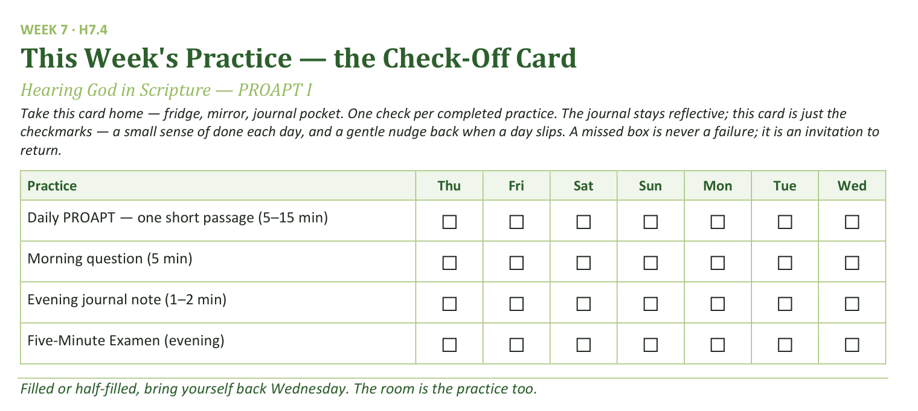
Your Take-Home Card — This Week’s Practice
Handed out now — fridge, mirror, journal pocket.
98
Notes:
W7 · 5:19–5:21 · SHARED
BEATS: 1. Send the check-off card home — fridge, mirror, journal pocket. 2. Four rows this week: daily PROAPT (the new anchor practice), morning question, evening note, Five-Minute Examen. 3. A missed box is never a failure — it is an invitation to return. 4. Ask each person to name a specific time of day for their PROAPT aloud — the spoken commitment makes the practice happen.

Slide 99
The Leader Feedback Round
• The evening’s leader goes first — three things, same as every week
– “What I think went well tonight: ______”
– “What I’d do differently next time: ______”
– “If I were to teach tonight’s process to someone, I would tell them: ______”
• Then the room — the same two questions about tonight
• The leader receives without defending — “thank you” is the whole response
99
Notes:
W7 · 5:21–5:24 · SHARED
BEATS: 1. Same round every week, leader first: what went well today; what I'd do differently; what I'd tell someone teaching this process. 2. Then the room, same two questions — two or three voices is plenty. 3. Receive without defending — 'thank you' is the whole response.
CUES: May be dropped if the room's energy needs something else; dropping it twice running goes to the team debrief.

Slide 100
Closing the Container + Aaronic Blessing
• We close the way we opened — the container, six steps:
1 Stand again — same circle, same posture as the open
2 One-word landing — compare it to your opening word
3 The one thing you are taking from tonight
4 The one practice — committed aloud, or modified to one you will actually keep
5 Blessings — specific, witnessed, short
6 Closing prayer — and the Aaronic blessing, spoken over each other, face to face
THE AARONIC BLESSING — NUMBERS 6:24–26
“The Lord bless you and keep you;
the Lord make his face to shine upon you, and be gracious to you;
the Lord lift up his countenance upon you, and give you peace.”
100
Notes:
W7 · 5:24–5:30 · SHARED
BEATS: 1. Bridge the weeks: last week we named hard places, today we practiced hearing — both are real, both are how the Father walks us home; the place named last week is the place PROAPT will keep speaking into. 2. Aaronic blessing, hands up. 3. Send: 'PROAPT one passage tomorrow. See you Wednesday.'
CUES: Stay accessible after the close for anyone still carrying Week 6.

Slide 101
WEEK 8
Hearing God — PROAPT II
The second running — the practice received last week is led this week, by one of the room's own seniors
Quarter 2: Connect with God
101
Notes:
W8 · pre-session · DIVIDER
On screen as families arrive. Greet at the door — the slide holds the room.

Slide 102
Week 8 — Tonight’s Road
1 Welcome and centering
2 Daily-practice check-in
3 Why a second running
4 PROAPT walked together — Mark 2:1–12
5 Bridge to the clusters and pair structure
6 PROAPT in family pairs in family clusters
7 Tell step — sharing in the cluster
8 Merge and between-session
9 The Leader Feedback Round
10 Closing container
102
Notes:
W8 · 4:15–4:22 · SHARED
BEATS: 1. Today is teen-led end to end: a Companion-in-Formation leads the welcome, the Mark 2:1–12 walk-through, the bridge, and the closing blessing. 2. Nothing new is taught — the second running completes what Week 7 began, and one senior gets their marquee. 3. Adults' discipline: chairs slightly outside the circle, eyes on the senior, no rescuing.
CUES: If the room's eyes drift to the adults, look at the senior — the room learns who leads from where the adults look.

Slide 103
Opening Container — the Eight Steps
1 Welcome — five minutes to open the container
2 Phones silenced and put away
3 Stand in a circle
4 One-word check-in — how you actually are, right now
5 Put out / bring in — set something down; bring a blessing in
6 Spoken commitment: “I am here. I am paying attention. I am willing to be moved.”
7 Opening prayer — “Holy Spirit, you are welcome here. Speak. We are listening.”
8 Sit. Begin.
103
Notes:
W8 · 4:15–4:22 · SHARED
BEATS: 1. The senior speaks the Aaronic blessing and restates the container: Safe, Present, Clear, Intentional. 2. Their frame: seven weeks ago most of us walked in not knowing what this was; today one of us is leading it — that is the design. 3. 'The team is here. But the practice is ours now.'
CUES: Adults sit back from the senior's first word. A ten-second stumble the senior recovers from is worth more than a smooth block an adult saved.

Slide 104
Daily-Practice Check-In
• “One sentence each, whoever wants: how did the week of daily practice actually go? Honest answers.”
– “‘I did two days and stopped’ is an honest answer.”
• A parent starts the round — arranged beforehand; anyone may pass
• Thin or empty week? No guilt — “The practice picks up where you are, not where you were supposed to be.”
• “Tonight is a fresh start” — everything tonight works whether you did seven days or zero
104
Notes:
W8 · 4:22–4:26 · SHARED
BEATS: 1. Senior asks: one sentence each — how did the week of daily PROAPT actually go? 'I did two days and stopped' is an honest answer. 2. Take 2–3 contributions; receive them all the same way. 3. Normalize the restart: this stretch is where daily practice thins for almost everyone — the practice picks up where you are, not where you were supposed to be. No guilt.
CUES: Arranged parent opens (check the Run Card) — never cold-call a teen; pass-anytime holds.

Slide 105
Why a Second Running
• Word → Hearing → Faith — “hearing is a skill, and skills take reps. Last week was rep one. Tonight is rep two.”
• Tonight one of the room’s own leads the walk-through — “The team is here. But the practice is ours now.”
• Tonight’s passage: Mark 2:1–12 — the paralytic whose friends dig through a roof to get him to Jesus
• Already PROAPTed it this week? Good — “a passage speaks differently on a second hearing. That’s not a theory; you’re about to test it.”
• Same six steps as last week — Bibles open to Mark 2
ROMANS 10:17
“So faith comes from hearing, and hearing through the word of Christ.”
105
Notes:
W8 · 4:26–4:29 · SHARED
BEATS: 1. Romans 10:17 restated: Word, hearing, faith — hearing is a skill and skills take reps; last week was rep one, today is rep two. 2. Frame Mark 2:1–12 — the paralytic whose friends dig through the roof. 3. Some have already PROAPTed it in daily practice: don't skip it — a passage speaks differently on a second hearing, and today tests that. 4. Handouts around; Bibles open to Mark 2.

Slide 106

PROAPT Walked Together — Mark 2:1–12
1 Pray — “Tell the Holy Spirit you want to hear what He has for you tonight — not what you already know about this passage.”
2 Read — once aloud, slowly; then silence while the room reads to receive
3 Observe — two layers, in order: first the data, straight off the page, then the interpretation — what stands out or surprises you in it. “Write three things — data first.”
4 Apply — “Where in your life are you the one on the mat — stuck, carried, waiting? Or are you one of the four — and who are you carrying?”
5 Pray again — “Tell God what you heard. Tell Him what you’re willing to do — or what you’re struggling to be willing to do.”
6 Tell — in your family cluster tonight — “it’s the step that makes the hearing stick.”
106
Notes:
W8 · 4:29–4:43 · SHARED
BEATS: 1. The marquee: the senior leads all six steps, timed, from facilitation card H8.1; the room works handout H8.2. 2. PRAY 90s, READ 2 min, OBSERVE 3.5 min (data then surprise; 3–4 shares), APPLY 3.5 min ('YOU, today, specifically'; 2–3 shares), PRAY AGAIN 90s, TELL 60s (in the clusters). 3. Adults: do not speak, do not rescue a silence, let a stumble recover itself — the recovery is the formation.
CUES: The handoff rule is live: anything heavy — the senior catches the adult's eye, hands it over, keeps holding the room. The senior never takes a disclosure.

Slide 107
Bridge to the Clusters — Pair Structure
• Same pair structure as last week — parent with teen, from your own family, by default
• One Reader, one Listener — after thirteen minutes, switch; stay with Mark 2 or take a fresh passage
• “Same pair as last week is not a rerun — a parent and a teen telling each other what they heard, a second week running, is the design working.”
• Your Cluster Companion settles any odd numbers; a small room stays as one circle
• “Father, You’ve already spoken tonight. Speak again in the pairs — something specific, something each of us can hear.”
107
Notes:
W8 · 4:43–4:44 · TRANSITION
BEATS: 1. Senior restates the pair shape: parent with own teen by default; Reader and Listener; switch at thirteen minutes; same passage or fresh — Reader's choice. 2. Same pair as last week is not a rerun — a parent and a teen telling each other what they heard, a second week running, is the design working. 3. Pray and send.
CUES: Cluster Companions settle odd numbers. Room about ten or fewer: stay as one circle, pair in place.

Slide 108
PROAPT in Family Pairs
1 First pass (13 min) — Reader leads PROAPT; Listener works alongside without interrupting
2 Reader’s Tell at the end goes to the Listener — one sentence
3 Switch — roles reverse; same passage or new
4 Second pass (13 min) — same structure, roles reversed
• Same unstick prompts as Week 7 — “one specific word or phrase that caught you” / “one situation in your life right now — be specific”
• Feels like a rerun? “Then you know what it said Thursday. What is it saying tonight? Second hearings are where the specific word comes.”
108
Notes:
W8 · 4:44–5:12 · PAIRS
BEATS: 1. First pass 13 min, switch, second pass 13 min — Reader leads, Listener works alongside without interrupting. 2. Same unstick prompts as Week 7: Observe — 'one word that caught you'; Apply — 'one situation, be specific'; slow the rushers; early finishers take another passage. 3. New this week — the pair treating it as a rerun: 'You know what it said Thursday. What is it saying today? Second hearings are where the specific word comes.'
CUES: Heavy material goes to the adults, always — receive the handoff so it costs the senior nothing.

Slide 109
Tell Step — Sharing in the Cluster
• “The Tell step — second time in the cluster, so you know the shape.”
• One specific thing you heard tonight — one sentence — “We listen to receive.”
• A parent opens the round — arranged beforehand, never a cold call on a teen
• Teens choose their own depth; pass-anytime holds
• Receive without preaching — “We hear that.” “Thank you for naming that.”
• “Take what you heard with you. It was given to be walked out.”
109
Notes:
W8 · 5:12–5:18 · CLUSTERS
BEATS: 1. Back into clusters. One specific thing you heard today, one sentence — second time in the cluster, the room knows the shape; let the expectation work. 2. Receive each: 'We hear that.' Brief. No preaching. 3. Close: take what you heard with you — it was given to be walked out.
CUES: Arranged parent opens (check the Run Card) — never cold-call a teen; teens choose their own depth; pass-anytime holds.

Slide 110
Merge and Between-Session
• Daily PROAPT continues — one passage, five to fifteen minutes, every day (journal Week 7–8 pages)
• “If last week thinned out, restart tomorrow. No guilt, no doubling up.”
• “Take a moment on the way home to notice what just happened in this room. One of our own led the whole practice tonight. That is the design working.”
110
Notes:
W8 · 5:18–5:21 · SHARED
BEATS: 1. The adult Lead Companion takes this block. 2. Daily PROAPT continues — one passage, five to fifteen minutes, every day; journal Week 7–8 pages. If last week thinned, restart tomorrow — no guilt, no doubling up. 3. Name what just happened: one of our own led the whole practice today; that is the design working. Suggest the car-ride version privately to parents — what they saw in the senior who led.

Slide 111
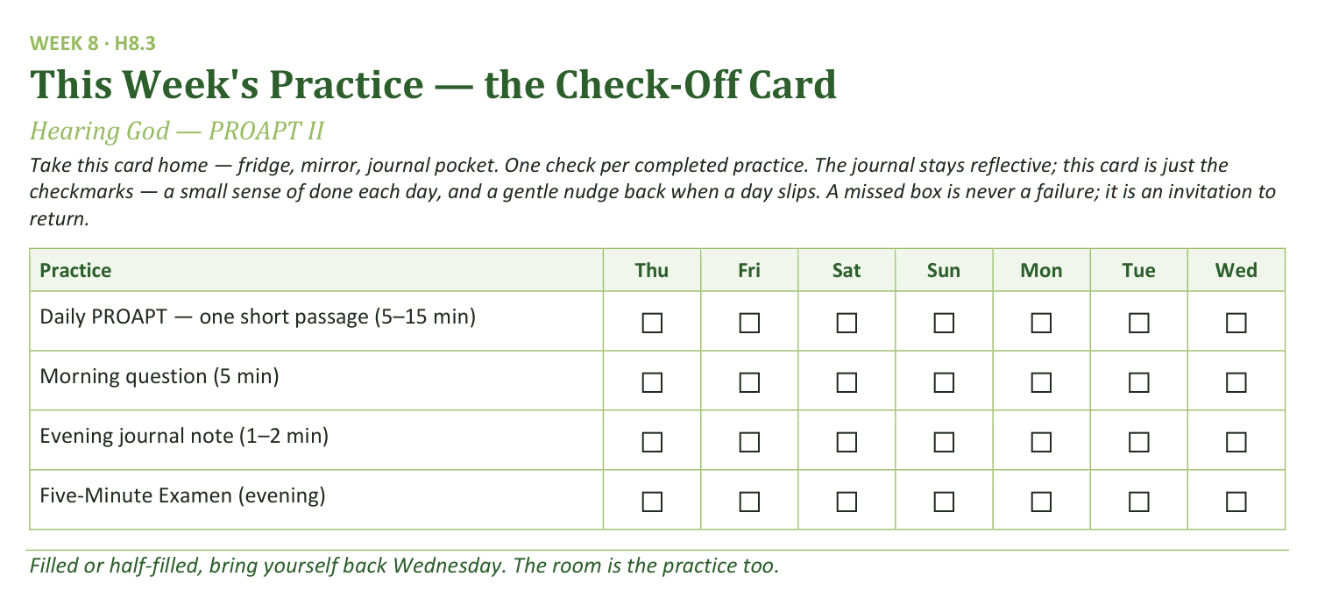
Your Take-Home Card — This Week’s Practice
Handed out now — fridge, mirror, journal pocket.
111
Notes:
W8 · 5:18–5:21 · SHARED
BEATS: 1. Check-off card home: daily PROAPT, morning question, evening note, Five-Minute Examen. 2. A missed box is an invitation to return, never a failure. 3. Keep this brief — the card explains itself; today's message was the senior's lead.

Slide 112
The Leader Feedback Round
• The evening’s leader goes first — three things, same as every week
– “What I think went well tonight: ______”
– “What I’d do differently next time: ______”
– “If I were to teach tonight’s process to someone, I would tell them: ______”
• Then the room — the same two questions about tonight
• The leader receives without defending — “thank you” is the whole response
112
Notes:
W8 · 5:21–5:25 · SHARED
BEATS: 1. Merged order today — a teen led: the senior answers the round's questions FIRST, the adult second. 2. The adult adds one specific affirmation of the senior ('you held the silence after Apply and didn't fill it') and at most ONE growth item — one thing, not a list. 3. Then, only by the senior's consent, the room takes the same two questions — popcorn, 'for you' language, covering both leaders. 4. Receive without defending; if the senior declines the room's round, it ends after the adult — no pressure, no exposure.

Slide 113
Closing the Container + Aaronic Blessing
• We close the way we opened — the container, six steps:
1 Stand again — same circle, same posture as the open
2 One-word landing — compare it to your opening word
3 The one thing you are taking from tonight
4 The one practice — committed aloud, or modified to one you will actually keep
5 Blessings — specific, witnessed, short
6 Closing prayer — and the Aaronic blessing, spoken over each other, face to face
THE AARONIC BLESSING — NUMBERS 6:24–26
“The Lord bless you and keep you;
the Lord make his face to shine upon you, and be gracious to you;
the Lord lift up his countenance upon you, and give you peace.”
113
Notes:
W8 · 5:25–5:30 · SHARED
BEATS: 1. The senior closes: seven weeks ago none of us had done this; next Wednesday we go deeper, into the Garden — today's skill of hearing Him is what the Garden depends on. 2. 'Keep the daily practice alive this week. It's the hinge.' 3. Aaronic blessing, spoken by the senior — its own quiet milestone. 4. 'PROAPT one passage tomorrow. See you Wednesday.'

Slide 114
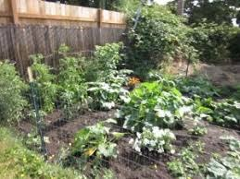
WEEK 9
The Garden of Your Heart I
An experiential encounter with Jesus in your interior space — the first guided run; a senior leads the second next week
Quarter 2: Connect with God
114
Notes:
W9 · pre-session · DIVIDER
On screen as families arrive. Greet at the door — the slide holds the room.

Slide 115
Week 9 — Tonight’s Road
1 Welcome and centering
2 Week 7 check-in
3 Scripture and framing
4 Bridge into the exercise
5 The Garden exercise — whole room, then clusters
6 Merge and one-word landing
7 Between-session practice
8 The Leader Feedback Round
9 Closing container
115
Notes:
W9 · 4:15–4:22 · SHARED
BEATS: 1. Today is the quietest deep work of the series: the Garden of Your Heart — a guided imaginative prayer with the whole room, then sharing in clusters by invitation only. 2. Frame gently and do not over-explain — of all the sessions, this one has produced the most lasting fruit. 3. Nothing is required today — not even doing the exercise.
CUES: Arrival runs quieter than usual; match the tone from the door.

Slide 116
Opening Container — the Eight Steps
1 Welcome — five minutes to open the container
2 Phones silenced and put away
3 Stand in a circle
4 One-word check-in — how you actually are, right now
5 Put out / bring in — set something down; bring a blessing in
6 Spoken commitment: “I am here. I am paying attention. I am willing to be moved.”
7 Opening prayer — “Holy Spirit, you are welcome here. Speak. We are listening.”
8 Sit. Begin.
116
Notes:
W9 · 4:15–4:22 · SHARED
BEATS: 1. 'Welcome back. Find a seat.' Wait — take a longer breath than usual before the blessing. 2. Aaronic blessing. 3. Frame: today is quiet, mostly interior; deeply familiar for some, brand new for others — both are fine. 4. Container: what is said here stays here; nothing is required; listen to receive.

Slide 117
Week 7 Check-In
• “Last week we walked PROAPT — a six-step practice for hearing God in scripture.”
• “One sentence about how that practice has been?”
• A parent starts — arranged beforehand, never a cold call on a teen
• Two or three voluntary contributions; anyone may pass — kept brief, tonight’s arc needs the time
117
Notes:
W9 · 4:22–4:27 · SHARED
BEATS: 1. One sentence each on how the daily PROAPT practice has been. 2. Take 2–3 voluntary contributions and keep it brief — today's arc needs the time later.
CUES: Arranged parent opens (check the Run Card) — never cold-call a teen; pass-anytime holds.

Slide 118

Scripture and Framing
• Two passages, read slowly — Psalm 23 and John 15:1–11 — “Listen as if you have not heard it.”
• Scripture pictures the heart as cultivated ground — green pastures, still waters, vine and vinedresser
• Tonight we walk into that image: picture your heart as a garden, invite Jesus in, notice what He does
• Imaginative prayer — Ignatius taught it, Bonaventure taught it, the Puritan writers under other names
• Not visualization-as-self-help, not contemplative emptying — filling the mind with one scriptural image
• “The exercise is not a test of imaginative power. It is a posture of receptivity.”
JOHN 15:5
“I am the vine; you are the branches. Whoever abides in me and I in him, he it is that bears much fruit, for apart from me you can do nothing.”
118
Notes:
W9 · 4:27–4:41 · SHARED
BEATS: 1. Read Psalm 23 and John 15:1–11 slowly — 'listen as if you have not heard it.' 2. Teach: scripture pictures the heart as cultivated ground; today we walk into that image and invite Jesus in to walk it with us. 3. Name the lineage — imaginative prayer: Ignatius, Bonaventure, the Puritans — and the two nots: not visualization-as-self-help, not emptying the mind. 4. 'Vivid experience or nothing at all — both fine. The turning toward Him is the practice.' 5. If you sense resistance, read the skepticism paragraph — the frame IS the work; do not skip it.

Slide 119
Bridge into the Exercise
• We stay right here, together, as one room — a guided imaginative prayer, twelve to fifteen minutes, read slowly
• Eyes closed or open — either is fine; your own family is beside you the whole time
• Then five minutes with your journal, then family clusters for sharing — by invitation only
• A parent will open each round — “Silence is a complete answer.”
• “Father, you are the vinedresser. … Where it is hard, be tender. Where it is closed, be patient. Where it is opening, be present.”
119
Notes:
W9 · 4:41–4:43 · TRANSITION
BEATS: 1. Preview the shape: guided prayer 12–15 min, whole room, eyes open or closed, your own family beside you; then 5 min silent journaling; then family clusters for sharing by invitation only — silence is a complete answer. 2. Room about ten or fewer: name it now — sharing happens right in this circle, no moving. 3. Pray the bridge prayer: where it is hard, be tender; where it is closed, be patient; where it is opening, be present.

Slide 120
The Garden Exercise — Whole Room, then Clusters
1 Settle (2 min) — “Take a breath. Settle. Eyes open or closed. Whatever feels honest. We have time.”
2 Guided prayer (12–15 min) — read slowly to the whole room; the pauses are not optional — they are where the work happens
3 Silent journaling (5 min) — “Write in your Week 9 journal page what you noticed. Whatever you noticed.”
4 Sharing in family clusters (8–10 min) — by invitation only; a parent opens; silence is a complete answer
• Receive without interpreting — “Thank you for sharing that.” Never “God was telling you _____.”
• If something painful surfaces — bless it: “I hear that. May Jesus stay with you in that place this week.”
120
Notes:
W9 · 4:43–5:13 · SHARED
BEATS: 1. Settle 2 min. Guided prayer 12–15 min: read H9.1 slowly — two words per second, not three; every (pause) is a full 30 seconds, every (longer pause) 60. The pauses are where the work happens. 2. Silent journaling 5 min. 3. Then clusters for sharing by invitation, 8–10 min: the Companion models two plain sentences first, the arranged parent opens — receive without interpreting; never 'God was telling you...'.
CUES: Soft tears — do not stop; the tears are often the work. Never cold-call a teen; pass-anytime holds.
GUARD: If overwhelm goes past quiet reassurance, run the Settle Protocol — stop for THEM, not for the circle: plain directive words, back to the room, breathe and anchor, no return to the exercise today; nobody leaves activated.

Slide 121
Merge and One-Word Landing
• “What happened in your cluster stays in your cluster.”
• One word about tonight — not what was said, but what you noticed
– “Surprised.” “Tender.” “Empty.” “Found.” “Confused.” “Quiet.”
• A parent begins; anyone may pass — each word received without commentary
• “Whatever happened tonight is yours. Some of it will keep happening across the week.”
121
Notes:
W9 · 5:13–5:18 · SHARED
BEATS: 1. The room will be quieter than usual — honor it; wait before speaking. 2. What happened in the clusters stays there; ask only one word about today — 'surprised', 'tender', 'empty', 'found', 'quiet'. 3. Receive each word with eye contact and a slight nod; say nothing else. 4. Close: whatever happened today is yours; some of it will quietly do its work for a long time.
CUES: Arranged parent begins; anyone may pass.

Slide 122
Between-Session Practice
• Three returns to the garden this week — five to ten minutes each, journaled
• “You don’t need the full guided script — you have the place now. Just go back.”
• Notice what is the same and what has changed — notice if Jesus is in a different place than He was tonight
• Pick three days and a time — morning before the day starts is often best
• If something heavy surfaces — stop, open your eyes, come back another day; tell a trusted adult
• Came in skeptical? The Note for the Skeptic handout is for you — adapting or sitting out for now is okay
122
Notes:
W9 · 5:18–5:21 · SHARED
BEATS: 1. Co-Companion (Parent) leads. Three brief returns to the garden this week, 5–10 min each — no script needed, you have the place now; journal each visit (H9.2). 2. Gentle warning: a return can surface something heavy — you can stop, open your eyes, come back another day; and tell a trusted adult. You are not meant to carry the heavy things alone. 3. For the uneasy: H9.3, the Note for the Skeptic — adapting the practice or sitting it out is honored.

Slide 123
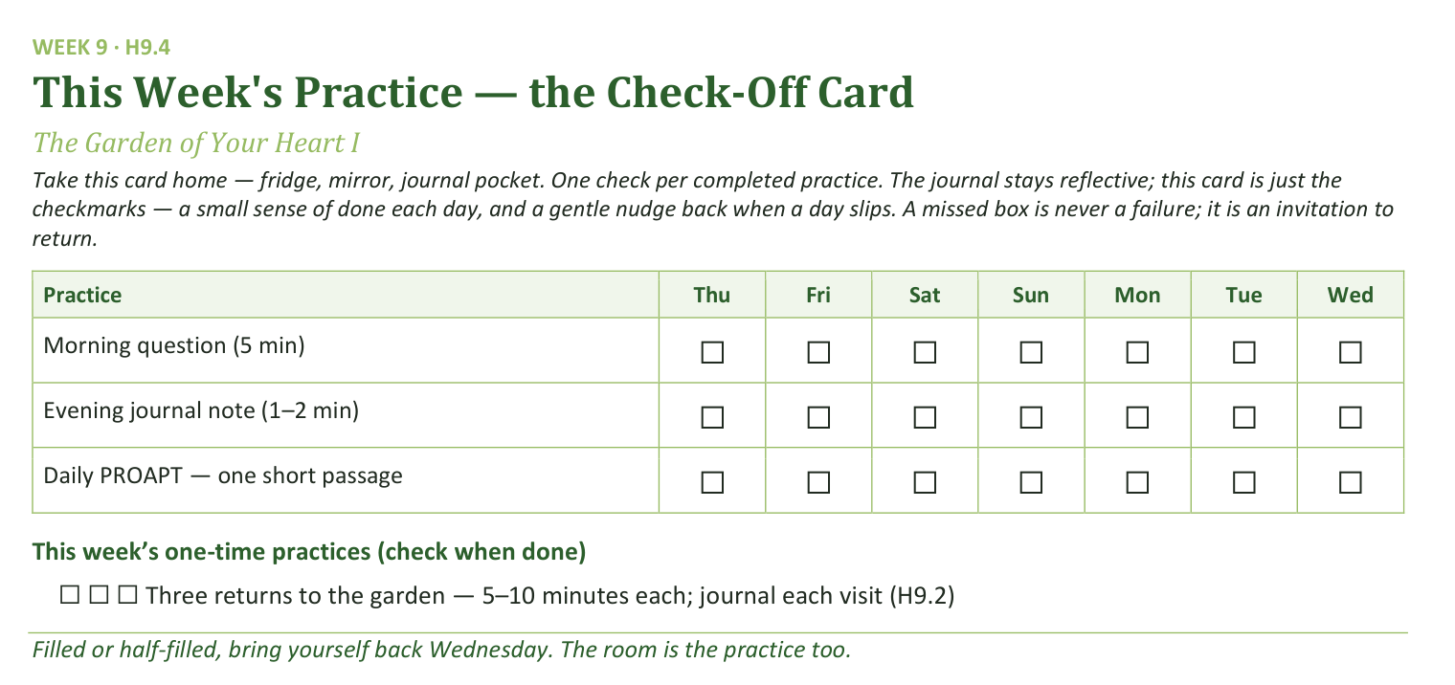
Your Take-Home Card — This Week’s Practice
Handed out now — fridge, mirror, journal pocket.
123
Notes:
W9 · 5:18–5:21 · SHARED
BEATS: 1. Card home: morning question, evening note, daily PROAPT — plus three garden returns as one-time checks. 2. Be honest with the room: this is the most demanding between-session week of the series. Two visits is fine. One is fine. The practice is the turning toward, not the metric.

Slide 124
The Leader Feedback Round
• The evening’s leader goes first — three things, same as every week
– “What I think went well tonight: ______”
– “What I’d do differently next time: ______”
– “If I were to teach tonight’s process to someone, I would tell them: ______”
• Then the room — the same two questions about tonight
• The leader receives without defending — “thank you” is the whole response
124
Notes:
W9 · 5:21–5:25 · SHARED
BEATS: 1. Same round: leader's three answers first, then the room's two questions; 'thank you' is the whole response. 2. Today is the likeliest night of the series to DROP the round: if the room is still deep in the garden's quiet, five minutes of process talk can break what the Spirit is holding. Drop it, and say so at the debrief.

Slide 125
Closing the Container + Aaronic Blessing
• We close the way we opened — the container, six steps:
1 Stand again — same circle, same posture as the open
2 One-word landing — compare it to your opening word
3 The one thing you are taking from tonight
4 The one practice — committed aloud, or modified to one you will actually keep
5 Blessings — specific, witnessed, short
6 Closing prayer — and the Aaronic blessing, spoken over each other, face to face
THE AARONIC BLESSING — NUMBERS 6:24–26
“The Lord bless you and keep you;
the Lord make his face to shine upon you, and be gracious to you;
the Lord lift up his countenance upon you, and give you peace.”
125
Notes:
W9 · 5:25–5:30 · SHARED
BEATS: 1. 'What happened in your cluster is yours. Carry it gently — don't debrief it on the way home unless your heart is fully ready.' 2. If something heavy surfaced, reach out — the team is walking with you. 3. Aaronic blessing; see you Wednesday.
CUES: Stay accessible for fifteen minutes after the close — today more than most, people will want to talk; the two-adult rule holds for any teen.

Slide 126
WEEK 10
The Garden of Your Heart II
The second guided run — the room returns to the garden deeper for a week of practice; a Companion-in-Formation leads the walk-through, and the adults hold the debrief
Quarter 2: Connect with God
126
Notes:
W10 · pre-session · DIVIDER
On screen as families arrive. Greet at the door — the slide holds the room.

Slide 127
Week 10 — Tonight’s Road
1 Welcome and centering
2 Garden week check-in
3 Scripture and brief re-framing
4 Bridge to the exercise
5 The Garden exercise — whole room, then family clusters
6 Merge and one-word landing
7 Between-session practice
8 Leader Feedback Round
9 Closing container
127
Notes:
W10 · 4:15–4:22 · SHARED
BEATS: 1. Second garden run: nothing new is taught — today completes what Week 9 began, and a senior reads the walk-through for the whole room. 2. The bright line on display: the teen leads the scripted walk-through; the adults hold the sharing and anything that surfaces. 3. The first visit finds the garden; the second visit begins the tending.
CUES: Pre-session check-ins with anyone whose Week 9 garden was dark or empty — going back in is optional; sitting and praying instead is fully honored, no explanation owed.

Slide 128
Opening Container — the Eight Steps
1 Welcome — five minutes to open the container
2 Phones silenced and put away
3 Stand in a circle
4 One-word check-in — how you actually are, right now
5 Put out / bring in — set something down; bring a blessing in
6 Spoken commitment: “I am here. I am paying attention. I am willing to be moved.”
7 Opening prayer — “Holy Spirit, you are welcome here. Speak. We are listening.”
8 Sit. Begin.
128
Notes:
W10 · 4:15–4:22 · SHARED
BEATS: 1. Open even quieter than Week 9 — lights low if the room allows. Aaronic blessing. 2. Frame the second run: not a rerun — deeper. 3. Name the senior once, warmly, and move on: 'the words are the same words; they will read from the card, slowly, the same way I did.' No build-up — a spotlight distorts what the slot is meant to form. 4. Container unchanged: cluster talk stays in the cluster; nothing required — not even the exercise.

Slide 129
Garden Week Check-In
• “One sentence about a garden visit this week? Not what happened in it — just how the going was.”
– “I went twice and it was quieter than Wednesday.” “I meant to and didn’t.” “I went once and it was hard.”
• A parent offers the first sentence — never a cold call on a teen; each one received identically
• “There is no junior varsity garden. Jesus meets each person in the garden they actually have.”
129
Notes:
W10 · 4:22–4:27 · SHARED
BEATS: 1. One sentence on how the going was this week — not what happened in the garden. 'I meant to and didn't' counts. 2. Receive each identically. 3. Land the line if comparison language surfaced: there is no junior varsity garden — Jesus meets each person in the garden they actually have, and the backyard He walks into is holy ground.
CUES: Arranged parent offers the first sentence (check the Run Card) — never cold-call a teen; pass-anytime holds.

Slide 130
Scripture and Brief Re-Framing
• Same two anchors as last week — Psalm 23 and John 15:1–11 — “Listen as if for the first time anyway.”
• A vinedresser does not visit a vine once — abiding is a rhythm, not an event
• Going back changes things — the garden is not a photograph; it is a living place, because your heart is
• A hard garden last week? Going back in tonight is optional — sit and pray instead, fully honored, no explanation owed
• “The words get you to the gate; the silence is where He meets you.”
PSALM 23:1–3
“The Lord is my shepherd; I shall not want. He makes me lie down in green pastures. He leads me beside still waters. He restores my soul.”
130
Notes:
W10 · 4:27–4:35 · SHARED
BEATS: 1. Re-read Psalm 23 and John 15:1–11, slowly — same anchors on purpose; the room hears them differently now. 2. Keep the framing SHORT — the theology was laid last week. 3. The second-visit frame: the garden is a living place; going back changes things. 4. The open door, said clearly: anyone whose garden was hard may sit with eyes open and simply pray while the others walk — a faithful way to spend the half hour; nobody will ask why. 5. Today the guide talks less and the silences run longer — on purpose. You know the way now.

Slide 131
Bridge to the Exercise
• Same shape as last week — guided walk-through, about twelve to fifteen minutes, all of us together in this room
• Read slowly, with longer quiet than last time — then five minutes with your journal
• Then family clusters for sharing by invitation only — “Silence is a complete answer.”
• “Father, You are the vinedresser. We are going back into the gardens You already know. Walk where You want to walk. Tend what You want to tend.”
131
Notes:
W10 · 4:35–4:37 · TRANSITION
BEATS: 1. Same shape as last week: walk-through 12–15 min, all together in this room, longer quiet than last time; then journaling; then clusters for sharing by invitation — silence is a complete answer. 2. Pray: 'Tend what You want to tend.' 3. No move yet — the room stays as one circle for the walk-through; the clusters come after the journaling.

Slide 132

The Garden Exercise — Whole Room, then Family Clusters
1 Settle (2 min) — then, simply: “[Name] will read for us tonight.”
2 Guided walk-through, senior-led (12–15 min) — same protocol as Week 9, longer pauses; the card carries the room
3 The visible handoff — “[Name], the room is yours.” / “Thank you, [name]. That was well led.”
4 Silent journaling (5 min) — what was the same as last week, what was different
5 Sharing in family clusters (10–12 min) — by invitation only; a parent opens; silence is a complete answer
• The bright line — the teen leads the walk-through; the adults hold the sharing and anything that surfaces
132
Notes:
W10 · 4:37–5:10 · SHARED
BEATS: 1. Settle 2 min, then the senior reads the walk-through from H10.1 — two words per second; (pause) = 30 full seconds, (longer pause) = 60, longer than Week 9 on purpose. Reading from the card IS the design. 2. Mid-read distress: the senior keeps reading, same pace, same volume; the pre-named adult moves to the person. Neither covers for the other. 3. The visible handoff when it ends: senior — '[Name], the room is yours.' Adult — 'Thank you. That was well led.' From there the adults carry everything. 4. Journaling 5 min, then clusters: arranged parent opens; receive without interpreting.
GUARD: Settle Protocol if overwhelm exceeds the two-role hold — stop for them, not the circle; no return to the exercise today. The senior never takes a disclosure, even a fragment — hand it to the adult immediately.

Slide 133
Merge and One-Word Landing
• “What happened in your cluster stays in your cluster.”
• One word each, when you’re ready — not what was said, but what you noticed; you can pass
– “Deeper.” “Same.” “Tender.” “Quiet.” “Harder.” “Found.”
• A parent offers the first word — each one received without commentary
• “A garden visited twice is a garden being tended. Whatever He is doing in yours, He will keep doing it this week.”
133
Notes:
W10 · 5:10–5:16 · SHARED
BEATS: 1. Quieter than last week — honor it; wait. 2. One word each, optional: 'deeper', 'same', 'tender', 'harder', 'found'. Receive with eye contact and a slight nod; say nothing else. 3. Close: a garden visited twice is a garden being tended — whatever He is doing in yours, He will keep doing this week.
CUES: Arranged parent offers the first word; pass-anytime holds.

Slide 134
Between-Session Practice
• Keep the garden rhythm — two returns this week, five to ten minutes each
• “You know the way now — you don’t need the script.” Go back, walk a little, notice where He is
• Journal each visit — even two sentences — “the garden speaks slowly, and the journal is how you hear it across weeks”
• If a return surfaces something heavy — stop, open your eyes, come back another day; tell a trusted adult
• Three visits drops to two on purpose — a rhythm that survives, not a sprint that impresses
134
Notes:
W10 · 5:16–5:19 · SHARED
BEATS: 1. Co-Companion (Parent) leads. Two garden returns this week, 5–10 min each — the load drops from three on purpose; a rhythm that survives beats a sprint that impresses. 2. Journal each visit, even two sentences — the garden speaks slowly; the journal is how you hear it across weeks. 3. Same gentle word: if a return surfaces something heavy, stop, and tell a trusted adult. Fresh Garden Journal pages at the door.

Slide 135
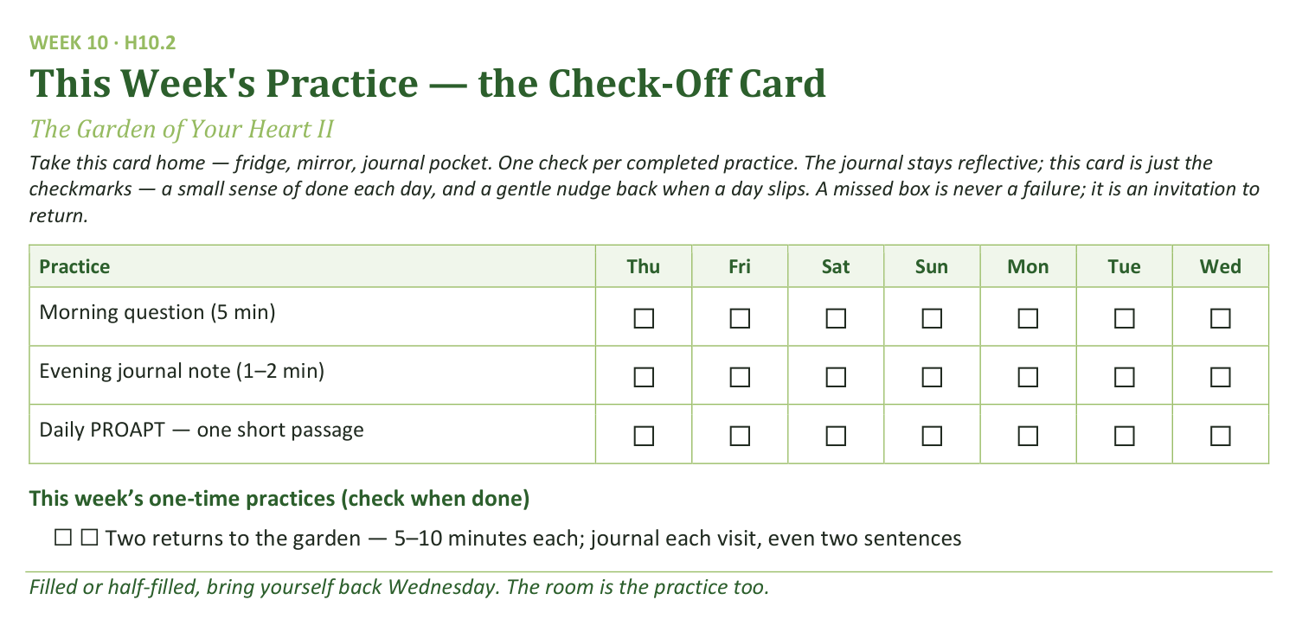
Your Take-Home Card — This Week’s Practice
Handed out now — fridge, mirror, journal pocket.
135
Notes:
W10 · 5:16–5:19 · SHARED
BEATS: 1. Card home: morning question, evening note, daily PROAPT, plus two garden-return checks. 2. A missed box is an invitation to return, never a failure. 3. Keep this brief — the room is full; do not try to empty it with more words.

Slide 136
The Leader Feedback Round
• The evening’s leader goes first — three things, same as every week
– “What I think went well tonight: ______”
– “What I’d do differently next time: ______”
– “If I were to teach tonight’s process to someone, I would tell them: ______”
• Then the room — the same two questions about tonight
• The leader receives without defending — “thank you” is the whole response
136
Notes:
W10 · 5:19–5:23 · SHARED
BEATS: 1. Merged round — a teen led the deepest practice: the senior answers first, the adult second, the room by consent, covering both. 2. For a first-time guide, pace and the held silences are the honest headline; ONE thing to try differently — one, not a list. 3. If the debrief ran heavy — something still visibly in the room — DROP the round entirely; it moves to the team debrief, and the senior is told why in these words: protecting the room came first today. That sentence is the lesson, not a consolation. The blessing still closes either way.

Slide 137
Closing the Container + Aaronic Blessing
• We close the way we opened — the container, six steps:
1 Stand again — same circle, same posture as the open
2 One-word landing — compare it to your opening word
3 The one thing you are taking from tonight
4 The one practice — committed aloud, or modified to one you will actually keep
5 Blessings — specific, witnessed, short
6 Closing prayer — and the Aaronic blessing, spoken over each other, face to face
THE AARONIC BLESSING — NUMBERS 6:24–26
“The Lord bless you and keep you;
the Lord make his face to shine upon you, and be gracious to you;
the Lord lift up his countenance upon you, and give you peace.”
137
Notes:
W10 · 5:23–5:30 · SHARED
BEATS: 1. What happened in your cluster is yours; carry it gently — no car-ride debrief unless the heart is fully ready. 2. If something heavy surfaced, reach out — the team is walking with you. 3. Aaronic blessing, hands up.
CUES: Stay accessible fifteen minutes after; two-adult rule for any teen. Afterward, a brief specific word of thanks to the senior, separate from the feedback round — leading deep water for the first time costs something; name that it was seen.

Slide 138

WEEK 11
Any Doubts?
Bringing the real question, and bringing it to God
Quarter 2: Connect with God
138
Notes:
W11 · pre-session · DIVIDER
On screen as families arrive. Greet at the door — the slide holds the room.

Slide 139
Week 11 — Tonight’s Road
1 Welcome and centering
2 Week 9 check-in
3 Mark 9:14–29 — the scripture ground
4 The Any Doubts? practice — teaching
5 Bridge to split
6 Any Doubts? in pairs within families
7 Merge and surface
8 Between-session practice
9 Leader Feedback Round
10 Closing container
139
Notes:
W11 · 4:15–4:22 · SHARED
BEATS: 1. Week 11 — last gathering of the quarter and the exact midpoint of the year: eleven Wednesdays behind, eleven ahead. 2. Today: Any Doubts? — bringing the small quiet doubts we never say aloud, honestly, to God, in front of one other person. 3. With the Garden, one of the two highest-confidence practices in this whole body of work — treat it with care. 4. Frame it early and repeat it: doubt is not disbelief; this is the gap between what we say and what we actually trust.

Slide 140
Opening Container — the Eight Steps
1 Welcome — five minutes to open the container
2 Phones silenced and put away
3 Stand in a circle
4 One-word check-in — how you actually are, right now
5 Put out / bring in — set something down; bring a blessing in
6 Spoken commitment: “I am here. I am paying attention. I am willing to be moved.”
7 Opening prayer — “Holy Spirit, you are welcome here. Speak. We are listening.”
8 Sit. Begin.
140
Notes:
W11 · 4:15–4:22 · SHARED
BEATS: 1. 'Welcome back. Settle.' Aaronic blessing. 2. Name the night: this goes against most of what we have been taught about how spiritual people should sound — we bring our actual doubts and bring them honestly to God. 3. Container: what is said in your pair stays in your pair; nothing is required; specificity is the practice, honesty is the goal.

Slide 141
Week 9 Check-In — the Garden Returns
• The practice was three returns to the garden
• “Anyone want to say one sentence about how that went — the garden visits, or what surfaced, or that you didn’t get to it?”
• One sentence each, voluntary — received without commentary
– “Good. The garden is still there. You can return any time. We continue.”
141
Notes:
W11 · 4:22–4:27 · SHARED
BEATS: 1. One sentence on the garden returns — how it went, what surfaced, or that you didn't get to it. 2. Take 2–3 voluntary contributions; receive without commentary. 3. Move on with: 'Good. The garden is still there. You can return any time. We continue.'
CUES: Arranged parent opens (check the Run Card) — never cold-call a teen; pass-anytime holds.

Slide 142

Mark 9:14–29 — the Scripture Ground
• The whole scene, read slowly — the desperate father, the failed disciples, the boy in convulsions
• He does not pretend the unbelief is not there — he names both at once. And Jesus does not rebuke him; Jesus heals the boy
• The unbelief that is named and brought to Jesus is the unbelief that can be released; suppressed, it works as a quiet brake
• Tonight is not generating new doubts — it is bringing the ones already there into the open, and bringing them to Jesus
MARK 9:24
“Immediately the father of the child cried out and said, ‘I believe; help my unbelief!’”
142
Notes:
W11 · 4:27–4:35 · SHARED
BEATS: 1. Read Mark 9:14–29 IN FULL from the physical Bible, slowly, without stopping to comment — the verse lands differently inside the whole scene. 2. Teach the model: the father names belief and unbelief at once — 'I believe; help my unbelief' — and Jesus does not rebuke him; He heals the boy. 3. Most of us say the believing half loud and bury the unbelieving half, where it works as a quiet brake on faith. 4. Today is not generating new doubts — it is bringing the unbelief already there into the open, and bringing it to Jesus.

Slide 143

The Any Doubts? Practice — Four Steps
1 NAME — the scripture, then the doubt. Specific, not abstract: “I doubt He hears prayer about this specific thing”
2 EXAGGERATE — make the doubt bigger, not smaller. You are not endorsing it; you are exposing it
3 SIT — what does the doubt feel like in your body? Ten or fifteen seconds. Don’t fix it. Feel it
4 RE-READ — your partner reads the same scripture again, slowly. The Spirit does the work; you do the noticing
• Watch the demo — specific, honest, brief, and unresolved-but-honest is the gift
143
Notes:
W11 · 4:35–4:43 · SHARED
BEATS: 1. Callback, 30s: journals open to the first-night question — naming a doubt takes the same courage. 2. The seat for the skeptic, named ALOUD: a doubt bigger than today's list is welcome and has its own standing door — any Companion, any week, for as long as it takes. 3. Whiteboard walk: NAME (specific, not abstract) / EXAGGERATE (expose the brake, not endorse it) / SIT (feel it, 10–15s) / RE-READ (the Spirit works; you notice). 4. Demo with a Co-Companion, 3 min — real scripture, real small doubt; do NOT resolve it at the end. The pairs calibrate everything against this demo.
CUES: Keep the demo brief — do not let teaching eat the pair time.
SUB: Demo YOUR OWN real, small doubt — never fake one, never borrow the founder's. If you cannot bring one honestly, walk the four steps only and let the arranged parents' first turns carry the modeling.

Slide 144
Bridge to the Split — Parents First
• Take the practice card from your chair — Name · Exaggerate · Sit · Re-read. Pairs form within your own family, a parent with their own teen
• In every pair the parent goes first — arranged this week; nobody is being put on the spot tonight
– “Teens: you go second, and you choose your own depth. A small doubt is enough. Passing is enough.”
• No scripture in mind? Pick one with a flicker for you, not a hurricane
– Romans 8:28 · Jeremiah 29:11 · Psalm 139:13–16 · John 14:1–3 · Romans 8:38–39 · James 1:5
• Partners: read, listen, re-read. Not fix. Not theologize. “We are not arguing the doubt. We are bringing it.”
144
Notes:
W11 · 4:43–4:45 · TRANSITION
BEATS: 1. Practice card H11.1 goes with them. Pairs are announced by the Cluster Companion — pre-considered, within families, parent with own teen; never improvised on the night. 2. Say it plainly: in every pair the PARENT goes first — arranged this week; Mark 9:24 is a parent's sentence first. Teens go second and choose their own depth; a small doubt is enough; passing is enough. 3. Scripture choice: a flicker, not a hurricane — H11.3 has options. 4. Partners: read, listen, re-read — never fix, never theologize. Pray and send.

Slide 145
Any Doubts? in Pairs, within Families
1 Pick a scripture; your partner reads it slowly — from the physical Bible if possible
2 “What I notice is ___. The doubt I am holding is ___.” — specific
3 Exaggerate it, then sit with the feeling for 10–20 seconds
4 “Read it again, please.” Then: “What I notice this time is ___.”
• The parent’s turn first, then switch — the teen at their own depth; pass-anytime holds
• Two agreements: you are not arguing or fixing the doubt — and nothing leaves your pair
145
Notes:
W11 · 4:45–5:15 · PAIRS
BEATS: 1. Thirty minutes: one full cycle each direction, about 7 min per turn, parent's turn first; partial second cycle if time allows. Companion calls switches at seven minutes; never interrupt a re-read. 2. The turn: partner reads; 'the doubt I am holding is ___'; gentle exaggerate; sit 10–20s; re-read; 'what I notice this time is ___'. 3. Interventions: apologetics — 'we're not arguing the doubt'; no doubt found — honest, run the partner's cycle; exaggeration won't come — don't push; distress — stop the exaggeration, re-read, sit with them.
GUARD: The practice never runs on a scripture the person actively rejects — flicker, not hurricane. A parent's doubt about the very teen across from them moves to a different doubt today and a 1:1 later. Anything bigger than the exercise: bless the naming, end the cycle gently, follow up within 48 hours.

Slide 146
Merge and Surface
• What happened in your pair stays in your pair — no one will be asked to share a doubt or a scripture
• “One word about what the practice was like. Not the doubt — the practice.”
– “Surprising.” “Heavy.” “Quiet.” “Awkward.” “Honest.” “Lighter.” Pass anytime
• This practice fits in five minutes alone, or twenty with a friend — a way of bringing your real questions to God for the rest of your life
• “The resolution is the Spirit’s work. The naming is yours. We do the naming. He does what only He can.”
146
Notes:
W11 · 5:15–5:20 · SHARED
BEATS: 1. What happened in your pair stays in your pair — not back to the cluster, not around the dinner table, unless the one who named it brings it up first. 2. One word about the practice, not the doubt: 'surprising', 'heavy', 'honest', 'lighter'. Receive with a nod; no commentary. 3. Two closers: this practice takes five minutes alone, for the rest of your life; and the naming is ours — the resolution is the Spirit's work.
CUES: Pass-anytime holds. Watch faces — follow up offline within 48 hours on anything the night stirred.

Slide 147
Between-Session Practice — the Doubts Inventory
• The Personal Doubts Inventory — twenty minutes with your journal, once this week
1 List 5–10 scriptures you say you believe; rate your honest trust, 1–5
2 For the two or three with the most hesitation — write the specific doubt, then sit with it
• No shame. Just data. Yours alone — never turned in, never seen by the team
• The Quarterly Pulse goes home tonight — three questions, five minutes, honest. Back in the bin at The Return’s door in January
• Over the break: keep one practice alive — just one, your choice
147
Notes:
W11 · 5:20–5:23 · SHARED
BEATS: 1. Personal Doubts Inventory (H11.2): twenty minutes once this week — list 5–10 scriptures you say you believe, rate your honest trust in each, and write one specific sentence on the 2–3 lowest. No shame, just data; nobody ever sees it. 2. Hand out the Quarterly Pulse (H11.4): three questions, five minutes at home, honest — back in the bin at The Return's door in January. 3. 'Body in the room, mind on the mortgage' is exactly the kind of answer the page is for.

Slide 148
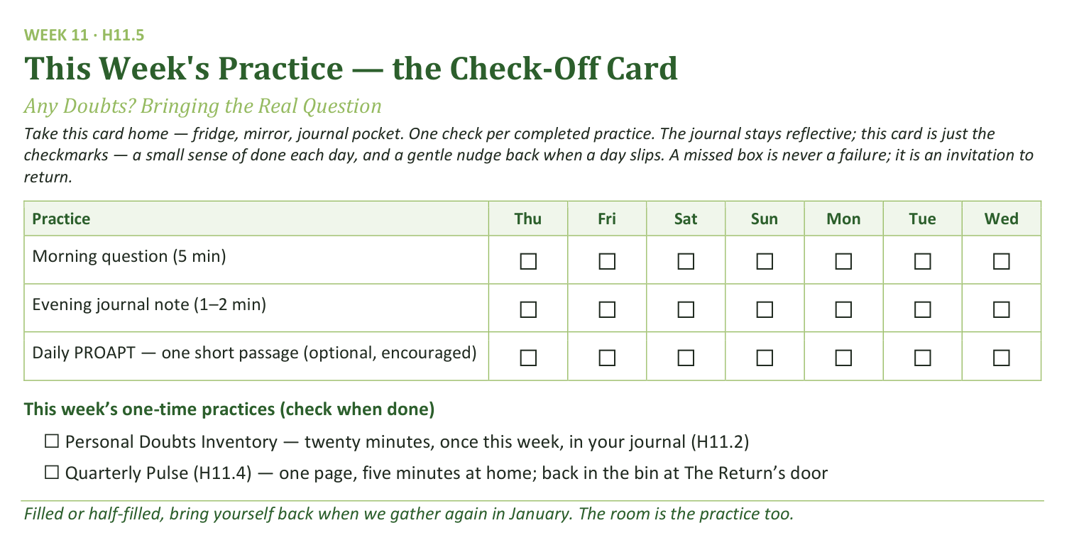
Your Take-Home Card — This Week’s Practice
Handed out now — fridge, mirror, journal pocket.
148
Notes:
W11 · 5:20–5:23 · SHARED
BEATS: 1. Card home: morning question, evening note, PROAPT (optional, encouraged), plus two one-time checks — the Doubts Inventory and the Pulse. 2. Over the break: keep ONE chosen daily practice alive — just one, their choice. 3. A missed box is an invitation to return, never a failure.

Slide 149
The Leader Feedback Round
• The evening’s leader goes first — three things, same as every week
– “What I think went well tonight: ______”
– “What I’d do differently next time: ______”
– “If I were to teach tonight’s process to someone, I would tell them: ______”
• Then the room — the same two questions about tonight
• The leader receives without defending — “thank you” is the whole response
149
Notes:
W11 · 5:23–5:27 · SHARED
BEATS: 1. Same round: leader's three answers first, then the room's two questions — two or three voices is plenty. 2. Receive without defending — 'thank you' is the whole response. 3. May be dropped if the room needs quiet; dropping it twice running goes to the team debrief.

Slide 150
Closing the Container + Aaronic Blessing
• We close the way we opened — the container, six steps:
1 Stand again — same circle, same posture as the open
2 One-word landing — compare it to your opening word
3 The one thing you are taking from tonight
4 The one practice — committed aloud, or modified to one you will actually keep
5 Blessings — specific, witnessed, short
6 Closing prayer — and the Aaronic blessing, spoken over each other, face to face
THE AARONIC BLESSING — NUMBERS 6:24–26
“The Lord bless you and keep you;
the Lord make his face to shine upon you, and be gracious to you;
the Lord lift up his countenance upon you, and give you peace.”
150
Notes:
W11 · 5:27–5:30 · SHARED
BEATS: 1. What was named in your pair is yours — some doubts quietly resolve, some deepen before they release; both are normal. If anything is heavier than today could hold, reach out. 2. Announce the road: quarter break now; The Return in January; then Week 13 turns outward to Mission, on toward the Rhythm week and the two commissionings. 3. Aaronic blessing. 'Keep one practice alive over the break — just one. See you in January, at The Return. Merry Christmas to every house in this room.'

Slide 151
Quarter 3
Mission & Rhythm
Weeks 12–17 · Six Wednesdays · The Return, Mission, the Rhythm and the Four Questions
151
Notes:
QUARTER 3 · pre-session · DIVIDER
On screen as families arrive — first Wednesday back after the Christmas break. Today is The Return: the open runs slow on purpose. Greet warmly at the door; nobody owes an explanation for the break.

Slide 152

WEEK 12
The Return
Coming home after the break — reading honestly what held, welcoming every walker back, and beginning again
Quarter 3: Mission & Rhythm
152
Notes:
W12 · pre-session · DIVIDER
On screen as families arrive. Greet at the door — the slide holds the room.

Slide 153
Week 12 — Tonight’s Road
1 Opening container — run slow
2 New every morning — Lam. 3:22–23, Ps. 126
3 “What held?”
4 The walk home
5 Re-anchoring the year — and the door out, once
6 Between-session practice — restart one
7 Closing container
8 Leader Feedback Round
9 Aaronic blessing and sending
153
Notes:
W12 · 4:15–4:26 · SHARED
BEATS: 1. First Wednesday back after Christmas — nothing new is taught today; the whole evening rebuilds what the break interrupted. 2. Three movements: 'What held?' in clusters; the Walk Home (the Path Home Card enacted); re-anchoring the year's map. 3. Deliberately adult-carried today — the container protocol itself is the teaching.
CUES: Pulse 2 bin staffed at the door — thank you and nothing else; name tags run again as if it were Week 1; note every empty chair for warm contact this week.

Slide 154
Opening Container — Run Slow
• Two weeks without Wednesdays — containers don’t keep. They are rebuilt every time, by the same small faithful steps
• “Tonight we open it slowly, on purpose. Don’t rush the steps. There is nowhere else we need to be.”
• The full eight steps — phones away, standing circle, put out / bring in, the prayer
• One-word check-in: “One word for how you actually are right now — not how you usually are, not how you should be.” Let each word have a breath
THE SPOKEN COMMITMENT
“I am here. I am paying attention. I am willing to be moved.”
154
Notes:
W12 · 4:15–4:26 · SHARED
BEATS: 1. Run ALL eight opening steps at two-thirds speed and name the slowness out loud: containers are rebuilt every time, by the same small faithful steps. 2. One-word check-in gets a second beat — one unhurried breath after each word; no commentary, no nodding anyone along. It is the most information-dense thirty seconds of the session. 3. Double the put-down silence to a full minute. 4. Spoken commitment, opening prayer, sit.
GUARD: The slow open runs about 12 minutes and IS the session's first teaching — do not rush it back to the usual clip. If the room will not settle, run it slower, not louder; contain the room, don't fight it.

Slide 155
New Every Morning — Lam. 3:22–23, Ps. 126
• Written in the ashes of Jerusalem — the mercies-new truth lives in the mornings after the seasons that didn’t hold
• Not new every morning that you earned. Issued fresh, this morning, to everyone in this circle — whatever the break looked like
• Psalm 126 — “those who sow in tears shall reap with shouts of joy!” Coming home is not make-up work; it is the happiest walk there is
• Tonight we read the break honestly — and we can afford to, because the mercy was already new before we walked in
LAMENTATIONS 3:22–23
“The steadfast love of the LORD never ceases; his mercies never come to an end; they are new every morning; great is your faithfulness.”
155
Notes:
W12 · 4:26–4:34 · SHARED
BEATS: 1. Read Lamentations 3:22–23 and Psalm 126 aloud, slowly, from the physical Bible. 2. Teach where the verse lives: in the ashes of Jerusalem — mercies-new-every-morning belongs to the mornings after the seasons that didn't hold. 3. No carried balance: His mercies are issued fresh this morning, to everyone in the circle, whatever the break looked like — that is why today's reading costs nothing. 4. Psalm 126: coming home is the happiest walk there is. Hold it — we come back to it after the clusters.

Slide 156
“What Held?”
• A reading, not a report card — which practices held through the break, and which slipped
• “Every break is a natural test, and it is a test of the practices, not of you.”
• One at a time, plain words — a parent starts in each cluster
• Nobody fixes anybody. Nobody compares. Slips are data — useful information, not a verdict
• “Most of it slipped” is a complete answer; pass is a complete answer
– If time allows: “Did anything about the break surprise you?”
“When your children ask their fathers in times to come, ‘What do these stones mean?’”
— JOSHUA 4:21 (ESV)
156
Notes:
W12 · 4:34–4:54 · CLUSTERS
BEATS: 1. Bridge from the front: a reading, not a report card — every break is a natural test of the practices, not of you. Then split. 2. In clusters, one at a time: which practices held, which slipped — plain words. Receive each with a nod and nothing else. 3. If time allows: 'did anything about the break surprise you?' 4. Companions keep rough counts for the debrief — numbers only, no names.
CUES: Arranged parent reads first, slips included (check the Run Card) — never cold-call a teen; 'most of it slipped' and pass are complete answers.
GUARD: Slips are data, not failure. Cut off confession warmly — 'no apology owed; that's data' — and widen the frame on any scoreboard reading. Everyone reads: a round where three talk long and four not at all has failed its shape.

Slide 157
The Walk Home
• The Path Home Card — filed weeks ago, while the room was warm. Tonight it is not taught; it is enacted
• “Nobody in this room owes anybody an explanation for the break. You already walked back. You are in the chair. That is the whole return.”
• The way back is unglamorous: do not start over from the beginning; begin again on the next available day. Five dry minutes tomorrow morning is a full return
• Everybody here came back — every chair filled tonight is a small feast
• If the break was hard in ways that have nothing to do with practices — that is a Companion conversation, tonight or this week
LUKE 15:20
“But while he was still a long way off, his father saw him and felt compassion, and ran and embraced him and kissed him.”
157
Notes:
W12 · 4:54–5:09 · SHARED
BEATS: 1. The heart of the session. Speak the welcome over the WHOLE room at once, so everyone who drifted walks back through the door together and nobody has to identify themselves to be received. 2. Luke 15: 'while he was still a long way off' — the father runs; nobody owes an explanation before the robe. 3. The house rule, said aloud: nobody in this room owes anybody an explanation for the break. You are in the chair — that is the whole return. 4. The way back is unglamorous: begin again on the next available day; five dry minutes tomorrow is a full return. Every chair filled today is a small feast.
CUES: No hands, no testimonies, no self-identification. If someone names their own drift, bless the telling, honor the return, add nothing. Watch for the going-still and the wet eyes — no spotlight; follow up at the door or this week.

Slide 158
Re-Anchoring the Year
• Behind us: the whole God arc — the container, your story, the soils, being known; then the hearing: PROAPT, the garden, the doubts brought honestly
• “That work is in you now. The break did not take it away.”
• Ahead: Week 13 — Mission, the turn outward; then the Rhythm — one card you build with your own hand; then the sendings and the commissionings
• “We are not starting over tonight. We are picking the trail back up, together, further along than we have ever been.”
158
Notes:
W12 · 5:09–5:13 · SHARED
BEATS: 1. Brief and plain — the map moment. 2. Behind us: the whole God arc — container, story, soils, being known, then PROAPT, the garden, the doubts brought honestly. That work is in you now; the break did not take it away. 3. Ahead: Week 13 turns outward to Mission; then the Rhythm week; then the closing quarter and the commissionings. 4. 'We are not starting over today. We are picking the trail back up, together, further along than we have ever been.'

Slide 159
One More Thing, While We Are Getting Our Bearings
• Pastor Bobby Gore · (831) 277-9878 — still there, and still not part of our team
• His number is on the safety page at the front of your journal
• Same as we said in September
159

Slide 160
Between-Session Practice — Restart One
• Not everything. One daily practice — the morning question, the evening note, or PROAPT. Just one
• Write it at the top of a fresh journal page tonight, with when and where: “The morning question, 6:50, kitchen table”
• That one practice, daily, this week
• Miss a day? Do not start over — begin again on the next available day
• “One seed goes back in the ground. His mercies are new every morning; you only need one practice to be standing there when they arrive.”
160
Notes:
W12 · 5:13–5:16 · SHARED
BEATS: 1. Co-Companion (Parent) leads. Restart ONE daily practice — just one; the smallness is the wisdom. 2. Journals open, ninety seconds to write: the practice at the top of a fresh page with when and where — 'the morning question, 6:50, kitchen table.' 3. Miss a day? Do not start over from the beginning — begin again on the next available day. One seed goes back in the ground this week.

Slide 161
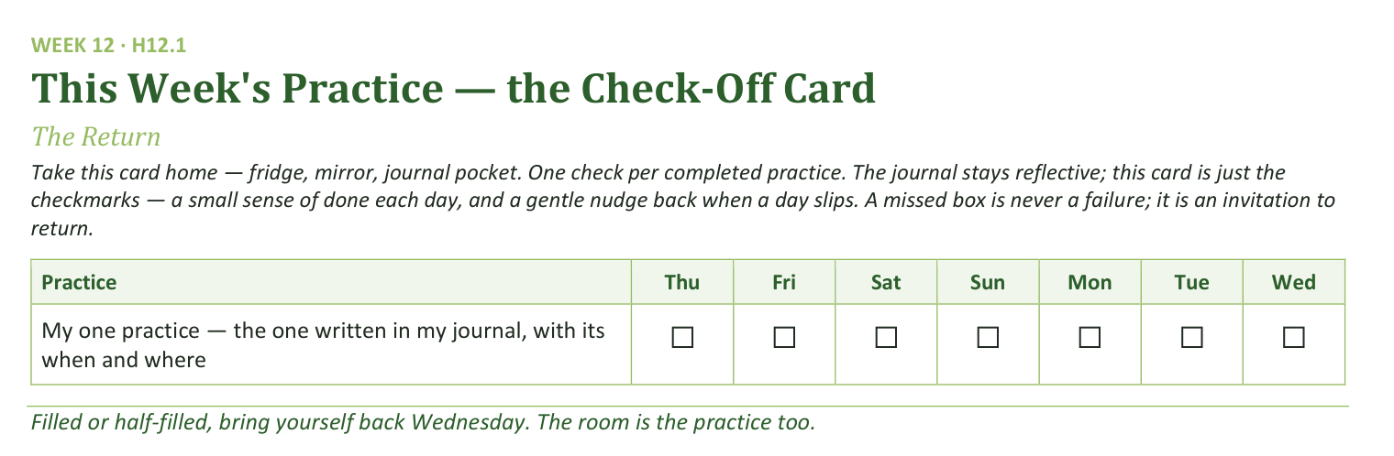
Your Take-Home Card — This Week’s Practice
Handed out now — fridge, mirror, journal pocket.
161
Notes:
W12 · 5:13–5:16 · SHARED
BEATS: 1. One row only this week: my one practice, with its when and where. 2. A missed box is never a failure — it is an invitation to return. 3. The rest of the rhythm comes back a piece at a time in the coming weeks.

Slide 162
Closing the Container + Aaronic Blessing
• We close the way we opened — the container, six steps:
1 Stand again — same circle, same posture as the open
2 One-word landing — compare it to your opening word
3 The one thing you are taking from tonight
4 The one practice — committed aloud, or modified to one you will actually keep
5 Blessings — specific, witnessed, short
6 Closing prayer — and the Aaronic blessing, spoken over each other, face to face
THE AARONIC BLESSING — NUMBERS 6:24–26
“The Lord bless you and keep you;
the Lord make his face to shine upon you, and be gracious to you;
the Lord lift up his countenance upon you, and give you peace.”
162
Notes:
W12 · 5:16–5:30 · SHARED
BEATS: 1. Closing protocol 5:12–5:20, unhurried: stand; one-word landing (the contrast with the opening words is today's best data); the one thing taken from today; the one practice (each names the one just written); blessings — let this step run warm today; the first Wednesday back is the right night for the room to bless itself. 2. Then the Leader Feedback Round interposes, 5:23–5:27 (next slide). 3. Return here 5:27–5:30: 'His mercies did not run out over the break, and they will not run out over this quarter.' Aaronic blessing, hands up. 'Welcome home. See you Wednesday — Week 13, Mission.'
CUES: Today's order is unusual — closing container BEFORE the feedback round, blessing last. Follow the slide flow, not habit.

Slide 163
The Leader Feedback Round
• The evening’s leader goes first — three things, same as every week
– “What I think went well tonight: ______”
– “What I’d do differently next time: ______”
– “If I were to teach tonight’s process to someone, I would tell them: ______”
• Then the room — the same two questions about tonight
• The leader receives without defending — “thank you” is the whole response
163
Notes:
W12 · 5:23–5:27 · SHARED
BEATS: 1. Same round: leader's three answers first, then the room's two questions; 'thank you' is the whole response. 2. Today it sits between the closing container and the blessing — after this round, flip back for the Aaronic blessing and sending. 3. May be dropped if the room's energy needs something else; dropping it twice running goes to the team debrief.

Slide 164

WEEK 13
What Was Prepared for You
Connecting with Mission — uphill, downhill, and the works prepared beforehand
Quarter 3: Mission & Rhythm
164
Notes:
W13 · pre-session · DIVIDER
On screen as families arrive. Greet at the door — the slide holds the room.

Slide 165
Week 13 — Tonight’s Road
1 Welcome and centering
2 Week 11 check-in
3 Ephesians 2:10 and the uphill/downhill distinction
4 Bridge to split
5 Gifts and Downhill in family clusters
6 Merge and surface
7 Between-session practice and closing-weeks logistics
8 Leader Feedback Round
9 Closing container
165
Notes:
W13 · 4:15–4:22 · SHARED CIRCLE
BEATS: 1. Aaronic blessing first. 2. Container reminder: what is said here stays here; nothing is required. 3. Frame the turn: eleven weeks looked inward and upward — today we turn outward to Mission: what was prepared for us to do, and to be. 4. Walk today's road briefly: teaching, two cluster exercises, merge, practice, blessing.
GUARD: Mission is bigger than career — say it early; today is not a what-will-you-do-for-a-living night.

Slide 166
Opening Container — the Eight Steps
1 Welcome — five minutes to open the container
2 Phones silenced and put away
3 Stand in a circle
4 One-word check-in — how you actually are, right now
5 Put out / bring in — set something down; bring a blessing in
6 Spoken commitment: “I am here. I am paying attention. I am willing to be moved.”
7 Opening prayer — “Holy Spirit, you are welcome here. Speak. We are listening.”
8 Sit. Begin.
166
Notes:
W13 · 4:15–4:22 · SHARED CIRCLE
BEATS: 1. Run the familiar open, unhurried: blessing; the four conditions — Safe, Present, Clear, Intentional; phones away. 2. Keep the container reminder brief today: what is said here stays here; nothing is required. 3. Settle the room before moving on — settled beats punctual.

Slide 167
Week 11 Check-In
• Before the break: Any Doubts? — and last week, The Return read what the break did with our practices
• The practice carried across: the Personal Doubts Inventory
• “Anyone want to say one sentence about how that landed — the inventory, or anything that surfaced, or that you didn’t get to it?”
• One sentence each, voluntary — received without commentary
167
Notes:
W13 · 4:22–4:26 · SHARED CIRCLE
BEATS: 1. Name the thread: Any Doubts? and the Personal Doubts Inventory carried since the break. 2. Invite one sentence on how it landed — 'I didn't get to it' counts. 3. Take two or three voluntary contributions; receive without commentary.
CUES: The arranged parent (Run Card) offers the first sentence — never a cold call on a teen; pass anytime.

Slide 168
Uphill and Downhill — Ephesians 2:10
• The works were prepared — beforehand, not by us, not for us to invent. Our job is to walk in them
• UPHILL mission — what I do: a goal, a plan, measurable steps. Good and real — and the smaller half
• DOWNHILL mission — what I am: the effect I have on the people around me when I am most aligned with the Spirit and most genuinely myself. It flows; you don’t have to push it
• The test: “When I am at my most genuinely myself — not performing, not managing, just present and open — what do the people around me get to be?”
• Eleven weeks of uphill clearing behind us — tonight we ask the downhill question
EPHESIANS 2:10
“For we are his workmanship, created in Christ Jesus for good works, which God prepared beforehand, that we should walk in them.”
168
Notes:
W13 · 4:26–4:36 · SHARED CIRCLE
BEATS: 1. Read Ephesians 2:10 slowly — the works were prepared; our job is to walk in them. 2. Whiteboard both columns: UPHILL = what I do (goal, plan, effort); DOWNHILL = what I am — what the room gets when I am most myself and most aligned with the Spirit. 3. The test: when I am not performing, what do the people around me get to be? 4. End with your OWN downhill answer — 90 seconds, specific, unpolished; the teens calibrate against your honesty. Give the version a spouse would recognize, not the resume.
GUARD: Mission is not career — reframe career drift on the spot.

Slide 169
Traveling the Mission — Tacking Against the Headwind
169
Notes:
W13 · 4:26–4:36 · SHARED
SUB: the founder's own diagram — his life drawn as a sailing chart. A substitute may teach it simply from the slide, or let it stand while running the plan's Block 3 script.
BEATS:
1. After uphill/downhill lands, show the chart: the straight line to God's goal is unsailable — headwinds, direct opposition.
2. A sailor gains against a headwind by tacking, leg by leg at forty-five degrees. Each leg IS God's direction — and each is a transformative learning path (Ephesians 2:10: works prepared beforehand, walked into leg by leg).
3. The turns are heard, not seen. Stop listening mid-leg and you don't crash — you drift past the turn, competent and off-course.
4. The threads: what leg A taught, leg C needed. Nobody sees that forward; everybody sees it looking back. Invite one backward look — name a past leg that trained you for a later one.
GUARD: testimony architecture, not a demand for a tidy life-map — some in the room are mid-leg and cannot see any pattern yet; say so.

Slide 170
Bridge to the Split — Two Exercises
1 Gifts and Passions — about twenty minutes: ten alone, ten sharing. Where are you alive? What comes naturally? Where do others tell you you have something to offer?
– Share frame: “The three things I noticed are ______. The one I’m most surprised by is ______.”
2 Downhill Mission — about twenty minutes: five alone, then name your answer to the cluster. “When I am at my best, what the room gets is ___.”
– The cluster adds: “What I’ve seen in you is ______.” — specific, brief, something actually seen
• In each round a parent goes first — teens choose their own depth, and passing holds
• The cluster may add what they have noticed — a parent may speak to a teen’s gifts, and a teen to a parent’s
170
Notes:
W13 · 4:36–4:37 · SHARED CIRCLE
BEATS: 1. Frame the two exercises: Gifts and Passions (~20 min, H13.1), then Downhill Mission (~20 min, H13.2) — each person ends by naming one downhill sentence to the cluster. 2. Pray the sending prayer. 3. Name each cluster's families and its Companion; send them for forty minutes.
CUES: A parent opens each sharing round — arranged this week (Run Card), never a cold call on a teen; teens choose their own depth; pass holds. About ten or fewer today? Skip the split — one circle.

Slide 171
Gifts and Downhill in Family Clusters
• Phase 1 — Gifts and Passions: quiet writing (10 min), then 60 seconds each: “The three things I noticed are ___. The one I’m most surprised by is ___.”
• After each share the cluster affirms what it has seen — specific and brief: “Yes — we see that in you. Specifically: ___.”
• Phase 2 — Downhill Mission: five quiet minutes, then around the circle, 90 seconds each
– “What I noticed is that when I’m at my best, what the room gets is ___.”
• One or two voices add what they have actually seen across Getting Started — especially each other’s family
• The naming is the gift — no over-processing. Pass-anytime holds
171
Notes:
W13 · 4:37–5:17 · FAMILY CLUSTERS
BEATS: 1. Phase 1 — Gifts (~20): ten quiet minutes on H13.1, then 60-second shares; the cluster affirms briefly and specifically. 2. Phase 2 — Downhill (~20): five minutes on H13.2, then 90-second rounds: the person names their answer, the cluster adds what it has actually seen; family speaking to family lands deepest. 3. If time compresses, compress the gifts, never the downhill.
CUES: The arranged parent goes first in each round (Run Card); never cold-call a teen; pass anytime.
GUARD: Push generic to specific — what does the person you're helping get to be? Witness means concrete moments, not flattery. If grief surfaces ('I haven't been doing this for years'), receive without rushing — it is part of the recognition.

Slide 172
Merge and Surface
• What was named in your cluster stays in your cluster — nobody repeats their downhill answer
• One sentence from each Cluster Companion — one general thing they noticed, not a specific person
• Then one observation across the room
• “The downhill mission you named is not a final answer. It is the working draft you are walking in this season.” It will deepen. It will sharpen
172
Notes:
W13 · 5:17–5:19 · SHARED CIRCLE
BEATS: 1. Ask no one to repeat their downhill answer — what was named in the cluster stays there. 2. One sentence per Cluster Companion: a general observation, no names. 3. One brief observation from you across the room. 4. Land it: today's answer is a working draft — closer to true than the resume version, and it will deepen.
GUARD: Five minutes only — this block gave its other five to the feedback round; a sentence each.

Slide 173
Practice This Week — and the Road Ahead
• One small action this week, aligned with your downhill answer. One. Not a campaign. Specific — then journal what happens
– If your downhill is “the room gets calmer” — sit with a friend in distress this week instead of trying to fix them
• Ahead: the Rhythm week — we build the practices you will carry when the Wednesdays stop
• Week 21 — the family commissioning: bring your whole family, even members who have not been here. We run to 6:15 that night — light food from 4:00 as the room builds
• Week 22 — the commissioning of our Companions-in-Formation. Their night; come to witness it
173
Notes:
W13 · 5:19–5:22 · SHARED CIRCLE (Parent Co-Companion leads if present)
BEATS: 1. The practice: ONE small action this week aligned with your downhill answer — specific, small, not a campaign; journal what happens (H13.3). 2. The road ahead: Week 15 is the Rhythm night and finishes today's mission work; Week 21 is the family commissioning — bring the whole family, 6:30 start, light food at 6:00, details by email; Week 22 commissions the Companions-in-Formation — come to witness.
GUARD: Be explicit and warm about Week 21 — people leave today deciding who to bring. Adjust specifics to the actual closing-weeks plan.

Slide 174
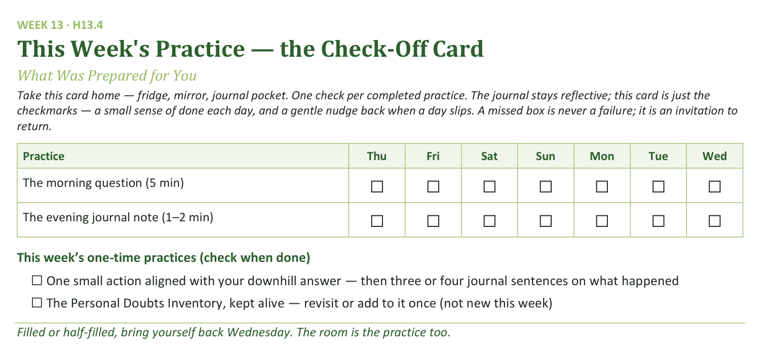
Your Take-Home Card — This Week’s Practice
Handed out now — fridge, mirror, journal pocket.
174
Notes:
W13 · 5:19–5:22 · SHARED CIRCLE
BEATS: 1. Point to the check-off card: the morning question and the session journal note, daily, carried forward. 2. One-time boxes: the one small downhill action, and the Doubts Inventory kept alive. 3. Say the card's spirit: a missed box is never failure — it is an invitation to return; filled or half-filled, come back Wednesday.

Slide 175
The Leader Feedback Round
• The evening’s leader goes first — three things, same as every week
– “What I think went well tonight: ______”
– “What I’d do differently next time: ______”
– “If I were to teach tonight’s process to someone, I would tell them: ______”
• Then the room — the same two questions about tonight
• The leader receives without defending — “thank you” is the whole response
175
Notes:
W13 · 5:22–5:26 · SHARED CIRCLE
BEATS: 1. The leader's three, same as every week: what went well; what I'd do differently; what I'd tell someone teaching today's process. 2. Then the room, same two questions — two or three voices each is plenty. 3. Receive without defending — 'thank you' is the whole response.
CUES: If a teen led today, they answer first, the adult second; the room's feedback covers both. The round may be dropped if the room needs something else — dropping it twice running goes to the team debrief.

Slide 176
Closing the Container + Aaronic Blessing
• We close the way we opened — the container, six steps:
1 Stand again — same circle, same posture as the open
2 One-word landing — compare it to your opening word
3 The one thing you are taking from tonight
4 The one practice — committed aloud, or modified to one you will actually keep
5 Blessings — specific, witnessed, short
6 Closing prayer — and the Aaronic blessing, spoken over each other, face to face
THE AARONIC BLESSING — NUMBERS 6:24–26
“The Lord bless you and keep you;
the Lord make his face to shine upon you, and be gracious to you;
the Lord lift up his countenance upon you, and give you peace.”
176
Notes:
W13 · 5:26–5:30 · SHARED CIRCLE
BEATS: 1. What was named in your cluster is yours — carry it gently; the downhill answer keeps deepening across the week. 2. Open the door for the heavy: shadow-mission recognition or mid-life vocational grief — reach out; the team is walking with you, especially before next Wednesday. 3. Aaronic blessing, hands up if you want; send them warmly.

Slide 177

WEEK 14
Second Running: Block A
The rotation’s evening — another willing teen takes a full leading rep with a practice the room already owns
Quarter 3: Mission & Rhythm
177
Notes:
W14 · pre-session · DIVIDER
On screen as families arrive. Greet at the door — the slide holds the room.

Slide 178
Week 14 — Tonight’s Road
1 Welcome and opening container
2 The mission round
3 Why tonight — the rotation’s charter
4 Closing container
5 Leader Feedback Round
6 Aaronic blessing and sending
178
Notes:
W14 · 4:15–4:22 · TEEN-LED
BEATS: 1. Today a willing teen leads end to end; nothing new is taught — the every-teen rotation is the curriculum. 2. The middle runs ONE of two options, decided at the prep meeting with the leading teen — never improvised on the night: Option 1 = PROAPT in pairs on a fresh passage (chosen if the daily practice thinned); Option 2 = the full opening container from memory plus a Family Conversation Cards round (chosen if the room needs warmth). Confirm before the door opens which was called, and who today's catch adult is.
CUES: Adults sit outside the circle, eyes on the teen, faces warm and unhelpful; the catch sits where the teen can find their eyes.
GUARD: The teen leads practices only — anything heavy hands to the adult immediately, and the handoff is honored publicly as leadership, not failure.

Slide 179
Opening Container — the Eight Steps
1 Welcome — five minutes to open the container
2 Phones silenced and put away
3 Stand in a circle
4 One-word check-in — how you actually are, right now
5 Put out / bring in — set something down; bring a blessing in
6 Spoken commitment: “I am here. I am paying attention. I am willing to be moved.”
7 Opening prayer — “Holy Spirit, you are welcome here. Speak. We are listening.”
8 Sit. Begin.
179
Notes:
W14 · 4:15–4:22 · TEEN-LED
BEATS: 1. The leading teen opens: phones away, blessing first. 2. Option 1: the short container restatement — Safe, Present, Clear, Intentional — then straight to the check-in word. Option 2: this IS half the rep — the full protocol from memory: standing circle, one-word check-in, put out / bring in, the spoken commitment, prayer naming the Holy Spirit. Measure completeness, not polish.
CUES: From the teen's first word, sit back outside the circle — the room learns who is leading from where the adults look. If the teen freezes: the catch counts silently to ten, steps in warm and seamless at the next one-liner, offers the lead back at the next step. No flag on the play.

Slide 180
The Mission Round
• The Mission night sent us home with one assignment — one small act, lined up with your downhill mission
• “One sentence each, whoever wants: what was your one act, or what got in the way?”
• “‘I didn’t get to it’ is an honest sentence.” A parent opens; pass anytime
• “The works were prepared beforehand; we keep walking into them. That assignment doesn’t expire.”
180
Notes:
W14 · 4:22–4:26 · TEEN-LED
BEATS: 1. One round on Week 13's assignment: one small act aligned with your downhill mission. 2. One sentence each, entirely optional — 'I didn't get to it' is an honest sentence. 3. Receive them all the same way; the close: the works were prepared beforehand — the assignment doesn't expire.
CUES: The arranged parent opens (Run Card) — never a cold call on a teen; pass anytime.
GUARD: An acknowledgment, not a debrief — don't let it become a testimony hour or a guilt audit.

Slide 181
Why Tonight — the Rotation’s Charter
• Nothing new gets taught tonight — on purpose. Everything we do, this room has already done
• See one, do one, in front of each other — every one of us who is willing, not just the seniors headed for commissioning
• “My turn is tonight. Somebody else’s turn is coming.”
• This is not a competition — no ranking. The room’s job for every leader is the same: receive them
• “The team is here. But the practice is ours now.”
1 TIMOTHY 4:12
“Let no one despise you for your youth, but set the believers an example in speech, in conduct, in love, in faith, in purity.”
181
Notes:
W14 · 4:26–4:28 · TEEN-LED
BEATS: 1. Say it plainly: nothing new today, on purpose — everything we do, this room has already done; one more of us leads it. 2. 1 Timothy 4:12 is the charter: let no one despise your youth; set the believers an example. 3. Name the score-keeping out loud: not a competition, no ranking — the room's job for every leader is the same: receive them.
GUARD: Today is not filler between the Mission week and the Rhythm week — it is the mechanism. Say so.

Slide 182
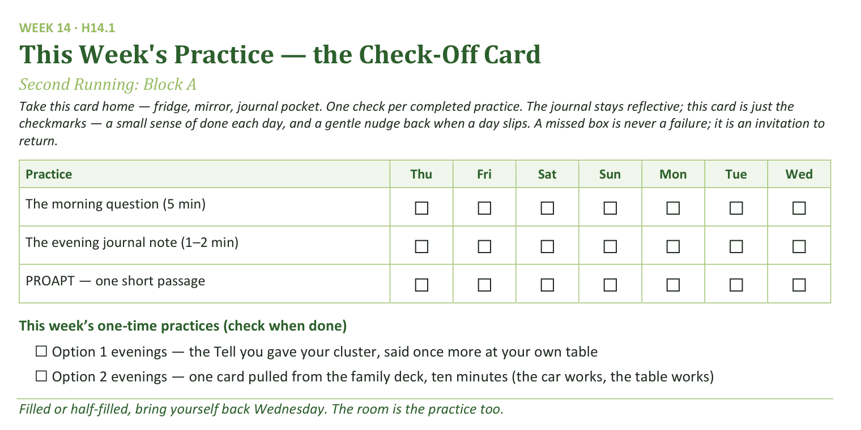
Your Take-Home Card — This Week’s Practice
Handed out now — fridge, mirror, journal pocket.
182
Notes:
W14 · ~5:12–5:19 · TEEN-LED (the merge block)
BEATS: 1. The daily rhythm continues: the morning question, the session note, PROAPT one short passage. 2. Option 1 nights: the Tell you gave your cluster, said once more at your own table this week. Option 2 nights: the family deck comes off the shelf once — one card, ten minutes; the car works, the table works. 3. A missed box is never failure — an invitation to return.
CUES: This lands in the teen's merge block (5:16 in Option 1, 5:12 in Option 2) — the teen says it, not you.

Slide 183
Closing the Container + Aaronic Blessing
• We close the way we opened — the container, six steps:
1 Stand again — same circle, same posture as the open
2 One-word landing — compare it to your opening word
3 The one thing you are taking from tonight
4 The one practice — committed aloud, or modified to one you will actually keep
5 Blessings — specific, witnessed, short
6 Closing prayer — and the Aaronic blessing, spoken over each other, face to face
THE AARONIC BLESSING — NUMBERS 6:24–26
“The Lord bless you and keep you;
the Lord make his face to shine upon you, and be gracious to you;
the Lord lift up his countenance upon you, and give you peace.”
183
Notes:
W14 · 5:19–5:23, blessing 5:27–5:30 · TEEN-LED
BEATS: 1. The teen runs the closing protocol: standing circle, one-word landing, the one thing, the one practice spoken aloud. 2. After the feedback round the teen returns for the send: next Wednesday is the Rhythm night — today was a rep of exactly that, the practice working without the team at the front. 3. Aaronic blessing, hands up; sent.
CUES: In Option 2, closing from memory completes the container half of the rep — let the teen carry all of it.

Slide 184
The Leader Feedback Round
• The evening’s leader goes first — three things, same as every week
– “What I think went well tonight: ______”
– “What I’d do differently next time: ______”
– “If I were to teach tonight’s process to someone, I would tell them: ______”
• Then the room — the same two questions about tonight
• The leader receives without defending — “thank you” is the whole response
184
Notes:
W14 · 5:23–5:27 · SHARED (Lead Companion runs)
BEATS: 1. The leading teen answers first: went well / do differently / what I'd tell someone teaching this. 2. The adult answers the two questions second, adds ONE specific affirmation of the lead and at most one growth item. 3. The room only by the teen's consent — ask aloud; popcorn, 'for you' language; two or three voices each. 4. Receive without defending — 'thank you' is the whole response.
GUARD: If the catch stepped in today, name what the teen did well FIRST; the stepping-in was the team working, not the teen failing. If the teen declines the room's round, it ends after the adult — no pressure, no exposure.

Slide 185

WEEK 15
The Rhythm and the Four Questions
The long walk installed before the sending — and four questions a parent dares to ask at their own kitchen table
Quarter 3: Mission & Rhythm
185
Notes:
W15 · pre-session · DIVIDER
On screen as families arrive. Greet at the door — the slide holds the room.

Slide 186
Week 15 — Tonight’s Road
1 Welcome and centering
2 Week 13 completion
3 The long walk — Gal. 6:9
4 The Rhythm Card introduced
5 Building your Rhythm Card
6 The Four Questions
7 The Leader Feedback Round
8 Between-week practice — the Rhythm Card begins; the Four Questions go home
9 Closing container + Aaronic blessing
186
Notes:
W15 · 4:15–4:22 · TEEN-LED (CiF)
BEATS: 1. The Companion-in-Formation carries today's rhythm arc — their fourth and final lead before Week 22; the Four Questions block belongs to the Lead Companion by design. 2. Frame the night: fourteen weeks of practices stop being something we come to and become something we carry — build your own rhythm in your own handwriting; then the parents receive the bravest homework of the series. 3. Name the gap warmly: the break is coming; momentum does not survive gaps — a rhythm does.
CUES: The Lead Companion sits where the senior can find their eyes all night.

Slide 187
Opening Container — the Eight Steps
1 Welcome — five minutes to open the container
2 Phones silenced and put away
3 Stand in a circle
4 One-word check-in — how you actually are, right now
5 Put out / bring in — set something down; bring a blessing in
6 Spoken commitment: “I am here. I am paying attention. I am willing to be moved.”
7 Opening prayer — “Holy Spirit, you are welcome here. Speak. We are listening.”
8 Sit. Begin.
187
Notes:
W15 · 4:15–4:22 · TEEN-LED (CiF, from memory)
BEATS: 1. The senior opens from memory: blessing first, then the container — Safe, Present, Clear, Intentional, same as every week. 2. Two things today: your rhythm, your handwriting; then four questions for the parents. 3. Unhurried — this is their ninth or tenth container rep, and Week 22 will ask for it in public.
CUES: Lead Companion in the senior's eyeline. Anything heavy is the adults' to hold — the senior never carries it.

Slide 188
Week 13 Completion — Finishing the Mission Week
• “Before we walk forward, we finish the Mission week” — unfinished downhill answers finish here
• Two weeks of living with the question usually deepens it — one sentence, now, to the room
• A parent opens the round; teens choose their own depth after — pass-anytime holds
• The answers carry forward to the Week 21 commissioning
• Practice check: one small action aligned with your downhill mission — ninety seconds, one sentence on what happened
188
Notes:
W15 · 4:22–4:26 · SHARED (Lead Companion)
BEATS: 1. Finish the Mission week: anyone whose downhill answer was unfinished, or has changed shape since — one sentence, now, to the room. 2. Receive each without commentary; the answers carry forward to the Week 21 commissioning. 3. Then the practice check, ninety seconds: one sentence on the one small action.
CUES: The arranged parent starts the round (Run Card) — never a cold call on a teen; teens choose their depth; pass anytime.

Slide 189
The Long Walk — Galatians 6:9
• The condition is not “if we feel it.” It is “if we do not give up” — Paul assumes the weariness
• The reaping is tied to the season, and the season is God's — our part is the not-giving-up
• Nobody white-knuckles their way through years; people with a rhythm walk through years
• The break is coming — what carries the practices across a gap is not momentum; it is a rhythm you built on purpose
• So we build it tonight, before the gap, not after it
GALATIANS 6:9 (ESV)
“And let us not grow weary of doing good, for in due season we will reap, if we do not give up.”
189
Notes:
W15 · 4:26–4:33 · TEEN-LED (CiF)
BEATS: 1. Read Galatians 6:9 slowly. 2. Teach it: Paul assumes the weariness; the condition is not giving up; the season is His — the not-giving-up is ours. Nobody white-knuckles through years; people with a rhythm walk through years. 3. Name the break plainly: for twelve weeks the room carried the practices; over the break there is no Wednesday. What crosses a gap is not momentum — it is a rhythm built on purpose, today, before the gap.
GUARD: For some families the breaks ARE the dry season — name that warmly from the front; Cluster Companions watch who flinches when it is named.

Slide 190
The Rhythm Card Introduced
• The whole series folded into one page — you have already received every practice on this card
• Daily — the morning question, the evening journal note, PROAPT if the season allows
• Weekly — one specific person who knows what you are working on, and a sabbath rhythm
• Monthly — a clearing time and a Four-Connects review. Seasonally — the deeper work
• One rule for the build: “write the rhythm you will actually keep, not the one that impresses you”
• The starter plan begins with two practices totaling six minutes a day — six honest minutes is a real rhythm
190
Notes:
W15 · 4:33–4:36 · TEEN-LED (CiF)
BEATS: 1. Rhythm Cards out of the folders: Daily (morning question, evening note, PROAPT if the season allows), Weekly (one named person, a sabbath rhythm), Monthly (clearing time, Four-Connects review), Seasonally. Nothing new — you are choosing what you actually take with you. 2. State the honesty rule; it is the whole exercise: write the rhythm you will actually keep, not the one that impresses you. 3. The starter floor is two practices, six minutes a day — six honest minutes is a real rhythm. 4. After the founder's morning-flow moment (next slide), send the clusters: families together, own handwriting. Go.

Slide 191




A Rhythm You Can See — One Morning Flow
GROUNDED
LISTENING
CHANGED, RIPPLING
LEAPING
The founder’s own morning flow — four images, one motto, kept for years. Yours will look different. The journal has a page waiting for it.
191
Notes:
W15 · 4:33–4:36 · SHARED (90 seconds inside the card intro)
BEATS: 1. Show where a kept card can go — four images, prayed in the same order every morning for years. 2. Walk them: a bench above an evening valley — drawn into God, grounded; a quiet chair with an open Bible — listening for His voice today; rings widening on still water — being changed, ripples reaching people never traced; a hiker mid-leap rock to rock — into the day, certain at each point. Grounding. Hearing. Changing. Leaping. 3. The invitation — never an assignment: as you keep your card, watch for your own four images; the journal has a page waiting.
SUB: These are John's images and John's morning flow, kept for years — present them AS his: this is our founder's rhythm; nobody assigned him these pictures — they became his by keeping them. Do not claim it as yours. Then the invitation stands unchanged.

Slide 192
Building Your Rhythm Card
• Twenty minutes in family clusters — in your own handwriting, on the build sheet
• Specific beats vague — “morning question, 6:50, kitchen table, before my phone” is a rhythm
• The weekly partner line is the most important line on the sheet — name an actual person
• Build down, not up — which two practices survive exam season? Start there; the card lets you add later
• Close: each participant reads their daily line aloud to the cluster — a parent first; pass-anytime holds
192
Notes:
W15 · 4:36–4:56 · FAMILY CLUSTERS
BEATS: 1. Everyone builds H15.2 in their own handwriting — never typed, never filled in for anyone; families build side by side. 2. Coach specificity: 'morning question, 6:50, kitchen table, before my phone' is a rhythm; a wish is not. 3. Coach DOWN, not up: which two survive exam season? Start there — the card lets you add later. 4. The weekly-partner line is the most important line on the sheet: an actual name. 5. Close with each person reading their daily line aloud to the cluster.
CUES: A parent reads first — arranged ahead (Run Card), never a cold call on a teen; pass anytime.
GUARD: A blank weekly line usually means 'nobody would want the job' — don't fix it in the cluster; note it for follow-up. Anything heavy goes to the adult after the cluster closes.

Slide 193
The Four Questions
• Parents, this next part is for you — nobody answers tonight. This week, at home, for the willing: unhurried, no audience, phone away, yours first
1 What has it been like to live with me all these years?
2 What have been my messages to you?
3 How have I wounded you?
4 What would you like from me going forward?
• The guards — willing only, both directions; receive without defending (listening questions and “thank you” only); invisible by default; a letter counts; the Section 6 boundary
PSALM 139:23–24
Asked of God, it is worship. Asked of your family, it is the bravest form of the same prayer.
James 1:19 — quick to hear, slow to speak.
193
Notes:
W15 · 4:56–5:19 · LEAD COMPANION (senior sits as a member)
BEATS: 1. Four questions on the board, in order, aloud — H15.3 has them exact. 2. Name the rehearsal: the weekly feedback round trained this posture. 3. The story (SUB). 4. Commission the willing; the card home in a parent's hand.
GUARD: Willing-only BOTH directions — pass is a full answer at home; alarm on a teen's face = repeat the guard 1:1 before they leave. Receive without defending; never punish an answer later; not ready means wait. Invisible by default — no audits. A letter counts; 'not yet' counts. Abuse or self-harm = Section 6. If it lands on someone mid-block, the second adult moves to them; keep presenting.
SUB: The block ends in the founder's own story of asking these at home. Summarize that John has done this himself — he never once regretted asking — or tell your own if you truly have one. Never claim his.

Slide 194
The Leader Feedback Round
• The evening’s leader goes first — three things, same as every week
– “What I think went well tonight: ______”
– “What I’d do differently next time: ______”
– “If I were to teach tonight’s process to someone, I would tell them: ______”
• Then the room — the same two questions about tonight
• The leader receives without defending — “thank you” is the whole response
194
Notes:
W15 · 5:19–5:23 · SHARED
BEATS: 1. The senior answers first — went well, do differently, what I'd tell someone teaching this. 2. The Lead Companion answers the two questions for the parts they carried. 3. The room, same two questions — two or three voices each. 4. Close by naming one thing the team watched grow across all four of the senior's leads — and say aloud that the room just heard what this round has been rehearsing all along. It sets the table for Week 22.
GUARD: Receive without defending — 'thank you' is the whole response.

Slide 195
Closing the Container + Aaronic Blessing
• We close the way we opened — the container, six steps:
1 Stand again — same circle, same posture as the open
2 One-word landing — compare it to your opening word
3 The one thing you are taking from tonight
4 The one practice — committed aloud, or modified to one you will actually keep
5 Blessings — specific, witnessed, short
6 Closing prayer — and the Aaronic blessing, spoken over each other, face to face
THE AARONIC BLESSING — NUMBERS 6:24–26
“The Lord bless you and keep you;
the Lord make his face to shine upon you, and be gracious to you;
the Lord lift up his countenance upon you, and give you peace.”
195
Notes:
W15 · 5:23–5:30 · SHARED (CiF opens, Lead Companion closes)
BEATS: 1. Practice, two pieces: for the willing, the four questions at home — the guards are on the card in their hand; for everyone, run the Rhythm Card as built and journal where it held and slipped — no guilt-engine. 2. The returning rule: miss a day, begin again on the next available day; returning, not streaks. 3. Name what happened today: a rhythm built by your own hand, and some houses about to have their most honest conversation in years. 4. Aaronic blessing — the senior speaks it, their last as a Companion-in-Formation.

Slide 196
Between-Session Practice — This Week and Across the Break
• The Four Questions (for the willing) — the parent asks their teen at home; married parents also ask their spouse, separately. “Not yet” is a full answer for everyone
• Run the Rhythm Card as built — for real, at the times and places written on it; the break is its first field test
• Journal the holds and the slips — one line a day; no fixing, no guilt-engine. The slips are data, not verdicts
• The returning rule — miss a day: begin again on the next available day. Do not start over; do not double up. Returning is the goal
• The morning question and evening note continue inside the rhythm — the practices have stopped being assignments and become a life
196
Notes:
W15 · 5:23–5:30 · SHARED
BEATS: 1. The Four Questions, willing only: unhurried, no audience, phone away, one person at a time; married parents also ask their spouse, separately. 2. Run the Rhythm Card as built — the break is its first field test. 3. One journal line a day: where it held, where it slipped — slips are data, not verdicts; nobody collects the journal. 4. The returning rule: begin again on the next available day.
GUARD: 'Not yet' is a full answer for everyone, and next week's check-in audits nothing.

Slide 197
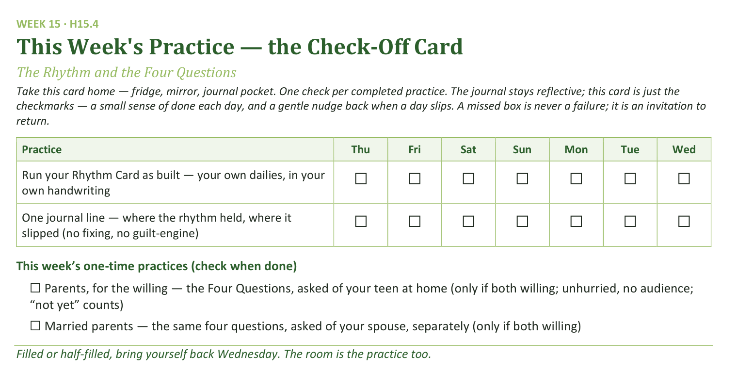
Your Take-Home Card — This Week’s Practice
Handed out now — fridge, mirror, journal pocket.
197
Notes:
W15 · 5:23–5:30 · SHARED
BEATS: 1. The check card rows: your own Rhythm Card dailies, plus one journal line on holds and slips. 2. The one-time boxes are willing-only: the four questions asked of your teen, and separately of your spouse — only if both willing; 'not yet' counts. 3. A missed box is never failure — an invitation to return; come back Wednesday either way.

Slide 198
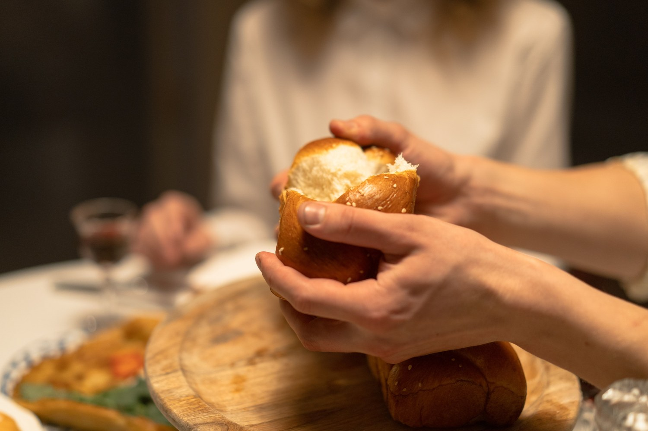
WEEK 16
Family Conversation Night
Cards and a shared meal — the night the year exhales
Quarter 3: Mission & Rhythm
198
Notes:
W16 · pre-session · DIVIDER
On screen as families arrive. Greet at the door — the slide holds the room.

Slide 199
Week 16 — Tonight’s Road
1 Welcome and opening container
2 Rhythm-noticing round
3 Acts 2:46 and the table grace
4 The meal
5 Cards over dessert
6 Pulse 3 framed and sent home
7 Leader Feedback Round
8 Closing container
199
Notes:
W16 · 4:15–4:22 · STANDING CIRCLE
BEATS: 1. Tell them the whole plan up front so nobody waits for the catch: we are going to eat together — that IS the session. A short round before food, a few good questions at dessert, one page at the end. 2. Tables today, not the circle — the one night of the year. 3. Nothing new is taught; the meal is the point.
GUARD: Do not program the meal — no devotional between courses, no teaching moment. Withholding content is today's team discipline.

Slide 200
Opening Container — the Eight Steps
1 Welcome — five minutes to open the container
2 Phones silenced and put away
3 Stand in a circle
4 One-word check-in — how you actually are, right now
5 Put out / bring in — set something down; bring a blessing in
6 Spoken commitment: “I am here. I am paying attention. I am willing to be moved.”
7 Opening prayer — “Holy Spirit, you are welcome here. Speak. We are listening.”
8 Sit. Begin.
200
Notes:
W16 · 4:15–4:22 · STANDING CIRCLE
BEATS: 1. Blessing first. 2. Container, briefly — Safe, Present, Clear, Intentional; it holds at a dinner table too. Phones silenced and away. 3. One word for how you actually are, around the circle; receive without commentary.
GUARD: Keep the open genuinely short — the room is smelling the food. A long preamble teaches the room the team cannot help itself.

Slide 201
Rhythm-Noticing Round
• One round before we eat — one sentence each
• “Where has your card held, or where has it slipped?”
• Both answers are welcome — a slip you noticed is the practice working, because noticing is the skill
• No fixing, no advice — a parent starts; pass-anytime holds
– “The card is a long walk; sixteen days in, everyone in this circle is still on it.”
201
Notes:
W16 · 4:22–4:26 · STANDING CIRCLE
BEATS: 1. One sentence each: where the Rhythm Card held, or where it slipped — both welcome; a noticed slip is the practice working. 2. No fixing, no advice, from anyone; if troubleshooting starts: good noticing — hold the fixing. 3. Close it: sixteen days in, everyone in this circle is still on the long walk.
CUES: The arranged parent opens (Run Card) — never a cold call on a teen; pass anytime.
GUARD: Watch quietly — whoever reports a slip with shame gets a warm follow-up this week; note it for the debrief, not the circle.

Slide 202
Acts 2:46 and the Table Grace
• Luke is describing the very first church — the most spiritually alive room in the history of the world
• The first church ran on three rails: the teaching, the table, and the prayers
• Our Wednesdays have lived on the teaching and the prayers — tonight is the table
• “Breaking bread with glad and generous hearts is not the break between the formation — it is the formation.”
• The grace — then: eat
ACTS 2:46 (ESV)
“And day by day, attending the temple together and breaking bread in their homes, they received their food with glad and generous hearts.”
202
Notes:
W16 · 4:26–4:28 · STANDING CIRCLE
BEATS: 1. Read Acts 2:46 — the first church, glad and generous hearts. 2. Thirty seconds of frame: the first church ran on three rails — the teaching, the table, the prayers; today is the table, and it IS the formation, not the break from it. 3. Pray the grace. 4. Send them to eat.

Slide 203
The Meal
• Real food, no agenda — no devotional between courses, no teaching moment
• “We are going to eat together. That's it. That's the session.”
• Phones silenced and put away — the people at your table tonight are the evening
• Dessert is held back — dessert arriving is the signal the cards are coming
203
Notes:
W16 · 4:28–4:59 · TABLES
BEATS: 1. No agenda — Companions sit and eat as members of their tables; the cohort needs to see its Companions laugh at dinner. 2. Watch faces gently, especially the Week 15 watch-list: a family sitting close and quiet, a parent with full eyes, a teen who won't look up — nobody names it today; offline contact within 48 hours. 3. Keep the food moving; note who is missing for the Sought Stray line.
GUARD: The allergy list is law — posted, current, every dish labeled with its allergens; the food-safety lead owns the serving table. Never ask, at a table or from the front, whether the Four Questions happened — invisible by default.

Slide 204
Cards over Dessert
• A small stack on your table — someone reads the first card aloud; a parent answers first, every table, every card
• Then anyone who wants to answers, in any order — nobody has to. When the card feels done, read the next one
1 One footprint — “Looking back at this past month — one place you can see God's hand more clearly now than you did at the time.”
2 Where you came alive — “What activity, conversation, or work this season has made you most alive? Why?”
3 The ten-year question — “What's one thing you hope is still true between us in ten years?”
• No report-out — what is said at your table stays at your table. Ten minutes of laughing at your dad's answer is not a failure of the exercise — that IS the exercise
204
Notes:
W16 · 4:59–5:19 · TABLES
BEATS: 1. Dessert lands and the card stack comes out — frame it from your seat; standing up breaks the spell. 2. How it works: read the card aloud; a parent answers first, every table, every card; anyone who wants answers; nobody has to; next card when it feels done. 3. Two rules said aloud: no report-out — what is said at your table stays there; and there is no wrong way for this to go.
GUARD: Laughter is a fully valid outcome — ten minutes laughing at dad's answer IS the exercise. Two cards done well beats three done fast. A card that finds a tender place: warmth, no working it at the table; a Companion follows up offline.

Slide 205
Pulse 3 Framed and Sent Home
• The Quarterly Pulse, third one this year — one page, three questions, about five minutes, at home
1 Presence — how present have I actually been in these sessions this quarter? Not attendance, presence (1–10, and one sentence why)
2 Surprise — one thing that has surprised me this quarter — about myself, about God, or about someone in this room
3 Steering — one specific way I want to engage differently in the final quarter
• “This room steers by these pages” — the final quarter, the consolidation weeks and the two commissionings, is shaped by what you write
• Back next Wednesday, in the bin at the door — signed or unsigned, your choice; nobody watches the bin
205
Notes:
W16 · 5:19–5:22 · WHOLE ROOM (seated)
BEATS: 1. One unhurried minute, no apology: this is the Quarterly Pulse, third of the year — one page, three questions, about five minutes at home. 2. Say the deal plainly: this room steers by these pages; the final quarter is built from what you write. 3. Back in the bin at next Wednesday's door — nobody watches the bin; signed or unsigned, your choice.
GUARD: 'Sorry to end a fun night with paperwork' undoes the instrument — frame it as steering, never homework.

Slide 206
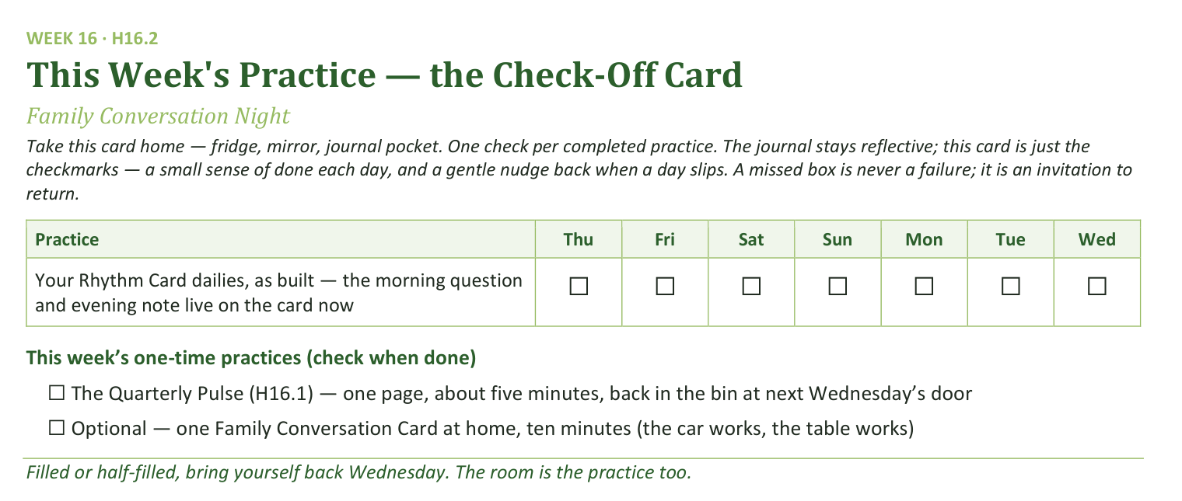
Your Take-Home Card — This Week’s Practice
Handed out now — fridge, mirror, journal pocket.
206
Notes:
W16 · 5:19–5:22 · WHOLE ROOM
BEATS: 1. One daily row: your Rhythm Card dailies as built — the morning question and evening note live on the card now. 2. One-time boxes: the Pulse, five minutes, back in the bin next Wednesday; optional — one Family Conversation Card at home, ten minutes. 3. A missed box is never failure — an invitation to return.

Slide 207
The Leader Feedback Round
• The evening’s leader goes first — three things, same as every week
– “What I think went well tonight: ______”
– “What I’d do differently next time: ______”
– “If I were to teach tonight’s process to someone, I would tell them: ______”
• Then the room — the same two questions about tonight
• The leader receives without defending — “thank you” is the whole response
207
Notes:
W16 · 5:22–5:26 · WHOLE ROOM
BEATS: 1. Same round, even on a dinner night — especially today; the round on an easy evening is what keeps it ordinary. 2. The leader's three, then the room's two questions — two or three voices each. 3. Receive without defending — 'thank you' is the whole response.
CUES: Expect food commentary; take it seriously — next year's family night is built from today's answers.

Slide 208
Closing the Container + Aaronic Blessing
• We close the way we opened — the container, six steps:
1 Stand again — same circle, same posture as the open
2 One-word landing — compare it to your opening word
3 The one thing you are taking from tonight
4 The one practice — committed aloud, or modified to one you will actually keep
5 Blessings — specific, witnessed, short
6 Closing prayer — and the Aaronic blessing, spoken over each other, face to face
THE AARONIC BLESSING — NUMBERS 6:24–26
“The Lord bless you and keep you;
the Lord make his face to shine upon you, and be gracious to you;
the Lord lift up his countenance upon you, and give you peace.”
208
Notes:
W16 · 5:26–5:30 · STANDING CIRCLE
BEATS: 1. Same circle as the start; one word for what is happening in you as we close. 2. Two thank-yous: every hand that cooked and served, and the cleanup crew by name; everyone clears their own place. 3. The week: five minutes with the Pulse, bin at the door next Wednesday; keep walking your card, slips and all. 4. Aaronic blessing. Go home glad.

Slide 209

WEEK 17
The Float
The evening that absorbs the year’s surprises — or walks the rhythm together
Quarter 3: Mission & Rhythm
209
Notes:
W17 · pre-session · DIVIDER
On screen as families arrive. Greet at the door — the slide holds the room.

Slide 210
Week 17 — Tonight’s Road
1 Mode A — a missed evening’s plan runs tonight, whole and unchanged
2 Mode B — the live Rhythm-Card walk: leaders first, slipped cards welcome
3 The borrow round — take ideas from each other’s cards shamelessly
4 Quarterly Pulse returns to the bin at the door
5 One practice chosen to carry across the break
6 The Leader Feedback Round
7 Closing container + Aaronic blessing
210
Notes:
W17 · 4:15–5:30 · DUAL MODE — confirm A or B before the night
BEATS: 1. Today is the Float, the quarter's shock absorber, and it runs ONE of two modes, decided by what the quarter needs: an evening was lost (snow, assembly, illness) = Mode A, that session runs whole; the quarter ran clean = Mode B, the room walks its Rhythm Cards together. 2. The call was made at the team prep meeting, 48 hours out — never game-day — and families were told by the weekend before. Confirm with the team which mode was called, and prepare from that mode's plan. 3. Either mode: the Pulse bin sits at the door, one break practice is commissioned, and the feedback round and blessing close the quarter.

Slide 211
Mode A — The Missed Evening Runs Whole
• If the quarter lost an evening — the snow, the assembly, the bug — tonight runs that session's plan, unchanged
• “Tonight is not a make-up class squeezed in. Tonight IS [session name] — whole, unhurried, the evening you were always going to get.”
• “Nothing was skipped this year; it just moved.”
• The lifted plan runs whole — its blocks, its scripts, its splits; only its closing yields to tonight's quarter-close constants
PROVERBS 16:9 (ESV)
“The heart of man plans his way, but the LORD establishes his steps.”
211
Notes:
W17 · 4:15–5:13 · MODE A — THE LIFTED SESSION
BEATS: 1. Bless, then say the reframe once, warmly: we lost [date] to [cause]; this afternoon exists in the calendar for exactly this — today IS [session name], whole, not a make-up. Nothing was skipped; it just moved. 2. At 4:20 hand the room to the lifted plan — its blocks, scripts, splits, and watch-fors run from its own run sheet, prepped via the lift checklist at the prep meeting. 3. Today's constants resume at 5:13: the break practice, the feedback round, the close.
GUARD: Trim the lifted plan's closing, never its center. If the lifted session is teen-led, its leadership spec applies, re-rehearsed. Its crisis contingencies travel with it — re-read at prep.

Slide 212
Mode B — The Live Rhythm-Card Walk
• If the quarter ran clean, the whole room walks its actual Rhythm Cards aloud — “the real ones, not the ideal ones”
• The leaders walk first — and walk genuinely slipped cards honestly; the whole evening stands on that
• Two or three minutes each: daily, weekly, monthly, as lived — holds and slips in the same voice
• Glad out loud about holds; never guilt about slips — “a slip you noticed is the practice working”
• “If you want help with a slip, ask for it, and we will spend a minute on it together. If you do not, name it and keep walking.”
• Everyone walks their own card — parents never their teen's; pass-anytime holds tonight like every night
212
Notes:
W17 · 4:15–5:13 · MODE B — THE RHYTHM WALK
BEATS: 1. Open: container, one word — we lost nothing this quarter; today we walk the real cards, not the ideal ones. 2. Proverbs 16:9, short: we planned the way; the LORD established the steps. 3. Leaders walk FIRST (4:28–4:38), genuinely slipped cards — the session stands on this; open with the slip. 4. The room walks (4:38–5:13): 2–3 min each, daily/weekly/monthly as lived; troubleshoot one minute only when invited; listen like a thief.
CUES: The arranged parent opens the room's round (Run Card) — never cold-call a teen; pass anytime.
GUARD: A noticed slip is the practice working — quote the Returning Rule from the front. Parents walk their OWN card, never their teen's. Perfect cards and eyes-down passes get a warm word after, not a spotlight. A slip that is really a household in trouble: bless it, don't troubleshoot, follow up in 48 hours.

Slide 213
The Borrow Round
• “Listen like a thief. If you hear an idea you want — a time of day, a trick, a place to keep the card — take it.”
• “That is not cheating. That is what a fellowship is for.”
• One sentence around the circle: one idea you heard tonight that you are stealing — name it, and the person you stole it from
• Fast, light — pass-anytime
213
Notes:
W17 · 5:13–5:20 · MODE B, SHARED CIRCLE
BEATS: 1. Fast and light: one sentence each — one idea you heard today that you are stealing, and who you stole it from. 2. Stealing is the point — that is what a fellowship is for. 3. Then move straight into the break-practice commissioning; it shares this window.
CUES: Pass anytime; keep the round quick — the commissioning needs its minutes.

Slide 214
Quarterly Pulse — Back in the Bin
• The return bin sits by the door — drop your Pulse 3 page as you arrive
• Nobody watches the bin; nobody is asked whether they dropped a page
• Spares sit beside it for those who forgot — a page next week is as welcome as a page tonight
• The team reads every page — the Quarter 4 planning conversation starts from what these pages say
214
Notes:
W17 · 6:45–4:15 arrival · EITHER MODE
BEATS: 1. The return bin sits by the door, labeled, spare Pulse pages beside it. 2. Pages drop in as families arrive — greeted, never checked. 3. Nobody watches the bin; nobody is asked whether they dropped a page; a page next week is as welcome as a page today.
GUARD: The bin is never a checkpoint. The team collects and reads every page this week — Quarter 4 is planned from them, and that promise is kept visibly.

Slide 215
One Practice Across the Break
• The break starts tomorrow — and we have done this before: at Christmas, every one of us carried one practice across the gap, and at The Return we heard what held
• Look at your card and choose ONE practice — just one — to carry through this break deliberately
• Not the whole card; the whole card can rest — that is sabbath, not failure
• Write it in your journal right now — the practice, and when, and where
• Then, one sentence around the circle: the practice you are carrying — “speaking it is part of carrying it”
• The Returning Rule travels: begin again on the next available day. At The Return II the first question will be the kind one: what held?
215
Notes:
W17 · 5:13–5:20 (Mode B) / 5:13–5:19 (Mode A) · EITHER MODE
BEATS: 1. Name the precedent: this same move carried the cohort across Christmas, and it worked. 2. Choose ONE practice from your card — just one — carried deliberately through the break; the rest of the card is allowed to rest. Sabbath, not failure. 3. Write it in the journal NOW — the practice, when, where; give the room the full quiet minute. 4. One sentence around the circle: the practice you are carrying — speaking it is part of carrying it. 5. The Return II opens with the kind question: what held?
GUARD: Never minimize the break from the front — 'see you in a couple weeks' is how practices die. The Returning Rule travels: begin again on the next available day.

Slide 216
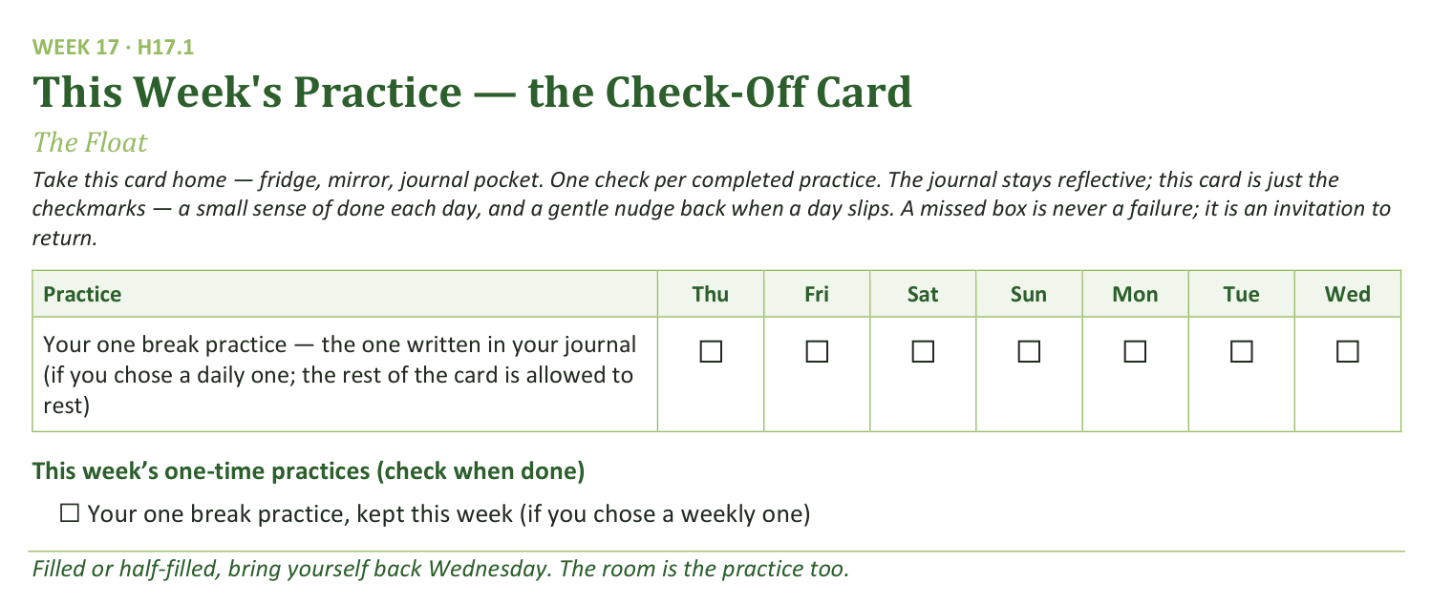
Your Take-Home Card — This Week’s Practice
Handed out now — fridge, mirror, journal pocket.
216
Notes:
W17 · 5:23–5:30 (B) / 5:25–5:30 (A) · EITHER MODE
BEATS: 1. One row on the card: your one break practice, the one written in your journal — daily row if daily, weekly box if weekly. 2. Everything else rests on purpose — a card suspended on purpose beats a card half-kept in guilt. 3. A missed box is never failure — begin again on the next available day; see you at The Return II.

Slide 217
The Leader Feedback Round
• The evening’s leader goes first — three things, same as every week
– “What I think went well tonight: ______”
– “What I’d do differently next time: ______”
– “If I were to teach tonight’s process to someone, I would tell them: ______”
• Then the room — the same two questions about tonight
• The leader receives without defending — “thank you” is the whole response
217
Notes:
W17 · 5:20–5:23 (B) / 5:19–5:25 (A) · EITHER MODE
BEATS: 1. The session's leader answers the three first — in Mode A that is the lifted session's leader, per its plan. 2. Then the room, same two questions — two or three voices each. 3. Receive without defending — 'thank you' is the whole response.

Slide 218
Closing the Container + Aaronic Blessing
• We close the way we opened — the container, six steps:
1 Stand again — same circle, same posture as the open
2 One-word landing — compare it to your opening word
3 The one thing you are taking from tonight
4 The one practice — committed aloud, or modified to one you will actually keep
5 Blessings — specific, witnessed, short
6 Closing prayer — and the Aaronic blessing, spoken over each other, face to face
THE AARONIC BLESSING — NUMBERS 6:24–26
“The Lord bless you and keep you;
the Lord make his face to shine upon you, and be gracious to you;
the Lord lift up his countenance upon you, and give you peace.”
218
Notes:
W17 · 5:23–5:30 (B) / 5:25–5:30 (A) · EITHER MODE
BEATS: 1. Standing circle, one word each. 2. Name the quarter closed: three walked, one to go — consolidation and the two commissionings; dates come in the break communication. 3. The send: one practice on purpose, everything else rests; if even the one goes down, begin again on the next available day. The Return II asks the kind question first: what held? 4. Aaronic blessing. Go rest — see you on the other side.
CUES: Every family leaves knowing which Companion is reachable over the break, and how.

Slide 219
Quarter 4
Consolidation & Sending
Weeks 18–22 · Five Wednesdays · the mercy cards, The Long Walk, two commissionings
219
Notes:
Q4 · pre-session · DIVIDER
On screen as families arrive. Greet at the door — the slide holds the room.

Slide 220

WEEK 18
The Return II
A lighter homecoming — the room knows the way now, and the year begins to hand itself over
Quarter 4: Consolidation & Sending
220
Notes:
W18 · pre-session · DIVIDER
On screen as families arrive. Greet at the door — the slide holds the room. Name tags out one more time; the year's last re-entry gets the same welcome as its first. Doors close at 4:15 and a Companion-in-Formation opens.

Slide 221
Week 18 — Tonight’s Road
1 Opening container
2 Not growing weary — Gal. 6:9, Phil. 1:6
3 “What held” — the whole room
4 The final stretch — the map
5 Between-session practice
6 Closing container
7 Leader Feedback Round
8 Aaronic blessing and sending
221
Notes:
W18 · 4:15–5:30 · SHARED CIRCLE
BEATS:
1. Frame the night light: Return II, not Return I — the room knows how to come back now; say it out loud and let the session prove it.
2. Walk the road: teen-led open, two verses, a one-sentence what-held round, the final-stretch map, practice, close.
3. One circle all night — no clustering.
GUARD: A light night still gets a full listening — read every check-in word closely; the break may have been hard in some house. Section 6 and the two-adult rule hold today as every night.

Slide 222
Opening Container — the Eight Steps
1 Welcome — five minutes to open the container
2 Phones silenced and put away
3 Stand in a circle
4 One-word check-in — how you actually are, right now
5 Put out / bring in — set something down; bring a blessing in
6 Spoken commitment: “I am here. I am paying attention. I am willing to be moved.”
7 Opening prayer — “Holy Spirit, you are welcome here. Speak. We are listening.”
8 Sit. Begin.
222
Notes:
W18 · 4:15–4:22 · SHARED CIRCLE
BEATS:
1. The Companion-in-Formation runs the full eight steps from memory, normal pace — nothing changes because a teen holds it; that is the point.
2. Sit where the teen can find your eyes; otherwise stay out of the way.
3. Receive every check-in word; the adults read them as closely as ever.
CUES: Timing Companion starts discreetly at 4:15 and notes the minute the room is truly present — expect it fast; the speed is the year's work showing, and it goes in the log.
GUARD: Do not shadow the open or add a welcome on top of the teen's — over-carrying teaches the room it still needs carrying.

Slide 223
Not Growing Weary — Galatians 6:9 and Philippians 1:6
• At the Rhythm week this verse was a warning; tonight, on the far side of a break, it is a receipt — you did not give up. You are here
– “And I am sure of this, that he who began a good work in you will bring it to completion at the day of Jesus Christ.” — Philippians 1:6 (ESV)
• The not-giving-up is not white-knuckling: the work being completed in you is His. He began it; He finishes it
• “Our rhythm is not the engine — it is the showing-up that keeps us where the engine is running.”
• The last re-entry of the year — look how fast the room came back. That is what it looks like when the practices start belonging to you
GALATIANS 6:9 (ESV)
“And let us not grow weary of doing good, for in due season we will reap, if we do not give up.”
223
Notes:
W18 · 4:22–4:29 · SHARED CIRCLE
BEATS:
1. Read Galatians 6:9 then Philippians 1:6 aloud from the physical Bible. Brief — the room already owns the first verse.
2. Teach: at the Rhythm week the verse was a warning; today it is a receipt — the chair they are sitting in is the not-giving-up it asks for.
3. Phil 1:6 names why it is not white-knuckling: He began the work; He finishes it; the rhythm just keeps us where the engine runs.
4. Land the observation: last re-entry of the year — look how fast the room came back; the practices belong to them now.

Slide 224
“What Held” — the Whole Room
• One sentence each, full circle — a harvest reading, not an examination
• “What held from your card across the break — or what slipped and got begun again?”
• Holds and slips are both good news tonight — both mean the card is real and you are reading it honestly
• A parent starts; brisk and warm; pass-anytime holds — laughter is allowed and likely
– “In September that round would have taken an hour and a crowbar. The practices are yours now.”
“When your children ask their fathers in times to come, ‘What do these stones mean?’”
— JOSHUA 4:21 (ESV)
224
Notes:
W18 · 4:29–4:54 · SHARED CIRCLE
BEATS:
1. One sentence each, full circle: what held from your Rhythm Card across the break — or what slipped and got begun again.
2. Keep it brisk and celebratory — a harvest reading, not an examination; holds and slips are both good news; laughter is allowed and likely.
3. If a sentence becomes a story, receive warmly and keep the circle turning.
4. Close: the room just read itself in one pass, nobody coaxed — best finding of the year; and Joshua's question is about to change hands.
CUES: The arranged parent (Run Card) gives the first sentence — never a cold call on a teen. A Companion quietly tallies how many reported a daily practice holding — numbers only, no names.
GUARD: A slip that sounds like a hard break, not a busy one — nearest Companion notes it and follows up at the door; the round does not stop.

Slide 225
The Final Stretch — the Map
1 Week 19 — our Companions-in-Formation teach the two mercy cards — the Signs Card and the Path Home Card — in your clusters
2 Week 20 — The Long Walk: the seniors teach the whole room; journals come along, and the testimony gathering begins
3 Week 21 — Sending and Blessing: whole families, a longer evening — two hours, 4:15 to 6:15
4 Week 22 — the Commissioning of the Companions, in front of everybody who watched them grow
• Hear the shape of that list: week by week, the people up front stop being us and start being you
• The sentence to keep: “the year now begins to hand itself over”
225
Notes:
W18 · 4:54–5:12 · SHARED CIRCLE
BEATS:
1. Write the five lines live on the whiteboard, saying each: Wk 19 the teens teach the two mercy cards in clusters; Wk 20 The Long Walk — the seniors teach the whole room, journals come; Wk 21 Sending and Blessing — whole families, a TWO-HOUR night; Wk 22 the Commissioning of the Companions.
2. Land the frame sentence: the year now begins to hand itself over — that was always the plan.
3. Three asks: come, bring your journal, bring the whole family to Week 21 — calendar it today, date visible on the board.
CUES: This script says 4:15–6:00 for Week 21, but the Week 21 plan runs food 6:00, session 6:30–5:30 — confirm the times in the family email before announcing.
GUARD: Watch the teens both ways — seniors hearing their commissioning named get a word of honor at the door; the teen who feels the ending gets warmth this week, not correction today.

Slide 226
Between-Session Practice
• Run your Rhythm Card as built — nothing new, nothing extra; if the break knocked a piece loose, begin again on the next available day
• The evening note, one extra flavor: note where you see God already handing pieces of this year over to you
• For the parents, said once: the Four Questions door is still open — willing-only, whenever the moment is right; nobody will ever check. The questions keep
• Bring your journal — and put Week 21's two hours on the calendar tonight
226
Notes:
W18 · 5:12–5:15 · SHARED CIRCLE
BEATS:
1. Co-Companion (Parent) leads: run the Rhythm Card as built — nothing new; if the break knocked a piece loose, begin again on the next available day.
2. Evening-note flavor this week: note where you see God already handing pieces of the year over to you.
3. The Four Questions word to parents — one paragraph, spoken to the middle distance, moved past without pausing for reaction: willing-only, not-yet counts, nobody checks.
GUARD: It is a door left ajar, not a knock. If any parent looks cornered, repeat the guards 1:1 before they leave; whatever they say afterward, receive, encourage, audit nothing.

Slide 227
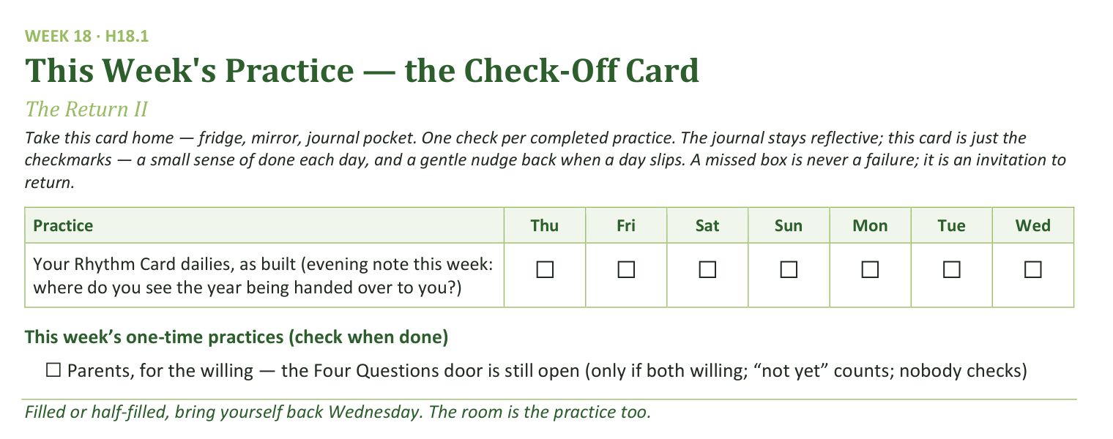
Your Take-Home Card — This Week’s Practice
Handed out now — fridge, mirror, journal pocket.
227
Notes:
W18 · 5:12–5:15 · SHARED CIRCLE
BEATS:
1. Hold up the check-off card (H18.1): one daily row — the Rhythm Card dailies as built, with this week's evening-note question.
2. One one-time box: the Four Questions door, willing parents only.
3. Say the card's own rule: a missed box is never a failure; it is an invitation to return.

Slide 228
Closing the Container + Aaronic Blessing
• We close the way we opened — the container, six steps:
1 Stand again — same circle, same posture as the open
2 One-word landing — compare it to your opening word
3 The one thing you are taking from tonight
4 The one practice — committed aloud, or modified to one you will actually keep
5 Blessings — specific, witnessed, short
6 Closing prayer — and the Aaronic blessing, spoken over each other, face to face
THE AARONIC BLESSING — NUMBERS 6:24–26
“The Lord bless you and keep you;
the Lord make his face to shine upon you, and be gracious to you;
the Lord lift up his countenance upon you, and give you peace.”
228
Notes:
W18 · 5:15–5:21 · SHARED CIRCLE
BEATS:
1. The Companion-in-Formation runs closing steps 1–5: stand; one-word landing (compare to the opening word — the contrast is data); the one thing; the one practice (the card, as built); the blessings.
2. Expect the blessings step to lean toward the seniors today — let it.
3. Hold the Aaronic blessing — today it comes AFTER the feedback round, on the final slide.
CUES: Blessing form = one short, specific, witnessed sentence of what someone saw the Father doing in another person today — not a speech.

Slide 229
The Leader Feedback Round
• The evening’s leader goes first — three things, same as every week
– “What I think went well tonight: ______”
– “What I’d do differently next time: ______”
– “If I were to teach tonight’s process to someone, I would tell them: ______”
• Then the room — the same two questions about tonight
• The leader receives without defending — “thank you” is the whole response
229
Notes:
W18 · 5:21–5:26 · SHARED CIRCLE
BEATS:
1. The teen who led answers first: what went well, what I'd do differently, what I'd tell someone teaching today's process.
2. The Lead Companion answers the first two, briefly, for the blocks they carried.
3. Then the room — same two questions; two or three voices each; leaders receive without defending — 'thank you' is the whole response.
CUES: The round may be dropped if the room's energy needs something else; dropping it twice running goes to the team debrief.

Slide 230
Aaronic Blessing and Sending
• “One sentence for the road: you came back tonight like people who know the way — because you do now.”
• “Five weeks to the sending. Let us not grow weary; the season is His, and it is nearly harvest.”
• “See you Wednesday. Week 19 — the teens have the cards.”
NUMBERS 6:24–26
“The Lord bless you and keep you; the Lord make His face shine on you and be gracious to you; the Lord turn His face toward you and give you peace.”
230
Notes:
W18 · 5:26–5:30 · SHARED CIRCLE
BEATS:
1. One sentence for the road: you came back like people who know the way — five weeks to the sending; the season is His, and it is nearly harvest.
2. Speak the Aaronic blessing (Numbers 6:24–26), hands up if you want.
3. Send them glad: see you Wednesday — Week 19, the teens have the cards.

Slide 231

WEEK 19
Second Running: Block B
The rehearsal — the Companions-in-Formation teach the two mercy cards in the small room, one week before they teach them in the large
Quarter 4: Consolidation & Sending
231
Notes:
W19 · pre-session · DIVIDER
On screen as families arrive. Greet at the door — the slide holds the room. Folders at each seat with both mercy cards in them; the CiFs set their first cluster spaces; tissues in every cluster space. Doors close at 4:15.

Slide 232
Week 19 — Tonight’s Road
1 Welcome and opening container
2 The frame — why these two cards
3 Bridge and split
4 First teaching rep — both cards
5 Cluster feedback — one keep, one adjust
6 Second teaching rep — both cards, tightened
7 Second cluster feedback
8 Merge and between-session
9 Closing container
10 Leader Feedback Round
11 Aaronic blessing and sending
232
Notes:
W19 · 4:15–5:30 · SHARED CIRCLE
BEATS:
1. Today is the rehearsal: the Companions-in-Formation teach the Signs Card and the Path Home Card in family clusters — twice each, coached — one week before they teach the whole room.
2. Shape: frame, split, first rep, keep-and-adjust feedback, rotation, tightened second rep, second feedback, merge, close.
3. Adults coach from inside the cluster, light touch — at most one whispered cue per rep; the rehearsal is the CiF's room.
GUARD: Teach the card, never probe the person — 'take out the card,' never 'which column are you in.' Any live disclosure passes to the cluster adult at once, and the handoff is honored publicly as leadership, not failure.

Slide 233
Opening Container — the Eight Steps
1 Welcome — five minutes to open the container
2 Phones silenced and put away
3 Stand in a circle
4 One-word check-in — how you actually are, right now
5 Put out / bring in — set something down; bring a blessing in
6 Spoken commitment: “I am here. I am paying attention. I am willing to be moved.”
7 Opening prayer — “Holy Spirit, you are welcome here. Speak. We are listening.”
8 Sit. Begin.
233
Notes:
W19 · 4:15–4:22 · SHARED CIRCLE
BEATS:
1. A Companion-in-Formation opens with the full protocol from memory — the weekly free rep.
2. The open goes to a CiF who is NOT teaching first-round in their strongest cluster, so the session's reps spread rather than stack.
3. Receive every check-in word; read the room — today's subject is dryness, and somebody is statistically in it right now.

Slide 234
The Frame — Why These Two Cards
• Sooner or later, everyone who walks with God hits a dry season — and the dangerous thing is not the dryness, it is the wrong diagnosis
• The Signs Card — so a misread dry season never ends a journey in this room
• The Path Home Card — the written door back, and it ends the way Luke 15 ends: the father runs
• Tonight is a rehearsal — the small room before the large one. Your cluster is their first congregation.
• At the end, your cluster gives its teacher two gifts: one thing to keep, and one thing to adjust
• Tonight is about the cards, not anyone’s current season — nobody will be asked where they are
2 TIMOTHY 2:2
“and what you have heard from me in the presence of many witnesses entrust to faithful men, who will be able to teach others also.”
Four generations in one sentence — Paul, Timothy, the faithful, and the others also. Tonight you are watching the third handoff happen.
234
Notes:
W19 · 4:22–4:28 · SHARED CIRCLE
BEATS:
1. Everyone takes out both cards. Why they exist: the danger of a dry season is the wrong diagnosis, and the way back must be written down — the father runs.
2. Read 2 Timothy 2:2 — four generations in one sentence; today the room watches the third handoff happen.
3. Name the rehearsal plainly and warmly: small room before the large one; your cluster is their first congregation, and at the end it gives its teacher two gifts — one keep, one adjust.
4. End gently: today is about the cards, not anyone's current season — but if a column has your name on it, the adult in your cluster is there for exactly that.
GUARD: Say from the front that nobody will be asked where they are — it keeps the promise true in the clusters.

Slide 235
Bridge and Split
• Each cluster named — its families, its adult, its first-round Companion-in-Formation
• Pray — for the teachers by name, and for any dry ground in the room, unnamed
• Then split — receive your teacher, and work the cards with them
235
Notes:
W19 · 4:28–4:29 · SHARED CIRCLE
BEATS:
1. Name each cluster: its families, its adult coach-and-catch, its first-round teacher.
2. Pray briefly — for the teachers by name, and for any dry ground in the room, unnamed.
3. Split fast — the teaching minutes are protected.
CUES: About ten or fewer in the room? Small-room variation: one circle, two CiFs split the cards, feedback after each, then a compressed second pass with the cards swapped — everyone still teaches twice.

Slide 236
First Teaching Rep — Both Cards
1 The Signs Card (~13 min) — the one question: “Which way does the desire point?” Then the four kinds of dry, from the card’s own table
– Cases 3 and 4 — one says resist, the other says receive; opposite motions. When you cannot tell which you are in, do not decide alone.
2 The Path Home Card (~10 min) — the five steps, and the reception: it ends with a feast, not a hearing
– “The door is not locked. The light is on.”
3 Close (~2 min) — both cards go home tonight; this week your family gives them a findable spot
• Questions of information are welcome — the teacher answers them. The adults hold every door that opens.
LUKE 15:20
“while he was still a long way off, his father saw him and felt compassion, and ran”
236
Notes:
W19 · 4:29–4:51 · FAMILY CLUSTERS
BEATS:
1. The CiF teaches both cards: Signs ~13 min — the sorting question (which way does the desire point?), the four kinds of dry, cases 3 and 4 command OPPOSITE motions (resist vs receive; when unsure, do not decide alone), the four rules; Path Home ~10 — five steps, the father runs, the door is not locked; close ~2 — the findable spot.
2. Adult sits inside the circle, coaching light — one whispered cue at most ('desire question' is usually the only one needed); everything else to the note sheet.
CUES: Teen-taught block — the adult sits where the teacher can find their eyes. If anything live surfaces the adult receives it at once while the CiF keeps teaching; a stumble is never the story of the night.
GUARD: Redirect probing and diagnosing gently and immediately — quote the card's own rule so the correction lands on the card, not the person.

Slide 237
Cluster Feedback — One Keep, One Adjust
• The adult models first — one specific keep, one specific adjust
– Specific means quotable: “keep the way you paused after the desire question” — not “you did great”
• Then a parent adds one; one or two more voices if brief — teens welcome
• The teacher receives without defending — “thank you” is the whole response
• Both gifts go on the note sheet — this block is the reason the evening exists
237
Notes:
W19 · 4:51–4:58 · FAMILY CLUSTERS
BEATS:
1. The adult models first — one specific keep, one specific adjust; quotable, never 'you did great.'
2. The arranged parent adds next (Run Card); one or two brief voices more, teens welcome.
3. The CiF receives without defending — 'thank you' is the whole response; the adult writes both gifts down.
4. Rotation at 4:56: 'Teachers, travel' — each CiF one cluster clockwise, adjust in hand; the new cluster does not hear the old feedback.
CUES: The adjust is the point of the rehearsal — a rehearsal with no adjusts was wasted. Keeps and adjusts are per-teacher coaching, never a leaderboard.

Slide 238
Second Teaching Rep — Both Cards, Tightened
• “Teachers, travel.” Each teacher moves one cluster over, adjust in hand — the new cluster is a clean room
• The same arc, compressed — Signs ~11 min, Path Home ~8, close ~1
• The compression is the second rep’s own skill — same spine, fewer words, the load-bearing minutes untouched
– The desire question — resist versus receive — the father runs
• The adjust from Round 1 gets tried here, while it is warm
238
Notes:
W19 · 4:58–5:15 · FAMILY CLUSTERS
BEATS:
1. Same arc, tightened: Signs ~11, Path Home ~8, close ~1 — same spine, fewer words; the load-bearing minutes untouched (the desire question, resist-versus-receive, the father runs).
2. Watch specifically for the Round-1 adjust being tried while warm — that is what this rep is for.
3. Against the clock? The agreed fallback: Signs Card in full; Path Home in its two sentences — the father runs; the door is not locked — with the card in every hand. Next week restores the whole.
CUES: Same posture as Rep 1 — anything live goes to the adult instantly and the teaching continues.

Slide 239
Second Cluster Feedback
• Same shape, briefer — the adult’s keep and adjust, then one cluster voice
• The keep, wherever honest, names the adjust that got tried
• Both recorded per teacher — these notes are next week’s prep meeting
239
Notes:
W19 · 5:15–5:19 · FAMILY CLUSTERS
BEATS:
1. Same shape, briefer: the adult's keep and adjust — the keep, where honest, naming the adjust that got tried — then one cluster voice.
2. Record both per CiF; these notes travel in writing to The Long Walk prep meeting.
3. Hold it to four minutes — the merge is waiting.

Slide 240
Merge and Between-Session
• One practice this week — the easiest assignment of the year: the two cards go home and get a spot
• Somewhere findable — a drawer everyone knows about, the kitchen cabinet door, inside the family Bible. Decide the spot together.
• If all goes well, they will sit there gathering dust for years. That is the job — the cards wait.
• Next Wednesday is The Long Walk — the whole room, the whole teaching, these same teachers. Come ready to receive them again.
240
Notes:
W19 · 5:19–5:22 · SHARED CIRCLE
BEATS:
1. One practice, the easiest of the year: both cards go home and get a findable spot — a drawer everyone knows, the cabinet door, the family Bible — decided together, in the car today if you like.
2. Say the strange truth: if all goes well the cards gather dust for years; the person who someday needs them will not be in a room like this when they do. The cards wait.
3. Name next week: The Long Walk — whole room, whole teaching, these same teachers. Come ready to receive them again.

Slide 241
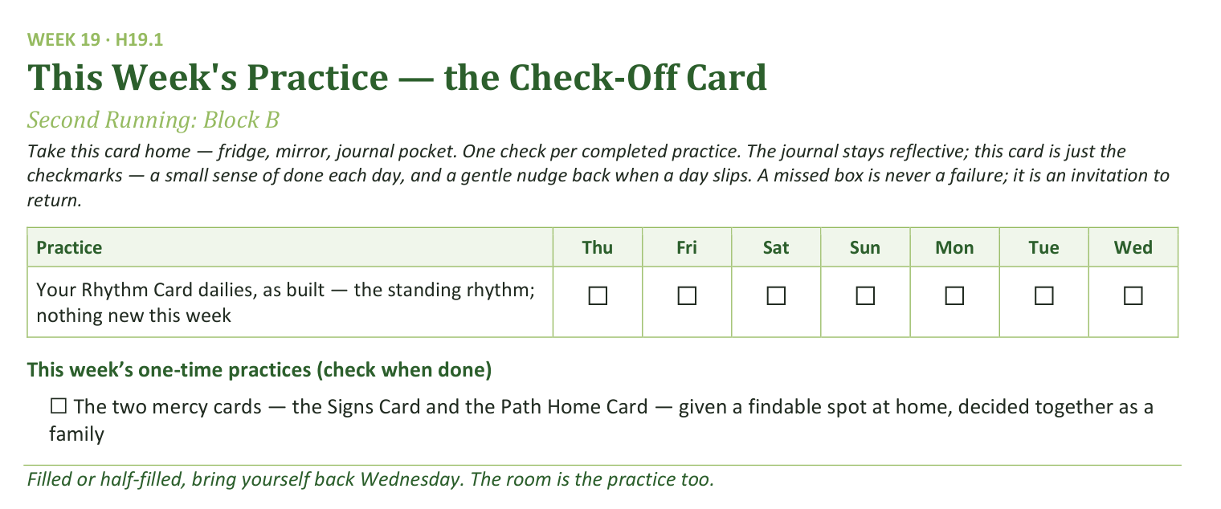
Your Take-Home Card — This Week’s Practice
Handed out now — fridge, mirror, journal pocket.
241
Notes:
W19 · 5:19–5:22 · SHARED CIRCLE
BEATS:
1. Check-off card H19.1: the Rhythm Card dailies as built — the standing rhythm, nothing new this week.
2. One one-time box: the two mercy cards given a findable spot at home, decided together as a family.
3. A missed box is never a failure; it is an invitation to return.

Slide 242
Closing the Container + Aaronic Blessing
• We close the way we opened — the container, six steps:
1 Stand again — same circle, same posture as the open
2 One-word landing — compare it to your opening word
3 The one thing you are taking from tonight
4 The one practice — committed aloud, or modified to one you will actually keep
5 Blessings — specific, witnessed, short
6 Closing prayer — and the Aaronic blessing, spoken over each other, face to face
THE AARONIC BLESSING — NUMBERS 6:24–26
“The Lord bless you and keep you;
the Lord make his face to shine upon you, and be gracious to you;
the Lord lift up his countenance upon you, and give you peace.”
242
Notes:
W19 · 5:22–5:24 · SHARED CIRCLE
BEATS:
1. A CiF runs the close, brief today: standing circle, one-word landing, the one thing, the one practice.
2. The one practice is the findable spot — committed aloud by a voice from each family.
3. Hold the Aaronic blessing — today it comes after the feedback round; a CiF speaks it at the very end.

Slide 243
The Leader Feedback Round
• The evening’s leader goes first — three things, same as every week
– “What I think went well tonight: ______”
– “What I’d do differently next time: ______”
– “If I were to teach tonight’s process to someone, I would tell them: ______”
• Then the room — the same two questions about tonight
• The leader receives without defending — “thank you” is the whole response
243
Notes:
W19 · 5:24–5:30 · SHARED CIRCLE
BEATS:
1. The CiFs answer first, together: what went well, what they'd do differently — next week IS the next time — and one sentence on what they'd tell someone teaching this.
2. The Lead Companion answers second for the whole evening, plus one specific affirmation of the teachers AS A GROUP; individual coaching stays in the cluster notes.
3. Room feedback only by the CiFs' consent — any one of them may decline for all; two or three voices, received undefended.
4. Then a CiF sends the room (5:27): Aaronic blessing, hands up — cards to their spot this week; see you at The Long Walk.

Slide 244
WEEK 20
The Long Walk
The dry-season teaching comes home — taught to the whole room by its own senior teens, the night before the sendings
Quarter 4: Consolidation & Sending
244
Notes:
W20 · pre-session · DIVIDER
On screen as families arrive. Greet at the door — the slide holds the room. Journals spotted at the door — quiet paper to anyone without one, no fuss, no spotlight. Folders each hold a fresh Signs Card and Path Home Card; survey stack and return bin visible by the door. Doors close at 4:15.

Slide 245
Week 20 — Tonight’s Road
1 Welcome and centering
2 Why tonight — Isaiah 50:10
3 The Signs Card — taught by a CiF
4 The Path Home Card — taught by a CiF
5 The journal arc review
6 One sentence, and the testimony gathering
7 The Post-Series Survey
8 The Leader Feedback Round
9 Closing container
245
Notes:
W20 · 4:15–5:30 · SHARED CIRCLE
BEATS:
1. Frame: nothing new is asked of the room today — it receives. The seniors teach the year's weightiest pastoral equipment (their final rep before commissioning); then the journals walk the year back; then testimonies are gathered for the two sendings.
2. Shape: open, why-today, Signs Card (CiF), Path Home Card (CiF), journal review, clusters for one sentence and the gathering, survey, feedback, close.
3. The whole team's job all night: hold the floor steady under the teaching seniors.
GUARD: The dry-season teaching will describe somebody's current life — the adults watch faces; nobody is looked at or asked; the follow-up is offline within 48 hours. Section 6 protocols stand.

Slide 246
Opening Container — the Eight Steps
1 Welcome — five minutes to open the container
2 Phones silenced and put away
3 Stand in a circle
4 One-word check-in — how you actually are, right now
5 Put out / bring in — set something down; bring a blessing in
6 Spoken commitment: “I am here. I am paying attention. I am willing to be moved.”
7 Opening prayer — “Holy Spirit, you are welcome here. Speak. We are listening.”
8 Sit. Begin.
246
Notes:
W20 · 4:15–4:22 · SHARED CIRCLE
BEATS:
1. The senior opens from memory: blessing first, phones away, the container reminder, the shape of the night, then the standard protocol whole.
2. Sit where the senior can find your eyes and otherwise do nothing.
3. Resist adding a welcome on top of the senior's welcome — this is one of the last container reps before Week 22 asks for it in public.

Slide 247
Why Tonight — Isaiah 50:10
• In two weeks this room stops meeting — the next two Wednesdays are sendings, not endings. On the other side: a summer with no Wednesday in it.
• Somewhere out there — this summer, or in twenty years — every person in this room will hit a season where the practices go gray
• The most dangerous thing on the long walk is not the dryness — it is the wrong diagnosis of the dryness
• So tonight we hand you the equipment for that season — on purpose, at the threshold, before anyone needs it
• Psalm 23:4 — “Even though I walk through the valley of the shadow of death, I will fear no evil, for you are with me.” The road goes through.
• Now the teaching — in the seniors’ voices, not ours
ISAIAH 50:10
“Who among you fears the LORD and obeys the voice of his servant? Let him who walks in darkness and has no light trust in the name of the LORD and rely on his God.”
247
Notes:
W20 · 4:22–4:28 · SHARED CIRCLE
BEATS:
1. Name the threshold honestly: in two weeks the room stops meeting; on the other side of the sending is a summer with no Wednesday — and someday a season where the practices go gray and a voice misdiagnoses it.
2. Land the key phrase: we hand out this equipment BEFORE anyone needs it — it gives the person currently dry cover; everyone receives, no one is looked at.
3. Read Isaiah 50:10 slowly from the physical Bible — fearing, obeying, AND walking in darkness, all at once; then step back. Do not preach it.
4. Introduce the teachers by name and hand them the room.
GUARD: Seven minutes, no more — the night belongs to the seniors.

Slide 248
The Signs Card — the Four Kinds of Dry
• The danger is not the dryness — it is the wrong diagnosis. One question sorts everything: “Which way does the desire point?”
1 Neglect — the desire has faded and the distance doesn’t ache; the world tastes fine. First step: wake and turn — rebuild the rhythm
2 Worn out — the desire is buried under duty; you want escape, not God. First step: rest — a lighter yoke, smaller faithful steps, stay put
3 The enemy’s dry wind — accused, pressured, a voice counseling change: quit, undo, leave. First step: resist — change nothing, pray a little more, tell someone
4 God’s own stripping — the desire intact and starving; the ache is the sign. First step: receive — wait, stay faithful, stay accompanied
• Three and four command opposite motions — one says fight, the other says yield. When you cannot tell which you are in, do not decide alone — that is what Companions are for.
– Four rules on the card — your own heart only; in every case, tell someone; no big decisions in the dark; know when to call the doctor
THE SENTENCE TO CARRY HOME
“The fact that His absence hurts you is the evidence that He has not gone. Drifting hearts do not ache. Abandoned fields do not thirst. A dry season is not a verdict.”
248
Notes:
W20 · 4:28–4:44 · SHARED CIRCLE
BEATS:
1. CiF 1 teaches standing, card as a net, six numbered points: why the card exists; the tide; the sorting question written LARGE (Which way does the desire point?); the four columns ~1 min each; cases 3 and 4 — opposite motions, never decide alone; the four rules and the carry-home sentence (the ache is the evidence He has not gone).
2. From the floor: hold steady and stay out of the teaching.
CUES: The named adult catch sits in the senior's sight line — close enough to step in inside three seconds, never beside them. Freeze-recovery: the catch picks up at the next numbered point and hands back the moment the senior reaches for it. A stumble is never the story of the night.
GUARD: If the teaching visibly lands on someone, a SECOND adult (not the catch) moves quietly to sit beside them; the teaching continues; the senior never holds the person.

Slide 249
The Path Home Card — the Written Door
• For the one who leaves and concludes a room like this would not want them back — most churches leave the way back unwritten. Not here.
1 Come as you are — conviction is specific and hopeful and draws you toward home; shame is vague and hopeless and drives you away
2 Tell it straight — to God in plain words, and to one trusted person; you choose the person and how much
3 Grieve what needs grieving — lament is faith with tears in its voice
4 Return to the table — small; do not start over, begin again on the next available day
5 Let it be celebrated — in the Lord’s own story of return, the ending is not a probation meeting. It is a feast.
• The witnessed filing — everyone files the card now, while we watch each other do it: “The door is not locked. The light is on.”
LUKE 15:20
“But while he was still a long way off, his father saw him and felt compassion, and ran and embraced him and kissed him.”
The father was watching the road. He ran first, embraced first, and asked for no accounting before the robe.
249
Notes:
W20 · 4:44–4:54 · SHARED CIRCLE
BEATS:
1. CiF 2 teaches with their own named catch, five points: why the card exists; the five steps; Luke 15:20 read exactly — the father runs; both sides of the door (how to return AND how to receive a returner); the witnessed filing.
2. The filing is a real moment, not a logistic — ten full seconds of silence; let the room hear the folders close: the door is not locked; the light is on.
CUES: Same catch and freeze-recovery as the Signs block — pick up at the next numbered point, hand back when the senior reaches for it; a stumble is never the story of the night.
GUARD: An adult moves to sit beside anyone the teaching lands on; the teaching continues; the senior never holds the person. Section 6 stands.

Slide 250
The Journal Arc Review
• Take out your journal — the one you have been writing in since September. If yours is missing, take paper and walk the year from memory.
• Go back to the beginning and read forward — you’re walking the road again, not re-taking the class
1 Where did I begin?
2 Where did He meet me? — mark those pages; fold a corner
3 What do I not want to lose?
• Twelve minutes, in quiet — parents and teens both. Then find your one sentence.
250
Notes:
W20 · 4:54–5:08 · QUIET INDIVIDUAL
BEATS:
1. Uncover the three prompts on the board: Where did I begin? / Where did He meet me? / What do I not want to lose?
2. Send them to page one first — the question they wrote on night one — then forward through the year, folding corners at the pages where something happened.
3. Then 12–15 genuinely quiet minutes — no music, no walking commentary; Companions visibly read their own journals; every adult walks the same road.
4. Two-minute warning, softly: find your one sentence — you will share exactly one in your cluster, nothing more.
GUARD: A missing journal gets paper and memory, no fuss. Watch faces gently; approach mid-block only for real distress (Settle Protocol, quietly).

Slide 251
One Sentence, and the Testimony Gathering
• One sentence each — where He met you this year, or what you don’t want to lose. Just the sentence; no story around it. A parent starts.
• Pass-anytime holds — a pass gets the same nod a sentence gets
• Then one more invitation, genuinely optional: your sentence, read aloud at the sendings — Week 21 or Week 22
• Written down exactly as you say it, read back for your nod — signed or anonymous, your choice
• “An empty card is a complete answer.” Nothing written, nothing noted, and nobody will ask again.
251
Notes:
W20 · 5:08–5:19 · FAMILY CLUSTERS
BEATS:
1. One-sentence round (~8 min): one sentence each from the review — no story around it; the arranged parent opens (Run Card), never a cold call on a teen; a pass gets the same nod a sentence gets.
2. The gathering (~8 min): genuinely optional — willing sentences written on a card VERBATIM, read back for the owner's nod, marked signed or anon.
3. Cards go into the Companion's pocket, not a pile — pastoral material from that moment on.
CUES: An empty card is a complete answer; decliners leave zero footprint — no card, no list, no follow-up ask. If a teen glances at a parent first, add lightly: families don't have to match.
GUARD: A sentence with something heavy inside gets received and blessed, never written on a card — hand it to the adult team after the cluster closes. A sentence naming another person needs that person's veto today.

Slide 252
The Post-Series Survey
• The bookend to orientation’s Pre-Series Survey. Home tonight; back in the bin at the Week 21 door.
• This is a pilot — the first year this has ever run, anywhere. Your honest answers — especially the critical ones — are a gift to families you will never meet.
• The same covenant covers it: no scores, no grades, mirrors not levers
• One per person — parents and teens each do their own. About twenty minutes. Signed or anonymous, your choice.
252
Notes:
W20 · 5:19–5:22 · SHARED CIRCLE
BEATS:
1. Co-Companion (Parent) frames H20.1 WITHOUT apology: this is a pilot's first year anywhere; honest answers — especially the critical ones — are a gift to families they will never meet.
2. The covenant holds: no scores, no grades, mirrors not levers; signed or anonymous.
3. Home today, one per person — parents and teens each their own; back in the bin at the Week 21 door.
CUES: An apologized-for instrument returns half-empty — warm and unapologetic is the register.

Slide 253
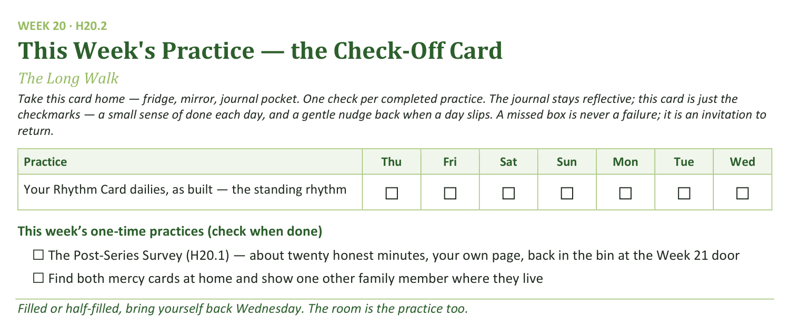
Your Take-Home Card — This Week’s Practice
Handed out now — fridge, mirror, journal pocket.
253
Notes:
W20 · 5:19–5:22 · SHARED CIRCLE
BEATS:
1. Check-off card H20.2: the Rhythm Card dailies, as built.
2. Two one-time boxes: the survey — twenty honest minutes, back in the Week 21 bin — and finding both mercy cards at home and showing one other family member where they live.
3. The cards gathering dust is the hope; everyone knowing the drawer is the point.

Slide 254
The Leader Feedback Round
• The evening’s leader goes first — three things, same as every week
– “What I think went well tonight: ______”
– “What I’d do differently next time: ______”
– “If I were to teach tonight’s process to someone, I would tell them: ______”
• Then the room — the same two questions about tonight
• The leader receives without defending — “thank you” is the whole response
254
Notes:
W20 · 5:22–5:25 · SHARED CIRCLE
BEATS:
1. Frame it: all year the journal has ended with 'if you were to teach this, what would you tell them?' — today the seniors stopped answering on paper and taught. They go first, together.
2. The seniors assess their own rep honestly, including anything that wobbled; then the room, two or three voices; received undefended — 'thank you' is the whole response.
3. Close the round with one specific witnessed sentence about what the room received because its own seniors carried the teaching.
CUES: If a freeze happened and the catch stepped in, honor it here in one sentence — the recovery was the leadership — never manage it away.

Slide 255
Closing the Container + Aaronic Blessing
• We close the way we opened — the container, six steps:
1 Stand again — same circle, same posture as the open
2 One-word landing — compare it to your opening word
3 The one thing you are taking from tonight
4 The one practice — committed aloud, or modified to one you will actually keep
5 Blessings — specific, witnessed, short
6 Closing prayer — and the Aaronic blessing, spoken over each other, face to face
THE AARONIC BLESSING — NUMBERS 6:24–26
“The Lord bless you and keep you;
the Lord make his face to shine upon you, and be gracious to you;
the Lord lift up his countenance upon you, and give you peace.”
255
Notes:
W20 · 5:25–5:30 · SHARED CIRCLE
BEATS:
1. Practice, two small pieces: the survey home and back; both mercy cards found at home and shown to one family member.
2. One-sentence summary: the dark stretch is not a verdict; the ache is the evidence He has not gone; the door is not locked and the light is on. This room now knows that — rooms that do are where people come home.
3. Name the two nights ahead: Week 21 sends the families — bring everyone; Week 22 commissions these Companions.
4. Standard closing protocol, then the Aaronic blessing, hands up. Go gently.

Slide 256

WEEK 21
Sending and Blessing
Family commissioning, the integration of the four Connects, and the bridge to Going Deeper
Quarter 4: Consolidation & Sending
256
Notes:
W21 · pre-session · DIVIDER
On screen as families arrive. Greet at the door — the slide holds the room. TONIGHT IS 120 MINUTES: light food at 4:00, session at 4:15, close at 6:15. Visiting family without the twenty weeks of context get a warm brief at the door and a familiar Companion beside them. Survey return bin visible at the door.

Slide 257
Week 21 — Tonight’s Road
1 Welcome and integration teaching
2 Brief blessing rehearsal
3 Reading and prayer
4 Family commissionings
5 Final reflection circle
6 Rhythm Card and Going Deeper bridge
7 The Leader Feedback Round
8 Final blessing and sending
257
Notes:
W21 · 4:15–6:15 · SHARED CIRCLE
BEATS:
1. Name the night: the Family Commissioning — a 120-minute night, extended on purpose; everything serves the hour in the middle.
2. Shape: integration teaching, blessing rehearsal, reading and prayer, the family commissionings (~55 min, the heart), reflection circle, Rhythm Card and Going Deeper bridge, feedback (droppable today), final blessing.
3. Hold the schedule — the time-keeper has real authority; 120 minutes must not become 150; the closing matters more than running long.
GUARD: Every absent-parent situation was pre-planned with the family — stand-in, cohort standing, or community blessing only. Decided in advance, never improvised on the night.

Slide 258
Welcome and Integration Teaching
• Fourteen Wednesdays — the soil of the heart, our stories, confession and restoration, hearing God in scripture, the gardens of our hearts, the quiet doubts, what was prepared for us
• Tonight is the integration. The four Connects are not separate disciplines — they are a sequence: Self, Others, God, Mission. Each one creates the conditions for the next.
• They are also a way of life — lived in family, witnessed in community
• Tonight: each parent-and-teen pair stands in the center; each speaks a specific witnessed blessing over the other; the whole community speaks the Aaronic blessing over each family
• If you are new tonight: your job is to bear witness. Your presence is the gift.
258
Notes:
W21 · 4:15–4:30 · SHARED CIRCLE
BEATS:
1. Welcome the new alongside the old — 'find a seat with your family' — and speak the Aaronic blessing over the room first, as every week.
2. Walk the year in one paragraph: the four Connects — Self, Others, God, Mission — a sequence and a way of life, done piece by piece across twenty Wednesdays.
3. Name today's specific act: each parent-and-teen pair stands center; each speaks a specific witnessed blessing over the other; the community seals each family with the Aaronic blessing.
4. To the visitors: you may not have words for what was done here — that is fine; your presence is the gift; today you bear witness.

Slide 259
Brief Blessing Rehearsal — the Form
• Three sentences. Just three. The worksheet you got Friday has the form.
1 “What I have specifically seen God doing in you across Getting Started is _____.” Something you actually noticed.
2 “What I bless in you tonight is _____.” Something true about who they are.
3 “What I commit to you in our relationship moving forward is _____.” Something you will actually do.
• The brevity is the discipline — we are not making speeches; we are speaking truth in front of witnesses
• Two Companions demo a real blessing, then brief questions
259
Notes:
W21 · 4:30–4:40 · SHARED CIRCLE
BEATS:
1. Walk the three-sentence form aloud: what I have specifically seen God doing in you; what I bless in you today; what I commit to you moving forward.
2. Two Companions demo a real blessing — brief, specific, honest, never theatrical; the parents calibrate against this demo.
3. Brief Q&A, one or two questions; do not over-explain — the worksheet and the demo already taught it. Trust the room.
CUES: Blessing form = one specific witnessed sentence per line, not a speech — the brevity is the discipline; say it twice before the commissionings begin.
SUB: The demo blessing must be the speakers' own — real words about a real person they know. A covering leader never performs a borrowed blessing; if you are new to this room, demo with a Companion you genuinely know, or let two Cluster Companions carry the demo.

Slide 260
Reading and Prayer
• Two scriptures before we begin — the blessing itself, and what we are commissioning each other into
• The Aaronic blessing is not a generic prayer — it is the specific words God gave Aaron and his sons to speak over Israel. When we speak it over each other, we are not improvising.
• Philippians 1:6 — Getting Started is not the completion; it is part of the beginning. The next stretch is a longer work that is His to finish, not ours.
– “And I am sure of this, that he who began a good work in you will bring it to completion at the day of Jesus Christ.” — Philippians 1:6
• Then prayer over the commissioning to come
NUMBERS 6:24–26
“The Lord bless you and keep you;
the Lord make his face to shine upon you and be gracious to you;
the Lord lift up his countenance upon you and give you peace.”
260
Notes:
W21 · 4:40–4:50 · SHARED CIRCLE
BEATS:
1. Read Numbers 6:24–26, then Philippians 1:6, from the physical Bible.
2. Two framings, 90 seconds total: the Aaronic blessing is covenantal — the words God specifically authorized, not improvisation; and Getting Started is part of the beginning — the work is His to finish.
3. Pray over the commissioning to come, then move — the families are ready.

Slide 261
Family Commissionings
• Each family in turn — parent and teen stand in the center; the rest of the family stands behind them in support
1 Brief framing — “We have walked with [name] through Getting Started; we have seen _____.”
2 Teen blesses parent first — the three sentences
3 Parent blesses teen — the three sentences
4 “Family of [last name], the community now blesses you.” The whole room speaks the Aaronic blessing aloud together, slowly.
• If you freeze — take your time, or ask the other person to read your worksheet for you. If you cry, that is fine. The room can wait.
261
Notes:
W21 · 4:50–5:45 · SHARED CIRCLE
BEATS:
1. Per family (~5–7 min): call them center, family standing behind; ONE framing sentence per member; teen blesses parent FIRST; parent blesses teen; the room speaks the Aaronic over them; 30 seconds of breath between families.
2. Running long? Compress the framing — never the blessings.
3. A frozen teen: 'Take your time — or your mom can read it for you.' An overwhelmed parent: wait; most recover; if not, name the worksheet's heart with permission.
CUES: Blessing form = one specific witnessed sentence per line, not a speech.
GUARD: Absent-parent plans were pre-decided — stick to them. Real conflict surfacing: stop, step aside with the family, no interpreting in the room; Section 6, backup within the hour.
SUB: The framing must be witnessed truth — speak the team's prepared line per family (Run Card) as theirs; never invent a witness you did not see.

Slide 262
Final Reflection Circle
• Around the circle, each person: one specific takeaway from Getting Started, and one specific next commitment — about thirty seconds each
– The takeaway can be small — “I learned that I can name a doubt without losing my faith.” “I learned that my dad sees me.”
– The commitment can be small too — “I will keep the morning question.” “I will tell my mom one true thing this week.”
• You can pass. Visiting family can pass — or share if you want to. The Cluster Companions go first; a parent opens for the families.
262
Notes:
W21 · 5:45–5:55 · SHARED CIRCLE
BEATS:
1. Around the circle: one specific takeaway, one specific next commitment — about thirty seconds each, brisk. Small counts: 'I will keep the morning question' is a real commitment.
2. Cluster Companions go first to model; then the arranged parent opens for the families (Run Card) — never a cold call on a teen; pass-anytime holds; visitors may pass or share.
3. Receive without commentary — eye contact, slight nod; do not summarize anyone's sentence.

Slide 263
Rhythm Card and Going Deeper Bridge
1 The Daily / Weekly / Monthly Rhythm Card — daily: the morning question and an evening journal note; weekly: one person who knows what you are working on; monthly: a clearing time. It is your card, in your handwriting.
2 The Going Deeper bridge — twelve Wednesdays. Decide on your own time. Tonight is not a recruiting pitch.
3 The Post-Series Survey — the bin at the door tonight, or email it this week. The next group of families benefits from your honesty.
• If a daily practice slips — do not start over from scratch; start the next day. Streaks are not the point. Returning is the point.
263
Notes:
W21 · 5:55–6:05 · SHARED CIRCLE
BEATS:
1. Three practical things, warm and brief: the Daily/Weekly/Monthly Rhythm Card (H21.3 is a fresh copy — it is their card, in their handwriting); the Going Deeper bridge (H21.4 — dates, details, registration; decide on your own time); the Post-Series Survey — bin at the door today, or email this week.
2. Today is a sending, not a recruiting pitch — some families will continue, some will not, and both are good. Say it plainly and leave it there.

Slide 264
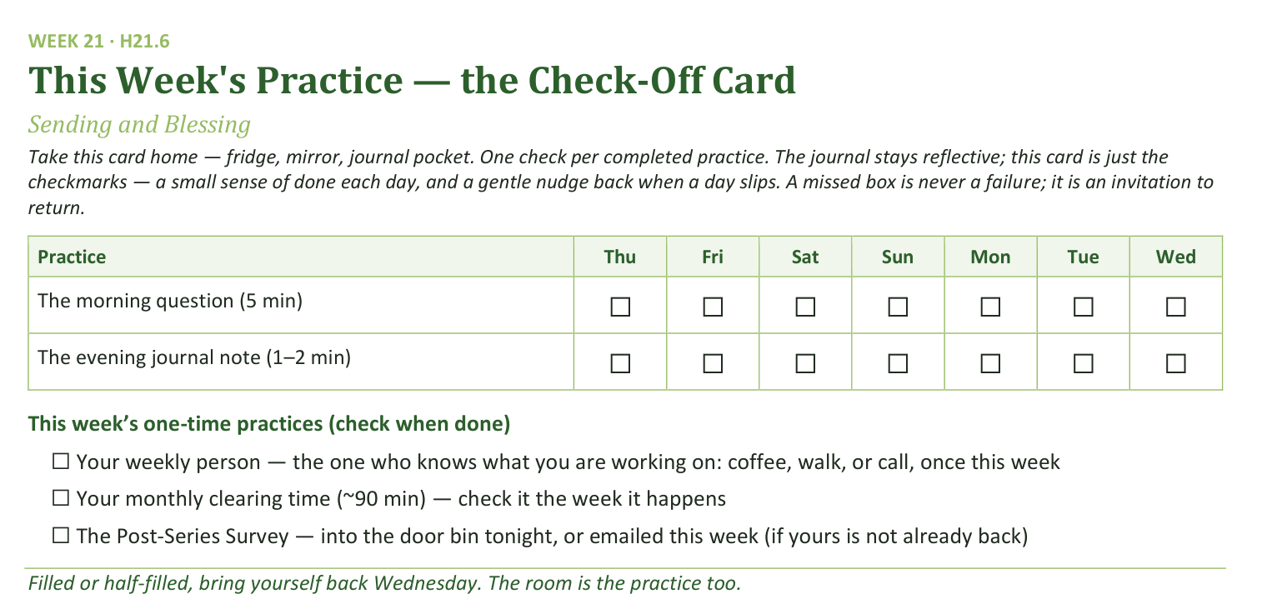
Your Take-Home Card — This Week’s Practice
Handed out now — fridge, mirror, journal pocket.
264
Notes:
W21 · 5:55–6:05 · SHARED CIRCLE
BEATS:
1. Check-off card H21.6: the morning question (5 min) and the session journal note (1–2 min), daily through the interlude.
2. One-time boxes: the weekly person who knows what you are working on; the monthly clearing time; the survey if not already back.
3. A missed box is never a failure; it is an invitation to return — streaks are not the point, returning is.

Slide 265
The Leader Feedback Round
• The evening’s leader goes first — three things, same as every week
– “What I think went well tonight: ______”
– “What I’d do differently next time: ______”
– “If I were to teach tonight’s process to someone, I would tell them: ______”
• Then the room — the same two questions about tonight
• The leader receives without defending — “thank you” is the whole response
265
Notes:
W21 · 6:05–6:15 · SHARED CIRCLE
BEATS:
1. Feedback round, standard shape — the leader's three answers, then the room, received undefended. On a commissioning night it may well be dropped: the ceremony is often the something-else the energy needs; dropping it twice running goes to the debrief.
2. Final blessing (6:10): the whole community speaks the Aaronic over the whole community — hands up, together, slowly. Pause; let the silence land.
3. 'You are sent. Walk gently.' Then announce Week 22 — the commissioning of the Companions; it is their night, and everyone is wanted in the room for it.
4. After the sending, do not pack up. Stay — some will not leave for an hour; the work after the closing is sometimes the work.

Slide 266

WEEK 22
Commissioning the Companions
The exit gate as a witnessed rite — the seniors leave having begun, not finished
Quarter 4: Consolidation & Sending
266
Notes:
W22 · pre-session · DIVIDER
On screen as families arrive. Greet at the door — the slide holds the room. Note the early times today: 4:15 open, 5:30 close, dessert after. Single wide circle, open center, no table; keepsake sheets and pens staged on the side table; the physical Lab-date card in the Lead's pocket.

Slide 267
Week 22 — Tonight’s Road
1 Welcome and framing
2 The final rep — the container opened
3 The word over the night
4 The three rules read aloud
5 The covering named
6 The commissioning
7 The first Lab scheduled
8 The Leader Feedback Round
9 The final rep — the container closed
267
Notes:
W22 · 4:15–5:30 · SHARED CIRCLE
BEATS:
1. Name the night: the seniors are commissioned FC1 — an exit gate run as a witnessed rite, not a graduation; nobody is leaving — the gate opens inward, onto a serving place in this body.
2. Four movements: the final rep (container opened and closed from memory), the three rules read aloud, the covering named, the commissioning — with Lab 1 on the calendar before anyone leaves.
3. The seniors lead; the adults confirm and bless; the cohort witnesses.
GUARD: Any unconfirmed sign-off was settled privately weeks ago — NEVER discovered today. If the team somehow arrives unsettled, stop and settle before the session, even at the cost of a delay. Section 6 protocols stand.

Slide 268
Welcome and Framing — a Gate, Not a Graduation
• Last week we commissioned the families. Tonight we commission the Companions — and this is not a graduation. Nobody is leaving; tonight opens a door further in.
• The seniors become FC1 — Formation Companion, Level One: a serving place in this body. Not finishing something — beginning something.
1 The final rep — the container opened and closed from memory, no script
2 The three rules that never bend, read aloud to the whole room
3 The covering named — the adult each new FC1 calls when they are over their head
4 The commissioning — blessing spoken over each one, and the first Leader Lab on the calendar before anyone leaves
268
Notes:
W22 · 4:15–4:18 · SHARED CIRCLE
BEATS:
1. Five minutes total — the small budget is the point; the night is handed over fast.
2. Say the distinction plainly: a graduation sends you out of a room; today opens a door further in — FC1 means a serving place in this body, beginning, not finishing.
3. Name the four movements so the room can follow the architecture — and flag the last one: the Lab date before anyone leaves is the proof today is a beginning.
4. Close: 'Seniors, the room is yours' — lean in one more time, because true things deserve witnesses.

Slide 269
The Final Rep — the Container Opened
• Container fluency is FC1’s spine competency — Safe, Present, Clear, Intentional, from memory, without a script. Tonight is the witness of it, not the exam.
• One senior opens the container whole — welcome, phones, the standing circle, one-word check-in, put out / bring in, the spoken commitment, opening prayer
– “I am here. I am paying attention. I am willing to be moved.”
• Every other senior speaks one condition from memory — in their own words, with one short true story of holding it while leading this year
• One senior is held in reserve — tonight’s close is theirs
• The gate is fluency across the arc, not perfection tonight. A stumble is not a fail.
269
Notes:
W22 · 4:18–4:31 · SHARED CIRCLE
BEATS:
1. One senior opens the full protocol from memory — no script, no cards; the whole room participates as every week.
2. Every other senior speaks one container condition — Safe, Present, Clear, Intentional — in their own words with one true story of holding it while leading, 60–90 seconds each. The closing senior is held in reserve for Block 9.
3. Your whole job: sit still and let them.
CUES: Grace protocol, decided in advance. A freeze: calm, from your seat — 'Take a breath. You have opened this container more times than anyone in this room but me. Start with Safe.' If they cannot continue: stand with them, hand on shoulder, tell the room the truth of their year, and finish it TOGETHER. The gate was passed weeks ago; today is the witness. A stumble is never the story of the night — never mentioned again in any tone but tenderness.

Slide 270
The Word Over the Night
• Count the generations: Paul. Timothy. Faithful ones. Others also. Four generations in a single sentence — and the handing happens “in the presence of many witnesses.” In a room like this one.
• Tonight the third generation stands up in front of the second — and the fourth is already sitting in the room
• 1 Timothy 4:12 — “Let no one despise you for your youth, but set the believers an example in speech, in conduct, in love, in faith, in purity.”
• Tonight this room does the opposite of despising. Then prayer over the seniors.
2 TIMOTHY 2:2
“and what you have heard from me in the presence of many witnesses entrust to faithful men, who will be able to teach others also.”
270
Notes:
W22 · 4:31–4:38 · SHARED CIRCLE
BEATS:
1. Read 2 Timothy 2:2 and 1 Timothy 4:12 from the physical Bible.
2. Frame briefly: count the generations — Paul, Timothy, the faithful, the others also — and notice where the handing happens: in the presence of many witnesses, in a room like this one. Today the third generation stands up, and the fourth is already sitting here.
3. 1 Timothy 4:12: written to a young leader wondering if he was too young — today this room does the opposite of despising.
4. Pray, then move — the movements are waiting.

Slide 271
The Three Rules Read Aloud
• The bright line made public — the whole room hears the boundaries its young leaders keep. These rules protect you and your kids as much as they protect the leaders.
1 A Companion-in-Formation never counts as one of the two adults. “Co-lead” means an adult Companion in the room — not nearby, in the room.
2 A Companion-in-Formation never takes a disclosure. If something heavy surfaces, their only job is to hand it to the adult immediately. They are not a junior counselor.
3 Lead only a block you have first received. See it, then lead it.
• These rules never bend — not for talent, not for maturity, not for a short-handed night. Handing the heavy thing to your adult is the strong, faithful move — never a failure.
271
Notes:
W22 · 4:38–4:46 · SHARED CIRCLE
BEATS:
1. Frame: the whole room hears the boundaries its young leaders keep — not a leash, the frame that lets a sixteen-year-old lead this room and every parent sleep at night.
2. Read the three rules VERBATIM from the handbook: a CiF never counts as one of the two adults; a CiF never takes a disclosure — hands it to the adult immediately; lead only a block you have first received.
3. Optional (team's pre-decided call): the Lead reads each first line and the seniors read them back together.
4. Close the movement: these rules never bend — not for talent, not for a short-handed night; handing the heavy thing over is the strong, faithful move, never a failure.

Slide 272
The Covering Named
• An FC1 never leads uncovered — an adult with a name and a phone number, who has said yes
• A covering that is public is a covering that holds
1 Each senior stands and says it plainly: “When I am over my head, I call _____.”
2 The sign-off confirmed publicly — the parent: “I confirm it.” The Lead Companion: “And I confirm it.”
3 The covering name goes onto the Commissioning Card, there in the circle — ink, not intention
272
Notes:
W22 · 4:46–4:55 · SHARED CIRCLE
BEATS:
1. Frame: an FC1 never leads uncovered; a covering that is public is a covering that holds.
2. Per senior (~90 sec): each stands and says plainly 'When I am over my head, I call ___' — name and relationship; a covering person present stands where they are.
3. Confirm the sign-off aloud: the parent — 'I confirm it' — then the Lead Companion.
4. The senior writes the covering name on their Commissioning Card in the circle — ink, not intention.
GUARD: A deferred sign-off was handled privately in Week 15's week, with a hopeful path — it NEVER surfaces as news today; that senior is honored by name in the blessing block, no explanation to the room.
SUB: The confirmation belongs to those who did the discernment. Covering for the founder, relay his word by name — 'John confirmed it before today; I carry that confirmation' — never as your own judgment.

Slide 273
The Commissioning
1 Each senior stands in the center; their family stands behind them
2 Two Companions speak their prepared blessings — drawn from specific moments of leading: what we saw, what we bless, what we see coming
3 The parent may add one sentence. One. It will be the one the teen remembers.
4 The cohort speaks the Aaronic blessing over the new FC1 — the whole room, slowly, hands extended
5 “[Name], the team commissions you as Formation Companion, Level One. Serve the body. Keep the rules. Call your covering. Watch the signs.”
• Then the charge, once, over all of them — keep your own walk first; keep the three rules when no one is checking; call your covering early, not late; watch the three signs. “FC1 is a real and honorable place to stand… Set the example. Begin.”
273
Notes:
W22 · 4:55–5:15 · SHARED CIRCLE
BEATS:
1. Per senior (~4–5 min): stand center, family behind; two Companions speak prepared blessings from specific leading moments, 1–3 sentences; the parent adds ONE; the cohort speaks the Aaronic; hand them the Commissioning and Limits Cards — serve the body, keep the rules, call your covering, watch the signs.
2. The senior returns to the circle, not a seat apart.
3. Then the charge over them all, brief: own walk first; the rules when no one is checking; covering early, not late; the three signs; FC1 is a real and honorable place to stand.
CUES: Blessing form = one specific witnessed sentence, not a speech. Tears under blessing are the night working — do not rush or rescue.
SUB: Blessings must be their authors' own; the charge is the founder's — read it named as his or speak your own. A covering leader never reads the founder's blessing as their own.

Slide 274
The First Lab Scheduled
• Before anyone reaches for a coat — one piece of business, on purpose, in front of everyone
• The first Leader Lab of the spring serving cycle: [day], [date], [time], [place]. Write it down now.
• The Lab 1 assignment is already set: bring one vital-signs observation from this room, tonight
• “Anyone can hold a beautiful ceremony. The proof that tonight was a gate and not a ceremony is a date on a calendar.” The exit is an entrance.
274
Notes:
W22 · 5:15–5:19 · SHARED CIRCLE
BEATS:
1. Before anyone reaches for a coat: hold up the physical date card and announce Lab 1 of the spring serving cycle — day, date, time, place; new FC1s write it down now.
2. Name their Lab 1 assignment: bring one vital-signs observation from this room today, seen with the lens from the charge.
3. Say the why out loud: anyone can hold a beautiful ceremony — a date on a calendar is the proof today was a gate. These leaders begin in days.
4. One sentence to the younger teens: in a year or two, some of you will stand where these seniors stand — watch how they begin. No promises, no selection talk; just the door left visibly open.

Slide 275
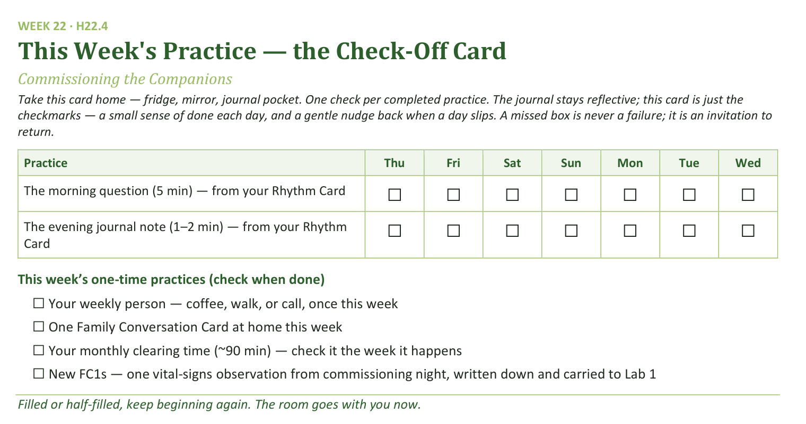
Your Take-Home Card — This Week’s Practice
Handed out now — fridge, mirror, journal pocket.
275
Notes:
W22 · 5:15–5:19 · SHARED CIRCLE
BEATS:
1. Check-off card H22.4: the morning question and the session journal note continue from the Rhythm Card, through the interlude.
2. One-time boxes: the weekly person; one Family Conversation Card at home; the monthly clearing time — and for the new FC1s, the vital-signs observation written down and carried to Lab 1.
3. Keep beginning again — the room goes with you now.

Slide 276
The Leader Feedback Round
• The evening’s leader goes first — three things, same as every week
– “What I think went well tonight: ______”
– “What I’d do differently next time: ______”
– “If I were to teach tonight’s process to someone, I would tell them: ______”
• Then the room — the same two questions about tonight
• The leader receives without defending — “thank you” is the whole response
276
Notes:
W22 · 5:19–5:22 · SHARED CIRCLE
BEATS:
1. The new FC1s answer first: what went well, what they'd do differently — and one last time before it becomes their question to carry: what would you tell whoever teaches this. A sentence or two each.
2. The adult answers for the parts the adults carried; then the room, two or three voices; received undefended — 'thank you' is the whole response.
3. May well be dropped today — the rite itself is often what the energy needs; dropping it twice running goes to the debrief.

Slide 277
The Final Rep — the Container Closed
• The reserved senior closes the container from memory — the standing circle, the one-word landing, the one thing, the one practice, the blessing round, the closing prayer and sending
• The rite that opened in a senior’s voice ends in a senior’s voice — the last words of Getting Started are spoken by the generation it raised
• If the senior sends the room, the room is sent — nothing is added after
• After: the signing — everyone signs each new FC1’s keepsake, the way you sign a Bible flyleaf. Then dessert. Stay.
277
Notes:
W22 · 5:22–5:30 · SHARED CIRCLE
BEATS:
1. The reserved senior closes the full protocol from memory: standing circle, one-word landing, the one thing, the one practice, the blessing round, closing prayer and sending.
2. Expect the blessing round to lean hard toward the FC1s — give it room; the closing senior was told beforehand: receive it, then finish. Ending well under a full heart is the most FC1 thing they will do all night.
3. Resist adding ANYTHING after the senior's sending — the last words of the series belong to the generation it raised; the team's silence is the loudest confirmation in the room.
4. After: keepsake signing at the side table — names as witnesses; nobody leaves without signing. Dessert, lingering; stay — the younger teens near the seniors are the pipeline forming in real time.

