Slide 1

Fellowship of the Heart
Getting Started — the Four Connects, walked around the table on alternating evenings
Evening Series 2026–27 · at the Tittle home · v1.5E DRAFT
All Scripture: ESV · The Companion lesson plans carry the full scripts — these slides carry the room
S1
Notes:
DECK TITLE · pre-session · DIVIDER
On screen as the room assembles on night one. All Scripture ESV; the plans carry the scripts; these slides carry the room — and these notes carry you.

Slide 2


EVENING 13
Serving Together
The room hears, plans and agrees together, serves someone in the two weeks, and reports back at Evening 14
Quarter 3: Mission & Rhythm
S2
Notes:
E13 · pre-session · DIVIDER
On screen through dinner. Ideas for whom to serve can be talked over at the table; nothing is decided yet. Set up the flip chart where everyone can see it.

Slide 3




Where We Are — the Four Connects
Evening 13 stands in the fourth box — Connect with Mission: tonight the room chooses, together, one of the works He prepared (Eph. 2:10), and does it before we meet again. Each connection makes the next one real (Matt. 22:37–40).
S3
Notes:
E13 · 7:00 · LEAD: CONTAINER HOLDER · GROUNDING — every session opens on this map
BEATS:
1. At Evening 11 each of us took one small step of obedience. At Evening 12 we looked for the works God prepared for us.
2. Tonight the room chooses one to do together. The serving happens in the next two weeks; at Evening 14 we report back.
3. Name the three skills: hearing together, planning together, agreeing together.

Slide 4

Evening 13 — Tonight’s Road
1 Welcome and centering
2 The check-in circle — and the ideas you brought
3 The room obeys together — John 13, Acts 13 and 15
4 Hear together
5 Plan together
6 Agree together
7 The circle, homework, feedback and the Aaronic blessing
S4
Notes:
E13 · 7:00–7:07 · LEAD: BOTH LEADERS
BEATS:
1. Walk the road briefly: tonight we do not serve yet. We hear, we plan and we agree, and we leave with a date.
2. Name the handoffs: the content presenter leads the teaching and the hearing; the teens run the chart in the planning; the container holder leads the check-in, the agreement round and the circle.
3. Two named adults hold safety tonight.

Slide 5
Opening Container — the Eight Steps
1 Welcome — five minutes to open the container
2 Phones silenced and put away
3 Stand in a circle
4 One-word check-in — how you actually are, right now
5 Put out / bring in — set something down; bring a blessing in
6 Spoken commitment: “I am here. I am paying attention. I am willing to be moved.”
7 Opening prayer — “Holy Spirit, you are welcome here. Speak. We are listening.”
8 Sit. Begin.
S5
Notes:
E13 · 7:00–7:07 · LEAD: CONTAINER HOLDER
BEATS:
1. Aaronic blessing first.
2. Full eight steps, normal pace. Safe, present, clear, intentional, said aloud.
CUES: The one-word check-in gets one unhurried breath after each word; no commentary.

Slide 6

The Check-In Circle
• Two weeks since What Was Prepared for You: what did you notice?
• The week-one check-ins: did your partner reach you? Did you reach them?
– A thin week is an honest answer; pass is a complete answer
• Then the idea you brought: someone near us the room could serve
– Each goes on the chart; no discussion yet
• A parent starts; received with “We hear that”
S6
Notes:
E13 · 7:07–7:17 · LEAD: CONTAINER HOLDER
BEATS:
1. One sentence each on the two weeks, the arranged parent first; then the week-one check-ins.
2. Second round: the idea each person brought. A teen writes each on the chart as it is said.
3. No discussion, no 'that's a good one.' The ideas wait for the hearing.
CUES: Ten minutes. Never cold-call a teen. No idea brought is fine; say so and pass.
GUARD: Ideas name people. Speak of them with honor; nothing said here we would not say in front of them.

Slide 7
The Room Obeys Together
• Jesus washed His disciples’ feet: “I have given you an example” (John 13:15)
• At Antioch, worshiping and fasting, the Spirit spoke to the whole group, and the group acted together (Acts 13:1–3)
• At Jerusalem, they heard each other out, weighed it by Scripture, and agreed (Acts 15)
• Tonight, three skills: hear together, plan together, agree together
• Say John 13:17 together
ACTS 15:28
“It has seemed good to the Holy Spirit and to us.”
S7
Notes:
E13 · 7:17–7:24 · LEAD: CONTENT PRESENTER
BEATS:
1. Read John 13:12–17 aloud from the physical Bible; the room says verse 17 together, once.
2. Read Acts 13:1–3: they were worshiping when the Spirit spoke, and the whole group acted on it.
3. Acts 15 in one breath: a hard question, stories heard, Scripture weighed, then 'it has seemed good to the Holy Spirit and to us.' That is tonight's shape: hear, plan, agree.
CUES: Seven minutes. The readings are the teaching.

Slide 8
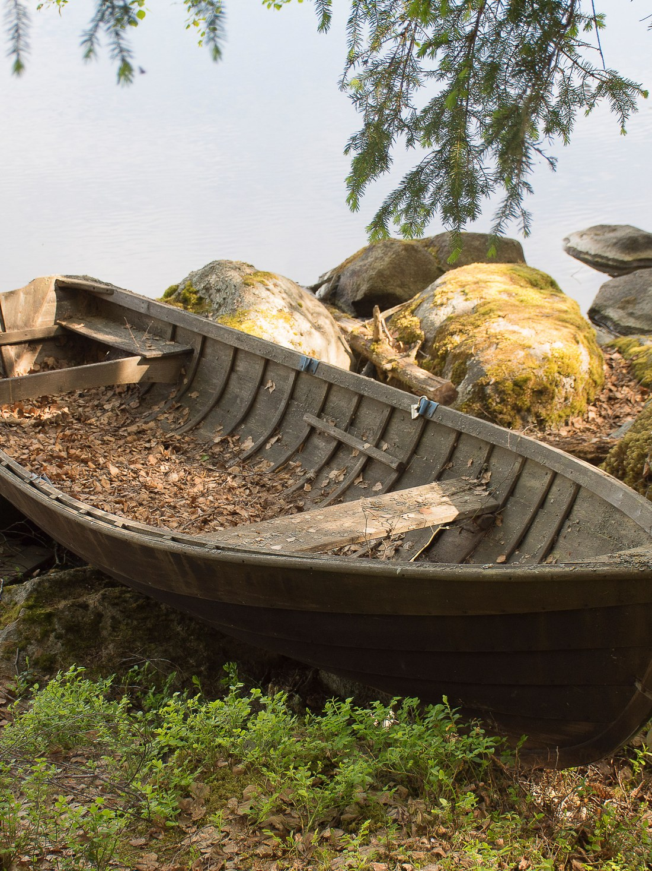
Hear Together
1 The question: “Lord, whom would you have us serve together, and how?”
2 Three minutes of quiet; write down what comes
3 Each says what came: a name, a need, a picture, a verse, or nothing
4 It goes on the chart, beside the ideas you brought
5 Received with “We hear that”
• Say what you heard, not why it is right
S8
Notes:
E13 · 7:24–7:36 · LEAD: CONTENT PRESENTER
BEATS:
1. Pray the question aloud, then keep three full minutes of quiet. Watch the clock, not the room.
2. Around the circle, a parent first: what came. A teen adds each to the chart; a star beside an idea already there.
3. 'Nothing came' is a full answer.
CUES: Twelve minutes.
GUARD: Nobody argues for an idea yet, and nobody says 'God told me' to end a discussion. What someone heard is weighed, like everything else (1 John 4:1).

Slide 9
Plan Together
• The teens at the chart: one holds the marker, one keeps the Serving Plan
• The four checks: local and concrete; a job for every age; an hour or two of real work; arranged with the people served
• Narrow to a first choice and a second
• Then the plan: the jobs and who, what each family brings, the date, the drivers
• Who calls them, and by when: a teen, with a parent alongside
S9
Notes:
E13 · 7:36–7:58 · LEAD: CONTENT PRESENTER · THE TEENS AT THE CHART · CONTAINER HOLDER WATCHING THE ROOM
BEATS:
1. Hand the marker to a teen. Parents give ideas and concerns like everyone else; the teens run it.
2. Read the four checks against the chart; strike what fails, star what passes. Look first at what was heard more than once.
3. Choose a first and a second. Then fill the Serving Plan: jobs (one for every age), what each family brings, a date in the next two weeks (usually a Saturday morning), drivers, and who makes the call by when.
CUES: Call the five-minute mark at 7:53. A plan that is mostly done is enough; the teens finish the details by text.
GUARD: Nothing is promised to anyone tonight. The call asks what they would like.

Slide 10
Agree Together
• Not a vote. Each in turn: “I’m in,” or “I’m in, with a concern,” or “Not yet: here is what would make it a yes”
• Concerns are heard; the plan changes until every voice is in
• After the call: something different, the teens and a parent adjust it; no thank you, the second choice
• The prayer of agreement, over the plan and the people, by name (Matt 18:19)
• Not one by 8:08? The room passes. That is a full answer; we pray for one mind (John 17:21)
S10
Notes:
E13 · 7:58–8:08 · LEAD: CONTAINER HOLDER
BEATS:
1. Go around the whole circle, parents and teens alike. Every voice, not the loudest.
2. A concern: thank them, ask what would answer it, and change the plan if it should change. A 'not yet': ask what would make it a yes.
3. When every voice is in, the room agrees how the plan may change after the call. Then a parent and a teen pray over the plan and the people, by name.
CUES: Ten minutes. At 8:06 say: 'Two minutes. If we are not one by then, we pass, and that is a full answer.' Then keep to it.
IF THE ROOM PASSES: name it plainly: 'We have not come to one mind tonight.' No blame, no names. The keeper writes the concerns on the Serving Plan as they were said. Pray for one mind, not for a plan (John 17:21). Nobody finishes the plan afterwards, not the leaders, not John, not by text; if the room wants to try again, it does so together at a later evening.
GUARD: A quiet 'not yet' is worth more than a fast yes. Nobody is pressed to agree, and no leader saves the plan by talking longer.

Slide 11

The Circle — Which Was Hardest?
• One sentence each: which was hardest tonight, hearing, planning or agreeing?
• And where did you see God in it?
• A parent starts; pass is a full answer
• Received as witness: “We hear that.” No commentary
• “If you know these things, blessed are you if you do them” (John 13:17)
S11
Notes:
E13 · 8:08–8:14 · LEAD: CONTAINER HOLDER
BEATS:
1. One sentence each, the arranged parent first.
2. 'We hear that' is the whole response.
3. Thank the teens at the chart by name, specifically: what they did, and what it made possible.
CUES: Six minutes. Listen for which skill the room found hardest; it goes to the debrief, with whether the room agreed or passed.
IF THE ROOM PASSED: the same question, received the same way. Do not reopen the plan here.

Slide 12
On Our Date — the Serving Day
1 Meet, pray for the people by name, and drive over together
2 An hour or two of work; the teens lead, an adult alongside each job
3 Before we leave: a blessing for the people we served
• Parents present; no one alone or out of sight; no ladders, roofs or power tools for teens
• We serve with people, not at them; no photos for show (Matt 6:1)
• The pastoral covering named aloud before we go
S12
Notes:
E13 · 8:14 · COMMISSIONING · LEAD: CONTENT PRESENTER
BEATS:
1. Walk the day in one breath: gather and pray, the work, a blessing before we leave.
2. Read the guards aloud, plainly. They protect the people we serve, and us.
3. If they ask why we came, say so simply. The kindness is the witness.

Slide 13
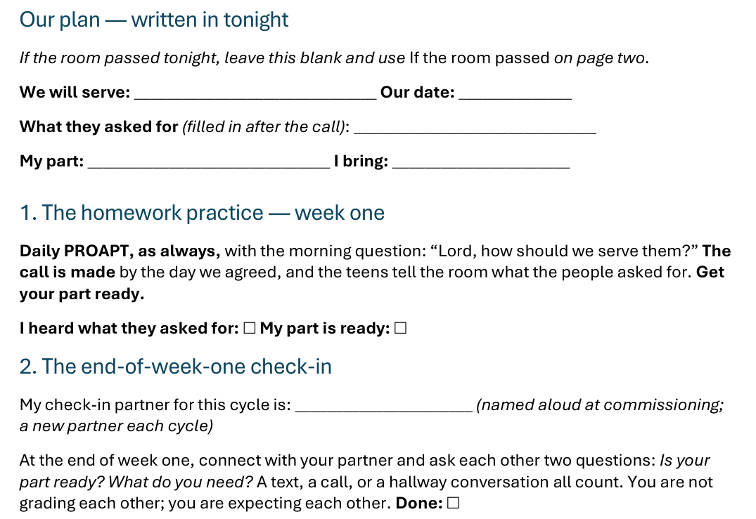


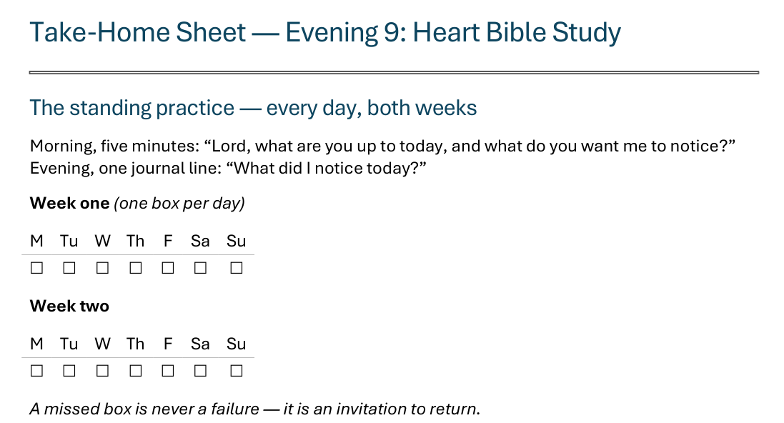
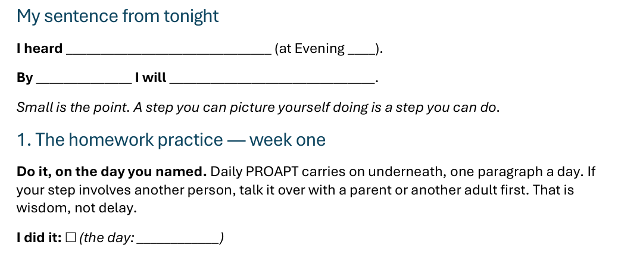
The Take-Home Sheet — Our Plan, and Week One
Handed out now — this is the sheet in your hands.
S13
Notes:
E13 · 8:14–8:20 · COMMISSIONING · LEAD: CONTENT PRESENTER
BEATS:
1. The sheet on the screen is the sheet in their hands: walk it, don't read it.
2. At the top: write in our plan now, whom we serve, our date and your part. What they asked for comes after the call.
3. Week one: daily PROAPT with 'Lord, how should we serve them?' The call is made by the day agreed; the teens tell the room what they asked for. Get your part ready.
4. Check-in partners named aloud: at the end of week one, 'Is your part ready? What do you need?'
IF THE ROOM PASSED: skip the plan; walk the last section on page two instead, eyes open for one chance to serve, unplanned.

Slide 14
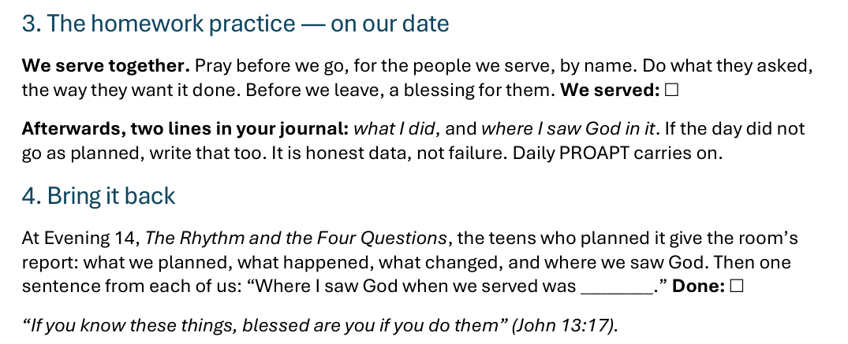



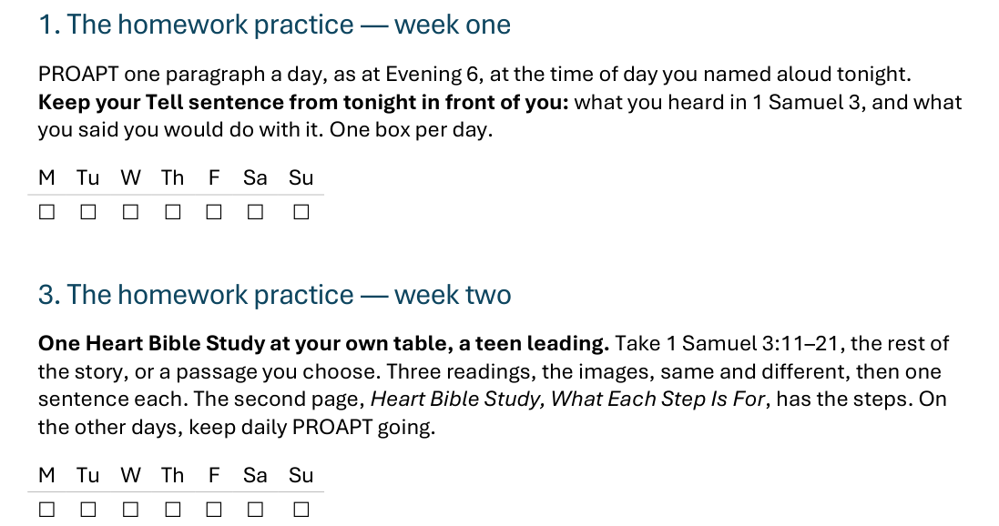
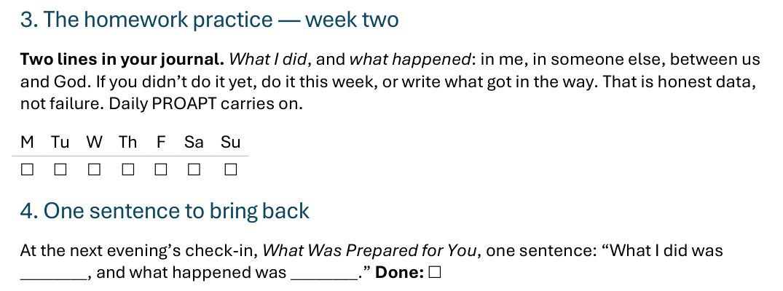
The Take-Home Sheet — On Our Date, and Bring It Back
One practice at a time — and a partner expecting you at the end of week one.
S14
Notes:
E13 · COMMISSIONING · LEAD: CONTENT PRESENTER
BEATS:
1. On our date: we serve together. Afterwards, two journal lines: what I did, and where I saw God in it.
2. If the day did not go as planned, write that too. Honest data, not failure.
3. At Evening 14 the teens who planned it give the room's report: what we planned, what happened, what changed, where we saw God. Then one sentence each.
IF THE ROOM PASSED: skip this slide; the next one is the practice.

Slide 15
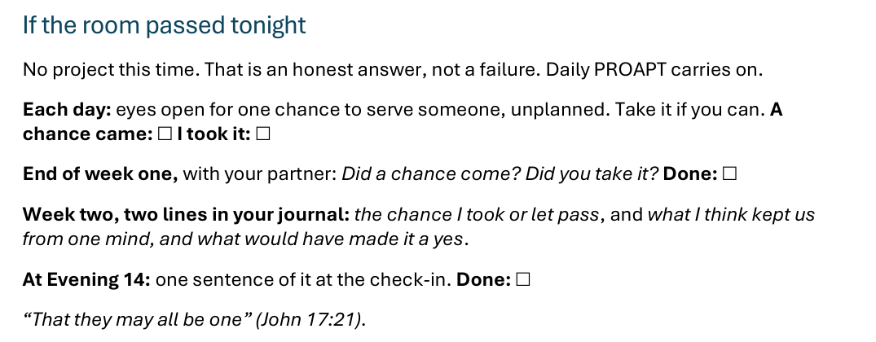
The Take-Home Sheet — If the Room Passed
Not a failure: an honest answer, and one more thing we learn about becoming one.
S15
Notes:
E13 · COMMISSIONING · LEAD: CONTENT PRESENTER · ONLY IF THE ROOM PASSED (otherwise skip)
BEATS:
1. No project this time. Say it without apology: the room gave an honest answer.
2. Each day: eyes open for one chance to serve someone, unplanned; take it if you can.
3. Check-in partners named aloud: at the end of week one, 'Did a chance come? Did you take it?'
4. Week two: two journal lines, the chance I took or let pass, and what I think kept us from one mind and what would have made it a yes. At Evening 14 each says a sentence of it.
GUARD: Nobody is named as the one who held it up, tonight or at Evening 14.

Slide 16

The Leader Feedback Round
• Two rounds, same as every session — the container holder first, then the content presenter: three things each
– “What I think went well tonight: ______”
– “What I’d do differently next time: ______”
– “If I were to teach tonight’s process to someone, I would tell them: ______”
• Then the room — the same two questions about tonight
• The leaders receive without defending — “thank you” is the whole response
S16
Notes:
E13 · 8:20–8:24 · LEAD: BOTH LEADERS
BEATS:
1. Same round every week, leader first: what went well tonight, what I'd do differently.
2. The teens who ran the chart are leaders tonight too: invite one of them to answer the same two.
3. Then the room, the same two questions about the leaders.
CUES: 'Thank you' is the whole response.

Slide 17
Closing the Container + Aaronic Blessing
• We close the way we opened — the container, six steps:
1 Stand again — same circle, same posture as the open
2 One-word landing — compare it to your opening word
3 The one thing you are taking from tonight
4 The one practice — committed aloud, or modified to one you will actually keep
5 Blessings — eyes on the person, not the screen: say what is on your heart for them. Specific, witnessed, short
6 Closing prayer — and the Aaronic blessing, spoken over each other, face to face
THE AARONIC BLESSING — NUMBERS 6:24–26
“The Lord bless you and keep you;
the Lord make his face to shine upon you, and be gracious to you;
the Lord lift up his countenance upon you, and give you peace.”
S17
Notes:
E13 · 8:24–8:30 · LEAD: CONTAINER HOLDER
BEATS:
1. Closing protocol, unhurried: stand; one-word landing; the one thing taken from tonight; the one practice: tonight, your part in the plan.
2. Name the road: we serve on our date (or, if the room passed, each keeps eyes open for one chance to serve); at Evening 14, The Rhythm and the Four Questions, the room tells what God did, and each person builds the rhythm they will carry.
3. Aaronic blessing.
BLESSINGS: eyes on the person, not the screen; say what is on your heart for them, specific and short.

