Slide 1
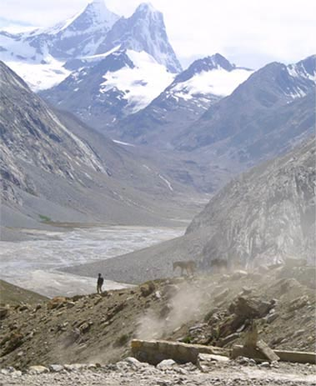
Fellowship of the Heart
Getting Started — the Four Connects, walked over twenty-two Wednesday evenings
CCA Club Year 2026–27 · Session Slides · v1.4 DRAFT
All Scripture: ESV · The Companion lesson plans carry the full scripts — these slides carry the room
1

Slide 2
Quarter 1
Connect with Self & Others
Weeks 1–6 · Six Wednesdays · the container is built, the stories are told
1

Slide 3

WEEK 1
Welcome to the Journey
Establishing the container; introducing the four Connects
Quarter 1: Connect with Self & Others
1

Slide 4
Week 1 — Tonight’s Road
1 Welcome — the very-first-time orientation
2 The Four Connects — kitchen-table teaching
3 Container introduction — the first full protocol
4 One True Sentence — why each of us is here
5 Between-week practice
6 The Leader Feedback Round (debut)
7 Closing container + Aaronic blessing
THIS YEAR, IN ONE LINE
Hearing and obeying God
1

Slide 5

Welcome — the Very-First-Time Orientation
• “I came that they may have life and have it abundantly.” — John 10:10
• This is a journey of exploration
– Your heart
– This process — the plans, practices, and pages live at the Fellowship of the Heart website
– This group
• This is not a youth group
• It is family formation and growth in Christ
• An offer of leadership opportunity
1

Slide 6
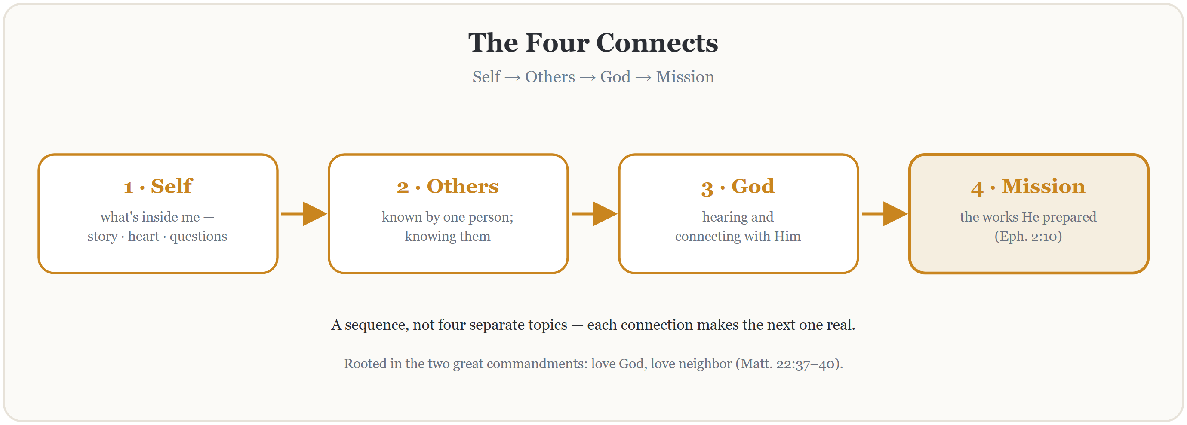
The Four Connects
THE SOWER — THREE WITNESSES: Mark 4:1–20 · Matthew 13:1–23 · Luke 8:4–15
1

Slide 7

Container Introduction
Safe
– What is shared in this room stays in this room — no judging, no fixing, no interrupting
– No shaming
Present
– Focused here — in this room, with these people
– Phones silent and put away
Clear
– Releasing any roadblocks to hearing — set them aside intentionally
Intentional
– “I’m leaning in. I’m looking for what God has for me in the next ninety minutes.”
1

Slide 8
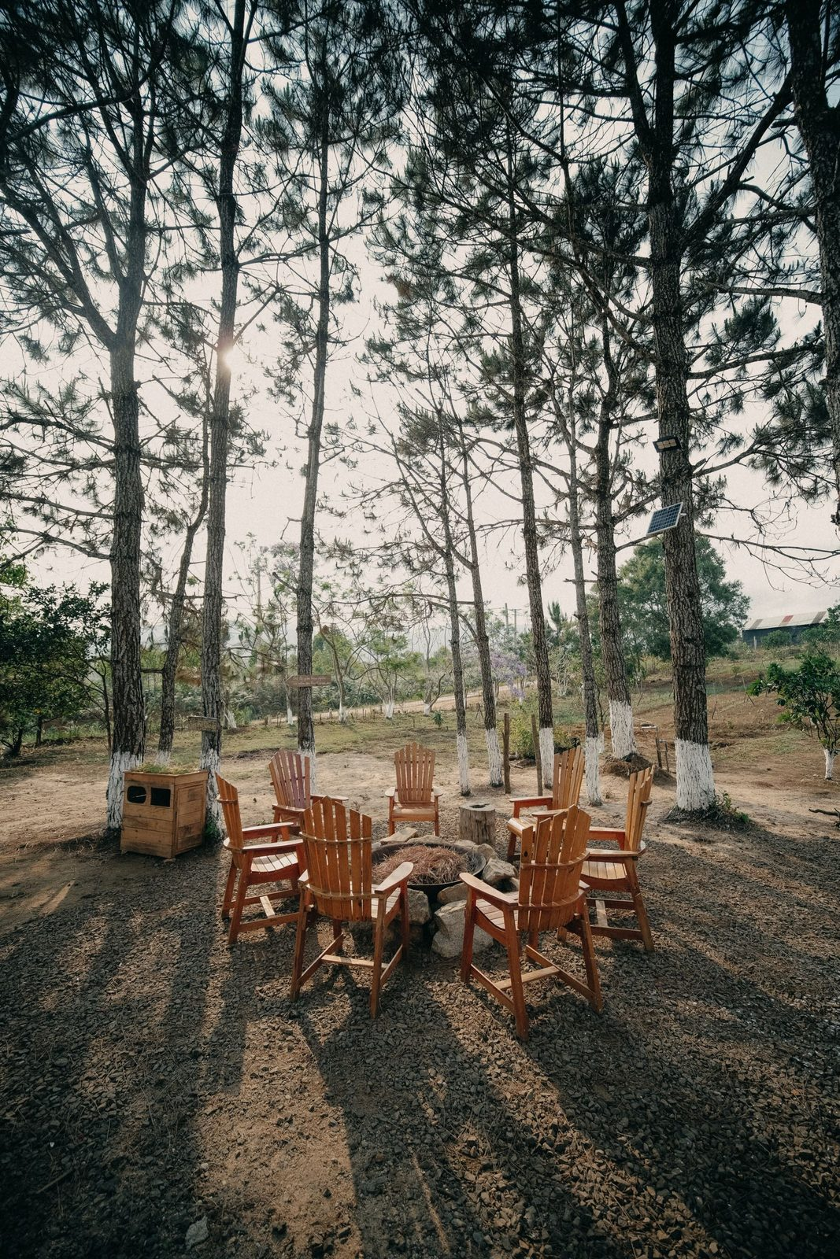
One True Sentence — Why Each of Us Is Here
• Around the circle: one true sentence about why you are here tonight
• One sentence — not a paragraph, not a story
• The word that matters is “true” — not what you think we want to hear
• “Because Mom said I had to be here” counts. “I don’t know yet” counts.
1

Slide 9

Between-Week Practice
• One practice this week — the simplest we will give you in all of Getting Started
• Each morning, before the phone: five quiet minutes
– Ask one question: “Father, what are you up to today, and what do you want me to notice?”
– Then sit. Listen. The asking is the practice.
• Each evening, sixty seconds: one specific sentence in the journal — what did I notice today?
• Parents are doing this too — we check in next Wednesday
1

Slide 10
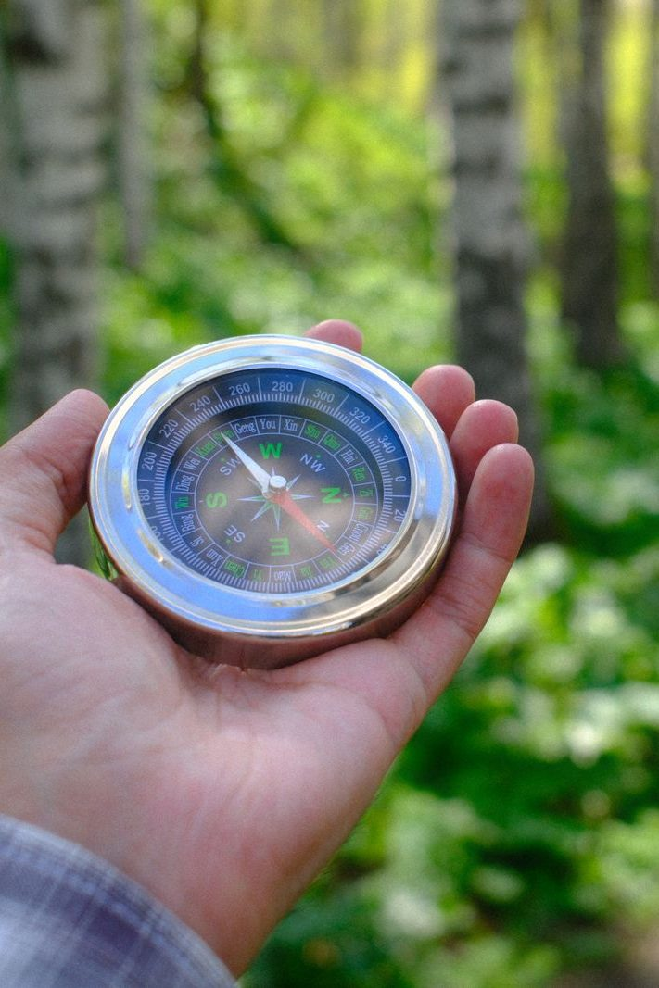
The Leader Feedback Round
• The evening’s leader goes first — three things, same as every week from here on
– “What I think went well tonight: ______”
– “What I’d do differently next time: ______”
– “If I were to teach tonight’s process to someone, I would tell them: ______”
• Then the room — the same two questions about tonight
• The leader receives without defending — “thank you” is the whole response
1

Slide 11
Closing the Container + Aaronic Blessing
• We close the way we opened — the container, six steps
• One-word landing · the one thing you are taking · the one practice
– The practice, said together: “Father, what are you up to today, and what do you want me to notice?”
• Then the blessing — spoken over each other, face to face
THE AARONIC BLESSING — NUMBERS 6:24–26
“The Lord bless you and keep you;
the Lord make his face to shine upon you, and be gracious to you;
the Lord lift up his countenance upon you, and give you peace.”
1

Slide 12
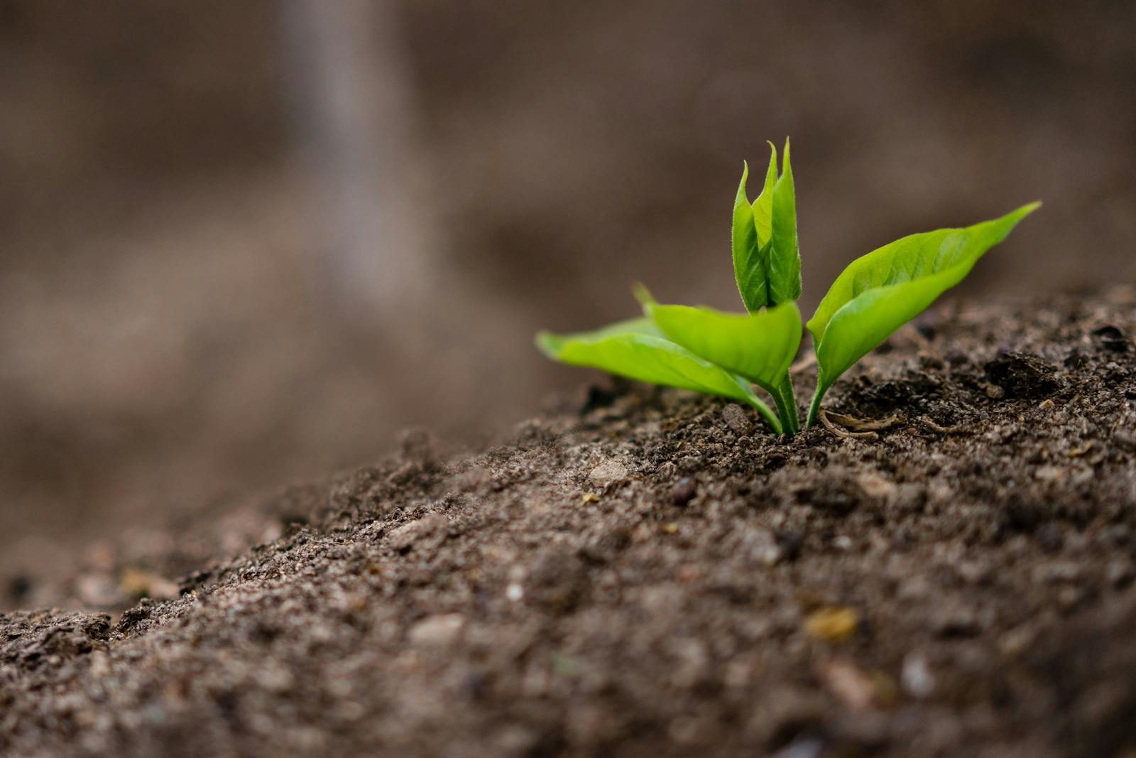
WEEK 2
The Soil of Your Heart
The Heart Soil diagnostic from Mark 4; beginning Connecting with Self
Quarter 1: Connect with Self & Others
1

Slide 13
Week 2 — Tonight’s Road
1 Opening container — full eight-step protocol
2 Check-in on Week 1 practice
3 Teaching: Mark 4 and the four soils
4 Family clusters: the Heart Soil diagnostic
5 Re-merge — shared debrief; Mark 4:20 re-read
6 Between-week practice
7 The Leader Feedback Round
8 Closing container + Aaronic blessing
1

Slide 14
Opening Container — the Full Eight Steps
1 Welcome — five minutes to open the container
2 Phones silenced and put away
3 Stand in a circle
4 One-word check-in — how you actually are, right now
5 Put out / bring in — set something down; bring a blessing in
6 Spoken commitment: “I am here. I am paying attention. I am willing to be moved.”
7 Opening prayer — “Holy Spirit, you are welcome here. Speak. We are listening.”
8 Sit. Begin.
1

Slide 15

Check-In on Week 1 Practice
• One quick round, one sentence each — a parent starts
– “One thing I noticed this week when I asked the morning question …”
– Or one thing about the practice itself — “I forgot it three days running” is a real answer
• No grades, no lectures — honesty over performance
• Missed it? “Thanks for the honesty. Pick it back up tomorrow.”
“When your children ask their fathers in times to come, ‘What do these stones mean?’”
— JOSHUA 4:21 (ESV)
1

Slide 16
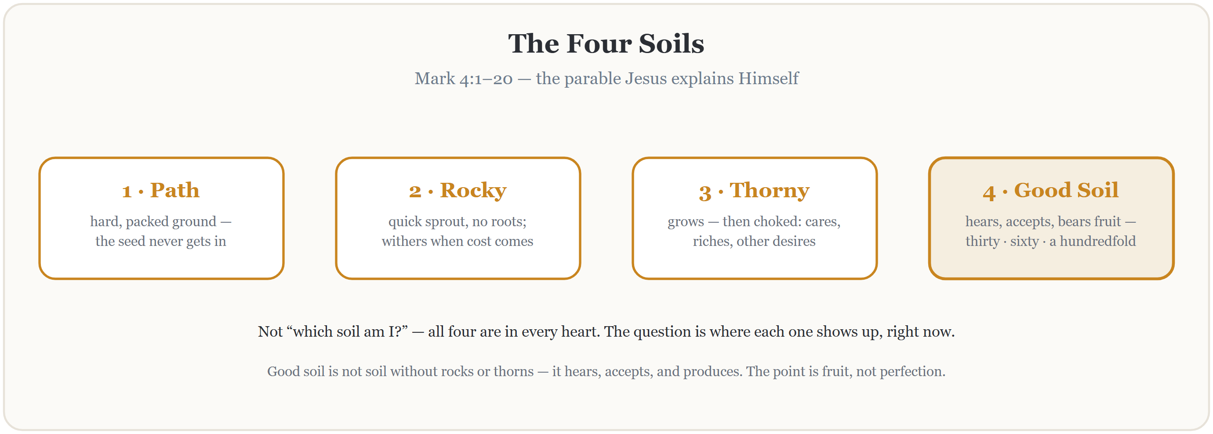
Teaching — Mark 4 and the Four Soils
Read Mark 4:1–20 in full, slowly — all twenty verses, no commentary. Then walk the four soils.
1

Slide 17
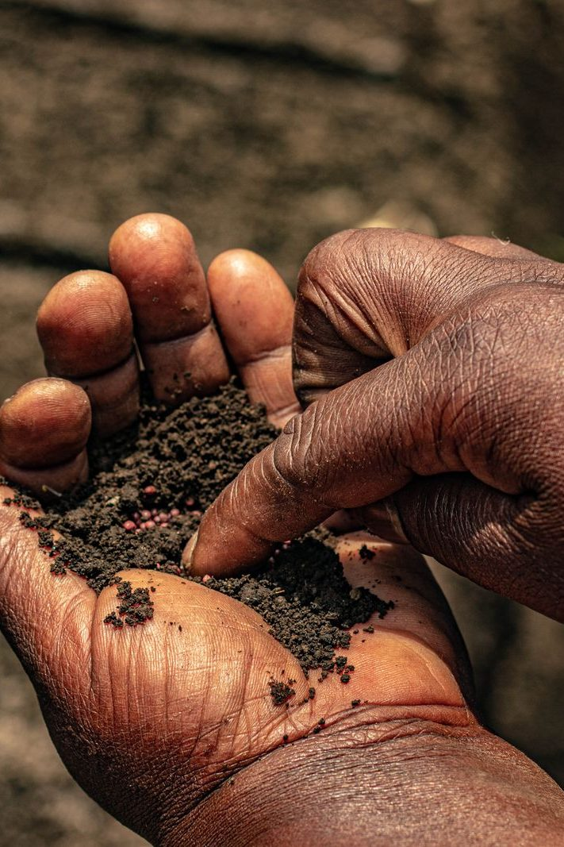
Family Clusters — the Heart Soil Diagnostic
• Not “which soil am I?” — where does each soil show up in my life right now? Specifically.
1 Path — where is the ground hard right now? One specific place, this week
2 Rocky — where has a season with God not lasted? What sun revealed the missing roots?
3 Thorny — what is choking me right now: cares, riches, other desires? Which is loudest?
4 Good — where has something God planted actually grown? Name one real piece of fruit
• Journal two minutes, then share — a parent answers first, every round
• “I’d rather not share that one” is a complete answer — a gift, not ammunition
1

Slide 18
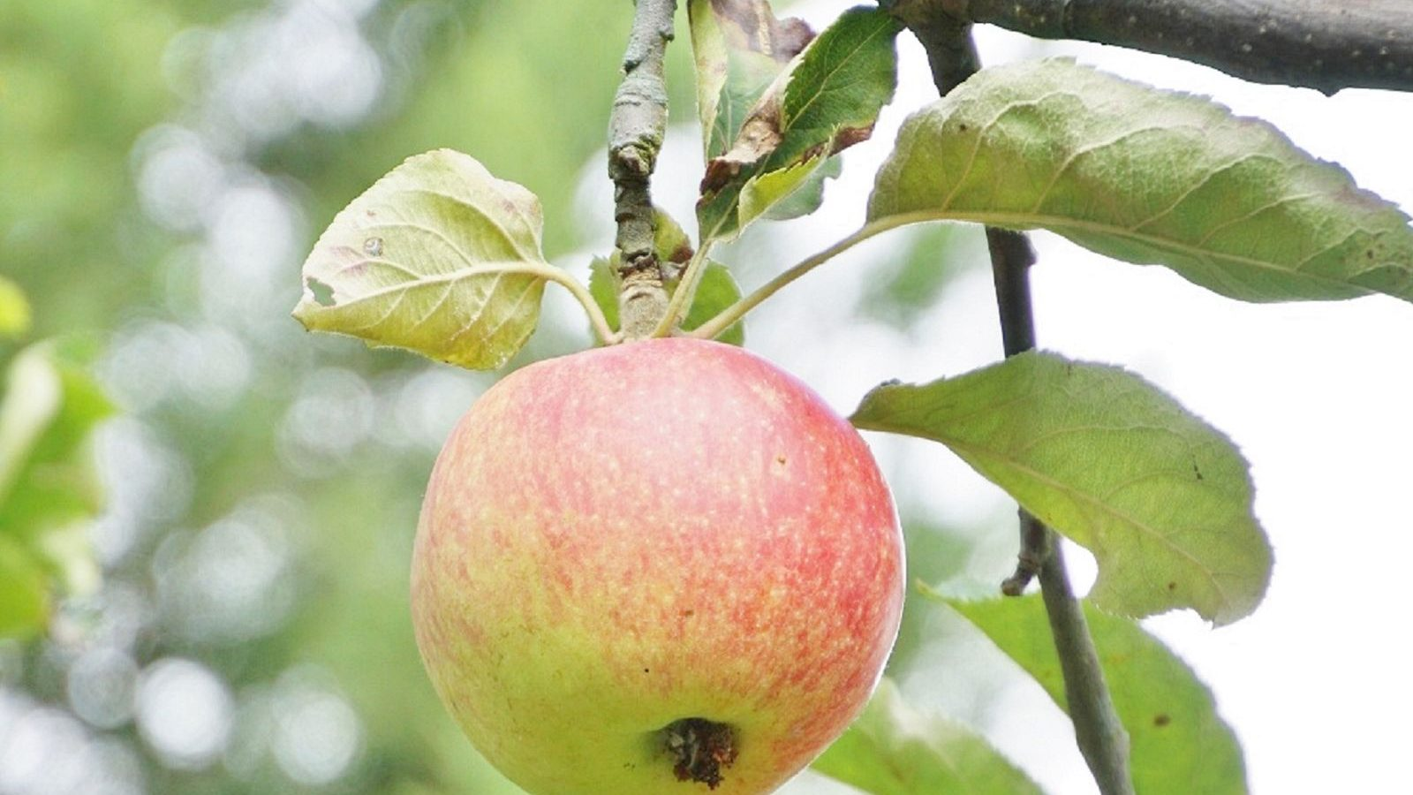
Re-Merge — One Word, Then the Verse
• What surfaced stays in your cluster — here, just one word from each of us
• Then the verse Jesus ends with, read slowly — listen for the word that lands
• Noticing rocks and thorns is not the opposite of good soil — it is what good soil does
MARK 4:20
“But those that were sown on the good soil are the ones who hear the word and accept it and bear fruit, thirtyfold and sixtyfold and a hundredfold.”
1

Slide 19

Between-Week Practice
• The Soil Journal — three times this week, five minutes each. Not every day; three times.
– Today, where did the path show up? The rocky? The thorny? The good soil?
– One sentence per soil. Specific, not general.
• No fixing. We notice; the Spirit fixes.
• Keep the morning question going too: “Father, what are you up to today?” The practices stack.
1

Slide 20
The Leader Feedback Round
• The evening’s leader goes first — three things, same as every week
– “What I think went well tonight: ______”
– “What I’d do differently next time: ______”
– “If I were to teach tonight’s process to someone, I would tell them: ______”
• Then the room — the same two questions about tonight
• The leader receives without defending — “thank you” is the whole response
1

Slide 21
Closing the Container + Aaronic Blessing
• We close the way we opened — the container, six steps
• One-word landing · the one thing you are taking · the one practice
– Commit to the week’s practice aloud — or modify it to something you will actually do
• Blessings — specific, witnessed, short
• Then the Aaronic blessing — spoken over each other, face to face
THE AARONIC BLESSING — NUMBERS 6:24–26
“The Lord bless you and keep you;
the Lord make his face to shine upon you, and be gracious to you;
the Lord lift up his countenance upon you, and give you peace.”
1

Slide 22

WEEK 3
Telling Your Story I
One question, one circle, and the practice of being known — the parents tell first; the teens’ night is Week 4
Quarter 1: Connect with Self & Others
1

Slide 23
Week 3 — Tonight’s Road
1 Welcome and centering
2 Week 2 check-in
3 Psalm 139 — being known
4 Companion demo story
5 Bridge to the clusters
6 Stories in family clusters
7 Merge and shared closing
8 Between-session practice
9 The Leader Feedback Round
10 Closing container
1

Slide 24
Opening Container — the Eight Steps
1 Welcome — five minutes to open the container
2 Phones silenced and put away
3 Stand in a circle
4 One-word check-in — how you actually are, right now
5 Put out / bring in — set something down; bring a blessing in
6 Spoken commitment: “I am here. I am paying attention. I am willing to be moved.”
7 Opening prayer — “Holy Spirit, you are welcome here. Speak. We are listening.”
8 Sit. Begin.
1

Slide 25
Week 2 Check-In — Heart Soil
• “Some of you journaled this week. Some of you didn’t. Both are fine.”
• One sentence about what showed up — optional, no pressure
– “‘Path soil at school’ — just one sentence. Anyone?”
• “The work is happening, whether or not we name it tonight.”
1

Slide 26
Psalm 139 — Being Known
• Psalm 139 is the psalm of being completely known by God — and the psalmist’s response is not panic. It is wonder
• Most of us have parts we hope nobody has noticed. The psalmist invites God to look further
• The opposite of being hidden is not being exposed — it is being seen and being safe at the same time. That is what the circle is
• Tonight is a small practice of Psalm 139 — parents answer one question, with what they are willing to say
PSALM 139:23–24
“Search me, O God, and know my heart! Try me and know my thoughts! And see if there be any grievous way in me, and lead me in the way everlasting!”
1

Slide 27
Companion Demo Story
• The Lead Companion tells their own story — five minutes, modeling the form
• The one question: “tell the story of how you got here — today, as you are. What has shaped you into who you are today?”
• Be specific — “I grew up in a house where I learned to read a slammed cabinet door”
• Not the hero, not the victim — what happened, and where you see God in it now, looking back
• “That is the form. Parents, you’ll do this in your cluster tonight. Teens, this is yours next week. Yours doesn’t have to look like mine.”
1

Slide 28
Bridge to the Clusters
1 One question — how you got here, and what has shaped you. The depth is yours to choose
2 Listening — do not fix. Do not advise. Do not say “that happened to me too.” Receive, then bless
3 Nothing leaves your circle. “Not a phrase, not a name, not a story.”
• Teens — your own storytelling card goes home tonight; next Wednesday is your night
• Two or three families together, your own family stays with you — thirty-five minutes
1

Slide 29
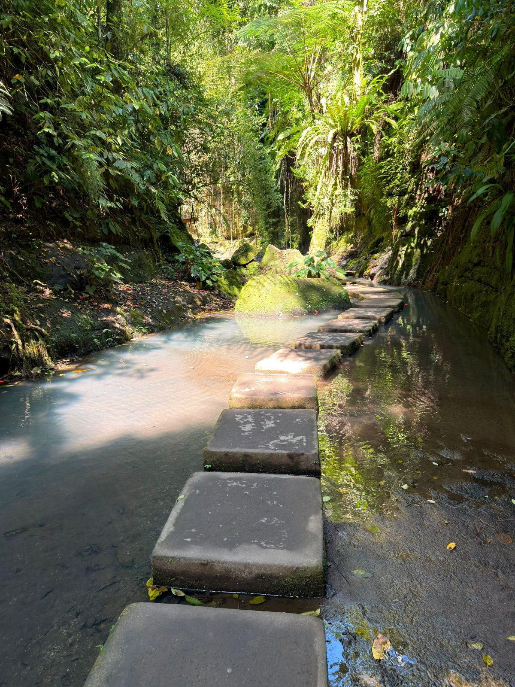
Stories in Family Clusters
• Tonight’s tellers: the parents — plus any Companion-in-Formation. The Cluster Companion goes first
1 Story — 5–7 minutes. The teller speaks; nobody interrupts, even the silences
2 Silence — ten seconds
3 Blessing round — one or two sentences each, teens included: “What I want to bless about your story is...”
• “Inside this cluster, what is said stays in this cluster. Not even back to the main room, and not back up in the car this week.”
• “When someone is telling their story... we are looking at them. We are receiving. That’s the practice.”
1

Slide 30
Merge and Shared Closing
• What happened in your circle stays in your circle
• One word — just one — about what tonight was like for you. You can pass
– “Heavy.” “Seen.” “Surprising.” “Tender.” “Hard.” Whatever the true word is
• “Each of you brought something true into this room tonight, and each of you received something true. That’s rare. It’s also the kind of room God shows up in.”
1

Slide 31

Between-Session Practice — Joint Footprints
• Joint Footprints — each parent-and-teen pair sits together once this week. Twenty minutes total
• Not in the car, not at dinner, not while the TV is on. Phones away
1 Five minutes telling the footprints question — where you grew up, who shaped you, what places and people made you who you are
2 The listener asks one or two follow-ups, then one sentence: “What I love about your footprints is...”
3 Then swap — the other person tells, the first listens and blesses
• The morning question and evening journal note continue daily
1

Slide 32
The Leader Feedback Round
• The evening’s leader goes first — three things, same as every week
– “What I think went well tonight: ______”
– “What I’d do differently next time: ______”
– “If I were to teach tonight’s process to someone, I would tell them: ______”
• Then the room — the same two questions about tonight
• The leader receives without defending — “thank you” is the whole response
1

Slide 33
Closing the Container + Aaronic Blessing
• We close the way we opened — the container, six steps
• One-word landing · the one thing you are taking · the one practice
– Commit to the week’s practice aloud — or modify it to something you will actually do
• Blessings — specific, witnessed, short
• Then the Aaronic blessing — spoken over each other, face to face
THE AARONIC BLESSING — NUMBERS 6:24–26
“The Lord bless you and keep you;
the Lord make his face to shine upon you, and be gracious to you;
the Lord lift up his countenance upon you, and give you peace.”
1

Slide 34
WEEK 4
Telling Your Story II
The second running — the teens tell, the round is completed, and the room watches one of its own hold it
Quarter 1: Connect with Self & Others
1

Slide 35
Week 4 — Tonight’s Road
1 Welcome and centering
2 Joint Footprints check-in
3 Psalm 139 — being known, again
4 Bridge to the split
5 Stories in family clusters
6 Merge and one-word landing
7 Between-session practice
8 The Leader Feedback Round
9 Closing container
1

Slide 36
Opening Container — the Eight Steps
1 Welcome — five minutes to open the container
2 Phones silenced and put away
3 Stand in a circle
4 One-word check-in — how you actually are, right now
5 Put out / bring in — set something down; bring a blessing in
6 Spoken commitment: “I am here. I am paying attention. I am willing to be moved.”
7 Opening prayer — “Holy Spirit, you are welcome here. Speak. We are listening.”
8 Sit. Begin.
1

Slide 37
Joint Footprints Check-In
• “Some of you got to it. Some of you didn’t. Both are fine — ‘we didn’t get to it’ is honest, and honest is what we do here.”
• One sentence about what it was like — “not what was said — that’s yours — just what it was like”
• An arranged parent starts; then it’s open, and optional
• “The work is happening, whether or not we name it tonight.”
1

Slide 38
Psalm 139 — Being Known, Again
• Same psalm as last week, on purpose — nothing new tonight; we’re completing the round
• One idea, repeated: the opposite of being hidden is not being exposed — it is being seen and being safe at the same time
• The parents practiced that last Wednesday. Tonight the teens do
• Put the comparison down — “Every story is its own. … The story you tell tonight is not in competition with any story told in this building last week. Tell yours.”
PSALM 139:23–24
“Search me, O God, and know my heart! Try me and know my thoughts! And see if there be any grievous way in me, and lead me in the way everlasting!”
1

Slide 39
Bridge to the Split
1 “It’s one question — tell the story of how you got here, and what has shaped you.” The depth is yours to choose
2 “When you’re listening — don’t fix, don’t advise, don’t relate back. Receive, and after each story, bless.”
3 “Nothing leaves your cluster. Not a phrase, not a name, not a story.”
• Same clusters and same rooms as last week — your family stays with you
1

Slide 40
Stories in Family Clusters — the Teens Tell
• The teens tell — same clusters, same single question, same blessing. Second running
1 Story — 5–7 minutes. Nobody interrupts, even the silences
2 Silence — ten seconds
3 Blessing round — the arranged parent blesses first, then the circle: one or two sentences each
• Parents tonight: receive and bless — no correcting the record, no filling silences
• “What’s said in this circle stays in this circle. And when someone is telling, we’re looking at them. We’re receiving.”
1

Slide 41
Merge and One-Word Landing
• What happened in your cluster stays in your cluster
• One word, when you’re ready, about what tonight was like — an arranged parent starts. You can pass
• “The round is complete — every person in this room, parent and teen, has now told a piece of their story to a circle that blessed them for it.”
• “Rooms like this one are rare. They’re also the kind of room God shows up in.”
1

Slide 42
Between-Session Practice
• Joint Footprints — for every family that hasn’t done it yet. Parent and teen, twenty minutes, sometime this week
• Not in the car, not in front of a screen. Phones away
• Five minutes telling, a follow-up question or two, and one sentence: “What I love about your footprints is...” Then swap
• “Families who already did it — you’re done; don’t force a repeat.”
• Everyone keeps the morning question and the evening journal note going — five minutes in the morning, two at night
1

Slide 43
The Leader Feedback Round
• The evening’s leader goes first — three things, same as every week
– “What I think went well tonight: ______”
– “What I’d do differently next time: ______”
– “If I were to teach tonight’s process to someone, I would tell them: ______”
• Then the room — the same two questions about tonight
• The leader receives without defending — “thank you” is the whole response
1

Slide 44
Closing the Container + Aaronic Blessing
• We close the way we opened — the container, six steps
• One-word landing · the one thing you are taking · the one practice
– Commit to the week’s practice aloud — or modify it to something you will actually do
• Blessings — specific, witnessed, short
• Then the Aaronic blessing — spoken over each other, face to face
THE AARONIC BLESSING — NUMBERS 6:24–26
“The Lord bless you and keep you;
the Lord make his face to shine upon you, and be gracious to you;
the Lord lift up his countenance upon you, and give you peace.”
1

Slide 45

WEEK 5
Knowing and Being Known
The four conditions of a container, applied to your real friendships
Quarter 1: Connect with Self & Others
1

Slide 46
Week 5 — Tonight’s Road
1 Welcome and centering
2 Week 4 check-in
3 The four conditions — teaching
4 Bridge to split
5 Friendship-mapping exercise
6 Merge and surface common patterns
7 Between-session practice
8 The Leader Feedback Round
9 Closing container
1

Slide 47
Opening Container — the Eight Steps
1 Welcome — five minutes to open the container
2 Phones silenced and put away
3 Stand in a circle
4 One-word check-in — how you actually are, right now
5 Put out / bring in — set something down; bring a blessing in
6 Spoken commitment: “I am here. I am paying attention. I am willing to be moved.”
7 Opening prayer — “Holy Spirit, you are welcome here. Speak. We are listening.”
8 Sit. Begin.
1

Slide 48
Week 4 Check-In — Joint Footprints
• “Some of you got to it. Some didn’t. Both are fine.”
• “Anyone want to say one sentence about how that landed for you?” — an arranged parent starts
• Receive without commentary
• “Good. Some of that work continues whether or not we got to it this week.”
1

Slide 49
The Four Conditions
• The threefold cord is stronger because the strands hold each other in tension — the strength is in the holding
• Four conditions have been quietly holding this room for four weeks. Tonight we name them
1 SAFE — the hearing condition. “I will not be judged as a person while I am doing my work” — Romans 14:3–4
2 PRESENT — the attention condition. “I am actually here” — aware that the Great I AM is also here — Revelation 1:8
3 CLEAR — the channel condition. Nothing unaddressed between God and me, or the circle and me — Matthew 7:5
4 INTENTIONAL — the obedience condition. On purpose, watching for what God is doing, willing to do it — John 5:19
ECCLESIASTES 4:9–12
“Two are better than one, because they have a good reward for their toil. For if they fall, one will lift up his fellow. … And though a man might prevail against one who is alone, two will withstand him—a threefold cord is not quickly broken.”
1

Slide 50
Bridge to the Split
• Each cluster takes the four conditions and asks: “for each one, where in my actual friendships does this show up? And where is it missing?”
• “We are not naming names tonight. ‘One of my friends’ is fine.” — we map conditions, not people
• Your Companion goes first on every condition, then one of the parents opens the round
• Teens, you choose your own depth. Pass anytime
• Twenty-eight minutes — same rooms as the last two weeks
1

Slide 51

Friendship-Mapping in Family Clusters
• Four conditions, about six minutes each — the Companion models first, the arranged parent opens the round
• Each turn 30–60 seconds — specific: one friendship where the condition is present, one where it is missing
• “No names of people who aren’t in this room — and for people who are, ‘one of my friendships’ or ‘one adult relationship in my life’ is the language. Nobody asks who you meant.”
• Parents map their own adult friendships — not their teens’
• If time remains, the quiet final question: “Of the four conditions, which one is the one I find hardest to offer to my friends?”
1

Slide 52
Merge — Surfacing Common Patterns
• What happened in your cluster stays in your cluster
• Patterns only — general, no names: “Many of us noticed Safety is the rarest condition in our friendships”
• Each Cluster Companion takes ninety seconds — one or two general patterns from their circle
• Then the Lead Companion names one observation across the clusters — “that is real, and it is the seed of the practice this week”
1

Slide 53
Between-Session Practice — One Friendship, One Condition
• “Pick one friendship in your life. Just one.” — you don’t have to tell anyone which one
• Pick one of the four conditions — the one most missing there, or the one you find hardest to offer
• Practice that one condition in that one friendship more intentionally than usual this week — practically
– Presence — your phone is in another room. Clear — name something you have been quietly carrying
• “One friendship. One condition. Practice. Journal what happens.” — the Week 5 journal pages carry the card
• The morning question and evening journal note continue daily
1

Slide 54
The Leader Feedback Round
• The evening’s leader goes first — three things, same as every week
– “What I think went well tonight: ______”
– “What I’d do differently next time: ______”
– “If I were to teach tonight’s process to someone, I would tell them: ______”
• Then the room — the same two questions about tonight
• The leader receives without defending — “thank you” is the whole response
1

Slide 55
Closing the Container + Aaronic Blessing
• We close the way we opened — the container, six steps
• One-word landing · the one thing you are taking · the one practice
– Commit to the week’s practice aloud — or modify it to something you will actually do
• Blessings — specific, witnessed, short
• Then the Aaronic blessing — spoken over each other, face to face
THE AARONIC BLESSING — NUMBERS 6:24–26
“The Lord bless you and keep you;
the Lord make his face to shine upon you, and be gracious to you;
the Lord lift up his countenance upon you, and give you peace.”
1

Slide 56
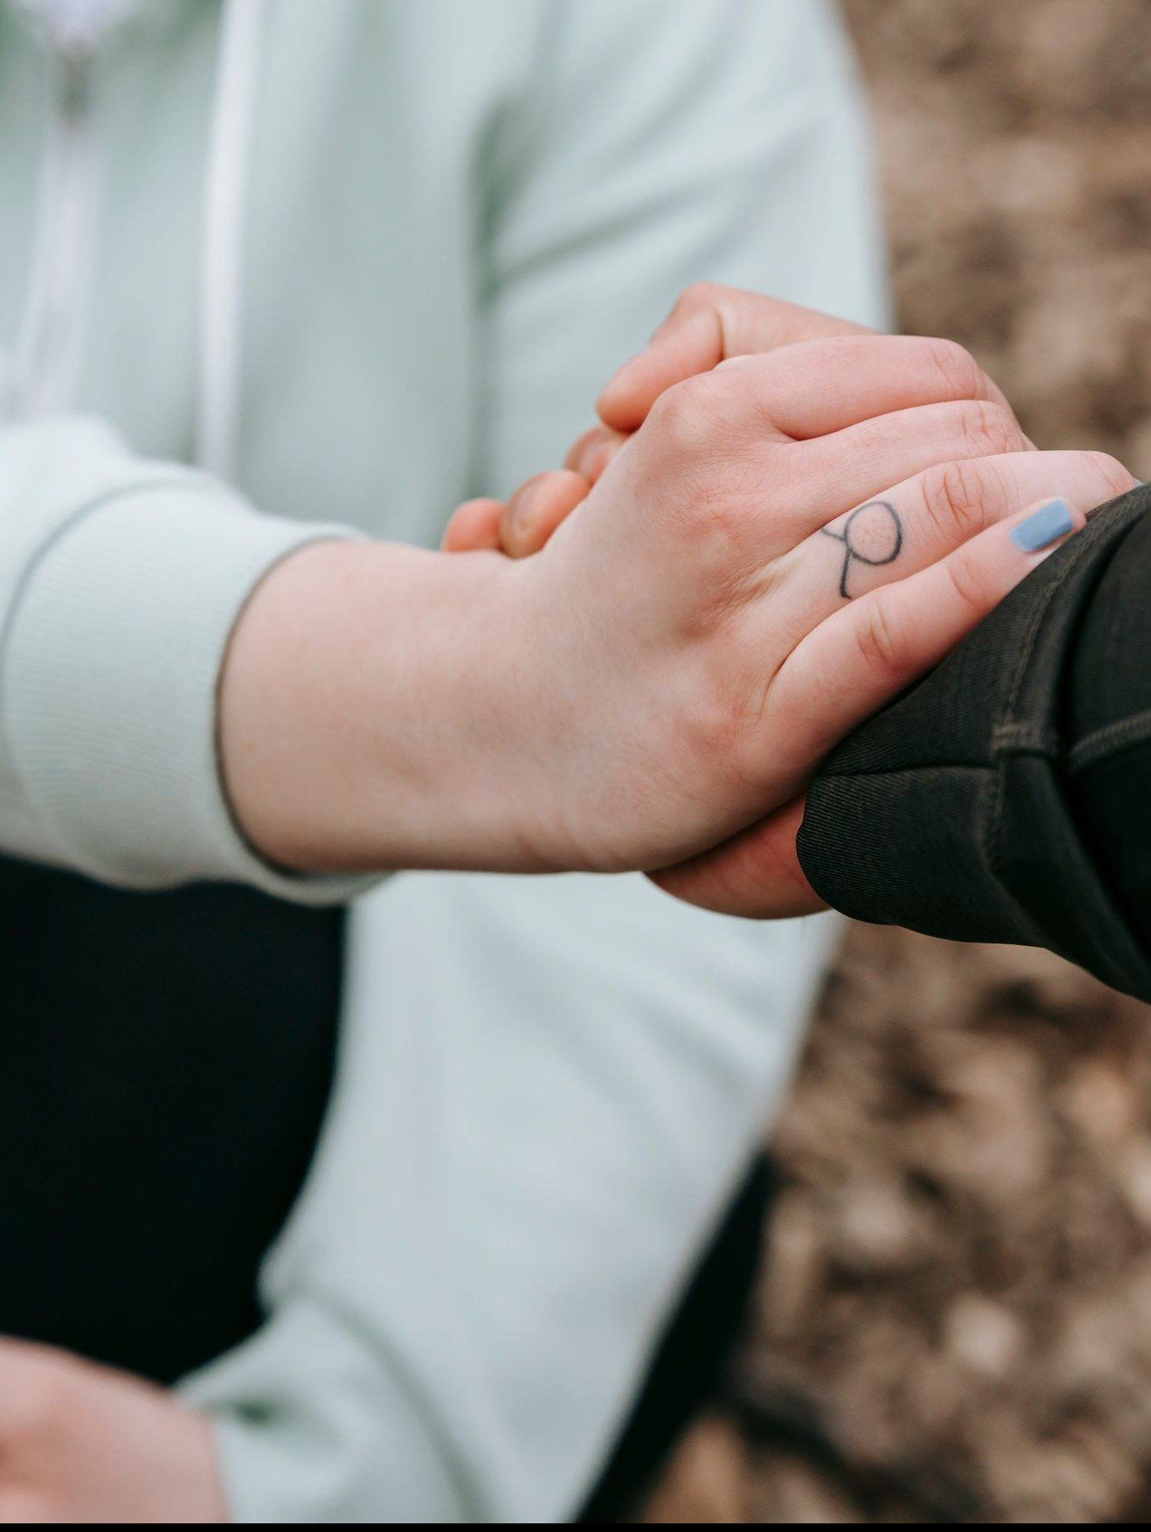
WEEK 6
Safe and Brave Together
Confession and restoration in an age-appropriate community
Quarter 1: Connect with Self & Others
1

Slide 57
Week 6 — Tonight’s Road
1 Welcome and centering
2 Wk 5 check-in
3 James 5:16 and 1 John 1:9 — confession as architecture
4 Companion demo
5 Bridge to the split
6 Confession-and-restoration in family clusters
7 Merge and shared blessing
8 Between-session practice
9 The Leader Feedback Round
10 Closing container
1

Slide 58
Opening Container — the Eight Steps
1 Welcome — five minutes to open the container
2 Phones silenced and put away
3 Stand in a circle
4 One-word check-in — how you actually are, right now
5 Put out / bring in — set something down; bring a blessing in
6 Spoken commitment: “I am here. I am paying attention. I am willing to be moved.”
7 Opening prayer — “Holy Spirit, you are welcome here. Speak. We are listening.”
8 Sit. Begin.
1

Slide 59
Week 5 Check-In
• “Last week we did the friendship audit and committed to one condition, one friendship, one week.”
• “One sentence about how that practice landed.” — an arranged parent starts
• Two or three voices is plenty — optional, no pressure
1

Slide 60
Confession as Architecture
• Two verses, two angles — 1 John 1:9 is vertical: confession to God, with full assurance. James 5:16 is horizontal: confession to one another, for healing
• Most Christians live in 1 John 1:9 and never enter James 5:16. Tonight we enter it carefully and at age
• Patterns we hide from each other tend to keep their grip — bringing them into the light, in front of trusted people, is part of what breaks it
• Not detailed sin disclosure — each person names ONE place where they want to walk in greater honesty: the place, the pattern, the pull
• The parents go first in every cluster — the older generation owes the younger the demonstration
• After each naming, the circle speaks a specific blessing of restoration — about three minutes per person
JAMES 5:16 · 1 JOHN 1:9
“Therefore, confess your sins to one another and pray for one another, that you may be healed. The prayer of a righteous person has great power as it is working.”
“If we confess our sins, he is faithful and just to forgive us our sins and to cleanse us from all unrighteousness.”
1

Slide 61
Companion Demo
• The Lead Companion does the practice in front of the whole room — this sets the depth and the form
• One sentence: “The place where I want to walk in greater honesty is ______.” Real but not graphic
• Pause. A pre-arranged Co-Companion speaks a brief blessing of restoration back
• Receive it — no deflecting, no joking, no minimizing. “Thank you.”
• “That is the practice. You will do it in your cluster — parents first, then teens. Yours doesn’t have to look like mine.”
1

Slide 62
Bridge to the Split
1 “Take what helps from the prompts. You don’t have to use any of them.”
2 The blessing card — specific, short, witnessed: “In the name of Jesus, we pray restoration over...”
3 “The container holds. Nothing leaves the cluster. Not even back to the main room. Especially this week.”
• The order holds too: your Companion first, then the parents, then the teens
• “Teens — your depth is yours, and pass is always allowed.”
1

Slide 63
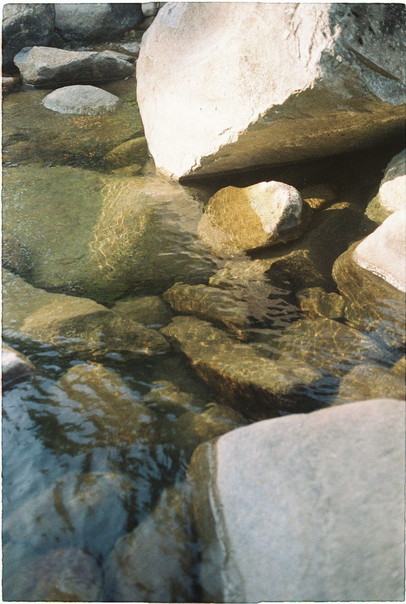
Confession and Restoration in Family Clusters
• Ninety seconds of silence to settle in — the silence is part of the practice
1 The Cluster Companion goes first — names one place, receives a blessing
2 The parents next — the arranged parent opens; own struggles only, within the rails
3 The teens — each names one place at whatever depth they choose. Pass is real, honored without a flicker
• The form: “The place where I want to walk in greater honesty before God is ______.”
• After each naming, a brief specific blessing — a teen blessing their own parent is one of the best things this night can produce
• Closing silence — “We have named real things tonight. Let’s sit with what was said.”
1

Slide 64
Merge and Shared Blessing
• What happened in your cluster stays in your cluster
• “One word about what tonight was like in your body. ‘Heavy.’ ‘Lighter.’ ‘Held.’ ‘Tender.’ ‘Surprised.’” — an arranged parent starts
• Then one shared blessing of restoration over the whole room — “Hands up if you want”
• “We pray restoration into every place that was named... Holy Spirit, walk these brothers and sisters home.”
1

Slide 65
Between-Session Practice — the Five-Minute Examen
• The Five-Minute Examen — five minutes with God each evening, before bed, carried through the quarter break
1 Thank Him for one specific thing from the day
2 Notice one place where you saw God moving
3 Ask Him about one place where you walked in less honesty than you wanted to today — just notice. No fixing
• The Quarterly Pulse goes home tonight — three questions, five minutes, sign it or leave it anonymous
• It comes back to the bin at the door at Week 7
1

Slide 66
The Leader Feedback Round
• The evening’s leader goes first — three things, same as every week
– “What I think went well tonight: ______”
– “What I’d do differently next time: ______”
– “If I were to teach tonight’s process to someone, I would tell them: ______”
• Then the room — the same two questions about tonight
• The leader receives without defending — “thank you” is the whole response
1

Slide 67
Closing the Container + Aaronic Blessing
• We close the way we opened — the container, six steps
• One-word landing · the one thing you are taking · the one practice
– Commit to the week’s practice aloud — or modify it to something you will actually do
• Blessings — specific, witnessed, short
• Then the Aaronic blessing — spoken over each other, face to face
THE AARONIC BLESSING — NUMBERS 6:24–26
“The Lord bless you and keep you;
the Lord make his face to shine upon you, and be gracious to you;
the Lord lift up his countenance upon you, and give you peace.”
1

Slide 68
Quarter 2
Connect with God
Weeks 7–11 · Five Wednesdays · PROAPT, the Garden, Any Doubts? · ends at the year’s midpoint
1

Slide 69
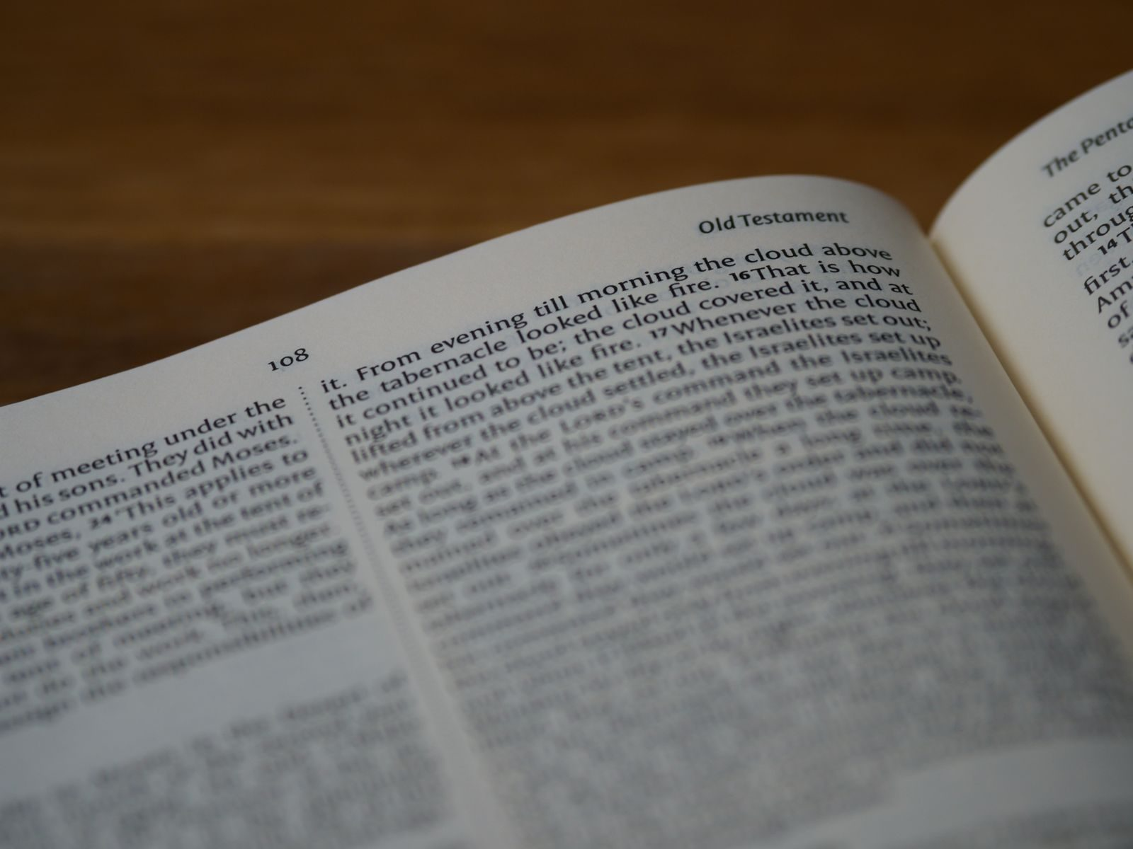
WEEK 7
Hearing God in Scripture — PROAPT I
PROAPT — the systematic practice of hearing; the first walk-through, received before it is led
Quarter 2: Connect with God
1

Slide 70
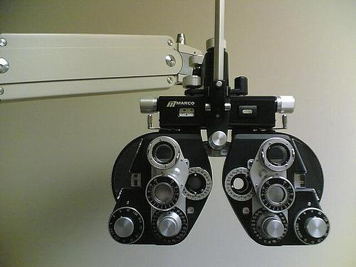

Week 7 — My Story: The Eye Test
“The more I obey what I have heard, the finer print I can read.”
— the founder’s story, told live
Hearing God is a practice that grows with obedience — tonight we learn the practice.
1

Slide 71
Week 7 — Tonight’s Road
1 Welcome and centering
2 Re-entry check-in
3 Romans 10:17 — the chain
4 PROAPT walked together
5 Bridge to the clusters and pair structure
6 PROAPT in family pairs in family clusters
7 Tell step — sharing in the cluster
8 Merge and between-session
9 The Leader Feedback Round
10 Closing container
1

Slide 72
Opening Container — the Eight Steps
1 Welcome — five minutes to open the container
2 Phones silenced and put away
3 Stand in a circle
4 One-word check-in — how you actually are, right now
5 Put out / bring in — set something down; bring a blessing in
6 Spoken commitment: “I am here. I am paying attention. I am willing to be moved.”
7 Opening prayer — “Holy Spirit, you are welcome here. Speak. We are listening.”
8 Sit. Begin.
1

Slide 73
Re-Entry Check-In
• First gathering of Quarter 2 — the container re-held slowly after the break
• “Take ninety seconds: one sentence about the Examen, or about how the break treated your practice, or anything that has shifted.”
– “Thinned out over the break is a completely normal answer — the practice picks up where you are.”
• A parent starts the round — pass-anytime holds
• Week 6 still sitting heavy? “The team is here. Find one of us before you leave tonight.”
1

Slide 74
Romans 10:17 — The Chain
• One short verse, three steps: Word → Hearing → Faith — the order matters
• Not trying harder, not emotional experience — faith is a fruit of a particular practice
• How much of our “Bible time” is actually hearing, and how much is reading without hearing?
• Hearing is a skill — skills develop with practice
• The practice: PROAPT — Pray, Read, Observe, Apply, Pray again, Tell (Truro Church, 1980s)
ROMANS 10:17
“So faith comes from hearing, and hearing through the word of Christ.”
1

Slide 75

PROAPT Walked Together — Mark 1:14–20
1 Pray — “Holy Spirit, you are welcome here. Speak. We are listening.”
2 Read — slowly, to receive it; don’t analyze yet
3 Observe — two layers, in order: first the data (who, what, when, where — straight off the page), then the interpretation — what stands out or surprises you in it
4 Apply — “What does this passage mean FOR YOU, TODAY, in your specific life?” — logos becomes rhema
5 Pray again — tell God what you heard, what you are willing to do, what you’re struggling to be willing to do
6 Tell — the most-often-skipped step; hearing spoken aloud has a different staying power
1

Slide 76
Bridge to the Clusters — Pair Structure
• Pair up in your family cluster — parent with teen, from your own family, by default
• One Reader, one Listener — Reader leads the six steps; after twelve minutes, switch
• “Pairing up with your own parent or your own teen is not the consolation-prize version — it is the design working.”
• Your Cluster Companion settles the pairs and completes any odd numbers
• Small room (about ten or fewer)? Stay as one circle and pair up in place
1

Slide 77
PROAPT in Family Pairs
1 First pass (12 min) — Reader leads PROAPT; Listener works alongside without interrupting
2 Reader’s Tell at the end goes to the Listener — one sentence
3 Switch roles — new passage or stay with Mark 1
4 Second pass (12 min) — same structure, roles reversed
• Stuck on Observe? “What’s one specific word or phrase that caught your attention?”
• “Slow down. The Spirit isn’t in a hurry.” — and if you finish early, get reps with another passage
1

Slide 78
Tell Step — Sharing in the Cluster
• Back in the family cluster — each of us tells ONE specific thing we heard tonight
• “Specific. One sentence. We listen to receive, like Week 3.”
• A parent opens the round — arranged beforehand, never a cold call on a teen; pass-anytime holds
• Receive without preaching — “We hear that.” “Thank you for naming that.”
• “What we heard tonight is not just for us — it is given to us to walk out.”
1

Slide 79
Merge and Between-Session Practice
• One word each — not what you heard (that’s yours), but what tonight’s practice was like; a parent begins
• Daily PROAPT — one passage per day, every day, for the next week — five to ten minutes
• The journal Week 7 pages have a daily PROAPT template
• Passage paths on the handout — the Gospel of Mark, the Sermon on the Mount, or Romans 8
• Commit aloud to a specific time of day — “Morning before school” / “Right after dinner”
• “The chain only works if we work it.”
1

Slide 80
The Leader Feedback Round
• The evening’s leader goes first — three things, same as every week
– “What I think went well tonight: ______”
– “What I’d do differently next time: ______”
– “If I were to teach tonight’s process to someone, I would tell them: ______”
• Then the room — the same two questions about tonight
• The leader receives without defending — “thank you” is the whole response
1

Slide 81
Closing the Container + Aaronic Blessing
• We close the way we opened — the container, six steps
• One-word landing · the one thing you are taking · the one practice
– Commit to the week’s practice aloud — or modify it to something you will actually do
• Blessings — specific, witnessed, short
• Then the Aaronic blessing — spoken over each other, face to face
THE AARONIC BLESSING — NUMBERS 6:24–26
“The Lord bless you and keep you;
the Lord make his face to shine upon you, and be gracious to you;
the Lord lift up his countenance upon you, and give you peace.”
1

Slide 82
WEEK 8
Hearing God — PROAPT II
The second running — the practice received last week is led this week, by one of the room's own seniors
Quarter 2: Connect with God
1

Slide 83
Week 8 — Tonight’s Road
1 Welcome and centering
2 Daily-practice check-in
3 Why a second running
4 PROAPT walked together — Mark 2:1–12
5 Bridge to the clusters and pair structure
6 PROAPT in family pairs in family clusters
7 Tell step — sharing in the cluster
8 Merge and between-session
9 The Leader Feedback Round
10 Closing container
1

Slide 84
Opening Container — the Eight Steps
1 Welcome — five minutes to open the container
2 Phones silenced and put away
3 Stand in a circle
4 One-word check-in — how you actually are, right now
5 Put out / bring in — set something down; bring a blessing in
6 Spoken commitment: “I am here. I am paying attention. I am willing to be moved.”
7 Opening prayer — “Holy Spirit, you are welcome here. Speak. We are listening.”
8 Sit. Begin.
1

Slide 85
Daily-Practice Check-In
• “One sentence each, whoever wants: how did the week of daily practice actually go? Honest answers.”
– “‘I did two days and stopped’ is an honest answer.”
• A parent starts the round — arranged beforehand; anyone may pass
• Thin or empty week? No guilt — “The practice picks up where you are, not where you were supposed to be.”
• “Tonight is a fresh start” — everything tonight works whether you did seven days or zero
1

Slide 86
Why a Second Running
• Word → Hearing → Faith — “hearing is a skill, and skills take reps. Last week was rep one. Tonight is rep two.”
• Tonight one of the room’s own leads the walk-through — “The team is here. But the practice is ours now.”
• Tonight’s passage: Mark 2:1–12 — the paralytic whose friends dig through a roof to get him to Jesus
• Already PROAPTed it this week? Good — “a passage speaks differently on a second hearing. That’s not a theory; you’re about to test it.”
• Same six steps as last week — Bibles open to Mark 2
ROMANS 10:17
“So faith comes from hearing, and hearing through the word of Christ.”
1

Slide 87

PROAPT Walked Together — Mark 2:1–12
1 Pray — “Tell the Holy Spirit you want to hear what He has for you tonight — not what you already know about this passage.”
2 Read — once aloud, slowly; then silence while the room reads to receive
3 Observe — two layers, in order: first the data, straight off the page, then the interpretation — what stands out or surprises you in it. “Write three things — data first.”
4 Apply — “Where in your life are you the one on the mat — stuck, carried, waiting? Or are you one of the four — and who are you carrying?”
5 Pray again — “Tell God what you heard. Tell Him what you’re willing to do — or what you’re struggling to be willing to do.”
6 Tell — in your family cluster tonight — “it’s the step that makes the hearing stick.”
1

Slide 88
Bridge to the Clusters — Pair Structure
• Same pair structure as last week — parent with teen, from your own family, by default
• One Reader, one Listener — after thirteen minutes, switch; stay with Mark 2 or take a fresh passage
• “Same pair as last week is not a rerun — a parent and a teen telling each other what they heard, a second week running, is the design working.”
• Your Cluster Companion settles any odd numbers; a small room stays as one circle
• “Father, You’ve already spoken tonight. Speak again in the pairs — something specific, something each of us can hear.”
1

Slide 89
PROAPT in Family Pairs
1 First pass (13 min) — Reader leads PROAPT; Listener works alongside without interrupting
2 Reader’s Tell at the end goes to the Listener — one sentence
3 Switch — roles reverse; same passage or new
4 Second pass (13 min) — same structure, roles reversed
• Same unstick prompts as Week 7 — “one specific word or phrase that caught you” / “one situation in your life right now — be specific”
• Feels like a rerun? “Then you know what it said Thursday. What is it saying tonight? Second hearings are where the specific word comes.”
1

Slide 90
Tell Step — Sharing in the Cluster
• “The Tell step — second time in the cluster, so you know the shape.”
• One specific thing you heard tonight — one sentence — “We listen to receive.”
• A parent opens the round — arranged beforehand, never a cold call on a teen
• Teens choose their own depth; pass-anytime holds
• Receive without preaching — “We hear that.” “Thank you for naming that.”
• “Take what you heard with you. It was given to be walked out.”
1

Slide 91
Merge and Between-Session
• Daily PROAPT continues — one passage, five to fifteen minutes, every day (journal Week 7–8 pages)
• “If last week thinned out, restart tomorrow. No guilt, no doubling up.”
• “Take a moment on the way home to notice what just happened in this room. One of our own led the whole practice tonight. That is the design working.”
1

Slide 92
The Leader Feedback Round
• The evening’s leader goes first — three things, same as every week
– “What I think went well tonight: ______”
– “What I’d do differently next time: ______”
– “If I were to teach tonight’s process to someone, I would tell them: ______”
• Then the room — the same two questions about tonight
• The leader receives without defending — “thank you” is the whole response
1

Slide 93
Closing the Container + Aaronic Blessing
• We close the way we opened — the container, six steps
• One-word landing · the one thing you are taking · the one practice
– Commit to the week’s practice aloud — or modify it to something you will actually do
• Blessings — specific, witnessed, short
• Then the Aaronic blessing — spoken over each other, face to face
THE AARONIC BLESSING — NUMBERS 6:24–26
“The Lord bless you and keep you;
the Lord make his face to shine upon you, and be gracious to you;
the Lord lift up his countenance upon you, and give you peace.”
1

Slide 94
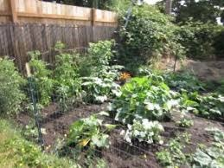
WEEK 9
The Garden of Your Heart I
An experiential encounter with Jesus in your interior space — the first guided run; a senior leads the second next week
Quarter 2: Connect with God
1

Slide 95
Week 9 — Tonight’s Road
1 Welcome and centering
2 Week 7 check-in
3 Scripture and framing
4 Bridge into the exercise
5 The Garden exercise — whole room, then clusters
6 Merge and one-word landing
7 Between-session practice
8 The Leader Feedback Round
9 Closing container
1

Slide 96
Opening Container — the Eight Steps
1 Welcome — five minutes to open the container
2 Phones silenced and put away
3 Stand in a circle
4 One-word check-in — how you actually are, right now
5 Put out / bring in — set something down; bring a blessing in
6 Spoken commitment: “I am here. I am paying attention. I am willing to be moved.”
7 Opening prayer — “Holy Spirit, you are welcome here. Speak. We are listening.”
8 Sit. Begin.
1

Slide 97
Week 7 Check-In
• “Last week we walked PROAPT — a six-step practice for hearing God in scripture.”
• “One sentence about how that practice has been?”
• A parent starts — arranged beforehand, never a cold call on a teen
• Two or three voluntary contributions; anyone may pass — kept brief, tonight’s arc needs the time
1

Slide 98

Scripture and Framing
• Two passages, read slowly — Psalm 23 and John 15:1–11 — “Listen as if you have not heard it.”
• Scripture pictures the heart as cultivated ground — green pastures, still waters, vine and vinedresser
• Tonight we walk into that image: picture your heart as a garden, invite Jesus in, notice what He does
• Imaginative prayer — Ignatius taught it, Bonaventure taught it, the Puritan writers under other names
• Not visualization-as-self-help, not contemplative emptying — filling the mind with one scriptural image
• “The exercise is not a test of imaginative power. It is a posture of receptivity.”
JOHN 15:5
“I am the vine; you are the branches. Whoever abides in me and I in him, he it is that bears much fruit, for apart from me you can do nothing.”
1

Slide 99
Bridge into the Exercise
• We stay right here, together, as one room — a guided imaginative prayer, twelve to fifteen minutes, read slowly
• Eyes closed or open — either is fine; your own family is beside you the whole time
• Then five minutes with your journal, then family clusters for sharing — by invitation only
• A parent will open each round — “Silence is a complete answer.”
• “Father, you are the vinedresser. … Where it is hard, be tender. Where it is closed, be patient. Where it is opening, be present.”
1

Slide 100
The Garden Exercise — Whole Room, then Clusters
1 Settle (2 min) — “Take a breath. Settle. Eyes open or closed. Whatever feels honest. We have time.”
2 Guided prayer (12–15 min) — read slowly to the whole room; the pauses are not optional — they are where the work happens
3 Silent journaling (5 min) — “Write in your Week 9 journal page what you noticed. Whatever you noticed.”
4 Sharing in family clusters (8–10 min) — by invitation only; a parent opens; silence is a complete answer
• Receive without interpreting — “Thank you for sharing that.” Never “God was telling you _____.”
• If something painful surfaces — bless it: “I hear that. May Jesus stay with you in that place this week.”
1

Slide 101
Merge and One-Word Landing
• “What happened in your cluster stays in your cluster.”
• One word about tonight — not what was said, but what you noticed
– “Surprised.” “Tender.” “Empty.” “Found.” “Confused.” “Quiet.”
• A parent begins; anyone may pass — each word received without commentary
• “Whatever happened tonight is yours. Some of it will keep happening across the week.”
1

Slide 102
Between-Session Practice
• Three returns to the garden this week — five to ten minutes each, journaled
• “You don’t need the full guided script — you have the place now. Just go back.”
• Notice what is the same and what has changed — notice if Jesus is in a different place than He was tonight
• Pick three days and a time — morning before the day starts is often best
• If something heavy surfaces — stop, open your eyes, come back another day; tell a trusted adult
• Came in skeptical? The Note for the Skeptic handout is for you — adapting or sitting out for now is okay
1

Slide 103
The Leader Feedback Round
• The evening’s leader goes first — three things, same as every week
– “What I think went well tonight: ______”
– “What I’d do differently next time: ______”
– “If I were to teach tonight’s process to someone, I would tell them: ______”
• Then the room — the same two questions about tonight
• The leader receives without defending — “thank you” is the whole response
1

Slide 104
Closing the Container + Aaronic Blessing
• We close the way we opened — the container, six steps
• One-word landing · the one thing you are taking · the one practice
– Commit to the week’s practice aloud — or modify it to something you will actually do
• Blessings — specific, witnessed, short
• Then the Aaronic blessing — spoken over each other, face to face
THE AARONIC BLESSING — NUMBERS 6:24–26
“The Lord bless you and keep you;
the Lord make his face to shine upon you, and be gracious to you;
the Lord lift up his countenance upon you, and give you peace.”
1

Slide 105
WEEK 10
The Garden of Your Heart II
The second guided run — the room returns to the garden deeper for a week of practice; a Companion-in-Formation leads the walk-through, and the adults hold the debrief
Quarter 2: Connect with God
1

Slide 106
Week 10 — Tonight’s Road
1 Welcome and centering
2 Garden week check-in
3 Scripture and brief re-framing
4 Bridge to the exercise
5 The Garden exercise — whole room, then family clusters
6 Merge and one-word landing
7 Between-session practice
8 Leader Feedback Round
9 Closing container
1

Slide 107
Opening Container — the Eight Steps
1 Welcome — five minutes to open the container
2 Phones silenced and put away
3 Stand in a circle
4 One-word check-in — how you actually are, right now
5 Put out / bring in — set something down; bring a blessing in
6 Spoken commitment: “I am here. I am paying attention. I am willing to be moved.”
7 Opening prayer — “Holy Spirit, you are welcome here. Speak. We are listening.”
8 Sit. Begin.
1

Slide 108
Garden Week Check-In
• “One sentence about a garden visit this week? Not what happened in it — just how the going was.”
– “I went twice and it was quieter than Wednesday.” “I meant to and didn’t.” “I went once and it was hard.”
• A parent offers the first sentence — never a cold call on a teen; each one received identically
• “There is no junior varsity garden. Jesus meets each person in the garden they actually have.”
1

Slide 109
Scripture and Brief Re-Framing
• Same two anchors as last week — Psalm 23 and John 15:1–11 — “Listen as if for the first time anyway.”
• A vinedresser does not visit a vine once — abiding is a rhythm, not an event
• Going back changes things — the garden is not a photograph; it is a living place, because your heart is
• A hard garden last week? Going back in tonight is optional — sit and pray instead, fully honored, no explanation owed
• “The words get you to the gate; the silence is where He meets you.”
PSALM 23:1–3
“The Lord is my shepherd; I shall not want. He makes me lie down in green pastures. He leads me beside still waters. He restores my soul.”
1

Slide 110
Bridge to the Exercise
• Same shape as last week — guided walk-through, about twelve to fifteen minutes, all of us together in this room
• Read slowly, with longer quiet than last time — then five minutes with your journal
• Then family clusters for sharing by invitation only — “Silence is a complete answer.”
• “Father, You are the vinedresser. We are going back into the gardens You already know. Walk where You want to walk. Tend what You want to tend.”
1

Slide 111

The Garden Exercise — Whole Room, then Family Clusters
1 Settle (2 min) — then, simply: “[Name] will read for us tonight.”
2 Guided walk-through, senior-led (12–15 min) — same protocol as Week 9, longer pauses; the card carries the room
3 The visible handoff — “[Name], the room is yours.” / “Thank you, [name]. That was well led.”
4 Silent journaling (5 min) — what was the same as last week, what was different
5 Sharing in family clusters (10–12 min) — by invitation only; a parent opens; silence is a complete answer
• The bright line — the teen leads the walk-through; the adults hold the sharing and anything that surfaces
1

Slide 112
Merge and One-Word Landing
• “What happened in your cluster stays in your cluster.”
• One word each, when you’re ready — not what was said, but what you noticed; you can pass
– “Deeper.” “Same.” “Tender.” “Quiet.” “Harder.” “Found.”
• A parent offers the first word — each one received without commentary
• “A garden visited twice is a garden being tended. Whatever He is doing in yours, He will keep doing it this week.”
1

Slide 113
Between-Session Practice
• Keep the garden rhythm — two returns this week, five to ten minutes each
• “You know the way now — you don’t need the script.” Go back, walk a little, notice where He is
• Journal each visit — even two sentences — “the garden speaks slowly, and the journal is how you hear it across weeks”
• If a return surfaces something heavy — stop, open your eyes, come back another day; tell a trusted adult
• Three visits drops to two on purpose — a rhythm that survives, not a sprint that impresses
1

Slide 114
The Leader Feedback Round
• The evening’s leader goes first — three things, same as every week
– “What I think went well tonight: ______”
– “What I’d do differently next time: ______”
– “If I were to teach tonight’s process to someone, I would tell them: ______”
• Then the room — the same two questions about tonight
• The leader receives without defending — “thank you” is the whole response
1

Slide 115
Closing the Container + Aaronic Blessing
• We close the way we opened — the container, six steps
• One-word landing · the one thing you are taking · the one practice
– Commit to the week’s practice aloud — or modify it to something you will actually do
• Blessings — specific, witnessed, short
• Then the Aaronic blessing — spoken over each other, face to face
THE AARONIC BLESSING — NUMBERS 6:24–26
“The Lord bless you and keep you;
the Lord make his face to shine upon you, and be gracious to you;
the Lord lift up his countenance upon you, and give you peace.”
1

Slide 116

WEEK 11
Any Doubts?
Bringing the real question, and bringing it to God
Quarter 2: Connect with God
1

Slide 117
Week 11 — Tonight’s Road
1 Welcome and centering
2 Week 9 check-in
3 Mark 9:14–29 — the scripture ground
4 The Any Doubts? practice — teaching
5 Bridge to split
6 Any Doubts? in pairs within families
7 Merge and surface
8 Between-session practice
9 Leader Feedback Round
10 Closing container
1

Slide 118
Opening Container — the Eight Steps
1 Welcome — five minutes to open the container
2 Phones silenced and put away
3 Stand in a circle
4 One-word check-in — how you actually are, right now
5 Put out / bring in — set something down; bring a blessing in
6 Spoken commitment: “I am here. I am paying attention. I am willing to be moved.”
7 Opening prayer — “Holy Spirit, you are welcome here. Speak. We are listening.”
8 Sit. Begin.
1

Slide 119
Week 9 Check-In — the Garden Returns
• The practice was three returns to the garden
• “Anyone want to say one sentence about how that went — the garden visits, or what surfaced, or that you didn’t get to it?”
• One sentence each, voluntary — received without commentary
– “Good. The garden is still there. You can return any time. We continue.”
1

Slide 120

Mark 9:14–29 — the Scripture Ground
• The whole scene, read slowly — the desperate father, the failed disciples, the boy in convulsions
• He does not pretend the unbelief is not there — he names both at once. And Jesus does not rebuke him; Jesus heals the boy
• The unbelief that is named and brought to Jesus is the unbelief that can be released; suppressed, it works as a quiet brake
• Tonight is not generating new doubts — it is bringing the ones already there into the open, and bringing them to Jesus
MARK 9:24
“Immediately the father of the child cried out and said, ‘I believe; help my unbelief!’”
1

Slide 121

The Any Doubts? Practice — Four Steps
1 NAME — the scripture, then the doubt. Specific, not abstract: “I doubt He hears prayer about this specific thing”
2 EXAGGERATE — make the doubt bigger, not smaller. You are not endorsing it; you are exposing it
3 SIT — what does the doubt feel like in your body? Ten or fifteen seconds. Don’t fix it. Feel it
4 RE-READ — your partner reads the same scripture again, slowly. The Spirit does the work; you do the noticing
• Watch the demo — specific, honest, brief, and unresolved-but-honest is the gift
1

Slide 122
Bridge to the Split — Parents First
• Take the practice card from your chair — Name · Exaggerate · Sit · Re-read. Pairs form within your own family, a parent with their own teen
• In every pair the parent goes first — arranged this week; nobody is being put on the spot tonight
– “Teens: you go second, and you choose your own depth. A small doubt is enough. Passing is enough.”
• No scripture in mind? Pick one with a flicker for you, not a hurricane
– Romans 8:28 · Jeremiah 29:11 · Psalm 139:13–16 · John 14:1–3 · Romans 8:38–39 · James 1:5
• Partners: read, listen, re-read. Not fix. Not theologize. “We are not arguing the doubt. We are bringing it.”
1

Slide 123
Any Doubts? in Pairs, within Families
1 Pick a scripture; your partner reads it slowly — from the physical Bible if possible
2 “What I notice is ___. The doubt I am holding is ___.” — specific
3 Exaggerate it, then sit with the feeling for 10–20 seconds
4 “Read it again, please.” Then: “What I notice this time is ___.”
• The parent’s turn first, then switch — the teen at their own depth; pass-anytime holds
• Two agreements: you are not arguing or fixing the doubt — and nothing leaves your pair
1

Slide 124
Merge and Surface
• What happened in your pair stays in your pair — no one will be asked to share a doubt or a scripture
• “One word about what the practice was like. Not the doubt — the practice.”
– “Surprising.” “Heavy.” “Quiet.” “Awkward.” “Honest.” “Lighter.” Pass anytime
• This practice fits in five minutes alone, or twenty with a friend — a way of bringing your real questions to God for the rest of your life
• “The resolution is the Spirit’s work. The naming is yours. We do the naming. He does what only He can.”
1

Slide 125
Between-Session Practice — the Doubts Inventory
• The Personal Doubts Inventory — twenty minutes with your journal, once this week
1 List 5–10 scriptures you say you believe; rate your honest trust, 1–5
2 For the two or three with the most hesitation — write the specific doubt, then sit with it
• No shame. Just data. Yours alone — never turned in, never seen by the team
• The Quarterly Pulse goes home tonight — three questions, five minutes, honest. Back in the bin at The Return’s door in January
• Over the break: keep one practice alive — just one, your choice
1

Slide 126
The Leader Feedback Round
• The evening’s leader goes first — three things, same as every week
– “What I think went well tonight: ______”
– “What I’d do differently next time: ______”
– “If I were to teach tonight’s process to someone, I would tell them: ______”
• Then the room — the same two questions about tonight
• The leader receives without defending — “thank you” is the whole response
1

Slide 127
Closing the Container + Aaronic Blessing
• We close the way we opened — the container, six steps
• One-word landing · the one thing you are taking · the one practice
– Commit to the week’s practice aloud — or modify it to something you will actually do
• Blessings — specific, witnessed, short
• Then the Aaronic blessing — spoken over each other, face to face
THE AARONIC BLESSING — NUMBERS 6:24–26
“The Lord bless you and keep you;
the Lord make his face to shine upon you, and be gracious to you;
the Lord lift up his countenance upon you, and give you peace.”
1

Slide 128
Quarter 3
Mission & Rhythm
Weeks 12–17 · Six Wednesdays · The Return, Mission, the Rhythm and the Four Questions
1

Slide 129

WEEK 12
The Return
Coming home after the break — reading honestly what held, welcoming every walker back, and beginning again
Quarter 3: Mission & Rhythm
1

Slide 130
Week 12 — Tonight’s Road
1 Opening container — run slow
2 New every morning — Lam. 3:22–23, Ps. 126
3 “What held?”
4 The walk home
5 Re-anchoring the year
6 Between-session practice — restart one
7 Closing container
8 Leader Feedback Round
9 Aaronic blessing and sending
1

Slide 131
Opening Container — Run Slow
• Two weeks without Wednesdays — containers don’t keep. They are rebuilt every time, by the same small faithful steps
• “Tonight we open it slowly, on purpose. Don’t rush the steps. There is nowhere else we need to be.”
• The full eight steps — phones away, standing circle, put out / bring in, the prayer
• One-word check-in: “One word for how you actually are right now — not how you usually are, not how you should be.” Let each word have a breath
THE SPOKEN COMMITMENT
“I am here. I am paying attention. I am willing to be moved.”
1

Slide 132
New Every Morning — Lam. 3:22–23, Ps. 126
• Written in the ashes of Jerusalem — the mercies-new truth lives in the mornings after the seasons that didn’t hold
• Not new every morning that you earned. Issued fresh, this morning, to everyone in this circle — whatever the break looked like
• Psalm 126 — “those who sow in tears shall reap with shouts of joy!” Coming home is not make-up work; it is the happiest walk there is
• Tonight we read the break honestly — and we can afford to, because the mercy was already new before we walked in
LAMENTATIONS 3:22–23
“The steadfast love of the LORD never ceases; his mercies never come to an end; they are new every morning; great is your faithfulness.”
1

Slide 133
“What Held?”
• A reading, not a report card — which practices held through the break, and which slipped
• “Every break is a natural test, and it is a test of the practices, not of you.”
• One at a time, plain words — a parent starts in each cluster
• Nobody fixes anybody. Nobody compares. Slips are data — useful information, not a verdict
• “Most of it slipped” is a complete answer; pass is a complete answer
– If time allows: “Did anything about the break surprise you?”
“When your children ask their fathers in times to come, ‘What do these stones mean?’”
— JOSHUA 4:21 (ESV)
1

Slide 134
The Walk Home
• The Path Home Card — filed weeks ago, while the room was warm. Tonight it is not taught; it is enacted
• “Nobody in this room owes anybody an explanation for the break. You already walked back. You are in the chair. That is the whole return.”
• The way back is unglamorous: do not start over from the beginning; begin again on the next available day. Five dry minutes tomorrow morning is a full return
• Everybody here came back — every chair filled tonight is a small feast
• If the break was hard in ways that have nothing to do with practices — that is a Companion conversation, tonight or this week
LUKE 15:20
“But while he was still a long way off, his father saw him and felt compassion, and ran and embraced him and kissed him.”
1

Slide 135
Re-Anchoring the Year
• Behind us: the whole God arc — the container, your story, the soils, being known; then the hearing: PROAPT, the garden, the doubts brought honestly
• “That work is in you now. The break did not take it away.”
• Ahead: Week 13 — Mission, the turn outward; then the Rhythm — one card you build with your own hand; then the sendings and the commissionings
• “We are not starting over tonight. We are picking the trail back up, together, further along than we have ever been.”
1

Slide 136
Between-Session Practice — Restart One
• Not everything. One daily practice — the morning question, the evening note, or PROAPT. Just one
• Write it at the top of a fresh journal page tonight, with when and where: “The morning question, 6:50, kitchen table”
• That one practice, daily, this week
• Miss a day? Do not start over — begin again on the next available day
• “One seed goes back in the ground. His mercies are new every morning; you only need one practice to be standing there when they arrive.”
1

Slide 137
Closing the Container + Aaronic Blessing
• We close the way we opened — the container, six steps
• One-word landing · the one thing you are taking · the one practice
– Commit to the week’s practice aloud — or modify it to something you will actually do
• Blessings — specific, witnessed, short
• Then the Aaronic blessing — spoken over each other, face to face
THE AARONIC BLESSING — NUMBERS 6:24–26
“The Lord bless you and keep you;
the Lord make his face to shine upon you, and be gracious to you;
the Lord lift up his countenance upon you, and give you peace.”
1

Slide 138
The Leader Feedback Round
• The evening’s leader goes first — three things, same as every week
– “What I think went well tonight: ______”
– “What I’d do differently next time: ______”
– “If I were to teach tonight’s process to someone, I would tell them: ______”
• Then the room — the same two questions about tonight
• The leader receives without defending — “thank you” is the whole response
1

Slide 139

WEEK 13
What Was Prepared for You
Connecting with Mission — uphill, downhill, and the works prepared beforehand
Quarter 3: Mission & Rhythm
1

Slide 140
Week 13 — Tonight’s Road
1 Welcome and centering
2 Week 11 check-in
3 Ephesians 2:10 and the uphill/downhill distinction
4 Bridge to split
5 Gifts and Downhill in family clusters
6 Merge and surface
7 Between-session practice and closing-weeks logistics
8 Leader Feedback Round
9 Closing container
1

Slide 141
Opening Container — the Eight Steps
1 Welcome — five minutes to open the container
2 Phones silenced and put away
3 Stand in a circle
4 One-word check-in — how you actually are, right now
5 Put out / bring in — set something down; bring a blessing in
6 Spoken commitment: “I am here. I am paying attention. I am willing to be moved.”
7 Opening prayer — “Holy Spirit, you are welcome here. Speak. We are listening.”
8 Sit. Begin.
1

Slide 142
Week 11 Check-In
• Before the break: Any Doubts? — and last week, The Return read what the break did with our practices
• The practice carried across: the Personal Doubts Inventory
• “Anyone want to say one sentence about how that landed — the inventory, or anything that surfaced, or that you didn’t get to it?”
• One sentence each, voluntary — received without commentary
1

Slide 143
Uphill and Downhill — Ephesians 2:10
• The works were prepared — beforehand, not by us, not for us to invent. Our job is to walk in them
• UPHILL mission — what I do: a goal, a plan, measurable steps. Good and real — and the smaller half
• DOWNHILL mission — what I am: the effect I have on the people around me when I am most aligned with the Spirit and most genuinely myself. It flows; you don’t have to push it
• The test: “When I am at my most genuinely myself — not performing, not managing, just present and open — what do the people around me get to be?”
• Eleven weeks of uphill clearing behind us — tonight we ask the downhill question
EPHESIANS 2:10
“For we are his workmanship, created in Christ Jesus for good works, which God prepared beforehand, that we should walk in them.”
1

Slide 144
Bridge to the Split — Two Exercises
1 Gifts and Passions — about twenty minutes: ten alone, ten sharing. Where are you alive? What comes naturally? Where do others tell you you have something to offer?
– Share frame: “The three things I noticed are ______. The one I’m most surprised by is ______.”
2 Downhill Mission — about twenty minutes: five alone, then name your answer to the cluster. “When I am at my best, what the room gets is ___.”
– The cluster adds: “What I’ve seen in you is ______.” — specific, brief, something actually seen
• In each round a parent goes first — teens choose their own depth, and passing holds
• The cluster may add what they have noticed — a parent may speak to a teen’s gifts, and a teen to a parent’s
1

Slide 145
Gifts and Downhill in Family Clusters
• Phase 1 — Gifts and Passions: quiet writing (10 min), then 60 seconds each: “The three things I noticed are ___. The one I’m most surprised by is ___.”
• After each share the cluster affirms what it has seen — specific and brief: “Yes — we see that in you. Specifically: ___.”
• Phase 2 — Downhill Mission: five quiet minutes, then around the circle, 90 seconds each
– “What I noticed is that when I’m at my best, what the room gets is ___.”
• One or two voices add what they have actually seen across Getting Started — especially each other’s family
• The naming is the gift — no over-processing. Pass-anytime holds
1

Slide 146
Merge and Surface
• What was named in your cluster stays in your cluster — nobody repeats their downhill answer
• One sentence from each Cluster Companion — one general thing they noticed, not a specific person
• Then one observation across the room
• “The downhill mission you named is not a final answer. It is the working draft you are walking in this season.” It will deepen. It will sharpen
1

Slide 147
Practice This Week — and the Road Ahead
• One small action this week, aligned with your downhill answer. One. Not a campaign. Specific — then journal what happens
– If your downhill is “the room gets calmer” — sit with a friend in distress this week instead of trying to fix them
• Ahead: the Rhythm week — we build the practices you will carry when the Wednesdays stop
• Week 21 — the family commissioning: bring your whole family, even members who have not been here. We start at 6:30, light food at 6:00
• Week 22 — the commissioning of our Companions-in-Formation. Their night; come to witness it
1

Slide 148
The Leader Feedback Round
• The evening’s leader goes first — three things, same as every week
– “What I think went well tonight: ______”
– “What I’d do differently next time: ______”
– “If I were to teach tonight’s process to someone, I would tell them: ______”
• Then the room — the same two questions about tonight
• The leader receives without defending — “thank you” is the whole response
1

Slide 149
Closing the Container + Aaronic Blessing
• We close the way we opened — the container, six steps
• One-word landing · the one thing you are taking · the one practice
– Commit to the week’s practice aloud — or modify it to something you will actually do
• Blessings — specific, witnessed, short
• Then the Aaronic blessing — spoken over each other, face to face
THE AARONIC BLESSING — NUMBERS 6:24–26
“The Lord bless you and keep you;
the Lord make his face to shine upon you, and be gracious to you;
the Lord lift up his countenance upon you, and give you peace.”
1

Slide 150

WEEK 14
Second Running: Block A
The rotation’s evening — another willing teen takes a full leading rep with a practice the room already owns
Quarter 3: Mission & Rhythm
1

Slide 151
Week 14 — Tonight’s Road
1 Welcome and opening container
2 The mission round
3 Why tonight — the rotation’s charter
4 Closing container
5 Leader Feedback Round
6 Aaronic blessing and sending
1

Slide 152
Opening Container — the Eight Steps
1 Welcome — five minutes to open the container
2 Phones silenced and put away
3 Stand in a circle
4 One-word check-in — how you actually are, right now
5 Put out / bring in — set something down; bring a blessing in
6 Spoken commitment: “I am here. I am paying attention. I am willing to be moved.”
7 Opening prayer — “Holy Spirit, you are welcome here. Speak. We are listening.”
8 Sit. Begin.
1

Slide 153
The Mission Round
• The Mission night sent us home with one assignment — one small act, lined up with your downhill mission
• “One sentence each, whoever wants: what was your one act, or what got in the way?”
• “‘I didn’t get to it’ is an honest sentence.” A parent opens; pass anytime
• “The works were prepared beforehand; we keep walking into them. That assignment doesn’t expire.”
1

Slide 154
Why Tonight — the Rotation’s Charter
• Nothing new gets taught tonight — on purpose. Everything we do, this room has already done
• See one, do one, in front of each other — every one of us who is willing, not just the seniors headed for commissioning
• “My turn is tonight. Somebody else’s turn is coming.”
• This is not a competition — no ranking. The room’s job for every leader is the same: receive them
• “The team is here. But the practice is ours now.”
1 TIMOTHY 4:12
“Let no one despise you for your youth, but set the believers an example in speech, in conduct, in love, in faith, in purity.”
1

Slide 155
Closing the Container + Aaronic Blessing
• We close the way we opened — the container, six steps
• One-word landing · the one thing you are taking · the one practice
– Commit to the week’s practice aloud — or modify it to something you will actually do
• Blessings — specific, witnessed, short
• Then the Aaronic blessing — spoken over each other, face to face
THE AARONIC BLESSING — NUMBERS 6:24–26
“The Lord bless you and keep you;
the Lord make his face to shine upon you, and be gracious to you;
the Lord lift up his countenance upon you, and give you peace.”
1

Slide 156
The Leader Feedback Round
• The evening’s leader goes first — three things, same as every week
– “What I think went well tonight: ______”
– “What I’d do differently next time: ______”
– “If I were to teach tonight’s process to someone, I would tell them: ______”
• Then the room — the same two questions about tonight
• The leader receives without defending — “thank you” is the whole response
1

Slide 157

WEEK 15
The Rhythm and the Four Questions
The long walk installed before the sending — and four questions a parent dares to ask at their own kitchen table
Quarter 3: Mission & Rhythm
1

Slide 158
Week 15 — Tonight’s Road
1 Welcome and centering
2 Week 13 completion
3 The long walk — Gal. 6:9
4 The Rhythm Card introduced
5 Building your Rhythm Card
6 The Four Questions
7 The Leader Feedback Round
8 Closing container
9 Between-week practice — the Rhythm Card begins; the Four Questions go home with the willing
1

Slide 159
Opening Container — the Eight Steps
1 Welcome — five minutes to open the container
2 Phones silenced and put away
3 Stand in a circle
4 One-word check-in — how you actually are, right now
5 Put out / bring in — set something down; bring a blessing in
6 Spoken commitment: “I am here. I am paying attention. I am willing to be moved.”
7 Opening prayer — “Holy Spirit, you are welcome here. Speak. We are listening.”
8 Sit. Begin.
1

Slide 160
Week 13 Completion — Finishing the Mission Week
• “Before we walk forward, we finish the Mission week” — unfinished downhill answers finish here
• Two weeks of living with the question usually deepens it — one sentence, now, to the room
• A parent opens the round; teens choose their own depth after — pass-anytime holds
• The answers carry forward to the Week 21 commissioning
• Practice check: one small action aligned with your downhill mission — ninety seconds, one sentence on what happened
1

Slide 161
The Long Walk — Galatians 6:9
• The condition is not “if we feel it.” It is “if we do not give up” — Paul assumes the weariness
• The reaping is tied to the season, and the season is God's — our part is the not-giving-up
• Nobody white-knuckles their way through years; people with a rhythm walk through years
• The break is coming — what carries the practices across a gap is not momentum; it is a rhythm you built on purpose
• So we build it tonight, before the gap, not after it
GALATIANS 6:9 (ESV)
“And let us not grow weary of doing good, for in due season we will reap, if we do not give up.”
1

Slide 162
The Rhythm Card Introduced
• The whole series folded into one page — you have already received every practice on this card
• Daily — the morning question, the evening journal note, PROAPT if the season allows
• Weekly — one specific person who knows what you are working on, and a sabbath rhythm
• Monthly — a clearing time and a Four-Connects review. Seasonally — the deeper work
• One rule for the build: “write the rhythm you will actually keep, not the one that impresses you”
• The starter plan begins with two practices totaling six minutes a day — six honest minutes is a real rhythm
1

Slide 163




A Rhythm You Can See — One Morning Flow
GROUNDED
LISTENING
CHANGED, RIPPLING
LEAPING
The founder’s own morning flow — four images, one motto, kept for years. Yours will look different. The journal has a page waiting for it.
1

Slide 164
Building Your Rhythm Card
• Twenty minutes in family clusters — in your own handwriting, on the build sheet
• Specific beats vague — “morning question, 6:50, kitchen table, before my phone” is a rhythm
• The weekly partner line is the most important line on the sheet — name an actual person
• Build down, not up — which two practices survive exam season? Start there; the card lets you add later
• Close: each participant reads their daily line aloud to the cluster — a parent first; pass-anytime holds
1

Slide 165
The Four Questions
• Parents, this next part is for you — nobody answers tonight. This week, at home, for the willing: unhurried, no audience, phone away, yours first
1 What has it been like to live with me all these years?
2 What have been my messages to you?
3 How have I wounded you?
4 What would you like from me going forward?
• The guards — willing only, both directions; receive without defending (listening questions and “thank you” only); invisible by default; a letter counts; the Section 6 boundary
PSALM 139:23–24
Asked of God, it is worship. Asked of your family, it is the bravest form of the same prayer.
James 1:19 — quick to hear, slow to speak.
1

Slide 166
The Leader Feedback Round
• The evening’s leader goes first — three things, same as every week
– “What I think went well tonight: ______”
– “What I’d do differently next time: ______”
– “If I were to teach tonight’s process to someone, I would tell them: ______”
• Then the room — the same two questions about tonight
• The leader receives without defending — “thank you” is the whole response
1

Slide 167
Closing the Container + Aaronic Blessing
• We close the way we opened — the container, six steps
• One-word landing · the one thing you are taking · the one practice
– Commit to the week’s practice aloud — or modify it to something you will actually do
• Blessings — specific, witnessed, short
• Then the Aaronic blessing — spoken over each other, face to face
THE AARONIC BLESSING — NUMBERS 6:24–26
“The Lord bless you and keep you;
the Lord make his face to shine upon you, and be gracious to you;
the Lord lift up his countenance upon you, and give you peace.”
1

Slide 168
Between-Session Practice — This Week and Across the Break
• The Four Questions (for the willing) — the parent asks their teen at home; married parents also ask their spouse, separately. “Not yet” is a full answer for everyone
• Run the Rhythm Card as built — for real, at the times and places written on it; the break is its first field test
• Journal the holds and the slips — one line a day; no fixing, no guilt-engine. The slips are data, not verdicts
• The returning rule — miss a day: begin again on the next available day. Do not start over; do not double up. Returning is the goal
• The morning question and evening note continue inside the rhythm — the practices have stopped being assignments and become a life
1

Slide 169
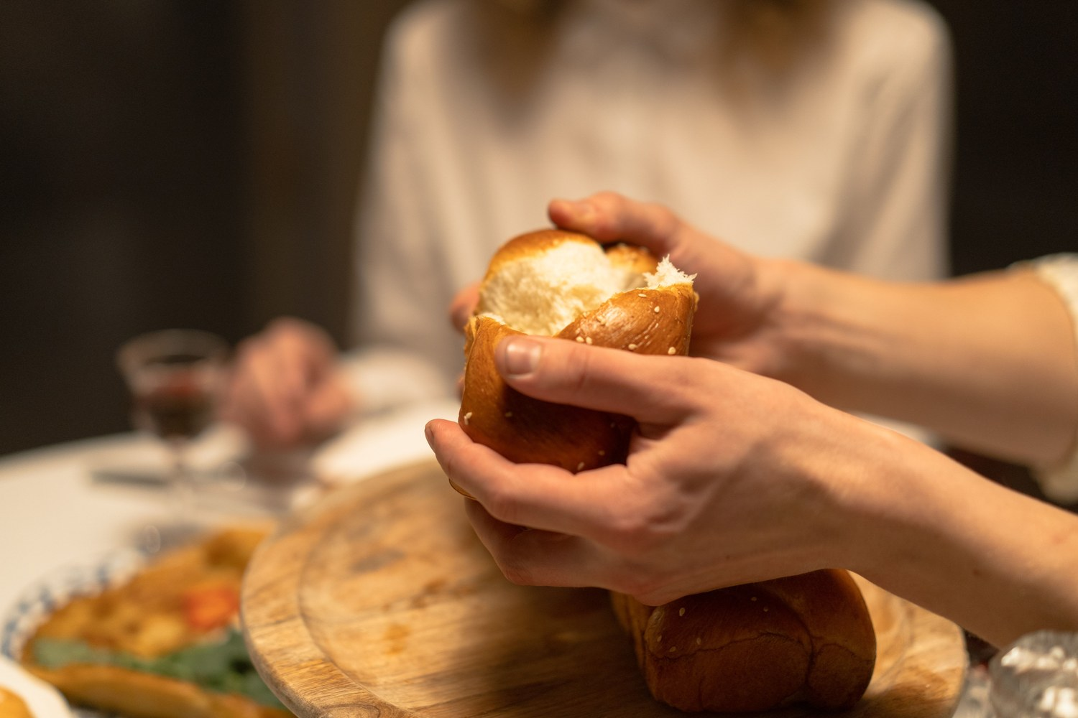
WEEK 16
Family Conversation Night
Cards and a shared meal — the night the year exhales
Quarter 3: Mission & Rhythm
1

Slide 170
Week 16 — Tonight’s Road
1 Welcome and opening container
2 Rhythm-noticing round
3 Acts 2:46 and the table grace
4 The meal
5 Cards over dessert
6 Pulse 3 framed and sent home
7 Leader Feedback Round
8 Closing container
1

Slide 171
Opening Container — the Eight Steps
1 Welcome — five minutes to open the container
2 Phones silenced and put away
3 Stand in a circle
4 One-word check-in — how you actually are, right now
5 Put out / bring in — set something down; bring a blessing in
6 Spoken commitment: “I am here. I am paying attention. I am willing to be moved.”
7 Opening prayer — “Holy Spirit, you are welcome here. Speak. We are listening.”
8 Sit. Begin.
1

Slide 172
Rhythm-Noticing Round
• One round before we eat — one sentence each
• “Where has your card held, or where has it slipped?”
• Both answers are welcome — a slip you noticed is the practice working, because noticing is the skill
• No fixing, no advice — a parent starts; pass-anytime holds
– “The card is a long walk; sixteen days in, everyone in this circle is still on it.”
1

Slide 173
Acts 2:46 and the Table Grace
• Luke is describing the very first church — the most spiritually alive room in the history of the world
• The first church ran on three rails: the teaching, the table, and the prayers
• Our Wednesdays have lived on the teaching and the prayers — tonight is the table
• “Breaking bread with glad and generous hearts is not the break between the formation — it is the formation.”
• The grace — then: eat
ACTS 2:46 (ESV)
“And day by day, attending the temple together and breaking bread in their homes, they received their food with glad and generous hearts.”
1

Slide 174
The Meal
• Real food, no agenda — no devotional between courses, no teaching moment
• “We are going to eat together. That's it. That's the session.”
• Phones silenced and put away — the people at your table tonight are the evening
• Dessert is held back — dessert arriving is the signal the cards are coming
1

Slide 175
Cards over Dessert
• A small stack on your table — someone reads the first card aloud; a parent answers first, every table, every card
• Then anyone who wants to answers, in any order — nobody has to. When the card feels done, read the next one
1 One footprint — “Looking back at this past month — one place you can see God's hand more clearly now than you did at the time.”
2 Where you came alive — “What activity, conversation, or work this season has made you most alive? Why?”
3 The ten-year question — “What's one thing you hope is still true between us in ten years?”
• No report-out — what is said at your table stays at your table. Ten minutes of laughing at your dad's answer is not a failure of the exercise — that IS the exercise
1

Slide 176
Pulse 3 Framed and Sent Home
• The Quarterly Pulse, third one this year — one page, three questions, about five minutes, at home
1 Presence — how present have I actually been in these sessions this quarter? Not attendance, presence (1–10, and one sentence why)
2 Surprise — one thing that has surprised me this quarter — about myself, about God, or about someone in this room
3 Steering — one specific way I want to engage differently in the final quarter
• “This room steers by these pages” — the final quarter, the consolidation weeks and the two commissionings, is shaped by what you write
• Back next Wednesday, in the bin at the door — signed or unsigned, your choice; nobody watches the bin
1

Slide 177
The Leader Feedback Round
• The evening’s leader goes first — three things, same as every week
– “What I think went well tonight: ______”
– “What I’d do differently next time: ______”
– “If I were to teach tonight’s process to someone, I would tell them: ______”
• Then the room — the same two questions about tonight
• The leader receives without defending — “thank you” is the whole response
1

Slide 178
Closing the Container + Aaronic Blessing
• We close the way we opened — the container, six steps
• One-word landing · the one thing you are taking · the one practice
– Commit to the week’s practice aloud — or modify it to something you will actually do
• Blessings — specific, witnessed, short
• Then the Aaronic blessing — spoken over each other, face to face
THE AARONIC BLESSING — NUMBERS 6:24–26
“The Lord bless you and keep you;
the Lord make his face to shine upon you, and be gracious to you;
the Lord lift up his countenance upon you, and give you peace.”
1

Slide 179

WEEK 17
The Float
The evening that absorbs the year’s surprises — or walks the rhythm together
Quarter 3: Mission & Rhythm
1

Slide 180
Week 17 — Tonight’s Road
1 Mode A — a missed evening’s plan runs tonight, whole and unchanged
2 Mode B — the live Rhythm-Card walk: leaders first, slipped cards welcome
3 The borrow round — take ideas from each other’s cards shamelessly
4 Quarterly Pulse returns to the bin at the door
5 One practice chosen to carry across the break
6 The Leader Feedback Round
7 Closing container + Aaronic blessing
1

Slide 181
Mode A — The Missed Evening Runs Whole
• If the quarter lost an evening — the snow, the assembly, the bug — tonight runs that session's plan, unchanged
• “Tonight is not a make-up class squeezed in. Tonight IS [session name] — whole, unhurried, the evening you were always going to get.”
• “Nothing was skipped this year; it just moved.”
• The lifted plan runs whole — its blocks, its scripts, its splits; only its closing yields to tonight's quarter-close constants
PROVERBS 16:9 (ESV)
“The heart of man plans his way, but the LORD establishes his steps.”
1

Slide 182
Mode B — The Live Rhythm-Card Walk
• If the quarter ran clean, the whole room walks its actual Rhythm Cards aloud — “the real ones, not the ideal ones”
• The leaders walk first — and walk genuinely slipped cards honestly; the whole evening stands on that
• Two or three minutes each: daily, weekly, monthly, as lived — holds and slips in the same voice
• Glad out loud about holds; never guilt about slips — “a slip you noticed is the practice working”
• “If you want help with a slip, ask for it, and we will spend a minute on it together. If you do not, name it and keep walking.”
• Everyone walks their own card — parents never their teen's; pass-anytime holds tonight like every night
1

Slide 183
The Borrow Round
• “Listen like a thief. If you hear an idea you want — a time of day, a trick, a place to keep the card — take it.”
• “That is not cheating. That is what a fellowship is for.”
• One sentence around the circle: one idea you heard tonight that you are stealing — name it, and the person you stole it from
• Fast, light — pass-anytime
1

Slide 184
Quarterly Pulse — Back in the Bin
• The return bin sits by the door — drop your Pulse 3 page as you arrive
• Nobody watches the bin; nobody is asked whether they dropped a page
• Spares sit beside it for those who forgot — a page next week is as welcome as a page tonight
• The team reads every page — the Quarter 4 planning conversation starts from what these pages say
1

Slide 185
One Practice Across the Break
• The break starts tomorrow — and we have done this before: at Christmas, every one of us carried one practice across the gap, and at The Return we heard what held
• Look at your card and choose ONE practice — just one — to carry through this break deliberately
• Not the whole card; the whole card can rest — that is sabbath, not failure
• Write it in your journal right now — the practice, and when, and where
• Then, one sentence around the circle: the practice you are carrying — “speaking it is part of carrying it”
• The Returning Rule travels: begin again on the next available day. At The Return II the first question will be the kind one: what held?
1

Slide 186
The Leader Feedback Round
• The evening’s leader goes first — three things, same as every week
– “What I think went well tonight: ______”
– “What I’d do differently next time: ______”
– “If I were to teach tonight’s process to someone, I would tell them: ______”
• Then the room — the same two questions about tonight
• The leader receives without defending — “thank you” is the whole response
1

Slide 187
Closing the Container + Aaronic Blessing
• We close the way we opened — the container, six steps
• One-word landing · the one thing you are taking · the one practice
– Commit to the week’s practice aloud — or modify it to something you will actually do
• Blessings — specific, witnessed, short
• Then the Aaronic blessing — spoken over each other, face to face
THE AARONIC BLESSING — NUMBERS 6:24–26
“The Lord bless you and keep you;
the Lord make his face to shine upon you, and be gracious to you;
the Lord lift up his countenance upon you, and give you peace.”
1

Slide 188
Quarter 4
Consolidation & Sending
Weeks 18–22 · Five Wednesdays · the mercy cards, The Long Walk, two commissionings
1

Slide 189

WEEK 18
The Return II
A lighter homecoming — the room knows the way now, and the year begins to hand itself over
Quarter 4: Consolidation & Sending
1

Slide 190
Week 18 — Tonight’s Road
1 Opening container
2 Not growing weary — Gal. 6:9, Phil. 1:6
3 “What held” — the whole room
4 The final stretch — the map
5 Between-session practice
6 Closing container
7 Leader Feedback Round
8 Aaronic blessing and sending
1

Slide 191
Opening Container — the Eight Steps
1 Welcome — five minutes to open the container
2 Phones silenced and put away
3 Stand in a circle
4 One-word check-in — how you actually are, right now
5 Put out / bring in — set something down; bring a blessing in
6 Spoken commitment: “I am here. I am paying attention. I am willing to be moved.”
7 Opening prayer — “Holy Spirit, you are welcome here. Speak. We are listening.”
8 Sit. Begin.
1

Slide 192
Not Growing Weary — Galatians 6:9 and Philippians 1:6
• At the Rhythm week this verse was a warning; tonight, on the far side of a break, it is a receipt — you did not give up. You are here
– “And I am sure of this, that he who began a good work in you will bring it to completion at the day of Jesus Christ.” — Philippians 1:6 (ESV)
• The not-giving-up is not white-knuckling: the work being completed in you is His. He began it; He finishes it
• “Our rhythm is not the engine — it is the showing-up that keeps us where the engine is running.”
• The last re-entry of the year — look how fast the room came back. That is what it looks like when the practices start belonging to you
GALATIANS 6:9 (ESV)
“And let us not grow weary of doing good, for in due season we will reap, if we do not give up.”
1

Slide 193
“What Held” — the Whole Room
• One sentence each, full circle — a harvest reading, not an examination
• “What held from your card across the break — or what slipped and got begun again?”
• Holds and slips are both good news tonight — both mean the card is real and you are reading it honestly
• A parent starts; brisk and warm; pass-anytime holds — laughter is allowed and likely
– “In September that round would have taken an hour and a crowbar. The practices are yours now.”
“When your children ask their fathers in times to come, ‘What do these stones mean?’”
— JOSHUA 4:21 (ESV)
1

Slide 194
The Final Stretch — the Map
1 Week 19 — our Companions-in-Formation teach the two mercy cards — the Signs Card and the Path Home Card — in your clusters
2 Week 20 — The Long Walk: the seniors teach the whole room; journals come along, and the testimony gathering begins
3 Week 21 — Sending and Blessing: whole families, a longer evening — two hours, 7:00 to 9:00
4 Week 22 — the Commissioning of the Companions, in front of everybody who watched them grow
• Hear the shape of that list: week by week, the people up front stop being us and start being you
• The sentence to keep: “the year now begins to hand itself over”
1

Slide 195
Between-Session Practice
• Run your Rhythm Card as built — nothing new, nothing extra; if the break knocked a piece loose, begin again on the next available day
• The evening note, one extra flavor: note where you see God already handing pieces of this year over to you
• For the parents, said once: the Four Questions door is still open — willing-only, whenever the moment is right; nobody will ever check. The questions keep
• Bring your journal — and put Week 21's two hours on the calendar tonight
1

Slide 196
Closing the Container + Aaronic Blessing
• We close the way we opened — the container, six steps
• One-word landing · the one thing you are taking · the one practice
– Commit to the week’s practice aloud — or modify it to something you will actually do
• Blessings — specific, witnessed, short
• Then the Aaronic blessing — spoken over each other, face to face
THE AARONIC BLESSING — NUMBERS 6:24–26
“The Lord bless you and keep you;
the Lord make his face to shine upon you, and be gracious to you;
the Lord lift up his countenance upon you, and give you peace.”
1

Slide 197
The Leader Feedback Round
• The evening’s leader goes first — three things, same as every week
– “What I think went well tonight: ______”
– “What I’d do differently next time: ______”
– “If I were to teach tonight’s process to someone, I would tell them: ______”
• Then the room — the same two questions about tonight
• The leader receives without defending — “thank you” is the whole response
1

Slide 198
Aaronic Blessing and Sending
• “One sentence for the road: you came back tonight like people who know the way — because you do now.”
• “Five weeks to the sending. Let us not grow weary; the season is His, and it is nearly harvest.”
• “See you Wednesday. Week 19 — the teens have the cards.”
NUMBERS 6:24–26
“The Lord bless you and keep you; the Lord make His face shine on you and be gracious to you; the Lord turn His face toward you and give you peace.”
1

Slide 199

WEEK 19
Second Running: Block B
The rehearsal — the Companions-in-Formation teach the two mercy cards in the small room, one week before they teach them in the large
Quarter 4: Consolidation & Sending
1

Slide 200
Week 19 — Tonight’s Road
1 Welcome and opening container
2 The frame — why these two cards
3 Bridge and split
4 First teaching rep — both cards
5 Cluster feedback — one keep, one adjust
6 Second teaching rep — both cards, tightened
7 Second cluster feedback
8 Merge and between-session
9 Closing container
10 Leader Feedback Round
11 Aaronic blessing and sending
1

Slide 201
Opening Container — the Eight Steps
1 Welcome — five minutes to open the container
2 Phones silenced and put away
3 Stand in a circle
4 One-word check-in — how you actually are, right now
5 Put out / bring in — set something down; bring a blessing in
6 Spoken commitment: “I am here. I am paying attention. I am willing to be moved.”
7 Opening prayer — “Holy Spirit, you are welcome here. Speak. We are listening.”
8 Sit. Begin.
1

Slide 202
The Frame — Why These Two Cards
• Sooner or later, everyone who walks with God hits a dry season — and the dangerous thing is not the dryness, it is the wrong diagnosis
• The Signs Card — so a misread dry season never ends a journey in this room
• The Path Home Card — the written door back, and it ends the way Luke 15 ends: the father runs
• Tonight is a rehearsal — the small room before the large one. Your cluster is their first congregation.
• At the end, your cluster gives its teacher two gifts: one thing to keep, and one thing to adjust
• Tonight is about the cards, not anyone’s current season — nobody will be asked where they are
2 TIMOTHY 2:2
“and what you have heard from me in the presence of many witnesses entrust to faithful men, who will be able to teach others also.”
Four generations in one sentence — Paul, Timothy, the faithful, and the others also. Tonight you are watching the third handoff happen.
1

Slide 203
Bridge and Split
• Each cluster named — its families, its adult, its first-round Companion-in-Formation
• Pray — for the teachers by name, and for any dry ground in the room, unnamed
• Then split — receive your teacher, and work the cards with them
1

Slide 204
First Teaching Rep — Both Cards
1 The Signs Card (~13 min) — the one question: “Which way does the desire point?” Then the four kinds of dry, from the card’s own table
– Cases 3 and 4 — one says resist, the other says receive; opposite motions. When you cannot tell which you are in, do not decide alone.
2 The Path Home Card (~10 min) — the five steps, and the reception: it ends with a feast, not a hearing
– “The door is not locked. The light is on.”
3 Close (~2 min) — both cards go home tonight; this week your family gives them a findable spot
• Questions of information are welcome — the teacher answers them. The adults hold every door that opens.
LUKE 15:20
“while he was still a long way off, his father saw him and felt compassion, and ran”
1

Slide 205
Cluster Feedback — One Keep, One Adjust
• The adult models first — one specific keep, one specific adjust
– Specific means quotable: “keep the way you paused after the desire question” — not “you did great”
• Then a parent adds one; one or two more voices if brief — teens welcome
• The teacher receives without defending — “thank you” is the whole response
• Both gifts go on the note sheet — this block is the reason the evening exists
1

Slide 206
Second Teaching Rep — Both Cards, Tightened
• “Teachers, travel.” Each teacher moves one cluster over, adjust in hand — the new cluster is a clean room
• The same arc, compressed — Signs ~11 min, Path Home ~8, close ~1
• The compression is the second rep’s own skill — same spine, fewer words, the load-bearing minutes untouched
– The desire question — resist versus receive — the father runs
• The adjust from Round 1 gets tried here, while it is warm
1

Slide 207
Second Cluster Feedback
• Same shape, briefer — the adult’s keep and adjust, then one cluster voice
• The keep, wherever honest, names the adjust that got tried
• Both recorded per teacher — these notes are next week’s prep meeting
1

Slide 208
Merge and Between-Session
• One practice this week — the easiest assignment of the year: the two cards go home and get a spot
• Somewhere findable — a drawer everyone knows about, the kitchen cabinet door, inside the family Bible. Decide the spot together.
• If all goes well, they will sit there gathering dust for years. That is the job — the cards wait.
• Next Wednesday is The Long Walk — the whole room, the whole teaching, these same teachers. Come ready to receive them again.
1

Slide 209
Closing the Container + Aaronic Blessing
• We close the way we opened — the container, six steps
• One-word landing · the one thing you are taking · the one practice
– Commit to the week’s practice aloud — or modify it to something you will actually do
• Blessings — specific, witnessed, short
• Then the Aaronic blessing — spoken over each other, face to face
THE AARONIC BLESSING — NUMBERS 6:24–26
“The Lord bless you and keep you;
the Lord make his face to shine upon you, and be gracious to you;
the Lord lift up his countenance upon you, and give you peace.”
1

Slide 210
The Leader Feedback Round
• The evening’s leader goes first — three things, same as every week
– “What I think went well tonight: ______”
– “What I’d do differently next time: ______”
– “If I were to teach tonight’s process to someone, I would tell them: ______”
• Then the room — the same two questions about tonight
• The leader receives without defending — “thank you” is the whole response
1

Slide 211
WEEK 20
The Long Walk
The dry-season teaching comes home — taught to the whole room by its own senior teens, the night before the sendings
Quarter 4: Consolidation & Sending
1

Slide 212
Week 20 — Tonight’s Road
1 Welcome and centering
2 Why tonight — Isaiah 50:10
3 The Signs Card — taught by a CiF
4 The Path Home Card — taught by a CiF
5 The journal arc review
6 One sentence, and the testimony gathering
7 The Post-Series Survey
8 The Leader Feedback Round
9 Closing container
1

Slide 213
Opening Container — the Eight Steps
1 Welcome — five minutes to open the container
2 Phones silenced and put away
3 Stand in a circle
4 One-word check-in — how you actually are, right now
5 Put out / bring in — set something down; bring a blessing in
6 Spoken commitment: “I am here. I am paying attention. I am willing to be moved.”
7 Opening prayer — “Holy Spirit, you are welcome here. Speak. We are listening.”
8 Sit. Begin.
1

Slide 214
Why Tonight — Isaiah 50:10
• In two weeks this room stops meeting — the next two Wednesdays are sendings, not endings. On the other side: a summer with no Wednesday in it.
• Somewhere out there — this summer, or in twenty years — every person in this room will hit a season where the practices go gray
• The most dangerous thing on the long walk is not the dryness — it is the wrong diagnosis of the dryness
• So tonight we hand you the equipment for that season — on purpose, at the threshold, before anyone needs it
• Psalm 23:4 — “Even though I walk through the valley of the shadow of death, I will fear no evil, for you are with me.” The road goes through.
• Now the teaching — in the seniors’ voices, not ours
ISAIAH 50:10
“Who among you fears the LORD and obeys the voice of his servant? Let him who walks in darkness and has no light trust in the name of the LORD and rely on his God.”
1

Slide 215
The Signs Card — the Four Kinds of Dry
• The danger is not the dryness — it is the wrong diagnosis. One question sorts everything: “Which way does the desire point?”
1 Neglect — the desire has faded and the distance doesn’t ache; the world tastes fine. First step: wake and turn — rebuild the rhythm
2 Worn out — the desire is buried under duty; you want escape, not God. First step: rest — a lighter yoke, smaller faithful steps, stay put
3 The enemy’s dry wind — accused, pressured, a voice counseling change: quit, undo, leave. First step: resist — change nothing, pray a little more, tell someone
4 God’s own stripping — the desire intact and starving; the ache is the sign. First step: receive — wait, stay faithful, stay accompanied
• Three and four command opposite motions — one says fight, the other says yield. When you cannot tell which you are in, do not decide alone — that is what Companions are for.
– Four rules on the card — your own heart only; in every case, tell someone; no big decisions in the dark; know when to call the doctor
THE SENTENCE TO CARRY HOME
“The fact that His absence hurts you is the evidence that He has not gone. Drifting hearts do not ache. Abandoned fields do not thirst. A dry season is not a verdict.”
1

Slide 216
The Path Home Card — the Written Door
• For the one who leaves and concludes a room like this would not want them back — most churches leave the way back unwritten. Not here.
1 Come as you are — conviction is specific and hopeful and draws you toward home; shame is vague and hopeless and drives you away
2 Tell it straight — to God in plain words, and to one trusted person; you choose the person and how much
3 Grieve what needs grieving — lament is faith with tears in its voice
4 Return to the table — small; do not start over, begin again on the next available day
5 Let it be celebrated — in the Lord’s own story of return, the ending is not a probation meeting. It is a feast.
• The witnessed filing — everyone files the card now, while we watch each other do it: “The door is not locked. The light is on.”
LUKE 15:20
“But while he was still a long way off, his father saw him and felt compassion, and ran and embraced him and kissed him.”
The father was watching the road. He ran first, embraced first, and asked for no accounting before the robe.
1

Slide 217
The Journal Arc Review
• Take out your journal — the one you have been writing in since September. If yours is missing, take paper and walk the year from memory.
• Go back to the beginning and read forward — you’re walking the road again, not re-taking the class
1 Where did I begin?
2 Where did He meet me? — mark those pages; fold a corner
3 What do I not want to lose?
• Twelve minutes, in quiet — parents and teens both. Then find your one sentence.
1

Slide 218
One Sentence, and the Testimony Gathering
• One sentence each — where He met you this year, or what you don’t want to lose. Just the sentence; no story around it. A parent starts.
• Pass-anytime holds — a pass gets the same nod a sentence gets
• Then one more invitation, genuinely optional: your sentence, read aloud at the sendings — Week 21 or Week 22
• Written down exactly as you say it, read back for your nod — signed or anonymous, your choice
• “An empty card is a complete answer.” Nothing written, nothing noted, and nobody will ask again.
1

Slide 219
The Post-Series Survey
• The bookend to orientation’s Pre-Series Survey. Home tonight; back in the bin at the Week 21 door.
• This is a pilot — the first year this has ever run, anywhere. Your honest answers — especially the critical ones — are a gift to families you will never meet.
• The same covenant covers it: no scores, no grades, mirrors not levers
• One per person — parents and teens each do their own. About twenty minutes. Signed or anonymous, your choice.
1

Slide 220
The Leader Feedback Round
• The evening’s leader goes first — three things, same as every week
– “What I think went well tonight: ______”
– “What I’d do differently next time: ______”
– “If I were to teach tonight’s process to someone, I would tell them: ______”
• Then the room — the same two questions about tonight
• The leader receives without defending — “thank you” is the whole response
1

Slide 221
Closing the Container + Aaronic Blessing
• We close the way we opened — the container, six steps
• One-word landing · the one thing you are taking · the one practice
– Commit to the week’s practice aloud — or modify it to something you will actually do
• Blessings — specific, witnessed, short
• Then the Aaronic blessing — spoken over each other, face to face
THE AARONIC BLESSING — NUMBERS 6:24–26
“The Lord bless you and keep you;
the Lord make his face to shine upon you, and be gracious to you;
the Lord lift up his countenance upon you, and give you peace.”
1

Slide 222

WEEK 21
Sending and Blessing
Family commissioning, the integration of the four Connects, and the bridge to Going Deeper
Quarter 4: Consolidation & Sending
1

Slide 223
Week 21 — Tonight’s Road
1 Welcome and integration teaching
2 Brief blessing rehearsal
3 Reading and prayer
4 Family commissionings
5 Final reflection circle
6 Rhythm Card and Going Deeper bridge
7 The Leader Feedback Round
8 Final blessing and sending
1

Slide 224
Welcome and Integration Teaching
• Fourteen Wednesdays — the soil of the heart, our stories, confession and restoration, hearing God in scripture, the gardens of our hearts, the quiet doubts, what was prepared for us
• Tonight is the integration. The four Connects are not separate disciplines — they are a sequence: Self, Others, God, Mission. Each one creates the conditions for the next.
• They are also a way of life — lived in family, witnessed in community
• Tonight: each parent-and-teen pair stands in the center; each speaks a specific witnessed blessing over the other; the whole community speaks the Aaronic blessing over each family
• If you are new tonight: your job is to bear witness. Your presence is the gift.
1

Slide 225
Brief Blessing Rehearsal — the Form
• Three sentences. Just three. The worksheet you got Friday has the form.
1 “What I have specifically seen God doing in you across Getting Started is _____.” Something you actually noticed.
2 “What I bless in you tonight is _____.” Something true about who they are.
3 “What I commit to you in our relationship moving forward is _____.” Something you will actually do.
• The brevity is the discipline — we are not making speeches; we are speaking truth in front of witnesses
• Two Companions demo a real blessing, then brief questions
1

Slide 226
Reading and Prayer
• Two scriptures before we begin — the blessing itself, and what we are commissioning each other into
• The Aaronic blessing is not a generic prayer — it is the specific words God gave Aaron and his sons to speak over Israel. When we speak it over each other, we are not improvising.
• Philippians 1:6 — Getting Started is not the completion; it is part of the beginning. The next stretch is a longer work that is His to finish, not ours.
– “And I am sure of this, that he who began a good work in you will bring it to completion at the day of Jesus Christ.” — Philippians 1:6
• Then prayer over the commissioning to come
NUMBERS 6:24–26
“The Lord bless you and keep you;
the Lord make his face to shine upon you and be gracious to you;
the Lord lift up his countenance upon you and give you peace.”
1

Slide 227
Family Commissionings
• Each family in turn — parent and teen stand in the center; the rest of the family stands behind them in support
1 Brief framing — “We have walked with [name] through Getting Started; we have seen _____.”
2 Teen blesses parent first — the three sentences
3 Parent blesses teen — the three sentences
4 “Family of [last name], the community now blesses you.” The whole room speaks the Aaronic blessing aloud together, slowly.
• If you freeze — take your time, or ask the other person to read your worksheet for you. If you cry, that is fine. The room can wait.
1

Slide 228
Final Reflection Circle
• Around the circle, each person: one specific takeaway from Getting Started, and one specific next commitment — about thirty seconds each
– The takeaway can be small — “I learned that I can name a doubt without losing my faith.” “I learned that my dad sees me.”
– The commitment can be small too — “I will keep the morning question.” “I will tell my mom one true thing this week.”
• You can pass. Visiting family can pass — or share if you want to. The Cluster Companions go first; a parent opens for the families.
1

Slide 229
Rhythm Card and Going Deeper Bridge
1 The Daily / Weekly / Monthly Rhythm Card — daily: the morning question and an evening journal note; weekly: one person who knows what you are working on; monthly: a clearing time. It is your card, in your handwriting.
2 The Going Deeper bridge — twelve Wednesdays. Decide on your own time. Tonight is not a recruiting pitch.
3 The Post-Series Survey — the bin at the door tonight, or email it this week. The next group of families benefits from your honesty.
• If a daily practice slips — do not start over from scratch; start the next day. Streaks are not the point. Returning is the point.
1

Slide 230
The Leader Feedback Round
• The evening’s leader goes first — three things, same as every week
– “What I think went well tonight: ______”
– “What I’d do differently next time: ______”
– “If I were to teach tonight’s process to someone, I would tell them: ______”
• Then the room — the same two questions about tonight
• The leader receives without defending — “thank you” is the whole response
1

Slide 231

WEEK 22
Commissioning the Companions
The exit gate as a witnessed rite — the seniors leave having begun, not finished
Quarter 4: Consolidation & Sending
1

Slide 232
Week 22 — Tonight’s Road
1 Welcome and framing
2 The final rep — the container opened
3 The word over the night
4 The three rules read aloud
5 The covering named
6 The commissioning
7 The first Lab scheduled
8 The Leader Feedback Round
9 The final rep — the container closed
1

Slide 233
Welcome and Framing — a Gate, Not a Graduation
• Last week we commissioned the families. Tonight we commission the Companions — and this is not a graduation. Nobody is leaving; tonight opens a door further in.
• The seniors become FC1 — Formation Companion, Level One: a serving place in this body. Not finishing something — beginning something.
1 The final rep — the container opened and closed from memory, no script
2 The three rules that never bend, read aloud to the whole room
3 The covering named — the adult each new FC1 calls when they are over their head
4 The commissioning — blessing spoken over each one, and the first Leader Lab on the calendar before anyone leaves
1

Slide 234
The Final Rep — the Container Opened
• Container fluency is FC1’s spine competency — Safe, Present, Clear, Intentional, from memory, without a script. Tonight is the witness of it, not the exam.
• One senior opens the container whole — welcome, phones, the standing circle, one-word check-in, put out / bring in, the spoken commitment, opening prayer
– “I am here. I am paying attention. I am willing to be moved.”
• Every other senior speaks one condition from memory — in their own words, with one short true story of holding it while leading this year
• One senior is held in reserve — tonight’s close is theirs
• The gate is fluency across the arc, not perfection tonight. A stumble is not a fail.
1

Slide 235
The Word Over the Night
• Count the generations: Paul. Timothy. Faithful ones. Others also. Four generations in a single sentence — and the handing happens “in the presence of many witnesses.” In a room like this one.
• Tonight the third generation stands up in front of the second — and the fourth is already sitting in the room
• 1 Timothy 4:12 — “Let no one despise you for your youth, but set the believers an example in speech, in conduct, in love, in faith, in purity.”
• Tonight this room does the opposite of despising. Then prayer over the seniors.
2 TIMOTHY 2:2
“and what you have heard from me in the presence of many witnesses entrust to faithful men, who will be able to teach others also.”
1

Slide 236
The Three Rules Read Aloud
• The bright line made public — the whole room hears the boundaries its young leaders keep. These rules protect you and your kids as much as they protect the leaders.
1 A Companion-in-Formation never counts as one of the two adults. “Co-lead” means an adult Companion in the room — not nearby, in the room.
2 A Companion-in-Formation never takes a disclosure. If something heavy surfaces, their only job is to hand it to the adult immediately. They are not a junior counselor.
3 Lead only a block you have first received. See it, then lead it.
• These rules never bend — not for talent, not for maturity, not for a short-handed night. Handing the heavy thing to your adult is the strong, faithful move — never a failure.
1

Slide 237
The Covering Named
• An FC1 never leads uncovered — an adult with a name and a phone number, who has said yes
• A covering that is public is a covering that holds
1 Each senior stands and says it plainly: “When I am over my head, I call _____.”
2 The sign-off confirmed publicly — the parent: “I confirm it.” The Lead Companion: “And I confirm it.”
3 The covering name goes onto the Commissioning Card, there in the circle — ink, not intention
1

Slide 238
The Commissioning
1 Each senior stands in the center; their family stands behind them
2 Two Companions speak their prepared blessings — drawn from specific moments of leading: what we saw, what we bless, what we see coming
3 The parent may add one sentence. One. It will be the one the teen remembers.
4 The cohort speaks the Aaronic blessing over the new FC1 — the whole room, slowly, hands extended
5 “[Name], the team commissions you as Formation Companion, Level One. Serve the body. Keep the rules. Call your covering. Watch the signs.”
• Then the charge, once, over all of them — keep your own walk first; keep the three rules when no one is checking; call your covering early, not late; watch the three signs. “FC1 is a real and honorable place to stand… Set the example. Begin.”
1

Slide 239
The First Lab Scheduled
• Before anyone reaches for a coat — one piece of business, on purpose, in front of everyone
• The first Leader Lab of the spring serving cycle: [day], [date], [time], [place]. Write it down now.
• The Lab 1 assignment is already set: bring one vital-signs observation from this room, tonight
• “Anyone can hold a beautiful ceremony. The proof that tonight was a gate and not a ceremony is a date on a calendar.” The exit is an entrance.
1

Slide 240
The Leader Feedback Round
• The evening’s leader goes first — three things, same as every week
– “What I think went well tonight: ______”
– “What I’d do differently next time: ______”
– “If I were to teach tonight’s process to someone, I would tell them: ______”
• Then the room — the same two questions about tonight
• The leader receives without defending — “thank you” is the whole response
1

Slide 241
The Final Rep — the Container Closed
• The reserved senior closes the container from memory — the standing circle, the one-word landing, the one thing, the one practice, the blessing round, the closing prayer and sending
• The rite that opened in a senior’s voice ends in a senior’s voice — the last words of Getting Started are spoken by the generation it raised
• If the senior sends the room, the room is sent — nothing is added after
• After: the signing — everyone signs each new FC1’s keepsake, the way you sign a Bible flyleaf. Then dessert. Stay.
1

