Slide 1

Fellowship of the Heart
Getting Started — the Four Connects, walked around the table on alternating evenings
Evening Series 2026–27 · at the Tittle home · v1.5E DRAFT
All Scripture: ESV · The Companion lesson plans carry the full scripts — these slides carry the room
G1
Notes:
DECK TITLE · pre-session · DIVIDER
On screen as the room assembles on night one. All Scripture ESV; the plans carry the scripts; these slides carry the room — and these notes carry you.

Slide 2
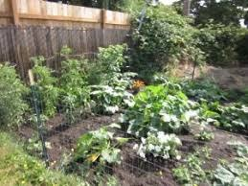
EVENING 7
The Garden of Your Heart — One Visit, the Returns Carry It
An experiential encounter with Jesus in your interior space — one guided run, teen-led; the week's returns are the second visit
Quarter 2: Connect with God
G2
Notes:
E7 · pre-session · DIVIDER
On screen through dinner and as the circle forms. Greet at the door — the slide holds the room.

Slide 3




Where We Are — the Four Connects
Evening 7 stands in the third box — Connect with God — one guided garden run, teen-led; the returns carry the second visit. Each connection makes the next one real (Matt. 22:37–40).
G3
Notes:
E7 · WELCOME · LEAD: CONTAINER HOLDER · GROUNDING — every session opens on this map
BEATS:
1. Locate tonight on the map, plainly: Evening 7 stands in the third box — Connect with God — one guided garden run, teen-led; the week's returns carry the second visit.
2. The four boxes are one journey — each connection makes the next one real — rooted in the two great commandments: love God, love neighbor (Matt 22:37–40).
3. This is also the 'where we are on the map' minute the welcome owes any newcomer.
CUES: Two minutes at most; then tonight's road.

Slide 4

Evening 7 — Tonight’s Road
1 Welcome and centering
2 Evening 6 check-in
3 When have you heard God? How did you know?
4 Scripture and framing
5 Bridge into the exercise
6 The Garden — two rounds, write and share each
7 Merge — the two gardens, then one word
8 Homework and the long gap
9 The Leader Feedback Round — both leaders
10 Closing container
G4
Notes:
E7 · 7:00–8:30 · LEAD: BOTH LEADERS
BEATS:
1. The garden's deepest work happens on repetition — in the two-session form the room came back a week later; in the combined form the three homework returns ARE the second visit, and next session's check-in receives them.
2. Shape: open, a short check-in, remembering a real hearing and how we knew (the tests, before the garden), Scripture and framing (John 15; Psalm 23), bridge and settle, the garden in two rounds — round one the garden, round two Jesus invited in with permission to do or say anything he wishes; a senior reads, two words per second, the pauses are where the work happens; write and share in pairs after each round, the adults holding the sharing; merge, the returns commissioned, feedback, gentle close.
3. The current-condition form: teen-led from the first run. The separate second-running evening (Session 10) is held in reserve for a larger room of newer people.
4. Why the testing comes first (John's word, 13 October): what anyone notices in the garden is held loosely and tested on the returns, not concluded tonight. Evening 8, Any Doubts?, starts from here.
GUARD: Settle Protocol stands — anything heavy in the garden: stop for them, not the circle; no return to the exercise today. The senior never takes a disclosure; the bright line governs.

Slide 5
Opening Container — the Eight Steps
1 Welcome — five minutes to open the container
2 Phones silenced and put away
3 Stand in a circle
4 One-word check-in — how you actually are, right now
5 Put out / bring in — set something down; bring a blessing in
6 Spoken commitment: “I am here. I am paying attention. I am willing to be moved.”
7 Opening prayer — “Holy Spirit, you are welcome here. Speak. We are listening.”
8 Sit. Begin.
G5
Notes:
E7 · 7:00–7:06 · LEAD: CONTAINER HOLDER
BEATS: 1. 'Welcome back. Find a seat.' Wait — take a longer breath than usual before the blessing. 2. Aaronic blessing. 3. Frame: today is quiet, mostly interior; deeply familiar for some, brand new for others — both are fine. 4. Container: what is said here stays here; nothing is required; listen to receive.
PAIR LEAD: name the leading pair in the welcome — two leaders hold tonight, and the room will see the evening handed back and forth between them; that is the design. The pair practices the session together beforehand.

Slide 6
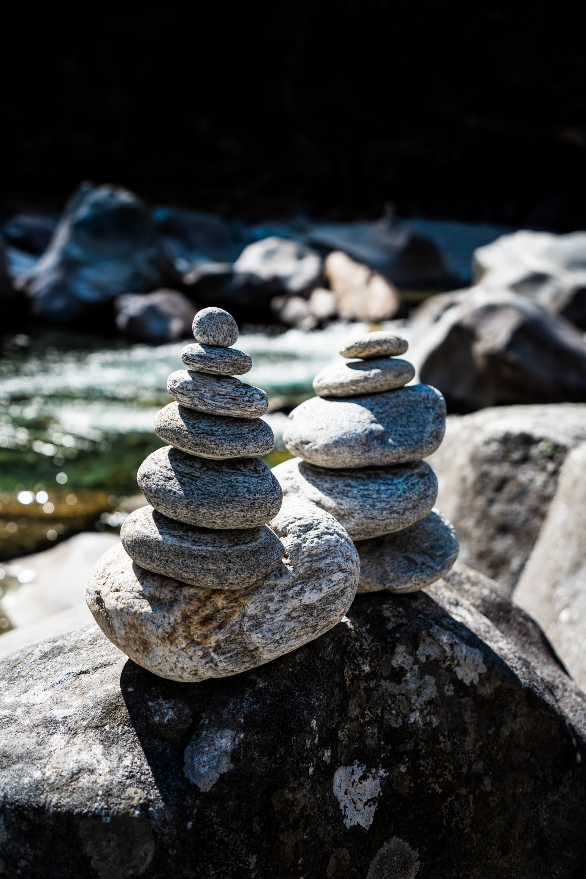
Evening 6 Check-In
• “Last week we walked PROAPT — a six-step practice for hearing God in scripture.”
• “One sentence about how that practice has been?”
• A parent starts — arranged beforehand, never a cold call on a teen
• Two or three voluntary contributions; anyone may pass — kept brief, tonight’s arc needs the time
G6
Notes:
E7 · 7:06–7:10 · LEAD: CONTAINER HOLDER
BEATS: 1. One sentence each on how the daily PROAPT practice has been. 2. Two voluntary contributions, kept brief — four minutes; tonight's arc needs the time.
CUES: Arranged parent opens (check the Run Card) — never cold-call a teen; pass-anytime holds.

Slide 7
When Have You Really Heard?
• Remember one time you really heard God — a verse that jumped off the page, a nudge, a word through someone, a quiet knowing
• Where were you, and what was going on? Reading, worship, a conversation, outdoors, a hard day
• What did it look like, sound like, feel like? Write it down — make it fuller
• What did you do with it — and what happened?
• Can’t think of one? A time creation stopped you in your tracks counts — God speaks through what he has made (Rom. 1:20)
• Pairs, by invitation — your partner asks one question: “How did you know?”
JOHN 10:27
“My sheep hear my voice, and I know them, and they follow me.”
G7
Notes:
E7 · 7:10–7:20 · LEAD: CONTENT PRESENTER
BEATS: 1. Frame, 30 seconds: 'Before we go into the garden, we remember a time we really heard — and how we knew. Next time is Any Doubts?; this is the ground under it.' 2. A leader tells first, arranged beforehand: two or three plain sentences — a real time you heard, how you knew, what you did. 3. Quiet recall, 3 minutes, journals open: when and where, what was going on, what it looked, sounded or felt like, what you heard, what you did with it. Make it fuller as you write. 4. Pairs, 4 minutes, by invitation: the partner asks only one question — 'How did you know?' — and listens.
CUES: Never cold-call a teen; pass-anytime holds. 'I can't think of one' is an honest answer — offer the creation door (Rom. 1:20) or a time you simply knew something was true. Keep the answers to 'How did you know?' for the next slide.
GUARD: This is remembering, not judging — no one rules on whether another person's hearing was God. If a memory turns heavy, the Settle Protocol stands.
FROM: the Four Connects deck (FotH, September 2025), 'Hearing God — The How': remember a time of hearing, see it, hear it, feel it, make it fuller, anchor it.

Slide 8
How Did You Know? — Testing What You Hear
• Scripture first — does it line up with what God has already said? Scripture is the court; the rest confirm
• Sense — does it make sense, or does it ask you to switch your mind off?
• The Spirit’s witness — an inner “yes” that rings true (Rom. 8:16)
• Peace — even when the word is hard (Col. 3:15)
• Company — what do people who know you and know God see?
• Circumstances — do doors open or close around it?
• Over time — obeying what you hear opens you to hear more
• Tonight in the garden: notice, don’t conclude — you will test it on your returns
1 THESSALONIANS 5:20–21
“Do not despise prophecies, but test everything; hold fast what is good.”
G8
Notes:
E7 · 7:20–7:25 · LEAD: CONTENT PRESENTER
BEATS: 1. The room round, 2 minutes: 'How did you know?' Collect the answers aloud; the container holder writes them on a sheet. 2. Then the slide: line the room's answers up with the checks — most will already be there. Name any the room found that the slide does not have; they count. 3. Scripture first: it is the court, and the others confirm. No one check is enough on its own — and peace can be faked by wanting something badly. 4. Obedience: 'What happened when you obeyed?' Obeying what you hear opens you to hear more. 5. Bridge: 'Tonight in the garden, notice — don't conclude. On your returns you will test what you noticed. The card in your take-home has these checks.'
CUES: A practice, not a lecture — the room's list leads and the slide confirms. Five minutes; the garden needs its time.
GUARD: No one tests someone else's hearing aloud tonight. Each person tests their own, in company they choose.
FROM: the Four Connects deck (FotH, September 2025), 'Hearing God — What If?': how do you know something is from the Lord? It lines up with Scripture, reason, the witness of the Spirit, peace, community, circumstances.

Slide 9
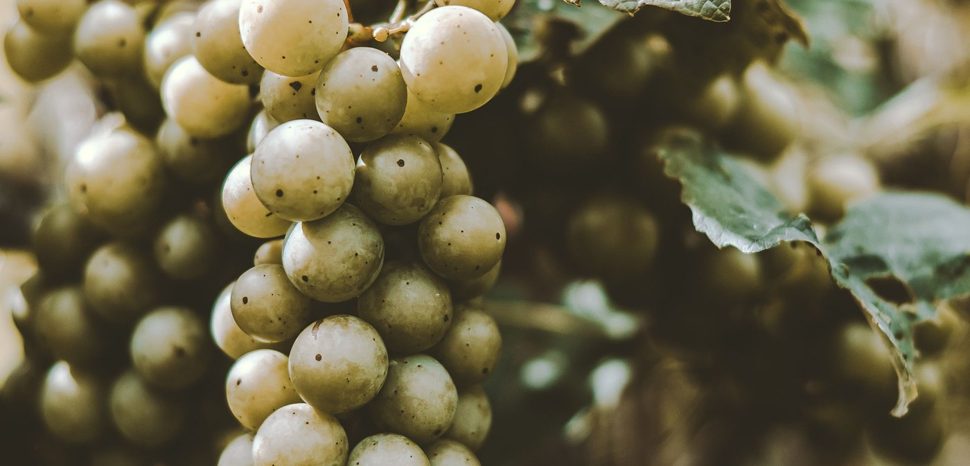
Scripture and Framing
• John 15:1–11, read slowly — “Listen as if you have not heard it.” Then Psalm 23:1–3
• Scripture pictures the heart as cultivated ground — green pastures, still waters, vine and vinedresser
• Tonight we walk into that image: picture your heart as a garden, invite Jesus in, notice what He does
• Imaginative prayer — Ignatius taught it, Bonaventure taught it, the Puritan writers under other names
• Not visualization-as-self-help, not contemplative emptying — filling the mind with one scriptural image
• “The exercise is not a test of imaginative power. It is a posture of receptivity.”
JOHN 15:5
“I am the vine; you are the branches. Whoever abides in me and I in him, he it is that bears much fruit, for apart from me you can do nothing.”
G9
Notes:
E7 · 7:25–7:31 · LEAD: CONTENT PRESENTER
BEATS: 1. Read John 15:1–11 slowly, then Psalm 23:1–3 — 'listen as if you have not heard it.' 2. Teach: scripture pictures the heart as cultivated ground; today we walk into that image and invite Jesus in to walk it with us. 3. Name the lineage in a sentence — imaginative prayer: Ignatius, Bonaventure, the Puritans — and the two nots: not visualization-as-self-help, not emptying the mind. 4. 'Vivid experience or nothing at all — both fine. The turning toward Him is the practice.' 5. If you sense resistance, read the skepticism paragraph — the frame IS the work; do not skip it.

Slide 10
Bridge into the Exercise
• We stay right here, together, as one room — the garden in two rounds, read slowly
• Round one: relax, then picture your heart as a garden — then write, then share
• Round two: go back, invite Jesus in, and give him permission to do or say anything he wishes — then write, then share
• Eyes closed or open; your own family is beside you; sharing is by invitation — “Silence is a complete answer.”
• Notice, don’t conclude — what you notice tonight, you hold loosely and test on your returns
• “Father, you are the vinedresser. … Where it is hard, be tender. Where it is closed, be patient. Where it is opening, be present.”
G10
Notes:
E7 · 7:31–7:35 · LEAD: CONTENT PRESENTER · TRANSITION
BEATS: 1. Preview the shape: two rounds. Round one, the garden — read, write, share. Round two, go back and invite Jesus in, giving him permission to do or say anything he wishes — read, write, share. Whole room, eyes open or closed, your own family beside you; sharing by invitation only — silence is a complete answer. 2. Room about ten or fewer: name it now — sharing happens right in this circle, no moving. 3. One line from the testing slide: notice, don't conclude — tonight is for noticing; the returns are for testing. 4. Pray the bridge prayer: where it is hard, be tender; where it is closed, be patient; where it is opening, be present.

Slide 11
The Garden — Round One: Your Heart as a Garden
1 Relax (2 min) — breathe in, breathe out; relax from your toes up; be present to the great I AM
2 Imagine (4 min) — picture your heart as a garden and let it sit; then make it clearer: the light, the temperature, the time of day
3 Write (3 min) — what did you see, hear, smell, or feel there?
4 Share in pairs (4 min) — by invitation only; a parent opens; silence is a complete answer
• Receive without interpreting — “Thank you for sharing that.”
• Jesus is not invited yet — this round is only the garden
G11
Notes:
E7 · 7:35–7:48 · LEAD: CONTENT PRESENTER
BEATS: 1. Pens and journals ready beforehand, then set aside. 2. RELAX, 2 minutes — the reader reads the Settle section of the Reading Card: breath focus, in and out, then relaxing from the toes up, stage by stage; relaxed and present, and so present to the great I AM. 3. ROUND ONE, about 4 minutes: picture your heart as a garden; let it sit a minute; make it clearer — the light, the temperature, the time of day; another minute; then come back to here. Two words per second; the pauses are where the work happens. Jesus is not invited yet. 4. Write, 3 minutes: what did you see, hear, smell, or feel there? 5. Share in pairs, 4 minutes, by invitation: the arranged parent opens — receive without interpreting.
CUES: Never cold-call a teen; pass-anytime holds. Keep the clock: round two needs its full time.
GUARD: If overwhelm goes past quiet reassurance, run the Settle Protocol — stop for THEM, not for the circle: plain directive words, back to the room, breathe and anchor, no return to the exercise today; nobody leaves activated.
FROM: the Four Connects deck (FotH, September 2025), 'Garden of the Heart': prepare to write, relaxation to get present to the great I AM, the garden, record, share.

Slide 12
The Garden — Round Two: Invite Jesus In
1 Go back to that relaxed place (1 min) — and picture your garden again
2 Invite Jesus in (8 min) — give him permission to do or say anything he wishes; then let it sit, in silence
3 Return — come back to here; open your eyes when you are ready
4 Write (4 min) — what did you see, hear, smell, or feel? What did he do or say? “Nothing happened” is honest
5 Share in pairs (6 min) — by invitation only; a parent opens; silence is a complete answer
• Never “God was telling you _____.” Notice, don’t conclude — the returns are for testing
• If something painful surfaces — bless it: “I hear that. May Jesus stay with you in that place this week.”
G12
Notes:
E7 · 7:48–8:07 · LEAD: CONTENT PRESENTER
BEATS: 1. Take them back to the relaxed state, 1 minute: breathe, relax, picture the garden again. 2. ROUND TWO: invite Jesus in; give him permission to do or say anything he wishes; ask him to do or say whatever he wants. Then the reader stops talking and holds the silence for about five minutes. Do not fill it; watch the clock, not the faces' patience. Then: 'When you are ready, come back to here, and open your eyes.' 3. Write, 4 minutes: what did you see, hear, smell, or feel? What did he do or say? 'Nothing happened' is honest. Everyone writes before anyone shares. 4. Share in pairs, 6 minutes, by invitation: the Companion models two plain sentences first, the arranged parent opens — receive without interpreting; never 'God was telling you...'. Notice, don't conclude: the returns are for testing.
CUES: Soft tears — do not stop; the tears are often the work. Never cold-call a teen; pass-anytime holds.
GUARD: If overwhelm goes past quiet reassurance, run the Settle Protocol — stop for THEM, not for the circle: plain directive words, back to the room, breathe and anchor, no return to the exercise today; nobody leaves activated.
FROM: the Four Connects deck (FotH, September 2025), 'Garden of the Heart': take them back to that relaxed state; picture the heart again; invite Jesus in; suggest they ask him to do or say whatever he wants; let it sit a few minutes; return and record; then share.

Slide 13
Merge — the Garden, and the Garden with Jesus in It
• “What happened in your pair stays in your pair.”
• Any differences between the garden and the garden with Jesus in it? What did they look like?
• What might your images tell you about yourself? About Jesus with you and in you?
• Each of us reads our own images — no one interprets anyone else’s
• Then one word about tonight — a parent begins; anyone may pass
G13
Notes:
E7 · 8:07–8:13 · LEAD: CONTENT PRESENTER
BEATS: 1. The room will be quieter than usual — honor it; wait before speaking. What happened in the pairs stays there. 2. The comparison, about 4 minutes, whole room, by invitation: 'Were there any differences between the garden and the garden with Jesus in it? What did they look like? What might your images tell you about yourself? About Jesus with you and in you?' Take one or two; time decides. 3. Each person reads their own images; no one interprets anyone else's. Receive with 'Thank you.' 4. Then one word about tonight, about 2 minutes — 'surprised', 'tender', 'empty', 'found', 'quiet' — received with a nod, nothing else. Close: whatever happened tonight is yours; some of it will keep happening across the week.
CUES: Arranged parent begins; anyone may pass.
FROM: the Four Connects deck (FotH, September 2025), 'Garden of the Heart': after the small groups, ask if anyone wants to share — the differences, and what the images tell you.

Slide 14
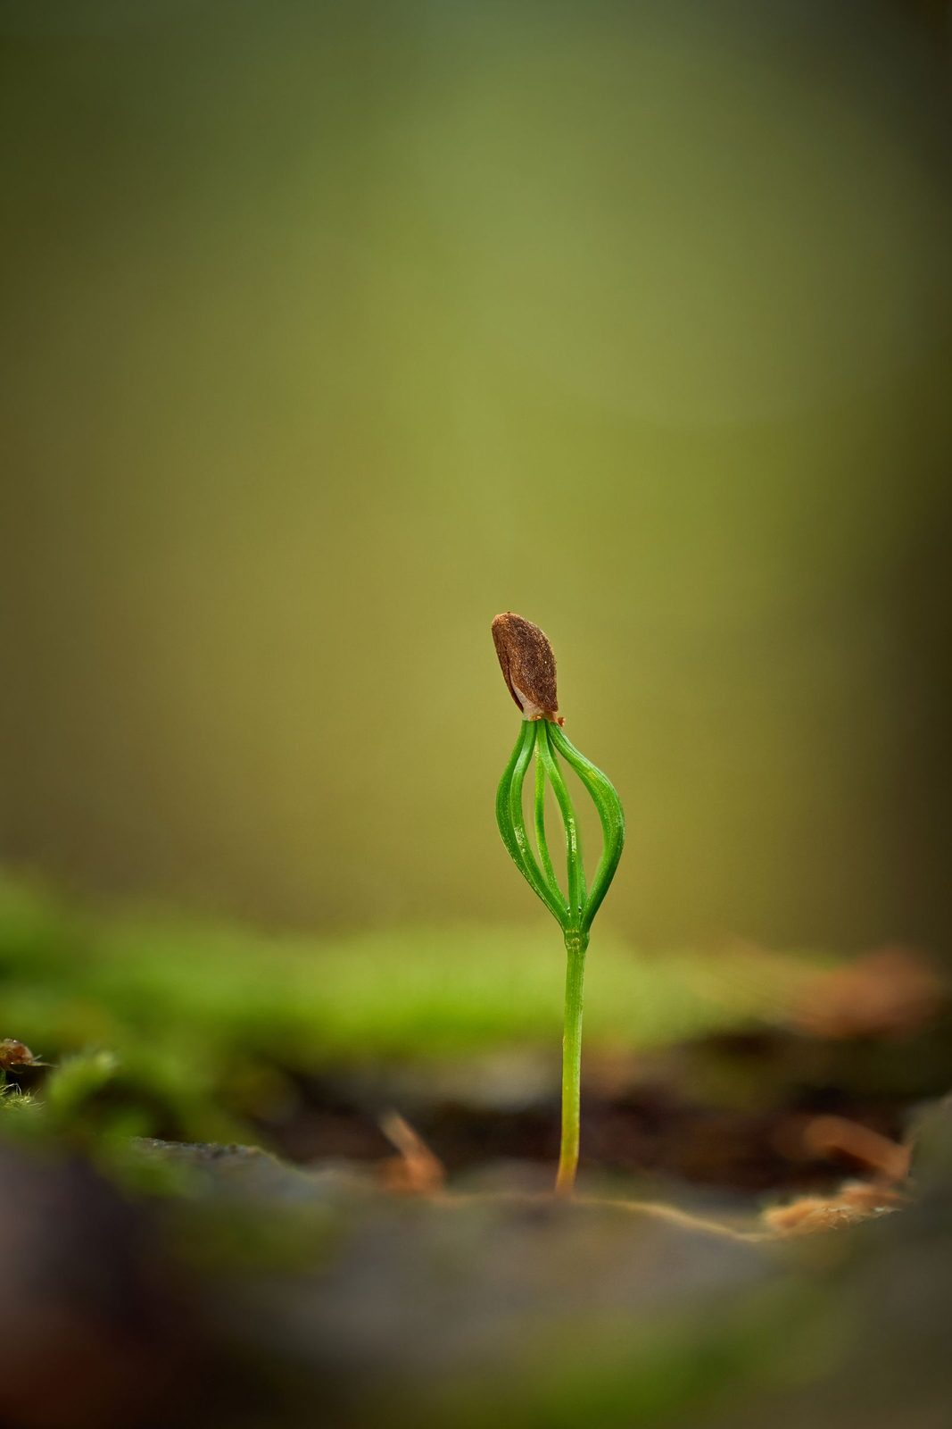
Homework — Weeks One and Two
• Three returns this week — the returns ARE the second visit: most of us only get all the way in on a return
• “You don’t need the full guided script — you have the place now. Just go back.”
• Notice what is the same and what has changed — notice if Jesus is in a different place than He was tonight
• After each return, test what you noticed — does it fit Scripture? Who could I tell? (the How Did You Know? card)
• Pick three days and a time — morning before the day starts is often best
• If something heavy surfaces — stop, open your eyes, come back another day; tell a trusted adult
• Came in skeptical? The Note for the Skeptic handout is for you — adapting or sitting out for now is okay
G14
Notes:
E7 · 8:13–8:16 · LEAD: CONTENT PRESENTER
BEATS: 1. Co-Companion (Parent) leads. Three brief returns to the garden this week, 5–10 min each — no script needed, you have the place now; journal each visit (H9.2). 2. Gentle warning: a return can surface something heavy — you can stop, open your eyes, come back another day; and tell a trusted adult. You are not meant to carry the heavy things alone. 3. After each return, test it: two lines in the journal — does what I noticed fit Scripture? who could I tell? The How Did You Know? card (H9.4) has the checks. 4. For the uneasy: H9.3, the Note for the Skeptic — adapting the practice or sitting it out is honored.
COMBINED FORM: say it plainly — the second guided evening lives in the returns now. Five to ten minutes each, journaled; no junior varsity garden: Jesus meets each person in the garden they actually have. Next session's check-in receives the returns.
THE LONG GAP: this is weeks one and two of four; the next slide gives weeks three and four.

Slide 15
The Long Gap — Weeks Three and Four
• No evening over Thanksgiving — we meet again Tuesday, December 8: four weeks
• Weeks one and two: the garden, with the check-in after week one
• Weeks three and four: your choice — one practice each week from The Practices So Far, a different one in week four
• Choose the one you would really like to do, not the one you think you should — write it down, and why
• If it slips: begin again the next day. No starting over, no streaks
• Over the gap, you know who to reach: ______ (named aloud)
• December 8 opens with: which did you choose? Did you come back on your own? Which would you keep?
The Practices So Far
• The abundance question (E1)
• Soil-noticing (E2)
• Joint Footprints (E3)
• Offering a condition (E4)
• The Five-Minute Examen (E5)
• PROAPT (E6)
• The garden (E7)
G15
Notes:
E7 · 8:16–8:19 · LEAD: CONTENT PRESENTER
BEATS: 1. Name the gap plainly: no evening over Thanksgiving week; four weeks to Tuesday, December 8. "See you in a couple of weeks" is how practices die. 2. Weeks one and two run as always: the garden returns, the check-in after week one. 3. Weeks three and four are yours: each week, one practice from The Practices So Far card, a different one in week four; write down which, and why. 4. Read the list once, aloud, so everyone knows the menu. The card now gives each practice what we did that evening and the homework that went home: before choosing, look back in your journal at what you actually did. 5. The returning rule: if it slips, begin again the next day; no starting over, no streaks. 6. Name who to reach over the gap. 7. December 8 opens with three questions: which did you choose, did you come back on your own, which would you keep?
GUARD: Walk the list; never steer. The choices are made at home, freely: which practices people really want to do is what we are learning (John's word, 28 October).
CUES: Hand out The Practices So Far card with the take-home sheet on the next slide.

Slide 16
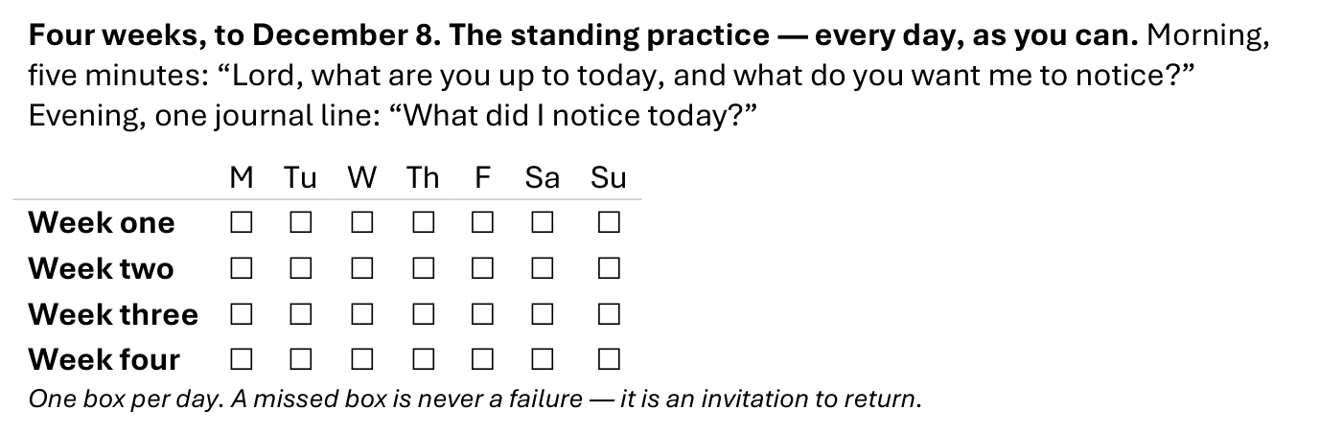
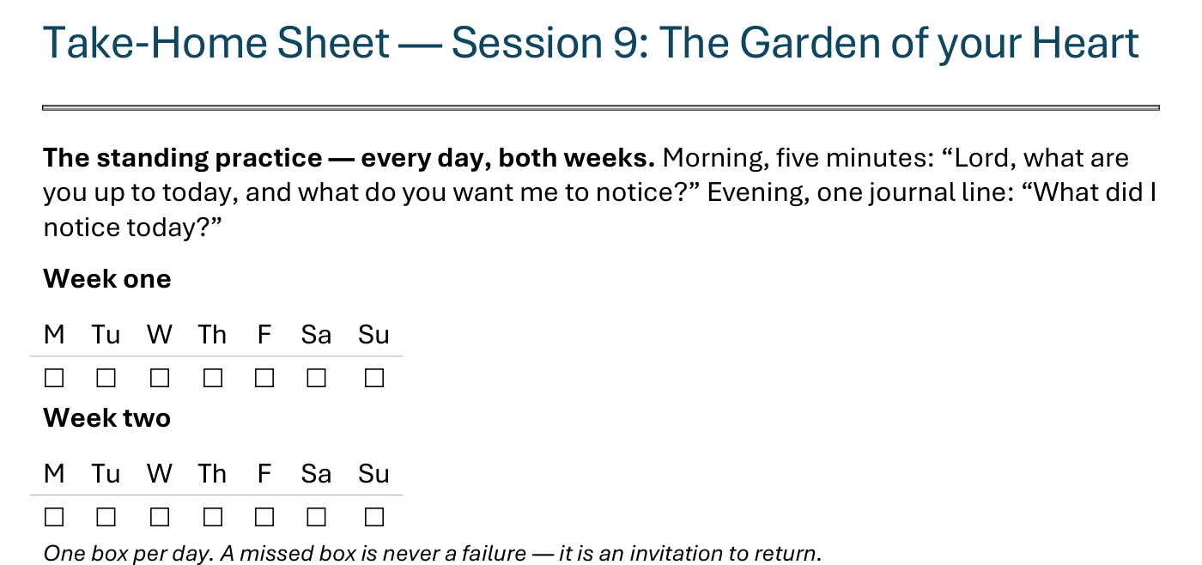
The Take-Home Sheet — the Daily Rhythm
Handed out now — this is the sheet in your hands.
G16
Notes:
E7 · COMMISSIONING · LEAD: CONTENT PRESENTER
BEATS:
1. The sheet on the screen is the sheet in their hands — walk it, don't read it.
2. The standing rhythm first: the morning question, the evening journal line — one box per day on the week-grids.
3. A missed box is never a failure — it is an invitation to return.
CUES: The five parts are the next slide.

Slide 17
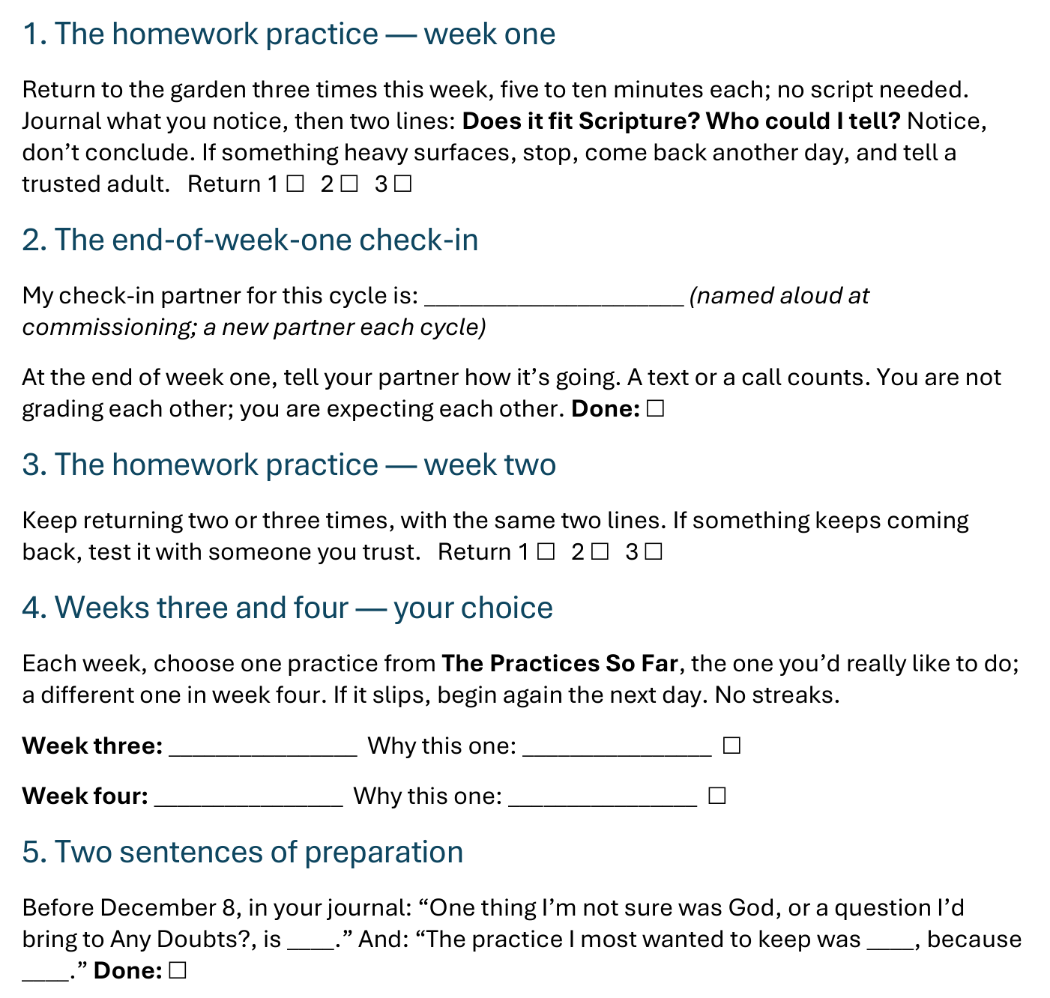
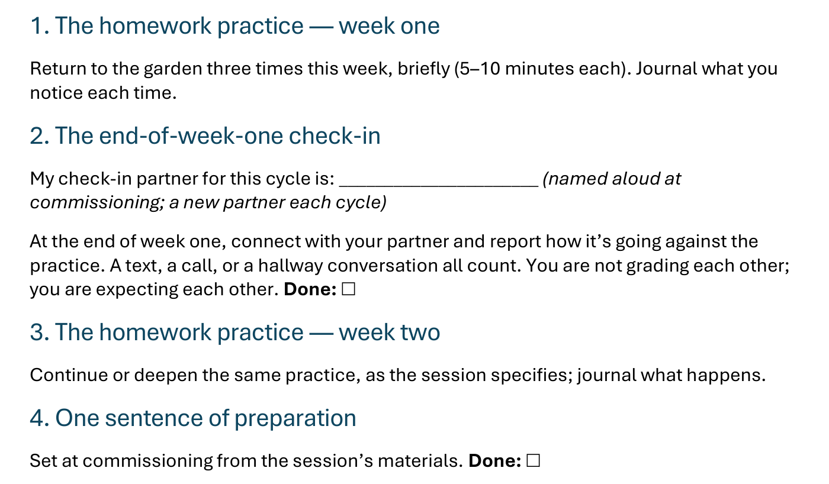
The Take-Home Sheet — the Five Parts
Two weeks as always, then two you choose — and a partner expecting you at the end of week one.
G17
Notes:
E7 · COMMISSIONING · 8:19–8:21 · LEAD: CONTENT PRESENTER
BEATS:
1. The five parts, in order: week one, the garden returns; the end-of-week-one check-in; week two, the garden again; weeks three and four, your choice from The Practices So Far; two sentences of preparation for December 8.
2. Check-in partners are named aloud before leaving this slide; the sheet has the line to write the name.
3. The Practices So Far card and the How Did You Know? card go with the sheet.
GUARD: The sheet-walk, not a re-teach.

Slide 18

The Leader Feedback Round
• Two rounds, same as every session — the container holder first, then the content presenter: three things each
– “What I think went well tonight: ______”
– “What I’d do differently next time: ______”
– “If I were to teach tonight’s process to someone, I would tell them: ______”
• Then the room — the same two questions; every parent answers, each adding only what hasn’t been said
• The leaders receive without defending — “thank you” is the whole response
G18
Notes:
E7 · 8:21–8:24 · LEAD: BOTH LEADERS
BEATS: 1. Same round: leader's three answers first, then the room's two questions; 'thank you' is the whole response. 2. Today is the likeliest night of the series to DROP the round: if the room is still deep in the garden's quiet, five minutes of process talk can break what the Spirit is holding. Drop it, and say so at the debrief.

Slide 19
Closing the Container + Aaronic Blessing
• We close the way we opened — the container, six steps:
1 Stand again — same circle, same posture as the open
2 One-word landing — compare it to your opening word
3 The one thing you are taking from tonight
4 What will you do or say differently? — the one practice, committed aloud
5 Blessings — eyes on the person, not the screen: say what is on your heart for them. Specific, witnessed, short
6 Closing prayer — and the Aaronic blessing, spoken over each other, face to face
THE AARONIC BLESSING — NUMBERS 6:24–26
“The Lord bless you and keep you;
the Lord make his face to shine upon you, and be gracious to you;
the Lord lift up his countenance upon you, and give you peace.”
G19
Notes:
E7 · 8:24–8:30 · LEAD: CONTAINER HOLDER
BEATS: 0. Step 4 tonight asks the Four Connects impact question: 'What will you do or say differently?' — one sentence, committed aloud. 1. 'What happened in your pair is yours. Carry it gently — don't debrief it on the way home unless your heart is fully ready.' 2. If something heavy surfaced, reach out — the team is walking with you. 3. Aaronic blessing; see you on Tuesday, December 8.
GAP: say the date once more, and who to reach over Thanksgiving.
CUES: Stay accessible for fifteen minutes after the close — today more than most, people will want to talk; the two-adult rule holds for any teen.
BLESSINGS: eyes on the person, not the screen — nothing to read; say what is on your heart for them, specific and short.

