Slide 1

Fellowship of the Heart
Getting Started — the Four Connects, walked around the table on alternating evenings
Evening Series 2026–27 · at the Tittle home · v1.5E DRAFT
All Scripture: ESV · The Companion lesson plans carry the full scripts — these slides carry the room
D1
Notes:
DECK TITLE · pre-session · DIVIDER
On screen as the room assembles on night one. All Scripture ESV; the plans carry the scripts; these slides carry the room — and these notes carry you.

Slide 2

EVENING 11
Doing the Word
The obey step: going back to what we heard, and doing one small thing — between hearing and being sent
Quarter 3: Mission & Rhythm
D2
Notes:
E11 · pre-session · DIVIDER
On screen through dinner and as the circle forms. Journals out: everyone needs their Tell sentences from Evenings 6 to 9 tonight.

Slide 3




Where We Are — the Four Connects
Evening 11 stands between hearing and being sent — we have heard (Evenings 6–9), we have come back (Evening 10); now we do one thing. Each connection makes the next one real (Matt. 22:37–40).
D3
Notes:
E11 · WELCOME · LEAD: CONTAINER HOLDER · GROUNDING — every session opens on this map
BEATS:
1. Locate tonight on the map: between Connect with God, behind us, and Connect with Mission, at the next evening.
2. Hearing has had four evenings. Obeying has had a step, Pray again, but no evening of its own. Tonight gives it one.
3. Tonight's obedience is small and personal. Mission is the larger one, and at Evening 13 the whole room obeys together.
CUES: Two minutes at most; then tonight's road.

Slide 4

Evening 11 — Tonight’s Road
1 Welcome and centering
2 The check-in circle — two weeks since The Return
3 The rock and the sand, the mirror
4 The read-back — your Tell sentences, Evenings 6 to 9
5 Choose one, and make it small
6 Pairs — two questions, and prayer
7 The merge — to the circle
8 Homework and the Leader Feedback Round
9 Closing container
D4
Notes:
E11 · 7:00–8:30 · LEAD: BOTH LEADERS
BEATS:
1. Walk the road briefly: a check-in, one short teaching, then quiet with your own journal, and one sentence each.
2. Name the leading pair and the handoffs: the content presenter leads the teaching, the read-back and the pairs; the container holder keeps the clock, watches the room and leads the check-in and the merge.
3. Two named adults hold safety tonight, whoever is leading.
CUES: Thirty seconds; the road, not a preview of the content.

Slide 5
Opening Container — the Eight Steps
1 Welcome — five minutes to open the container
2 Phones silenced and put away
3 Stand in a circle
4 One-word check-in — how you actually are, right now
5 Put out / bring in — set something down; bring a blessing in
6 Spoken commitment: “I am here. I am paying attention. I am willing to be moved.”
7 Opening prayer — “Holy Spirit, you are welcome here. Speak. We are listening.”
8 Sit. Begin.
D5
Notes:
E11 · 7:00–7:08 · LEAD: CONTAINER HOLDER
BEATS:
1. Aaronic blessing first.
2. Full eight steps, normal pace. Safe, present, clear, intentional, said aloud.
CUES: The one-word check-in gets one unhurried breath after each word; no commentary.

Slide 6

The Check-In Circle
• Two weeks since The Return: the one practice you restarted — how did it go?
• The week-one check-ins: did your partner reach you? Did you reach them?
– A thin week is an honest answer; pass is a complete answer
• A parent starts the round — pass-anytime holds
• Received with “We hear that” — no fixing, no follow-up
D6
Notes:
E11 · 7:08–7:22 · LEAD: CONTAINER HOLDER
BEATS:
1. One or two sentences each, the arranged parent first: the one practice restarted at The Return, and how it went.
2. Then the week-one check-ins: did the partners connect? Thank the pairs who did, by name.
3. Receive each with 'We hear that'; no advice.
CUES: Never cold-call a teen. Fourteen minutes, not more.
GUARD: Anything heavy goes to a safety adult after the close, not into the circle.

Slide 7
The Rock and the Sand, the Mirror
• Two builders, two houses, one storm. The difference was not the hearing; both heard. One did what he heard (Luke 6:46–49)
• Hearing without doing is a glance in the mirror: you walk away and forget your own face (James 1:23–24)
• The one who does it “will be blessed in his doing” (James 1:25)
• Since Evening 6 we have learned to hear. Tonight we ask the question the whole journey is about: did I do it?
• Hearing that is not done does not hold
JAMES 1:22
“But be doers of the word, and not hearers only, deceiving yourselves.”
D7
Notes:
E11 · 7:22–7:32 · LEAD: CONTENT PRESENTER
BEATS:
1. Read Luke 6:46–49 aloud, slowly, from the physical Bible. Then James 1:22–25.
2. The one idea: both builders heard. Only one did. The storm showed the difference.
3. Name the mirror honestly: every one of us has heard something and walked away from it. Leaders first: say one of yours, briefly.
4. Turn to the journals: 'Tonight we go back to what we heard.'
CUES: Ten minutes; the leader's own example does more than any explanation.

Slide 8

The Read-Back
1 Open your journal to your Tell sentences — Evenings 6, 7, 8 and 9
2 Read them slowly, alone, in silence
3 Mark the ones you have already done — give thanks for them
4 Mark the ones you heard and have not yet done
5 Ask: “Lord, which one is for now?”
• No journal tonight? Write what you remember hearing; that counts
D8
Notes:
E11 · 7:32–7:40 · LEAD: CONTENT PRESENTER
BEATS:
1. Eight minutes of real quiet. Do not fill it.
2. Spare paper ready for anyone without a journal.
3. At the end, one sentence: 'If more than one stands out, choose the smallest.'
CUES: The container holder watches the room; a teen who finds nothing gets a quiet word later, not a spotlight now.

Slide 9
Choose One, and Make It Small
• “I heard ________ (at Evening ___). By ________ I will ________.”
• Small is the point. Not “be more patient with my brother” but “on Thursday, when he takes my charger, I will ask instead of yelling”
• Not “pray more” but “five minutes before school on Monday, Wednesday and Friday”
• A step you can picture yourself doing is a step you can do
D9
Notes:
E11 · 7:40–7:48 · LEAD: CONTENT PRESENTER
BEATS:
1. Walk the sentence once, slowly; everyone writes theirs on the take-home, at the top.
2. Give both examples; the room will laugh at the charger one, and remember it.
3. Then the test (next slide) before anyone takes it to their pair.
CUES: If someone can't find one, 'I'm still listening' is an honest sentence.

Slide 10
The Test, Before the Doing
• Scripture first — does it line up with what God has already said?
• Peace — is there peace, even if the step is hard? Does it sound like the Lord’s conviction, or like accusation?
• Company — what does your partner, who knows you and knows God, see?
• Nothing that fails the checks gets done (1 John 4:1). Choose again, or say “I’m still listening”
D10
Notes:
E11 · 7:44–7:48 · LEAD: CONTENT PRESENTER
BEATS:
1. Three of the How Did You Know? checks from Evening 7, said aloud before the pairs.
2. Name accusation plainly: a step that sounds like self-punishment ('I have to stop being so stupid') fails the Peace check.
3. Then send the room to pairs.
CUES: This slide comes up inside the 'choose one' block, before the pairs.

Slide 11
Pairs — Two Questions, and Prayer
1 A parent with their own teen, by default; the parent goes first
2 Say your sentence. Your partner asks: Is it small enough to do in two weeks?
3 And: Does it involve another person? Then talk it over with a parent or another adult first
4 Switch at 7:54
5 Pray for each other, by name, from 8:00
• The Pair Card has the steps; the container holder keeps the clock
D11
Notes:
E11 · 7:48–8:06 · LEAD: CONTENT PRESENTER · CONTAINER HOLDER WATCHING THE ROOM
BEATS:
1. Pair Cards out; pairs spread through the room.
2. The container holder calls the switch at 7:54 and the prayer at 8:00, and the return at 8:06.
3. Walk the room; listen for steps that are too big, and help shrink them.
GUARD: A step involving another person (an apology, making something right) is talked over with an adult before it is taken. A step can be private from the room; it is never hidden from a teen's parents.

Slide 12

The Merge — to the Circle
• One sentence each: “By ___ I will ___.” Or simply: “I have one.”
• A parent begins; pass anytime
• Received as witness: “We hear that.” No commentary
• Some obediences are between a person and God, and that is fine
• A small step done is worth more than a big one announced
D12
Notes:
E11 · 8:06–8:14 · LEAD: CONTAINER HOLDER
BEATS:
1. One sentence each, the arranged parent first.
2. 'I have one' is a full answer; do not ask what it is.
3. Close the round: 'At the next evening, we hear what happened.'
CUES: Never cold-call a teen; no comparing, no performing.

Slide 13
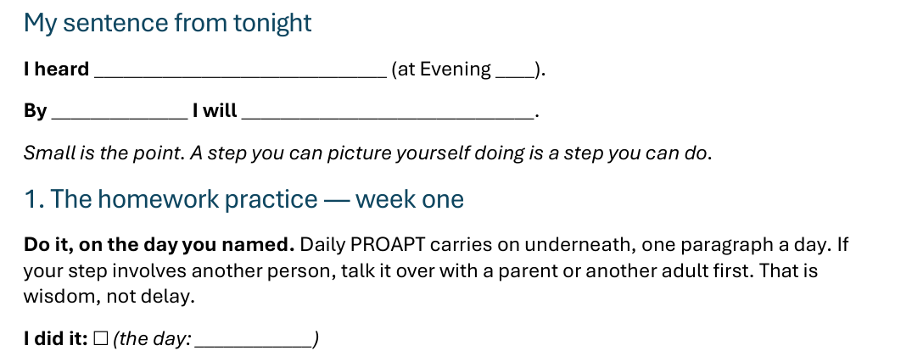


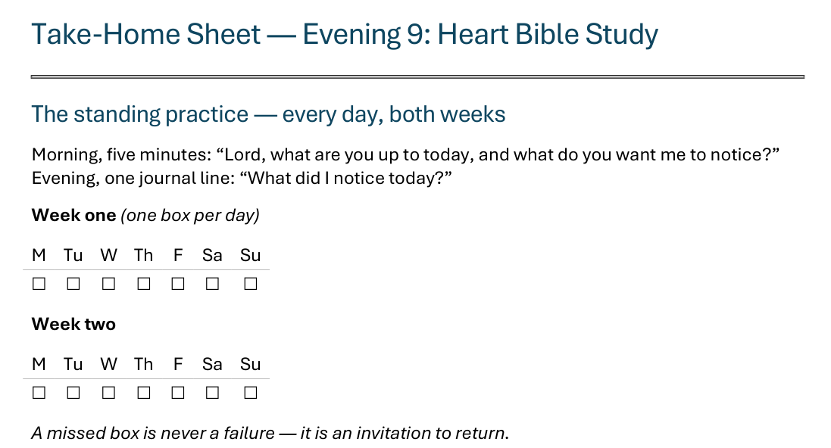
The Take-Home Sheet — Your Sentence, and Week One
Handed out now — this is the sheet in your hands.
D13
Notes:
E11 · COMMISSIONING · LEAD: CONTENT PRESENTER
BEATS:
1. The sheet on the screen is the sheet in their hands: walk it, don't read it.
2. Your sentence at the top, in your own words. The standing rhythm carries on at the head of the sheet, as always.
3. Week one: do it, on the day you named. Daily PROAPT carries on underneath.
4. Check-in partners named aloud: at the end of week one, two questions, 'Did you do it yet? What's in the way?'

Slide 14
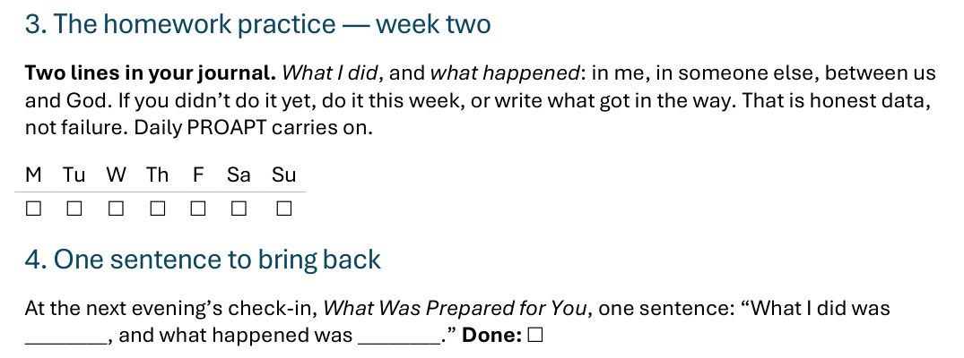



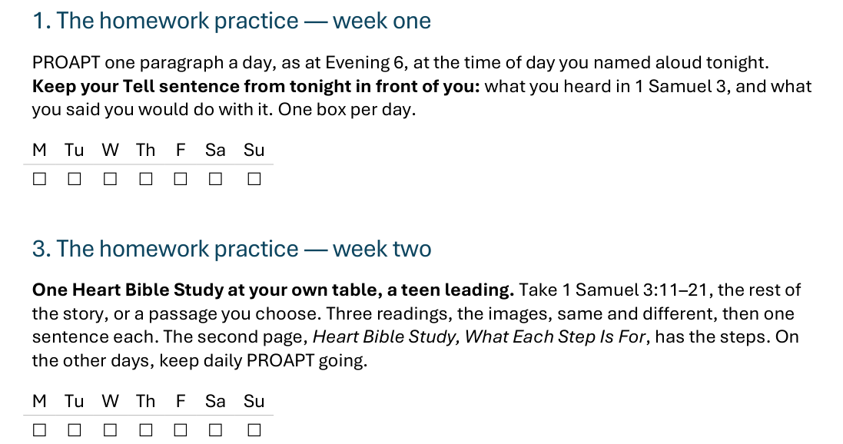
The Take-Home Sheet — Week Two
One practice at a time — and a partner expecting you at the end of week one.
D14
Notes:
E11 · COMMISSIONING · LEAD: CONTENT PRESENTER
BEATS:
1. Week two: two lines in the journal, what I did and what happened.
2. Didn't do it yet? Do it this week, or write what got in the way. Honest data, not failure.
3. Bring one sentence back to the next evening's check-in: what I did, and what happened.

Slide 15

The Leader Feedback Round
• Two rounds, same as every session — the container holder first, then the content presenter: three things each
– “What I think went well tonight: ______”
– “What I’d do differently next time: ______”
– “If I were to teach tonight’s process to someone, I would tell them: ______”
• Then the room — the same two questions; every parent answers, each adding only what hasn’t been said
• The leaders receive without defending — “thank you” is the whole response
D15
Notes:
E11 · 8:20–8:24 · LEAD: BOTH LEADERS
BEATS:
1. Same round every week, leader first: what went well tonight, what I'd do differently.
2. Then the room, the same two questions about the leaders.
CUES: 'Thank you' is the whole response.

Slide 16
Closing the Container + Aaronic Blessing
• We close the way we opened — the container, six steps:
1 Stand again — same circle, same posture as the open
2 One-word landing — compare it to your opening word
3 The one thing you are taking from tonight
4 The one practice — committed aloud, or modified to one you will actually keep
5 Blessings — eyes on the person, not the screen: say what is on your heart for them. Specific, witnessed, short
6 Closing prayer — and the Aaronic blessing, spoken over each other, face to face
THE AARONIC BLESSING — NUMBERS 6:24–26
“The Lord bless you and keep you;
the Lord make his face to shine upon you, and be gracious to you;
the Lord lift up his countenance upon you, and give you peace.”
D16
Notes:
E11 · 8:24–8:30 · LEAD: CONTAINER HOLDER
BEATS:
1. Closing protocol, unhurried: stand; one-word landing; the one thing taken from tonight; the one practice.
2. Name the road: at the next evening, What Was Prepared for You, the check-in hears what happened.
3. Aaronic blessing.
BLESSINGS: eyes on the person, not the screen; say what is on your heart for them, specific and short.

