Slide 1

Did Berlin do well to introduce the rental cap?
Julius Gunnemann Final Project GOV 1005

Slide 2
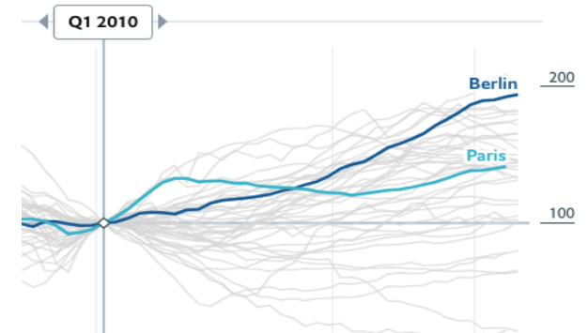
Context: Since 2010, steepest growth in housing prices amongst world cities, despite rent control since 2015
World city housing prices relative to net income (logs, normalized)
06/2015:
Rent control
2010:
375 EUR
2015:
712 EUR
2020:
1,125 EUR
Price for a
median sized apartment:
Note: 2015 rent control meant maximum rental increases of 15% every three years, and local rental price ceilings for new tenants. Furnished or short-term rentals were excluded, leading to substantial leakage. Graph from The Economist Global Housing Price Index, *Applicable ceiling rental price varies slightly with the age and condition of the building.

Slide 3
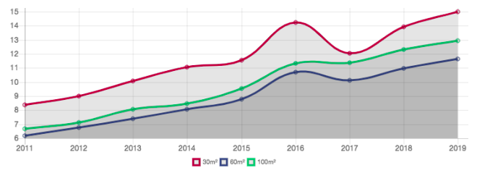
New Policy: An unprecedented market intervention effectively demanding a halving of median prices
Ceiling for all apartments except new-builds
Apartment rental prices over time vs. new price ceiling
New policy
All rental prices frozen for 5 years (06/2019)
No new rental contracts above EUR 6.50/m2* (02/2020)
Landlords to reimburse tenants for any rents paid above cap since 06/2019
→ Opposition has launched an appeal in the constitutional court
Imposed rental cap equivalent to 2010 prices
Note: *Newly enforced ceiling corresponds to 2010 average price. Graph from Berliner Wohnungsboerse (https://www.wohnungsboerse.net/mietspiegel-Berlin/2825)

Slide 4
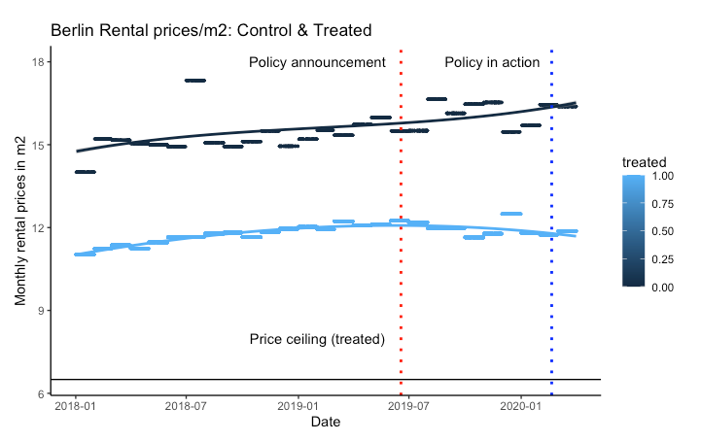
Prices: treated apartments with slight downward trend since announcement

Slide 5
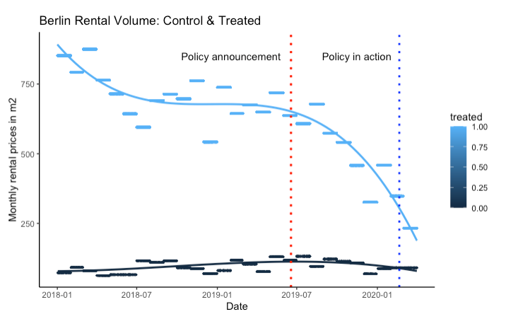
Volume: Most landlords appear to just take their apartments off the market and wait for policy change
Holidays

Slide 6
Empirical approach: Diff-in-diff identification
Data
Diff-in-Diff approach
Daily rental market offers since 2018, 66k transactions
Hamburg (Control)
Berlin (Treatment)
Daily purchase price offers since 2018, 35k transactions
Hamburg (Control)
Berlin (Treatment)
Controls for size, location, building condition, vacancy, amenities, etc.*
Price
Time trend: b2
Control
Diff-in-diff: b3
Initial difference: b1
Treated
Treated
2020
2018
2019
Year
Estimation equation
Log(Price_{i}) = β₀ + β₁ (Treatment) + β₂ (Timing) + β₃ (Treatment*Timing) + γt + γt² + β₄ (Controls_{I,x}) + ε _{I t}
Controls include: City, post code level district, number of rooms of apartment, floor in building, amenities (Kitchen type, bathroom type, floor heating etc.), condition, year of construction

Slide 7
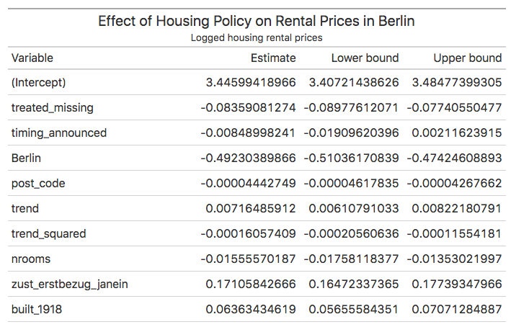
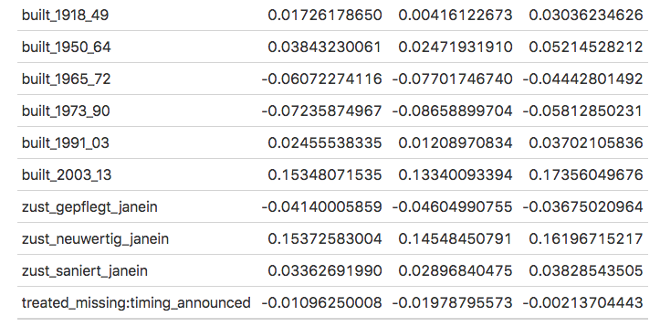
Results: Significant differential negative effect of policy on regulated apartments rental prices
Take-away:
Diff-in-diff estimator is significant at the 1% level
The policy has led to a very small 1% decrease in apartment rental prices.

Slide 8
Theoretical framework: ceiling should lead to drop in prices and quantity supplied
In Theory
S’
Price
S
Short term: Price decrease and supply shortage
Long term:
Increase in supply of unregulated new builds
P
P’
Shortage
Qs
Q
Qd
Quantity

Slide 9
A landlord’s decision framework: two hypothesized actions
Comply & reduce price
Sharp decline in prices (-100%)
Let
Leave
empty
Sell
Comply & hope
to reclaim*
Hypothesis
Steady prices
Offer on black market /
ignore regulation**
Difficult to measure
Landlord with vacant apartments built before 2014
Let once policy ruled unconstitutional
Hypothesis
Decline in rental offers
Sell on purchase market
Increase in supply & drop in prices on purchase market
Note: *Institutional investors advertise apartments at their market value, then accept only the enforced ceiling price but then reclaim delta if policy is ruled unconstitutional; **If ignoring regulation, landlords face fines of up to EUR 0.5M.

Slide 10

Evidence: suggests landlords continue to offer apartments at market values or leave them vacant
Comply & reduce price
Sharp decline in prices (-100%)
Let
Leave
empty
Sell
Comply & hope
to reclaim*
Steady prices
Hypothesis
Apartments advertised at market prices, ceiling prices are paid but then repay delta if voted unconstitutional.
Offer on black market /
ignore regulation**
Difficult to measure
Landlord with vacant apartments built before 2014
Let once policy ruled unconstitutional
Hypothesis
Decline in rental offers
Volume has halved.
Sell on purchase market
Increase in supply & drop in prices on purchase market
Evidence
Small but precisely estimated negative effect
Note: *Institutional investors advertise apartments at their market value, then accept only the enforced ceiling price but then reclaim delta if policy is ruled unconstitutional; **If ignoring regulation, landlords face fines of up to EUR 0.5M.

Slide 11
Conclusion, distributional effects & recommendations
Findings
Distributional effects
Alternative recommendations
Virtually no apartments rented at legal rent cap
Landlords appear to bet on constitutional court decision
Tiny reduction in rental and purchase prices
Massive drop in number of offers
Winners
Abolishment of the rent cap & reimbursement policy
Increase in supply through strong building development incentives, esp. for affordable housing
Better enforcement of rent control, incl. the closing of loopholes
Ruling coalition (popular policy with median voter)
Current tenants
Losers
Private landlords, institutional landlords potentially less so
Tenants currently looking for a lease
Possible debt trap for tenants that will need to reimburse landlords
Notes:
because most policies are implemented at national level

Slide 12
Appendix: Academic literature: One of few opportunities for causal inference on housing policies, the first to study a rent freeze
Simps (2007):
Diff-in-Diff using elimination of rent control in Cambridge, MA.
Find little effect on construction, decreased investment in housing stock, and shifts ownership from rental to owner-occupied
Autor et al (2015):
Assess spillovers on overall housing stock, using same Cambridge, MA, data
Find elimination of control causes large positive spillover effects on never-regulated, nearby housing
Kholodin et al (2015):
Exploit variation in rent-control policies at municipality level in Germany
Find that rent control has, if anything, led to an increase in rental prices
My Project:
Exploits rent-cap & reimbursement policy in Berlin, using diff-in-diff approach
Find small price decreases in both rental and purchase market and drastic volume drop
Notes:
because most policies are implemented at national level

