Slide 1
Vector Models for IR
Gerald Salton, Cornell
      (Salton + Lesk, 68)
      (Salton, 71)
      (Salton + McGill, 83)
SMART System
    Chris Buckely, Cornell / SAPIR systems
     Current keeper of the flame
Salton’s Magical Automatic Retrieval Tool(?)

Slide 2
Vector Models for IR
Boolean Model
Doc V₁
0 0 0 0 0 1 0 1 0 1 0 0 1 0 0 0 0 0 0 0 0 0
Doc V₂
0 0 0 0 0 1 0 1 0 1 0 0 1 0 0 0 0 0 0 0 0 0
Word
Stem
Special compounds
SMART Vector Model
Term_{i}
Doc V₁
1.0 3.5 4.6 0.1 0.0 0.0
Doc V₂
0.0 0.0 0.0 0.1 4.0 0.0
SMART vectors are composed of real valued Term weights
NOT simply Boolean Term Present or NOT

Slide 3
Example
Compiler
DNA
Comput* C++ Sparc genome bilog* protein
Doc V₁
3 5 4 1 0 1 0 0
Doc V₂
1 0 0 0 5 3 1 4
Doc V₃
2 8 0 1 0 1 0 0
Issues
How are weights determined?
(simple option :
raw freq.
weighted by region, titles, keywords)
Which terms to include? Stoplists
Stem or not?

Slide 4

Queries and Documents share same vector representation
D₁
D₂
Q
D₃
Given Query D_{Q}  map to vector V_{Q}
and find document D_{i} : sim (V_{i} ,V_{Q}) is greatest

Slide 5
Similarity Functions
Many other options available(Dice, Jaccard)
Cosine similarity is self normalizing
V₁
100 200 300 50
D₂
V₂
1 2 3 0.5
Q
D₃
V₃
10 20 30 5
Can use arbitrary integer values
(don’t need to be probabilities)

Slide 6
Projection of Vectors into 2-D Plane
V₅
V₁
V₁₀
V₂
V₄
V₆
C₁
V₃
V₇
V₉
C₂
V₈

Slide 7
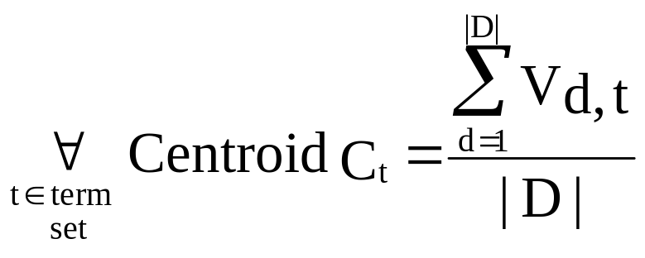
C₁
C₂
Basically, the average of the vectors
in the centroid set
Centroid computation :
D = documents in
centroid set
Total docs in centroid set

Slide 8
Hierarchical Search with Document Centroids
V₁
V₃
V₂
V₄
V₅
V₆
V₇
V₉
V₈
V₁₀

Slide 9
Hierarchical Query Matching
V_{Q} = Query Vector
C_{i} = Root Centroid
  For all children of C_{i} {C_{j} }
    find C_{j} : sim (V_{Q} , C_{j}) is maximum
    if C_{j} is a leaf(document vector), return C_{j}
    else C_{i} = C_{j} and iterate
log ( | D | ) vector comparisons
(height of tree)

Slide 10
Ideal Clustering Behavior

Slide 11
Sample Clustered
Document Collection
 document vector
centroid vector

Slide 12
Ideal Document Space
relevant document with respect
to a queryvector
nonrelevant document with respect
to a query

Slide 13
Introduction of Superclusters
 document vector
centroid vector
❐ supercentroid vector

