Slide 1
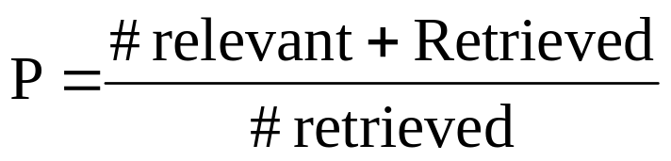
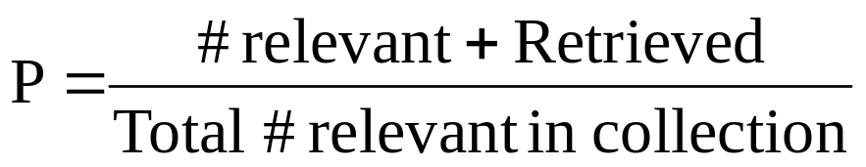
Precision and Recall
Reminder:
Precision : % of # of retrieved documents
that are relevant
Recall : % of all relevant documents
that are retrieved

Slide 2
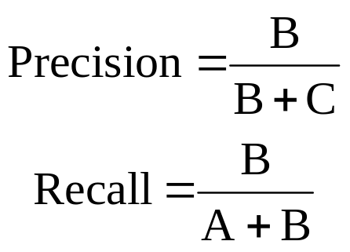
Not Relevant
Relevant
Not Rel
Not Ret
Rel but
Not Ret
A
Ret but
Not Rel
C
Rel and Ret
B
Not Retrieved
Relevant
Not Relevant
Retrieved

Slide 3
Computing Precision and Recall
Theoretically : a continuous relationship
1.0
(Precision value for every
level for recall)
Precision
Recall
1.0
In practice :
1.0
Can only estimate at a resolution ∝ to the
# of relevant docs in the collection
Precision
Recall
1.0

Slide 4
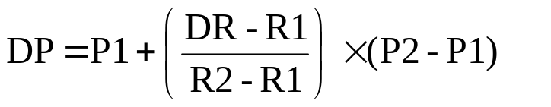
Interpolation of Precision/Recall
.9
P1
Precision
DP
.7
P2
R1
.20
(DR)
R2
.125
.20
.25
Recall
Interpolation

Slide 5
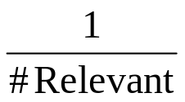
Extrapolation of Precision/Recall
?
( for Recall
less than
)
1.0
.9
?
P1
Precision
.7
P2
R1
R2
.125
.20
.25
Recall

Slide 6
Precision/Recall Curves
1.0
.9
.8
Precision
.7
.6
.5
.4
.3
.2
.1
0
1/8
2/8
3/8
4/8
5/8
6/8
7/8
8/8
.125
.25
.375
.5
.625
.75
.875
1.0
Recall

Slide 7
Precision/Recall Curves
(1/1)
(2/2)
(3/3)
1.0
.9
.8
Precision
.7
.667(4/6)
.6
.5
.4
.312(5/16)
.3
.2
.111(6/54)
.030(7/230)
.1
.003(8/2664)
0
1/8
2/8
3/8
4/8
5/8
6/8
7/8
8/8
.125
.25
.375
.5
.625
.75
.875
1.0
Recall

Slide 8
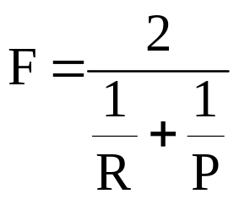
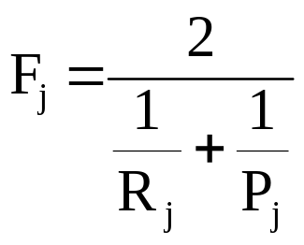
F-measure
Harmonic mean between Precision and Recall
for R = Recall
P = Precision
for any relevance-scored
retrieved set
and
for Recall and Precision
at j-th document in
an ordered ranking

Slide 9
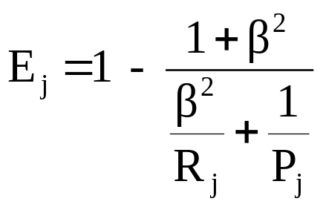
E-measure
Van Rijsbergen(1979)
relative importance of Precision/Recall weighted
by user given parameter β
if β = 1, E_{j} is complement to harmonic mean
if β > 1, Precision more important than Recall
if β < 1, Recall more important than Precision

Slide 10
Normalized Recall
How closely do the ranks of the retrieved documents
(e.g. 1,2,4,6,13) match the ideal ranking of
true retrieved documents(1,2,3,4,5)?
Ideal ranks(1,2,3,4,5)
1
Recall
4/5
3/5
2/5
Actual ranks(1,2,4,6,13)
Worst ranks
(196,197,198,199,200)
1/5
0
1
5
10
15
195
Ranks of retrieved documents

