Slide 1
Multiple binary splits
Q1
A
B
A1
A2
B1
B2
Flat K-way Classifications
A
B
C
     
K

Slide 2
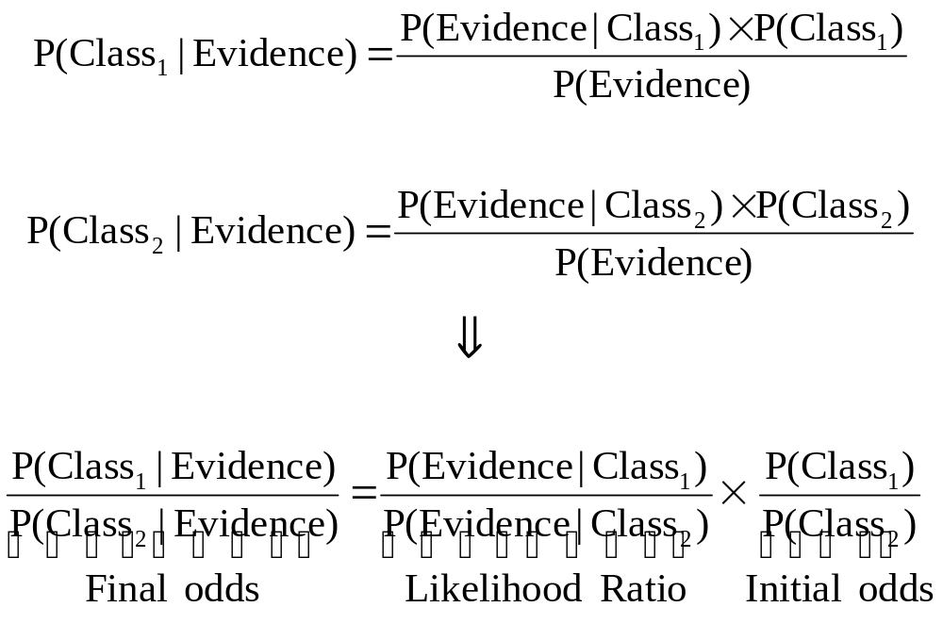
Likelihood Ratios

Slide 3
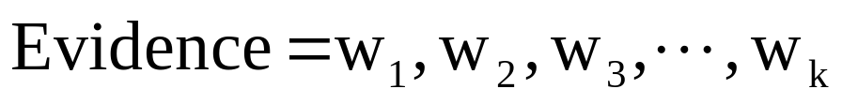
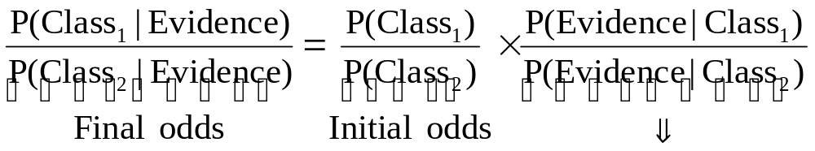
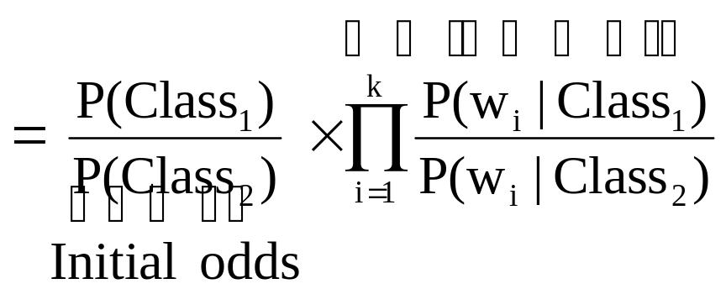
Independence Assumption

Slide 4
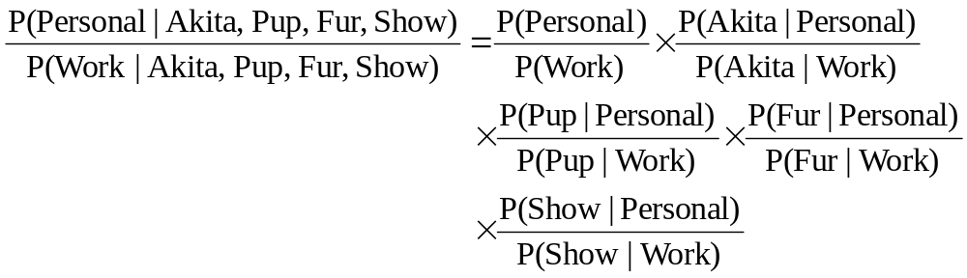
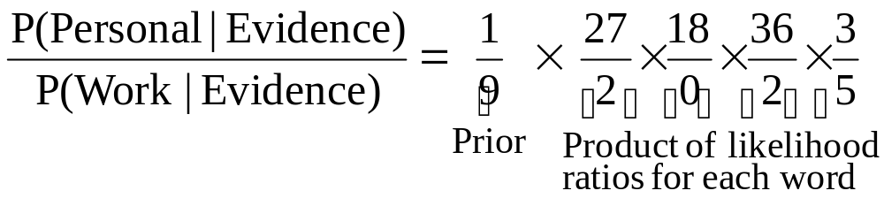
Using Independence Assumption
Prior
α = small constant

Slide 5
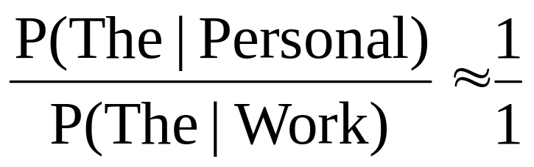
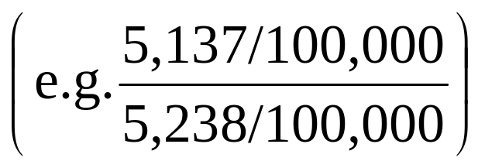
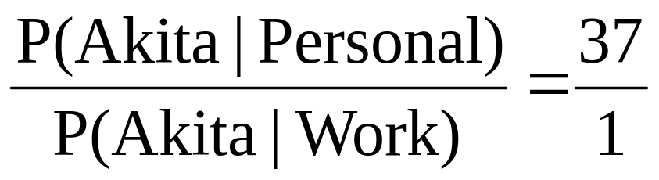
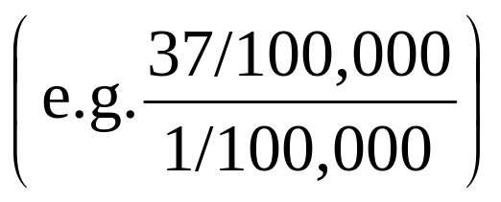
Note : Ratios (Partially) self weighting

Slide 6
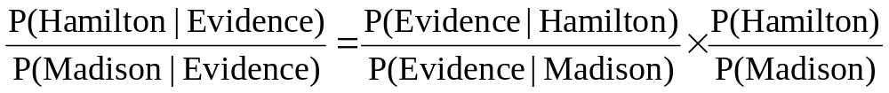
Authorship Identification
Applications of Bayesian Models
Sense Disambiguation
(Mosteller &Wallace, 64)

Slide 7
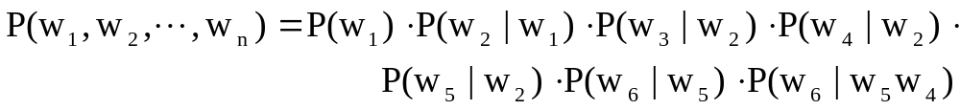
Dependence Trees
Hierarchical Bayesian Models
w₁
w₂
= direction of
dependence
w₃
w₅
w₄
w₆

Slide 8
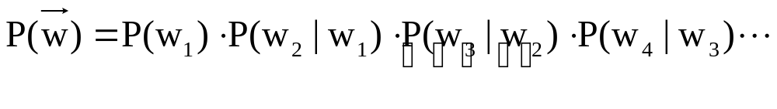
Full Probability Decomposition
Using Simplifying(Markov) Assumption
Assume word only condition on prob. of prev. word
Assumption of Full Independence
(Graphical) models – Partial Decomposition into Dependence Trees

