Slide 1
DOT PLOT (addl points)
To Show:
  Repetition
  Regions of self similarity (same TOPIC blocks)
Increasing corpus position
Plot
 | D1 | D2 | D3 | D4
D1
D2
D3
D4
Diagonal =
repetition
Increasing
Corpus
Position
Dense Blocks =
Self similarity
Main Diagonal

Slide 2
Motivation for Block Formation
NSF | ARPA | NSF | ARPA | NSF
NSF | ARPA | NSF
 | D1 | D2 | D3 | D4
D1
D2
D3
D4
NSF
ARPA
NSF
ARPA
NSF
PPP
PPP
PPP
NSF
NSF
NSF

Slide 3
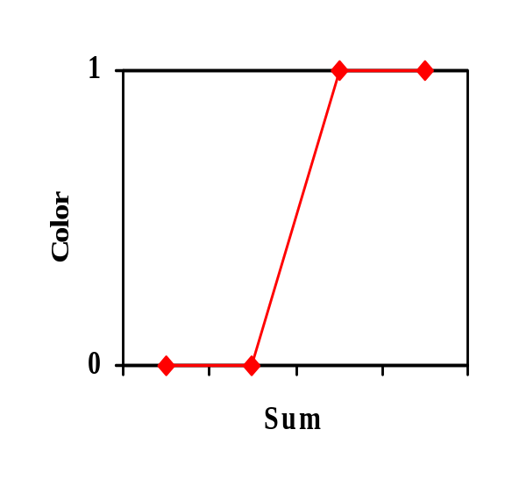
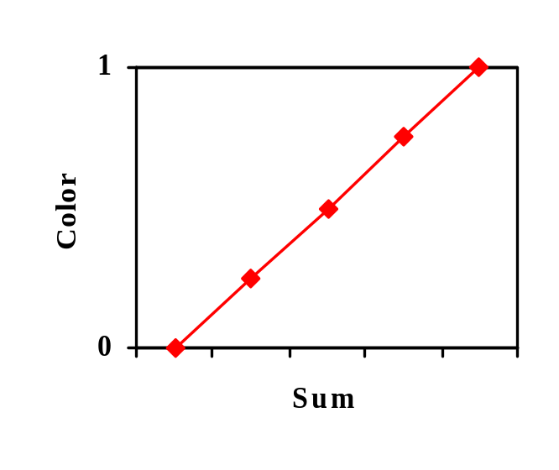
Region Mapping (Image Compression)
3,004,000
F: max [cell[i], cell[j]] +=
Color or Blue
Compressing to single
pixel value
2,901,000 2,902,000
3,004,000
Dot represents 1000x row character block
Block or Repetition Diagonal Enhancements
Average Density
Max Density
Thresholding (Signal Processing Techniques)
Cut off threshold for Display if Black or White

