Slide 1
Google
1998 Stanford Project
Rank pages by a universal weighting function for all pages on the web (PageRank), using transitive merit assignment
Return pages containing search terms in order of page rank

Slide 2
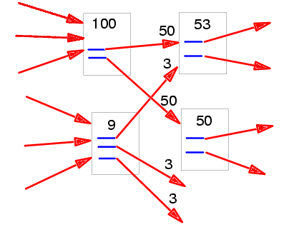
Page Rank Algorithm
Assign merit to a page as a weighted sum of all links pointing to the page
Weight a link pointing to a page proportional to the merit of the pointer
Rank(WP) =
c 1/N(v) * R(v)
Σ
V in PointTo(WP)

Slide 3
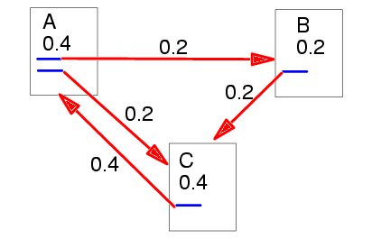
Page Rank Algorithm
Assign merit to a page as a weighted sum of all links pointing to the page
Weight a link pointing to a page proportional to the merit of the pointer
Rank(WP) =
c 1/N(v) * R(v)
Σ
V in PointTo(WP)

Slide 4
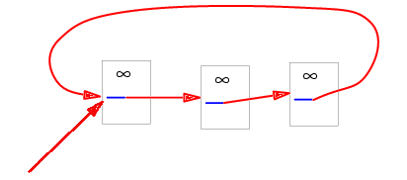
Page Rank Algorithm
Problem: cycles may lead to infinite weight in basic algorithm
Add a weighting factor proportional to original rank source.
Rank(WP) =
c 1/N(v) * R(v)
Σ
V in PointTo(WP)

Slide 5
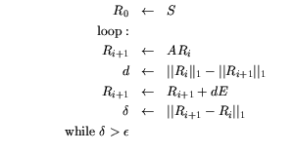
Page Rank Algorithm

