Slide 1
Labs for Network Programming-3
BUPT/QMUL
2014-3-20

Slide 2
Lab on UDP
Write the programs for data sending based on UDP
  You can design the running command format, e.g.,
    ./<exefile> <server> <data> ……
    The server may be specified in domain name or IP address
    One or more data can be delivered each time
  Each time the server receives data, the source (client’s IP address and port number) and the data should be displayed on the screen

Slide 3
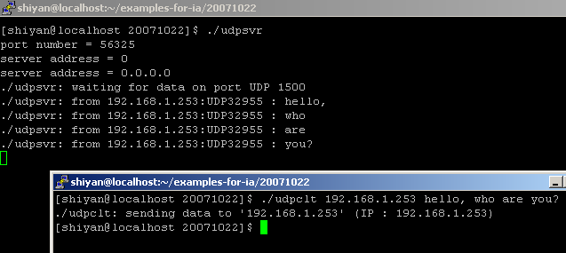
An Example
Only an example, you can design the format by yourself

Slide 4
About Evaluation
This lab will be checked on March 27.

