Slide 1
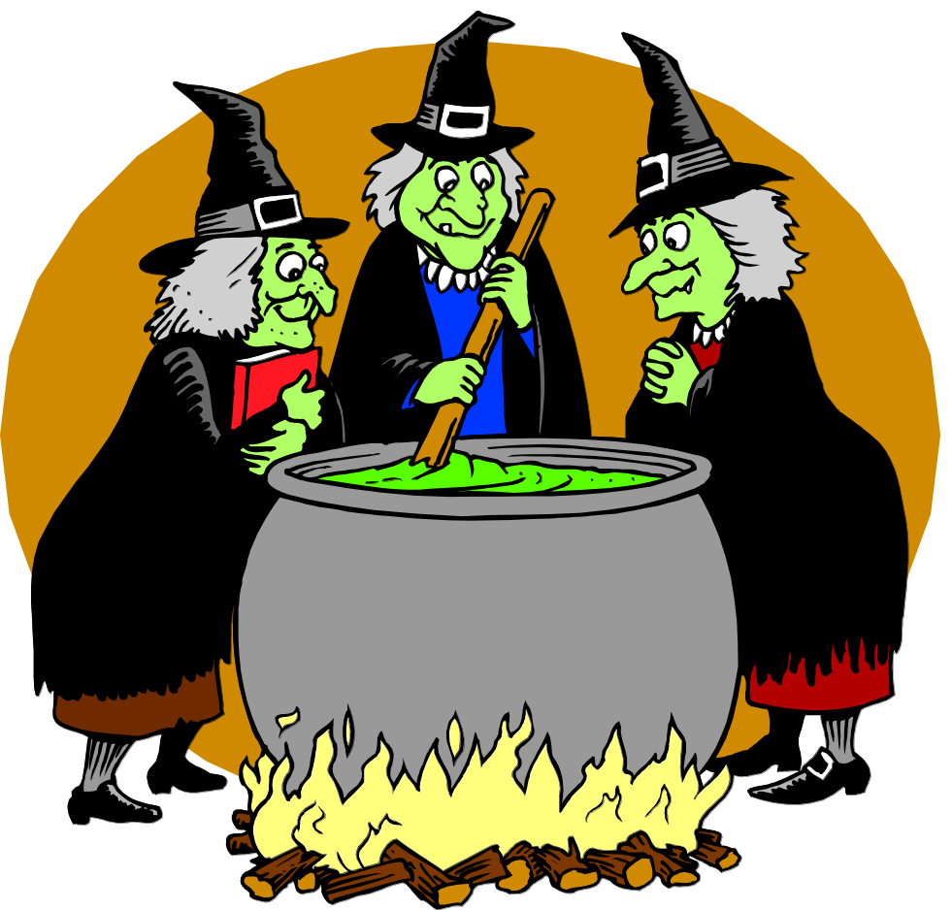
Smoothing
This dark art is why NLP is taught in the engineering school.
There are more principled smoothing methods, too. We’ll look next at log-linear models, which are a good and popular general technique.
But the traditional methods are easy to implement, run fast, and will give you intuitions about what you want from a smoothing method.
600.465 - Intro to NLP - J. Eisner

Slide 2
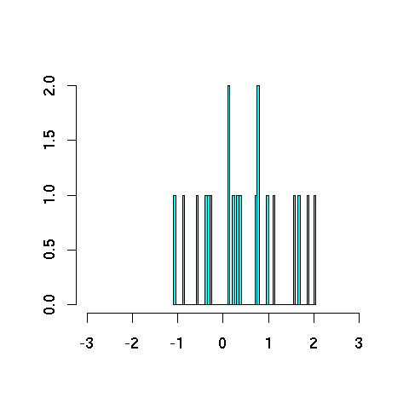
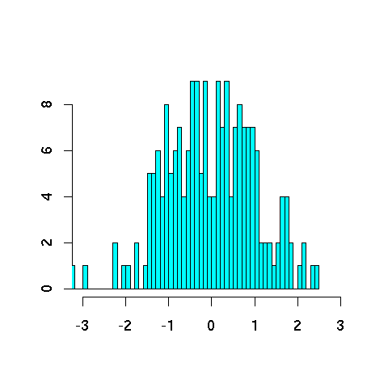
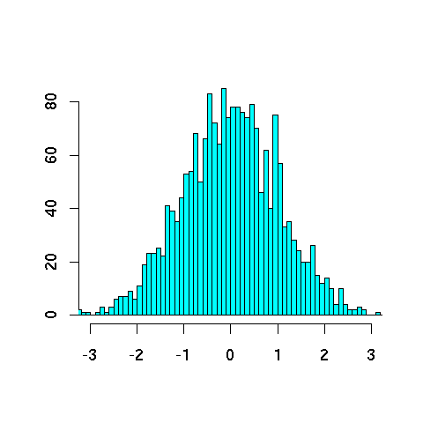
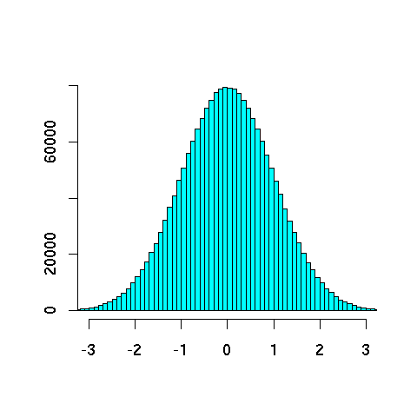
Never trust a sample under 30
20
200
2000
2000000

Slide 3
Never trust a sample under 30
Smooth out the bumpy histograms to look more like the truth
(we hope!)

Slide 4
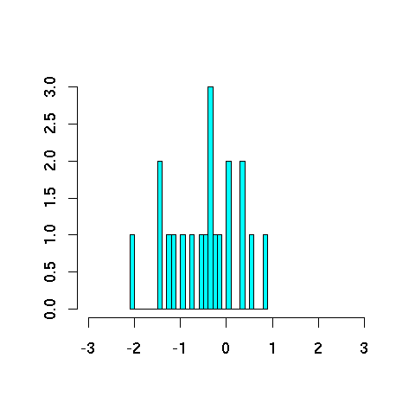
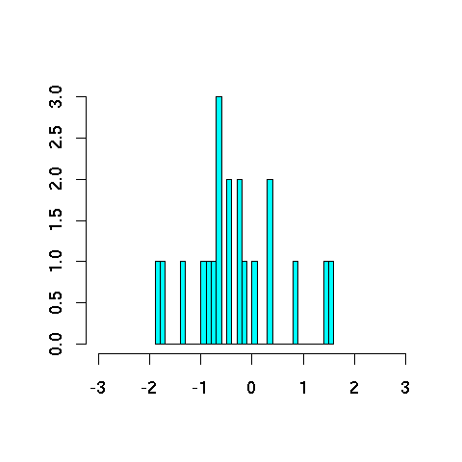
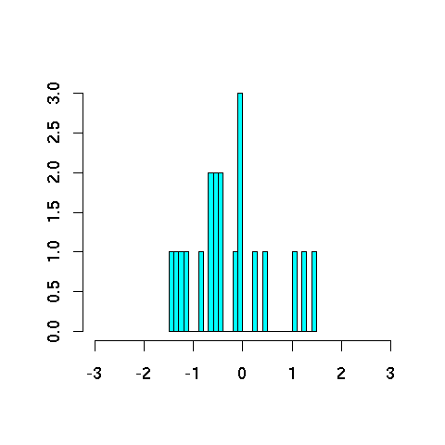
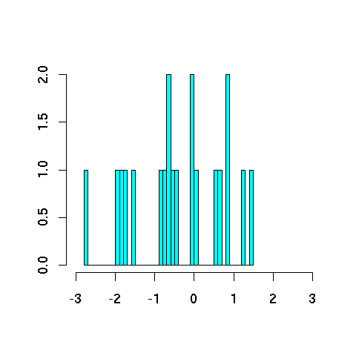
Smoothing reduces variance
20
20
Different samples of size 20 vary considerably
(though on average, they give the correct bell curve!)
20
20

Slide 5
Parameter Estimation
p(x₁=h, x₂=o, x₃=r, x₄=s, x₅=e, x₆=s, …)
≈ p(h | BOS, BOS)
* p(o | BOS, h)
* p(r | h, o)
* p(s | o, r)
* p(e | r, s)
* p(s | s, e)
* …
trigram model’s
parameters
4470/ 52108
395/ 4470
1417/ 14765
1573/ 26412
1610/ 12253
2044/ 21250
values of
those parameters, as naively estimated from Brown corpus.
600.465 - Intro to NLP - J. Eisner

Slide 6
Terminology: Types vs. Tokens
Word type = distinct vocabulary item
  A dictionary is a list of types (once each)
Word token = occurrence of that type
  A corpus is a list of tokens (each type has many tokens)
We’ll estimate probabilities of the dictionary types
by counting the corpus tokens
26 types
300 tokens
a | 100
b | 0
c | 0
d | 200
e | 0
…
z | 0
Total | 300
100 tokens of this type
0 tokens of this type
200 tokens of this type
(in context)

Slide 7
How to Estimate?
p(z | xy) = ?
Suppose our training data includes
… xya ..
… xyd …
… xyd …
but never xyz
Should we conclude
p(a | xy) = 1/3?
p(d | xy) = 2/3?
p(z | xy) = 0/3?
NO! Absence of xyz might just be bad luck.
600.465 - Intro to NLP - J. Eisner

Slide 8
Smoothing the Estimates
Should we conclude
p(a | xy) = 1/3? reduce this
p(d | xy) = 2/3? reduce this
p(z | xy) = 0/3? increase this
Discount the positive counts somewhat
Reallocate that probability to the zeroes
Especially if the denominator is small …
  1/3 probably too high, 100/300 probably about right
Especially if numerator is small …
  1/300 probably too high, 100/300 probably about right
600.465 - Intro to NLP - J. Eisner

Slide 9
Add-One Smoothing
xya | 1 | 1/3 | 2 | 2/29
xyb | 0 | 0/3 | 1 | 1/29
xyc | 0 | 0/3 | 1 | 1/29
xyd | 2 | 2/3 | 3 | 3/29
xye | 0 | 0/3 | 1 | 1/29
…
xyz | 0 | 0/3 | 1 | 1/29
Total xy | 3 | 3/3 | 29 | 29/29
600.465 - Intro to NLP - J. Eisner

Slide 10
Add-One Smoothing
300 observations instead of 3 – better data, less smoothing
xya | 100 | 100/300 | 101 | 101/326
xyb | 0 | 0/300 | 1 | 1/326
xyc | 0 | 0/300 | 1 | 1/326
xyd | 200 | 200/300 | 201 | 201/326
xye | 0 | 0/300 | 1 | 1/326
…
xyz | 0 | 0/300 | 1 | 1/326
Total xy | 300 | 300/300 | 326 | 326/326
600.465 - Intro to NLP - J. Eisner

Slide 11
Problem with Add-One Smoothing
We’ve been considering just 26 letter types …
xya | 1 | 1/3 | 2 | 2/29
xyb | 0 | 0/3 | 1 | 1/29
xyc | 0 | 0/3 | 1 | 1/29
xyd | 2 | 2/3 | 3 | 3/29
xye | 0 | 0/3 | 1 | 1/29
…
xyz | 0 | 0/3 | 1 | 1/29
Total xy | 3 | 3/3 | 29 | 29/29
600.465 - Intro to NLP - J. Eisner

Slide 12
Problem with Add-One Smoothing
Suppose we’re considering 20000 word types, not 26 letters
see the abacus | 1 | 1/3 | 2 | 2/20003
see the abbot | 0 | 0/3 | 1 | 1/20003
see the abduct | 0 | 0/3 | 1 | 1/20003
see the above | 2 | 2/3 | 3 | 3/20003
see the Abram | 0 | 0/3 | 1 | 1/20003
…
see the zygote | 0 | 0/3 | 1 | 1/20003
Total | 3 | 3/3 | 20003 | 20003/20003
600.465 - Intro to NLP - J. Eisner

Slide 13
Problem with Add-One Smoothing
Suppose we’re considering 20000 word types, not 26 letters
see the abacus | 1 | 1/3 | 2 | 2/20003
see the abbot | 0 | 0/3 | 1 | 1/20003
see the abduct | 0 | 0/3 | 1 | 1/20003
see the above | 2 | 2/3 | 3 | 3/20003
see the Abram | 0 | 0/3 | 1 | 1/20003
…
see the zygote | 0 | 0/3 | 1 | 1/20003
Total | 3 | 3/3 | 20003 | 20003/20003
“Novel event” = 0-count event (never happened in training data).
Here: 19998 novel events, with total estimated probability 19998/20003.
So add-one smoothing thinks we are extremely likely to see novel events, rather than words we’ve seen in training data.
It thinks this only because we have a big dictionary: 20000 possible events.
  Is this a good reason?
600.465 - Intro to NLP - J. Eisner

Slide 14
Infinite Dictionary?
In fact, aren’t there infinitely many possible word types?
see the aaaaa | 1 | 1/3 | 2 | 2/(∞+3)
see the aaaab | 0 | 0/3 | 1 | 1/(∞+3)
see the aaaac | 0 | 0/3 | 1 | 1/(∞+3)
see the aaaad | 2 | 2/3 | 3 | 3/(∞+3)
see the aaaae | 0 | 0/3 | 1 | 1/(∞+3)
…
see the zzzzz | 0 | 0/3 | 1 | 1/(∞+3)
Total | 3 | 3/3 | (∞+3) | (∞+3)/(∞+3)
600.465 - Intro to NLP - J. Eisner

Slide 15
Add-Lambda Smoothing
A large dictionary makes novel events too probable.
To fix: Instead of adding 1 to all counts, add λ = 0.01?
  This gives much less probability to novel events.
But how to pick best value for λ?
  That is, how much should we smooth?
  E.g., how much probability to “set aside” for novel events?
    Depends on how likely novel events really are!
    Which may depend on the type of text, size of training corpus, …
  Can we figure it out from the data?
    We’ll look at a few methods for deciding how much to smooth.
600.465 - Intro to NLP - J. Eisner

Slide 16
Setting Smoothing Parameters
How to pick best value for λ? (in add- λ smoothing)
Try many λ values & report the one that gets best results?
How to measure whether a particular λ gets good results?
Is it fair to measure that on test data (for setting λ)?
  Story: Stock scam …
  Moral: Selective reporting on test data can make a method look artificially good. So it is unethical.
  Rule: Test data cannot influence system development. No peeking! Use it only to evaluate the final system(s). Report all results on it.
Training
Test
Also, tenure letters …
General Rule of Experimental Ethics:
Never skew anything in your favor.
Applies to experimental design, reporting, analysis, discussion.
Feynman’s Advice: “The first principle is that you must not
fool yourself, and you are the easiest person to fool.”
600.465 - Intro to NLP - J. Eisner

Slide 17
Setting Smoothing Parameters
How to pick best value for λ?
Try many λ values & report the one that gets best results?
How to fairly measure whether a λ gets good results?
Hold out some “development data” for this purpose
Training
Test
Dev.
Training
… and report results of that final model on test data.
Pick λ that
gets best
results on this 20% …
Now use that λ to get smoothed counts from all 100% …
… when we collect counts from this 80% and smooth them using add-λ smoothing.
600.465 - Intro to NLP - J. Eisner

Slide 18
Setting Smoothing Parameters
Here we held out 20% of our training set (yellow) for development.
Would like to use > 20% yellow:
Would like to use > 80% blue:
Could we let the yellow and blue sets overlap?
☹ 20% not enough to reliably assess λ
☹ Best λ for smoothing 80%
≠ best λ for smoothing 100%
☹ Ethical, but foolish
Training
Test
Dev.
Training
… and report results of that final model on test data.
Pick λ that
gets best
results on this 20% …
Now use that λ to get smoothed counts from all 100% …
… when we collect counts from this 80% and smooth them using add-λ smoothing.
600.465 - Intro to NLP - J. Eisner

Slide 19
5-fold Cross-Validation (“Jackknifing”)
☹ 20% not enough to reliably assess λ
☹ Best λ for smoothing 80%
≠ best λ for smoothing 100%
Would like to use > 20% yellow:
Would like to use > 80% blue:
Old version: Train on 80%, test on 20%
If 20% yellow too little: try 5 training/dev splits as below
  Pick λ that gets best average performance
  ☺ Tests on all 100% as yellow, so we can more reliably assess λ
  ☹ Still picks a λ that’s good at smoothing the 80% size, not 100%.
    But now we can grow that 80% without trouble …
Dev.
Training
Dev.
Dev.
Dev.
animation
Dev.
Test
Dev.
600.465 - Intro to NLP - J. Eisner

Slide 20
Cross-Validation Pseudocode
for λ in {0.01, 0.02, 0.03, … 9.99}
  for each of the 5 blue/yellow splits
    train on the 80% blue data, using λ to smooth the counts
    test on the 20% yellow data, and measure performance
  goodness of this λ = average performance over the 5 splits
using best λ we found above:
  train on 100% of the training data, using λ to smooth the counts
  test on the red test data, measure performance & report it
Dev.
Dev.
Dev.
Dev.
Dev.
Training
Test
600.465 - Intro to NLP - J. Eisner

Slide 21
N-fold Cross-Validation (“Leave One Out”)
(more extreme
version of strategy
from last slide)
…
Test
To evaluate a particular λ during dev, test on all the training data:
test each sentence with smoothed model from other N-1 sentences
☺ Still tests on all 100% as yellow, so we can reliably assess λ
☺ Trains on nearly 100% blue data ((N-1)/N) to measure whether λ is good for smoothing that much data: nearly matches true test conditions
☺ Surprisingly fast: why?
  Usually easy to retrain on blue by adding/subtracting 1 sentence’s counts
600.465 - Intro to NLP - J. Eisner

Slide 22
Smoothing reduces variance
Remember: So does backoff
(by increasing size of sample). Use both?
20
20
200
20
20

Slide 23
Use the backoff, Luke!
Why are we treating all novel events as the same?
p(zygote | see the) vs. p(baby | see the)
  Unsmoothed probs: count(see the zygote) / count(see the)
  Smoothed probs: (count(see the zygote) + 1) / (count(see the) + V)
  What if count(see the zygote) = count(see the baby) = 0?
baby beats zygote as a unigram
the baby beats the zygote as a bigram
∴ see the baby beats see the zygote ?
(even if both have the same count, such as 0)
Backoff introduces bias, as usual:
  Lower-order probabilities (unigram, bigram) aren’t quite what we want
  But we do have enuf data to estimate them & they’re better than nothing.
600.465 - Intro to NLP - J. Eisner

Slide 24
Early idea: Model averaging
Jelinek-Mercer smoothing (“deleted interpolation”):
  Use a weighted average of backed-off naïve models:
  p_{average}(z | xy) = μ₃ p(z | xy) + μ₂ p(z | y) + μ₁ p(z)
  where μ₃ + μ₂ + μ₁ = 1 and all are ≥ 0
The weights μ can depend on the context xy
  If we have “enough data” in context xy, can make μ₃ large. E.g.:
    If count(xy) is high
    If the entropy of z is low in the context xy
  Learn the weights on held-out data w/ jackknifing
    Different μ₃ when xy is observed 1 time, 2 times, 3-5 times, …
We’ll see some better approaches shortly
600.465 - Intro to NLP - J. Eisner

Slide 25
More Ideas for Smoothing
Cross-validation is a general-purpose wrench for tweaking any constants in any system.
  Here, the system will train the counts from blue data, but we use yellow data to tweak how much the system smooths them (λ) and how much it backs off for different kinds of contexts (μ₃ etc.)
Is there anything more specific to try in this case?
Remember, we’re trying to decide how much to smooth.
  E.g., how much probability to “set aside” for novel events?
    Depends on how likely novel events really are …
    Which may depend on the type of text, size of training corpus, …
  Can we figure this out from the data?

Slide 26
How likely are novel events?
Is there any theoretically nice way to pick λ?
20000 types
300 tokens
300 tokens
a | 150 |  | 0
both | 18 |  | 0
candy | 0 |  | 1
donuts | 0 |  | 2
every | 50 | versus | 0
farina | 0 |  | 0
grapes | 0 |  | 1
his | 38 |  | 0
ice cream | 0 |  | 7
…
0/300
0/300
which zero would you expect is really rare?
600.465 - Intro to NLP - J. Eisner

Slide 27
How likely are novel events?
20000 types
300 tokens
300 tokens
a | 150 |  | 0
both | 18 |  | 0
candy | 0 |  | 1
donuts | 0 |  | 2
every | 50 | versus | 0
farina | 0 |  | 0
grapes | 0 |  | 1
his | 38 |  | 0
ice cream | 0 |  | 7
…
determiners:
a closed class
600.465 - Intro to NLP - J. Eisner

Slide 28
How likely are novel events?
20000 types
300 tokens
300 tokens
a | 150 |  | 0
both | 18 |  | 0
candy | 0 |  | 1
donuts | 0 |  | 2
every | 50 | versus | 0
farina | 0 |  | 0
grapes | 0 |  | 1
his | 38 |  | 0
ice cream | 0 |  | 7
…
(food) nouns:
an open class
600.465 - Intro to NLP - J. Eisner

Slide 29
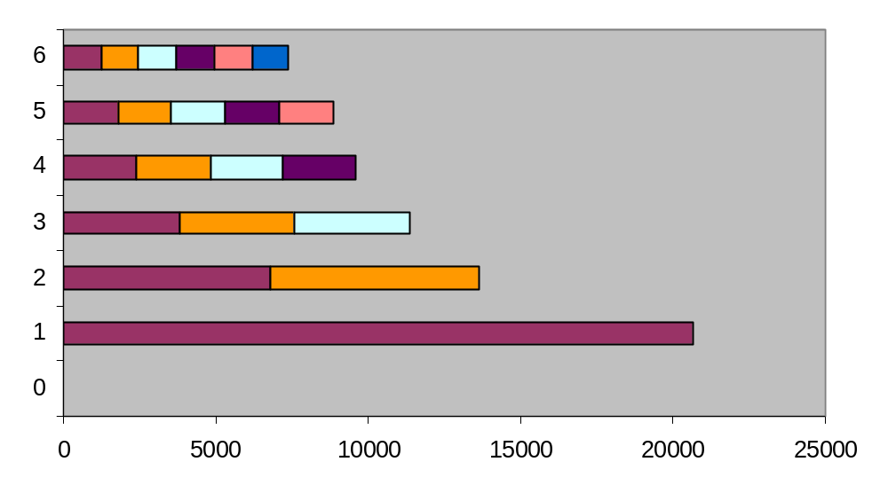
How common are novel events?
Counts from Brown Corpus (N ≈ 1 million tokens)
N₆ *
N₅ *
N₄ *
N₃ *
N₂ *
doubletons (occur twice)
N₁ *
singletons (occur once)
N₀ *
novel words (in dictionary but never occur)
N2 = # doubleton types
N2 * 2 = # doubleton tokens
∑_{r} N_{r} = total # types = T (purple bars)
∑_{r} (N_{r} * r) = total # tokens = N (all bars)

Slide 30
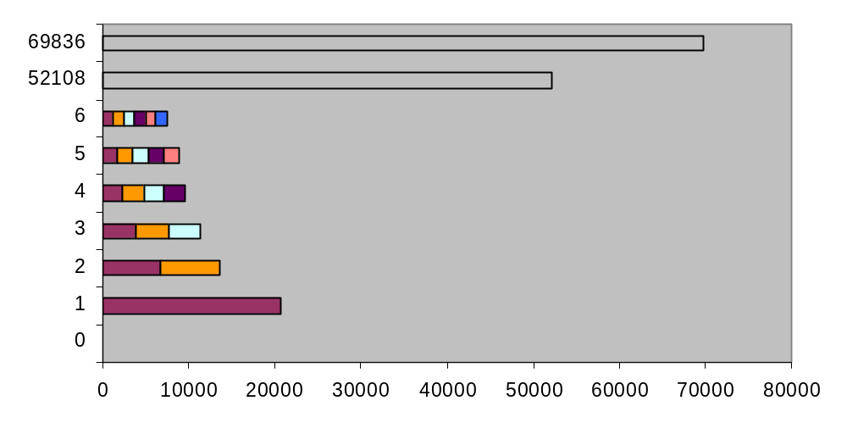
How common are novel events?
1 *
the
1 *
EOS
N₆ *
abdomen, bachelor, Caesar …
N₅ *
aberrant, backlog, cabinets …
N₄ *
abdominal, Bach, cabana …
N₃ *
Abbas, babel, Cabot …
N₂ *
aback, Babbitt, cabanas …
N₁ *
abaringe, Babatinde, cabaret …
N₀ *

Slide 31
Witten-Bell Smoothing Idea
If T/N is large, we’ve seen lots of novel types in the past, so we expect lots more.
  Imagine scanning the corpus in order.
  Each type’s first token was novel.
  So we saw T novel types (purple).
N₆ *
N₅ *
N₄ *
N₃ *
unsmoothed → smoothed
N₂ *
doubletons
2/N → 2/(N+T)
N₁ *
singletons
1/N → 1/(N+T)
N₀ *
novel words
0/N → (T/(N+T)) / N₀
Intuition: When we see a new type w in training, ++count(w); ++count(novel)
So p(novel) is estimated as T/(N+T), divided among N₀ specific novel types

Slide 32
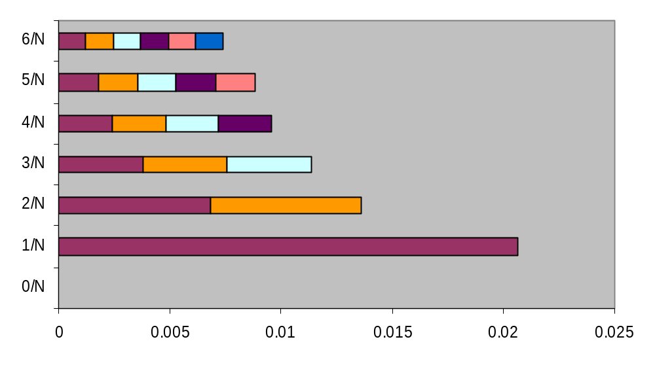
Good-Turing Smoothing Idea
Partition the type vocabulary into classes
(novel, singletons, doubletons, …)
by how often they occurred in training data
Use observed total probability of class r+1
to estimate total probability of class r
N₆*
N₅*
N₄*
N₃*
obs. (tripleton)
unsmoothed → smoothed
1.2%
est. p(doubleton)
2/N → (N₃*3/N)/N₂
N₂*
obs. p(doubleton)
(N₃*3/N)/N₂
1.5%
N₁*
obs. p(singleton)
est. p(singleton)
1/N → (N₂*2/N)/N₁
(N₂*2/N)/N₁
2%
N₀*
est. p(novel)
0/N → (N₁*1/N)/N₀
(N₁*1/N)/N₀
r/N = (N_{r}*r/N)/N_{r} → (N_{r+1}*(r+1)/N)/N_{r}

Slide 33
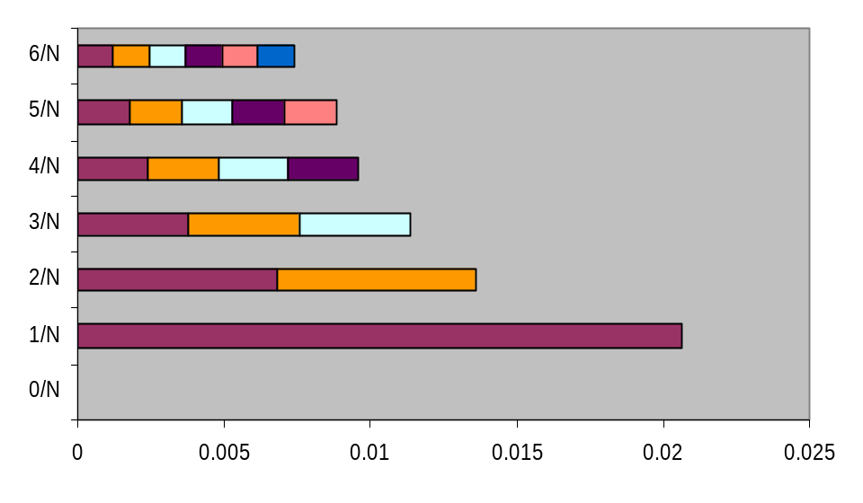
Justification of Good-Turing
obs. (tripleton)
…
1.2%
est. p(doubleton)
obs. p(doubleton)
1.5%
est. p(singleton)
obs. p(singleton)
2%
est. p(novel)
Justified by leave-one-out training!
Instead of just tuning λ, we will tune
  p(novel)=0.02 [= frac. of yellow dev. words that were novel in blue training]
  p(singleton)=0.015 [= frac. of yellow dev. words that were singletons in blue training]
  p(doubleton)=0.012 [= frac. of yellow dev. words that were doubletons in blue training]
i.e.,
  p(novel) = fraction of singletons in full training
  p(singleton) = fraction of doubletons in full training, etc.

Slide 34
Witten-Bell Smoothing
Witten-Bell intuition: If we’ve seen a lot of different events, then new novel events are also likely. (Considers the type/token ratio.)
  Formerly covered on homework 3
Good-Turing intuition: If we’ve seen a lot of singletons, then new novel events are also likely.
  Very nice idea (but a bit tricky in practice)
600.465 - Intro to NLP - J. Eisner

Slide 35
Good-Turing Smoothing
Intuition: Can judge rate of novel events by rate of singletons.
Let N_{r} = # of word types with r training tokens
  e.g., N₀ = number of unobserved words
  e.g., N₁ = number of singletons
Let N = Σ r N_{r} = total # of training tokens
600.465 - Intro to NLP - J. Eisner

Slide 36
Good-Turing Smoothing
Let N_{r} = # of word types with r training tokens
Let N = Σ r N_{r} = total # of training tokens
Naïve estimate: if x has r tokens, p(x) = ?
  Answer: r/N
Total naïve probability of all word types with r tokens?
  Answer: N_{r} r / N.
Good-Turing estimate of this total probability:
  Defined as: N_{r+1} (r+1) / N
  So proportion of novel words in test data is estimated by proportion of singletons in training data.
  Proportion in test data of the N₁ singletons is estimated by proportion of the N₂ doubletons in training data. Etc.
So what is Good-Turing estimate of p(x)?
600.465 - Intro to NLP - J. Eisner

Slide 37
Smoothing + backoff
Basic smoothing (e.g., add-λ, Good-Turing, Witten-Bell):
  Holds out some probability mass for novel events
  E.g., Good-Turing gives them total mass of N₁/N
  Divided up evenly among the novel events
Backoff smoothing
  Holds out same amount of probability mass for novel events
  But divide up unevenly in proportion to backoff prob.
  When defining p(z | xy), the backoff prob for novel z is p(z | y)
    Novel events are types z that were never observed after xy.
  When defining p(z | y), the backoff prob for novel z is p(z)
    Here novel events are types z that were never observed after y.
    Even if z was never observed after xy, it may have been observed after the shorter, more frequent context y. Then p(z | y) can be estimated without further backoff. If not, we back off further to p(z).
  When defining p(z), do we need a backoff prob for novel z?
    What are novel z in this case? What could the backoff prob be? What if the vocabulary is known and finite? What if it’s potentially infinite?
600.465 - Intro to NLP - J. Eisner

Slide 38
Smoothing + backoff
Note: The best known backoff smoothing methods:
  modified Kneser-Ney (smart engineering)
  Witten-Bell + one small improvement (Carpenter 2005)
  hierarchical Pitman-Yor (clean Bayesian statistics)
  All are about equally good.
Note:
  A given context like xy may be quite rare – perhaps we’ve only observed it a few times.
  Then it may be hard for Good-Turing, Witten-Bell, etc. to accurately guess that context’s novel-event rate as required
  We could try to make a better guess by aggregating xy with other contexts (all contexts? similar contexts?).
  This is another form of backoff. By contrast, basic Good-Turing, Witten-Bell, etc. were limited to a single implicit context.
  Log-linear models accomplish this very naturally.
600.465 - Intro to NLP - J. Eisner

Slide 39
Smoothing
This dark art is why NLP is taught in the engineering school.
There are more principled smoothing methods, too. We’ll look next at log-linear models, which are a good and popular general technique.
600.465 - Intro to NLP - J. Eisner

Slide 40
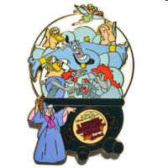
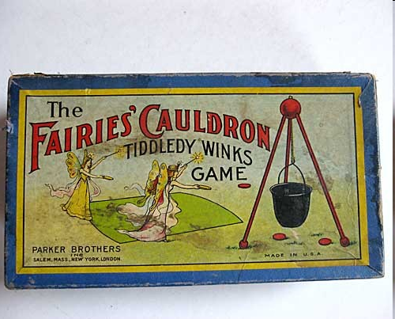
Smoothing as Optimization
There are more principled smoothing methods, too. We’ll look next at log-linear models, which are a good and popular general technique.
600.465 - Intro to NLP - J. Eisner

Slide 41
Conditional Modeling
Given a context x
Which outcomes y are likely in that context?
We need a conditional distribution p(y | x)
  A black-box function that we call on x, y
  p(NextWord=y | PrecedingWords=x)
    y is a unigram
    x is an (n-1)-gram
  p(Category=y | Text=x)
    y ∈ {personal email, work email, spam email}
    x ∈ ∑* (it’s a string: the text of the email)
Remember: p can be any function over (x,y)!
  Provided that p(y | x) ≥ 0, and ∑_{y} p(y | x) = 1
600.465 - Intro to NLP - J. Eisner

Slide 42
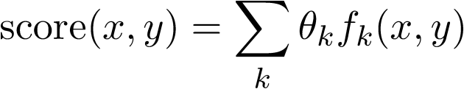
Linear Scoring
We need a conditional distribution p(y | x)
Convert our linear scoring function to this distribution p
  Require that p(y | x) ≥ 0, and ∑_{y} p(y | x) = 1; not true of score(x,y)
How well does y go with x?
Simplest option: a linear function of (x,y). But (x,y) isn’t a number.
So describe it by one or more numbers:“numeric features” that you pick.
Then just use a linear function of those numbers.
Weight of feature k
To be learned …
Ranges over all features,
e.g., k=5 (numbered features)
or k=“see Det Noun” (named features)
Whether (x,y) has feature k(0 or 1)
Or how many times it fires (≥ 0)
Or how strongly it fires (real #)

Slide 43
What features should we use?
Weight of feature k
To be learned …
  p(NextWord=y | PrecedingWords=x)
    y is a unigram
    x is an (n-1)-gram
  p(Category=y | Text=x)
    y ∈ {personal email, work email, spam email}
    x ∈ ∑* (it’s a string: the text of the email)
Ranges over all features,
e.g., k=5 (numbered features)
or k=“see Det Noun” (named features)
Whether (x,y) has feature k (0 or 1)
Or how many times it fires (≥ 0)
Or how strongly it fires (real #)

Slide 44
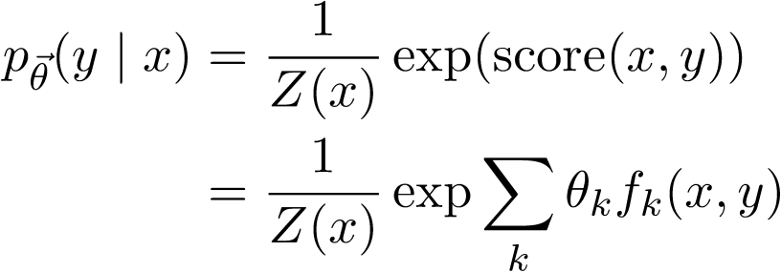

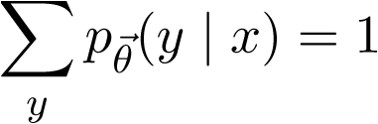
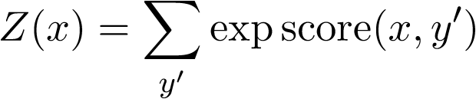
Log-Linear Conditional Probability
(interpret score as a log-prob, up to a constant)
unnormalized
prob (at least
it’s positive!)
where we choose Z(x) to ensure that
thus,
sum of unnormalized
probabilities of all the
output candidates y’
Sometimes just written as Z
600.465 - Intro to NLP - J. Eisner

Slide 45


Training θ
This version is “discriminative training”:
to learn to predict y from x, maximize p(y|x).
Whereas “joint training” learns
to model x, too, by maximizing p(x,y).
n training examples
feature functions f₁, f₂, …
Want to maximize p(training data|θ)
Easier to maximize the log of that:
Alas, some weights θ_{i} may be optimal at -∞ or +∞.
When would this happen? What’s going “wrong”?

Slide 46
Training θ
This version is “discriminative training”:
to learn to predict y from x, maximize p(y|x).
Whereas “joint training” learns
to model x, too, by maximizing p(x,y).
n training examples
feature functions f₁, f₂, …
Want to maximize p(training data|θ) ⋅ p_{prior}(θ)
Easier to maximize the log of that:
Encourages weights close to 0: “L2 regularization” (other choices possible)
Corresponds to a Gaussian prior, since Gaussian bell curve is just exp(quadratic).

Slide 47
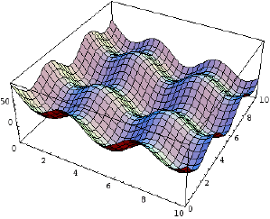
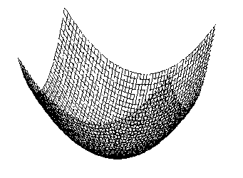
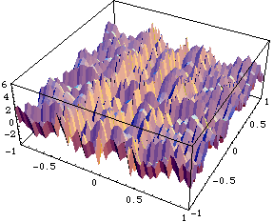
Gradient-based training
Gradually adjust θ in a direction that increases this
For this, use your favorite function maximization algorithm.
  gradient descent, conjugate gradient, variable metric,etc.
    (Go take an optimization course: 550.{361,661,662}.)
    (Or just download some software!)
nasty non-differentiable cost function with local minima
nice smooth and convex cost function: pick one of these

Slide 48
Gradient-based training
Gradually adjust θ in a direction that improves this
Gradient ascent to gradually increase f(θ):
while (∇f(θ) ≠ 0) // not at a local max or min
  θ = θ + ∈⋅∇f(θ) // for some small ∈ > 0
Remember: ∇f(θ) = (∂f(θ)/∂θ₁, ∂f(θ)/∂θ₂, …)
So update just means: θ_{k} += ∂f(θ)/∂θ_{k}
This takes a little step “uphill”
(direction of steepest increase).
This is why you took calculus. ☺

Slide 49
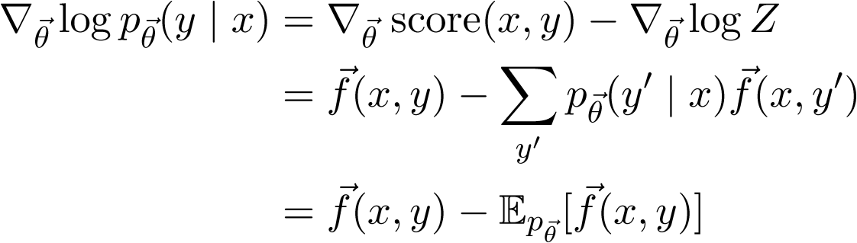
Gradient-based training
Gradually adjust θ in a direction that improves this
  The key part of the gradient works out as …

Slide 50
Maximum Entropy
Suppose there are 10 classes, A through J.
I don’t give you any other information.
Question: Given message m: what is your guess for p(C | m)?
Suppose I tell you that 55% of all messages are in class A.
Question: Now what is your guess for p(C | m)?
Suppose I also tell you that 10% of all messages contain Buy and 80% of these are in class A or C.
Question: Now what is your guess for p(C | m),
if m contains Buy?
OUCH!
600.465 - Intro to NLP - J. Eisner

Slide 51
Maximum Entropy
 | A | B | C | D | E | F | G | H | I | J
Buy | .051 | .0025 | .029 | .0025 | .0025 | .0025 | .0025 | .0025 | .0025 | .0025
Other | .499 | .0446 | .0446 | .0446 | .0446 | .0446 | .0446 | .0446 | .0446 | .0446
Column A sums to 0.55 (“55% of all messages are in class A”)
600.465 - Intro to NLP - J. Eisner

Slide 52
Maximum Entropy
 | A | B | C | D | E | F | G | H | I | J
Buy | .051 | .0025 | .029 | .0025 | .0025 | .0025 | .0025 | .0025 | .0025 | .0025
Other | .499 | .0446 | .0446 | .0446 | .0446 | .0446 | .0446 | .0446 | .0446 | .0446
Column A sums to 0.55
Row Buy sums to 0.1 (“10% of all messages contain Buy”)
600.465 - Intro to NLP - J. Eisner

Slide 53
Maximum Entropy
 | A | B | C | D | E | F | G | H | I | J
Buy | .051 | .0025 | .029 | .0025 | .0025 | .0025 | .0025 | .0025 | .0025 | .0025
Other | .499 | .0446 | .0446 | .0446 | .0446 | .0446 | .0446 | .0446 | .0446 | .0446
Column A sums to 0.55
Row Buy sums to 0.1
(Buy, A) and (Buy, C) cells sum to 0.08 (“80% of the 10%”)
Given these constraints, fill in cells “as equally as possible”: maximize the entropy (related to cross-entropy, perplexity)
Entropy = -.051 log .051 - .0025 log .0025 - .029 log .029 - …
Largest if probabilities are evenly distributed
600.465 - Intro to NLP - J. Eisner

Slide 54
Maximum Entropy
 | A | B | C | D | E | F | G | H | I | J
Buy | .051 | .0025 | .029 | .0025 | .0025 | .0025 | .0025 | .0025 | .0025 | .0025
Other | .499 | .0446 | .0446 | .0446 | .0446 | .0446 | .0446 | .0446 | .0446 | .0446
Column A sums to 0.55
Row Buy sums to 0.1
(Buy, A) and (Buy, C) cells sum to 0.08 (“80% of the 10%”)
Given these constraints, fill in cells “as equally as possible”: maximize the entropy
Now p(Buy, C) = .029 and p(C | Buy) = .29
We got a compromise: p(C | Buy) < p(A | Buy) < .55
600.465 - Intro to NLP - J. Eisner

Slide 55
Maximum Entropy
 | A | B | C | D | E | F | G | H | I | J
Buy | .051 | .0025 | .029 | .0025 | .0025 | .0025 | .0025 | .0025 | .0025 | .0025
Other | .499 | .0446 | .0446 | .0446 | .0446 | .0446 | .0446 | .0446 | .0446 | .0446
Given these constraints, fill in cells “as equally as possible”: maximize the entropy
Now p(Buy, C) = .029 and p(C | Buy) = .29
We got a compromise: p(C | Buy) < p(A | Buy) < .55
Punchline: This is exactly the maximum-likelihood log-linear distribution p(y) that uses 3 binary feature functions that ask: Is y in column A? Is y in row Buy? Is y one of the yellow cells? So, find it by gradient ascent.
600.465 - Intro to NLP - J. Eisner

