Slide 1
It’s All About High-Probability Paths in Graphs
Airport Travel
Hidden Markov Models
Parsing (if you generalize)
Edit Distance
Finite-State Machines (regular languages)
Computational Linguistics - Jason Eisner

Slide 2
HMM trellis: Graph with 2³³ ≈ 8 billion paths yet small: only 2*33 + 2 = 68 states and 2*67 = 134 edges
Day 1: 2 cones
Day 2: 3 cones
Day 3: 3 cones
C
p(C|C)*p(3|C)
C
p(C|C)*p(3|C)
…
p(C|Start)*p(2|C)
C
Start
p(H|C)*p(3|H)
p(C|H)*p(3|C)
p(H|C)*p(3|H)
p(C|H)*p(3|C)
p(H|Start)*p(2|H)
H
p(H|H)*p(3|H)
H
p(H|H)*p(3|H)
H
Day 32: 2 cones
Day 33: 2 cones
Day 34: lose diary
…
C
p(C|C)*p(2|C)
C
p(C|C)*p(2|C)
C
p(Stop|C)
p(C|H)*p(2|C)
p(H|C)*p(2|H)
p(C|H)*p(2|C)
p(H|C)*p(2|H)
Stop
p(Stop|H)
H
p(H|H)*p(2|H)
H
p(H|H)*p(2|H)
H
We don’t know the correct path
But we know how likely each path is (a posteriori )
  At least according to our current model …
So which is the most likely path?
Computational Linguistics - Jason Eisner

Slide 3
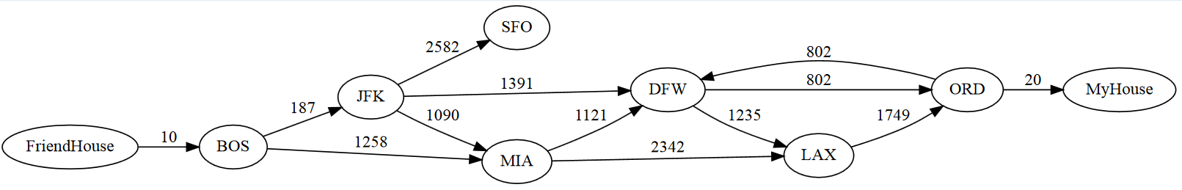
Finding the Minimum-Cost Path
(a.k.a. the “shortest path problem”)
This is a classic problem in graph algorithms.
How many paths from FriendHouse to MyHouse?
How many miles is the longest such path?
How many miles is the shortest such path? Impossible to compute?
What is the shortest such path?
Airports, miles
∞ (cycles)
∞ (cycles)
2410
FriendHouse → BOS → JFK → DFW → ORD → MyHouse
example from Goodrich & Tamassia

Slide 4
Minimum-Cost Path (in Dyna)
  path_to(start) min= 0.
  path_to(B) min= path_to(A) + edge(A,B).
  goal min= path_to(end).

Slide 5
Understanding the Central Rule
The shortest path from start to state B
must first go to some previous state A
and then on to B, so the total cost is
  path_to(B) min= path_to(A) + edge(A,B).
e.g., path_to(“DFW”)
path_to(“MIA”)
+ edge(“MIA”, “DFW”) = 1268 + 1121 = 2389
is defined to be 1588
path_to(“JFK”)
…
+ edge(“JFK”, “DFW”) = 197 + 1391 = 1588
…
but there may be many choices of A, so choose the minimum of all such possibilities.
the cost of the shortest path from start to A
plus one extra edge.

Slide 6
Minimum-Cost Path (in Dyna)
We take min=
over all paths:
Length 0 paths
from start to B
(must have B==start)
  path_to(B) min= 0 for B==start.
“Can get to start for free” (just stay put!)
Length > 0 paths from start to B (must have a next-to-last state A)
  path_to(B) min= path_to(A) + edge(A,B).
“Can get to B by going to a previous state A + paying for A→B edge”
  goal min= path_to(end).
  % or use = instead of min=
“In particular, here’s how much it costs to get to end”
(Note: goal has no value if there’s no way to get to end)
  start := “FriendHouse”.
  end := “MyHouse”.

Slide 7
Minimum-Cost Path (in Dyna)
  path_to(start) min= 0.
  path_to(B) min= path_to(A) + edge(A,B).
  goal min= path_to(end).
Note: This runs fine in Dyna.
  But if you want to write a procedural algorithm instead of a declarative specification, you can use Dijkstra’s algorithm.
  Dyna is doing something like that internally for this program.
  If the graph has no cycles, you can use a simpler algorithm, which visits the vertices “in order.” So, compute path_to(B) only after computing path_to(A) for all states A such that edge(A,B) is defined.

Slide 8
How to find the min-cost path itself?
  path_to(start) min= 0.
  path_to(B) min= path_to(A) + edge(A,B).
with_key A.
Store a backpointer from “DTW” back to “JFK”
Remembers that path_to(“DTW”) got its min value when A was “JFK”
We’ll define $key(path_to(“DTW”)) to be “JFK”
  Automatic definition using the “with_key” construction
  Lets us store information in $key(…) about how the minimum was achieved

Slide 9
How to find the min-cost path itself?
  path_to(start) min= 0.
  path_to(B) min= path_to(A) + edge(A,B).
  bestpath(B) = [B | bestpath($key(path_to(B)))].
with_key []. % base case used by bestpath(start)
with_key A.
Now we can trace backpointers from any B back to start
  bestpath(“FriendHouse”) = [“FriendHouse”]
  bestpath(“BOS”) = [“BOS”, “FriendHouse”]
  bestpath(“JFK”) = [“JFK”, “BOS”, “FriendHouse”]
  bestpath(“DFW”) = [“DFW”, “JFK”, “BOS”, “FriendHouse”]
  = [“DFW” | bestpath(“JFK”)]
  prepends “DFW” to [“JFK”, “BOS”, ...]
  = [“DFW” | bestpath($key(path_to(“DFW”)))]

Slide 10
How to find the min-cost path itself?
  path_to(start) min= 0.
  path_to(B) min= path_to(A) + edge(A,B).
  bestpath(B) = [B | bestpath($key(path_to(B)))].
  goal min= path_to(end).
  optimal_path = bestpath(end).
with_key []. % base case used by bestpath(start)
with_key A.

Slide 11
How to find the min-cost path itself?
  path_to(start) min= 0.
  path_to(B) min= path_to(A) + edge(A,B).
  bestpath(B) = [B | bestpath($key(path_to(B)))].
  goal min= path_to(end).
  optimal_path = bestpath(end).
with_key [].
with_key A.
Or key can be whole path back from B (not just the 1 preceding state A).
  path_to(start) min= 0 with_key [start].
  path_to(B) min= path_to(A) + edge(A,B)
  with_key [B | $key(path_to(A))].
  goal min= path_to(end).
  optimal_path = $key(path_to(end)).

Slide 12
Defining the Input Graph
  path_to(start) min= 0.
  path_to(B) min= path_to(A) + edge(A,B).
  goal min= path_to(end).
We need a graph with weights on the edges:
What if there are multiple edges from A to B?
  Pick the shortest: For example, define edge(A,B) using min=.
  start := “FriendHouse”.
  end := “MyHouse”.
  edge(“BOS”, “JFK”) := 187.
  edge(“BOS”, “MIA”) := 1258.
  edge(“JFK”, “DFW”) := 1391.
  edge(“JFK”, “SFO”) := 2582.
  …

Slide 13
Defining the Input Graph
  path_to(start) min= 0.
  path_to(B) min= path_to(A) + edge(A,B).
  goal min= path_to(end).
We could define distances between airports by rule!
Euclidean distance formula (assuming flat earth):
  dist( &point(X,Y) , &point(X2,Y2) ) = sqrt((X-X2)**2 + (Y-Y2)**2).
  edge(A,B) = dist( loc(A) , loc(B) ).
for has_flight(A,B).
  loc(“BOS”) = &point(2927, -3767).
  loc(“JFK”) = &point(2808, -3914).
  loc(“MIA”) = &point(1782, -4260).
  …
  has_flight(“BOS”, “JFK”).
  has_flight(“JFK”, “MIA”).
  has_flight(“BOS”, “MIA”).
  …
In Dyna, the value of &point(X,Y) is just point(X,Y) itself: a location.
If we wrote point(X,Y), Dyna would want rules defining the point function.

Slide 14
Edit Distance
Baby actually said caca
Baby was probably thinking clara (?)
Do these match up well? How well?
clara
clar a
clara
clara
caca
c a ca
c aca
caca
3 substitutions
+ 1 deletion
= total cost 4
2 deletions
+ 1 insertion
= total cost 3
1 deletion
+ 1 substitution
= total cost 2
5 deletions
+ 4 insertions
= total cost 9
minimum edit distance
(best alignment)

Slide 15
Edit distance as min-cost path
position in upper string
0 1 2 3 4 5
0 1 2 3 4 5
c l a r a
c:ε
l:ε
a:ε
r:ε
a:ε
0
1
2
3
4
?
a:c
c:c
l:c
a:c
r:c
c a c a
ε:c
ε:c
ε:c
ε:c
ε:c
ε:c
0 1 2 3 4
c:ε
l:ε
a:ε
r:ε
a:ε
c:a
l:a
a:a
r:a
a:a
ε:a
ε:a
ε:a
ε:a
ε:a
ε:a
c:ε
l:ε
a:ε
r:ε
a:ε
Minimum-cost path shows the best alignment,
and its cost is the edit distance
position in lower string
c:c
l:c
a:c
r:c
a:c
ε:c
ε:c
ε:c
ε:c
ε:c
ε:c
c:ε
l:ε
a:ε
r:ε
a:ε
c:a
l:a
a:a
r:a
a:a
ε:a
ε:a
ε:a
ε:a
ε:a
ε:a
c:ε
l:ε
a:ε
r:ε
a:ε
600.465 - Intro to NLP - J. Eisner

Slide 16
Edit distance as min-cost path
position in upper string
0 1
0 1 2 3 4 5
0 1 2
0 1 2 3
0 1 2 3 4
0 1 2 3 4 5
0
c l
c l a
c l a r
c l a r a
c
c:ε
l:ε
a:ε
r:ε
a:ε
0
1
2
3
4
c:c
l:c
a:c
r:c
a:c
c a c a
c a
c a c
c
ε:c
ε:c
ε:c
ε:c
ε:c
ε:c
0 1
0 1 2
0 1 2 3
0 1 2 3 4
0
c:ε
l:ε
a:ε
r:ε
a:ε
c:a
l:a
a:a
r:a
a:a
ε:a
ε:a
ε:a
ε:a
ε:a
ε:a
c:ε
l:ε
a:ε
r:ε
a:ε
Minimum-cost path shows the best alignment,
and its cost is the edit distance
position in lower string
c:c
l:c
a:c
r:c
a:c
ε:c
ε:c
ε:c
ε:c
ε:c
ε:c
c:ε
l:ε
a:ε
r:ε
a:ε
c:a
l:a
a:a
r:a
a:a
ε:a
ε:a
ε:a
ε:a
ε:a
ε:a
c:ε
l:ε
a:ε
r:ε
a:ε
600.465 - Intro to NLP - J. Eisner

Slide 17
Edit distance as min-cost path
position in upper string
0 1 2 3 4 5
c:ε
l:ε
a:ε
r:ε
a:ε
0
1
2
3
4
A deletion edge
has cost 1
It advances in the upper string only, so it’s horizontal
It pairs the next letter of the upper string with ε (empty) in the lower string
c:ε
l:ε
a:ε
r:ε
a:ε
c:ε
l:ε
a:ε
r:ε
a:ε
position in lower string
c:ε
l:ε
a:ε
r:ε
a:ε
c:ε
l:ε
a:ε
r:ε
a:ε
600.465 - Intro to NLP - J. Eisner

Slide 18
Edit distance as min-cost path
position in upper string
0 1 2 3 4 5
0
1
2
3
4
An insertion edge
has cost 1
It advances in the lower string only, so it’s vertical
It pairs ε (empty) in the upper string with the next letter of the lower string
ε:c
ε:c
ε:c
ε:c
ε:c
ε:c
ε:a
ε:a
ε:a
ε:a
ε:a
ε:a
position in lower string
ε:c
ε:c
ε:c
ε:c
ε:c
ε:c
ε:a
ε:a
ε:a
ε:a
ε:a
ε:a
600.465 - Intro to NLP - J. Eisner

Slide 19
Edit distance as min-cost path
position in upper string
A substitution edge
has cost 0 or 1
It advances in the upper and lower strings simultaneously,
so it’s diagonal
It pairs the next letter of the upper string with the next letter of the lower string
Cost is 0 or 1 depending on whether those letters are identical!
0 1 2 3 4 5
0
1
2
3
4
c:c
l:c
a:c
r:c
a:c
c:a
l:a
a:a
r:a
a:a
position in lower string
c:c
l:c
a:c
r:c
a:c
c:a
l:a
a:a
r:a
a:a
600.465 - Intro to NLP - J. Eisner

Slide 20
Edit distance as min-cost path
position in upper string
0 1 2 3 4 5
We’re looking for a path from upper left to lower right
(so as to get through both strings)
Solid edges have
cost 0, dashed edges have cost 1
So we want the path with the fewest dashed edges
c:ε
l:ε
a:ε
r:ε
a:ε
0
1
2
3
4
c:c
l:c
a:c
r:c
a:c
ε:c
ε:c
ε:c
ε:c
ε:c
ε:c
c:ε
l:ε
a:ε
r:ε
a:ε
c:a
l:a
a:a
r:a
a:a
ε:a
ε:a
ε:a
ε:a
ε:a
ε:a
c:ε
l:ε
a:ε
r:ε
a:ε
position in lower string
c:c
l:c
a:c
r:c
a:c
ε:c
ε:c
ε:c
ε:c
ε:c
ε:c
c:ε
l:ε
a:ε
r:ε
a:ε
c:a
l:a
a:a
r:a
a:a
ε:a
ε:a
ε:a
ε:a
ε:a
ε:a
c:ε
l:ε
a:ε
r:ε
a:ε
600.465 - Intro to NLP - J. Eisner

Slide 21
Edit distance as min-cost path
position in upper string
0 1 2 3 4 5
c:ε
l:ε
a:ε
r:ε
a:ε
0
1
2
3
4
c:c
l:c
a:c
r:c
a:c
clara
ε:c
ε:c
ε:c
ε:c
ε:c
ε:c
c:ε
l:ε
a:ε
r:ε
a:ε
caca
c:a
l:a
a:a
r:a
a:a
3 substitutions
+ 1 deletion
= total cost 4
ε:a
ε:a
ε:a
ε:a
ε:a
ε:a
c:ε
l:ε
a:ε
r:ε
a:ε
position in lower string
c:c
l:c
a:c
r:c
a:c
ε:c
ε:c
ε:c
ε:c
ε:c
ε:c
c:ε
l:ε
a:ε
r:ε
a:ε
c:a
l:a
a:a
r:a
a:a
ε:a
ε:a
ε:a
ε:a
ε:a
ε:a
c:ε
l:ε
a:ε
r:ε
a:ε
600.465 - Intro to NLP - J. Eisner

Slide 22
Edit distance as min-cost path
position in upper string
0 1 2 3 4 5
c:ε
l:ε
a:ε
r:ε
a:ε
0
1
2
3
4
c:c
l:c
a:c
r:c
a:c
clar a
ε:c
ε:c
ε:c
ε:c
ε:c
ε:c
c:ε
l:ε
a:ε
r:ε
a:ε
c a ca
c:a
l:a
a:a
r:a
a:a
2 deletions
+ 1 insertion
= total cost 3
ε:a
ε:a
ε:a
ε:a
ε:a
ε:a
c:ε
l:ε
a:ε
r:ε
a:ε
position in lower string
c:c
l:c
a:c
r:c
a:c
ε:c
ε:c
ε:c
ε:c
ε:c
ε:c
c:ε
l:ε
a:ε
r:ε
a:ε
c:a
l:a
a:a
r:a
a:a
ε:a
ε:a
ε:a
ε:a
ε:a
ε:a
c:ε
l:ε
a:ε
r:ε
a:ε
600.465 - Intro to NLP - J. Eisner

Slide 23
Edit distance as min-cost path
position in upper string
0 1 2 3 4 5
c:ε
l:ε
a:ε
r:ε
a:ε
0
1
2
3
4
c:c
l:c
a:c
r:c
a:c
clara
ε:c
ε:c
ε:c
ε:c
ε:c
ε:c
c:ε
l:ε
a:ε
r:ε
a:ε
c aca
c:a
l:a
a:a
r:a
a:a
1 deletion
+ 1 substitution
= total cost 2
ε:a
ε:a
ε:a
ε:a
ε:a
ε:a
c:ε
l:ε
a:ε
r:ε
a:ε
position in lower string
c:c
l:c
a:c
r:c
a:c
ε:c
ε:c
ε:c
ε:c
ε:c
ε:c
c:ε
l:ε
a:ε
r:ε
a:ε
c:a
l:a
a:a
r:a
a:a
ε:a
ε:a
ε:a
ε:a
ε:a
ε:a
c:ε
l:ε
a:ε
r:ε
a:ε
600.465 - Intro to NLP - J. Eisner

Slide 24
Edit distance as min-cost path
position in upper string
0 1 2 3 4 5
c:ε
l:ε
a:ε
r:ε
a:ε
0
1
2
3
4
c:c
l:c
a:c
r:c
a:c
clara
ε:c
ε:c
ε:c
ε:c
ε:c
ε:c
c:ε
l:ε
a:ε
r:ε
a:ε
caca
c:a
l:a
a:a
r:a
a:a
5 deletions
+ 4 insertions
= total cost 9
ε:a
ε:a
ε:a
ε:a
ε:a
ε:a
c:ε
l:ε
a:ε
r:ε
a:ε
position in lower string
c:c
l:c
a:c
r:c
a:c
ε:c
ε:c
ε:c
ε:c
ε:c
ε:c
c:ε
l:ε
a:ε
r:ε
a:ε
c:a
l:a
a:a
r:a
a:a
ε:a
ε:a
ε:a
ε:a
ε:a
ε:a
c:ε
l:ε
a:ε
r:ε
a:ε
600.465 - Intro to NLP - J. Eisner

Slide 25
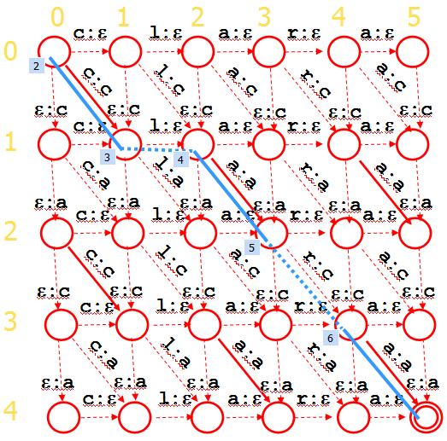
Edit distance as min-cost path
Again, we have to define the graph by rule:
  start = &state(0,0). end= &state(upper_length, lower_length).
  edge( &state(U-1, L-1) , &state(U, L) ) = subst_cost( upper(U), lower(L) ).
  edge( &state(U, L-1) , &state(U, L) ) = ins_cost( lower(L) ).
  edge( &state(U-1, L) , &state(U, L) ) = del_cost( upper(U) ).
Upper string:
Lower string:
  upper(1) := “c”.
  upper(2) := “l”.
  upper(3) := “a”.
  …
  upper_length := 5.
  lower(1) := “c”.
  lower(2) := “a”.
  lower(3) := “c”.
  lower(4) := “a”.
  lower_length := 4.
In Dyna, the value of &state(U,L) is state(U,L) itself: a compound name.
If we wrote state(U,L), Dyna would want rules defining the state function.

Slide 26
We’ve seen lots of “min-cost path” problems
Same algorithm in all cases, just different graphs
  And you can run other useful algorithms on those graphs too
Airports
Edit distance
Parsing
  Parsing is actually a little more general.
  Still a dynamic programming problem. Still uses min= in Dyna.
  We need a “hypergraph” with hyperedges like “S” → [“NP”, “VP”].
  Find a “hyperpath” from the start state (“START” nonterminal)
  to the end state (the collection of all input words).
Viterbi tagging in an HMM
  Ice cream → weather
  Words → part of speech tags

Slide 27
HMM trellis: Graph with 2³³ ≈ 8 billion paths yet small: only 2*33 + 2 = 68 states and 2*67 = 134 edges
Day 1: 2 cones
Day 2: 3 cones
Day 3: 3 cones
C
p(C|C)*p(3|C)
C
p(C|C)*p(3|C)
…
p(C|Start)*p(2|C)
C
Start
p(H|C)*p(3|H)
p(C|H)*p(3|C)
p(H|C)*p(3|H)
p(C|H)*p(3|C)
p(H|Start)*p(2|H)
H
p(H|H)*p(3|H)
H
p(H|H)*p(3|H)
H
Day 32: 2 cones
Day 33: 2 cones
Day 34: lose diary
…
C
p(C|C)*p(2|C)
C
p(C|C)*p(2|C)
C
p(Stop|C)
p(C|H)*p(2|C)
p(H|C)*p(2|H)
p(C|H)*p(2|C)
p(H|C)*p(2|H)
Stop
p(Stop|H)
H
p(H|H)*p(2|H)
H
p(H|H)*p(2|H)
H
Paths are different ways that we could explain the observed evidence
Which is the most likely path? (according to our current model)
Computational Linguistics - Jason Eisner

Slide 28
Max-Probability Path in an HMM
To extract the actual path, use with_key and follow backpointers.
This is called the Viterbi algorithm.
  path_to(start) max= 1.
  path_to(B) max= path_to(A) * edge(A,B).
  goal max= path_to(end).
Finds the max-prob path instead of the min-cost path.
Again, we have to define the graph by rule:
  edge( &state(Time-1, PrevTag) , &state(Time, Tag) )
  = p_transition(PrevTag, Tag) * p_emission(Tag, word(Time)).
e.g., edge( &state(“C”,1) , &state(“H”,2) )
= p_transition(“C”, “H”) * p_emission(“H”, word(2))
Day 1: 2 cones
Day 2: 3 cones
C
p(C|C)*p(3|C)
C
p(C|Start)*p(2|C)
  start = &state(0, &start_tag).
  end = state(length+1, &end_tag).
p(H|C)*p(3|H)
p(C|H)*p(3|C)
Start
p(H|C)*p(3|H)
p(H|Start)*p(2|H)
H
p(H|H)*p(3|H)
H
In Dyna, the value of &state(Time,Tag) is just state(Time,Tag) itself.
Similarly, &start_tag, &end_tag, &eos are just symbols, not items.

Slide 29
Max-Probability Path in an HMM
Initial model:
Input sentence:
  p_emission(“H”, “3”) := 0.7. …
  p_transition(“C”, “H”) := 0.1. …
  p_transition(&start_tag, “C”) := 0.5. …
  p_emission(&end_tag, &eos) := 1. …
  word(1) := “2”.
  word(2) := “3”.
  word(3) := “3”.
  …
  length := 33.
  word(length+1)
  := &eos.
Again, we have to define the graph by rule:
  edge( &state(Time-1, PrevTag) , &state(Time, Tag) )
  = p_transition(PrevTag, Tag) * p_emission(Tag, word(Time)).
e.g., edge( &state(“C”,1) , &state(“H”,2) )
= p_transition(“C”, “H”) * p_emission(“H”, word(2))
Day 1: 2 cones
Day 2: 3 cones
C
p(C|C)*p(3|C)
C
p(C|Start)*p(2|C)
  start = &state(0, &start_tag).
  end = state(length+1, &end_tag).
p(H|C)*p(3|H)
p(C|H)*p(3|C)
Start
p(H|C)*p(3|H)
p(H|Start)*p(2|H)
H
p(H|H)*p(3|H)
H
In Dyna, the value of &state(Time,Tag) is just state(Time,Tag) itself.
Similarly, &start_tag, &end_tag, &eos are just symbols, not items.

Slide 30
Max-Probability Path in an HMM
Initial model:
Input sentence:
  p_emission(“PlNoun”, “horses”) := 0.0013. …
  p_transition(“PlNoun”, “Conj”) := 0.075. …
  p_transition(&start_tag, “PlNoun”) := 0.19. …
  p_emission(&end_tag, &eos) := 1. …
  word(1) := “horses”.
  word(2) := “and”.
  word(3) := “Lukasiewicz”.
  …
Again, we have to define the graph by rule:
  edge( &state(Time-1, PrevTag) , &state(Time, Tag) )
  = p_transition(PrevTag, Tag) * p_emission(Tag, word(Time)).
e.g., edge( &state(“C”,1) , &state(“H”,2) )
= p_transition(“C”, “H”) * p_emission(“H”, word(2))
Day 1: 2 cones
Day 2: 3 cones
C
p(C|C)*p(3|C)
C
p(C|Start)*p(2|C)
  start = &state(0, &start_tag).
  end = state(length+1, &end_tag).
p(H|C)*p(3|H)
p(C|H)*p(3|C)
Start
p(H|C)*p(3|H)
p(H|Start)*p(2|H)
H
p(H|H)*p(3|H)
H
In Dyna, the value of &state(Time,Tag) is just state(Time,Tag) itself.
Similarly, &start_tag, &end_tag, &eos are just symbols, not items.

Slide 31
Viterbi tagging
Paths that explain our 2-word input sentence:
  Det Adj 0.35
  Det N 0.2
  N V 0.45
Most probable path gives the single best tag sequence:
  N V 0.45
Find it by following backpointers
But for a long sentence with many ambiguous words,
there might be a gazillion paths to explain it
  So even best path might have prob 0.00000000000002
  Do we really trust it to be the right answer?
600.465 - Intro to NLP - J. Eisner
600.465 - Intro to NLP - J. Eisner

Slide 32
HMM trellis: Graph with 2³³ ≈ 8 billion paths yet small: only 2*33 + 2 = 68 states and 2*67 = 134 edges
Day 1: 2 cones
Day 2: 3 cones
Day 3: 3 cones
…
Day 32: 2 cones
Day 33: 2 cones
lose diary
C
p(C|C)*p(3|C)
C
p(C|C)*p(3|C)
C
C
p(C|C)*p(2|C)
C
p(C|C)*p(2|C)
C
p(Stop|C)
p(C|Start)*p(2|C)
Start
p(H|C)*p(3|H)
p(C|H)*p(3|C)
p(H|C)*p(3|H)
p(C|H)*p(3|C)
p(C|H)*p(2|C)
p(H|C)*p(2|H)
p(C|H)*p(2|C)
p(H|C)*p(2|H)
Stop
p(H|Start)*p(2|H)
p(Stop|H)
H
p(H|H)*p(3|H)
H
p(H|H)*p(3|H)
H
H
p(H|H)*p(2|H)
H
p(H|H)*p(2|H)
H
We know how likely each path is (a posteriori )
  At least according to our current model …
Don’t just find the single best path (“Viterbi path”).
If we chose random paths from the posterior distribution, which states and edges would we usually see?
  That is, which states and edges are probably correct –
  according to model?
600.465 - Intro to NLP - J. Eisner

Slide 33
Alternative to Viterbi tagging: Posterior tagging
Give each word the tag that’s most probable in context.
  Det Adj 0.35
  Det N 0.2
  N V 0.45
Output is
  Det V 0
Defensible: maximizes expected # of correct tags.
But not a coherent sequence. May screw up subsequent processing (e.g., can’t find any parse).
How do we compute highest-prob tag for each word?
  Forward-backward algorithm!
← exp # correct tags = 0.55+0.35 = 0.9
← exp # correct tags = 0.55+0.2 = 0.75
← exp # correct tags = 0.45+0.45 = 0.9
← exp # correct tags = 0.55+0.45 = 1.0
600.465 - Intro to NLP - J. Eisner
600.465 - Intro to NLP - J. Eisner

Slide 34
Remember Forward-Backward Algorithm
All paths to state:
α = (ap₁ + bp₁ + cp₁)
+ (dp₂ + ep₂ + fp₂)
a
All paths from state:
β = (p₃u + p₃v + p₃w)
+ (p₄x + p₄y + p₄z)
α₁
b
p₃
u
c
C
p₁
v
β₃
C
C
w
α
p₄
d
p₂
β
= α₁⋅p₁ + α₂⋅p₂
H
H
x
= p₃⋅β₃ + p₄⋅β₄
α₂
e
H
f
y
β₄
z
All paths through state:
ax + ay + az
+ bx + by + bz
+ cx + cy + cz
a
x
α
b
y
= (a+b+c)⋅(x+y+z)
= α(C) ⋅ β(C)
β
c
C
z
All paths through edge:
apx + apy + apz
+ bpx + bpy + bpz
+ cpx + cpy + cpz
x
y
β
C
z
p
a
= (a+b+c)⋅p⋅(x+y+z)
= α(H) ⋅ p ⋅ β(C)
α
b
c
H

Slide 35
Forward-Backward Algorithm in Dyna
Most probable path from start to each B:
  path_to(start) max= 1.
  path_to(B) max= path_to(A) * edge(A,B).
  goal max= path_to(end). % max of all complete paths

Slide 36
Forward-Backward Algorithm in Dyna
Total probability of all paths from start to each B:
Total probability of all paths from each A to end:
Total prob of paths through state B or edge A→B:
  alpha(start) += 1.
  alpha(B) += alpha(A) * edge(A,B).
  z += alpha(end). % total of all complete paths
  beta(end) += 1.
  beta(A) += edge(A,B) * beta(B).
  z_another_way += beta(start). % total of all complete paths
  alphabeta(B) = alpha(B) * beta(B).
  alphabeta(A,B) = alpha(A) * edge(A,B) * beta(B).

Slide 37
Forward-Backward Algorithm in Dyna
Total probability of all paths from start to each B:
Total probability of all paths from each A to end:
Total posterior prob of paths through state B or edge A→B
(i.e., what fraction of paths go through B or A→B?):
  alpha(start) += 1.
  alpha(B) += alpha(A) * edge(A,B).
  z += alpha(end). % total of all complete paths
  beta(end) += 1.
  beta(A) += edge(A,B) * beta(B).
  z_another_way += beta(start). % total of all complete paths
use for posterior tagging
  p_posterior(B) = alpha(B) * beta(B) / z.
  p_posterior(A,B) = alpha(A) * edge(A,B) * beta(B) / z.

Slide 38
Forward Algorithm
Total probability of all paths from start to each B:
z is now the probability of the evidence
(total probability of all ways of generating the evidence):
p(word sequence) or p(ice cream sequence)
We can apply the same idea to other noisy channels …
  alpha(start) += 1.
  alpha(B) += alpha(A) * edge(A,B).
  z += alpha(end). % total of all complete paths

Slide 39
Forward algorithm applied to edit distance
Baby was thinking clara? Or something else?
It went through noisy channel and came out as caca
To reconstruct underlying form, use Bayes’ Theorem!
Assume we have prior p(clara)
What z tells us is p(caca | clara) …
  … if we define edge weights to be probs
  of the insertions, deletions, or substitutions
  on those specific edges – e.g., p(ε | l), p(c | r)
  So each path describes a sequence of
  edits that might happen given clara
  The paths in our graph are all edit seqs
  yielding caca; we’re summing their probs
  alpha(start) += 1.
  alpha(B) += alpha(A) * edge(A,B).
  z += alpha(end). % total of all complete paths
c:ε
l:ε
a:ε
r:ε
a:ε
c:c
l:c
a:c
r:c
a:c
ε:c
c:ε
ε:c
l:ε
ε:c
a:ε
ε:c
r:ε
ε:c
a:ε
ε:c
c:a
l:a
a:a
r:a
a:a
ε:a
c:ε
ε:a
l:ε
ε:a
a:ε
ε:a
r:ε
ε:a
a:ε
ε:a
c:c
l:c
a:c
r:c
a:c
ε:c
c:ε
ε:c
l:ε
ε:c
a:ε
ε:c
r:ε
ε:c
a:ε
ε:c
c:a
l:a
a:a
r:a
a:a
ε:a
c:ε
ε:a
l:ε
ε:a
a:ε
ε:a
r:ε
ε:a
a:ε
ε:a
600.465 - Intro to NLP - J. Eisner

Slide 40
Reestimating HMM parameters
Day 1: 2 cones
Day 2: 3 cones
Day 3: 3 cones
…
Day 32: 2 cones
Day 33: 2 cones
lose diary
C
p(C|C)*p(3|C)
C
p(C|C)*p(3|C)
C
C
p(C|C)*p(2|C)
C
p(C|C)*p(2|C)
C
p(Stop|C)
p(C|Start)*p(2|C)
Start
p(H|C)*p(3|H)
p(C|H)*p(3|C)
p(H|C)*p(3|H)
p(C|H)*p(3|C)
p(C|H)*p(2|C)
p(H|C)*p(2|H)
p(C|H)*p(2|C)
p(H|C)*p(2|H)
Stop
p(H|Start)*p(2|H)
p(Stop|H)
H
p(H|H)*p(3|H)
H
p(H|H)*p(3|H)
H
H
p(H|H)*p(2|H)
H
p(H|H)*p(2|H)
H
Having computed which states and edges are likely on random paths,
we can now summarize what tends to happen on random paths:
  How many of the H states fall on 3-ice-cream days?
  How many of the H states are followed by another H?
  We used these faux “observed” counts to re-estimate the params.
  count_emission(Tag,word(Time)) += p_posterior( &state(Time,Tag) ).
can add 1
to these
counts for
smoothing
  count_transition(PrevTag,Tag) += p_posterior( &state(Time,Tag) ).
  p_emission(Tag, Word) = count_emission(Tag,Word) / count(Tag).
  p_transition(Prev, Tag) = count_transition(Prev, Tag) / count(Prev).

Slide 41
Reestimating parameters:
Expectation-Maximization (EM) in General
Start by devising a noisy channel
  Any model that predicts the corpus observations via some hidden structure (tags, parses, …)
Initially guess the parameters of the model!
  Educated guess is best, but random can work
Expectation step: Use current parameters (and observations) to reconstruct hidden structure
Maximization step: Use that hidden structure (and observations) to reestimate parameters
Repeat until convergence!
600.465 - Intro to NLP - J. Eisner

Slide 42
Expectation-Maximization (EM) in General
initial
guess
E step
Guess of
unknown
parameters
(probabilities)
Guess of unknown
hidden structure
(tags, parses, weather)
Observed structure
(words, ice cream)
M step
600.465 - Intro to NLP - J. Eisner

Slide 43
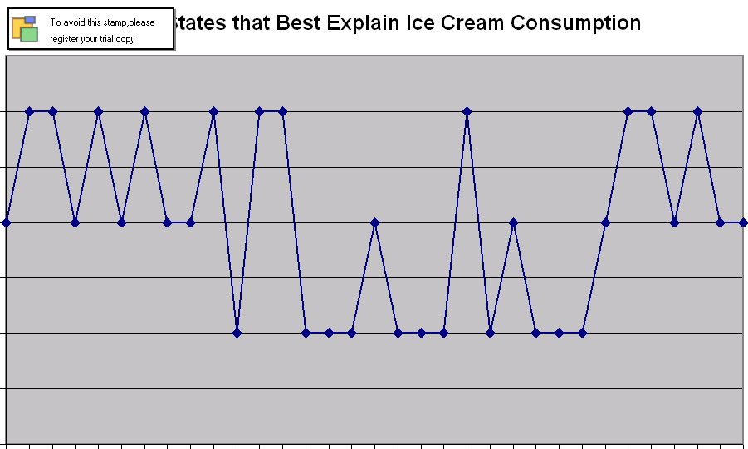
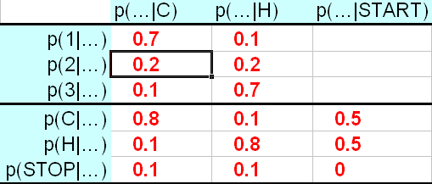
EM for Hidden Markov Models
initial
guess
E step
Guess of
unknown
parameters
(probabilities)
Guess of unknown
hidden structure
(tags, parses, weather)
Observed structure
(words, ice cream)
M step
600.465 - Intro to NLP - J. Eisner

Slide 44
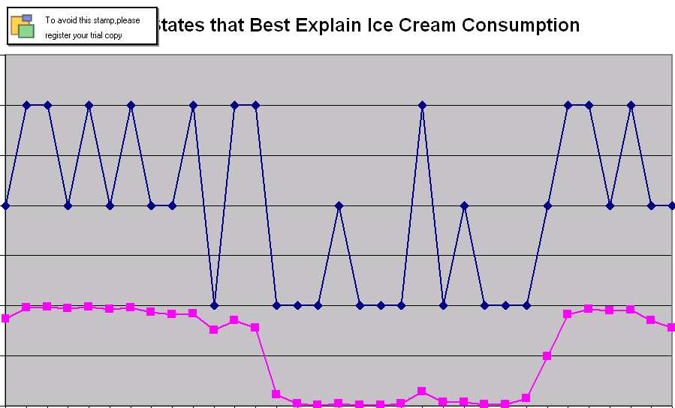
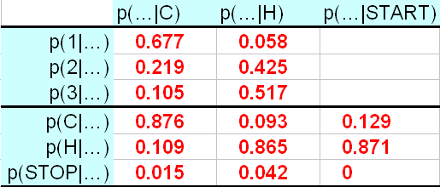
EM for Hidden Markov Models
initial
guess
E step
Guess of
unknown
parameters
(probabilities)
Guess of unknown
hidden structure
(tags, parses, weather)
Observed structure
(words, ice cream)
M step
600.465 - Intro to NLP - J. Eisner

Slide 45
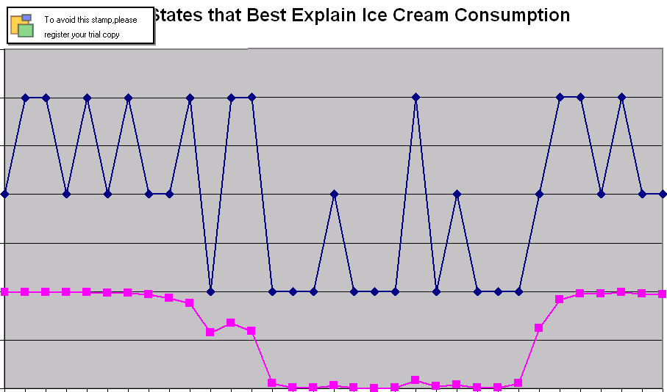
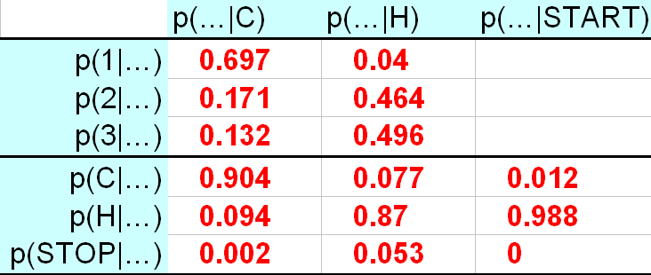
EM for Hidden Markov Models
initial
guess
E step
Guess of
unknown
parameters
(probabilities)
Guess of unknown
hidden structure
(tags, parses, weather)
Observed structure
(words, ice cream)
M step
600.465 - Intro to NLP - J. Eisner

Slide 46
EM for Grammar Reestimation
correct test trees
E step
P
A
R
S
E
R
s
c
o
r
e
r
accuracy
test
sentences
expensive and/or
wrong sublanguage
cheap, plentiful
and appropriate
Grammar
LEARNER
M step
training
trees
600.465 - Intro to NLP - J. Eisner

Slide 47
Two Versions of EM
The Viterbi approximation (max=)
  Expectation: pick the best parse of each sentence
  Maximization: retrain on this best-parsed corpus
  Advantage: Speed!
Real EM (+=)
  Expectation: find all parses of each sentence
  Maximization: retrain on all parses in proportion to their probability (as if we observed fractional count)
  Advantage: p(training corpus) guaranteed to increase
  Exponentially many parses, so need something clever (inside-outside algorithm – generalizes forward-backward)
600.465 - Intro to NLP - J. Eisner

Slide 48

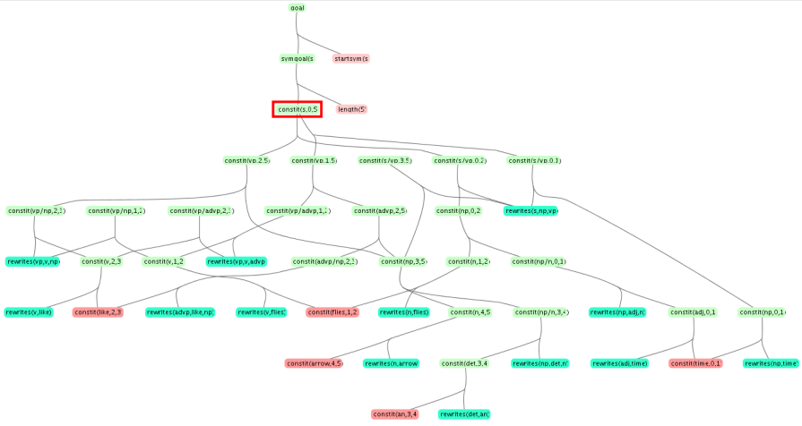
Summary: Graphs and EM
Given incomplete data
Construct a graph (or hypergraph) of all possible ways to complete it
  May be exponentially or infinitely many paths (or hyperpaths)
  Yet number of states and edges is manageable
Day 1: 2 cones
Day 2: 3 cones
Day 3: 3 cones
HMM tagging
(observe word sequence:
unknown tag sequence)
C
p(C|C)*p(3|C)
C
p(C|C)*p(3|C)
C
…
p(C|Start)*p(2|C)
Start
p(H|C)*p(3|H)
p(C|H)*p(3|C)
p(H|C)*p(3|H)
p(C|H)*p(3|C)
p(H|Start)*p(2|H)
H
p(H|H)*p(3|H)
H
p(H|H)*p(3|H)
H
c:ε
l:ε
a:ε
r:ε
a:ε
Parsing
(observe string: unknown tree)
c:c
l:c
a:c
r:c
a:c
Edit distance
(observe 2 strings:
unknown alignment
and edit sequence)
ε:c
c:ε
ε:c
l:ε
ε:c
a:ε
ε:c
r:ε
ε:c
a:ε
ε:c
c:a
l:a
a:a
r:a
a:a
ε:a
c:ε
ε:a
l:ε
ε:a
a:ε
ε:a
r:ε
ε:a
a:ε
ε:a
c:c
l:c
a:c
r:c
a:c
ε:c
c:ε
ε:c
l:ε
ε:c
a:ε
ε:c
r:ε
ε:c
a:ε
ε:c
c:a
l:a
a:a
r:a
a:a
ε:a
c:ε
ε:a
l:ε
ε:a
a:ε
ε:a
r:ε
ε:a
a:ε
ε:a

Slide 49
Summary: Graphs and EM
Given incomplete data
Construct a graph (or hypergraph) of all possible ways to complete it
The E step uses += or max= to reason efficiently about the paths
Collects a set of probable edges (and how probable they were)
  Notice that the states are tied to positions in the input
  On each edge, something happened as a result of rolling a die or dice
Edit distance
Parsing
₀S₇
HMM tagging
Edit distance
C,7
H:3
3,2
r:c
S→NP VP
p(NP VP | S)
p(H|C)*p(3|H)
p(c | r)
₀NP₁
₁VP₇
H,8
4,3

Slide 50
Summary: Graphs and EM
Given incomplete data
Construct a graph (or hypergraph) of all possible ways to complete it
The E step uses += or max= to reason efficiently about the paths
Collects a set of probable edges (and how probable they were)
The M step treats these edges as training data
  On each edge, something happened as a result of rolling a die or dice
  Reestimates model parameters to predict these “observed” dice rolls
HMM tagging
Edit distance
Parsing
Edit distance
H:3
r:c
S→NP VP
p(NP VP | S)
p(H|C)*p(3|H)
p(c | r)

Slide 51
Summary: Graphs and EM
Given incomplete data
Construct a graph (or hypergraph) of all possible ways to complete it
The E step collects a set of probable edges
The M step treats these edges as training data
To train what? How about using a conditional log-linear model?
  E step counts features of the “observed” edges
  M step adjusts θ until the expected feature counts equal the “observed” counts
  What linguistic features might help define the probabilities below?
HMM tagging
Edit distance
Parsing
Edit distance
H:3
r:c
S→NP VP
p(NP VP | S)
p(H|C)*p(3|H)
p(c | r)

Slide 52
Use this paradigm across NLP …
First define a probability distribution over structured objects
To compute about unseen parts, just have to construct the right graph!
Examples:
  Change what’s observed vs. unknown below; some may be partly observed
  More context in the states – trigram HMM, contextual edit distance, FSTs
  Beyond edit distance: complex models of string pairs for machine translation
Day 1: 2 cones
Day 2: 3 cones
Day 3: 3 cones
HMM tagging
(observe word sequence:
unknown tag sequence)
C
p(C|C)*p(3|C)
C
p(C|C)*p(3|C)
C
…
p(C|Start)*p(2|C)
Start
p(H|C)*p(3|H)
p(C|H)*p(3|C)
p(H|C)*p(3|H)
p(C|H)*p(3|C)
p(H|Start)*p(2|H)
H
p(H|H)*p(3|H)
H
p(H|H)*p(3|H)
H
c:ε
l:ε
a:ε
r:ε
a:ε
Parsing
(observe string: unknown tree)
c:c
l:c
a:c
r:c
a:c
Edit distance
(observe 2 strings:
unknown alignment
and edit sequence)
ε:c
c:ε
ε:c
l:ε
ε:c
a:ε
ε:c
r:ε
ε:c
a:ε
ε:c
c:a
l:a
a:a
r:a
a:a
ε:a
c:ε
ε:a
l:ε
ε:a
a:ε
ε:a
r:ε
ε:a
a:ε
ε:a
c:c
l:c
a:c
r:c
a:c
ε:c
c:ε
ε:c
l:ε
ε:c
a:ε
ε:c
r:ε
ε:c
a:ε
ε:c
c:a
l:a
a:a
r:a
a:a
ε:a
c:ε
ε:a
l:ε
ε:a
a:ε
ε:a
r:ε
ε:a
a:ε
ε:a

