Slide 1
Parsing

Slide 2
What is Parsing?
S → NP VP
NP → Det N
NP → NP PP
VP → V NP
VP → VP PP
PP → P NP
NP → Papa
N → caviar
N → spoon
V → spoon
V → ate
P → with
Det → the
Det → a
S
NP
VP
VP
PP
V
NP
P
NP
Det
N
Det
N
Papa
ate
the
caviar
with
a
spoon

Slide 3
What is Parsing?
S → NP VP
NP → Det N
NP → NP PP
VP → V NP
VP → VP PP
PP → P NP
NP → Papa
N → caviar
N → spoon
V → spoon
V → ate
P → with
Det → the
Det → a
S
NP
VP
Papa
VP
PP
V
NP
P
NP
ate
Det
N
with
Det
N
the
caviar
a
spoon

Slide 4
Programming languages
printf ("/charset [%s",
(re_opcode_t) *(p - 1) == charset_not ? "^" : "");
assert (p + *p < pend);
for (c = 0; c < 256; c++)
if (c / 8 < *p && (p[1 + (c/8)] & (1 << (c % 8)))) {
/* Are we starting a range? */
if (last + 1 == c && ! inrange) {
putchar ('-');
inrange = 1;
}
/* Have we broken a range? */
else if (last + 1 != c && inrange) {
putchar (last);
inrange = 0;
}
if (! inrange)
putchar (c);
last = c;
}
Easy to parse.
Designed that way!
Notes:
Let me start with a few words on parsing.
This is random code from Emacs, so if you see anything you like, it’s yours.
It’s written in an artificial language, designed to be easy to parse. Not completely trivial - we can’t tell whether (re_opcode_t) * (p-1) is a pointer cast or a mulitiplication, without some more context. But the scope of the ifs and fors is clearly marked. So is order of operations.

Slide 5
Natural languages
printf "/charset %s", re_opcode_t *p - 1 == charset_not ? "^" : ""; assert p + *p < pend; for c = 0; c < 256; c++ if c / 8 < *p && p1 + c/8 & 1 << c % 8 Are we starting a range? if last + 1 == c && ! inrange putchar '-'; inrange = 1; Have we broken a range? else if last + 1 != c && inrange putchar last; inrange = 0; if ! inrange putchar c; last = c;
No {} () [] to indicate scope & precedence
Lots of overloading (arity varies)
Grammar isn’t known in advance!
Context-free grammar not best formalism
Notes:
To get some flavor for why natural language is harder , think about parsing
this. Same code, but now we have no parentheses or indentation. Without that information, this is wildly ambiguous.
There are many other reasons why natural languages are subtle and difficult, but maybe the biggest - and most important for today - is function overloading. The English verb “bet”, B-E-T, can be either a noun or a verb, and as a verb it can take from 1 to 4 arguments: “I, would bet, you, five dollars, that it’s got four arguments.” But you can also say “you bet!”
Finally, you didn’t design the language, so you don’t know the grammar in advance. In fact, there’s a long-standing question as to what class of grammars is even appropriate for natural languages.

Slide 6
Ambiguity
S → NP VP
NP → Det N
NP → NP PP
VP → V NP
VP → VP PP
PP → P NP
S
NP → Papa
N → caviar
N → spoon
V → spoon
V → ate
P → with
Det → the
Det → a
NP
VP
Papa
VP
PP
V
NP
P
NP
ate
Det
N
with
Det
N
the
caviar
a
spoon

Slide 7
Ambiguity
S → NP VP
NP → Det N
NP → NP PP
VP → V NP
VP → VP PP
PP → P NP
S
NP → Papa
N → caviar
N → spoon
V → spoon
V → ate
P → with
Det → the
Det → a
NP
VP
Papa
V
NP
ate
NP
PP
Det
N
P
NP
the
caviar
with
Det
N
a
spoon

Slide 8
The parsing problem
correct test trees
P
A
R
S
E
R
s
c
o
r
e
r
accuracy
test
sentences
Recent parsers quite accurate
… good enough
to help a range of NLP tasks!
Grammar
Notes:
That’s why parsing is hard; here’s what a parser does. We feed it some sentences. For each sentence, it consults its grammar, and produces a tree whose leaves are the sentence’s words, and whose structure is intended to be helpful.
If you want to see how good the parser is, feed it some test sentences, and using your favorite scoring method, compare the output trees to an answer key of trees produced by a human. Suffice it to say that the recent crop of parsers is quite accurate. Most sentences are parsed correctly, or with one error.
Eisner is me, and while today’s talk isn’t really about parsing ...

Slide 9
Applications of parsing (1/2)
Warning: these slides are out of date
Machine translation (Alshawi 1996, Wu 1997, ...)
tree
operations
English
Chinese
Speech synthesis from parses (Prevost 1996)
  The government plans to raise income tax.
  The government plans to raise income tax the imagination.
Speech recognition using parsing (Chelba et al 1998)
  Put the file in the folder.
  Put the file and the folder.
Notes:
So why is accurate parsing a good thing? Many hard natural language problems become somewhat easier once you can parse the input.
(MT) If you want to translate sentences, it helps to parse them first, because the manipulations that turn English into Chinese are more easily defined or learned over trees than over sentences.
(SS) If you want your machine to read your email to you over the phone, let’s say in Rex Harrison’s voice with perfect elocution, then it had better be careful with the following apparently similar strings: (read). These similar strings have very different intonation because they have very different parses. So again, computing intonation from the parse is much easier.
(SR) It’s recently been demonstrated that parsing helps in speech recognition. Commercial speech recognizers will mix up these sentences, because they sound the same and each is locally well-formed within a three-word window. But the first transcription is much more likely for syntactic reasons. A recognizer that parses as it goes will prefer the first transcription.

Slide 10
Applications of parsing (2/2)
Warning: these slides are out of date
Grammar checking (Microsoft)
Indexing for information retrieval (Woods 1997)
  ... washing a car with a hose ... vehicle maintenance
Information extraction (Hobbs 1996)
NY Times
archive
Database
query
Notes:
(GC) Microsoft is doing a lot of work on parsing, in part to improve the grammar checker in MS Word.
(IR) Bill Woods at Sun has an Information Retrieval system that uses light parsing to get really great results in user tests. If your document says “washing a car with a hose,” Bill will pick out this phrase and construct up a bunch of ways to index it, including “vehicle maintenance.”
(IE) Finally, there’s so much information out there on the web. If we parse it, we should be able to read all kinds of useful information off the parse trees, both in general and for specific queries. Informative queries are easier to write over parse trees than over strings.

Slide 11
Parsing for Interpretation
Most linguistic properties are defined over trees.
One needs to parse to see subtle distinctions. E.g.:
Sara dislikes criticism of her. (her ≠ Sara)
Sara dislikes criticism of her by anyone. (her ≠ Sara)
Sara dislikes anyone’s criticism of her. (her = Sara or her ≠ Sara)
Notes:
Finally, if you want to really understand language, deeply, you gotta parse. Almost everything linguists care about is in the trees, not the words. People make subtle distinction in languages, and eventually machines must too.
What do I mean by subtle distinctions? Well, look at this sentence ...
(stress HER when reading it, to make it easier for audience)
“her” might refer to Sara’s mom, or Sara’s favorite student, but it can’t refer to Sara - we’d have to say “herself.”

Slide 12
Parsing → Compositional Semantics
Preview of the next topic!
+
What is meaning of 3+5*6?
First parse it into 3+(5*6)
3
*
5
6
E
E
F
E
N
+
E
F
E
3
N
*
N
5
6
600.465 - Intro to NLP - J. Eisner

Slide 13
Preview of the next topic!
Parsing → Compositional Semantics
+
33
What is meaning of 3+5*6?
First parse it into 3+(5*6)
Now give a meaning to
each node in the tree
(bottom-up)
3
3
*
30
5
5
6
6
E
33
E
F
E
30
3
N
+
E
F
E
add
3
5
N
*
N
6
mult
5
6
600.465 - Intro to NLP - J. Eisner

Slide 14
Preview of the next topic!
Parsing → Compositional Semantics
assert(every(nation, λx ∃e present(e),
act(e,wanting), wanter(e,x),
wantee(e, λe’ act(e’,loving),
lover(e’,G), lovee(e’,L))))
ROOT
S_{fin}
Punc
.
NP
VP_{fin}
λs assert(s)
Det
Every
N
nation
T
-s
VP_{stem}
every
nation
V_{stem}
want
S_{inf}
λv λx ∃e present(e),v(x)(e)
NP
George
VP_{inf}
λy λx λe act(e,wanting),
wanter(e,x), wantee(e,y)
G
T
to
VP_{stem}
λa a
V_{stem}
love
NP
Laura
λy λx λe act(e,loving),
lover(e,x), lovee(e,y)
L
600.465 - Intro to NLP - J. Eisner

Slide 15
Now let’s develop some parsing algorithms!
What substrings of this sentence are NPs?
Which substrings could be NPs in the right context?
Which substrings could be other types of phrases?
How would you defend a substring on your list?
0
1
2
3
4
5
6
7
8
9
The government plans to raise income
tax
are unpopular

Slide 16
“Papa ate the caviar with a spoon”
0
1
2
3
4
5
6
7
S → NP VP
NP → Det N
NP → NP PP
VP → V NP
VP → VP PP
PP → P NP
NP → Papa
N → caviar
N → spoon
V → spoon
V → ate
P → with
Det → the
Det → a

Slide 17
First try … does it work?
“Papa ate the caviar with a spoon”
0
1
2
3
4
5
6
7
for each constituent on the LIST (Y I Mid)
  scan the LIST for an adjacent constituent (Z Mid J)
  if grammar has a rule to combine them (X → Y Z)
    then add the result to the LIST (X I J)

Slide 18
Second try …
“Papa ate the caviar with a spoon”
0
1
2
3
4
5
6
7
initialize the list with parts-of-speech (T J-1 J)
where T is a preterminal tag (like Noun) for the J^{th} word
for each constituent on the LIST (Y I Mid)
  scan the LIST for an adjacent constituent (Z Mid J)
  if grammar has a rule to combine them (X → Y Z)
    then add the result to the LIST (X I J)
if the above loop added anything, do it again!
(so that X I J gets a chance to combine or be combined with)

Slide 19
Third try …
“Papa ate the caviar with a spoon”
0
1
2
3
4
5
6
7
initialize the list with parts-of-speech (T J-1 J)
where T is a preterminal tag (like Noun) for the J^{th} word
for each constituent on the LIST (Y I Mid)
  for each adjacent constituent on the list (Z Mid J)
    for each rule to combine them (X → Y Z)
      add the result to the LIST (X I J)
      if it’s not already there
if the above loop added anything, do it again!
(so that X I J gets a chance to combine or be combined with)

Slide 20
Third try …
“Papa ate the caviar with a spoon”
0
1
2
3
4
5
6
7
Initialize
NP 0 1
V 1 2
Det 2 3
N 3 4
P 4 5
Det 5 6
N 6 7
V 6 7
1st pass
NP 2 4
NP 5 7
2nd pass
VP 1 4
NP 2 4
PP 4 7
NP 5 7
3rd pass
…

Slide 21
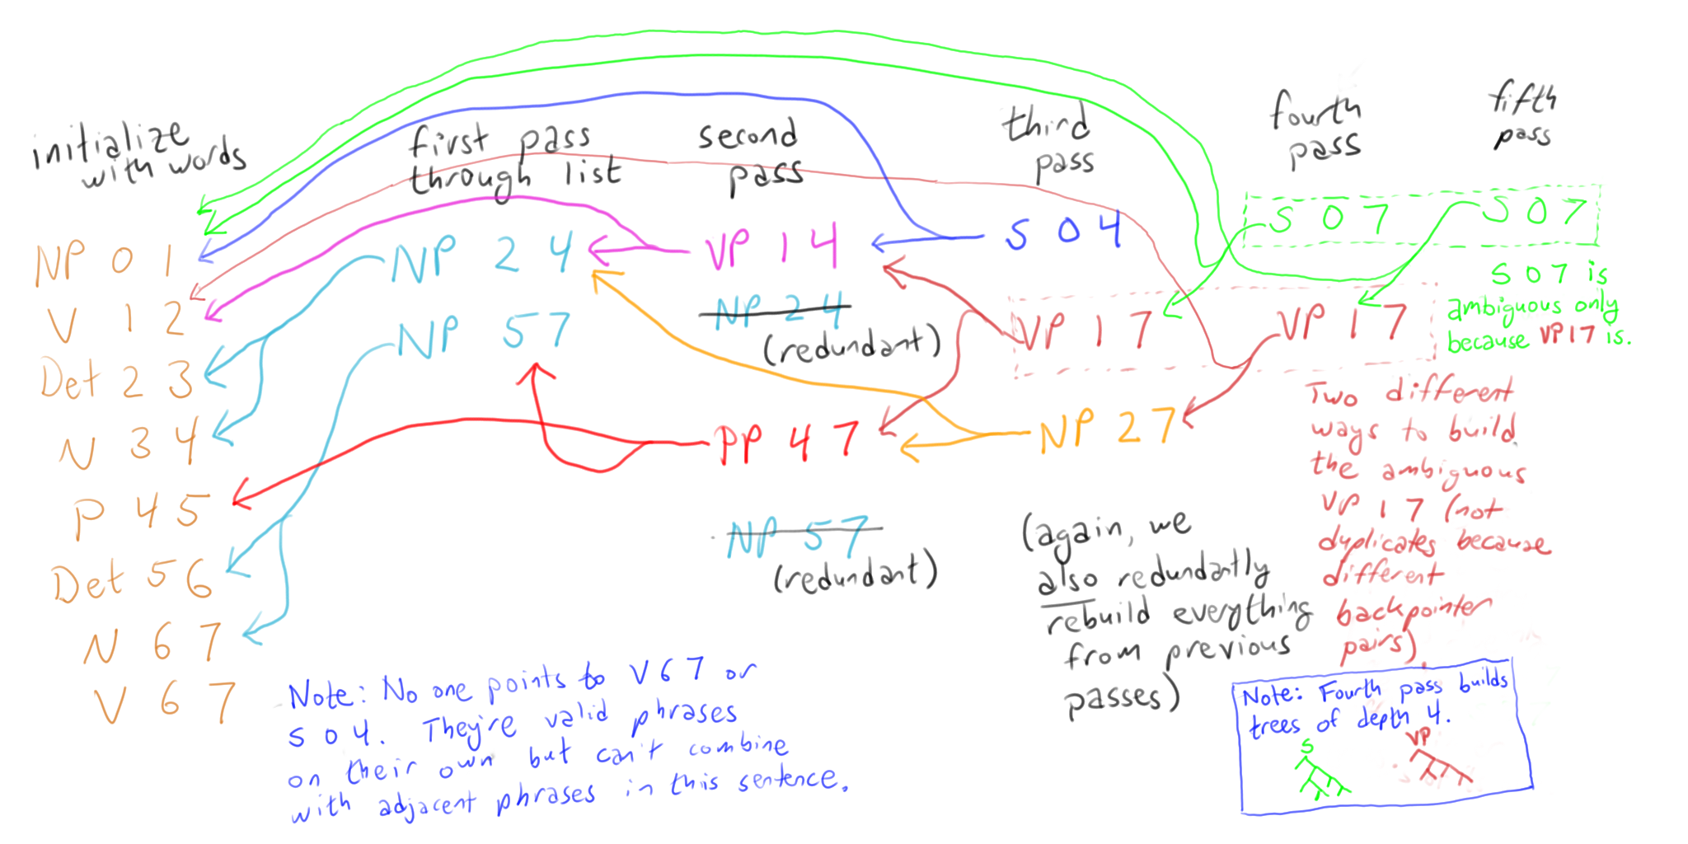
Follow backpointers to get the parse
“Papa ate the caviar with a spoon”
0
1
2
3
4
5
6
7

Slide 22
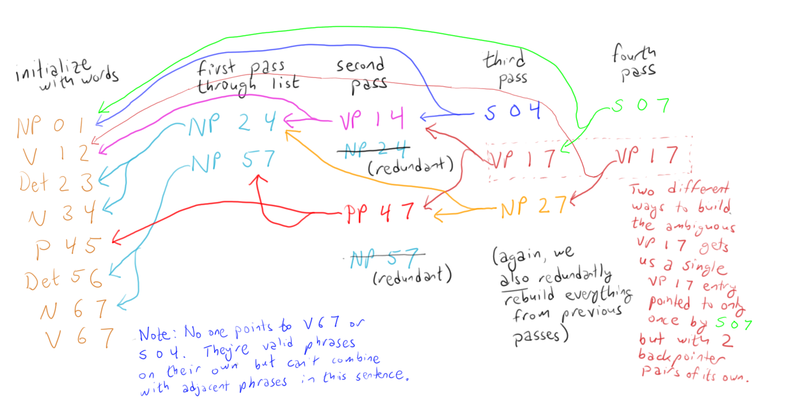
Turn sideways:
See the trees?
“Papa ate the caviar with a spoon”

Slide 23
Correct but still inefficient …
We kept checking the same pairs that we’d checked before (both bad and good pairs)
    Can’t we manage the process in a way that avoids duplicate work?
Right phrase
 | old | new
old | old pair | new pair
new | new pair | new pair
Left phrase

Slide 24
Correct but still inefficient …
We kept checking the same pairs that we’d checked before (both bad and good pairs)
    Can’t we manage the process in a way that avoids duplicate work?
And even finding new pairs was expensive because we had to scan the whole list
    Can’t we have some kind of index that will help us find adjacent pairs?

Slide 25

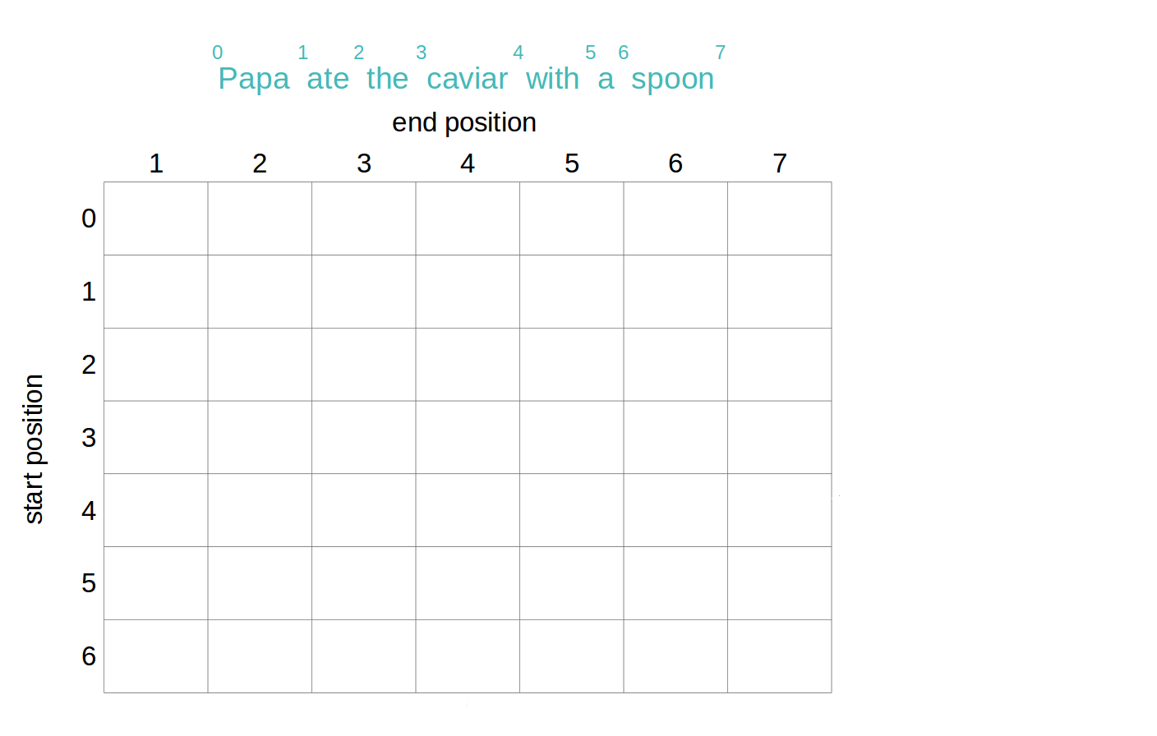
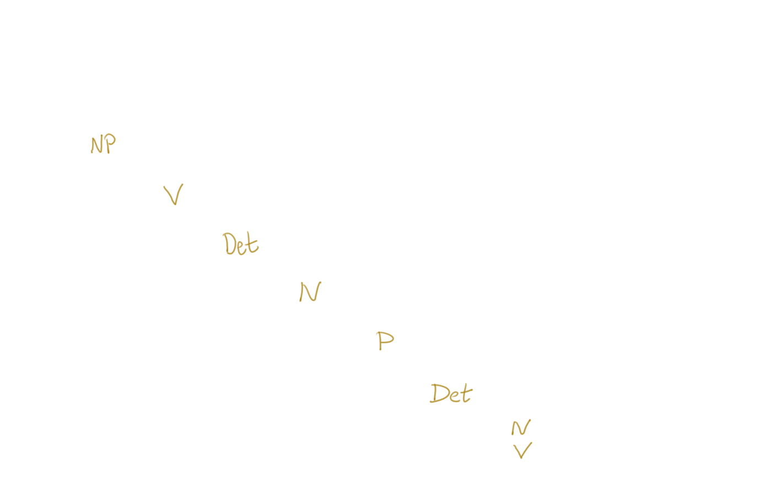
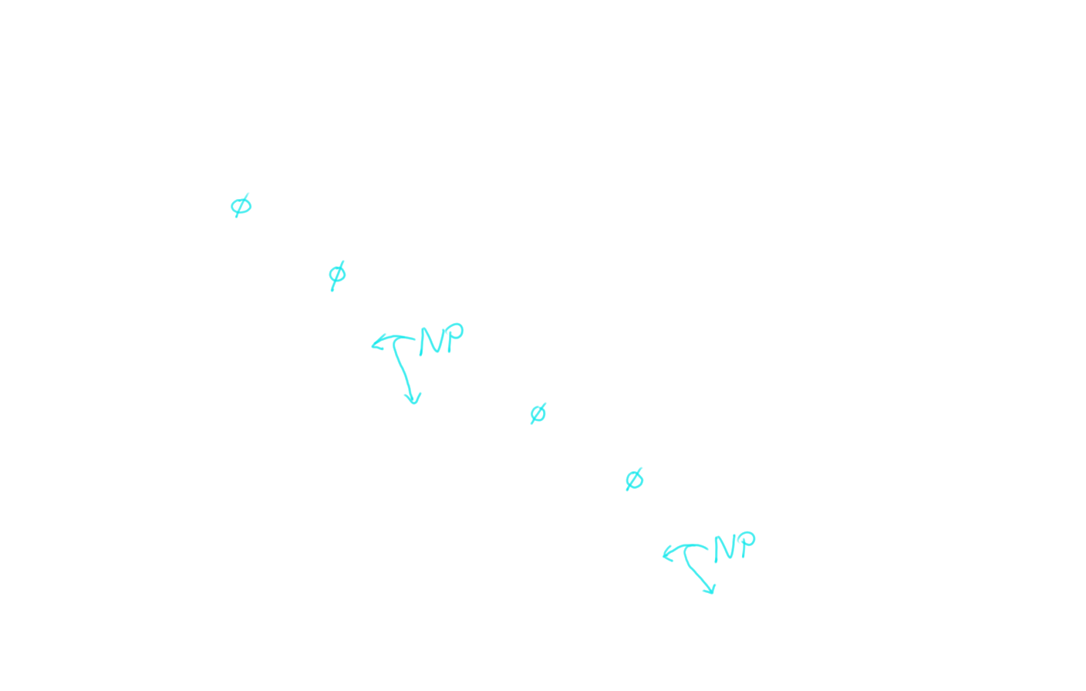
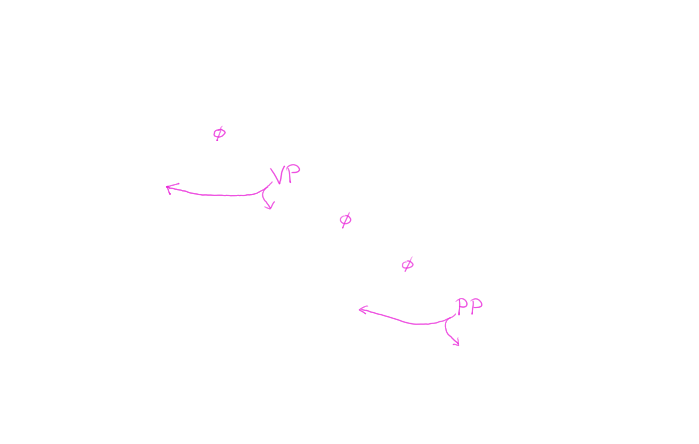
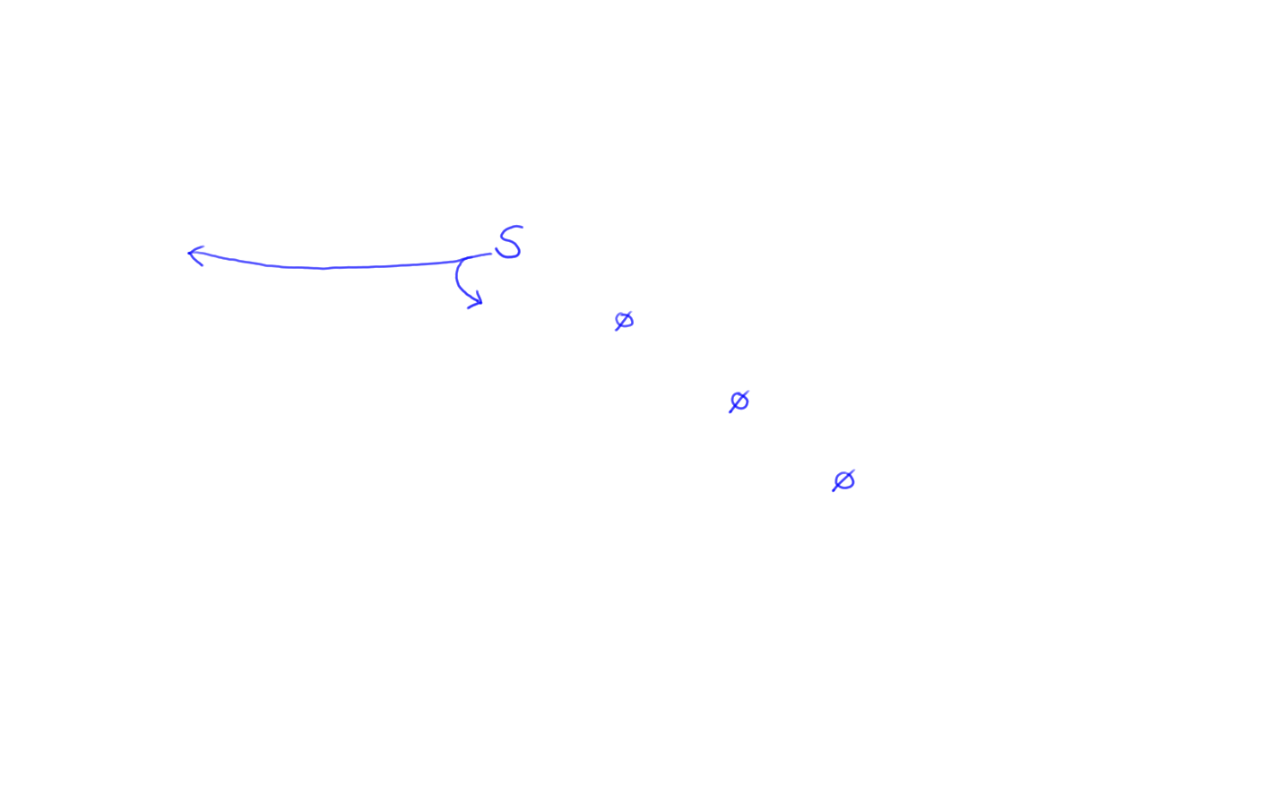
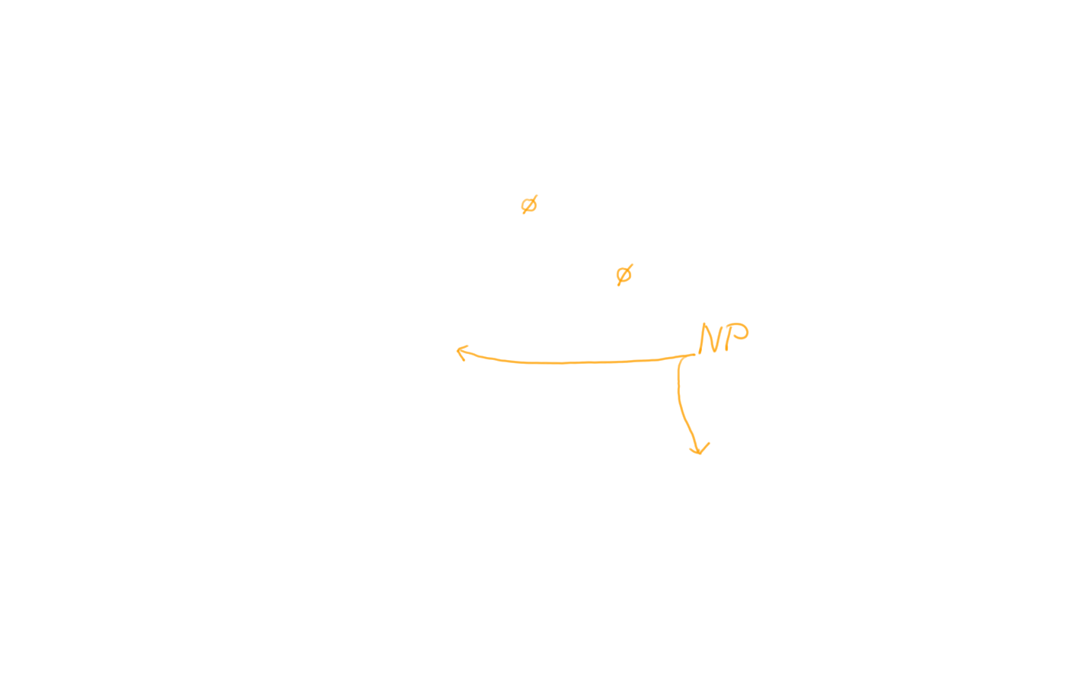
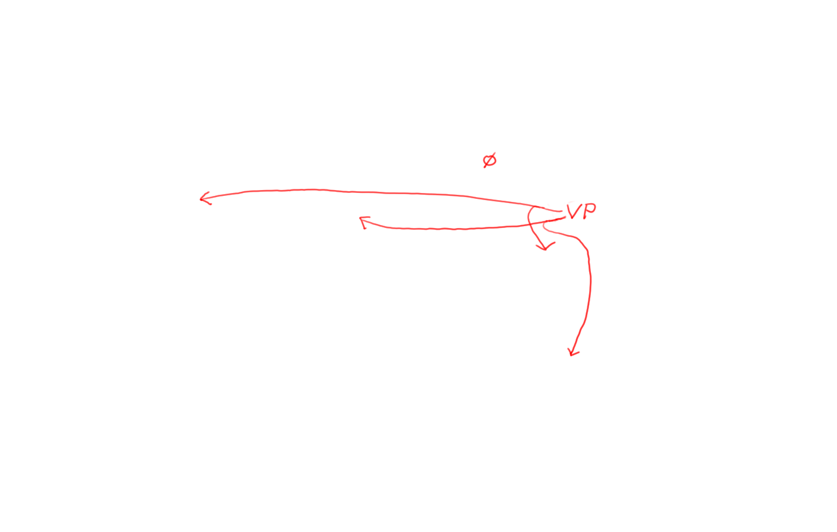
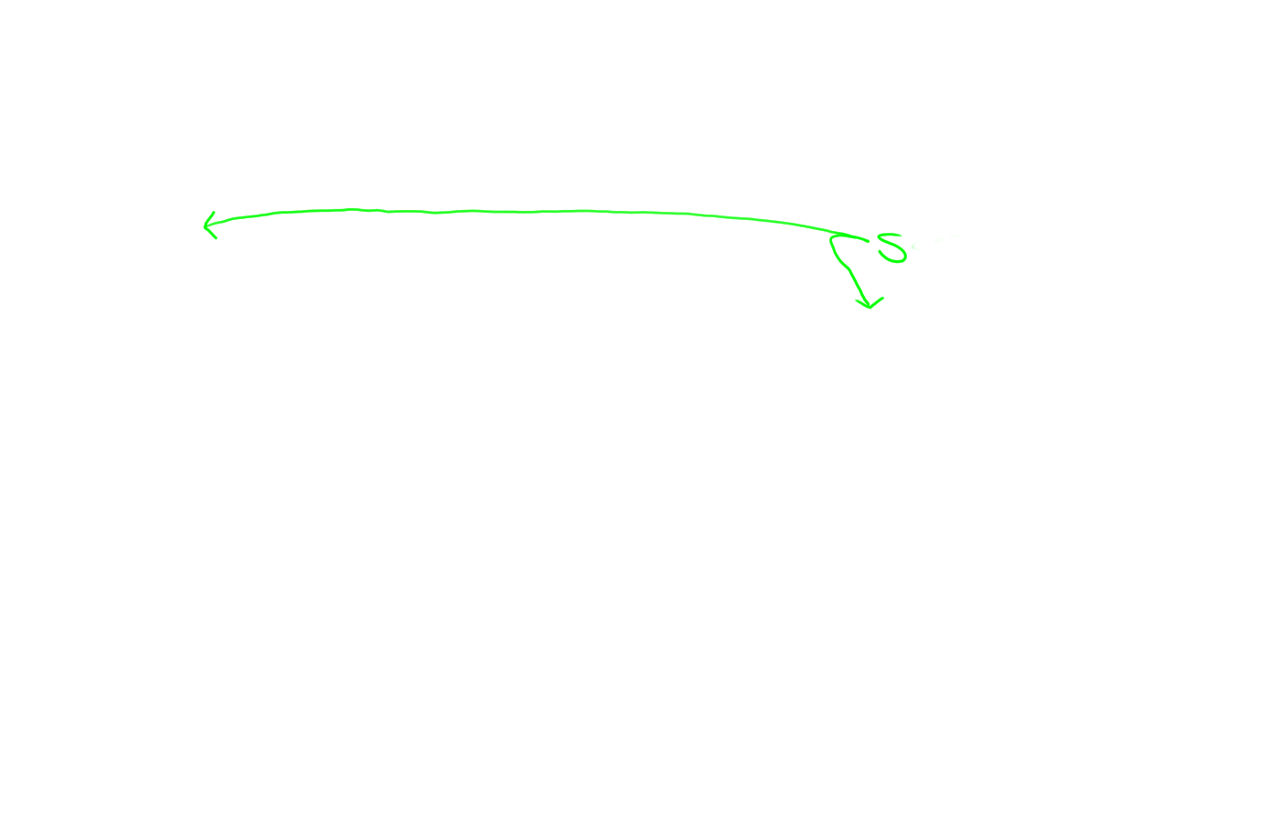
Indexing: Store S 0 4 in chart[0,4]

Slide 26
Avoid duplicate work:
Build width-1, then width-2, etc.

Slide 27
How do we build a width-6 phrase?
(after building and indexing all shorter phrases)
?
1 7 =
1 2 + 2 7 ☺
1 3 + 3 7
1 4 + 4 7 ☺
1 5 + 5 7
1 6 + 6 7

Slide 28
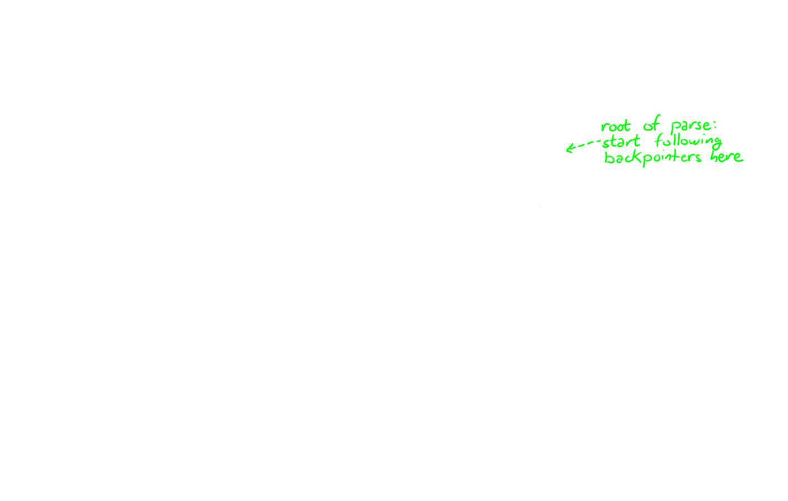
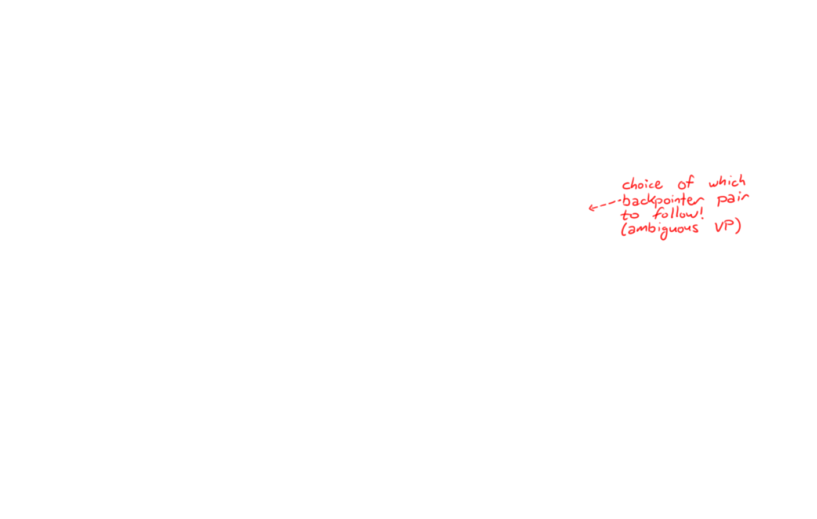
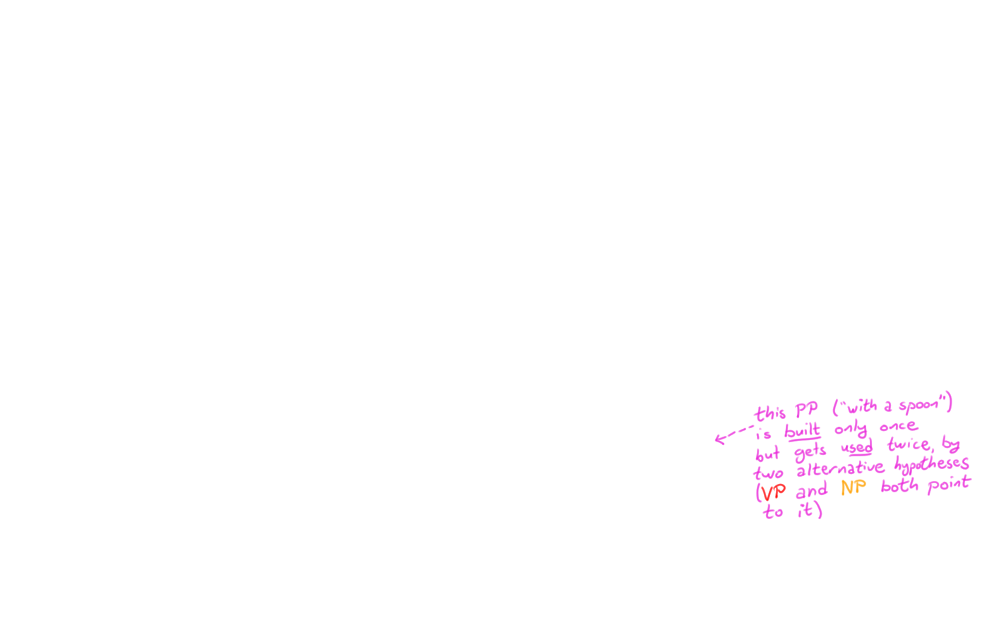
Avoid duplicate work:
Build width-1, then width-2, etc.

Slide 29
CKY algorithm, recognizer version
Input: string of n words
Output: yes/no (since it’s only a recognizer)
Data structure: n × n table
  rows labeled 0 to n-1
  columns labeled 1 to n
  cell [i,j] lists constituents found between i and j
Basic idea: fill in width-1 cells, then width-2, …

Slide 30
CKY algorithm, recognizer version
for J := 1 to n
  Add to [J-1,J] all categories for the J^{th} word
for width := 2 to n
    for start := 0 to n-width // this is I
      Define end := start + width // this is J
      for mid := start+1 to end-1 // find all I-to-J phrases
        for every nonterminal Y in [start,mid]
        for every nonterminal Z in [mid,end]
        for all nonterminals X
        if X → Y Z is in the grammar
        then add X to [start,end]

Slide 31
Loose ends to tie up (no slides)
What’s the space?
  Duplicate entries?
  How many parses could there be?
  Can we fix this?
What’s the runtime?

Slide 32
CKY algorithm, recognizer version
for J := 1 to n
  Add to [J-1,J] all categories for the J^{th} word
for width := 2 to n
    for start := 0 to n-width // this is I
      Define end := start + width // this is J
      for mid := start+1 to end-1 // find all I-to-J phrases
        for every nonterminal Y in [start,mid]
        for every nonterminal Z in [mid,end]
        for all nonterminals X
        if X → Y Z is in the grammar
        then add X to [start,end]

Slide 33
Alternative version of inner loops
for J := 1 to n
  Add to [J-1,J] all categories for the J^{th} word
for width := 2 to n
    for start := 0 to n-width // this is I
      Define end := start + width // this is J
      for mid := start+1 to end-1 // find all I-to-J phrases
        for every rule X → Y Z in the grammar
        if Y in [start,mid] and Z in [mid,end]
        then add X to [start,end]

Slide 34
Extensions to discuss (no slides)
In Chinese, no spaces between the words!?
Incremental (left-to-right) parsing?
We assumed rules like X → Y Z or X → word.
  Grammar in “Chomsky Normal Form.” What if it’s not?
How do we choose among parses?

Slide 35
Chart Parsing in Dyna
  phrase(X,I,J) :- rewrite(X,W), word(W,I,J).
  phrase(X,I,J) :- rewrite(X,Y,Z), phrase(Y,I,Mid), phrase(Z,Mid,J).
  goal :- phrase(start_symbol, 0, sentence_length).

Slide 36
Understanding the Key Rule
Substring from
I to J could
be a phrase
of category X
if
  phrase(X,I,J) :- rewrite(X,Y,Z) , phrase(Y,I,Mid), phrase(Z,Mid,J).
e.g., phrase(“VP”,1,7)
rewrite(“VP”,“V”,“NP”)
e.g., phrase(“V”,1,2), phrase(“NP”,2,7)
it breaks up into adjacent substrings
(from I to Mid and Mid to J)
that could be phrases
of categories Y and Z
the
grammar
has a rule
X → Y Z
(“an X can be made of a Y next to a Z”)

Slide 37
Chart Parsing in Dyna
  phrase(X,I,J) :- rewrite(X,W), word(W,I,J).
“A word is a phrase” (if grammar allows)
  phrase(X,I,J) :- rewrite(X,Y,Z), phrase(Y,I,Mid), phrase(Z,Mid,J).
“Two adjacent phrases are a phrase” (if grammar allows)
  goal :- phrase(start_symbol, 0, sentence_length).
“A phrase that covers the whole sentence is a parse”
(achieves our goal by showing that the sentence is grammatical)
  start_symbol := “S”.
  sentence_length := 7.
  Alternatively:
  sentence_length max= J for word(_,_,J).

Slide 38
Chart Parsing in Dyna
  phrase(X,I,J) :- rewrite(X,W), word(W,I,J).
  phrase(X,I,J) :- rewrite(X,Y,Z), phrase(Y,I,Mid), phrase(Z,Mid,J).
  goal :- phrase(start_symbol, 0, sentence_length).
We also need a sentence:
We also need a grammar:
  word(“Papa”,0,1).
  word(“ate”,1,2).
  word(“the”,2,3).
  word(“caviar”,3,4).
  word(“with”,4,5).
  word(“a”,5,6).
  word(“spoon”,6,7).
  rewrite(“NP”,“Papa”).
  rewrite(“N”,“caviar”).
  …
  rewrite(“S”,“NP”,“VP”).
  rewrite(“NP”,“Det”,“N”).
  rewrite(“NP”,“NP”,“PP”).
  …

Slide 39
Procedural Algorithms
The Dyna program runs fine.
It nicely displays the abstract structure of the algorithm.
But Dyna is a declarative programming language that hides the details of the actual execution from you.
If you had to find the possible phrases by hand (or with a procedural programming language), what steps would you go through?

Slide 40
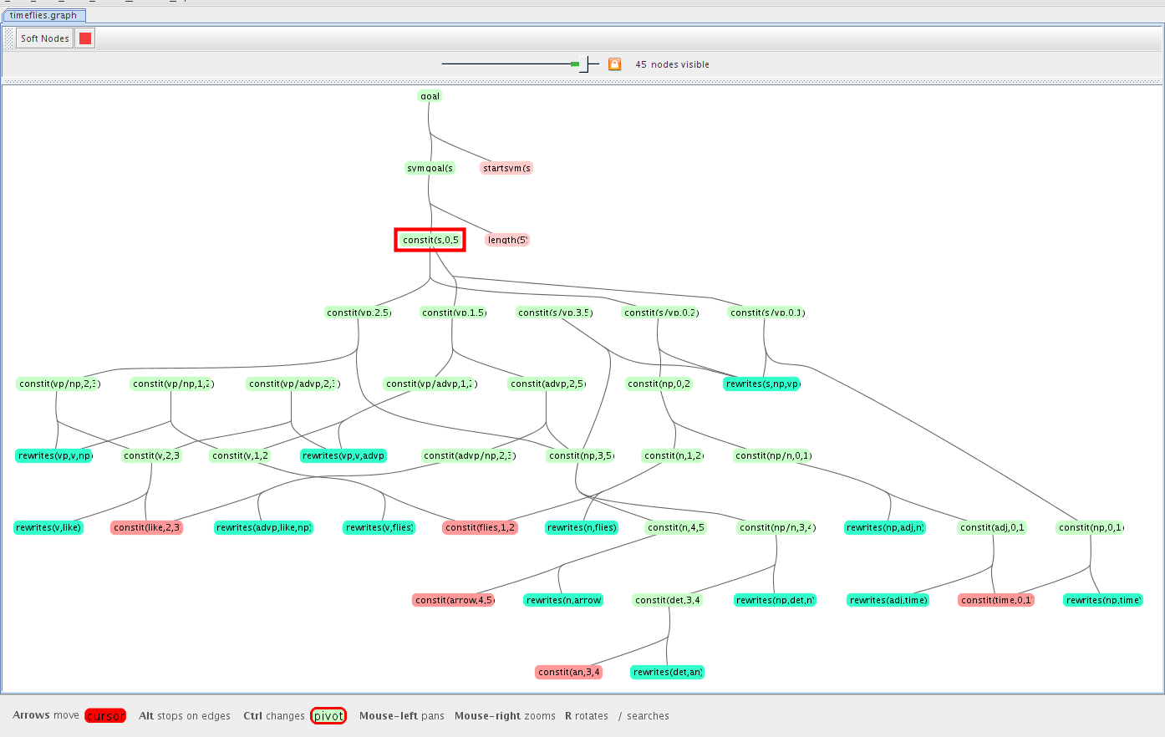
Discovered phrases & their relationships (“parse forest”) when parsing the ambiguous sentence “Time flies like an arrow”
This picture assumes a slightly different version of the Dyna program, sorry
desired theorem
ambiguity
dead end
shared substructure
(dynamic programming)
axioms

Slide 41
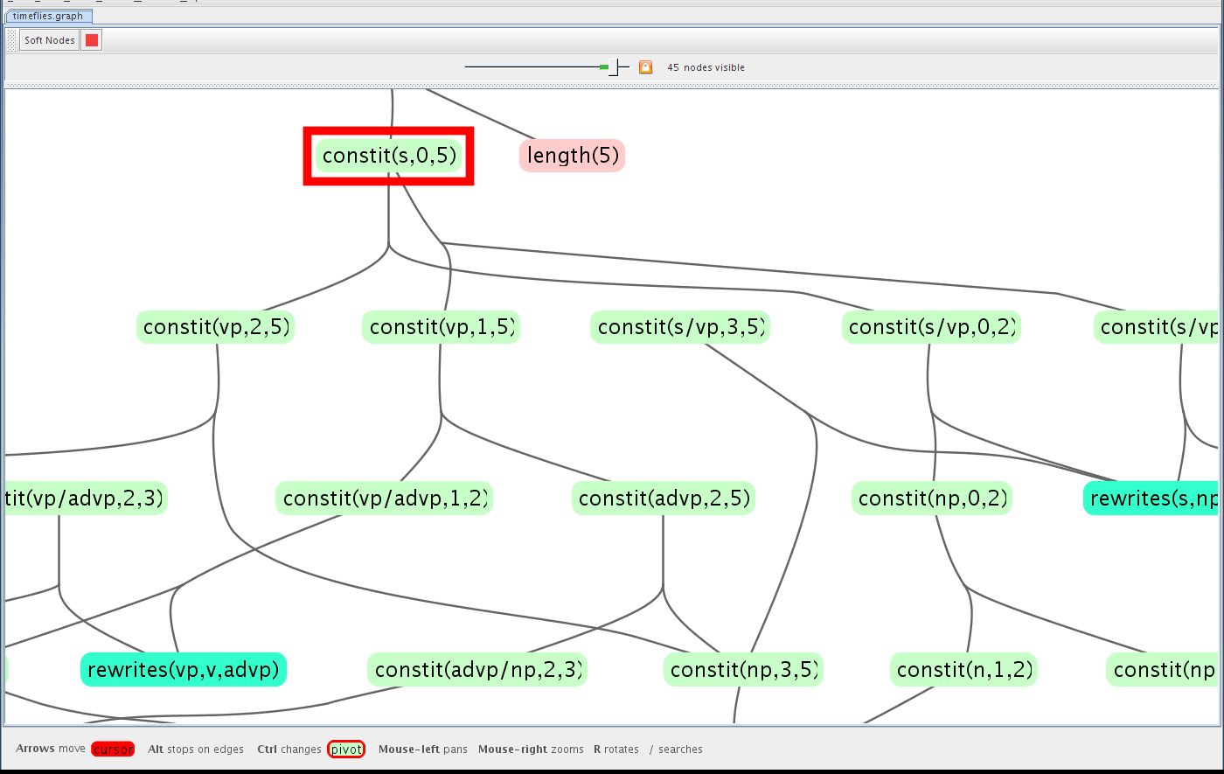
This picture assumes a slightly different version of the Dyna program, sorry
Discovered phrases & their relationships (“parse forest”)
when parsing the ambiguous sentence “Time flies like an arrow”
ambiguity
dead end
shared substructure
(dynamic programming)

Slide 42
Procedural algorithms like CKY are just strategies for running this declarative program
  phrase(X,I,J) :- rewrite(X,W), word(W,I,J).
  phrase(X,I,J) :- rewrite(X,Y,Z), phrase(Y,I,Mid), phrase(Z,Mid,J).
  goal :- phrase(start_symbol, 0, sentence_length).
And we’ll look at further such strategies later, e.g.
  magic sets / Earley’s algorithm / left-to-right parsing,
  agenda-based forward chaining,
  backward chaining with memoization,
  coarse-to-fine search,
  probability-guided search and pruning, …

