Slide 1
Building Finite-State Machines
600.465 - Intro to NLP - J. Eisner

Slide 2
todo
Why is it called closure?
  What is a closed set?
  Examples: closure of {1} or {2} or {2,5} under addition
E* = eps | E | EE | EEE | …
Show construction of complementation
Non-final states have weight semizero
Say what semiring is used in the examples (and maybe change to prob semiring)
Show construction of final states
Complain about Perl; explain why union/concat/closure is the standard subset (theory, efficiency); consider (A&B)* for why boolean tests aren’t enough
Mention that ? or . is the standard way to write Sigma
Explain that a:b and (e,f) and E .o. F all have upper on left, lower on right (we need a 2-dimensional parser!)
600.465 - Intro to NLP - J. Eisner

Slide 3
Xerox Finite-State Tool
You’ll use it for homework …
Commercial (we have license; open-source clone is Foma)
  One of several finite-state toolkits available
  This one is easiest to use but doesn’t have probabilities
Usage:
  Enter a regular expression; it builds FSA or FST
  Now type in input string
    FSA: It tells you whether it’s accepted
    FST: It tells you all the output strings (if any)
    Can also invert FST to let you map outputs to inputs
  Could hook it up to other NLP tools that need finite-state processing of their input or output
600.465 - Intro to NLP - J. Eisner

Slide 4
Common Regular Expression Operators (in XFST notation)
concatenation EF
* + iteration E*, E+
| union E | F
& intersection E & F
~ \ - complementation, minus ~E, \x, F-E
.x. crossproduct E .x. F
.o. composition E .o. F
.u upper (input) language E.u “domain”
.l lower (output) language E.l “range”
600.465 - Intro to NLP - J. Eisner

Slide 5
Common Regular Expression Operators (in XFST notation)
concatenation EF
EF = {ef: e ∈ E, f ∈ F}
  ef denotes the concatenation of 2 strings.
  EF denotes the concatenation of 2 languages.
  To pick a string in EF, pick e ∈ E and f ∈ F and concatenate them.
  To find out whether w ∈ EF, look for at least one way to split w into two “halves,” w = ef, such that e ∈ E and f ∈ F.
A language is a set of strings.
It is a regular language if there exists an FSA that accepts all the strings in the language, and no other strings.
If E and F denote regular languages, than so does EF.
(We will have to prove this by finding the FSA for EF!)
600.465 - Intro to NLP - J. Eisner

Slide 6
Common Regular Expression Operators (in XFST notation)
concatenation EF
* + iteration E*, E+
E* = {e₁e₂ … e_{n}: n≥0, e₁∈ E, … e_{n}∈ E}
  To pick a string in E*, pick any number of strings in E and concatenate them.
  To find out whether w ∈ E*, look for at least one way to split w into 0 or more sections, e₁e₂ … e_{n}, all of which are in E.
E+ = {e₁e₂ … e_{n}: n>0, e₁∈ E, … e_{n}∈ E} =EE*
600.465 - Intro to NLP - J. Eisner

Slide 7
Common Regular Expression Operators (in XFST notation)
concatenation EF
* + iteration E*, E+
| union E | F
E | F = {w: w∈ E or w∈ F} = E ∪ F
  To pick a string in E | F, pick a string from either E or F.
  To find out whether w ∈ E | F, check whether w ∈ E or w ∈ F.
600.465 - Intro to NLP - J. Eisner

Slide 8
Common Regular Expression Operators (in XFST notation)
concatenation EF
* + iteration E*, E+
| union E | F
& intersection E & F
E & F = {w: w∈ E and w∈ F} = E ∩ F
  To pick a string in E & F, pick a string from E that is also in F.
  To find out whether w ∈ E & F, check whether w ∈ E and w ∈ F.
600.465 - Intro to NLP - J. Eisner

Slide 9
Common Regular Expression Operators (in XFST notation)
concatenation EF
* + iteration E*, E+
| union E | F
& intersection E & F
~ \ - complementation, minus ~E, \x, F-E
~E = {e: e ∉ E} = Σ* - E
E – F = {e: e ∈ E and e ∉ F} = E & ~F
\E = Σ - E (any single character not in E)
600.465 - Intro to NLP - J. Eisner
Σ is set of all letters; so Σ* is set of all strings

Slide 10
Regular Expressions
A language is a set of strings.
It is a regular language if there exists an FSA that accepts all the strings in the language, and no other strings.
If E and F denote regular languages, than so do EF, etc.
Regular expression: EF*|(F & G)+
Syntax:
|
Semantics:
Denotes a regular language.
As usual, can build semantics compositionally bottom-up.
E, F, G must be regular languages.
As a base case, e denotes {e} (a language containing a single string),
so ef*|(f&g)+ is regular.
+
concat
*
&
E
F
F
G
600.465 - Intro to NLP - J. Eisner

Slide 11
Regular Expressions for Regular Relations
A language is a set of strings.
It is a regular language if there exists an FSA that accepts all the strings in the language, and no other strings.
If E and F denote regular languages, than so do EF, etc.
A relation is a set of pairs – here, pairs of strings.
It is a regular relation if there exists an FST that accepts all the pairs in the language, and no other pairs.
If E and F denote regular relations, then so do EF, etc.
EF = {(ef,e’f’): (e,e’) ∈ E, (f,f’) ∈ F}
Can you guess the definitions for E*, E+, E | F, E & F
when E and F are regular relations?
Surprise: E & F isn’t necessarily regular in the case of relations; so not supported.
600.465 - Intro to NLP - J. Eisner

Slide 12
Common Regular Expression Operators (in XFST notation)
concatenation EF
* + iteration E*, E+
| union E | F
& intersection E & F
~ \ - complementation, minus ~E, \x, F-E
.x. crossproduct E .x. F
E .x. F = {(e,f): e ∈ E, f ∈ F}
  Combines two regular languages into a regular relation.
600.465 - Intro to NLP - J. Eisner

Slide 13
Common Regular Expression Operators (in XFST notation)
concatenation EF
* + iteration E*, E+
| union E | F
& intersection E & F
~ \ - complementation, minus ~E, \x, F-E
.x. crossproduct E .x. F
.o. composition E .o. F
E .o. F = {(e,f): ∃m. (e,m) ∈ E, (m,f) ∈ F}
  Composes two regular relations into a regular relation.
  As we’ve seen, this generalizes ordinary function composition.
600.465 - Intro to NLP - J. Eisner

Slide 14
Common Regular Expression Operators (in XFST notation)
concatenation EF
* + iteration E*, E+
| union E | F
& intersection E & F
~ \ - complementation, minus ~E, \x, F-E
.x. crossproduct E .x. F
.o. composition E .o. F
.u upper (input) language E.u “domain”
E.u = {e: ∃m. (e,m) ∈ E}
600.465 - Intro to NLP - J. Eisner

Slide 15
Common Regular Expression Operators (in XFST notation)
concatenation EF
* + iteration E*, E+
| union E | F
& intersection E & F
~ \ - complementation, minus ~E, \x, F-E
.x. crossproduct E .x. F
.o. composition E .o. F
.u upper (input) language E.u “domain”
.l lower (output) language E.l “range”
600.465 - Intro to NLP - J. Eisner

Slide 16
Function from strings to ...
Acceptors (FSAs)
Transducers (FSTs)
{false, true}
c
strings
c:z
a
a:x
Unweighted
ε
ε:y
numbers
c/.7
(string, num) pairs
c:z/.7
a/.5
a:x/.5
Weighted
.3
.3
ε/.5
ε:y/.5

Slide 17
Weighted Relations
If we have a language [or relation], we can ask it:
Do you contain this string [or string pair]?
If we have a weighted language [or relation], we ask:
What weight do you assign to this string [or string pair]?
Pick a semiring: all our weights will be in that semiring.
  Just as for parsing, this makes our formalism & algorithms general.
  The unweighted case is the boolean semring {true, false}.
  If a string is not in the language, it has weight .
  If an FST or regular expression can choose among multiple ways to match, use ⊕ to combine the weights of the different choices.
  If an FST or regular expression matches by matching multiple substrings, use ⊗ to combine those different matches.
  Remember, ⊕ is like “or” and ⊗ is like “and”!

Slide 18
Which Semiring Operators are Needed?
concatenation EF
* + iteration E*, E+
| union E | F
~ \ - complementation, minus ~E, \x, E-F
& intersection E & F
.x. crossproduct E .x. F
.o. composition E .o. F
.u upper (input) language E.u “domain”
.l lower (output) language E.l “range”
⊕ to sum over 2 choices
⊗ to combine the matches against E and F
600.465 - Intro to NLP - J. Eisner

Slide 19
Common Regular Expression Operators (in XFST notation)
| union E | F
E | F = {w: w∈ E or w∈ F} = E ∪ F
  Weighted case: Let’s write E(w) to denote the weight of w in the weighted language E.
(E|F)(w) = E(w) ⊕ F(w)
⊕ to sum over 2 choices
600.465 - Intro to NLP - J. Eisner

Slide 20
Which Semiring Operators are Needed?
concatenation EF
* + iteration E*, E+
| union E | F
~ \ - complementation, minus ~E, \x, E-F
& intersection E & F
.x. crossproduct E .x. F
.o. composition E .o. F
.u upper (input) language E.u “domain”
.l lower (output) language E.l “range”
need both ⊕ and ⊗
⊕ to sum over 2 choices
⊗ to combine the matches against E and F
600.465 - Intro to NLP - J. Eisner

Slide 21
Which Semiring Operators are Needed?
concatenation EF
+ iteration E*, E+
EF = {ef: e ∈ E, f ∈ F}
  Weighted case must match two things (⊗), but there’s a choice (⊕) about which two things:
(EF)(w) = (E(e) ⊗ F(f))
need both ⊕ and ⊗
⊕
e,f such
that w=ef
600.465 - Intro to NLP - J. Eisner

Slide 22
Which Semiring Operators are Needed?
concatenation EF
* + iteration E*, E+
| union E | F
~ \ - complementation, minus ~E, \x, E-F
& intersection E & F
.x. crossproduct E .x. F
.o. composition E .o. F
.u upper (input) language E.u “domain”
.l lower (output) language E.l “range”
need both ⊕ and ⊗
⊕ to sum over 2 choices
⊗ to combine the matches against E and F
both ⊕ and ⊗ (why?)
⊕
⊕
600.465 - Intro to NLP - J. Eisner

Slide 23
Definition of FSTs
[Red material shows differences from FSAs.]
Simple view:
  An FST is simply a finite directed graph, with some labels.
  It has a designated initial state and a set of final states.
  Each edge is labeled with an “upper string” (in Σ*).
  Each edge is also labeled with a “lower string” (in Δ*).
  [Upper/lower are sometimes regarded as input/output.]
  Each edge and final state is also labeled with a semiring weight.
More traditional definition specifies an FST via these:
  a state set Q
  initial state i
  set of final states F
  input alphabet Σ (also define Σ*, Σ+, Σ?)
  output alphabet Δ
  transition function d: Q x Σ? --> 2^{Q}
  output function s: Q x Σ? x Q --> Δ?
600.465 - Intro to NLP - J. Eisner

Slide 24
How to implement?
slide courtesy of L. Karttunen (modified)
concatenation EF
* + iteration E*, E+
| union E | F
~ \ - complementation, minus ~E, \x, E-F
& intersection E & F
.x. crossproduct E .x. F
.o. composition E .o. F
.u upper (input) language E.u “domain”
.l lower (output) language E.l “range”
600.465 - Intro to NLP - J. Eisner

Slide 25
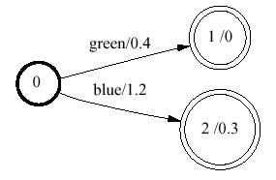
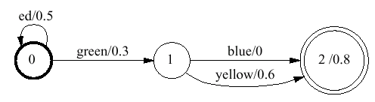
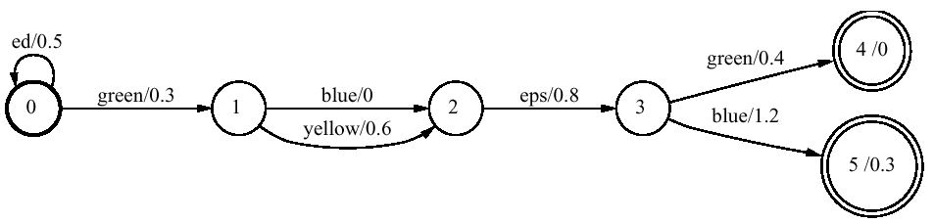
Concatenation
example courtesy of M. Mohri
r
r
=
600.465 - Intro to NLP - J. Eisner

Slide 26
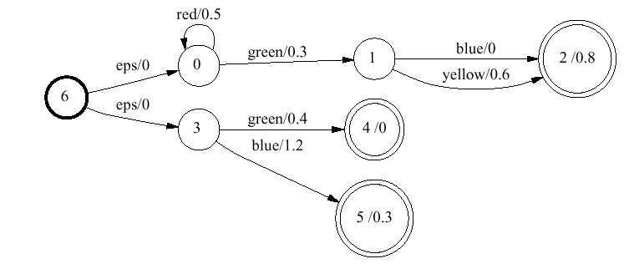
Union
example courtesy of M. Mohri
r
|
=
600.465 - Intro to NLP - J. Eisner

Slide 27
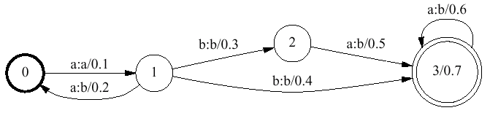

Closure (this example has outputs too)
example courtesy of M. Mohri
*
=
why add new start state 4?
why not just make state 0 final?
600.465 - Intro to NLP - J. Eisner

Slide 28
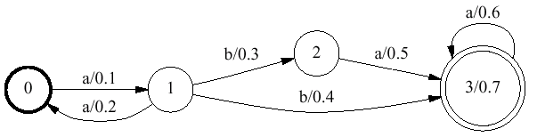
Upper language (domain)
example courtesy of M. Mohri
.u
=
similarly construct lower language .l
also called input & output languages
600.465 - Intro to NLP - J. Eisner

Slide 29
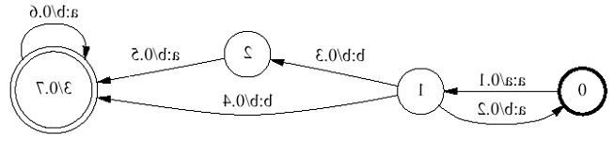
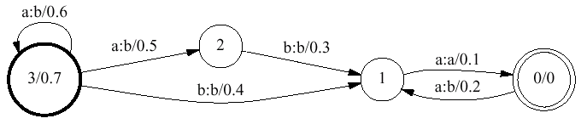
Reversal
example courtesy of M. Mohri
.r
=
600.465 - Intro to NLP - J. Eisner

Slide 30
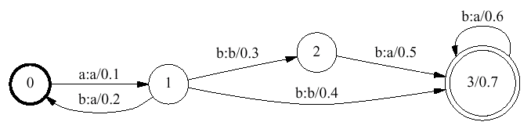
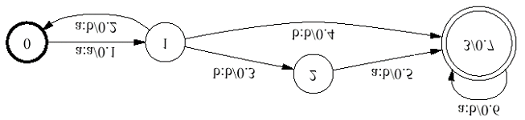
Inversion
example courtesy of M. Mohri
.i
=
600.465 - Intro to NLP - J. Eisner

Slide 31
Complementation
Given a machine M, represent all strings not accepted by M
Just change final states to non-final and vice-versa
Works only if machine has been determinized and completed first (why?)
600.465 - Intro to NLP - J. Eisner

Slide 32
Intersection
example adapted from M. Mohri
fat/0.5
pig/0.3
eats/0
2/0.8
0
1
sleeps/0.6
pig/0.4
&
fat/0.2
sleeps/1.3
2/0.5
0
1
eats/0.6
2,0/0.8
eats/0.6
=
0,0
fat/0.7
0,1
pig/0.7
1,1
2,2/1.3
sleeps/1.9
600.465 - Intro to NLP - J. Eisner

Slide 33
Intersection
fat/0.5
pig/0.3
eats/0
2/0.8
0
1
sleeps/0.6
pig/0.4
&
fat/0.2
sleeps/1.3
2/0.5
0
1
eats/0.6
2,0/0.8
eats/0.6
=
0,0
fat/0.7
0,1
pig/0.7
1,1
2,2/1.3
sleeps/1.9
Paths 0012 and 0110 both accept fat pig eats
So must the new machine: along path 0,0 0,1 1,1 2,0
600.465 - Intro to NLP - J. Eisner

Slide 34
Intersection
fat/0.5
pig/0.3
eats/0
2/0.8
0
1
sleeps/0.6
pig/0.4
&
fat/0.2
sleeps/1.3
2/0.5
0
1
eats/0.6
=
0,0
fat/0.7
0,1
Paths 00 and 01 both accept fat
So must the new machine: along path 0,0 0,1
600.465 - Intro to NLP - J. Eisner

Slide 35
Intersection
fat/0.5
pig/0.3
eats/0
2/0.8
0
1
sleeps/0.6
pig/0.4
&
fat/0.2
sleeps/1.3
2/0.5
0
1
eats/0.6
=
0,0
fat/0.7
0,1
pig/0.7
1,1
Paths 00 and 11 both accept pig
So must the new machine: along path 0,1 1,1
600.465 - Intro to NLP - J. Eisner

Slide 36
Intersection
fat/0.5
pig/0.3
eats/0
2/0.8
0
1
sleeps/0.6
pig/0.4
&
fat/0.2
sleeps/1.3
2/0.5
0
1
eats/0.6
=
0,0
fat/0.7
0,1
pig/0.7
1,1
Paths 12 and 12 both accept fat
So must the new machine: along path 1,1 2,2
2,2/1.3
sleeps/1.9
600.465 - Intro to NLP - J. Eisner

Slide 37
Intersection
fat/0.5
pig/0.3
eats/0
2/0.8
0
1
sleeps/0.6
pig/0.4
&
fat/0.2
sleeps/1.3
2/0.5
0
1
eats/0.6
2,0/0.8
eats/0.6
=
0,0
fat/0.7
0,1
pig/0.7
1,1
2,2/1.3
sleeps/1.9
600.465 - Intro to NLP - J. Eisner

Slide 38
What Composition Means
f
g
3
4
ab?d
abcd
αβγδ
2
2
abed
αβεδ
8
6
αβ∈δ
abjd
...
600.465 - Intro to NLP - J. Eisner

Slide 39
What Composition Means
ab?d
3+4
αβγδ
2+2
αβεδ
Relation composition: f ° g
6+8
αβ∈δ
...
600.465 - Intro to NLP - J. Eisner

Slide 40
Relation = set of pairs
does not contain any pair of the form abjd → …
ab?d → abcd
ab?d → abed
ab?d → abjd
…
abcd → αβγδ
abed → αβεδ
abed → αβ∈δ
…
f
g
3
4
ab?d
abcd
αβγδ
2
2
abed
αβεδ
8
6
αβ∈δ
abjd
...
600.465 - Intro to NLP - J. Eisner

Slide 41
Relation = set of pairs
ab?d → abcd
ab?d → abed
ab?d → abjd
…
abcd → αβγδ
abed → αβεδ
abed → αβ∈δ
…
f ° g
ab?d → αβγδ
ab?d → αβεδ
ab?d → αβ∈δ
…
4
ab?d
αβγδ
2
αβεδ
f ° g = {x→z: ∃y (x→y ∈ f and y→z ∈ g)}
where x, y, z are strings
8
αβ∈δ
...
600.465 - Intro to NLP - J. Eisner

Slide 42
Intersection vs. Composition
Intersection
pig/0.4
pig/0.3
&
=
0,1
pig/0.7
0
1
1
1,1
Composition
pig:pink/0.4
Wilbur:pig/0.3
Wilbur:pink/0.7
0
1
.o.
1
=
0,1
1,1
600.465 - Intro to NLP - J. Eisner

Slide 43
Intersection vs. Composition
Intersection mismatch
elephant/0.4
pig/0.3
&
=
0,1
pig/0.7
0
1
1
1,1
Composition mismatch
elephant:gray/0.4
Wilbur:pig/0.3
Wilbur:gray/0.7
0
1
.o.
1
=
0,1
1,1
600.465 - Intro to NLP - J. Eisner

Slide 44

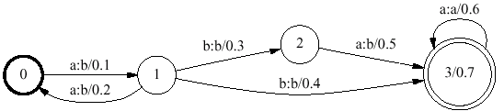
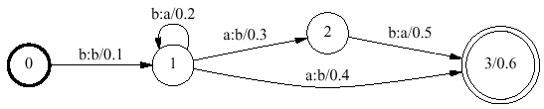
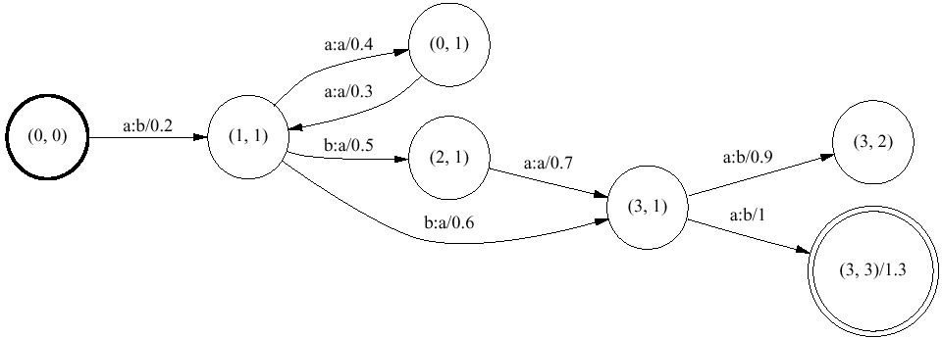
Composition
example courtesy of M. Mohri
.o.
=
Notes:
FIRST MACHINE: odd # of a’s (which become b’s), then b that is left alone, then any # of a’s the first of which is optionally replaced by b
SECOND MACHINE: one or more b’s (all but the first of which become a’s), then a:b, then optional b:a

Slide 45
Composition
.o.
=
a:b .o. b:b = a:b

Slide 46
Composition
.o.
=
a:b .o. b:a = a:a

Slide 47
Composition
.o.
=
a:b .o. b:a = a:a

Slide 48
Composition
.o.
=
b:b .o. b:a = b:a

Slide 49
Composition
.o.
=
a:b .o. b:a = a:a

Slide 50
Composition
.o.
=
a:a .o. a:b = a:b

Slide 51
Composition
.o.
=
b:b .o. a:b = nothing
(since intermediate symbol doesn’t match)

Slide 52
Composition
.o.
=
b:b .o. b:a = b:a

Slide 53
Composition
.o.
=
a:b .o. a:b = a:b

Slide 54
Relation = set of pairs
ab?d → abcd
ab?d → abed
ab?d → abjd
…
abcd → αβγδ
abed → αβεδ
abed → αβ∈δ
…
f ° g
ab?d → αβγδ
ab?d → αβεδ
ab?d → αβ∈δ
…
4
ab?d
αβγδ
2
αβεδ
f ° g = {x→z: ∃y (x→y ∈ f and y→z ∈ g)}
where x, y, z are strings
8
αβ∈δ
...
600.465 - Intro to NLP - J. Eisner

Slide 55
Composition with Sets
We’ve defined A .o. B where both are FSTs
Now extend definition to allow one to be a FSA
Two relations (FSTs):
A ° B = {x→z: ∃y (x→y ∈ A and y→z ∈ B)}
Set and relation:
A ° B = {x→z: x ∈ A and x→z ∈ B }
Relation and set:
A ° B = {x→z: x→z ∈ A and z ∈ B }
Two sets (acceptors) – same as intersection:
A ° B = {x: x ∈ A and x ∈ B }
600.465 - Intro to NLP - J. Eisner

Slide 56
Composition and Coercion
Really just treats a set as identity relation on set
{abc, pqr, …} = {abc→abc, pqr→pqr, …}
Two relations (FSTs):
A ° B = {x→z: ∃y (x→y ∈ A and y→z ∈ B)}
Set and relation is now special case (if ∃y then y=x):
A ° B = {x→z: x→x ∈ A and x→z ∈ B }
Relation and set is now special case (if ∃y then y=z):
A ° B = {x→z: x→z ∈ A and z→z ∈ B }
Two sets (acceptors) is now special case:
A ° B = {x→x: x→x ∈ A and x→x ∈ B }
600.465 - Intro to NLP - J. Eisner

Slide 57
3 Uses of Set Composition:
Feed string into Greek transducer:
  {abed→abed} .o. Greek = {abed→αβεδ, abed→αβ∈δ}
  {abed} .o. Greek = {abed→αβεδ, abed→αβ∈δ}
  [{abed} .o. Greek].l = {αβεδ, αβ∈δ}
Feed several strings in parallel:
  {abcd, abed} .o. Greek
  = {abcd→αβγδ, abed→αβεδ, abed→αβ∈δ}
  [{abcd,abed} .o. Greek].l = {αβγδ, αβεδ, αβ∈δ}
Filter result via Noε = {αβγδ, αβ∈δ, …}
  {abcd,abed} .o. Greek .o. Noε
  = {abcd→αβγδ, abed→αβ∈δ}
600.465 - Intro to NLP - J. Eisner

Slide 58
What are the “basic” transducers?
The operations on the previous slides combine transducers into bigger ones
But where do we start?
a:ε for a ∈ Σ
ε:x for x ∈ Δ
Q: Do we also need a:x? How about ε:ε ?
a:ε
ε:x
600.465 - Intro to NLP - J. Eisner

