Slide 1
Finite-State Programming
Some Examples
600.465 - Intro to NLP - J. Eisner

Slide 2
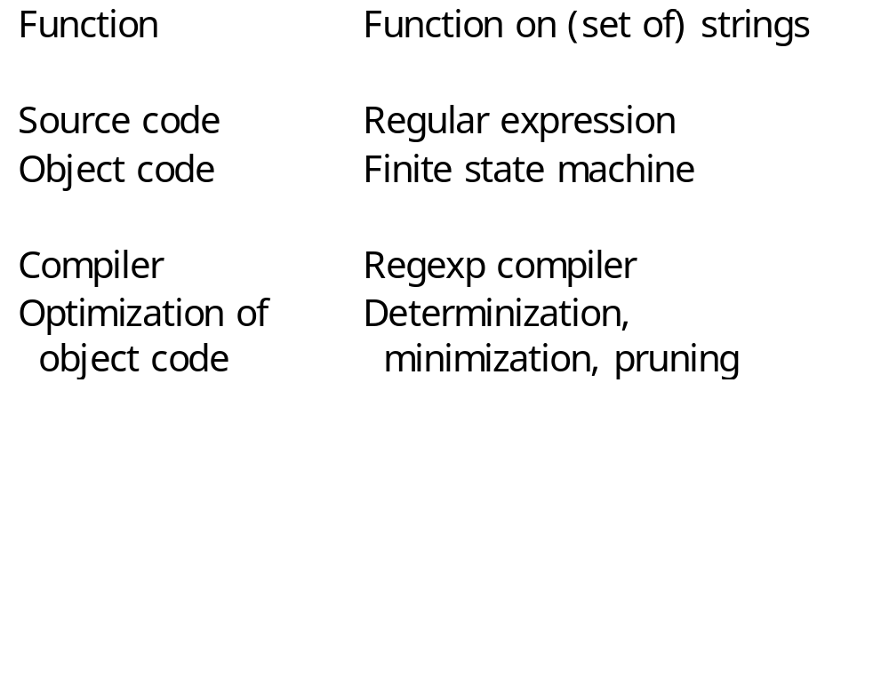
Finite-state “programming”
600.465 - Intro to NLP - J. Eisner

Slide 3
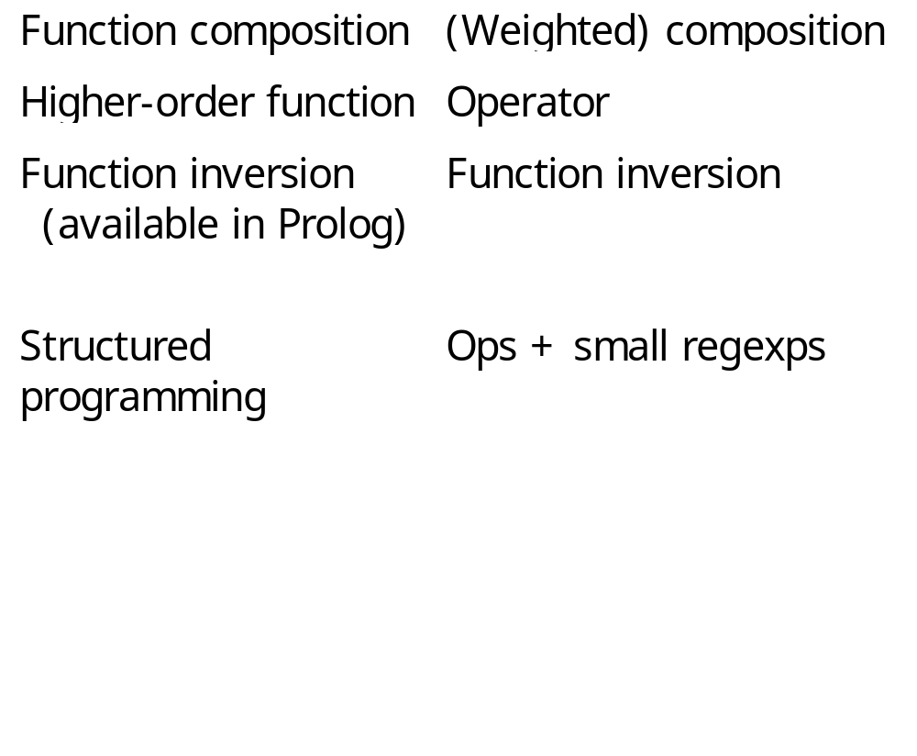
Finite-state “programming”
600.465 - Intro to NLP - J. Eisner

Slide 4
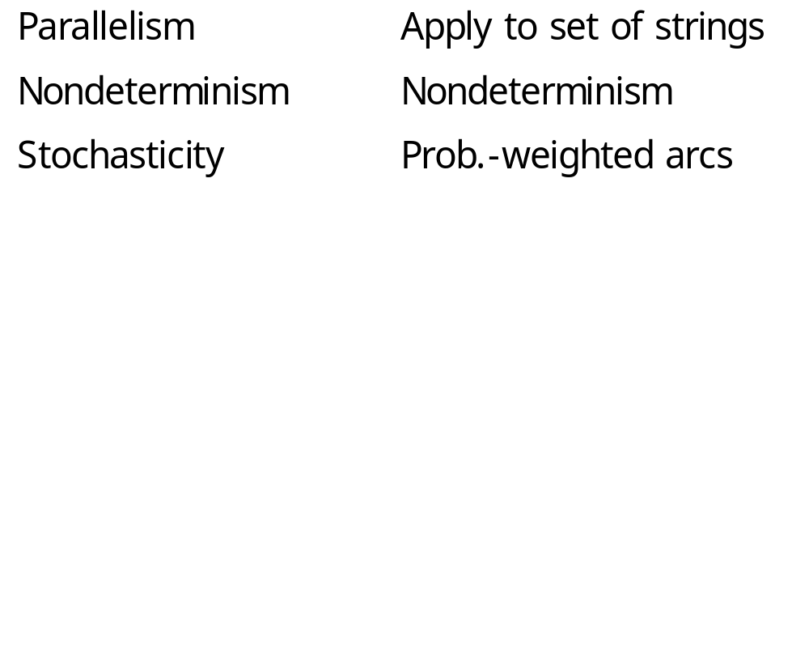
Finite-state “programming”
600.465 - Intro to NLP - J. Eisner

Slide 5
Some Xerox Extensions
slide courtesy of L. Karttunen (modified)
$ containment
=> restriction
-> @-> replacement
  Make it easier to describe complex languages and relations without extending the formal power of finite-state systems.
600.465 - Intro to NLP - J. Eisner

Slide 6
Containment
a,b,c,?
$[ab*c]
b
a
a,b,c,?
“Must contain a substring
that matches ab*c.”
Accepts xxxacyy
Rejects bcba
c
Warning: ? in regexps means
“any character at all.”
But ? in machines means
“any character not explicitly
mentioned anywhere
in the machine.”
?* [ab*c] ?*
Equivalent expression
600.465 - Intro to NLP - J. Eisner

Slide 7
Restriction
slide courtesy of L. Karttunen (modified)
b
a => b _ c
b
?
a
c
“Any a must be preceded by b
and followed by c.”
Accepts bacbbacde
Rejects baca
?
c
c
contains a not preceded by b
contains a not followed by c
~[~[?* b] a ?*] & ~[?* a ~[c ?*]]
Equivalent expression
600.465 - Intro to NLP - J. Eisner

Slide 8
Replacement
slide courtesy of L. Karttunen (modified)
a:b
a b -> b a
b:a
b
?
a:b
“Replace ‘ab’ by ‘ba’.”
Transduces abcdbaba
to bacdbbaa
?
a
a
[~$[a b] [[a b] .x. [b a]]]* ~$[a b]
Equivalent expression
600.465 - Intro to NLP - J. Eisner

Slide 9
Replacement is Nondeterministic
a b -> b a | x
“Replace ‘ab’ by ‘ba’ or ‘x’, nondeterministically.”
Transduces abcdbaba
to {bacdbbaa, bacdbxa, xcdbbaa, xcdbxa}
600.465 - Intro to NLP - J. Eisner

Slide 10
Replacement is Nondeterministic
[ a b -> b a | x ] .o. [ x => _ c ]
“Replace ‘ab’ by ‘ba’ or ‘x’, nondeterministically.”
Transduces abcdbaba
to {bacdbbaa, bacdbxa, xcdbbaa, xcdbxa}
600.465 - Intro to NLP - J. Eisner

Slide 11
Replacement is Nondeterministic
slide courtesy of L. Karttunen (modified)
a b | b | b a | a b a -> x
applied to “aba”
Four overlapping substrings match; we haven’t told it which one to replace so it chooses nondeterministically
a b a a b a a b a a b a
a x a a x x a x
600.465 - Intro to NLP - J. Eisner

Slide 12
More Replace Operators
slide courtesy of L. Karttunen
Optional replacement: a b (->) b a
Directed replacement
  guarantees a unique result by constraining the factorization of the input string by
    Direction of the match (rightward or leftward)
    Length (longest or shortest)
600.465 - Intro to NLP - J. Eisner

Slide 13
@-> Left-to-right, Longest-match Replacement
slide courtesy of L. Karttunen
a b | b | b a | a b a @-> x
applied to “aba”
a b a a b a a b a a b a
a x a a x x a x
@-> left-to-right, longest match
@> left-to-right, shortest match
->@ right-to-left, longest match
>@ right-to-left, shortest match
600.465 - Intro to NLP - J. Eisner

Slide 14
Using “…” for marking
slide courtesy of L. Karttunen (modified)
a|e|i|o|u -> [ ... ]
0:[
[
a
i
?
o
]
e
p o t a t o
p[o]t[a]t[o]
u
0:]
Note: actually have to write as -> %[ ... %]
or -> “[” ... “]”
since [] are parens in the regexp language
600.465 - Intro to NLP - J. Eisner

Slide 15
Using “…” for marking
slide courtesy of L. Karttunen (modified)
a|e|i|o|u -> [ ... ]
0:[
[
a
i
?
o
]
e
p o t a t o
p[o]t[a]t[o]
u
0:]
Which way does the FST transduce potatoe?
p o t a t o e
p[o]t[a]t[o][e]
p o t a t o e
p[o]t[a]t[o e]
vs.
How would you change it to get the other answer?
600.465 - Intro to NLP - J. Eisner

Slide 16
Example: Finnish Syllabification
slide courtesy of L. Karttunen
define C [ b | c | d | f ...
define V [ a | e | i | o | u ];
[C* V+ C*] @-> ... "-" || _ [C V]
“Insert a hyphen after the longest instance of the
C* V+ C* pattern in front of a C V pattern.”
why?
s t r u k t u r a l i s m i
s t r u k - t u - r a - l i s - m i
600.465 - Intro to NLP - J. Eisner

Slide 17
Conditional Replacement
slide courtesy of L. Karttunen
A -> B
L _ R
Replacement
Context
The relation that replaces A by B between L and R leaving everything else unchanged.
Sources of complexity:
Replacements and contexts may overlap
Alternative ways of interpreting
“between left and right.”
600.465 - Intro to NLP - J. Eisner

Slide 18
Hand-Coded Example: Parsing Dates
slide courtesy of L. Karttunen
Today is [Tuesday, July 25, 2000].
Best result
Today is Tuesday, [July 25, 2000].
Today is [Tuesday, July 25], 2000.
Today is Tuesday, [July 25], 2000.
Today is [Tuesday], July 25, 2000.
Bad results
Need left-to-right, longest-match constraints.
600.465 - Intro to NLP - J. Eisner

Slide 19
Source code: Language of Dates
slide courtesy of L. Karttunen
Day = Monday | Tuesday | ... | Sunday
Month = January | February | ... | December
Date = 1 | 2 | 3 | ... | 3 1
Year = %0To9 (%0To9 (%0To9 (%0To9))) - %0?*
from 1 to 9999
AllDates = Day | (Day “, ”) Month “ ” Date (“, ” Year))
600.465 - Intro to NLP - J. Eisner

Slide 20
Object code:
All Dates from 1/1/1 to 12/31/9999
slide courtesy of L. Karttunen
actually represents 7 arcs, each labeled by a string
,
,
Mon
Jan
1
1
0
0
0
Tue
Feb
2
0
2
1
1
1
Wed
Mar
1
3
2
2
2
Thu
Apr
4
2
4
3
3
3
May
5
3
5
4
4
4
Fri
6
4
6
5
5
5
Sat
Jun
7
5
7
6
6
Jul
3
8
8
6
Sun
6
7
7
7
Aug
9
7
9
8
8
Sep
8
8
9
9
9
Oct
9
Nov
0
Dec
1
,
,
13 states, 96 arcs
29 760 007 date expressions
Jan
Feb
Mar
Apr
May
Jun
Jul
Aug
Sep
Oct
Nov
Dec
600.465 - Intro to NLP - J. Eisner

Slide 21
Parser for Dates
slide courtesy of L. Karttunen (modified)
Compiles into an unambiguous transducer (23 states, 332 arcs).
AllDates @-> “[DT ” ... “]”
Xerox left-to-right replacement operator
Today is [DT Tuesday, July 25, 2000] because yesterday was [DT Monday] and it was [DT July 24] so tomorrow must be [DT Wednesday, July 26] and not [DT July 27] as it says on the program.
600.465 - Intro to NLP - J. Eisner

Slide 22
Problem of Reference
slide courtesy of L. Karttunen
Valid dates
Tuesday, July 25, 2000
Tuesday, February 29, 2000
Monday, September 16, 1996
Invalid dates
Wednesday, April 31, 1996
Thursday, February 29, 1900
Tuesday, July 26, 2000
600.465 - Intro to NLP - J. Eisner

Slide 23
Refinement by Intersection
slide courtesy of L. Karttunen (modified)
AllDates
MaxDays
In Month
LeapYears
“ 31” => Jan|Mar|May|… _
Valid
Dates
“ 30” => Jan|Mar|Apr|… _
Feb 29, => _ …
Q: Why does this rule
end with a comma?
Q: Can we write the whole rule?
Xerox contextual
restriction operator
WeekdayDate
Q: Why do these rules
start with spaces?
(And is it enough?)
600.465 - Intro to NLP - J. Eisner

Slide 24
Defining Valid Dates
slide courtesy of L. Karttunen
AllDates
&
MaxDaysInMonth
&
LeapYears
&
WeekdayDates
AllDates: 13 states, 96 arcs
29 760 007 date expressions
= ValidDates
ValidDates: 805 states, 6472 arcs
7 307 053 date expressions
600.465 - Intro to NLP - J. Eisner

Slide 25
Parser for Valid and Invalid Dates
slide courtesy of L. Karttunen
[AllDates - ValidDates] @-> “[ID ” ... “]”
,
ValidDates @-> “[VD ” ... “]”
2688 states,
20439 arcs
Comma creates a single FST that does left-to-right longest match against either pattern
Today is [VD Tuesday, July 25, 2000],
not [ID Tuesday, July 26, 2000].
valid date
invalid date
600.465 - Intro to NLP - J. Eisner

Slide 26
More Engineering Applications
Markup
  Dates, names, places, noun phrases; spelling/grammar errors?
  Hyphenation
  Informative templates for information extraction (FASTUS)
  Word segmentation (use probabilities!)
  Part-of-speech tagging (use probabilities – maybe!)
Translation
  Spelling correction / edit distance
  Phonology, morphology: series of little fixups? constraints?
  Speech
  Transliteration / back-transliteration
  Machine translation?
Learning …
600.465 - Intro to NLP - J. Eisner

Slide 27
FASTUS – Information Extraction
Appelt et al, 1992-?
Input: Bridgestone Sports Co. said Friday it has set up a joint venture in Taiwan with a local concern and a Japanese trading house to produce golf clubs to be shipped to Japan. The joint venture, Bridgestone Sports Taiwan Co., capitalized at 20 million new Taiwan dollars, will start production in January 1990 with …
Output:
Relationship: TIE-UP
Entities: “Bridgestone Sports Co.”
“A local concern”
“A Japanese trading house”
Joint Venture Company: “Bridgestone Sports Taiwan Co.”
Amount: NT$20000000
600.465 - Intro to NLP - J. Eisner

Slide 28
FASTUS: Successive Markups
(details on subsequent slides)
Tokenization
.o.
Multiwords
.o.
Basic phrases (noun groups, verb groups …)
.o.
Complex phrases
.o.
Semantic Patterns
.o.
Merging different references
600.465 - Intro to NLP - J. Eisner

Slide 29
FASTUS: Tokenization
Spaces, hyphens, etc.
wouldn’t → would not
their → them ’s
company. → company .
but
Co. → Co.
600.465 - Intro to NLP - J. Eisner

Slide 30
FASTUS: Multiwords
“set up”
“joint venture”
“San Francisco Symphony Orchestra,” “Canadian Opera Company”
… use a specialized regexp to match musical groups.
... what kind of regexp would match company names?
600.465 - Intro to NLP - J. Eisner

Slide 31
FASTUS : Basic phrases
Output looks like this (no nested brackets!):
… [NG it] [VG had set_up] [NG a joint_venture] [Prep in] …
Company Name: Bridgestone Sports Co.
Verb Group: said
Noun Group: Friday
Noun Group: it
Verb Group: had set up
Noun Group: a joint venture
Preposition: in
Location: Taiwan
Preposition: with
Noun Group: a local concern
600.465 - Intro to NLP - J. Eisner

Slide 32
FASTUS: Noun Groups
Build FSA to recognize phrases like
  approximately 5 kg
  more than 30 people
  the newly elected president
  the largest leftist political force
  a government and commercial project
Use the FSA for left-to-right longest-match markup
What does FSA look like? See next slide …
600.465 - Intro to NLP - J. Eisner

Slide 33
FASTUS: Noun Groups
Described with a kind of non-recursive CFG …
(a regexp can include names that stand for other regexps)
NG → Pronoun | Time-NP | Date-NP
NG → (Det) (Adjs) HeadNouns
…
Adjs → sequence of adjectives maybe with commas, conjunctions, adverbs
…
Det → DetNP | DetNonNP
DetNP → detailed expression to match “the only five, another three, this, many, hers, all, the most …”
…
600.465 - Intro to NLP - J. Eisner

Slide 34
FASTUS: Semantic patterns
BusinessRelationship =
NounGroup(Company/ies) VerbGroup(Set-up) NounGroup(JointVenture) with NounGroup(Company/ies) | …
ProductionActivity =
VerbGroup(Produce) NounGroup(Product)
NounGroup(Company/ies) → NounGroup & …
is made easy by the processing done at a previous level
Use this for spotting references to put in the database.
600.465 - Intro to NLP - J. Eisner

