Slide 1
Part-of-Speech Tagging
A Canonical Finite-State Task
600.465 - Intro to NLP - J. Eisner

Slide 2
The Tagging Task
Input: the lead paint is unsafe
Output: the/Det lead/N paint/N is/V unsafe/Adj
Uses:
  text-to-speech (how do we pronounce “lead”?)
  can write regexps like (Det) Adj* N+ over the output
  preprocessing to speed up parser (but a little dangerous)
  if you know the tag, you can back off to it in other tasks
600.465 - Intro to NLP - J. Eisner

Slide 3
Why Do We Care?
Input: the lead paint is unsafe
Output: the/Det lead/N paint/N is/V unsafe/Adj
The first statistical NLP task
Been done to death by different methods
Easy to evaluate (how many tags are correct?)
Canonical finite-state task
  Can be done well with methods that look at local context
  Though should “really” do it by parsing!
600.465 - Intro to NLP - J. Eisner

Slide 4
Degree of Supervision
Supervised: Training corpus is tagged by humans
Unsupervised: Training corpus isn’t tagged
Partly supervised: Training corpus isn’t tagged, but you have a dictionary giving possible tags for each word
We’ll start with the supervised case and move to decreasing levels of supervision.
600.465 - Intro to NLP - J. Eisner

Slide 5
Current Performance
Input: the lead paint is unsafe
Output: the/Det lead/N paint/N is/V unsafe/Adj
How many tags are correct?
  About 97% currently
  But baseline is already 90%
    Baseline is performance of stupidest possible method
    Tag every word with its most frequent tag
    Tag unknown words as nouns
600.465 - Intro to NLP - J. Eisner

Slide 6
What Should We Look At?
correct tags
PN Verb Det Noun Prep Noun Prep Det Noun
Bill directed a cortege of autos through the dunes
PN Adj Det Noun Prep Noun Prep Det Noun
Verb Verb Noun Verb
Adj some possible tags for
Prep each word (maybe more)
…?
Each unknown tag is constrained by its word
and by the tags to its immediate left and right.
But those tags are unknown too …
600.465 - Intro to NLP - J. Eisner

Slide 7
What Should We Look At?
correct tags
PN Verb Det Noun Prep Noun Prep Det Noun
Bill directed a cortege of autos through the dunes
PN Adj Det Noun Prep Noun Prep Det Noun
Verb Verb Noun Verb
Adj some possible tags for
Prep each word (maybe more)
…?
Each unknown tag is constrained by its word
and by the tags to its immediate left and right.
But those tags are unknown too …
600.465 - Intro to NLP - J. Eisner

Slide 8
What Should We Look At?
correct tags
PN Verb Det Noun Prep Noun Prep Det Noun
Bill directed a cortege of autos through the dunes
PN Adj Det Noun Prep Noun Prep Det Noun
Verb Verb Noun Verb
Adj some possible tags for
Prep each word (maybe more)
…?
Each unknown tag is constrained by its word
and by the tags to its immediate left and right.
But those tags are unknown too …
600.465 - Intro to NLP - J. Eisner

Slide 9
Three Finite-State Approaches
Noisy Channel Model (statistical)
real language X
part-of-speech tags
(n-gram model)
noisy channel X → Y
replace tags
with words
yucky language Y
text
want to recover X from Y
600.465 - Intro to NLP - J. Eisner

Slide 10
Three Finite-State Approaches
Noisy Channel Model (statistical)
Deterministic baseline tagger composed with a cascade of fixup transducers
Nondeterministic tagger composed with a cascade of finite-state automata that act as filters
600.465 - Intro to NLP - J. Eisner

Slide 11
Review: Noisy Channel
real language X
p(X)
*
noisy channel X → Y
p(Y | X)
=
yucky language Y
p(X,Y)
want to recover x∈X from y∈Y
choose x that maximizes p(x | y) or equivalently p(x,y)
600.465 - Intro to NLP - J. Eisner

Slide 12
Review: Noisy Channel
a:a/0.7
b:b/0.3
p(X)
.o.
*
a:C/0.1
b:C/0.8
p(Y | X)
a:D/0.9
b:D/0.2
=
=
p(X,Y)
a:C/0.07
b:C/0.24
a:D/0.63
b:D/0.06
Note p(x,y) sums to 1.
Suppose y=“C”; what is best “x”?
600.465 - Intro to NLP - J. Eisner

Slide 13
Review: Noisy Channel
a:a/0.7
b:b/0.3
p(X)
.o.
*
a:C/0.1
b:C/0.8
p(Y | X)
a:D/0.9
b:D/0.2
=
=
p(X,Y)
a:C/0.07
b:C/0.24
a:D/0.63
b:D/0.06
Suppose y=“C”; what is best “x”?
600.465 - Intro to NLP - J. Eisner

Slide 14
Review: Noisy Channel
a:a/0.7
b:b/0.3
p(X)
.o.
*
a:C/0.1
b:C/0.8
p(Y | X)
a:D/0.9
b:D/0.2
.o.
*
restrict just to
paths compatible
with output “C”
(Y = y)?
C:C/1
=
=
p(X, y)
a:C/0.07
b:C/0.24
best path
600.465 - Intro to NLP - J. Eisner

Slide 15
Noisy Channel for Tagging
acceptor: p(tag sequence)
a:a/0.7
b:b/0.3
p(X)
“Markov Model”
.o.
*
a:C/0.1
b:C/0.8
p(Y | X)
transducer: tags → words
a:D/0.9
b:D/0.2
“Unigram Replacement”
.o.
*
acceptor: the observed words
(Y = y)?
C:C/1
“straight line”
=
=
transducer: scores candidate tag seqs
on their joint probability with obs words;
pick best path
p(X, y)
a:C/0.07
b:C/0.24
best path
600.465 - Intro to NLP - J. Eisner

Slide 16
Markov Model (bigrams)
Verb
Det
Start
Prep
Adj
Noun
Stop
600.465 - Intro to NLP - J. Eisner

Slide 17
Markov Model
Verb
Det
0.3
0.7
Start
Prep
Adj
0.4
0.5
Noun
Stop
0.1
600.465 - Intro to NLP - J. Eisner

Slide 18
Markov Model
Verb
0.8
Det
0.3
0.7
Start
Prep
Adj
0.4
0.5
Noun
Stop
0.2
0.1
600.465 - Intro to NLP - J. Eisner

Slide 19
Markov Model
p(tag seq)
Verb
0.8
Det
0.3
0.7
Start
Prep
Adj
0.4
0.5
Noun
Stop
0.2
0.1
Start Det Adj Adj Noun Stop = 0.8 * 0.3 * 0.4 * 0.5 * 0.2
600.465 - Intro to NLP - J. Eisner

Slide 20
Markov Model as an FSA
p(tag seq)
Verb
0.8
Det
0.3
0.7
Start
Prep
Adj
0.4
0.5
Noun
Stop
0.2
0.1
Start Det Adj Adj Noun Stop = 0.8 * 0.3 * 0.4 * 0.5 * 0.2
600.465 - Intro to NLP - J. Eisner

Slide 21
Markov Model as an FSA
p(tag seq)
Verb
Det 0.8
Det
Noun
0.7
Adj 0.3
Start
Prep
Adj
Noun
0.5
Adj 0.4
Noun
Stop
ε 0.2
ε 0.1
Start Det Adj Adj Noun Stop = 0.8 * 0.3 * 0.4 * 0.5 * 0.2
600.465 - Intro to NLP - J. Eisner

Slide 22
Markov Model (tag bigrams)
p(tag seq)
Det 0.8
Det
Adj 0.3
Start
Adj
Noun
0.5
Adj 0.4
Noun
Stop
ε 0.2
Start Det Adj Adj Noun Stop = 0.8 * 0.3 * 0.4 * 0.5 * 0.2
600.465 - Intro to NLP - J. Eisner

Slide 23
Noisy Channel for Tagging
automaton: p(tag sequence)
p(X)
“Markov Model”
.o.
*
transducer: tags → words
p(Y | X)
“Unigram Replacement”
.o.
*
automaton: the observed words
p(y | Y)
“straight line”
=
=
transducer: scores candidate tag seqs
on their joint probability with obs words;
pick best path
p(X, y)
600.465 - Intro to NLP - J. Eisner

Slide 24
Noisy Channel for Tagging
Det
Verb
Det 0.8
Noun
0.7
Adj 0.3
p(X)
Start
Prep
Adj
Noun
0.5
.o.
Adj 0.4
Noun
Stop
…
Noun:cortege/0.000001
*
ε 0.1
ε 0.2
Noun:autos/0.001
Noun:Bill/0.002
p(Y | X)
Det:a/0.6
Det:the/0.4
Adj:cool/0.003
.o.
Adj:directed/0.0005
*
Adj:cortege/0.000001
…
the
cool
directed
autos
p(y | Y)
=
=
transducer: scores candidate tag seqs
on their joint probability with obs words;
we should pick best path
p(X, y)
600.465 - Intro to NLP - J. Eisner

Slide 25
Unigram Replacement Model
p(word seq | tag seq)
…
Noun:cortege/0.000001
Noun:autos/0.001
sums to 1
Noun:Bill/0.002
Det:a/0.6
Det:the/0.4
Adj:cool/0.003
sums to 1
Adj:directed/0.0005
Adj:cortege/0.000001
…
600.465 - Intro to NLP - J. Eisner

Slide 26
Compose
Verb
…
Noun:cortege/0.000001
Det
Noun:autos/0.001
Det 0.8
Adj 0.3
Noun
0.7
Noun:Bill/0.002
Start
Prep
Det:a/0.6
Adj
Noun
0.5
Det:the/0.4
Adj 0.4
Noun
Stop
Adj:cool/0.003
ε 0.1
Adj:directed/0.0005
ε 0.2
Adj:cortege/0.000001
…
p(tag seq)
Verb
Det 0.8
Det
Adj 0.3
Start
Prep
Adj
Noun
0.5
Adj 0.4
Noun
Stop
ε 0.2
600.465 - Intro to NLP - J. Eisner

Slide 27
Compose
Verb
…
Noun:cortege/0.000001
Det
Noun:autos/0.001
Det 0.8
Adj 0.3
Noun
0.7
Noun:Bill/0.002
Start
Prep
Det:a/0.6
Adj
Noun
0.5
Det:the/0.4
Adj 0.4
Noun
Stop
Adj:cool/0.003
ε 0.1
Adj:directed/0.0005
ε 0.2
Adj:cortege/0.000001
…
p(word seq, tag seq) = p(tag seq) * p(word seq | tag seq)
Verb
Det:a 0.48
Det:the 0.32
Det
Adj:cool 0.0009
Adj:directed 0.00015
Adj:cortege 0.000003
Start
Prep
Adj
Noun
ε
Stop
N:cortege
N:autos
Adj:cool 0.0012
Adj:directed 0.00020
Adj:cortege 0.000004
600.465 - Intro to NLP - J. Eisner

Slide 28
Observed Words as Straight-Line FSA
word seq
the
cool
directed
autos
600.465 - Intro to NLP - J. Eisner

Slide 29
Compose with
the
cool
directed
autos
p(word seq, tag seq) = p(tag seq) * p(word seq | tag seq)
Verb
Det:a 0.48
Det:the 0.32
Det
Adj:cool 0.0009
Adj:directed 0.00015
Adj:cortege 0.000003
Start
Prep
Adj
Noun
ε
Stop
N:cortege
N:autos
Adj:cool 0.0012
Adj:directed 0.00020
Adj:cortege 0.000004
600.465 - Intro to NLP - J. Eisner

Slide 30
Compose with
the
cool
directed
autos
p(word seq, tag seq) = p(tag seq) * p(word seq | tag seq)
Verb
Det:the 0.32
Det
Adj:cool 0.0009
Start
Prep
Adj
why did this
loop go away?
Noun
ε
Stop
N:autos
Adj:directed 0.00020
Adj
600.465 - Intro to NLP - J. Eisner

Slide 31
The best path:
Start Det Adj Adj Noun Stop = 0.32 * 0.0009 …
the cool directed autos
p(word seq, tag seq) = p(tag seq) * p(word seq | tag seq)
Verb
Det:the 0.32
Det
Adj:cool 0.0009
Start
Prep
Adj
Noun
ε
Stop
N:autos
Adj:directed 0.00020
Adj
600.465 - Intro to NLP - J. Eisner

Slide 32
In Fact, Paths Form a “Trellis”
p(word seq, tag seq)
Adj:cool 0.0009
Det
Det
Det
Det
Det:the 0.32
Start
Adj
Adj
Adj:directed…
Adj
Adj
Stop
Noun:cool 0.007
Noun:autos…
ε 0.2
Adj:directed…
Noun
Noun
Noun
Noun
The best path:
Start Det Adj Adj Noun Stop = 0.32 * 0.0009 …
the cool directed autos
600.465 - Intro to NLP - J. Eisner

Slide 33
The Trellis Shape Emerges from the Cross-Product Construction for Finite-State Composition
3
ε
0
1
ε
4
ε
2
.o.
0
1
2
3
4
=
All paths here are 4 words
1,1
1,2
1,3
1,4
ε
ε
0,0
2,1
2,2
2,3
2,4
4,4
ε
3,1
3,2
3,3
3,4
So all paths here must have 4 words on output side
600.465 - Intro to NLP - J. Eisner

Slide 34
Actually, Trellis Isn’t Complete
p(word seq, tag seq)
Trellis has no Det → Det or Det →Stop arcs; why?
Adj:cool 0.0009
Det
Det
Det
Det
Det:the 0.32
Start
Adj
Adj
Adj:directed…
Adj
Adj
Stop
Noun:cool 0.007
Noun:autos…
ε 0.2
Adj:directed…
Noun
Noun
Noun
Noun
The best path:
Start Det Adj Adj Noun Stop = 0.32 * 0.0009 …
the cool directed autos
600.465 - Intro to NLP - J. Eisner

Slide 35
Actually, Trellis Isn’t Complete
p(word seq, tag seq)
Lattice is missing some other arcs; why?
Adj:cool 0.0009
Det
Det
Det
Det
Det:the 0.32
Start
Adj
Adj
Adj:directed…
Adj
Adj
Stop
Noun:cool 0.007
Noun:autos…
ε 0.2
Adj:directed…
Noun
Noun
Noun
Noun
The best path:
Start Det Adj Adj Noun Stop = 0.32 * 0.0009 …
the cool directed autos
600.465 - Intro to NLP - J. Eisner

Slide 36
Actually, Trellis Isn’t Complete
p(word seq, tag seq)
Lattice is missing some states; why?
Adj:cool 0.0009
Det
Det:the 0.32
Start
Adj
Adj:directed…
Adj
Stop
Noun:cool 0.007
Noun:autos…
ε 0.2
Adj:directed…
Noun
Noun
Noun
The best path:
Start Det Adj Adj Noun Stop = 0.32 * 0.0009 …
the cool directed autos
600.465 - Intro to NLP - J. Eisner

Slide 37
Find best path from Start to Stop
Adj:cool 0.0009
Det
Det
Det
Det
Det:the 0.32
Start
Adj
Adj
Adj:directed…
Adj
Adj
Stop
Noun:cool 0.007
Noun:autos…
ε 0.2
Adj:directed…
Noun
Noun
Noun
Noun
Use dynamic programming – like prob. parsing:
  What is best path from Start to each node?
  Work from left to right
  Each node stores its best path from Start (as probability plus one backpointer)
Special acyclic case of Dijkstra’s shortest-path alg.
Faster if some arcs/states are absent
600.465 - Intro to NLP - J. Eisner

Slide 38
In Summary
We are modeling p(word seq, tag seq)
The tags are hidden, but we see the words
Is tag sequence X likely with these words?
Noisy channel model is a “Hidden Markov Model”:
probs
from tag
bigram
model
0.4
0.6
Start PN Verb Det Noun Prep Noun Prep Det Noun Stop
0.001
probs from
unigram
replacement
Bill directed a cortege of autos through the dunes
Find X that maximizes probability product
600.465 - Intro to NLP - J. Eisner

Slide 39
Another Viewpoint
We are modeling p(word seq, tag seq)
Why not use chain rule + some kind of backoff?
Actually, we are!
p(
Start PN Verb Det …
Bill directed a …
)
= p(Start) * p(PN | Start) * p(Verb | Start PN) * p(Det | Start PN Verb) * …
* p(Bill | Start PN Verb …) * p(directed | Bill, Start PN Verb Det …)
* p(a | Bill directed, Start PN Verb Det …) * …
600.465 - Intro to NLP - J. Eisner

Slide 40
Another Viewpoint
We are modeling p(word seq, tag seq)
Why not use chain rule + some kind of backoff?
Actually, we are!
p(
Start PN Verb Det …
Bill directed a …
)
= p(Start) * p(PN | Start) * p(Verb | Start PN) * p(Det | Start PN Verb) * …
* p(Bill | Start PN Verb …) * p(directed | Bill, Start PN Verb Det …)
* p(a | Bill directed, Start PN Verb Det …) * …
Start PN Verb Det Noun Prep Noun Prep Det Noun Stop
Bill directed a cortege of autos through the dunes
600.465 - Intro to NLP - J. Eisner

Slide 41
Three Finite-State Approaches
Noisy Channel Model (statistical)
Deterministic baseline tagger composed with a cascade of fixup transducers
Nondeterministic tagger composed with a cascade of finite-state automata that act as filters
600.465 - Intro to NLP - J. Eisner

Slide 42
Another FST Paradigm: Successive Fixups
Like successive markups but alter
Morphology
Phonology
Part-of-speech tagging
…
Initial annotation
input
Fixup 1
Fixup 2
Fixup 3
output
600.465 - Intro to NLP - J. Eisner

Slide 43
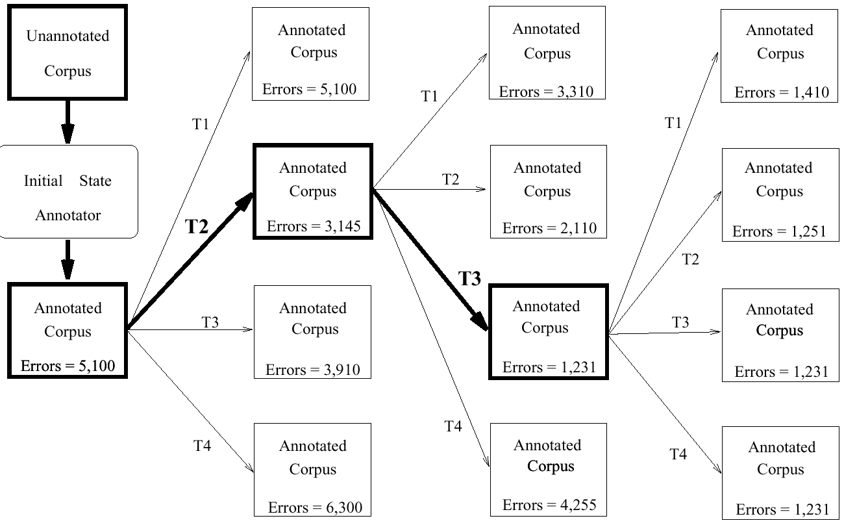
Transformation-Based Tagging
(Brill 1995)
figure from Brill’s thesis
600.465 - Intro to NLP - J. Eisner

Slide 44
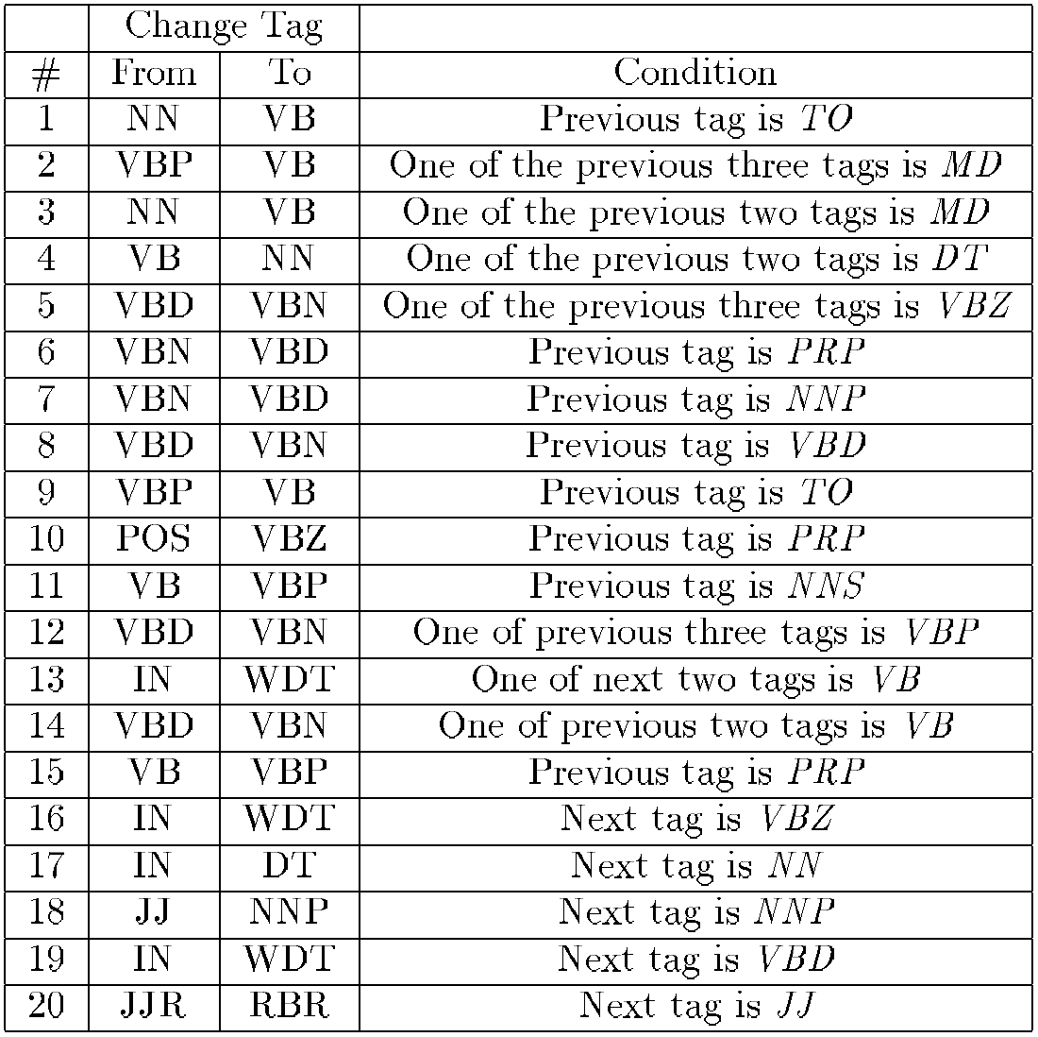
Transformations Learned
figure from Brill’s thesis
BaselineTag*
NN @→ VB // TO _
VBP @→ VB // ... _
etc.
Compose this
cascade of FSTs.
Gets a big FST that
does the initial
tagging and the
sequence of fixups
“all at once.”
600.465 - Intro to NLP - J. Eisner

Slide 45
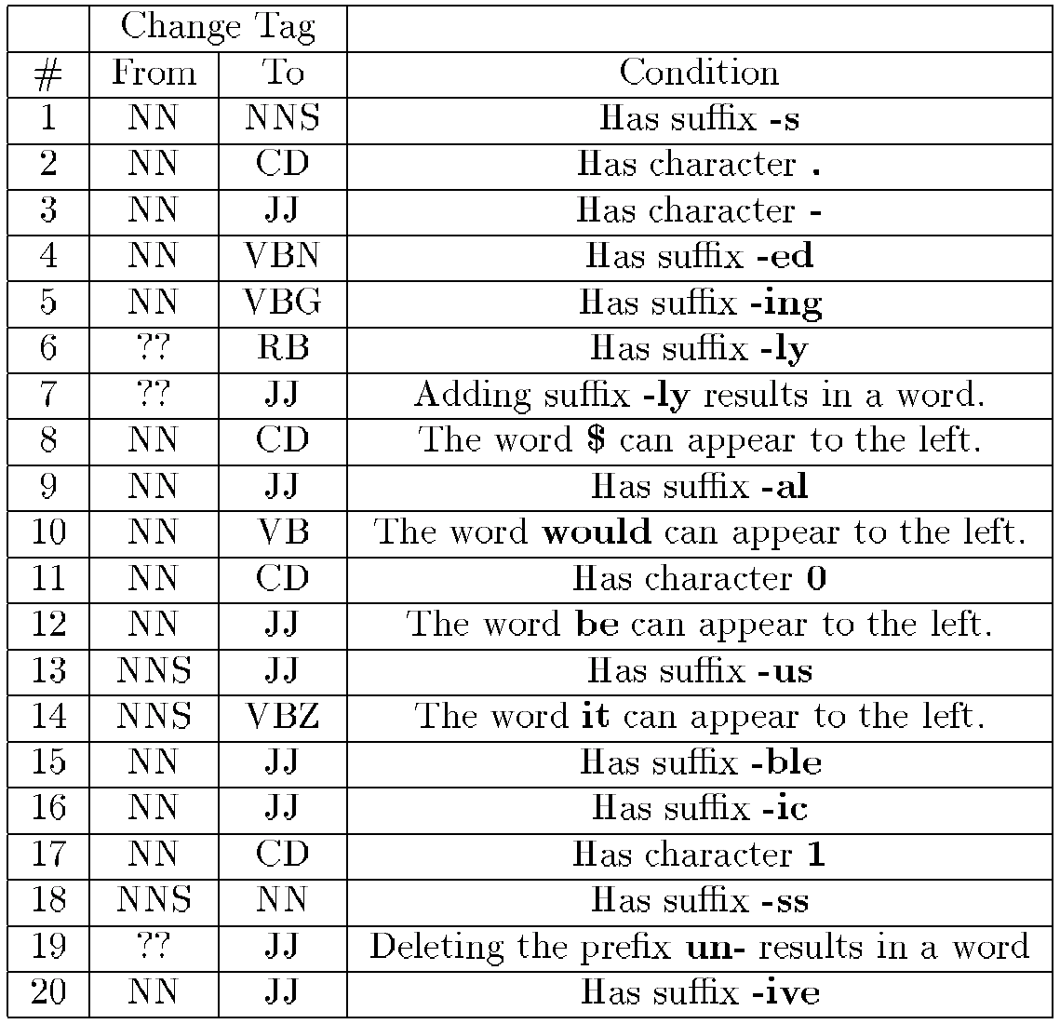
Initial Tagging of OOV Words
figure from Brill’s thesis
600.465 - Intro to NLP - J. Eisner

Slide 46
Three Finite-State Approaches
Noisy Channel Model (statistical)
Deterministic baseline tagger composed with a cascade of fixup transducers
Nondeterministic tagger composed with a cascade of finite-state automata that act as filters
600.465 - Intro to NLP - J. Eisner

Slide 47
Variations
Multiple tags per word
  Transformations to knock some of them out
How to encode multiple tags and knockouts?
Use the above for partly supervised learning
  Supervised: You have a tagged training corpus
  Unsupervised: You have an untagged training corpus
  Here: You have an untagged training corpus and a dictionary giving possible tags for each word
600.465 - Intro to NLP - J. Eisner

