Slide 1
The Expectation Maximization (EM) Algorithm
… continued!
600.465 - Intro to NLP - J. Eisner

Slide 2
General Idea
Start by devising a noisy channel
  Any model that predicts the corpus observations via some hidden structure (tags, parses, …)
Initially guess the parameters of the model!
  Educated guess is best, but random can work
Expectation step: Use current parameters (and observations) to reconstruct hidden structure
Maximization step: Use that hidden structure (and observations) to reestimate parameters
Repeat until convergence!
600.465 - Intro to NLP - J. Eisner

Slide 3
General Idea
initial
guess
E step
Guess of
unknown
parameters
(probabilities)
Guess of unknown
hidden structure
(tags, parses, weather)
Observed structure
(words, ice cream)
M step
600.465 - Intro to NLP - J. Eisner

Slide 4
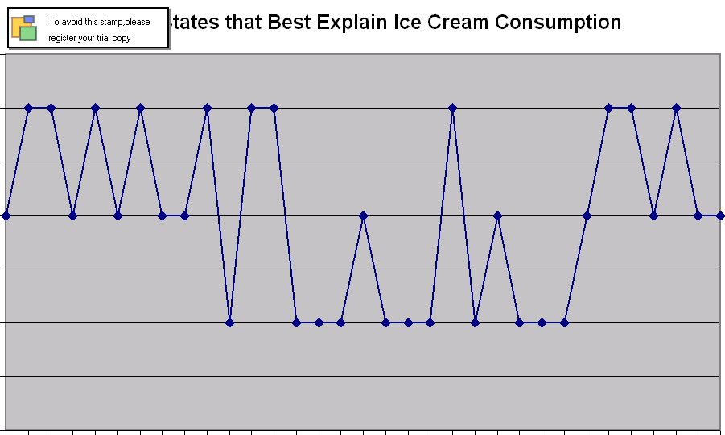
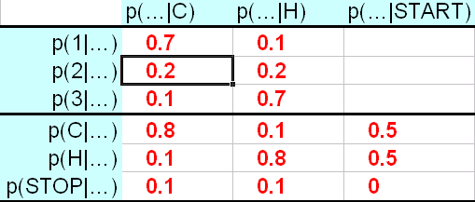
For Hidden Markov Models
initial
guess
E step
Guess of
unknown
parameters
(probabilities)
Guess of unknown
hidden structure
(tags, parses, weather)
Observed structure
(words, ice cream)
M step
600.465 - Intro to NLP - J. Eisner

Slide 5
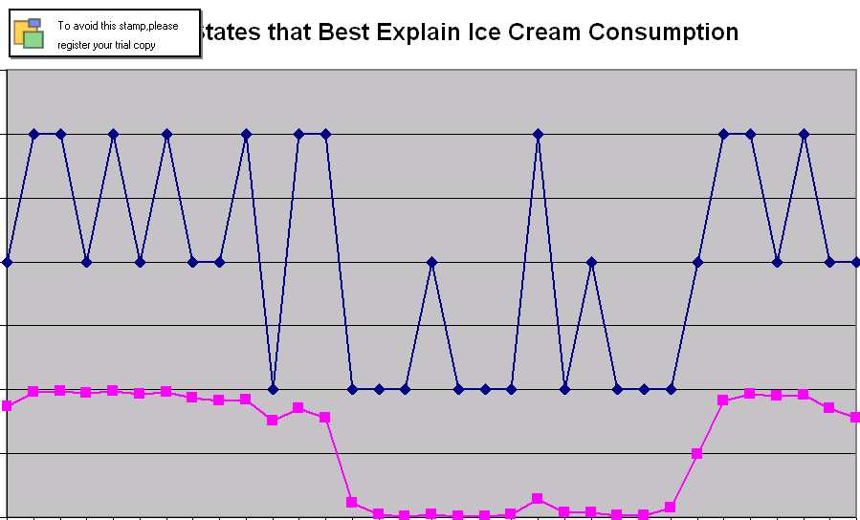
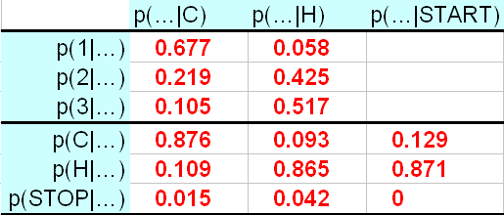
For Hidden Markov Models
initial
guess
E step
Guess of
unknown
parameters
(probabilities)
Guess of unknown
hidden structure
(tags, parses, weather)
Observed structure
(words, ice cream)
M step
600.465 - Intro to NLP - J. Eisner

Slide 6
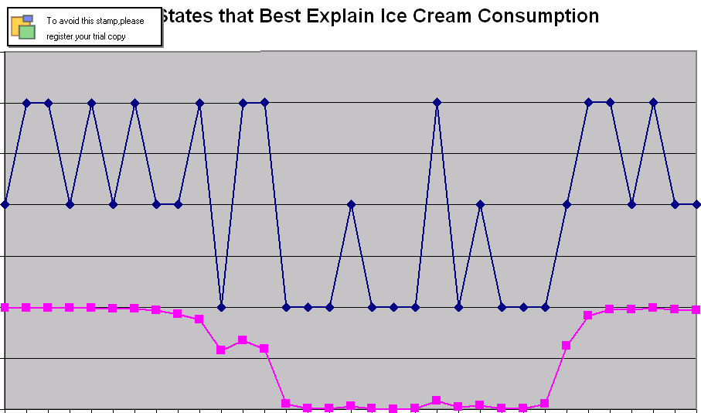
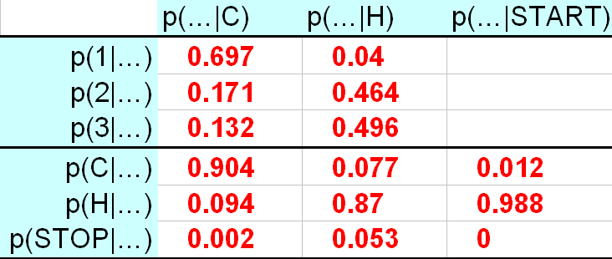
For Hidden Markov Models
initial
guess
E step
Guess of
unknown
parameters
(probabilities)
Guess of unknown
hidden structure
(tags, parses, weather)
Observed structure
(words, ice cream)
M step
600.465 - Intro to NLP - J. Eisner

Slide 7
Grammar Reestimation
correct test trees
E step
P
A
R
S
E
R
s
c
o
r
e
r
accuracy
test
sentences
expensive and/or
wrong sublanguage
cheap, plentiful
and appropriate
Grammar
LEARNER
M step
training
trees
600.465 - Intro to NLP - J. Eisner

Slide 8
EM by Dynamic Programming: Two Versions
The Viterbi approximation
  Expectation: pick the best parse of each sentence
  Maximization: retrain on this best-parsed corpus
  Advantage: Speed!
Real EM
  Expectation: find all parses of each sentence
  Maximization: retrain on all parses in proportion to their probability (as if we observed fractional count)
  Advantage: p(training corpus) guaranteed to increase
  Exponentially many parses, so don’t extract them from chart – need some kind of clever counting
why slower?
600.465 - Intro to NLP - J. Eisner

Slide 9
Examples of EM
Finite-State case: Hidden Markov Models
  “forward-backward” or “Baum-Welch” algorithm
  Applications:
    explain ice cream in terms of underlying weather sequence
    explain words in terms of underlying tag sequence
    explain phoneme sequence in terms of underlying word
    explain sound sequence in terms of underlying phoneme
Context-Free case: Probabilistic CFGs
  “inside-outside” algorithm: unsupervised grammar learning!
  Explain raw text in terms of underlying cx-free parse
    In practice, local maximum problem gets in the way
    But can improve a good starting grammar via raw text
Clustering case: explain points via clusters
compose
these?
600.465 - Intro to NLP - J. Eisner

Slide 10
Our old friend PCFG
S
NP
time
VP
| S) = p(S → NP VP | S) * p(NP → time | NP)
p(
V
flies
PP
* p(VP → V PP | VP)
P
like
NP
* p(V → flies | V) * …
Det
an
N
arrow
600.465 - Intro to NLP - J. Eisner

Slide 11
Viterbi reestimation for parsing
Start with a “pretty good” grammar
  E.g., it was trained on supervised data (a treebank) that is small, imperfectly annotated, or has sentences in a different style from what you want to parse.
Parse a corpus of unparsed sentences:
Reestimate:
  Collect counts: …; c(S → NP VP) += 12; c(S) += 2*12; …
  Divide: p(S → NP VP | S) = c(S → NP VP) / c(S)
  May be wise to smooth
S
…
12 Today stocks were up
…
AdvP
S
# copies of this sentence
in the corpus
12
NP
VP
Today
stocks
V
PRT
were
up
600.465 - Intro to NLP - J. Eisner

Slide 12
True EM for parsing
Similar, but now we consider all parses of each sentence
Parse our corpus of unparsed sentences:
Collect counts fractionally:
  …; c(S → NP VP) += 10.8; c(S) += 2*10.8; …
  …; c(S → NP VP) += 1.2; c(S) += 1*1.2; …
But there may be exponentially
many parses of a length-n sentence!
  How can we stay fast? Similar to taggings…
S
…
12 Today stocks were up
…
AdvP
S
# copies of this sentence
in the corpus
10.8
NP
VP
Today
stocks
V
PRT
1.2
were
up
S
NP
VP
NP
NP
V
PRT
Today
stocks
up
600.465 - Intro to NLP - J. Eisner
were

Slide 13
Analogies to α, β in PCFG?
The dynamic programming computation of α. (β is similar but works back from Stop.)
Day 1: 2 cones
Day 2: 3 cones
Day 3: 3 cones
α=0.1*0.08+0.1*0.01
=0.009
α=0.009*0.08+0.063*0.01
=0.00135
α=0.1
C
p(C|C)*p(3|C)
C
p(C|C)*p(3|C)
C
p(C|Start)*p(2|C)
0.8*0.1=0.08
0.8*0.1=0.08
0.5*0.2=0.1
p(C|H)*p(3|C)
Start
p(H|C)*p(3|H)
p(C|H)*p(3|C)
p(H|C)*p(3|H)
0.1*0.7=0.07
0.1*0.1=0.01
0.1*0.7=0.07
0.1*0.1=0.01
p(H|Start)*p(2|H)
0.5*0.2=0.1
H
p(H|H)*p(3|H)
H
p(H|H)*p(3|H)
0.8*0.7=0.56
H
0.8*0.7=0.56
α=0.1
α=0.1*0.07+0.1*0.56
=0.063
α=0.009*0.07+0.063*0.56
=0.03591
Call these α_{H}(2) and β_{H}(2)
α_{H}(3) and β_{H}(3)
600.465 - Intro to NLP - J. Eisner

Slide 14
“Inside Probabilities”
S
NP
time
VP
| S) = p(S → NP VP | S) * p(NP → time | NP)
p(
V
flies
PP
* p(VP → V PP | VP)
P
like
NP
* p(V → flies | V) * …
Det
an
N
arrow
Sum over all VP parses of “flies like an arrow”:
    β_{VP}(1,5) = p(flies like an arrow | VP)
Sum over all S parses of “time flies like an arrow”:
    β_{S}(0,5) = p(time flies like an arrow | S)
600.465 - Intro to NLP - J. Eisner

Slide 15
Compute β Bottom-Up by CKY
S
NP
time
VP
| S) = p(S → NP VP | S) * p(NP → time | NP)
p(
V
flies
PP
* p(VP → V PP | VP)
P
like
NP
* p(V → flies | V) * …
Det
an
N
arrow
β_{VP}(1,5) = p(flies like an arrow | VP) = …
β_{S}(0,5) = p(time flies like an arrow | S)
= β_{NP}(0,1) * β_{VP}(1,5) * p(S → NP VP|S) + …
600.465 - Intro to NLP - J. Eisner

Slide 16
Compute β Bottom-Up by CKY
time 1 flies 2 like 3 an 4 arrow 5
0 | NP 3 Vst 3 | NP 10 S 8 S 13 |  |  | NP 24 NP 24 S 22 S 27 S 27
1 |  | NP 4 VP 4 |  |  | NP 18 S 21 VP 18
2 |  |  | P 2 V 5 |  | PP 12 VP 16
3 |  |  |  | Det 1 | NP 10
4 |  |  |  |  | N 8
1 S → NP VP
6 S → Vst NP
2 S → S PP
1 VP → V NP
2 VP → VP PP
1 NP → Det N
2 NP → NP PP
3 NP → NP NP
0 PP → P NP

Slide 17
Compute β Bottom-Up by CKY
time 1 flies 2 like 3 an 4 arrow 5
0 | NP 2⁻³ Vst 2⁻³ | NP 2⁻¹⁰ S 2⁻⁸ S 2⁻¹³ |  |  | NP 2⁻²⁴ NP 2⁻²⁴ S 2⁻²² S 2⁻²⁷ S 2⁻²⁷
 |  | NP 2⁻⁴ VP 2⁻⁴ |  |  | NP 2⁻¹⁸ S 2⁻²¹ VP 2⁻¹⁸
2 |  |  | P 2⁻² V 2⁻⁵ |  | PP 2⁻¹² VP 2⁻¹⁶
3 |  |  |  | Det 2⁻¹ | NP 2⁻¹⁰
4 |  |  |  |  | N 2⁻⁸
2⁻¹ S → NP VP
2⁻⁶ S → Vst NP
2⁻² S → S PP
2⁻¹ VP → V NP
2⁻² VP → VP PP
2⁻¹ NP → Det N
2⁻² NP → NP PP
2⁻³ NP → NP NP
2⁻⁰ PP → P NP
S 2⁻²²

Slide 18
Compute β Bottom-Up by CKY
time 1 flies 2 like 3 an 4 arrow 5
0 | NP 2⁻³ Vst 2⁻³ | NP 2⁻¹⁰ S 2⁻⁸ S 2⁻¹³ |  |  | NP 2⁻²⁴ NP 2⁻²⁴ S 2⁻²² S 2⁻²⁷ S 2⁻²⁷ S 2⁻²²
 |  | NP 2⁻⁴ VP 2⁻⁴ |  |  | NP 2⁻¹⁸ S 2⁻²¹ VP 2⁻¹⁸
2 |  |  | P 2⁻² V 2⁻⁵ |  | PP 2⁻¹² VP 2⁻¹⁶
3 |  |  |  | Det 2⁻¹ | NP 2⁻¹⁰
4 |  |  |  |  | N 2⁻⁸
2⁻¹ S → NP VP
2⁻⁶ S → Vst NP
2⁻² S → S PP
2⁻¹ VP → V NP
2⁻² VP → VP PP
2⁻¹ NP → Det N
2⁻² NP → NP PP
2⁻³ NP → NP NP
2⁻⁰ PP → P NP
S 2⁻²⁷

Slide 19
The Efficient Version: Add as we go
time 1 flies 2 like 3 an 4 arrow 5
0 | NP 2⁻³ Vst 2⁻³ | NP 2⁻¹⁰ S 2⁻⁸ S 2⁻¹³ |  |  | NP 2⁻²⁴ NP 2⁻²⁴ S 2⁻²² S 2⁻²⁷ S 2⁻²⁷
 |  | NP 2⁻⁴ VP 2⁻⁴ |  |  | NP 2⁻¹⁸ S 2⁻²¹ VP 2⁻¹⁸
2 |  |  | P 2⁻² V 2⁻⁵ |  | PP 2⁻¹² VP 2⁻¹⁶
3 |  |  |  | Det 2⁻¹ | NP 2⁻¹⁰
4 |  |  |  |  | N 2⁻⁸
2⁻¹ S → NP VP
2⁻⁶ S → Vst NP
2⁻² S → S PP
2⁻¹ VP → V NP
2⁻² VP → VP PP
2⁻¹ NP → Det N
2⁻² NP → NP PP
2⁻³ NP → NP NP
2⁻⁰ PP → P NP

Slide 20
The Efficient Version: Add as we go
time 1 flies 2 like 3 an 4 arrow 5
0 | NP 2⁻³ Vst 2⁻³ | NP 2⁻¹⁰ S 2⁻⁸ +2⁻¹³ |  |  | NP 2⁻²⁴ +2⁻²⁴ S 2⁻²² +2⁻²⁷ +2⁻²⁷
 |  | NP 2⁻⁴ VP 2⁻⁴ |  |  | NP 2⁻¹⁸ S 2⁻²¹ VP 2⁻¹⁸
2 |  |  | P 2⁻² V 2⁻⁵ |  | PP 2⁻¹² VP 2⁻¹⁶
3 |  |  |  | Det 2⁻¹ | NP 2⁻¹⁰
4 |  |  |  |  | N 2⁻⁸
β_{s}(0,5)
β_{S}(0,2)
2⁻¹ S → NP VP
2⁻⁶ S → Vst NP
2⁻² S → S PP
2⁻¹ VP → V NP
2⁻² VP → VP PP
2⁻¹ NP → Det N
2⁻² NP → NP PP
2⁻³ NP → NP NP
2⁻⁰ PP → P NP
β_{s}(0,2)* β_{PP}(2,5)*p(S → S PP | S)
+2⁻²²
+2⁻²⁷
β_{PP}(2,5)

Slide 21
Compute β probs bottom-up (CKY)
need some initialization up here for the width-1 case
for width := 2 to n (* build smallest first *)
for i := 0 to n-width (* start *)
let k := i + width (* end *)
for j := i+1 to k-1 (* middle *)
for all grammar rules X → Y Z
β_{X}(i,k) += p(X → Y Z | X) * β_{Y}(i,j) * β_{Z}(j,k)
X
Y
Z
what if you changed + to max?
what if you replaced all rule probabilities by 1?
i
j
k
600.465 - Intro to NLP - J. Eisner

Slide 22
Inside & Outside Probabilities
S
“outside” the VP
NP
time
VP
α_{VP}(1,5) = p(time VP today | S)
VP
NP
today
V
flies
PP
β_{VP}(1,5) = p(flies like an arrow | VP)
P
like
NP
α_{VP}(1,5) * β_{VP}(1,5)
= p(time [VP flies like an arrow] today | S)
Det
an
N
arrow
“inside” the VP
600.465 - Intro to NLP - J. Eisner

Slide 23
Inside & Outside Probabilities
S
NP
time
VP
α_{VP}(1,5) = p(time VP today | S)
VP
NP
today
V
flies
PP
β_{VP}(1,5) = p(flies like an arrow | VP)
P
like
NP
/ β_{S}(0,6)
α_{VP}(1,5) * β_{VP}(1,5)
= p(time flies like an arrow today & VP(1,5) | S)
Det
an
N
arrow
p(time flies like an arrow today | S)
= p(VP(1,5) | time flies like an arrow today, S)
600.465 - Intro to NLP - J. Eisner

Slide 24
Inside & Outside Probabilities
S
NP
time
VP
α_{VP}(1,5) = p(time VP today | S)
VP
NP
today
V
flies
PP
β_{VP}(1,5) = p(flies like an arrow | VP)
P
like
NP
strictly analogous
to forward-backward
in the finite-state case!
Det
an
N
arrow
So α_{VP}(1,5) * β_{VP}(1,5) / β_{s}(0,6)
is probability that there is a VP here,
given all of the observed data (words)
C
C
C
Start
600.465 - Intro to NLP - J. Eisner
H
H
H

Slide 25
Inside & Outside Probabilities
S
NP
time
VP
α_{VP}(1,5) = p(time VP today | S)
VP
NP
today
V
flies
PP
β_{V}(1,2) = p(flies | V)
P
like
NP
β_{PP}(2,5) = p(like an arrow | PP)
Det
an
N
arrow
So α_{VP}(1,5) * β_{V}(1,2) * β_{PP}(2,5) / β_{s}(0,6)
is probability that there is VP → V PP here,
given all of the observed data (words)
… or is it?
600.465 - Intro to NLP - J. Eisner

Slide 26
Inside & Outside Probabilities
S
strictly analogous
to forward-backward
in the finite-state case!
NP
time
VP
α_{VP}(1,5) = p(time VP today | S)
VP
NP
today
C
C
C
Start
V
flies
PP
H
H
H
β_{V}(1,2) = p(flies | V)
P
like
NP
β_{PP}(2,5) = p(like an arrow | PP)
Det
an
N
arrow
sum prob over all position triples like (1,2,5) to
get expected c(VP → V PP); reestimate PCFG!
So α_{VP}(1,5) * p(VP → V PP) * β_{V}(1,2) * β_{PP}(2,5) / β_{s}(0,6)
is probability that there is VP → V PP here (at 1-2-5),
given all of the observed data (words)
600.465 - Intro to NLP - J. Eisner

Slide 27
Compute β probs bottom-up
(gradually build up larger blue “inside” regions)
Summary: β_{VP}(1,5) += p(V PP | VP) * β_{V}(1,2) * β_{PP}(2,5)
inside 1,5
inside 1,2
inside 2,5
p(flies like an arrow | VP)
β_{VP}(1,5)
VP
+=
p(V PP | VP)
β_{V}(1,2)
V
flies
PP
β_{PP}(2,5)
*
p(flies | V)
P
like
NP
*
p(like an arrow | PP)
Det
an
N
arrow
600.465 - Intro to NLP - J. Eisner

Slide 28
Compute α probs top-down
(uses β probs as well)
Summary: α_{V}(1,2) += p(V PP | VP) * α_{VP}(1,5) * β_{PP}(2,5)
outside 1,2
outside 1,5
inside 2,5
S
(gradually build up larger pink “outside” regions)
NP
time
VP
α_{VP}(1,5)
NP
today
VP
p(time V like an arrow today | S)
α_{V}(1,2)
V
flies
PP
β_{PP}(2,5)
+= p(time VP today | S)
* p(V PP | VP) * p(like an arrow | PP)
P
like
NP
Det
an
N
arrow
600.465 - Intro to NLP - J. Eisner

Slide 29
Compute α probs top-down
(uses β probs as well)
Summary: α_{PP}(2,5) += p(V PP | VP) * α_{VP}(1,5) * β_{V}(1,2)
outside 2,5
outside 1,5
inside 1,2
S
NP
time
VP
α_{VP}(1,5)
NP
today
VP
p(time flies PP today | S)
V
flies
PP
α_{PP}(2,5)
+= p(time VP today | S)
* p(V PP | VP)
* p(flies| V)
β_{V}(1,2)
P
like
NP
Det
an
N
arrow
600.465 - Intro to NLP - J. Eisner

Slide 30
Details:
Compute β probs bottom-up
When you build VP(1,5), from VP(1,2) and VP(2,5)
during CKY,
increment β_{VP}(1,5) by
p(VP → VP PP) *
β_{VP}(1,2) * β_{PP}(2,5)
Why? β_{VP}(1,5) is total probability of all derivations p(flies like an arrow | VP)
and we just found another.
(See earlier slide of CKY chart.)
β_{VP}(1,5)
VP
β_{VP}(1,2)
VP
flies
PP
β_{PP}(2,5)
P
like
NP
Det
an
N
arrow
600.465 - Intro to NLP - J. Eisner

Slide 31
Details:
Compute β probs bottom-up (CKY)
for width := 2 to n (* build smallest first *)
for i := 0 to n-width (* start *)
let k := i + width (* end *)
for j := i+1 to k-1 (* middle *)
for all grammar rules X → Y Z
β_{X}(i,k) += p(X → Y Z) * β_{Y}(i,j) * β_{Z}(j,k)
X
Y
Z
i
j
k
600.465 - Intro to NLP - J. Eisner

Slide 32
Details:
Compute α probs top-down (reverse CKY)
n downto 2
“unbuild” biggest first
for width := 2 to n (* build smallest first *)
for i := 0 to n-width (* start *)
let k := i + width (* end *)
for j := i+1 to k-1 (* middle *)
for all grammar rules X → Y Z
α_{Y}(i,j) += ???
α_{Z}(j,k) += ???
X
Y
Z
i
j
k
600.465 - Intro to NLP - J. Eisner

Slide 33
Details:
Compute α probs top-down (reverse CKY)
S
After computing β during CKY, revisit constits in reverse order (i.e., bigger constituents first).
When you “unbuild” VP(1,5) from VP(1,2) and VP(2,5),
increment α_{VP}(1,2) by
α_{VP}(1,5) * p(VP → VP PP) * β_{PP}(2,5)
and increment α_{PP}(2,5) by
α_{VP}(1,5) * p(VP → VP PP) * β_{VP}(1,2)
NP
time
VP
α_{VP}(1,5)
VP
NP
today
α_{VP}(1,2)
VP
PP
α_{PP}(2,5)
β_{VP}(1,2)
β_{PP}(2,5)
already computed on
bottom-up pass
α_{VP}(1,2) is total prob of all ways to gen VP(1,2) and all outside words.
600.465 - Intro to NLP - J. Eisner

Slide 34
Details:
Compute α probs top-down (reverse CKY)
n downto 2
“unbuild” biggest first
for width := 2 to n (* build smallest first *)
for i := 0 to n-width (* start *)
let k := i + width (* end *)
for j := i+1 to k-1 (* middle *)
for all grammar rules X → Y Z
α_{Y}(i,j) += α_{X}(i,k) * p(X → Y Z) * β_{Z}(j,k)
α_{Z}(j,k) += α_{X}(i,k) * p(X → Y Z) * β_{Y}(i,j)
X
Y
Z
i
j
k
600.465 - Intro to NLP - J. Eisner

Slide 35
What Inside-Outside is Good For
As the E step in the EM training algorithm
Predicting which nonterminals are probably where
Viterbi version as an A* or pruning heuristic
As a subroutine within non-context-free models

Slide 36
What Inside-Outside is Good For
As the E step in the EM training algorithm
  That’s why we just did it
S
…
12 Today stocks were up
…
AdvP
S
10.8
NP
VP
Today
stocks
V
PRT
c(S) += ∑_{i,j} α_{S}(i,j)⋅β_{S}(i,j)/Z
c(S → NP VP) += ∑_{i,j,k} α_{S}(i,k)⋅p(S → NP VP)
⋅β_{NP}(i,j) ⋅β_{VP}(j,k)/Z
where
Z = total prob of all parses = β_{S}(0,n)
were
up
1.2
S
NP
VP
NP
NP
V
PRT
Today
stocks
up
were

Slide 37
What Inside-Outside is Good For
As the E step in the EM training algorithm
Predicting which nonterminals are probably where
  Posterior decoding of a single sentence
    Like using α⋅β to pick the most probable tag for each word
    But can’t just pick most probable nonterminal for each span …
      Wouldn’t get a tree! (Not all spans are constituents.)
    So, find the tree that maximizes expected # correct nonterms.
      Alternatively, expected # of correct rules.
    For each nonterminal (or rule), at each position:
      α⋅β tells you the probability that it’s correct.
      For a given tree, sum these probabilities over all positions to get that tree’s expected # of correct nonterminals (or rules).
    How can we find the tree that maximizes this sum?
      Dynamic programming – just weighted CKY all over again.
      But now the weights come from α⋅β (run inside-outside first).

Slide 38
What Inside-Outside is Good For
As the E step in the EM training algorithm
Predicting which nonterminals are probably where
  Posterior decoding of a single sentence
  As soft features in a predictive classifier
    You want to predict whether the substring from i to j is a name
    Feature 17 asks whether your parser thinks it’s an NP
    If you’re sure it’s an NP, the feature fires
      add 1 ⋅ θ₁₇ to the log-probability
    If you’re sure it’s not an NP, the feature doesn’t fire
      add 0 ⋅ θ₁₇ to the log-probability
    But you’re not sure!
      The chance there’s an NP there is p = α_{NP}(i,j)⋅β_{NP}(i,j)/Z
      So add p ⋅ θ₁₇ to the log-probability

Slide 39
What Inside-Outside is Good For
As the E step in the EM training algorithm
Predicting which nonterminals are probably where
  Posterior decoding of a single sentence
  As soft features in a predictive classifier
  Pruning the parse forest of a sentence
    To build a packed forest of all parse trees, keep all backpointer pairs
    Can be useful for subsequent processing
      Provides a set of possible parse trees to consider for machine translation, semantic interpretation, or finer-grained parsing
      But a packed forest has size O(n³); single parse has size O(n)
    To speed up subsequent processing, prune forest to manageable size
      Keep only constits with prob α⋅β/Z ≥ 0.01 of being in true parse
      Or keep only constits for which μ⋅ν/Z ≥ (0.01 ⋅ prob of best parse)
        I.e., do Viterbi inside-outside, and keep only constits from parses that are competitive with the best parse (1% as probable)

Slide 40
What Inside-Outside is Good For
As the E step in the EM training algorithm
Predicting which nonterminals are probably where
Viterbi version as an A* or pruning heuristic
  Viterbi inside-outside uses a semiring with max in place of +
    Call the resulting quantities ν,μ instead of β,α (as for HMM)
  Prob of best parse that contains a constituent x is ν(x)⋅μ(x)
    Suppose the best overall parse has prob p. Then all its constituents have ν(x)⋅μ(x)=p, and all other constituents have ν(x)⋅μ(x) < p.
    So if we only knew ν(x)⋅μ(x) < p, we could skip working on x.
  In the parsing tricks lecture, we wanted to prioritize or prune x according to “p(x)⋅q(x).” We now see better what q(x) was:
    p(x) was just the Viterbi inside probability: p(x) = ν(x)
    q(x) was just an estimate of the Viterbi outside prob: q(x) ≈ μ(x).

Slide 41
What Inside-Outside is Good For
As the E step in the EM training algorithm
Predicting which nonterminals are probably where
Viterbi version as an A* or pruning heuristic
  [continued]
  q(x) was just an estimate of the Viterbi outside prob: q(x) ≈ μ(x).
    If we could define q(x) = μ(x) exactly, prioritization would first process the constituents with maximum ν⋅μ, which are just the correct ones! So we would do no unnecessary work.
      But to compute μ (outside pass), we’d first have to finish parsing (since μ depends on ν from the inside pass). So this isn’t really a “speedup”: it tries everything to find out what’s necessary.
    But if we can guarantee q(x) ≥ μ(x), get a safe A* algorithm.
      We can find such q(x) values by first running Viterbi inside-outside on the sentence using a simpler, faster, approximate grammar …

Slide 42
What Inside-Outside is Good For
As the E step in the EM training algorithm
Predicting which nonterminals are probably where
Viterbi version as an A* or pruning heuristic
  [continued]
  If we can guarantee q(x) ≥ μ(x), get a safe A* algorithm.
    We can find such q(x) values by first running Viterbi inside-outside on the sentence using a faster approximate grammar.
max
0.6 S → NP[sing] VP[sing]
0.3 S → NP[plur] VP[plur]
0 S → NP[sing] VP[plur]
0 S → NP[plur] VP[sing]
0.1 S → VP[stem]
…
0.6 S → NP[?] VP[?]
This “coarse” grammar ignores features and makes optimistic assumptions about how they will turn out. Few nonterminals, so fast.
Now define q_{NP[sing]}(i,j) = q_{NP[plur]}(i,j) = μ_{NP[?]}(i,j)

Slide 43
What Inside-Outside is Good For
As the E step in the EM training algorithm
Predicting which nonterminals are probably where
Viterbi version as an A* or pruning heuristic
As a subroutine within non-context-free models
  We’ve always defined the weight of a parse tree as the sum of its rules’ weights.
  Advanced topic: Can do better by considering additional features of the tree (“non-local features”), e.g., within a log-linear model.
  CKY no longer works for finding the best parse. ☹
    Approximate “reranking” algorithm: Using a simplified model that uses only local features, use CKY to find a parse forest. Extract the best 1000 parses. Then re-score these 1000 parses using the full model.
    Better approximate and exact algorithms: Beyond scope of this course. But they usually call inside-outside or Viterbi inside-outside as a subroutine, often several times (on multiple variants of the grammar, where again each variant can only use local features).

