Slide 1
Structured Prediction with Perceptrons and CRFs
S
S
VP
VP
PP
?
PP
NP
VP
NP
N
V
P
D
N
V
N
P
D
N
Time flies like an arrow
Time flies like an arrow
…
S
S
VP
V
S
NP
NP
V
NP
N
N
V
D
N
V
V
V
D
N
Time flies like an arrow
Time flies like an arrow
600.465 - Intro to NLP - J. Eisner

Slide 2

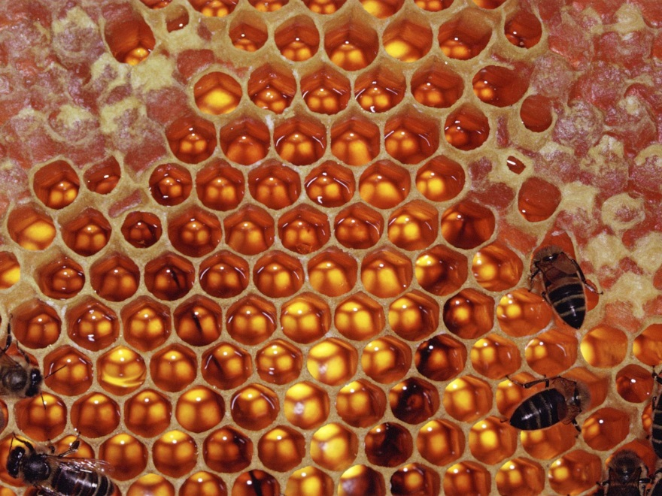
Structured Prediction with Perceptrons and CRFs
Back to conditional
log-linear modeling …
But now, model
structures!
600.465 - Intro to NLP - J. Eisner

Slide 3
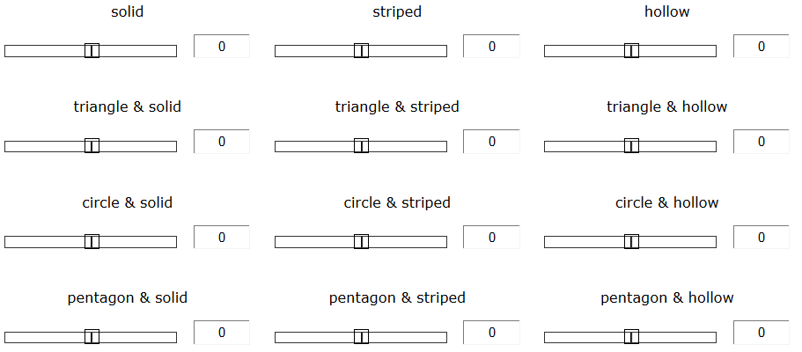
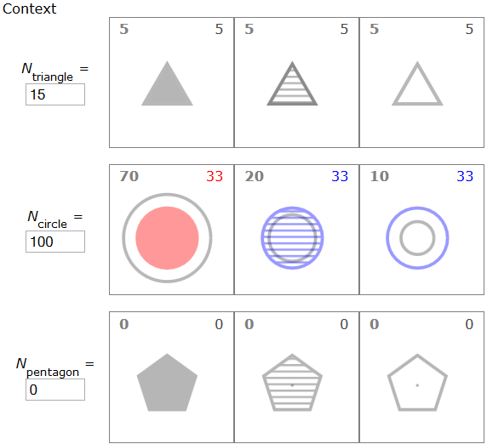
p(fill | shape)
600.465 - Intro to NLP - J. Eisner

Slide 4
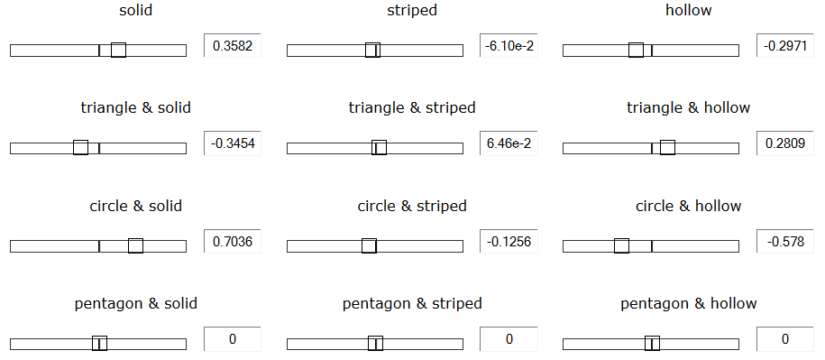
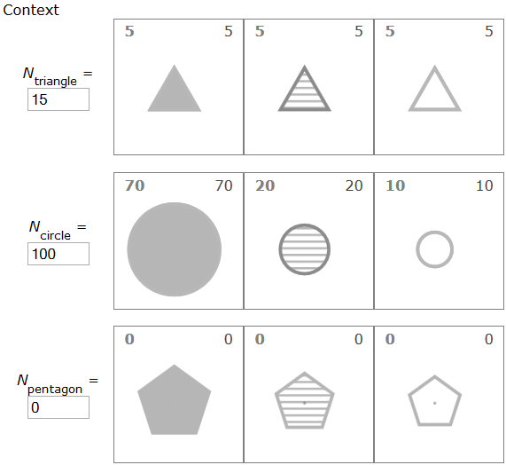
p(fill | shape)
600.465 - Intro to NLP - J. Eisner

Slide 5
p(category | message)
goodmail
spam
Reply today to claim your …
Reply today to claim your …
goodmail
spam
Wanna get pizza tonight?
Wanna get pizza tonight?
goodmail
spam
Thx; consider enlarging the …
Thx; consider enlarging the …
goodmail
spam
Enlarge your hidden …
Enlarge your hidden …

Slide 6
p(RHS | LHS)
S →
NP VP
S →
N VP
S →
NP[+wh] V S/V/NP
…
S →
VP NP
S →
Det N
S →
PP P
600.465 - Intro to NLP - J. Eisner

Slide 7
p(RHS | LHS)
S →
NP VP
S →
N VP
S →
NP[+wh] V S/V/NP
…
S →
VP NP
S →
Det N
S →
PP P
NP →
NP VP
NP →
N VP
NP →
NP CP/NP
…
NP →
VP NP
NP →
Det N
NP →
NP PP
…
600.465 - Intro to NLP - J. Eisner

Slide 8
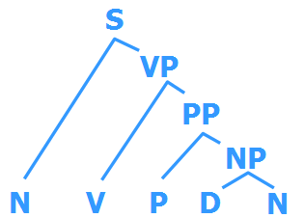
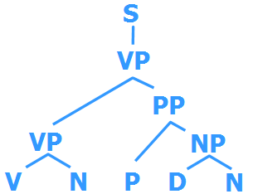
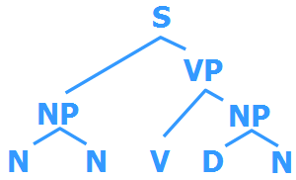
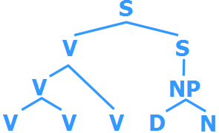
p(parse | sentence)
Time flies like an arrow
Time flies like an arrow
…
Time flies like an arrow
Time flies like an arrow
600.465 - Intro to NLP - J. Eisner

Slide 9
p(tag sequence | word sequence)
Time flies like an arrow
Time flies like an arrow
…
Time flies like an arrow
Time flies like an arrow
600.465 - Intro to NLP - J. Eisner

Slide 10
Today’s general problem
Given some input x
  Occasionally empty, e.g., no input needed for a generative n-gram or model of strings (randsent)
Consider a set of candidate outputs y
  Classifications for x (small number: often just 2)
  Taggings of x (exponentially many)
  Parses of x (exponential, even infinite)
  Translations of x (exponential, even infinite)
  …
Want to find the “best” y, given x
Structured prediction
600.465 - Intro to NLP - J. Eisner

Slide 11
Remember Weighted CKY …
(find the minimum-weight parse)
time 1 flies 2 like 3 an 4 arrow 5
0 | NP 3 Vst 3 | NP 10 S 8 |  |  | NP 24 S 22
1 |  | NP 4 VP 4 |  |  | NP 18 S 21 VP 18
2 |  |  | P 2 V 5 |  | PP 12 VP 16
3 |  |  |  | Det 1 | NP 10
4 |  |  |  |  | N 8
1 S → NP VP
6 S → Vst NP
2 S → S PP
1 VP → V NP
2 VP → VP PP
1 NP → Det N
2 NP → NP PP
3 NP → NP NP
0 PP → P NP

Slide 12
So far, we used weighted CKY only to implement probabilistic CKY for PCFGs
But is weighted CKY good for anything else??
multiply to get 2⁻²²
time 1 flies 2 like 3 an 4 arrow 5
0 | NP 3 Vst 3 | NP 10 S 8 |  |  | NP 24 S 22
1 |  | NP 4 VP 4 |  |  | NP 18 S 21 VP 18
2 |  |  | P 2 V 5 |  | PP 12 VP 16
3 |  |  |  | Det 1 | NP 10
4 |  |  |  |  | N 8
2⁻²
2⁻⁸
1 S → NP VP
6 S → Vst NP
2 S → S PP
1 VP → V NP
2 VP → VP PP
1 NP → Det N
2 NP → NP PP
3 NP → NP NP
0 PP → P NP
2⁻¹²

Slide 13
We set the weights to log probs
But is weighted CKY good for anything else??
Do the weights have to be probabilities?
S
NP
time
VP
| S) = w(S → NP VP) + w(NP → time)
w(
VP
flies
PP
P
like
NP
+ w(VP → VP NP)
Det
an
N
arrow
+ w(VP → flies) + …
Just let w(X → Y Z) = -log p(X → Y Z | X)
Then lightest tree has highest prob

Slide 14
Probability is Useful
summary of half of the course (statistics)
We love probability distributions!
  We’ve learned how to define & use p(…) functions.
Pick best output text T from a set of candidates
  speech recognition (HW2); machine translation; OCR; spell correction...
  maximize p₁(T) for some appropriate distribution p₁
Pick best annotation T for a fixed input I
  text categorization; parsing; part-of-speech tagging …
  maximize p(T | I); equivalently maximize joint probability p(I,T)
    often define p(I,T) by noisy channel: p(I,T) = p(T) * p(I | T)
  speech recognition & other tasks above are cases of this too:
    we’re maximizing an appropriate p₁(T) defined by p(T | I)
Pick best probability distribution (a meta-problem!)
  really, pick best parameters θ: train HMM, PCFG, n-grams, clusters …
  maximum likelihood; smoothing; EM if unsupervised (incomplete data)
  Bayesian smoothing: max p(θ|data) = max p(θ, data) =p(θ)p(data|θ)
600.465 - Intro to NLP - J. Eisner

Slide 15
Probability is Flexible
summary of other half of the course (linguistics)
We love probability distributions!
  We’ve learned how to define & use p(…) functions.
We want p(…) to define probability of linguistic objects
  Trees of (non)terminals (PCFGs; CKY, Earley, pruning, inside-outside)
  Sequences of words, tags, morphemes, phonemes (n-grams, FSAs, FSTs; regex compilation, best-paths, forward-backward, collocations)
  Vectors (decis.lists, Gaussians, naïve Bayes; Yarowsky, clustering/k-NN)
We’ve also seen some not-so-probabilistic stuff
  Syntactic features, semantics, morph., Gold. Could be stochasticized?
  Methods can be quantitative & data-driven but not fully probabilistic: transf.-based learning, bottom-up clustering, LSA, competitive linking
But probabilities have wormed their way into most things
p(…) has to capture our intuitions about the ling. data
600.465 - Intro to NLP - J. Eisner

Slide 16

An Alternative Tradition
Old AI hacking technique:
  Possible parses (or whatever) have scores.
  Pick the one with the best score.
  How do you define the score?
    Completely ad hoc!
    Throw anything you want into the stew
    Add a bonus for this, a penalty for that, etc.
600.465 - Intro to NLP - J. Eisner

Slide 17
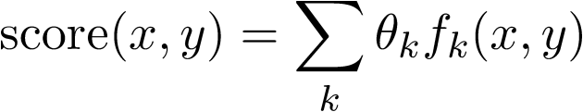
Scoring by Linear Models
Given some input x
Consider a set of candidate outputs y
Define a scoring function score(x,y)
  Linear function: A sum of feature weights (you pick the features!)
Choose y that maximizes score(x,y)
Weight of feature k
(learned or set by hand)
Ranges over all features,
e.g., k=5 (numbered features)
or k=“see Det Noun” (named features)
Whether (x,y) has feature k(0 or 1)
Or how many times it fires (≥ 0)
Or how strongly it fires (real #)
600.465 - Intro to NLP - J. Eisner

Slide 18

Scoring by Linear Models
Given some input x
Consider a set of candidate outputs y
Define a scoring function score(x,y)
  Linear function: A sum of feature weights (you pick the features!)
Choose y that maximizes score(x,y)
(learned or set by hand)
This linear decision rule is sometimes called a “perceptron.”
It’s a “structured perceptron” if it does structured prediction
(number of y candidates is unbounded, e.g., grows with |x|).
600.465 - Intro to NLP - J. Eisner

Slide 19
An Alternative Tradition
Old AI hacking technique:
  Possible parses (or whatever) have scores.
  Pick the one with the best score.
  How do you define the score?
    Completely ad hoc!
    Throw anything you want into the stew
    Add a bonus for this, a penalty for that, etc.
“Learns” over time – as you adjust bonuses and penalties by hand to improve performance. ☺
Total kludge, but totally flexible too …
  Can throw in any intuitions you might have
Could we make it learn automatically?
600.465 - Intro to NLP - J. Eisner

Slide 20
Perceptron Training Algorithm
initialize θ (usually to the zero vector)
repeat:
  Pick a training example (x,y)
  Model predicts y* that maximizes score(x,y*)
  Update weights by a step of size ε > 0:
  θ = θ + ε ∙ (f(x,y) – f(x,y*))
If model prediction was correct (y=y*), θ doesn’t change.
So once model predicts all training examples correctly, stop.
If some θ can do the job, this eventually happens!
(If not, θ will oscillate, but the average θ from all steps
will settle down. So return that eventual average.)

Slide 21
Perceptron Training Algorithm
initialize θ (usually to the zero vector)
repeat:
  Pick a training example (x,y)
  Model predicts y* that maximizes score(x,y*)
  Update weights by a step of size ε > 0:
  θ = θ + ε ∙ (f(x,y) – f(x,y*))
If model prediction was wrong (y≠y*), then we must have
score(x,y) ≤ score(x,y*) instead of > as we want.
Equivalently, θ∙f(x,y) ≤ θ∙f(x,y*)
Equivalently, θ∙(f(x,y) - f(x,y*)) ≤ 0 but we want it positive.
Our update increases it (by ε ∙ || f(x,y) – f(x,y*) ||² ≥ 0)

Slide 22
p(parse | sentence) score(sentence, parse)
Time flies like an arrow
Time flies like an arrow
…
Time flies like an arrow
Time flies like an arrow
600.465 - Intro to NLP - J. Eisner

Slide 23
Finding the best y given x
At both training & test time, given input x,
perceptron picks y that maximizes score(x,y)
How do we compute that crucial prediction??
  Easy when only a few candidates y (text classification, WSD, …)
    Just try each y in turn.
  Harder for structured prediction: but you now know how!
    Find the best string, path, or tree …
    That’s what Viterbi-style or Dijkstra-style algorithms are for.
      That is, use dynamic programming to find the score of the best y.
      Then follow backpointers to recover the y that achieves that score.
600.465 - Intro to NLP - J. Eisner

Slide 24
An Alternative Tradition
really so alternative?
Old AI hacking technique:
  Possible parses (or whatever) have scores.
  Pick the one with the best score.
  How do you define the score?
    Completely ad hoc!
    Throw anything you want into the stew
    Add a bonus for this, a penalty for that, etc.
“Learns” over time – as you adjust bonuses and penalties by hand to improve performance. ☺
Total kludge, but totally flexible too …
  Can throw in any intuitions you might have
Exposé at 9
Probabilistic Revolution
Not Really a Revolution,
Critics Say
Log-probabilities no more
than scores in disguise
“We’re just adding stuff up like the old corrupt regime did,” admits spokesperson
600.465 - Intro to NLP - J. Eisner

Slide 25
Nuthin’ but adding weights
n-grams: … + log p(w7 | w5, w6) + log p(w8 | w6, w7) + …
PCFG: log p(NP VP | S) + log p(Papa | NP) + log p(VP PP | VP) …
HMM tagging: … + log p(t7 | t5, t6) + log p(w7 | t7) + …
Noisy channel: [log p(source)] + [log p(data | source)]
Cascade of composed FSTs:
[log p(A)] + [log p(B | A)] + [log p(C | B)] + …
Naïve Bayes:
log p(Class) + log p(feature1 | Class) + log p(feature2 | Class) …
Note: Here we’re using +logprob not –logprob:
i.e., bigger weights are better.
600.465 - Intro to NLP - J. Eisner

Slide 26
Nuthin’ but adding weights
n-grams: … + log p(w7 | w5, w6) + log p(w8 | w6, w7) + …
PCFG: log p(NP VP | S) + log p(Papa | NP) + log p(VP PP | VP) …
  Score of a parse is its total weight
  The weights we add up have always been log-probs (≤ 0)
    but what if we changed that?
HMM tagging: … + log p(t7 | t5, t6) + log p(w7 | t7) + …
Noisy channel: [log p(source)] + [log p(data | source)]
Cascade of FSTs:
[log p(A)] + [log p(B | A)] + [log p(C | B)] + …
Naïve Bayes:
log(Class) + log(feature1 | Class) + log(feature2 | Class) + …
600.465 - Intro to NLP - J. Eisner

Slide 27
What if our weights were arbitrary real numbers?
Change log p(this | that) to θ(this; that)
n-grams: … + log p(w7 | w5, w6) + log p(w8 | w6, w7) + …
PCFG: log p(NP VP | S) + log p(Papa | NP) + log p(VP PP | VP) …
HMM tagging: … + log p(t7 | t5, t6) + log p(w7 | t7) + …
Noisy channel: [log p(source)] + [log p(data | source)]
Cascade of FSTs:
[log p(A)] + [log p(B | A)] + [log p(C | B)] + …
Naïve Bayes:
log p(Class) + log p(feature1 | Class) + log p(feature2 | Class) …
600.465 - Intro to NLP - J. Eisner

Slide 28
What if our weights were arbitrary real numbers?
Change log p(this | that) to θ(this ; that)
n-grams: … + θ(w7 ; w5, w6) + θ(w8 ; w6, w7) + …
PCFG: θ(NP VP ; S) + θ(Papa ; NP) + θ(VP PP ; VP) …
HMM tagging: … + θ(t7 ; t5, t6) + θ(w7 ; t7) + …
Noisy channel: [ θ(source)] + [ θ(data ; source)]
Cascade of FSTs:
[ θ(A)] + [ θ(B ; A)] + [ θ(C ; B)] + …
Naïve Bayes:
θ(Class) + θ(feature1 ; Class) + θ(feature2 ; Class) …
In practice, θ is a hash table
Maps from feature name (a string or object) to feature weight (a float)
e.g., θ(NP VP ; S) = weight of the S → NP VP rule, say -0.1 or +1.3
600.465 - Intro to NLP - J. Eisner

Slide 29
What if our weights were arbitrary real numbers?
Change log p(this | that) to θ(this ; that) θ(that & this) [prettier
name]
n-grams: … + θ(w5 w6 w7) + θ(w6 w7 w8) + …
PCFG: θ(S → NP VP) + θ(NP → Papa) + θ(VP → VP PP) …
HMM tagging: … + θ(t5 t6 t7) + θ(t7 → w7) + …
Noisy channel: [ θ(source)] + [ θ(source, data)]
Cascade of FSTs:
[ θ(A)] + [ θ(A, B) ] + [ θ(B, C)] + …
Naïve Bayes:
θ(Class) + θ(Class, feature 1) + θ(Class, feature2) …
WCFG
(multi-class) logistic regression
In practice, θ is a hash table
Maps from feature name (a string or object) to feature weight (a float)
e.g., θ(S → NP VP) = weight of the S → NP VP rule, say -0.1 or +1.3
600.465 - Intro to NLP - J. Eisner

Slide 30
What if our weights were arbitrary real numbers?
Change log p(this | that) to θ(that & this)
n-grams: … + θ(w5 w6 w7) + θ(w6 w7 w8) + …
  Best string is the one whose trigrams have the highest total weight
PCFG: θ(S → NP VP) + θ(NP → Papa) + θ(VP → VP PP) …
    Best parse is one whose rules have highest total weight
HMM tagging: … + θ(t5 t6 t7) + θ(t7 → w7) + …
    Best tagging has highest total weight of all transitions and emissions
Noisy channel: [ θ(source)] + [ θ(source, data)]
    To guess source: max (weight of source + weight of source-data match)
Naïve Bayes: θ(Class) + θ(Class, feature 1) + θ(Class, feature 2) …
    Best class maximizes prior weight + weight of compatibility with features
WCFG
(multi-class) logistic regression
600.465 - Intro to NLP - J. Eisner

Slide 31
What if our weights were arbitrary real numbers?
Change log p(this | that) to θ(that & this)
n-grams: … + θ(w5 w6 w7) + θ(w6 w7 w8) + …
  Best string is the one whose trigrams have the highest total weight
PCFG: θ(S → NP VP) + θ(NP → Papa) + θ(VP → VP PP) …
    Best parse is one whose rules have highest total weight (use CKY/Earley)
HMM tagging: … + θ(t5 t6 t7) + θ(t7 → w7) + …
    Best tagging has highest total weight of all transitions and emissions
Noisy channel: [ θ(source)] + [ θ(source, data)]
    To guess source: max (weight of source + weight of source-data match)
Naïve Bayes: θ(Class) + θ(Class, feature 1) + θ(Class, feature 2) …
    Best class maximizes prior weight + weight of compatibility with features
All our algorithms still work!
We’ll just add up arbitrary
feature weights θ that might not be
log conditional probabilities
(they might even be positive!)
Total score(x,y) can’t be interpreted
anymore as log p(x,y)
But we can still find the highest-scoring y
WCFG
(multi-class) logistic regression
600.465 - Intro to NLP - J. Eisner

Slide 32
Given sentence x
You know how to find max-score parse y (or min-cost parse as shown)
  Provided that the score of a parse = total score of its rules
time 1 flies 2 like 3 an 4 arrow 5
0 | NP 3 Vst 3 | NP 10 S 8 S 13 |  |  | NP 24 S 22 S 27 NP 24 S 27 S 22 S 27
1 |  | NP 4 VP 4 |  |  | NP 18 S 21 VP 18
2 |  |  | P 2 V 5 |  | PP 12 VP 16
3 |  |  |  | Det 1 | NP 10
4 |  |  |  |  | N 8
1 S → NP VP
6 S → Vst NP
2 S → S PP
1 VP → V NP
2 VP → VP PP
1 NP → Det N
2 NP → NP PP
3 NP → NP NP
0 PP → P NP
S
VP
PP
NP
N
V
P
D
N
Time flies like an arrow

Slide 33
Given word sequence x
You know how to find max-score tag sequence y
  Provided that the score of a tagged sentence
  = total score of its emissions and transitions
  These don’t have to be log-probabilities!
    Emission scores assess tag-word compatibility
    Transition scores assess goodness of tag bigrams
…?
Prep
Adj
Verb Verb Noun Verb
PN Adj Det Noun Prep Noun Prep Det Noun
Bill directed a cortege of autos through the dunes

Slide 34
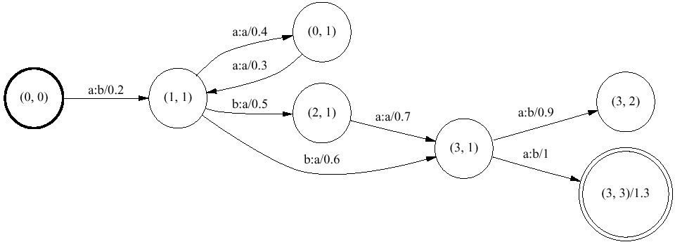
Given upper string x
You know how to find max-score path that accepts x (or min-cost path)
  Provided that the score of a path = total score of its arcs
  Then the best lower string y is the one along that best path
    (So in effect, score(x,y) is score of best path that transduces x to y)
  Q: How do you make sure that the path accepts x, such as aaaaaba?
    A: Compose with straight-line automaton for x, then find best path.

Slide 35
Why would we switch from probabilities to scores?
“Discriminative” training (e.g., perceptron) might work better.
  It tries to optimize weights to actually predict the right y for each x.
  More important than maximizing log p(x,y) = log p(y|x) + log p(x),
  as we’ve been doing in HMMs and PCFGs.
  Satisfied once the right y wins. The example puts no more pressure on the weights to raise log p(y|x). And never pressures us to raise log p(x).
Having more freedom in the weights might help?
  Now weights can be positive or negative.
  Exponentiated weights no longer have to sum to 1.
  But turns out new θ vectors can’t do more than the old restricted ones.
    Roughly, for every WCFG there’s an equivalent PCFG.
    Though it’s true a regularizer might favor one of the new ones.
We can throw lots more features into the stewpot.
  Allows model to capture more of the useful predictive patterns!
  So, what features can we throw in efficiently?

Slide 36
When can you efficiently choose best y?
“Provided that the score of a parse = total score of its rules”
“Provided that the score of a tagged sentence
= total score of its transitions and emissions”
“Provided that the score of a path = total score of its arcs”
This implies certain kinds of features in linear model …
e.g, θ₃ = score of VP → VP PP
f₃(x,y) = # times VP → VP PP
appears in y
600.465 - Intro to NLP - J. Eisner

Slide 37
When can you efficiently choose best y?
“Provided that the score of a parse = total score of its rules”
“Provided that the score of a tagged sentence
= total score of its transitions and emissions”
“Provided that the score of a path = total score of its arcs”
This implies certain kinds of features in linear model …
More generally: make a list of interesting substructures.
The feature f_{k}(x,y) counts tokens of kth substructure in (x,y).
So far, the substructures = the grammar rules (for a PCFG).
But model could use any features … what ones are efficient?
600.465 - Intro to NLP - J. Eisner

Slide 38
1. Single-rule substructures
S
VP
PP
NP
VP
NP
N
V
P
D
N
Time flies like an arrow
Count of VP → VP PP

Slide 39
1. Single-rule substructures
S
VP
These features are efficient for CKY to consider.
PP
NP
VP
NP
N
V
P
D
N
Time flies like an arrow
Count of VP → VP PP
Count of V → flies
(looks at y only)
(looks at both x and y)

Slide 40
2. Within-rule substructures
S
VP
PP
NP
VP
NP
N
V
P
D
N
Time flies like an arrow
Count of VP with a PP child

Slide 41
2. Within-rule substructures
S
VP
PP
NP
VP
NP
N
V
P
D
N
Time flies like an arrow
Count of VP with a PP child
Count of any node with a PP right child

Slide 42
2. Within-rule substructures
S
VP
PP
NP
VP
NP
N
V
P
D
N
Time flies like an arrow
Count of VP with a PP child
Count of any node with a PP right child
Count of any node with a PP right child and whose label matches left child’s label

Slide 43
2. Within-rule substructures
S
Efficient?
Yes: the weight that CKY uses for VP → VP PP is the total weight of all of its within-rule features.
VP
PP
NP
VP
NP
Some of these features fire on both VP → VP PP and NP → NP PP. So they’re really backoff features.
N
V
P
D
N
Time flies like an arrow
Count of VP with a PP child
Count of any node with a PP right child
Count of any node with a PP right child and whose label matches left child’s label

Slide 44
3. Cross-rule substructures
S
VP
PP
NP
VP
NP
N
V
P
D
N
Time flies like an arrow
Count of “flies” as a verb with subject “time”

Slide 45
3. Cross-rule substructures
S
VP
PP
NP
VP
NP
N
V
P
D
N
Time flies like an arrow
Count of “flies” as a verb with subject “time”
Count of NP → D N when the NP is the object of a preposition

Slide 46
3. Cross-rule substructures
S
Two such VPs, so feature fires twice on this (x,y) pair
VP
PP
NP
VP
NP
N
V
P
D
N
Time flies like an arrow
Count of “flies” as a verb with subject “time”
Count of NP → D N when the NP is the object of a preposition
Count of VPs that contain a V

Slide 47
3. Cross-rule substructures
S
Efficient? Sort of.
For CKY to work, must add attributes to the nonterminals so that these features can now be detected within-rule. That enlarges the grammar. ☹
VP
[hasV=true]
PP
NP
VP
[head=time]
[hasV=true]
NP
[role=prepobj]
N
V
P
D
N
Time flies like an arrow
Count of “flies” as a verb with subject “time”
Count of NP → D N when the NP is the object of a preposition
Count of VPs that contain a V
What’s the analogue in FSMs? Splitting states to remember more history.

Slide 48
4. Global features
S
VP
PP
NP
VP
NP
N
V
P
D
N
Time flies like an arrow
Count of “NP and NP” when the two NPs have very different size or structure [this feature has weight < 0]
The number of PPs is even
The depth of the tree is prime ☺
Count of the tag bigram V P in the preterminal seq

Slide 49
4. Global features
Or stop relying only on dynamic programming. Start using approximate or exact general methods for combinatorial optimization. Hot area!
S
Efficient? Depends on whether you can do it with attributes.
If you have infinitely many nonterminals, it’s not technically a PCFG anymore, but CKY might still apply.
[depth=5]
VP
[depth=4]
PP
NP
VP
[depth=3]
[depth=2]
[depth=2]
NP
[depth=2]
N
V
P
D
N
[depth=1]
[depth=1]
[depth=1]
[depth=1]
Time flies like an arrow
Count of “NP and NP” when the two NPs have very different size or structure [this feature has weight < 0]
The number of PPs is even
The depth of the tree is prime ☺
Count of the tag bigram V P in the preterminal seq

Slide 50
5. Context-specific features
Take any efficient feature that counts a substructure. Modify it to count only tokens
appearing in
a particular
red context.
S
VP
PP
NP
VP
NP
N
V
P
D
N
Time flies like an arrow

Slide 51
5. Context-specific features
Take any efficient feature that counts a substructure. Modify it to count only tokens
appearing in
a particular
red context.
S
VP
PP
NP
VP
NP
N
V
P
D
N
Time flies like an arrow
Count of VP → VP PP whose first word is “flies”

Slide 52
5. Context-specific features
Take any efficient feature that counts a substructure. Modify it to count only tokens
appearing in
a particular
red context.
S
VP
PP
NP
VP
NP
N
V
P
D
N
Time flies like an arrow
Count of VP → VP PP whose first word is “flies”
Count of VP → VP PP whose right child has width 3

Slide 53
5. Context-specific features
Take any efficient feature that counts a substructure. Modify it to count only tokens
appearing in
a particular
red context.
S
VP
PP
NP
VP
NP
N
V
P
D
N
Time flies like an arrow
0
1
2
3
4
5
Count of VP → VP PP whose first word is “flies”
Count of VP → VP PP whose right child has width 3
Count of VP → VP PP at the end of the input

Slide 54
5. Context-specific features
Take any efficient feature that counts a substructure. Modify it to count only tokens
appearing in
a particular
red context.
S
VP
PP
NP
VP
NP
N
V
P
D
N
Time flies like an arrow
Count of VP → VP PP whose first word is “flies”
Count of VP → VP PP whose right child has width 3
Count of VP → VP PP at the end of the input
Count of VP → VP PP right after a capitalized word

Slide 55
5. Context-specific features
Take any efficient feature that counts a substructure. Modify it to count only tokens
appearing in
a particular
red context.
S
Still efficient?
Amazingly, yes!
Features like these have played a big role in improving real-world accuracy of NLP systems.
VP
PP
NP
VP
NP
N
V
P
D
N
Time flies like an arrow
Count of VP → VP PP whose first word is “flies”
Count of VP → VP PP whose right child has width 3
Count of VP → VP PP at the end of the input
Count of VP → VP PP right after a capitalized word

Slide 56
5. Context-specific features
No longer do we
look up a constant
rule weight!
time 1 flies 2 like 3 an 4 arrow 5
0 | NP 3 Vst 3 | NP 10 S 8 |  |  | NP 24 S 22
1 |  | NP 4 VP 4 |  |  | NP 18 S 21 VP 18
2 |  |  | P 2 V 5 |  | PP 12 VP 16
3 |  |  |  | Det 1 | NP 10
4 |  |  |  |  | N 8
1 S → NP VP
6 S → Vst NP
2 S → S PP
1 VP → V NP
2 VP → VP PP
1 NP → Det N
2 NP → NP PP
3 NP → NP NP
0 PP → P NP
When CKY combines [1,2] with [2,5] using the rule VP → VP PP,
it is using that rule in a particular context.
The weight of the rule in that context can sum over features that look at the context (i.e., the red information). Doesn’t change CKY runtime!

Slide 57
Same approach for tagging …
Previous slides used parsing as an example.
  Given a sentence of length n,
  reconstructing the best tree takes time O(n³).
    Specifically, O(Gn³) where G = # of grammar rules.
As we’ll see, many NLP tasks only need to tag the words (not necessarily with parts of speech).
  Don’t need training trees, only training tags.
  Reconstructing the best tagging takes only time O(n).
    Specifically, O(Gn) where G = # of legal tag bigrams.
  It’s just the Viterbi tagging algorithm again.
    But now score is a sum of many feature weights …

Slide 58
Same approach for tagging …
N
V
P
D
N
Time flies like an arrow
Count of tag P as the tag for “like”
Weight of this feature is like
log of an emission probability
in an HMM

Slide 59
Same approach for tagging …
N
V
P
D
N
Time flies like an arrow
Count of tag P as the tag for “like”
Count of tag P

Slide 60
Same approach for tagging …
N
V
P
D
N
Time flies like an arrow
0
1
2
3
4
5
Count of tag P as the tag for “like”
Count of tag P
Count of tag P in the middle third of the sentence

Slide 61
Same approach for tagging …
N
V
P
D
N
Time flies like an arrow
Count of tag P as the tag for “like”
Count of tag P
Count of tag P in the middle third of the sentence
Count of tag bigram V P
Weight of this feature is like
log of a transition probability
in an HMM

Slide 62
Same approach for tagging …
N
V
P
D
N
Time flies like an arrow
Count of tag P as the tag for “like”
Count of tag P
Count of tag P in the middle third of the sentence
Count of tag bigram V P
Count of tag bigram V P followed by “an”

Slide 63
Same approach for tagging …
N
V
P
D
N
Time flies like an arrow
Count of tag P as the tag for “like”
Count of tag P
Count of tag P in the middle third of the sentence
Count of tag bigram V P
Count of tag bigram V P followed by “an”
Count of tag bigram V P where P is the tag for “like”

Slide 64
Same approach for tagging …
N
V
P
D
N
Time flies like an arrow
Count of tag P as the tag for “like”
Count of tag P
Count of tag P in the middle third of the sentence
Count of tag bigram V P
Count of tag bigram V P followed by “an”
Count of tag bigram V P where P is the tag for “like”
Count of tag bigram V P where both words are lowercase

Slide 65
Same approach for tagging …
N
V
P
D
N
Time flies like an arrow
Count of tag trigram N V P?
  A bigram tagger can only consider within-bigram features:
  only look at 2 adjacent blue tags (plus arbitrary red context).
  So here we need a trigram tagger, which is slower.
  As an FST, its state would remember two previous tags.
P
N V
V P
We take this arc once per N V P triple,
so its weight is the total weight of
the features that fire on that triple.

Slide 66
Same approach for tagging …
N
V
P
D
N
Time flies like an arrow
Count of tag trigram N V P?
  A bigram tagger can only consider within-bigram features:
  only look at 2 adjacent blue tags (plus arbitrary red context).
  So here we need a trigram tagger, which is slower.
Count of “post-verbal” nouns? (“discontinuous bigram” V N)
  An n-gram tagger can only look at a narrow window.
  So here we need an FSM whose states remember whether there was a verb in the left context.
V
P
D
N
N
V
P
D
N
V … P
V … D
V … N
Post-verbal
P D bigram
Post-verbal
D N bigram

Slide 67
How might you come up with the features that you will use to score (x,y)?
Think of some attributes (“basic features”) that you can compute at each position in (x,y).
For position i in a tagging, these might include:
  Full name of tag i
  First letter of tag i (will be “N” for both “NN” and “NNS”)
  Full name of tag i-1 (possibly BOS); similarly tag i+1 (possibly EOS)
  Full name of word i
  Last 2 chars of word i (will be “ed” for most past-tense verbs)
  First 4 chars of word i (why would this help?)
  “Shape” of word i (lowercase/capitalized/all caps/numeric/…)
  Whether word i is part of a known city name listed in a “gazetteer”
  Whether word i appears in thesaurus entry e (one attribute per e)
  Whether i is in the middle third of the sentence

Slide 68
How might you come up with the features that you will use to score (x,y)?
Think of some attributes (“basic features”) that you can compute at each position in (x,y).
For a node n in a parse tree that covers the substring (i,j):
  Nonterminal at n
  Nonterminal at first child of n, or “null” if child is a word
  Nonterminal at second child of n, or “null” if only one child
  Constituent width j-i
  Whether j-i ≤ 3 (true/false)
  Whether j-i ≤ 10 (true/false)
  Words i+1 and j (first and last words of constituent)
  Words i and j+1 (words immediately before and after constituent)
  Suffixes, prefixes, shapes, and categories of all of these words

Slide 69
How might you come up with the features that you will use to score (x,y)?
Think of some attributes (“basic features”) that you can compute at each position in (x,y).
Now conjoin them into various “feature templates.”
E.g., template 7 might be (tag(i-1), tag(i), suffix2(i+1)).
At each position of (x,y), exactly one of the many template7 features will fire:
N
V
P
D
N
Time flies like an arrow
At i=1, we see an instance of “template7=(BOS,N,-es)”
so we add one copy of that feature’s weight to score(x,y)

Slide 70
How might you come up with the features that you will use to score (x,y)?
Think of some attributes (“basic features”) that you can compute at each position in (x,y).
Now conjoin them into various “feature templates.”
E.g., template 7 might be (tag(i-1), tag(i), suffix2(i+1)).
At each position of (x,y), exactly one of the many template7 features will fire:
N
V
P
D
N
Time flies like an arrow
At i=2, we see an instance of “template7=(N,V,-ke)”
so we add one copy of that feature’s weight to score(x,y)

Slide 71
How might you come up with the features that you will use to score (x,y)?
Think of some attributes (“basic features”) that you can compute at each position in (x,y).
Now conjoin them into various “feature templates.”
E.g., template 7 might be (tag(i-1), tag(i), suffix2(i+1)).
At each position of (x,y), exactly one of the many template7 features will fire:
N
V
P
D
N
Time flies like an arrow
At i=3, we see an instance of “template7=(N,V,-an)”
so we add one copy of that feature’s weight to score(x,y)

Slide 72
How might you come up with the features that you will use to score (x,y)?
Think of some attributes (“basic features”) that you can compute at each position in (x,y).
Now conjoin them into various “feature templates.”
E.g., template 7 might be (tag(i-1), tag(i), suffix2(i+1)).
At each position of (x,y), exactly one of the many template7 features will fire:
N
V
P
D
N
Time flies like an arrow
At i=4, we see an instance of “template7=(P,D,-ow)”
so we add one copy of that feature’s weight to score(x,y)

Slide 73
How might you come up with the features that you will use to score (x,y)?
Think of some attributes (“basic features”) that you can compute at each position in (x,y).
Now conjoin them into various “feature templates.”
E.g., template 7 might be (tag(i-1), tag(i), suffix2(i+1)).
At each position of (x,y), exactly one of the many template7 features will fire:
N
V
P
D
N
Time flies like an arrow
At i=5, we see an instance of “template7=(D,N,-)”
so we add one copy of that feature’s weight to score(x,y)

Slide 74
How might you come up with the features that you will use to score (x,y)?
Think of some attributes (“basic features”) that you can compute at each position in (x,y).
Now conjoin them into various “feature templates.”
E.g., template 7 might be (tag(i-1), tag(i), suffix2(i+1)).
This template gives rise to many features, e.g.:
    score(x,y) = …
    + θ[“template7=(P,D,-ow)”] * count(“template7=(P,D,-ow)”)
    + θ[“template7=(D,D,-xx)”] * count(“template7=(D,D,-xx)”)
    + …
With a handful of feature templates and a large vocabulary, you can easily end up with millions of features.

Slide 75
How might you come up with the features that you will use to score (x,y)?
Think of some attributes (“basic features”) that you can compute at each position in (x,y).
Now conjoin them into various “feature templates.”
E.g., template 7 might be (tag(i-1), tag(i), suffix2(i+1)).
Note: Every template should mention at least some blue.
  Given an input x, a feature that only looks at red will contribute the same weight to score(x,y₁) and score(x,y₂).
  So it can’t help you choose between outputs y₁, y₂.

Slide 76
How might you come up with the features that you will use to score (x,y)?
Think of some attributes (“basic features”) that you can compute at each position in (x,y).
Now conjoin them into various “feature templates.”
Train your system!
  What if you had too many features?
    That’s what regularization is for. Prevents overfitting.
    An L1 regularizer will do “feature selection” for you. Keeps a feature’s weight at 0 if it didn’t help enough on the training data.
    Fancier extensions of L1 will even do feature template selection.
      If training throws out a template, you get a test-time speedup.
      (Ordinarily at test time, at every position, you’d have to construct a feature from that template & look up its weight in a hash table.)
Group lasso, graphical lasso, feature induction in random fields, meta-features …
Notes:
“Group lasso” lets you designate feature groups (e.g., templates).
Keeps a whole group of features at 0 if it doesn’t help enough.
The “graphical lasso” lets you request that a complex feature (trigram) be used only if its backoff features (bigrams) are used.
To speed up training, initially don’t allow complex templates at all (so
train first with simpler templates only. Then build more complex templates by conjoining or refining the simple templates that were selected. Iterate. (Can be automated …)

Slide 77
How might you come up with the features that you will use to score (x,y)?
Think of some attributes (“basic features”) that you can compute at each position in (x,y).
Now conjoin them into various “feature templates.”
Train your system!
  What if you had too many features?
  What if you didn’t have enough features?
    Then your system will have some errors.
    Study errors and come up with features that might help fix them.
    Maybe try to learn features automatically (e.g., “deep learning”).
    Alternatively, the “kernel trick” lets you expand to mind-bogglingly big (even infinite) feature sets. E.g., all 5-way conjunctions of existing features, including conjunctions that don’t stay within an n-gram!
      Runtime no longer scales up with the # of features that fire on a sentence. But now it scales up with the # of training examples.
Check out “kernelized perceptron.”
But the trick started with kernel SVMs.

Slide 78
Probabilists Rally Behind Paradigm
83% of
^
“.2, .4, .6, .8! We’re not gonna take your bait!”
Maybe we like our training criterion better than perceptron
  Modeling the true probability distribution may generalize better
Our model offers a whole distribution, not just one output:
  How sure are we that y is the correct parse? (confidence)
  What’s the expected error of parse y? (Bayes risk)
  What parse y has minimum expected error? (posterior decoding)
  Marginal prob that [time flies] is NP? (soft feature for another system)
Our results can be meaningfully combined ⇒ modularity!
  Train several systems and multiply their conditional probabilities
  p(English text) * p(English phonemes | English text) * p(Jap. phonemes | English phonemes) * p(Jap. text | Jap. phonemes)
  p(semantics) * p(syntax | semantics) * p(morphology | syntax) * p(phonology | morphology) * p(sounds | phonology)
600.465 - Intro to NLP - J. Eisner

Slide 79
Probabilists Regret Being Bound by Principle
Those context-specific features sure seem helpful!
Even with the same features, discriminative training generally gets better accuracy.
Fortunately, both of these deficiencies can be fixed within a probabilistic framework. ☺
600.465 - Intro to NLP - J. Eisner

Slide 80
back to p(parse | sentence)
p(parse | sentence) score(sentence, parse)
Time flies like an arrow
Time flies like an arrow
…
Time flies like an arrow
Time flies like an arrow
600.465 - Intro to NLP - J. Eisner

Slide 81
Generative processes
Those context-specific features sure seem helpful!
Even with the same features, discriminative training generally gets better accuracy.
Fortunately, both of these deficiencies can be fixed within a probabilistic framework. ☺
  Our PCFG, HMM, and probabilistic FST frameworks relied on modeling the probabilities of individual context-free moves:
    p(rule | nonterminal), p(word | tag), p(tag | previous tag), p(transition | state)
  Perhaps each of these was a log-linear conditional probability.
  Our models multiplied them all to get a joint probability p(x,y).
  What could we change?
600.465 - Intro to NLP - J. Eisner

Slide 82
Generative processes
Random Fields
Those context-specific features sure seem helpful!
Even with the same features, discriminative training generally gets better accuracy.
Fortunately, both of these deficiencies can be fixed within a probabilistic framework. ☺
Markov Random Field (MRF)
p(x,y) = 1/Z exp θ∙f(x,y)
Train to maximize log p(x,y)
Conditional Random Field (CRF)
p(y|x) = (1/Z(x)) exp θ∙f(x,y)
Train to maximize log p(y|x)
Generates x,y “all at once.”
Scores result as a whole, not individual generative steps.
Generates y “all at once” given x.
Discriminative like perceptron … and efficient for same features.

Slide 83
Finding the best y given x
How do you make predictions given input x?
Can just use the same Viterbi algorithms again!
Perceptron picks y that maximizes score(x,y).
CRF defines p(y | x) = (1/Z(x)) exp score(x,y).
  For a single output, could pick y that maximizes p(y | x).
    This “1-best” prediction is the single y that is most likely to be completely right (according to your trained model).
  But that’s exactly the y that maximizes score(x,y).
    Why? exp is an increasing function, and 1/Z(x) is constant.
The only difference is in how θ is trained.
600.465 - Intro to NLP - J. Eisner

Slide 84
Perceptron Training Algorithm
initialize θ (usually to the zero vector)
repeat:
  Pick a training example (x,y)
  Current θ predicts y* maximizing score(x,y*)
  Update weights by a step of size ε > 0:
  θ = θ + ε ∙ (f(x,y) – f(x,y*))

Slide 85
Perceptron Training Algorithm
CRF
initialize θ (usually to the zero vector)
repeat:
  Pick a training example (x,y)
  Current θ predicts y* maximizing score(x,y*)
  Update weights by a step of size ε > 0:
  θ = θ + ε ∙ (f(x,y) – f(x,y*))
defines a distribution p(y* | x)
expected features of a random y*
chosen from the distribution:
∑_{y*} p(y* | x) f(x,y*)

Slide 86
CRF Training Algorithm
initialize θ (usually to the zero vector)
repeat:
  Pick a training example (x,y)
  Current θ defines a distribution p(y* | x)
  Update weights by a step of size ε > 0:
  θ = θ + ε ∙ (f(x,y) – ∑_{y*} p(y* | x) f(x,y*))
observed – expected features
That is, we’re training a conditional log-linear model p(y | x)
by gradient ascent as usual.
But now y is a big structure like trees or taggings.
The version of gradient ascent above is a little different …

Slide 87
CRF Training Algorithm
initialize θ (usually to the zero vector)
repeat:
  Pick a training example (x,y)
  Current θ defines a distribution p(y* | x)
  Update weights by a step of size ε > 0:
  θ = θ + ε ∙ (f(x,y) – ∑_{y*} p(y* | x) f(x,y*))
  Update ε.
Must get
smaller
but not
too fast;
can use
ε = 1/(t+1000) on iter t
observed – expected features
We left out the regularizer. But we could put it back in.
“Stochastic gradient descent”: Updates θ after every example, following the gradient for making just that example more probable. (Rather than the total gradient over all examples. Learns faster, especially on large datasets.)

Slide 88
Why is discriminative training good?
Perceptrons and CRFs can efficiently make use of richer features.
S
VP
N
V
P
D
N
PP
Time flies like an arrow
NP
VP
NP
N
V
P
D
N
Time flies like an arrow

Slide 89
Why is discriminative training good?
And even with the same features, discriminative usually wins!
Joint training tries to predict both x and y.
Discriminative training only tries to predict y (given x), so it does a better job of that:
  predict the correct y (perceptron)
  predict the distribution over y (CRF)
In fact, predicting x and y together may be too much to expect …

Slide 90
Why is discriminative training good?
Predicting x and y together may be too much to expect of a “weak model” like a PCFG or HMM.
If you generate (x,y) from a PCFG or HMM, it looks awful!
  You get silly or ungrammatical sentences x.
  Suggests that PCFG and HMM aren’t really such great models of p(x,y), at least not at their current size (≈ 50 nonterminals or states).
But generating y given x might still give good results.
  PCFG and HMM can provide good conditional distributions p(y | x).
So just model p(y | x). Twisting the weights to also predict sentences x will distort our estimate of p(y | x).

Slide 91
Why is discriminative training good?
Predicting x and y together may be too much to expect of a “weak model” like a PCFG or HMM.
So just model p(y | x). Twisting the weights to also predict sentences x will distort our estimate of p(y | x).
  Let p_{θ} denote the PCFG with weight parameters θ.
  Joint training: Adjust θ so that p_{θ}(x,y) matches joint distribution of data.
  Discrim. training: Adjust θ so that p_{θ}(y | x) matches conditional distribution.
  Or equivalently, so that p_{hybrid}(x,y) matches joint distribution:
  p_{hybrid}(x,y) = p_{empirical}(x) ∙ p_{θ}(y | x).
  where p_{empirical}(x) = 1/n for each of the n training sentences, and is not sensitive to θ. So we’re letting the data (not the PCFG!) tell us the distribution of sentences x.

Slide 92
When do you want joint training?
Predicting x and y together may be too much to expect of a “weak model” like a PCFG or HMM. So just model p(y | x). Twisting the weights to also predict sentences x will distort our estimate of p(y | x).
On the other hand, not trying to predict x means we’re not learning from the distribution of x. “Throwing away data.”
  Use joint training if we trust our model. Discriminative training throws away x data only because we doubt we can model it well.
  Also use joint in unsupervised/semisupervised learning. Here x is all we have for some sentences, so we can’t afford to throw it away…
    EM algorithm fills in y to locally maximize log p_{θ}(x) = log ∑_{y} p_{θ}(x,y).
    Requires joint model p_{θ}(x,y). (Q: Why not max log ∑_{y} p_{θ}(y | x) instead?)
    This estimate of θ is then used for prediction: p_{θ}(y | x) = p_{θ}(x,y) / p_{θ}(x).
    Idea of EM is that the PCFG or HMM generates x,y together. We never see y, but since parameters θ are implicated in both p_{θ}(x) and p_{θ}(y | x), we can use the observed distribution of x to estimate θ to predict y.

Slide 93
Naïve Bayes vs. Logistic Regression
Dramatic example of training p(y | x) versus p(x,y).
Let’s go back to text categorization.
  x = (x₁, x₂, x₃, …) (a feature vector)
  y = {spam, gen}
“Naïve Bayes” is a popular, very simple joint model:
  p(x,y) = p(y) ∙ p(x₁ | y) ∙ p(x₂ | y) ∙ p(x₃ | y) ∙ ∙∙∙
  Q: How would you train this from supervised (x,y) data?
  Q: Given document x, how do we predict category y?
  Q: What are the conditional independence assumptions?
  Q: When are those “naïve” assumptions reasonable?

Slide 94
Naïve Bayes’s conditional independence assumptions break easily
Pick y maximizing p(y) ∙ p(x₁ | y) ∙ p(x₂ | y) ∙ ∙∙∙
x = Buy this supercalifragilistic Ginsu knife set for only $39 today …
Some features x_{k} that fire on this example …
  Contains Buy
  Contains supercalifragilistic
  Contains a dollar amount under $100
  Contains an imperative sentence
  Reading level = 7th grade
  Mentions money (use word classes and/or regexp to detect this)
  …
600.465 - Intro to NLP - J. Eisner

Slide 95
Naïve Bayes’s conditional independence assumptions break easily
Pick y maximizing p(y) ∙ p(x₁ | y) ∙ p(x₂ | y) ∙ ∙∙∙
x = Buy this supercalifragilistic Ginsu knife set for only $39 today …
Some features x_{k} that fire on this example,
and their prob of firing when y=spam versus y=gen:
  Contains a dollar amount under $100
  Mentions money
.5 .02
.9 .1
spam
gen
Naïve Bayes claims .5*.9=45% of spam has both features – 25*9=225x more likely than in gen.
50% of spam has this – 25x more likely than in gen
90% of spam has this – 9x more likely than in gen
But here are the emails with both features – only 25x!
First feature implies second feature. Naïve Bayes is overconfident because it thinks they’re independent.
600.465 - Intro to NLP - J. Eisner

Slide 96
Naïve Bayes vs. Logistic Regression
We have here a lousy model of p(x,y), namely p(y) ∙ p(x₁ | y) ∙ p(x₂ | y) ∙ ∙∙∙
  If we used it to generate (x,y), we’d get incoherent feature vectors that could not come from any actual document x (“mentions < $100”=1, “mentions money”=0).
Its conditional distribution p(y | x) is nonetheless serviceable.
Training options:
  Supervised: maximize log p(x,y). (“Naïve Bayes”)
  Unsupervised: maximize log p(x) = log ∑_{y} p(x,y) via EM. (“document clustering”)
  Supervised: maximize log p(y | x). (“logistic regression”)
Directly train conditional distribution we need. How?
Reinterpret Naïve Bayes conditional distrib as log-linear (“nuthin’ but adding weights”):
p(y | x) = p(x,y) / p(x)
= (1/p(x)) p(y) ∙ p(x₁ | y) ∙ p(x₂ | y) ∙ ∙∙∙
= (1/Z(x)) exp (θ(y) + θ(x₁, y) + θ(x₂, y) ∙ ∙∙∙)
where Z(x) = p(x) θ(y) = log p(y) θ(x_{k}, y) = log p(x_{k} | y)
So just do ordinary gradient ascent training of a conditional log-linear model.
  Whose features are as shown: conjoin features of x with the identity of y.

Slide 97
Logistic Regression doesn’t model x, so doesn’t model x’s features as independent given y!
Naïve Bayes
p(x_{k} | y)
initial θ(x_{k},y)
= log p(x_{k} | y)
final θ(x_{k},y) after
gradient ascent
.5 .02
.9 .1
-1 -5.6
-.15 -3.3
-.85 -2.3
-.15 -3.3
  Contains a dollar amount under $100
  Mentions money
spam
gen
spam
gen
spam
gen
Changed to compensate for the fact that whenever this feature fires, so will “Mentions money” feature.
Logistic regression trains weights to work together (needs gradient ascent).
Naïve Bayes trains weights independently for each k (easier: count & divide).
600.465 - Intro to NLP - J. Eisner

Slide 98
Logistic Regression doesn’t model x, so doesn’t model x’s features as independent given y!
Naïve Bayes
p(x_{k} | y)
initial θ(x_{k},y)
= log p(x_{k} | y)
final θ(x_{k},y) after
gradient ascent
.5 .02
.9 .1
-1 -5.6
-.15 -3.3
-.85 -2.3
-.15 -3.3
  Contains a dollar amount under $100
  Mentions money
spam
gen
spam
gen
spam
gen
Q: Is this truly just conditional training of the parameters of our original model? The old parameters were probabilities that had to sum to 1. But now it seems we’re granting ourselves the freedom to use any old weights that can no longer be interpreted as log p(y) and log p(x_{k} | y). Is this extra power why we do better?
A: No extra power! Challenge: Show how to adjust the weights after training, without disturbing p(y|x), to restore ∑_{y} exp θ(y) = 1 and ∀y∀k ∑_{xk}exp θ(x_{k},y) = 1.

Slide 99

Summary
Given x, always compute best y by Viterbi algorithm.
What’s different is the meaning of the resulting score.
Joint model, p(x,y):
  Classical models: PCFG, HMM, Naïve Bayes
    Product of many simple conditional distributions over generative moves.
    “Locally normalized”: Each distribution must sum to 1: divide by some Z.
  Or Markov random field: p(x,y) = (1/Z) exp θ ∙ f(x,y)
    “Globally normalized”: One huge distribution normalized by a single Z.
    Z is hard to compute since it sums over all parses of all sentences.
Conditional model, p(y | x):
  Conditional random field: p(y|x) = (1/Z(x)) exp θ ∙ f(x,y)
    Globally normalized, but Z(x) only sums over all parses of sentence x.
    Z(x) is efficient to compute via inside algorithm.
    Features can efficiently conjoin any properties of x and a “local” property of y. Train by gradient ascent:
    Doesn’t try to model p(x), i.e., “throws away” x data: good riddance?
Discriminative model, score(x,y):
  E.g., perceptron: No probabilistic interpretation of the score.
  Train θ to make the single correct y beat the others (for each x).
  (Variants: Train to make “better” y values beat “worse” ones.)

