Slide 1
NLP Tasks and Applications
600.465 - Intro to NLP - J. Eisner

Slide 2
The NLP Research Community
Papers
  ACL Anthology has nearly everything, free!
    Over 36,000 papers!
    Free-text searchable
      Great way to learn about current research on a topic
      New search interfaces currently available in beta
        Find recent or highly cited work; follow citations
    Used as a dataset by various projects
      Analyzing the text of the papers (e.g., parsing it)
      Extracting a graph of papers, authors, and institutions
      (Who wrote what? Who works where? What cites what?)

Slide 3
The NLP Research Community
Conferences
  Most work in NLP is published as 8-page conference papers with 3 double-blind reviewers.
  Main annual conferences: ACL, EMNLP, NAACL
    Also EACL, IJCNLP, COLING
    + various specialized conferences and workshops
  Big events, and growing fast! ACL 2015:
    About 1500 attendees
    692 full-length papers submitted (173 accepted)
    648 short papers submitted (145 accepted)
    14 workshops on various topics

Slide 4
The NLP Research Community
Institutions
  Universities: Many have 2+ NLP faculty
    Several “big players” with many faculty
    Some of them also have good linguistics,
    cognitive science, machine learning, AI
  Companies:
    Old days: AT&T Bell Labs, IBM
    Now: Google, Microsoft, IBM, many startups …
      Speech: Nuance, …
      Machine translation: Language Weaver, Systran, …
      Many niche markets – online reviews, medical transcription, news summarization, legal search and discovery …

Slide 5
The NLP Research Community
Standard tasks
  If you want people to work on your problem, make it easy for them to get started and to measure their progress. Provide:
    Test data, for evaluating the final systems
    Development data, for measuring whether a change to the system helps, and for tuning parameters
    An evaluation metric (formula for measuring how well a system does on the dev or test data)
    A program for computing the evaluation metric
    Labeled training data and other data resources
    A prize? – with clear rules on what data can be used

Slide 6
The NLP Research Community
Software
  Lots of people distribute code for these tasks
    Or you can email a paper’s authors to ask for their code
  Some lists of software, but no central site ☹
  Some end-to-end pipelines for text analysis
    “One-stop shopping”
    Cleanup/tokenization + morphology + tagging + parsing + …
    NLTK is easy for beginners and has a free book (intersession?)
    GATE has been around for a long time and has a bunch of modules

Slide 7
The NLP Research Community
Software
  To find good or popular tools:
    Search current papers, ask around, use the web
  Still, often hard to identify the best tool for your job:
    Produces appropriate, sufficiently detailed output?
    Accurate? (on the measure you care about)
    Robust? (accurate on your data, not just theirs)
    Fast?
    Easy and flexible to use? Nice file formats, command line options, visualization?
    Trainable for new data and languages? How slow is training?
    Open-source and easy to extend?

Slide 8
The NLP Research Community
Datasets
  Raw text or speech corpora
    Or just their n-gram counts, for super-big corpora
    Various languages and genres
    Usually there’s some metadata (each document’s date, author, etc.)
    Sometimes ∃ licensing restrictions (proprietary or copyright data)
  Text or speech with manual or automatic annotations
    What kind of annotations? That’s the rest of this lecture …
    May include translations into other languages
  Words and their relationships
    Morphological, semantic, translational, evolutionary
  Grammars
  World Atlas of Linguistic Structures
  Parameters of statistical models (e.g., grammar weights)

Slide 9
The NLP Research Community
Datasets
  Read papers to find out what datasets others are using
    Linguistic Data Consortium (searchable) hosts many large datasets
    Many projects and competitions post data on their websites
    But sometimes you have to email the author for a copy
  CORPORA mailing list is also good place to ask around
  LREC Conference publishes papers about new datasets & metrics
  Amazon Mechanical Turk – pay humans (very cheaply) to annotate your data or to correct automatic annotations
    Old task, new domain: Annotate parses etc. on your kind of data
    New task: Annotate something new that you want your system to find
    Auxiliary task: Annotate something new that your system may benefit from finding (e.g., annotate subjunctive mood to improve translation)
  Can you make annotation so much fun or so worthwhile
  that they’ll do it for free?

Slide 10
The NLP Research Community
Standard data formats
  Often just simple ad hoc text-file formats
    Documented in a README; easily read with scripts
  Some standards:
    Unicode – strings in any language (see ICU toolkit)
    PCM (.wav, .aiff) – uncompressed audio
      BWF and AUP extend w/metadata; also many compressed formats
    XML – documents with embedded annotations
    Text Encoding Initiative – faithful digital representations of printed text
    Protocol Buffers, JSON – structured data
    UIMA – “unstructured information management”; Watson uses it
  Standoff markup: raw text in one file, annotations in other files (“∃ noun phrase from byte 378—392”)
    Annotations can be independently contributed & distributed

Slide 11
The NLP Research Community
Survey articles
  May help you get oriented in a new area
  Synthesis Lectures on Human Language Technologies
  Handbook of Natural Language Processing
  Oxford Handbook of Computational Linguistics
  Foundations & Trends in Machine Learning
  Survey articles in journals – JAIR, CL, JMLR
  ACM Computing Surveys?
  Online tutorial papers
  Slides from tutorials at conferences
  Textbooks

Slide 12
To Write A Typical Paper
Need some of these ingredients:
  A domain of inquiry
  A task
  Resources
  A method for training & testing
  An algorithm
  Analysis of results
There are other kinds of papers too: theoretical papers on formal grammars and their properties, new error metrics, new tasks or resources, etc.
Scientific or engineering question
Input & output representations, evaluation metric
Corpora, annotations, dictionaries, …
Derived from a model?
Comparison to baselines & other systems,
significance testing, learning curves,
ablation analysis, error analysis

Slide 13
Text Annotation Tasks
Classify the entire document
(“text categorization”)
600.465 - Intro to NLP - J. Eisner

Slide 14

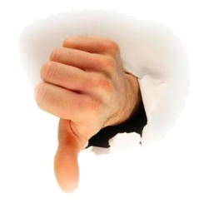
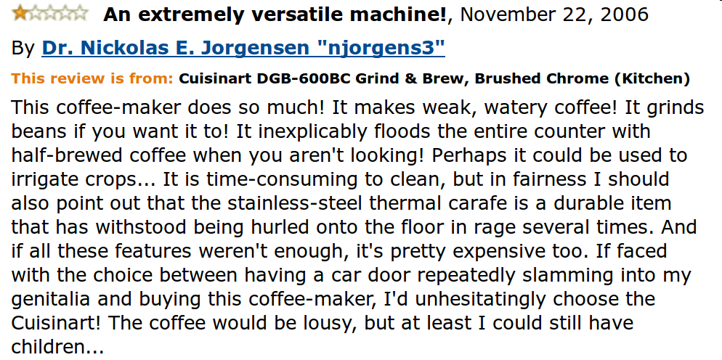
Sentiment classification
?
What features of the text could help predict # of stars?
(e.g., using a log-linear model) How to identify more?
Are the features hard to compute? (syntax? sarcasm?)
600.465 - Intro to NLP - J. Eisner
example from amazon.com, thanks to Delip Rao

Slide 15
Other text categorization tasks
Is it spam? (see features)
What medical billing code for this visit?
What grade, as an answer to this essay question?
Is it interesting to this user?
  News filtering; helpdesk routing
Is it interesting to this NLP program?
  If it’s Spanish, translate it from Spanish
  If it’s subjective, run the sentiment classifier
  If it’s an appointment, run information extraction
Where should it be filed?
  Which mail folder? (work, friends, junk, urgent ...)
  Yahoo! / Open Directory / digital libraries
600.465 - Intro to NLP - J. Eisner

Slide 16
Measuring Performance
Classification accuracy: What % of messages were classified correctly?
Is this what we care about?
 | Overall accuracy | Accuracy on spam | Accuracy on gen
System 1 | 95% | 99.99% | 90%
System 2 | 95% | 90% | 99.99%
Which system do you prefer?
600.465 - Intro to NLP - J. Eisner

Slide 17
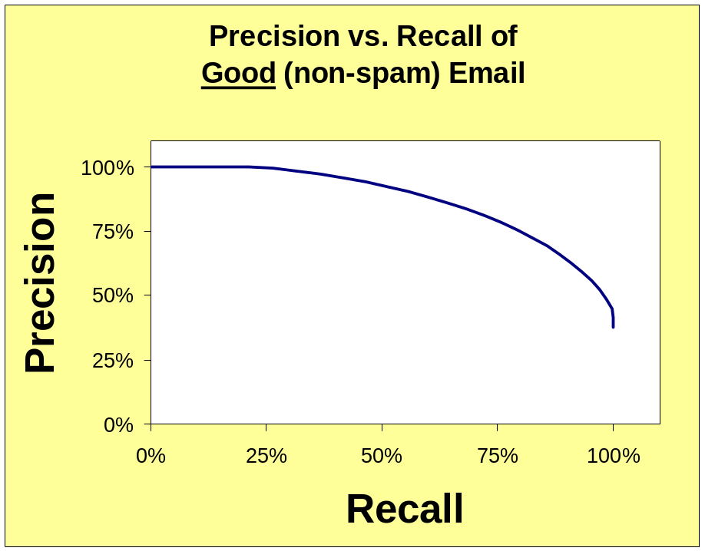
Measuring Performance
Precision =
good messages kept
all messages kept
Recall =
good messages kept
all good messages
Move from high precision to high recall by
deleting fewer messages (delete only if spamminess > high threshold)
600.465 - Intro to NLP - J. Eisner

Slide 18
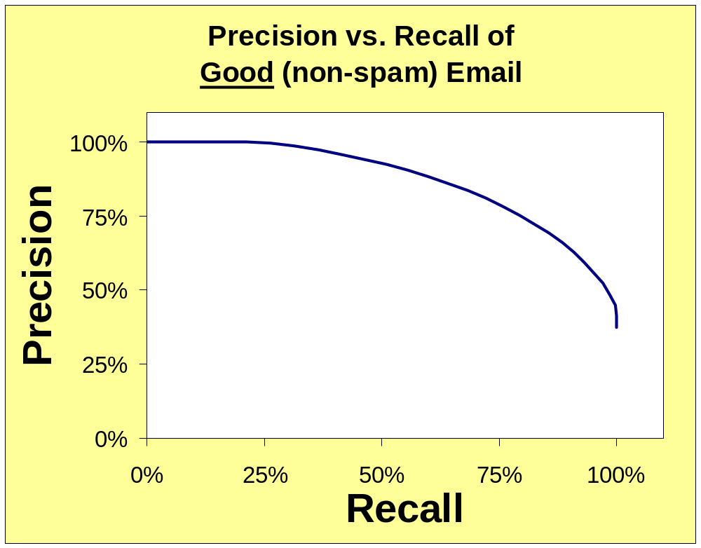
Measuring Performance
OK for search engines (users only want top 10)
high threshold:
all we keep is good,
but we don’t keep much
would prefer to be here!
point where
precision=recall
(occasionally reported)
low threshold:
keep all the good stuff,
but a lot of the bad too
OK for spam filtering and legal search
600.465 - Intro to NLP - J. Eisner

Slide 19
Measuring Performance
Precision =
good messages kept
all messages kept
Recall =
good messages kept
all good messages
F-measure =
another system: better for some users, worse for others (can’t tell just by comparing F-measures)
( )⁻¹
precision⁻¹ + recall⁻¹
Move from high precision to high recall by
deleting fewer messages (raise threshold)
Conventional to tune system and threshold to optimize F-measure on dev data
But it’s more informative to report the whole curve
  Since in real life, the user should be able to pick a tradeoff point they like
2
600.465 - Intro to NLP - J. Eisner

Slide 20
Supervised Learning Methods
Conditional log-linear models are a good hammer
  Feature engineering: Throw in enough features to fix most errors
  Training: Learn weights θ such that in training data, the true answer tends to have a high probability
  Test: Output the highest-probability answer
  If the evaluation metric allows for partial credit,
  can do fancier things (“minimum-risk” training and decoding)
The most popular alternatives are roughly similar
  Perceptron, SVM, MIRA, neural network, …
  These also learn a (usually linear) scoring function
  However, the score is not interpreted as a log-probability
  Learner just seeks weights θ such that in training data,
  the desired answer has a higher score than the wrong answers

Slide 21
Fancier Perfomance Metrics
For multi-way classifiers:
  Average accuracy (or precision or recall) of 2-way distinctions: Sports or not, News or not, etc.
  Better, estimate the cost of different kinds of errors
    e.g., how bad is each of the following?
      putting Sports articles in the News section
      putting Fashion articles in the News section
      putting News articles in the Fashion section
    Now tune system to minimize total cost
For ranking systems:
  Correlate with human rankings?
  Get active feedback from user?
  Measure user’s wasted time by tracking clicks?
Which articles are most Sports-like?
Which articles / webpages most relevant?
600.465 - Intro to NLP - J. Eisner

Slide 22
Supervised Learning Methods
Easy to build a “yes” or “no” predictor from supervised training data
  Plenty of software packages to do the learning & prediction
  Lots of people in NLP never go beyond this ☺
Similarly, easy to build a system that chooses from a small finite set
  Basically the same deal
  But runtime goes up linearly with the size of the set, unless you’re clever (HW3)

Slide 23
Text Annotation Tasks
Classify the entire document
Classify individual word tokens
600.465 - Intro to NLP - J. Eisner

Slide 24

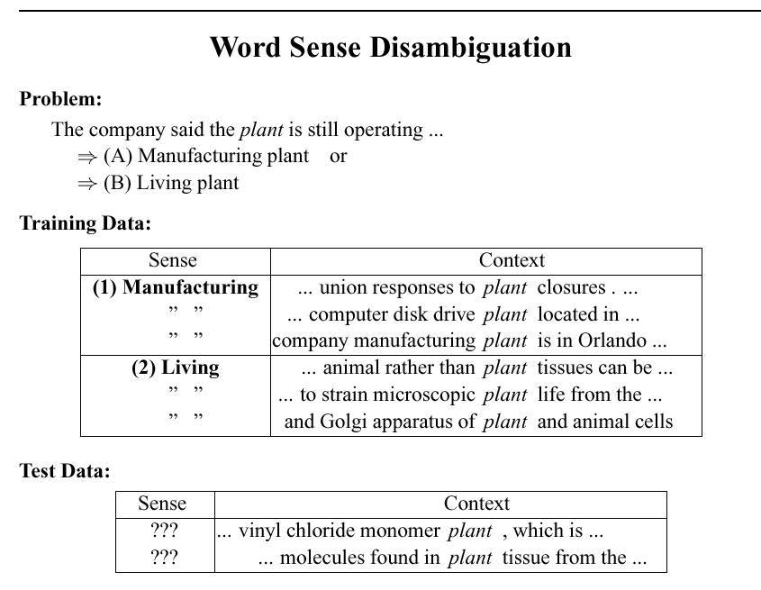
p(class | token in context)
(WSD)
Build a special classifier just for tokens of “plant”
slide courtesy of D. Yarowsky

Slide 25
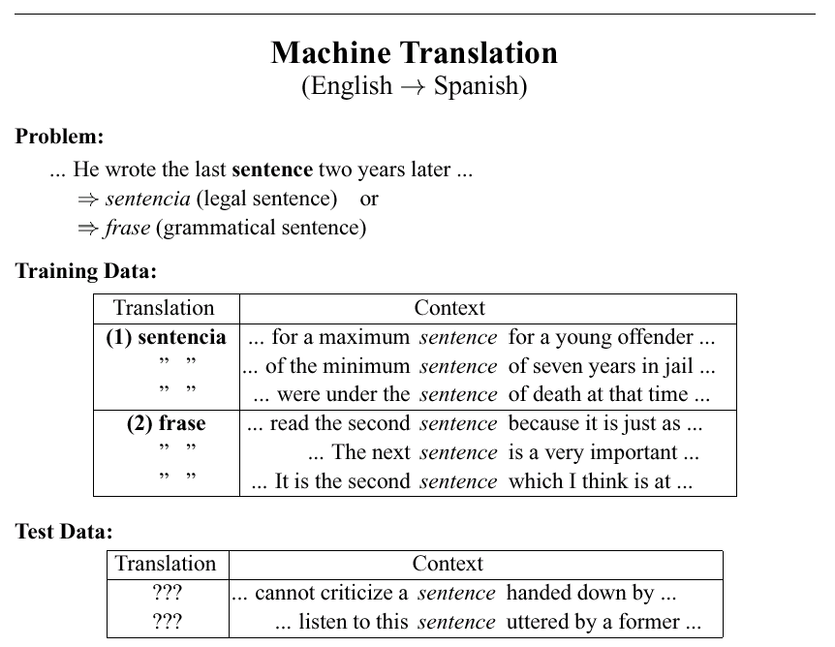
p(class | token in context)
WSD for
Build a special classifier just for tokens of “sentence”
slide courtesy of D. Yarowsky

Slide 26
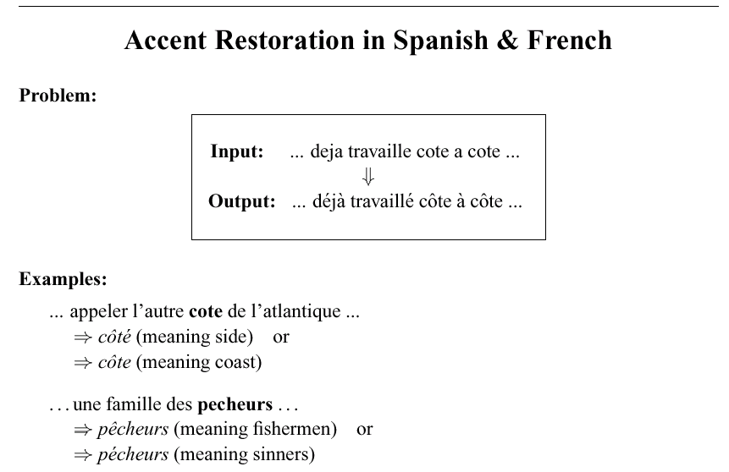
p(class | token in context)
slide courtesy of D. Yarowsky

Slide 27
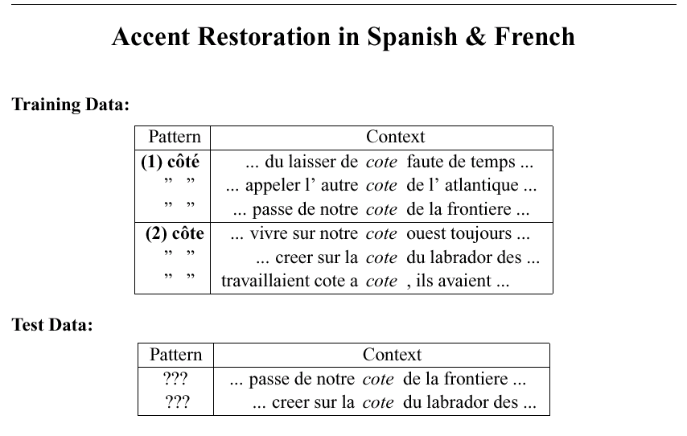
p(class | token in context)
slide courtesy of D. Yarowsky

Slide 28
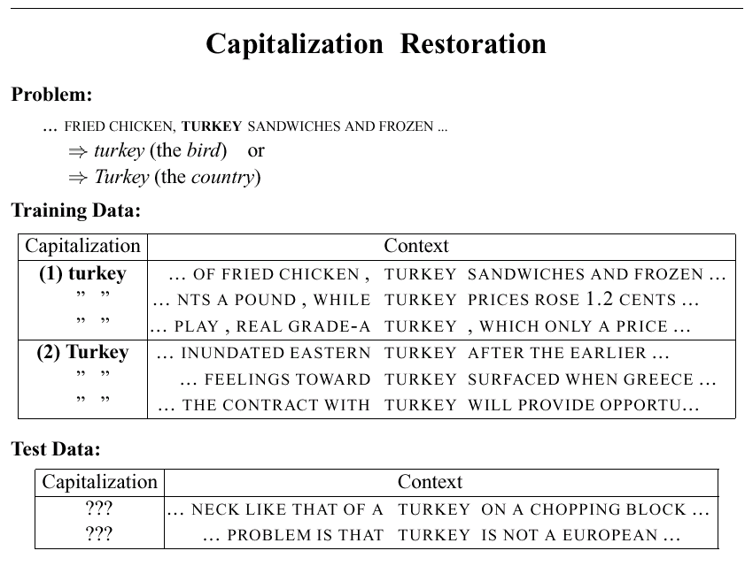
p(class | token in context)
slide courtesy of D. Yarowsky

Slide 29
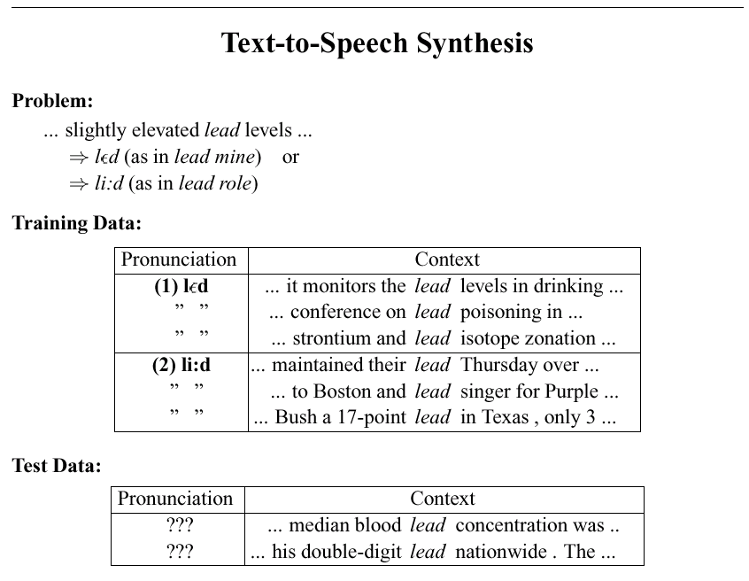
p(class | token in context)
slide courtesy of D. Yarowsky

Slide 30
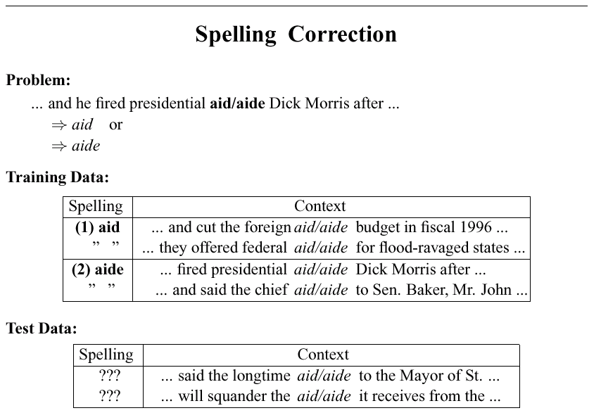
p(class | token in context)
slide courtesy of D. Yarowsky

Slide 31
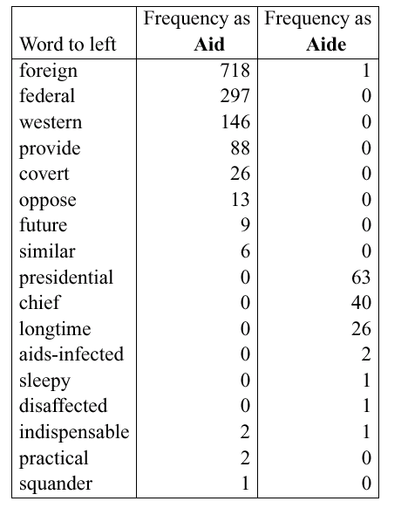
What features? Example: “word to left”
slide courtesy of D. Yarowsky (modified)
Spelling correction using an n-gram language model
(n ≥ 2) would use words to left and right to help predict the true word.
Similarly, an HMM would predict a word’s class using classes to left and right.
But we’d like to throw in all kinds of other features, too …
600.465 - Intro to NLP - J. Eisner

Slide 32
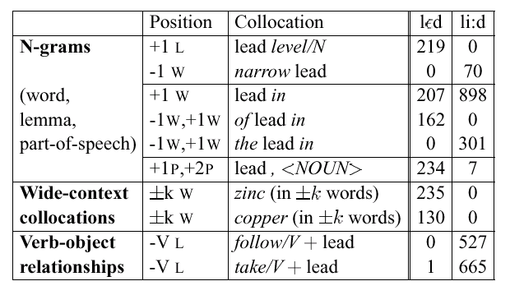
An assortment of possible cues ...
slide courtesy of D. Yarowsky (modified)
generates a whole bunch of potential cues – use data to find out which ones work best
600.465 - Intro to NLP - J. Eisner

Slide 33
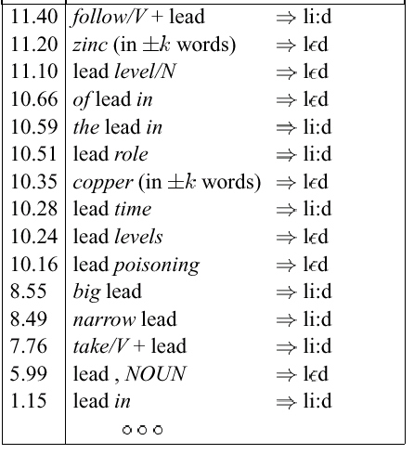
An assortment of possible cues ...
slide courtesy of D. Yarowsky (modified)
This feature is relatively weak, but weak features are still useful, especially since
very few features will fire in a given context.
merged ranking
of all cues
of all these types
600.465 - Intro to NLP - J. Eisner

Slide 34
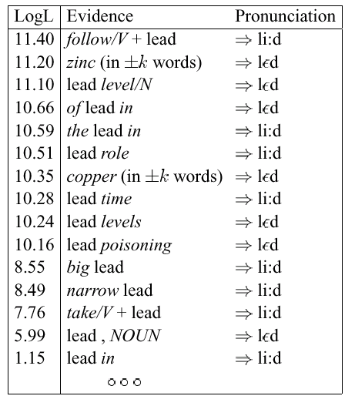
Final decision list for lead (abbreviated)
slide courtesy of D. Yarowsky (modified)
List of all features,
ranked by their weight.
(These weights are for a simple “decision list” model where the single highest-weighted feature that fires gets to make the decision all by itself.
However, a log-linear model, which adds up the weights of all features that fire, would be roughly similar.)
600.465 - Intro to NLP - J. Eisner

Slide 35
Part of Speech Tagging
We could treat tagging as a token classification problem
  Tag each word independently given features of context
  And features of the word’s spelling (suffixes, capitalization)
600.465 - Intro to NLP - J. Eisner

Slide 36
Sequence Labeling as Classification
Classify each token independently but use as input features, information about the surrounding tokens (sliding window).
John saw the saw and decided to take it to the table.
classifier
NNP
Slide from Ray Mooney

Slide 37
Sequence Labeling as Classification
Classify each token independently but use as input features, information about the surrounding tokens (sliding window).
John saw the saw and decided to take it to the table.
classifier
VBD
Slide from Ray Mooney

Slide 38
Sequence Labeling as Classification
Classify each token independently but use as input features, information about the surrounding tokens (sliding window).
John saw the saw and decided to take it to the table.
classifier
DT
Slide from Ray Mooney

Slide 39
Sequence Labeling as Classification
Classify each token independently but use as input features, information about the surrounding tokens (sliding window).
John saw the saw and decided to take it to the table.
classifier
NN
Slide from Ray Mooney

Slide 40
Sequence Labeling as Classification
Classify each token independently but use as input features, information about the surrounding tokens (sliding window).
John saw the saw and decided to take it to the table.
classifier
CC
Slide from Ray Mooney

Slide 41
Sequence Labeling as Classification
Classify each token independently but use as input features, information about the surrounding tokens (sliding window).
John saw the saw and decided to take it to the table.
classifier
VBD
Slide from Ray Mooney

Slide 42
Sequence Labeling as Classification
Classify each token independently but use as input features, information about the surrounding tokens (sliding window).
John saw the saw and decided to take it to the table.
classifier
TO
Slide from Ray Mooney

Slide 43
Sequence Labeling as Classification
Classify each token independently but use as input features, information about the surrounding tokens (sliding window).
John saw the saw and decided to take it to the table.
classifier
VB
Slide from Ray Mooney

Slide 44
Sequence Labeling as Classification
Classify each token independently but use as input features, information about the surrounding tokens (sliding window).
John saw the saw and decided to take it to the table.
classifier
PRP
Slide from Ray Mooney

Slide 45
Sequence Labeling as Classification
Classify each token independently but use as input features, information about the surrounding tokens (sliding window).
John saw the saw and decided to take it to the table.
classifier
IN
Slide from Ray Mooney

Slide 46
Sequence Labeling as Classification
Classify each token independently but use as input features, information about the surrounding tokens (sliding window).
John saw the saw and decided to take it to the table.
classifier
DT
Slide from Ray Mooney

Slide 47
Sequence Labeling as Classification
Classify each token independently but use as input features, information about the surrounding tokens (sliding window).
John saw the saw and decided to take it to the table.
classifier
NN
Slide from Ray Mooney

Slide 48
Part of Speech Tagging
Or we could use an HMM:
Adj:cool 0.0009
Det
Det
Det
Det
Det:the 0.32
Start
Adj
Adj
Adj:directed…
Adj
Adj
Stop
Noun:cool 0.007
Noun:autos…
ε 0.2
Adj:directed…
Noun
Noun
Noun
Noun
probs
from tag
bigram
model
0.4
0.6
Start PN Verb Det Noun Prep Noun Prep Det Noun Stop
0.001
probs from
unigram
replacement
Bill directed a cortege of autos through the dunes
600.465 - Intro to NLP - J. Eisner

Slide 49
Part of Speech Tagging
We could treat tagging as a token classification problem
  Tag each word independently given features of context
  And features of the word’s spelling (suffixes, capitalization)
Or we could use an HMM:
  The point of the HMM is basically that the tag of one word might depend on the tags of adjacent words.
Combine these two ideas??
  We’d like rich features (e.g., in a log-linear model), but we’d also like our feature functions to depend on adjacent tags.
  So, the problem is to predict all tags together.
600.465 - Intro to NLP - J. Eisner

Slide 50
Supervised Learning Methods
Easy to build a “yes” or “no” predictor from supervised training data
  Plenty of software packages to do the learning & prediction
  Lots of people in NLP never go beyond this ☺
Similarly, easy to build a system that chooses from a small finite set
  Basically the same deal
  But runtime goes up linearly with the size of the set, unless you’re clever (HW3)
Harder to predict the best string or tree (set is exponentially large or infinite)

Slide 51
Part of Speech Tagging
Idea #1
  Classify tags one at a time from left to right
  Each feature function can look at the context of the word being tagged, including the tags of all previous words
600.465 - Intro to NLP - J. Eisner

Slide 52
Forward Classification
John saw the saw and decided to take it to the table.
classifier
NNP
Slide from Ray Mooney

Slide 53
Forward Classification
NNP
John saw the saw and decided to take it to the table.
classifier
VBD
Slide from Ray Mooney

Slide 54
Forward Classification
NNP VBD
John saw the saw and decided to take it to the table.
classifier
DT
Slide from Ray Mooney

Slide 55
Forward Classification
NNP VBD DT
John saw the saw and decided to take it to the table.
classifier
NN
Slide from Ray Mooney

Slide 56
Forward Classification
NNP VBD DT NN
John saw the saw and decided to take it to the table.
classifier
CC
Slide from Ray Mooney

Slide 57
Forward Classification
NNP VBD DT NN CC
John saw the saw and decided to take it to the table.
classifier
VBD
Slide from Ray Mooney

Slide 58
Forward Classification
NNP VBD DT NN CC VBD
John saw the saw and decided to take it to the table.
classifier
TO
Slide from Ray Mooney

Slide 59
Forward Classification
NNP VBD DT NN CC VBD TO
John saw the saw and decided to take it to the table.
classifier
VB
Slide from Ray Mooney

Slide 60
Forward Classification
NNP VBD DT NN CC VBD TO VB
John saw the saw and decided to take it to the table.
classifier
PRP
Slide from Ray Mooney

Slide 61
Forward Classification
NNP VBD DT NN CC VBD TO VB PRP
John saw the saw and decided to take it to the table.
classifier
IN
Slide from Ray Mooney

Slide 62
Forward Classification
NNP VBD DT NN CC VBD TO VB PRP IN
John saw the saw and decided to take it to the table.
classifier
DT
Slide from Ray Mooney

Slide 63
Forward Classification
NNP VBD DT NN CC VBD TO VB PRP IN DT
John saw the saw and decided to take it to the table.
classifier
NN
Slide from Ray Mooney

Slide 64
Backward Classification
Disambiguating “to” in this case would be even easier backward.
John saw the saw and decided to take it to the table.
classifier
NN
Slide from Ray Mooney

Slide 65
Backward Classification
Disambiguating “to” in this case would be even easier backward.
NN
John saw the saw and decided to take it to the table.
classifier
DT
Slide from Ray Mooney

Slide 66
Backward Classification
Disambiguating “to” in this case would be even easier backward.
DT NN
John saw the saw and decided to take it to the table.
classifier
IN
Slide from Ray Mooney

Slide 67
Backward Classification
Disambiguating “to” in this case would be even easier backward.
IN DT NN
John saw the saw and decided to take it to the table.
classifier
PRP
Slide from Ray Mooney

Slide 68
Backward Classification
Disambiguating “to” in this case would be even easier backward.
PRP IN DT NN
John saw the saw and decided to take it to the table.
classifier
VB
Slide from Ray Mooney

Slide 69
Backward Classification
Disambiguating “to” in this case would be even easier backward.
VB PRP IN DT NN
John saw the saw and decided to take it to the table.
classifier
TO
Slide from Ray Mooney

Slide 70
Backward Classification
Disambiguating “to” in this case would be even easier backward.
TO VB PRP IN DT NN
John saw the saw and decided to take it to the table.
classifier
VBD
Slide from Ray Mooney

Slide 71
Backward Classification
Disambiguating “to” in this case would be even easier backward.
VBD TO VB PRP IN DT NN
John saw the saw and decided to take it to the table.
classifier
CC
Slide from Ray Mooney

Slide 72
Backward Classification
Disambiguating “to” in this case would be even easier backward.
CC VBD TO VB PRP IN DT NN
John saw the saw and decided to take it to the table.
classifier
VBD
Slide from Ray Mooney

Slide 73
Backward Classification
Disambiguating “to” in this case would be even easier backward.
VBD CC VBD TO VB PRP IN DT NN
John saw the saw and decided to take it to the table.
classifier
DT
Slide from Ray Mooney

Slide 74
Backward Classification
Disambiguating “to” in this case would be even easier backward.
DT VBD CC VBD TO VB PRP IN DT NN
John saw the saw and decided to take it to the table.
classifier
VBD
Slide from Ray Mooney

Slide 75
Backward Classification
Disambiguating “to” in this case would be even easier backward.
VBD DT VBD CC VBD TO VB PRP IN DT NN
John saw the saw and decided to take it to the table.
classifier
NNP
Slide from Ray Mooney

Slide 76
Part of Speech Tagging
Idea #1
  Classify tags one at a time from left to right
    p(tag | wordseq, prevtags) = (1/Z) exp score(tag, wordseq, prevtags)
    where Z sums up exp score(tag’, wordseq, prevtags) over all possible tags
  Each feature function can look at the context of the word being tagged, including the tags of all previous words
  Asymmetric: can’t look at following tags, only preceding ones
Idea #2 (“maximum entropy Markov model (MEMM)”)
  Same model, but don’t commit to a tag before we predict
  the next tag. Instead, consider probabilities of all tag sequences.
600.465 - Intro to NLP - J. Eisner

Slide 77
Maximum Entropy Markov Model
Is this a probable tag sequence for this sentence?
NNP VBD DT NN CC VBD TO VB PRP IN DT NN
John saw the saw and decided to take it to the table.
classifier
classifier
classifier
classifier
classifier
classifier
classifier
classifier
classifier
classifier
classifier
classifier
NNP
VBD
DT
NN
CC
VBD
TO
VB
PRP
IN
DT
NN
Does each of these classifiers assign a high
probability to the desired tag?
Is this the most likely sequence to get by rolling dice?
(Does it maximize product of probabilities?)
Slide adapted from
Ray Mooney

Slide 78
Part of Speech Tagging
Idea #1
  Classify tags one at a time from left to right
    p(tag | wordseq, prevtags) = (1/Z) exp score(tag, wordseq, prevtags)
    where Z sums up exp score(tag’, wordseq, prevtags) over all possible tags
  Each feature function can look at the context of the word being tagged, including the tags of all previous words
  Asymmetric: can’t look at following tags, only preceding ones
Idea #2 (“maximum entropy Markov model (MEMM)”)
  Same model, but don’t commit to a tag before we predict
  the next tag. Instead, consider probabilities of all tag sequences.
  Use dynamic programming to find the most probable sequence
    For dynamic programming to work, features can only consider
    the (n-1) previous tags, just as in an HMM
    Same algorithms as in an HMM, but now transition probability
    is p(tag | previous n-1 tags and all words)
  Still asymmetric: can’t look at following tags
600.465 - Intro to NLP - J. Eisner

Slide 79
Part of Speech Tagging
Idea #1
  Classify tags one at a time from left to right
    p(tag | wordseq, prevtags) = (1/Z) exp score(tag, wordseq, prevtags)
    where Z sums up exp score(tag’, wordseq, prevtags) over all possible tags
Idea #2 (“maximum entropy Markov model (MEMM)”)
  Same model, but don’t commit to a tag before we predict
  the next tag. Instead, evaluate probability of every tag sequence.
Idea #3 (“linear-chain conditional random field (CRF)”)
  This version is symmetric, and very popular.
  Score each tag sequence as a whole, using arbitrary features
    p(tagseq | wordseq) = (1/Z) exp score(tagseq, wordseq)
    where Z sums up exp score(tagseq’, wordseq) over competing tagseqs
  Can still compute Z and best path using dynamic programming
    Dynamic programming works if, for example, each feature f(tagseq,wordseq) considers at most an n-gram of tags.
    Then you can score a (tagseq,wordseq) pair with a WFST whose state remembers the previous (n-1) tags.
    As in #2, arc weight can consider the current tag n-gram and all words.
    But unlike #2, arc weight isn’t a probability (only normalize at the end).
600.465 - Intro to NLP - J. Eisner

Slide 80
Supervised Learning Methods
Easy to build a “yes” or “no” predictor from supervised training data
  Plenty of software packages to do the learning & prediction
  Lots of people in NLP never go beyond this ☺
Similarly, easy to build a system that chooses from a small finite set
  Basically the same deal
  But runtime goes up linearly with the size of the set, unless you’re clever (HW3)
Harder to predict the best string or tree (set is exponentially large or infinite)
  Requires dynamic programming; you might have to write your own code
  But finite-state or CRF toolkits will find the best string for you
  And you could modify someone else’s parser to pick the best tree
  An algorithm for picking the best can usually be turned into a learning algorithm

Slide 81
Text Annotation Tasks
Classify the entire document
Classify individual word tokens
Identify phrases (“chunking”)
600.465 - Intro to NLP - J. Eisner

Slide 82
Named Entity Recognition
CHICAGO (AP) — Citing high fuel prices, United Airlines said Friday it has increased fares by $6 per round trip on flights to some cities also served by lower-cost carriers. American Airlines, a unit AMR, immediately matched the move, spokesman Tim Wagner said. United, a unit of UAL, said the increase took effect Thursday night and applies to most routes where it competes against discount carriers, such as Chicago to Dallas and Atlanta and Denver to San Francisco, Los Angeles and New York.
Slide from Jim Martin

Slide 83
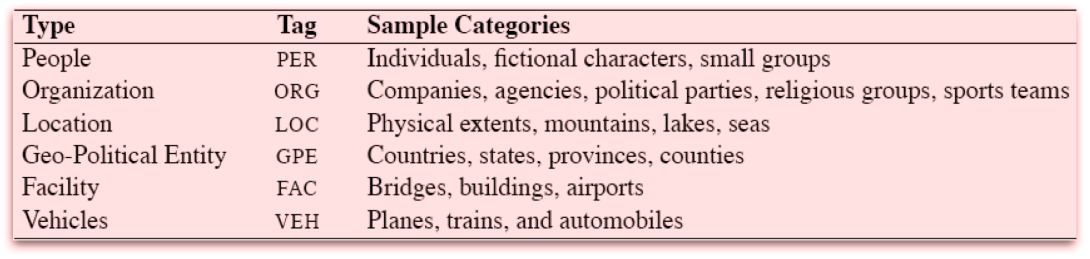
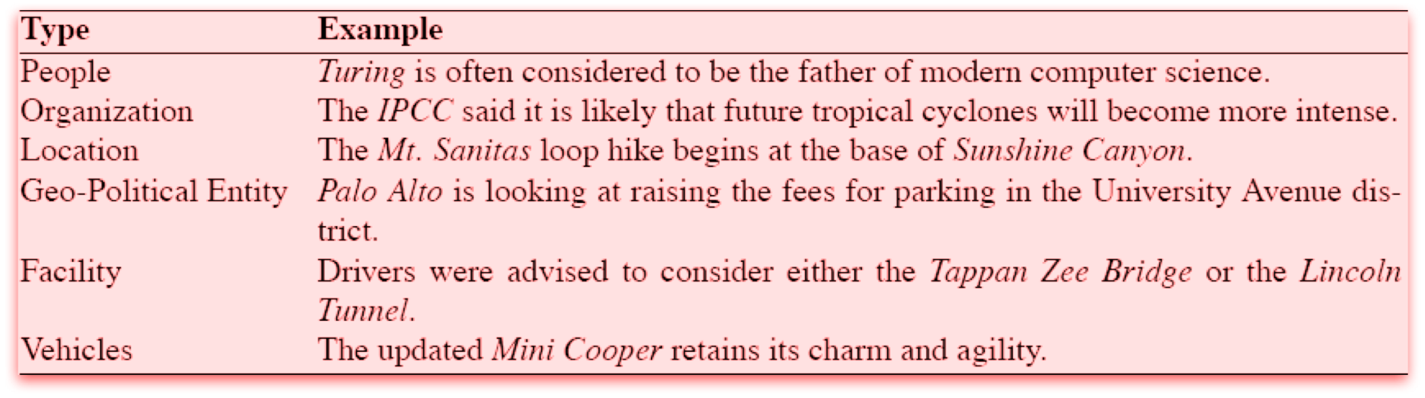
NE Types
Slide from Jim Martin

Slide 84
Information Extraction
As a task:
Filling slots in a database from sub-segments of text.
October 14, 2002, 4:00 a.m. PT
For years, Microsoft Corporation CEO Bill Gates railed against the economic philosophy of open-source software with Orwellian fervor, denouncing its communal licensing as a "cancer" that stifled technological innovation.
Today, Microsoft claims to "love" the open-source concept, by which software code is made public to encourage improvement and development by outside programmers. Gates himself says Microsoft will gladly disclose its crown jewels--the coveted code behind the Windows operating system--to select customers.
"We can be open source. We love the concept of shared source," said Bill Veghte, a Microsoft VP. "That's a super-important shift for us in terms of code access.“
Richard Stallman, founder of the Free Software Foundation, countered saying…
IE
NAME TITLE ORGANIZATION
Bill Gates CEO Microsoft
Bill Veghte VP Microsoft
Richard Stallman founder Free Soft..
Slide from Chris Brew, adapted from slide by William Cohen

Slide 85
The Semantic Web
A simple scheme for representing factual knowledge as a labeled graph
  [draw example with courses, students, their names and locations, etc.]
Many information extraction tasks aim to produce something like this
Is a labeled graph (triples) really enough?
  ☺ Can transform k-tuples to triples
  (cf. Davidsonian event variable)
  ☹ Supports facts about individuals, but no direct support for quantifiers or reasoning

Slide 86
Phrase Types to Identify for IE
Closed set
Regular set
U.S. states
U.S. phone numbers
He was born in Alabama…
Phone: (413) 545-1323
The big Wyoming sky…
The CALD main office can be
reached at 412-268-1299
Complex pattern
Ambiguous patterns,
needing context and
many sources of evidence
U.S. postal addresses
University of Arkansas
P.O. Box 140
Hope, AR 71802
Person names
…was among the six houses sold by Hope Feldman that year.
Headquarters:
1128 Main Street, 4th Floor
Cincinnati, Ohio 45210
Pawel Opalinski, Software
Engineer at WhizBang Labs.
Slide from Chris Brew, adapted from slide by William Cohen
Notes:
How complicated a modeling technique will you have to use?

Slide 87
Identifying phrases
A key step in IE is to identify relevant phrases
  Named entities
    As on previous slides
  Relationship phrases
    “said”, “according to”, …
    “was born in”, “hails from”, …
    “bought”, “hopes to acquire”, “formed a joint agreement with”, …
  Simple syntactic chunks (e.g., non-recursive NPs)
    “Syntactic chunking” sometimes done before (or instead of) parsing
    Also, “segmentation”: divide Chinese text into words (no spaces)
So, how do we learn to mark phrases?
  Earlier, we built an FST to mark dates by inserting brackets
  But, it’s common to set this up as a tagging problem …

Slide 88
Reduce to a tagging problem …
The IOB encoding (Ramshaw & Marcus 1995):
  B_X = “beginning” (first word of an X)
  I_X = “inside” (non-first word of an X)
  O = “outside” (not in any phrase)
  Does not allow overlapping or recursive phrases
…United Airlines said Friday it has increased …
  B_ORG I_ORG O O O O O
… the move , spokesman Tim Wagner said …
O O O O B_PER I_PER O
What if this were tagged as B_ORG instead?
Slide adapted from Chris Brew

Slide 89
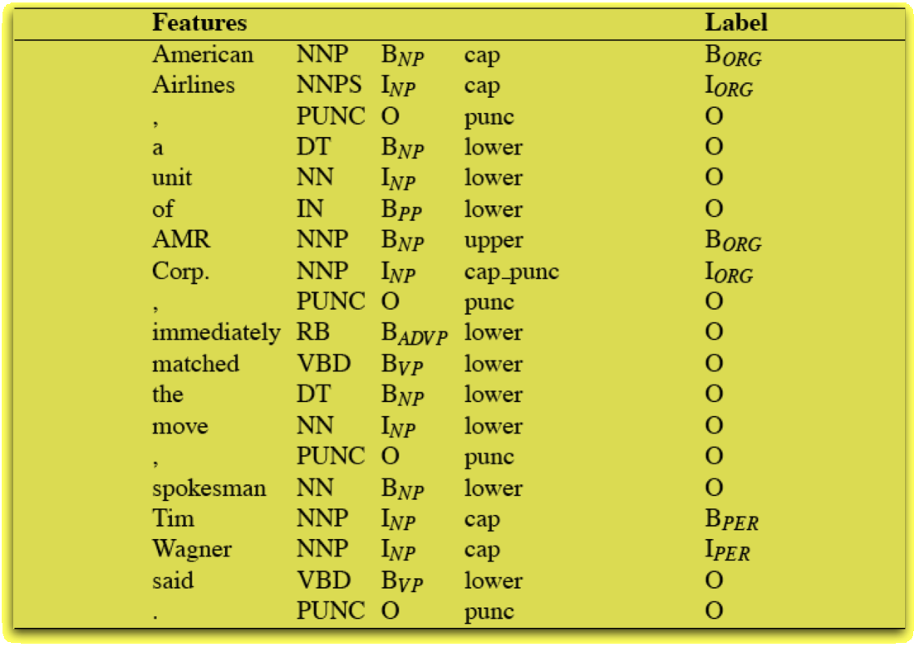
Some Simple NER Features
POS tags and chunks
from earlier processing
Now predict NER tagseq
A feature of this tagseq might give a positive or negative weight to this B_ORG in conjunction with some subset of the nearby properties
Or even faraway properties: B_ORG is more likely in a sentence with a spokesman!
Slide adapted from Jim Martin

Slide 90
Example applications for IE
Classified ads
Restaurant reviews
Bibliographic citations
Appointment emails
Legal opinions
Papers describing clinical medical studies
…

Slide 91
Text Annotation Tasks
Classify the entire document
Classify individual word tokens
Identify phrases (“chunking”)
Syntactic annotation (parsing)
600.465 - Intro to NLP - J. Eisner

Slide 92
Parser Evaluation Metrics
Runtime
Exact match
  Is the parse 100% correct?
Labeled precision, recall, F-measure of constituents
  Precision: You predicted (NP,5,8); was it right?
  Recall: (NP,5,8) was right; did you predict it?
Easier versions:
  Unlabeled: Don’t worry about getting (NP,5,8) right, only (5,8)
  Short sentences: Only test on sentences of ≤ 15, ≤ 40, ≤ 100 words
  Dependency parsing: Labeled and unlabeled attachment accuracy
Crossing brackets
  You predicted (…,5,8), but there was really a constituent (…,6,10)

Slide 93
Labeled Dependency Parsing
Raw sentence
He reckons the current account deficit will narrow to only 1.8 billion in September.
Part-of-speech tagging
POS-tagged sentence
He reckons the current account deficit will narrow to only 1.8 billion in September.
PRP VBZ DT JJ NN NN MD VB TO RB CD CD IN NNP .
Word dependency parsing
Word dependency parsed sentence
He reckons the current account deficit will narrow to only 1.8 billion in September .
SUBJ
MOD
MOD
COMP
MOD
SUBJ
COMP
SPEC
MOD
S-COMP
ROOT
slide adapted from Yuji Matsumoto
Notes:
Can insert some introductory slides here (from NLP class) on why parsing is hard and why we do it.

Slide 94
Dependency Trees
1. Assign heads
S
[head=thrill]
NP
VP
[head=plan]
[head=thrill]
Det
The
N
V
has
VP
[head=plan]
[head=thrill]
N
plan
VP
V
been
VP
[head=plan]
[head=swallow]
[head=thrill]
to
VP
V
thrilling
NP
Otto
[head=swallow]
[head=thrill]
[head=Otto]
V
swallow
NP
Wanda
[head=swallow]
[head=Wanda]

Slide 95
Dependency Trees
2. Each word is the head of a whole connected subgraph
S
[head=thrill]
NP
VP
[head=plan]
[head=thrill]
Det
The
N
V
has
VP
[head=plan]
[head=thrill]
N
plan
VP
V
been
VP
[head=plan]
[head=swallow]
[head=thrill]
to
VP
V
thrilling
NP
Otto
[head=swallow]
[head=thrill]
[head=Otto]
V
swallow
NP
Wanda
[head=swallow]
[head=Wanda]

Slide 96
Dependency Trees
2. Each word is the head of a whole connected subgraph
S
NP
VP
Det
The
N
V
has
VP
N
plan
VP
V
been
VP
to
VP
V
thrilling
NP
Otto
V
swallow
NP
Wanda

Slide 97
Dependency Trees
3. Just look at which words are related
thrilling
plan
The
has
swallow
been
to
Otto
Wanda

Slide 98
Dependency Trees
4. Optionally flatten the drawing
Shows which words modify (“depend on”) another word
Each subtree of the dependency tree is still a constituent
  But not all of the original constituents are subtrees (e.g., VP)
Easy to spot semantic relations (“who did what to whom?”)
  Good source of syntactic features for other tasks
Easy to annotate (high agreement)
Easy to evaluate (what % of words have correct parent?)
The plan to swallow Wanda has been thrilling Otto.

Slide 99
Supervised Learning Methods
Easy to build a “yes” or “no” predictor from supervised training data
  Plenty of software packages to do the learning & prediction
  Lots of people in NLP never go beyond this ☺
Similarly, easy to build a system that chooses from a small finite set
  Basically the same deal
  But runtime goes up linearly with the size of the set, unless you’re clever (HW3)
Harder to predict the best string or tree (set is exponentially large or infinite)
  Requires dynamic programming; you might have to write your own code
  But finite-state or CRF toolkits will find the best string for you
  And you could modify someone else’s parser to pick the best tree
  An algorithm for picking the best can usually be turned into a learning algorithm
Hardest if your features look at “non-local” properties of the string or tree
  Now dynamic programming won’t work (or will be something awful like O(n⁹))
  You need some kind of approximate search
  Can be harder to turn approximate search into a learning algorithm
  Still, this is a standard preoccupation of machine learning
  (“structured prediction,” “graphical models”)

Slide 100
Text Annotation Tasks
Classify the entire document
Classify individual word tokens
Identify phrases (“chunking”)
Syntactic annotation (parsing)
Semantic annotation
600.465 - Intro to NLP - J. Eisner

Slide 101
Semantic Role Labeling (SRL)
For each predicate (e.g., verb)
  find its arguments (e.g., NPs)
  determine their semantic roles
John drove Mary from Austin to Dallas in his Toyota Prius.
The hammer broke the window.
  agent: Actor of an action
  patient: Entity affected by the action
  source: Origin of the affected entity
  destination: Destination of the affected entity
  instrument: Tool used in performing action.
  beneficiary: Entity for whom action is performed
Slide thanks to Ray Mooney (modified)

Slide 102
As usual, can solve as classification …
Consider one verb at a time: “bit”
Classify the role (if any) of each of the 3 NPs
Color Code:
not-a-role
agent
patient
source
destination
instrument
beneficiary
S
NP VP
NP PP
V NP
Det A N
Prep NP
bit
Det A N
The
Adj A
dog
with
Det A N
a
ε
girl
big
ε
the
ε
boy
Slide thanks to Ray Mooney (modified)

Slide 103
Parse tree paths as classification features
Path feature is
V ↑ VP ↑ S ↓ NP
which tends to
be associated
with agent role
S
NP VP
NP PP
V NP
Det A N
Prep NP
bit
Det A N
The
Adj A
dog
with
Det A N
a
ε
girl
big
ε
the
ε
boy
Slide thanks to Ray Mooney (modified)

Slide 104
Parse tree paths as classification features
Path feature is
V ↑ VP ↑ S ↓ NP ↓ PP ↓ NP
which tends to
be associated
with no role
S
NP VP
NP PP
V NP
Det A N
Prep NP
bit
Det A N
The
Adj A
dog
with
Det A N
a
ε
girl
big
ε
the
ε
boy
Slide thanks to Ray Mooney (modified)

Slide 105
Head words as features
Some roles prefer to be filled by certain kinds of NPs.
This can give us useful features for classifying accurately:
  “John ate the spaghetti with chopsticks.” (instrument)
  “John ate the spaghetti with meatballs.” (patient)
  “John ate the spaghetti with Mary.”
    Instruments should be tools
    Patient of “eat” should be edible
  “John bought the car for $21K.” (instrument)
  “John bought the car for Mary.” (beneficiary)
    Instrument of “buy” should be Money
    Beneficiaries should be animate (things with desires)
  “John drove Mary to school in the van”
  “John drove the van to work with Mary.”
    What do you think?
Slide thanks to Ray Mooney (modified)

Slide 106
Uses of Semantic Roles
Find the answer to a user’s question
  “Who” questions usually want Agents
  “What” question usually want Patients
  “How” and “with what” questions usually want Instruments
  “Where” questions frequently want Sources/Destinations.
  “For whom” questions usually want Beneficiaries
  “To whom” questions usually want Destinations
Generate text
  Many languages have specific syntactic constructions that must or should be used for specific semantic roles.
Word sense disambiguation, using selectional restrictions
  The bat ate the bug. (what kind of bat? what kind of bug?)
    Agents (particularly of “eat”) should be animate – animal bat, not baseball bat
    Patients of “eat” should be edible – animal bug, not software bug
  John fired the secretary.
  John fired the rifle.
    Patients of fire₁ are different than patients of fire₂
Slide thanks to Ray Mooney (modified)

Slide 107
Other Current Semantic Annotation Tasks (similar to SRL)
PropBank – coarse-grained roles of verbs
NomBank – similar, but for nouns
FrameNet – fine-grained roles of any word
TimeBank – temporal expressions

Slide 108
FrameNet Example
REVENGE FRAME
Avenger
Offender (unexpressed in this sentence)
Injury
Injured Party (unexpressed in this sentence)
Punishment
We avenged the insult by setting fire to his village.
a word/phrase that triggers the REVENGE frame
Slide thanks to CJ Fillmore (modified)

Slide 109
FrameNet Example
REVENGE FRAME
triggering words and phrases
(not limited to verbs)
avenge, revenge, retaliate, get back at, pay back, get even, …
revenge, vengeance, retaliation, retribution, reprisal, …
vengeful, retaliatory, retributive; in revenge, in retaliation, …
take revenge, wreak vengeance, exact retribution, …
Slide thanks to CJ Fillmore (modified)

Slide 110
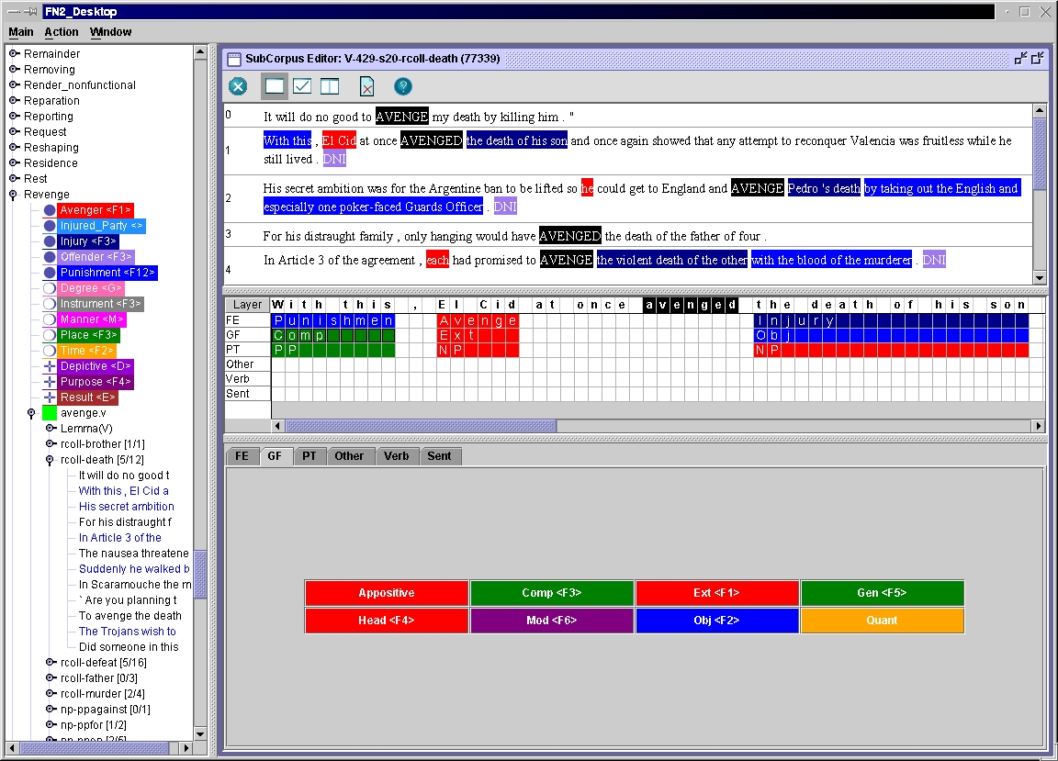

Slide 111
Generating new text
Speech recognition (transcribe as text)
Machine translation
Text generation from semantics
Inflect, analyze, or transliterate words
Single- or multi-doc summarization
600.465 - Intro to NLP - J. Eisner

Slide 112
Deeper Information Extraction
Coreference resolution (within a document)
Entity linking (across documents)
Event extraction and linking
Knowledge base population (KBP)
Recognizing texual entailment (RTE)
600.465 - Intro to NLP - J. Eisner

Slide 113
User interfaces
Dialogue systems
  Personal assistance
  Human-computer collaboration
  Interactive teaching
Language teaching; writing help
Question answering
Information retrieval
600.465 - Intro to NLP - J. Eisner

Slide 114
Multimodal interfaces or modeling
Sign languages
Speech + gestures
Images + captions
Brain recordings, human reaction times
600.465 - Intro to NLP - J. Eisner

Slide 115
Discovering Linguistic Structure
NLP automates things that humans do well, so that they can be done automatically on more sentences. But this slide is about language analysis that’s hard even for humans. Computational linguistics (like comp bio, etc.) can discover underlying patterns in large datasets: things we didn’t know!
Decipherment
Grammar induction
Topic modeling
Deep learning of word meanings
Language evolution (historical linguistics)
Grounded semantics
600.465 - Intro to NLP - J. Eisner

