Slide 1
Business Advisor
---Solution to support business decision with up-to-date customer feedback
Team 11: Lingyun Yi, Ankit Phaterpekar, Jui Saba Guram, Yupeng Su, Xiaoting cui

Slide 2
Business Problem: No Business Intelligence Tool to support business decision with up-to-date customer feedback
More than 100 million reviews on Yelp
Yelp Rankings and Reviews Directly Affect the future customers
But no BI tool using yelp or other application tool to support decisions

Slide 3
Solution: Business Advisor – A business intelligence tool provide up-to date customer feedback data visualization and analysis
Business summary on Customer reviews
Review Diving
Data Analysis on Business Reviews
Data Analysis on Local Businesses
Data Analysis on US Yelp Reviews
Interactive Mapping Feature

Slide 4
Data Storage/ Visualization
JSON Files containing Yelp’s businesses , review and user data.
2.7M reviews and 649K tips by 687K users for 86K businesses
566K business attributes, e.g., hours, parking availability, ambience.
Social network of 687K users for a total of 4.2M social edges.
Aggregated check-ins over time for each of the 86K businesses

Slide 5



Data Storage/ Visualization
The JSON files were imported into MongoDB. Tableau was used with an ODBC connector to provide data visualization capabilities on top of the content indexed on the MongoDB database.

Slide 6
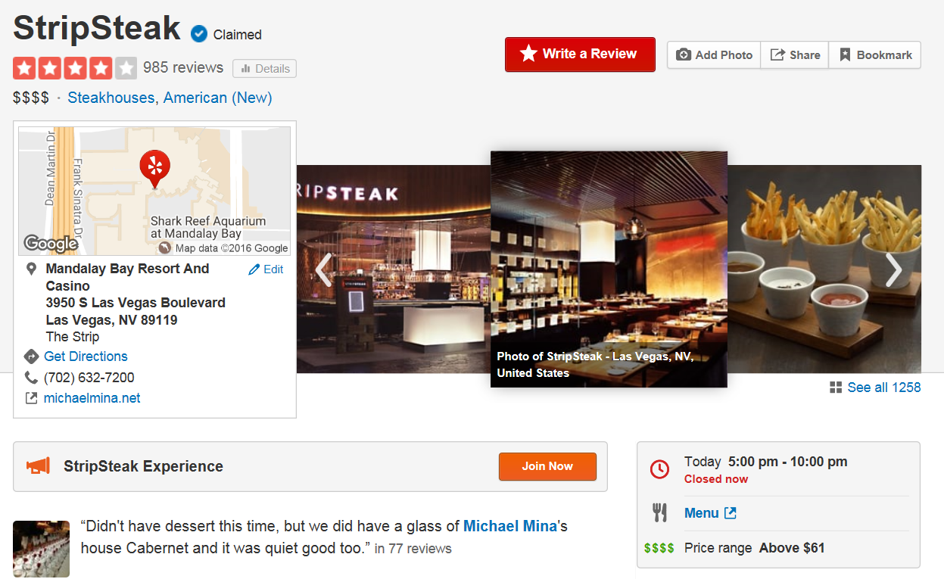
4 stars
985 reviews
Location: Las Vegas, The strip
Category: Steakhouses, American (New)
4 Dollars (Above $ 61)

Slide 7
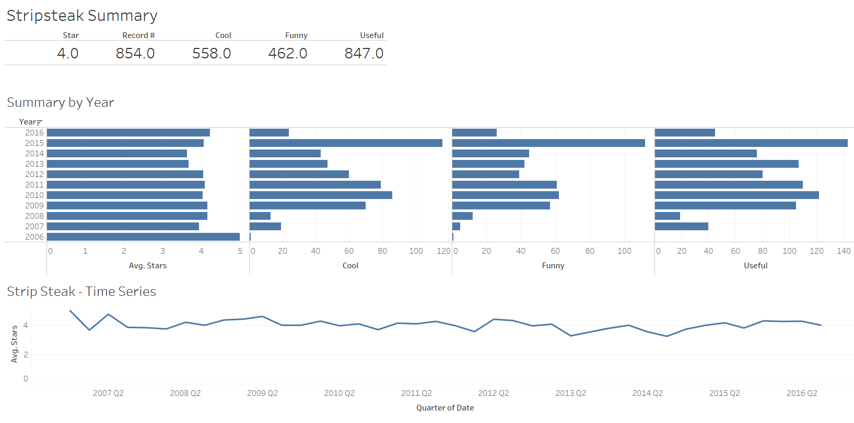

Slide 8
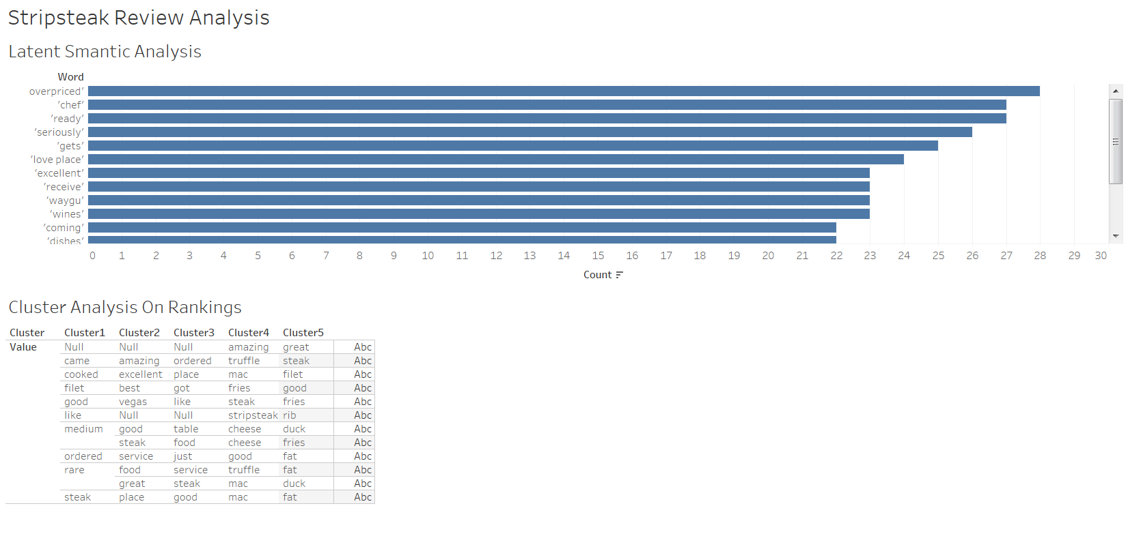

Slide 9
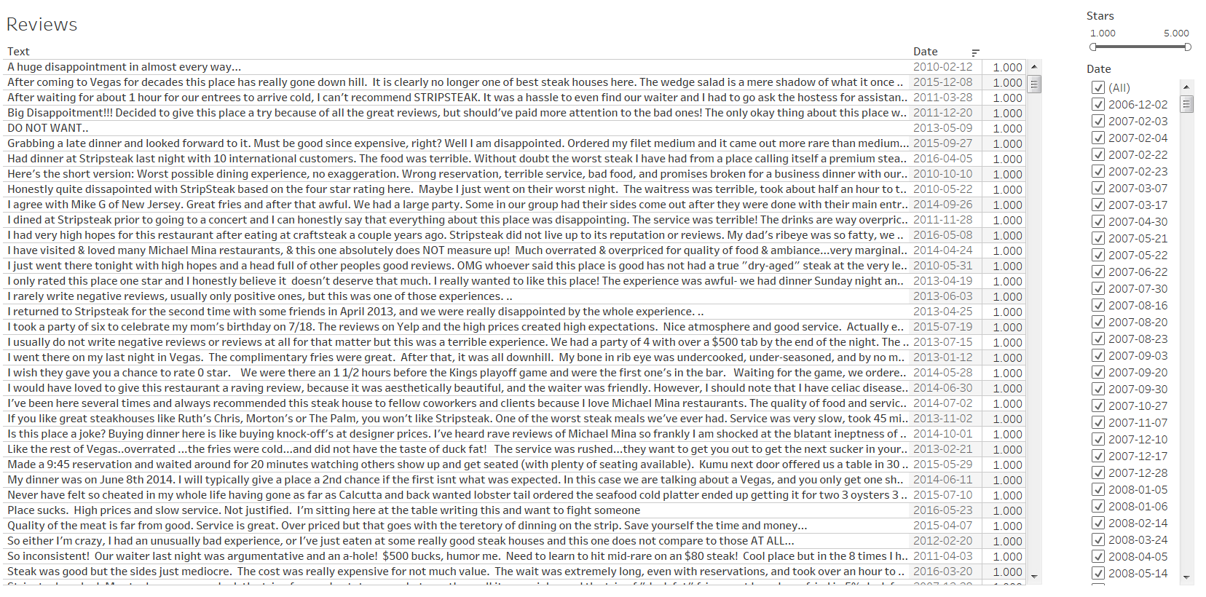

Slide 10
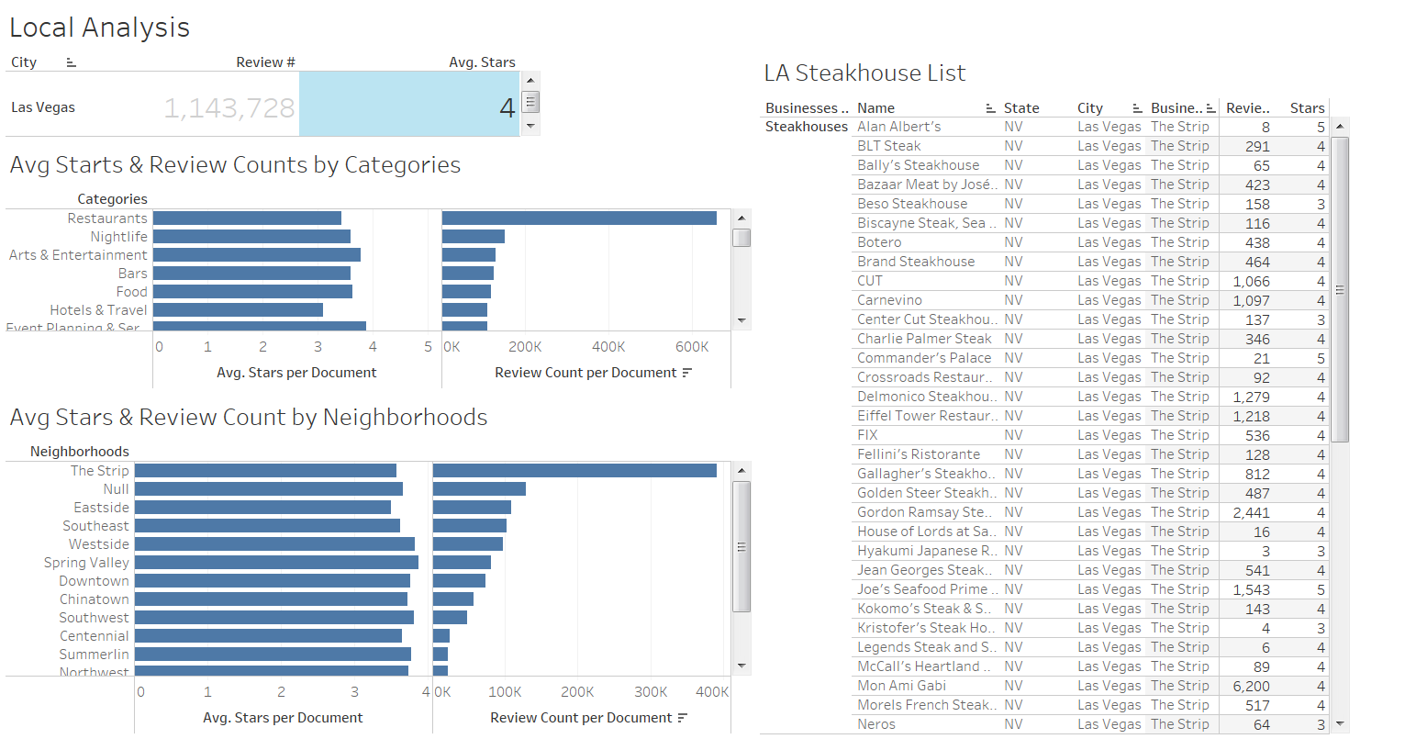

Slide 11
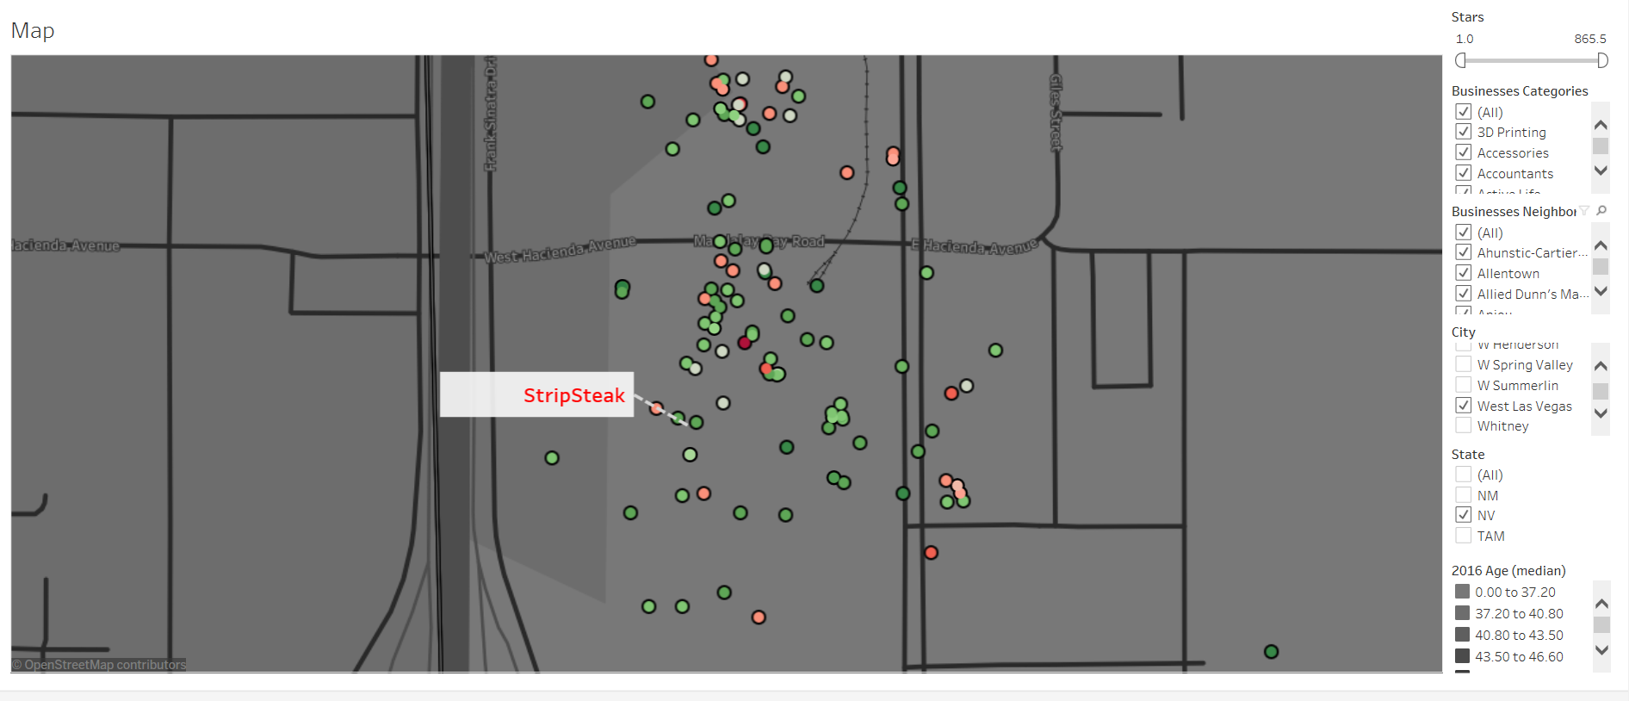

Slide 12
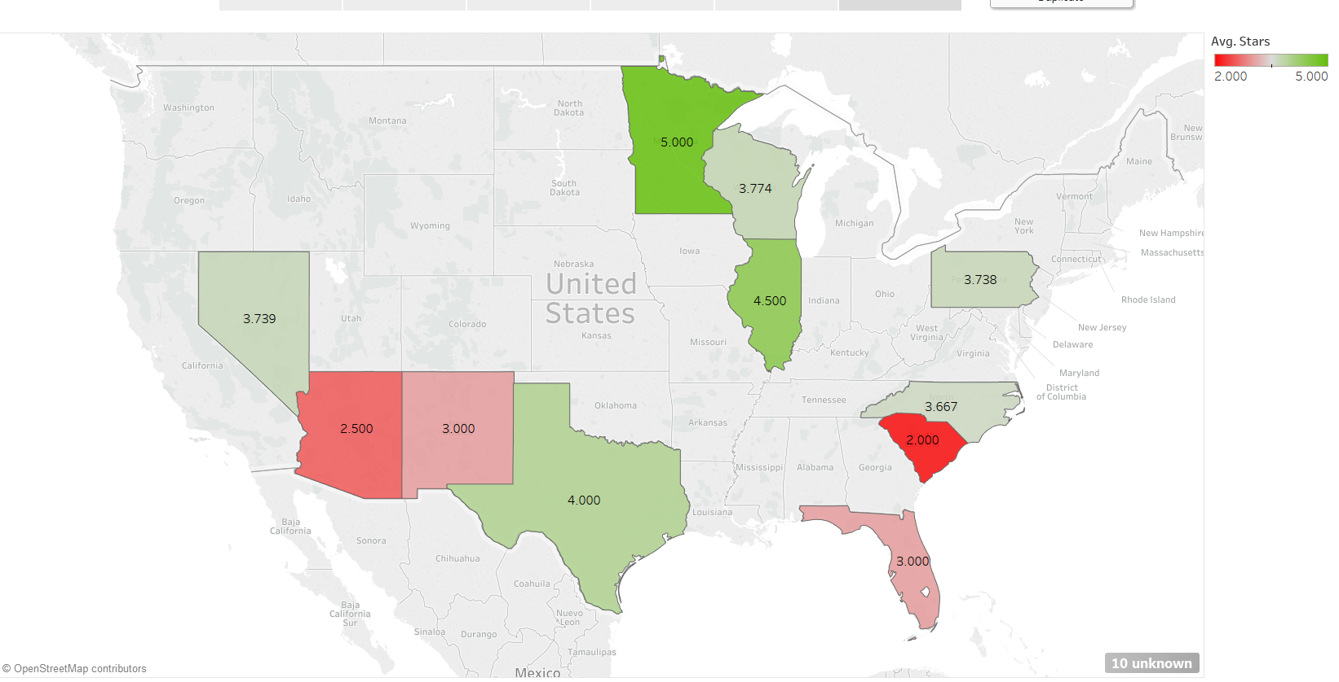

Slide 13
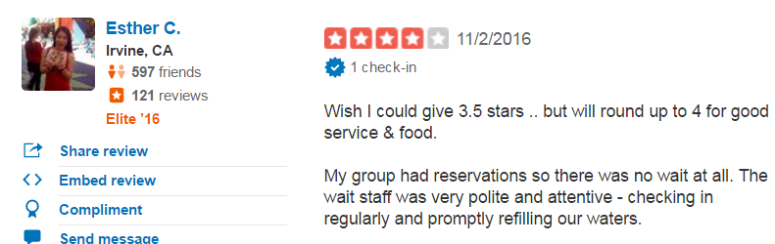
Data description
854 reviews
Stars labeld
(what if no labeled?)
https://www.yelp.com/biz/stripsteak-las-vegas

Slide 14
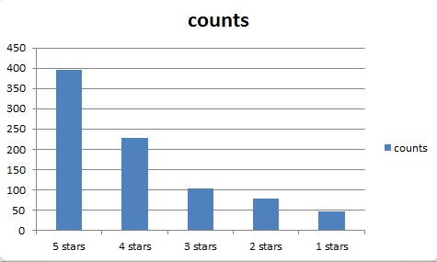
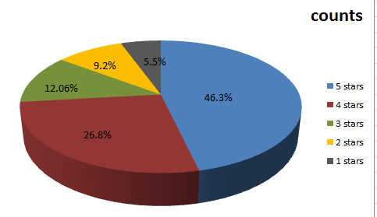
How is my restaurant doing?

Slide 15
Semantic analysis on the reviews
Predicting future reviews belong to which category of stars
"loved the resturant,really good chicken.The servers are friendly"
- 4 stars
"Hated the resturant,very bad food.The service sucks” -1 star

Slide 16
Latent Semantic analysis
Target:
Care about when people writing a review what words are showed up togother frequently.
Motivation
Be helpful to manager to figure out the circumstance of their restaurant.

Slide 17
Latent Semantic analysis
Approach:
Save data to json.(easy to query)
Preprocessing (remove punctuation)
Tokenize text(try stem tokenizer, word tokenizer)
Vectorize tokenized texts by applying tf-idf method
Apply svd to generate concept

Slide 18
Latent Semantic analysis
Result
854 reviews corresponding to the 854 concepts
Word frequency count on 854 concepts
concept 0: | concept 1: | concept 2: | concept 3:
steak | duck fat | duck fat | rib
good | duck | steak | cap
fries | fat fries | fat fries | steak
great | fat | duck | rib cap
food | fries | fat | kobe
cheese | cheese | great | wagyu
ordered | mac | fries | eye
place | mac cheese | best | rib eye
just | truffle | vegas | best steak
service | truffle mac | best steak | beef
duck | trio | awesome | american
fat | truffled | happy hour | best
mac | truffled mac | happy | american kobe
like | sauce | food | aged
mac cheese | filet | place | foie

Slide 19
Latent Semantic analysis
Word | Count | Word | Count
overpriced' | 28 | 'coming' | 22
'ready' | 27 | 'dishes' | 22
'chef' | 27 | 'sea' | 22
'seriously' | 26 | 'yummy' | 22
'gets' | 25 | 'worth' | 21
'love place' | 24 | 'cocktails' | 21
'receive' | 23 | 'absolutely' | 21
'excellent' | 23 | 'wow' | 21
'wines' | 23 | 'happy hour' | 20
'waygu' | 23 | 'service great' | 19

Slide 20
Advantage
No need to check review one by one.
More representative than only check frequency of whole reviews directly.

Slide 21
However, some disadvantages
High frequency positive words cover up the negative words.
Solution:
tune parameters min_df, max_df.
According to label to divide the review dataset

Slide 22
What if no label?
Cluster
Five different clusters represent different # stars
However, get poor result!
Homogeneity: 0.102 Completeness: 0.087 V-measure: 0.094 Adjusted Rand-Index: 0.067 Silhouette Coefficient: 0.025
Cluster1 | medium | rare | steak | medium | rare | ordered | good | filet | came | cooked | like
Cluster2 | steak | great | place | good | food | service | vegas | best | amazing | excellent
Cluster3 | food | steak | good | table | service | just | like | got | ordered | place
Cluster4 | cheese | mac | mac | cheese | truffle | good | steak | fries | truffle | mac | stripsteak | amazing
Cluster5 | fries | duck | fat | duck | fat | fat | fries | good | steak | filet | rib | great

Slide 23
How to improve?
Find good feature.
Remove feature like(rib eye steak, eye, steak)

Slide 24


