Slide 1

DS501 Case Study1- Team 10
How can Trump win? --- Data analysis on presidential-election-related tweets
Target Customer: Donald Trump Campaign Team
Team Members
Phaterpekar, Ankit Manohar
Yi, Lingyun
Su, Yupeng
Guram, Jui Saba
Cui, Xiaoting

Slide 2
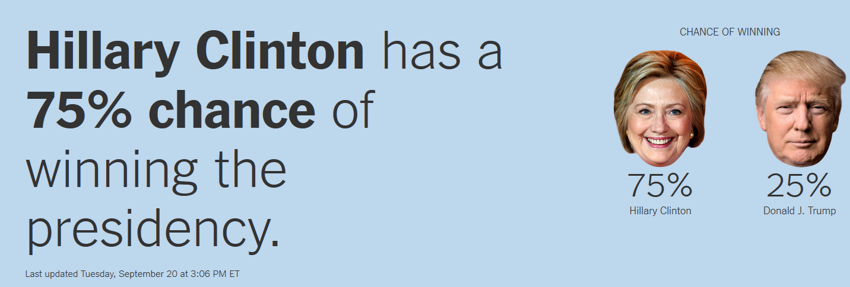
The Upshot’s elections model suggests that Hillary Clinton is favored to win the presidency, based on the latest state and national polls
http://www.nytimes.com/interactive/2016/upshot/presidential-polls-forecast.html

Slide 3
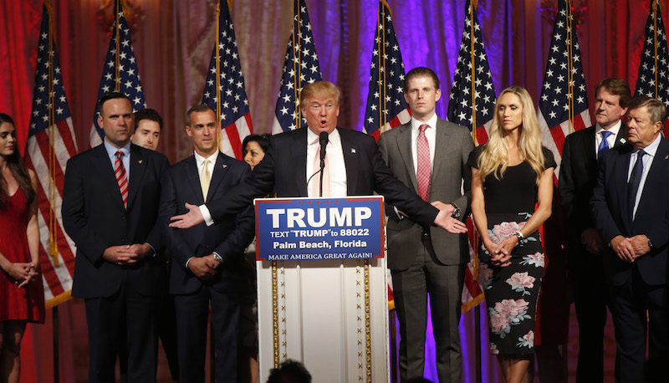
How could Donald J. Trump Win More Votes?
Target Customer: Donald Trump Campaign Team

Slide 4
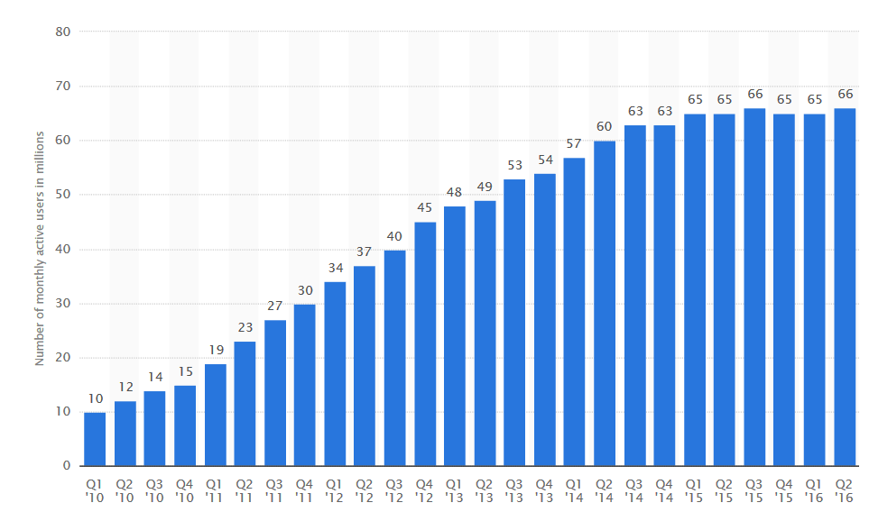
Social Media can Help!!
29.2% of US social media users are Twitter users
500 million tweets per day
Since 2015, we have around 65 millions active US twitter users per month.

Slide 5

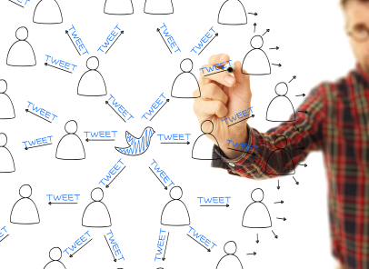




Twitter Data Analysis will help you understand:
What exactly people think?
which election issue people care most about ? Difference by State?
What is the most influential user/group/thought?

Slide 6
Data Gathering
Twitter streaming API was used to collect tweets based on key words for 3 days, (Friday, Saturday & Sunday).
A total of 127,367 tweets were obtained and stored in a JSON file.
Key Words
“ 'Trump2016', 'Hillary2016', '#imwithher', '#makeamericagreatagain', 'election2016', 'Donald Trump', 'Hillary Clinton', 'presidentialelections2016', 'donald trump', 'hillary clinton' “

Slide 7



Data Storage Visualization
The JSON file was then imported into MongoDB. Kibana Plugin was used with Elasticsearch to provide data visualizations capabilities on top of the content indexed on the Elasticsearch cluster.

Slide 8
Analysis method:
Focus on what exactly people think?
Adjectives, and Nouns.
Attitudes, and topics.
Sentiment analysis to the tweets to the donald trump.

Slide 9
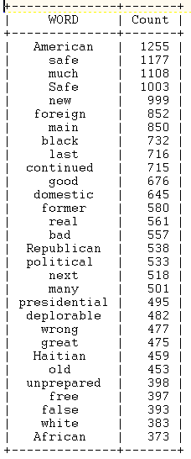
What political issues people care the most?
Top 10 Words
Safety, as “safe” word shown up 2180 times in total, is the issue people care the most.
Foreign word shown up 852 times.
If we combine “black” and “white” together, we will get 1115 counts. People’s tweets do talk about race when they comment on 2016 election
black
White
Safe
African
Haitian
foreign

Slide 10
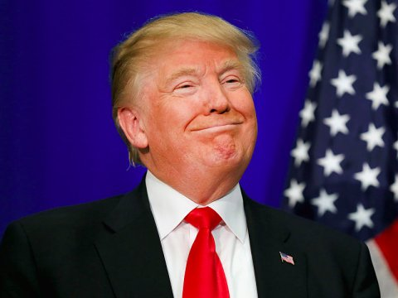
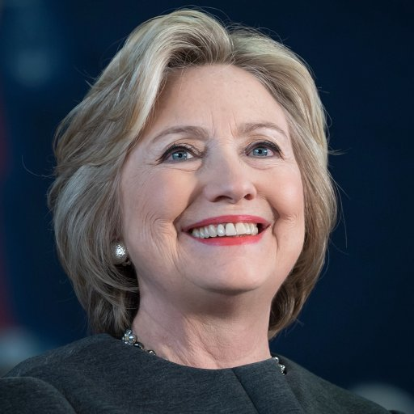
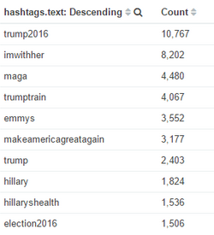


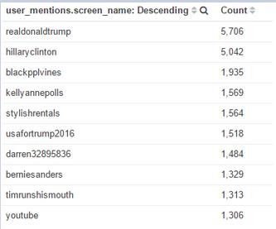
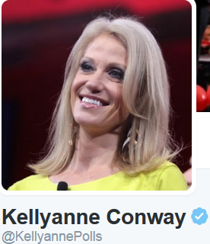

Top 10 hashtags
Top 10 User Mentions

Slide 11
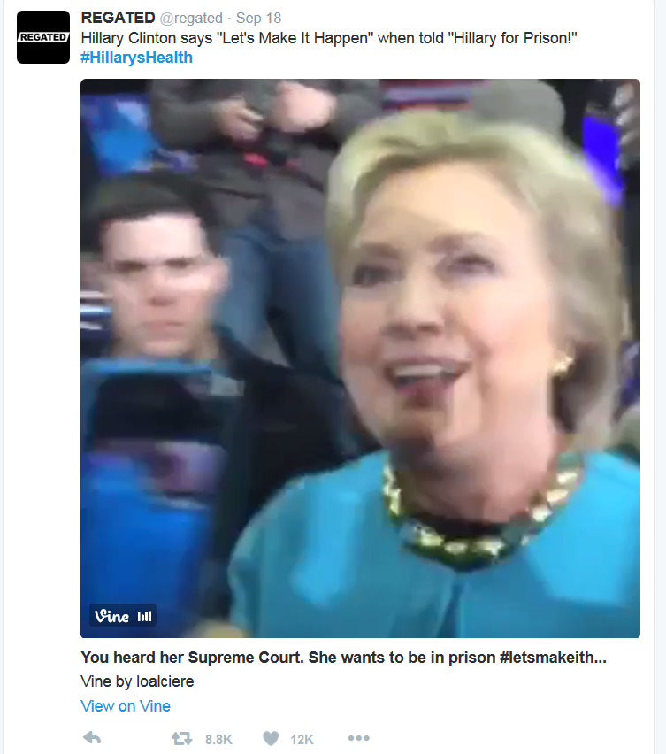
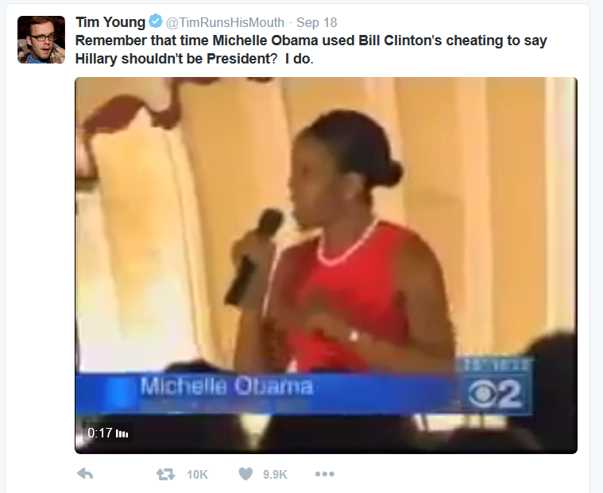
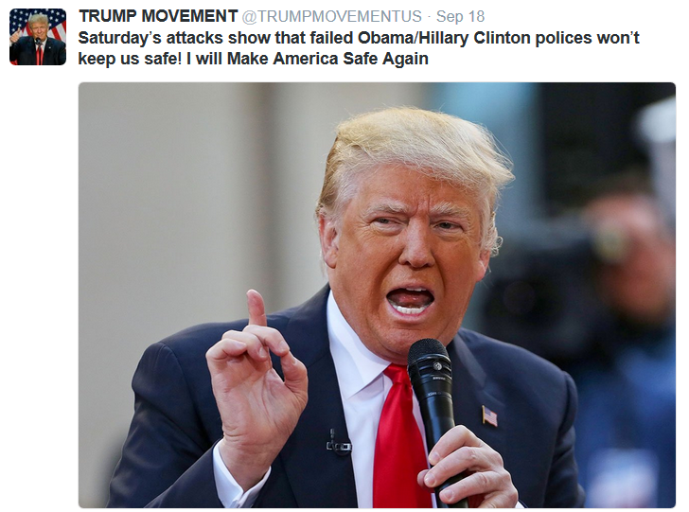
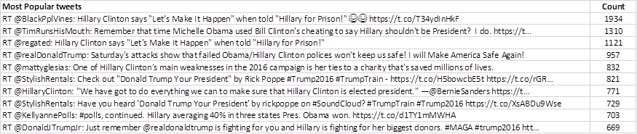
Which tweets influence people the most?
1310 Retweets
957 Retweets
3055 Retweets

Slide 12
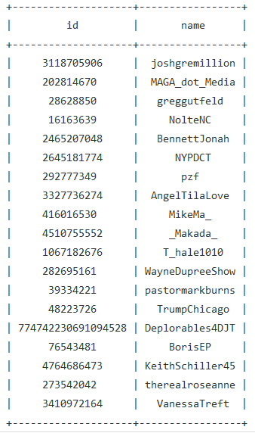
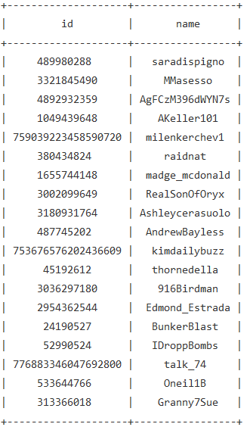
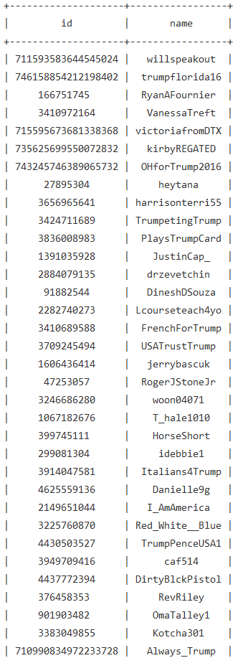
Friends, Followers & Mutual Friends USAforTrump2016 (Official Trump Campaign Account)
309 friends 49082 followers 157 Mutual Friends

Slide 13
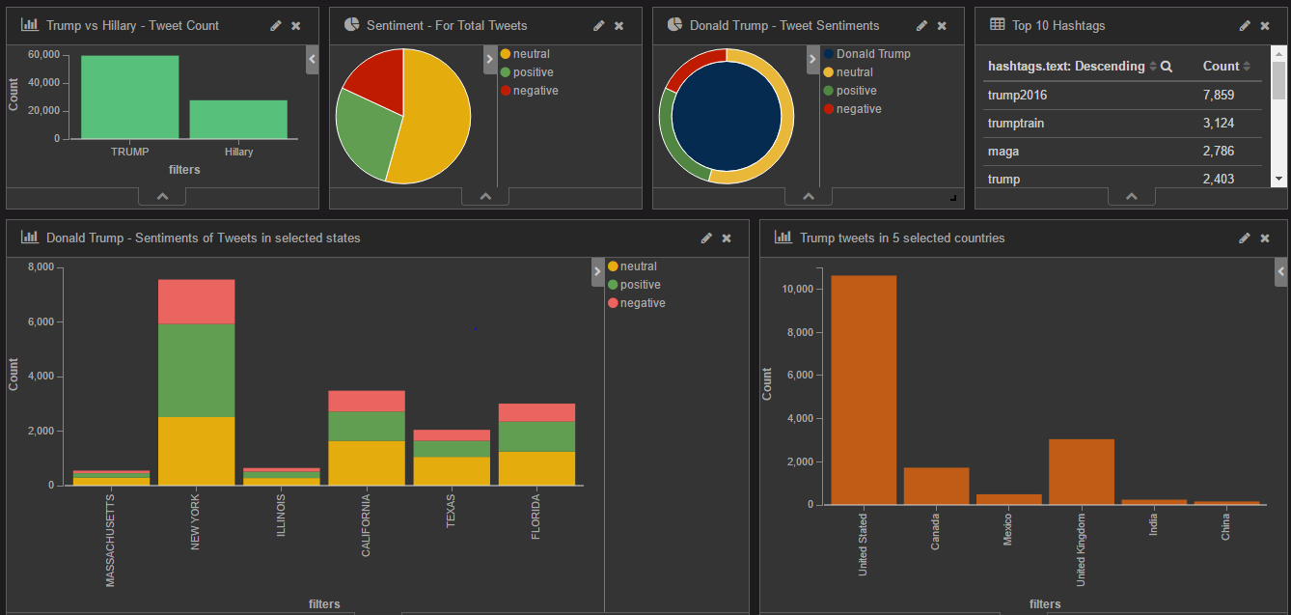
Further Analysis-Real Time BI Dashboard

Slide 14
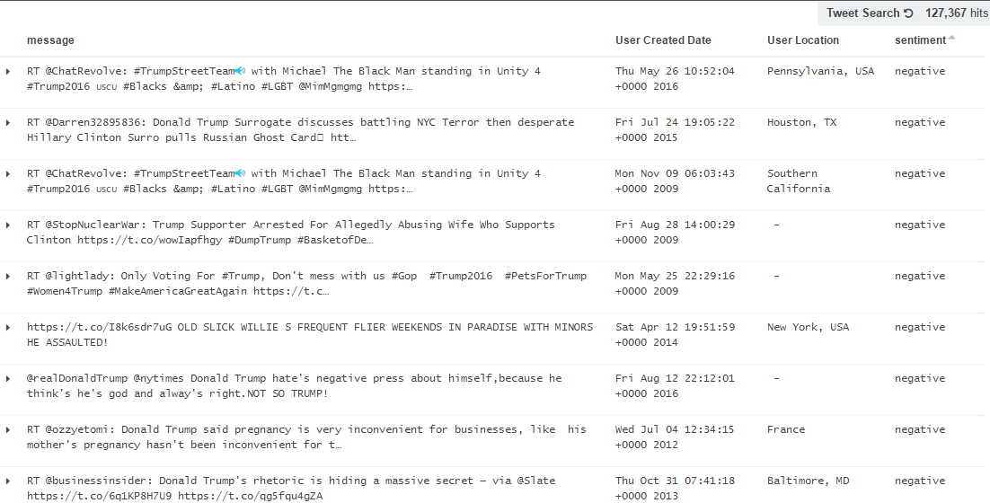
Live Twitter Feed

Slide 15
Conclusion
People have certain political issue mentioned much more than others, like safety, race.
Controversial tweets are the key to get more attention within Twitter
Twitter Data shows that Donald Trump should spend more resources in Massachusetts and Illionois.
By keeping an eye on the how the trends evolve the campaign can change its tactics.

Slide 16
Data Limitation
Twitter users could not represent the whole US population
The typical Twitter user are an 18-29 year-old educated minority with a well-paying job, and is slightly more likely to be male than female.
Tweets we collected could not represent the opinion for Twitter Users
Twitter Users who have strong opinion usually contribute more on the tweets.
The 3 day Time frame limits the information we could collect
Real time dashboard is our approach to address this issue.

Slide 17


