Slide 1

Automate Test Scenario-Create User Scenario in acquire.io

Slide 2
Requirement
Scenario 1: Log into agent dashboard. Navigate to settings
on the left navigation panel. Account Settings -> Users,
Roles and Skills -> Create User. This scenario should also
validate required fields.
You've been added to lo4h4a. To log in, use the following credentials:
• email: virijukix@givmail.com
• password: Hereisanew1!
• Click the link below to log in to your account:
• https://accounts.uat.env.acquire.io/login?endpoint=account&return=&account
=lo4h4a

Slide 3
Approach
Used the POM –PageObject Model and Page Factory as part of the automation framework
Language :Java with Selenium Webdriver,TestNG
Tools:IntelliJ/Eclipse
Browser:Chrome

Slide 4
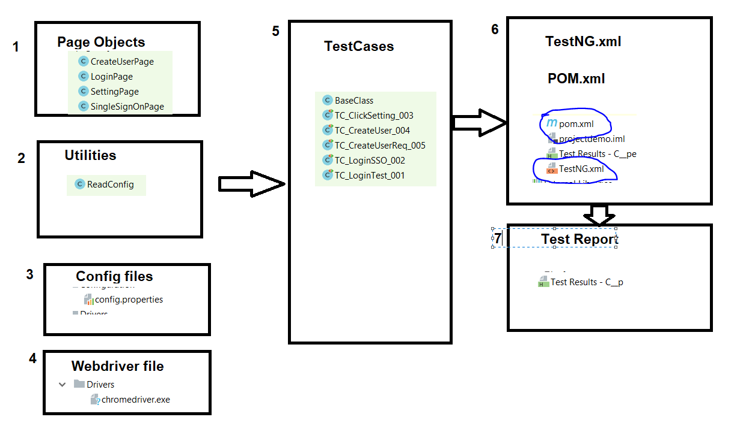
Automation framework

Slide 5
Implementation
Create Maven Project
Update pom.xml with seleniumjar, testng, maven build plugin dependency
Create Page Objects
Create the Test scenarios
Read the common values for ex., username, emailid, password,role from properties file
Run the test case on the browser i.e Chrome

Slide 6
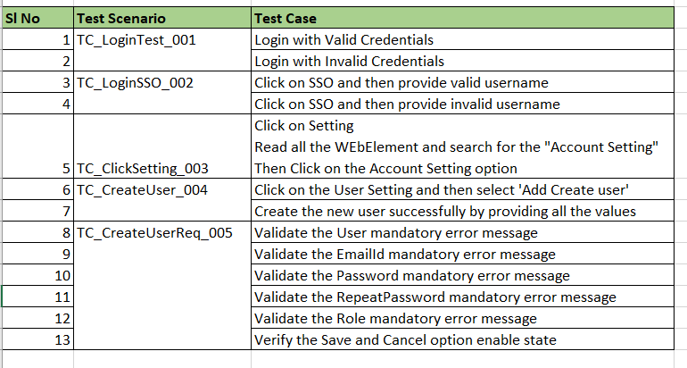
Test Scenarios

Slide 7
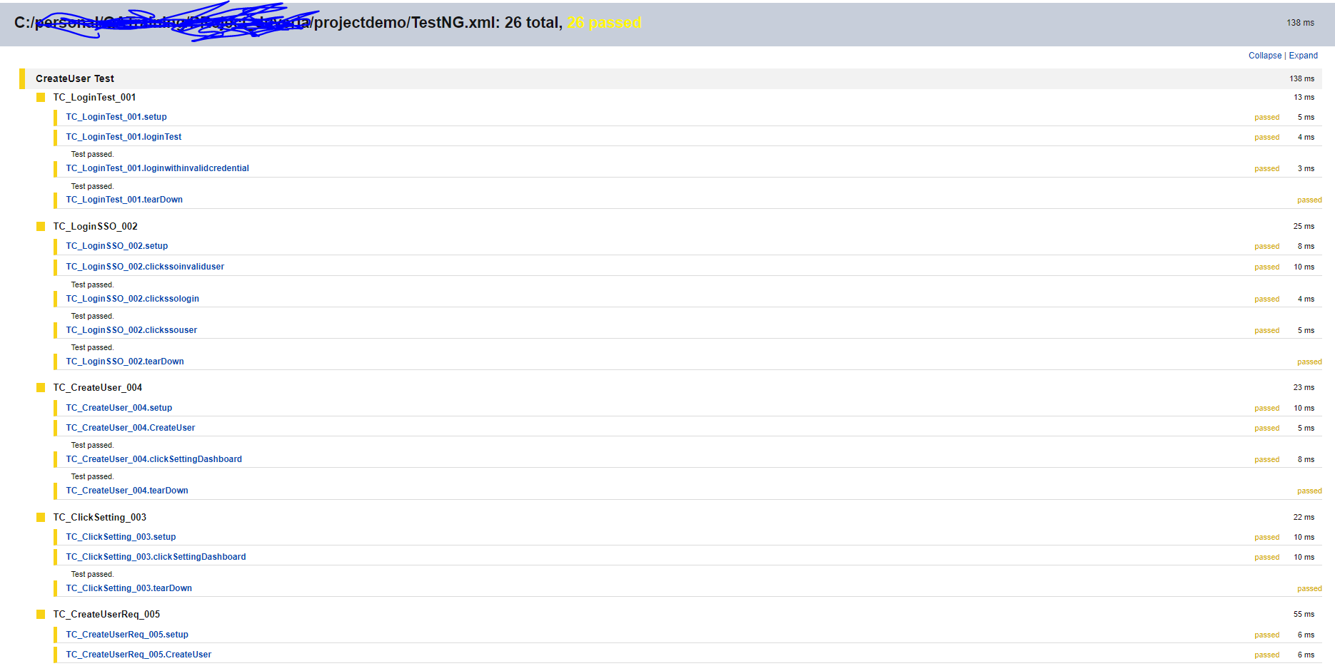
Test Report

Slide 8
Steps to execute(included different ways i.e. using testng/mvn/run.bat file
TestNG configuration is used to run the scripts.
Right click on the TestNG.xml file and run .
All the test cases are included in the TestNG.xml file
Also we can run the script using the maven. Select the pom.xml file and perform the below instructions
mvn clean install
mvn test
Also we have created the run.bat file inside the project file. Refer the readme instruction to run the file

Slide 9
Thank You
Thank You

