Slide 1
INTRODUCTION
Opening Steakhouse Restaurant in Rio de Janeiro - BRAZIL
Rio de janeiro or simply "Rio" is the second most populous city in Brazil and the sixth-most populous in the Americas. Rio de Janeiro is the capital of the state of Rio de Janeiro, Brazil's third-most populous state.
In this project, I will determine which place is good for opening a Steakhouse Restaurant in "Rio"

Slide 2
Description
I’ll get the neighborhood from Wikipedia for
I’ll use python geocoder library to get geographical coordinates of neighborhoods
I’ll use Foursquare API venues explore method to get the venues of given neighborhoods of Bucharest.
I’ll use Foursquare API venues method to get ranks and likes of restaurants by given venue id.

Slide 3
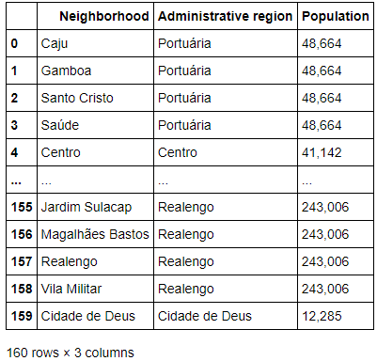
Webscrapping with BeautifulSoup
I took neighborhood from Wikipedia: “https://en.wikipedia.org/wiki/List_of_Administrative_Regions_in_Rio_de_Janeiro “
And create Data frame with all information.
There are 160 neighborhoods for 33 Administrative regions

Slide 4
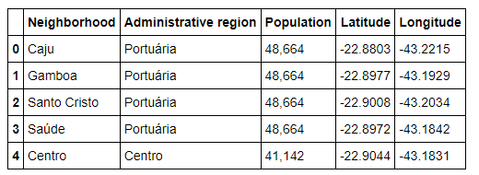
Latitude and Longitude with Geocode
Including latitude and longitute in a new data frame with Neighborhood, Administrative region, Population, Latitude and longitude.

Slide 5
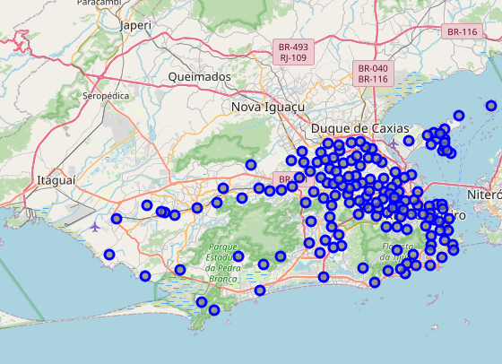
Create map with Folium
Reading dataframe and creating
map using Folium to show all
neighborhoods in Rio.

Slide 6
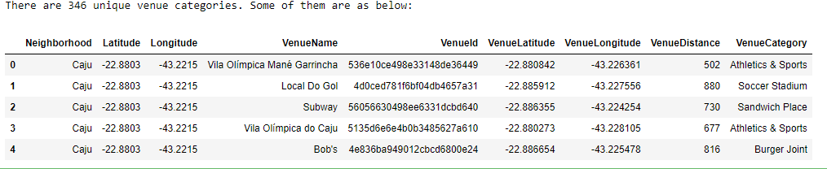
Foursquare/Developer
To use Foursquare API to get relevant information for each nearby venue.

Slide 7
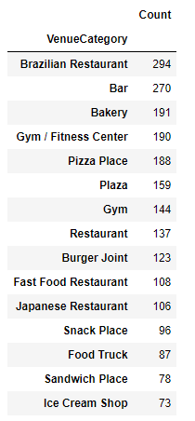
Top 15 distinct venue counts
Printing Top 15 distinct venues acessing and manipulating the Neighborhood data frame.

Slide 8

Filter restaurants
Reading and filtering data frame per restaurants to get the numbers and percentage

Slide 9
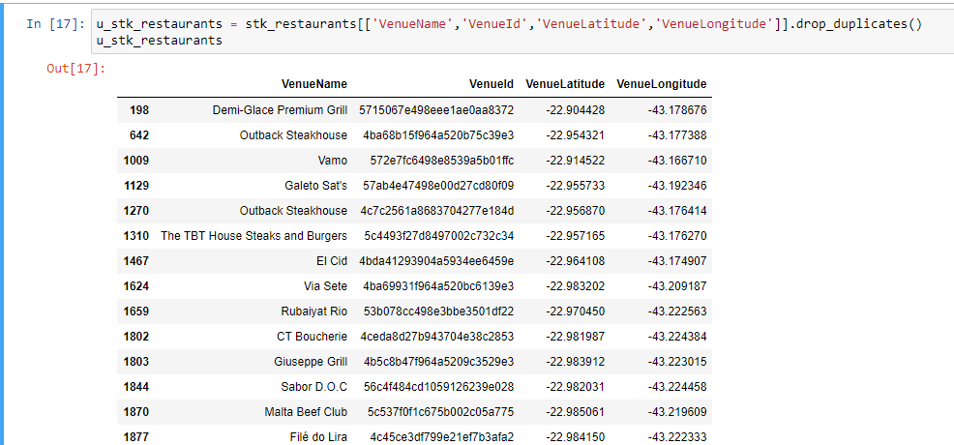
Filter Steak Restaurants
Reading and filtering data frame per steak restaurants

Slide 10
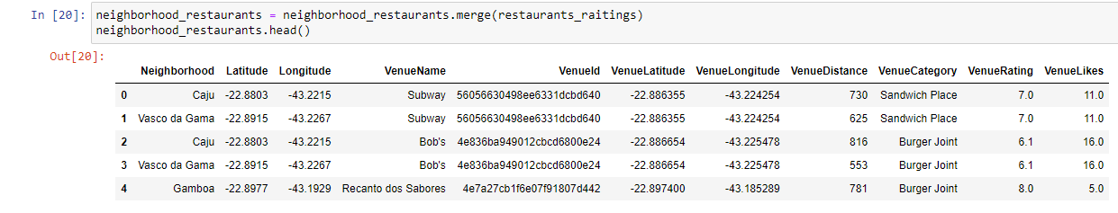
Merge data frames
Merging data frame Restaurants Neighborhoods with Raiting

Slide 11
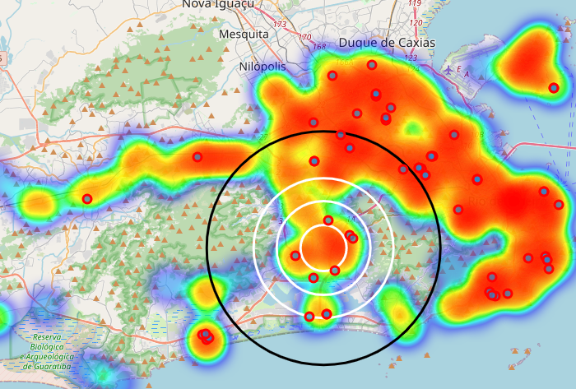
Map of Steak restaurants
Using folium to show the steak restaurants in the map

Slide 12
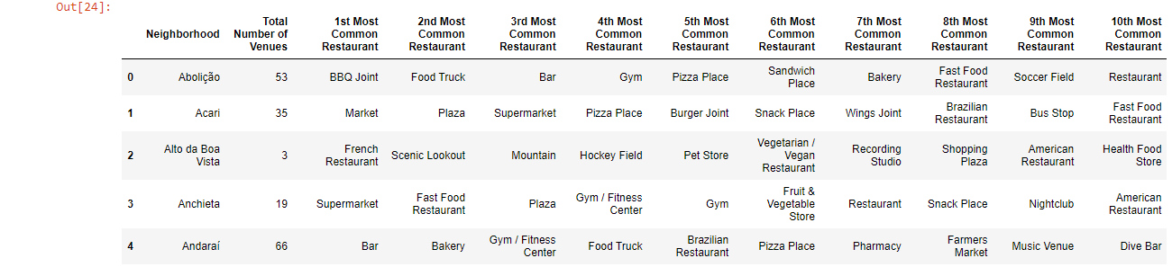
Most common restaurants
create a new dataframe with most common venue categories

Slide 13
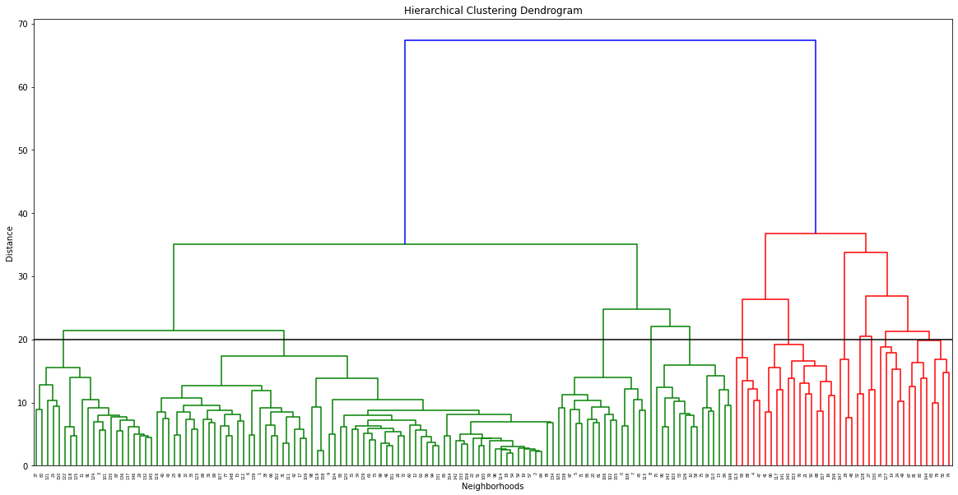
Hierachical Clustering Dendogram

Slide 14
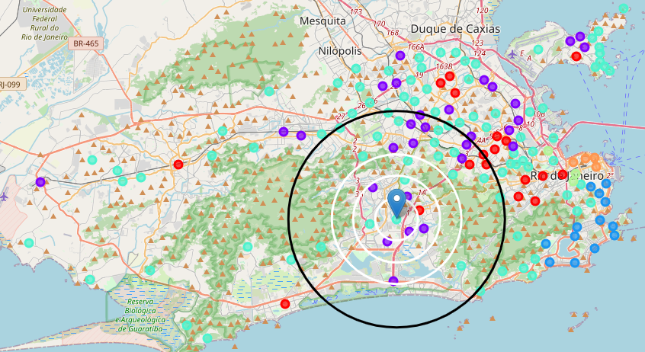
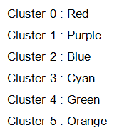
Cluster Map

Slide 15
Final Decision
Neighborhood : Tijuca - Cluster 0, Region Number VIII, Population: 181810
I choosed Tijuca. with only 2 Steak restaurant and with big population, this neighborhood is not a poor region and a very good point to start.

