Slide 1
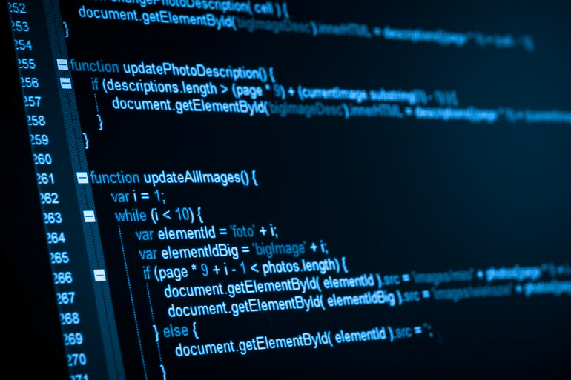

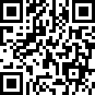
Sponsored by:
It’s Free!
Go to:
https://goo.gl/forms/8VZWaT815N5jfDqh2
12 sessions
Special prize for best performing Project!
Spring 2019
GPU Programming Basics
Northeastern Students:
A free GPU Programming class will be offered this Spring sponsored by NUCAR Laboratory. Students will learn about GPUs and interact with them, learning how to write and design algorithms to develop efficient and high performance programs using the CUDA Framework.
The course consists of 12 sessions, 2 sessions per week*. We will offer a certification for those students who participated through the entire course as well as a certification for the best performing program for the final project.
If you’re interested, please go to the link above and fill out the form.
*Schedule will be determined before the beginning of classes. Expect classes to start on the second week of classes.
For more information contact:
Julian Gutierrez
gutierrez.jul@husky.neu.edu

