Slide 1
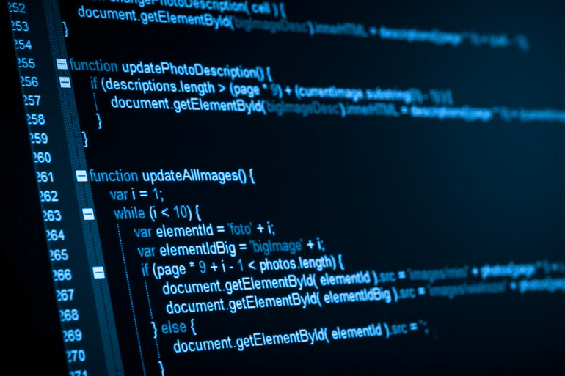

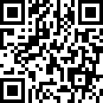
Sponsored by:
It’s Free!
Go to:
https://goo.gl/forms/8VZWaT815N5jfDqh2
12 sessions
Special prize for best performing Project!
Fall 2018
GPU Programming Basics
Northeastern Students:
A free GPU Programming class will be offered this Fall sponsored by NUCAR Laboratory. Students will learn about GPUs and interact with them, learning how to write and design algorithms to develop efficient and high performance programs using the CUDA Framework.
The course consists of 12 sessions, 2 sessions per week*. We will offer a certification for those students who participated through the entire course as well as a certification for the best performing program for the final project.
If you’re interested, please go to the link above and fill up the form.
*Schedule will be determined during the first weeks of Fall classes in September. Expect classes to start on the third week of classes.
For more information contact:
Julian Gutierrez
gutierrez.jul@husky.neu.edu

