Slide 1
Brother, can you spare a dime?
José Enrique García Verdes
Nov 2020

Slide 2
Environment
Covid 19
Economies down
Increase in default expected

Slide 3
Goal
Financial institutions decide who gets financing
Decision based on probability of default
Decisions need to be consistent, automatic, fast
What determines probability of default

Slide 4
How
Kaggle dataset
Approx. 250,000 récords (train and test)
Historical data - individuals

Slide 5
Hypothesis
Income – The bigger the income the less probability of default
Payment capacity – The better the capacity the less probability of default
Delinquency – Previous delinquent behaviour increases probability of default

Slide 6
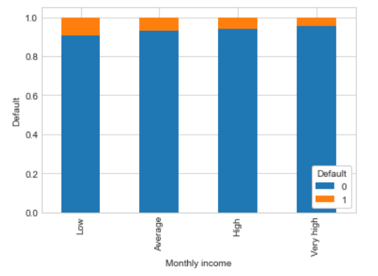
Findings - Income
Not significant enough

Slide 7
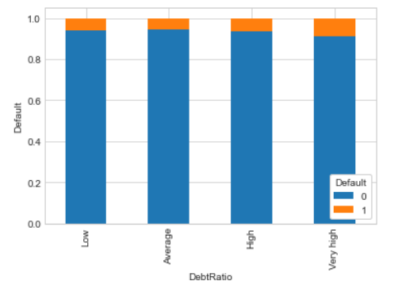
Findings – Payment capacity
Not significant enough

Slide 8
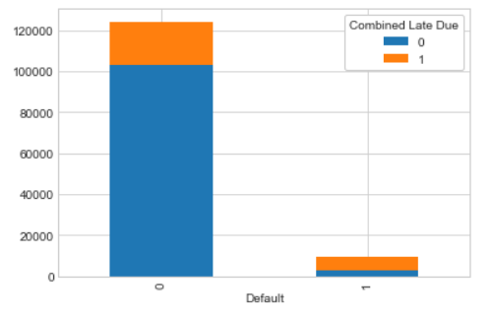
Findings - Delinquency
Slightly significant

Slide 9
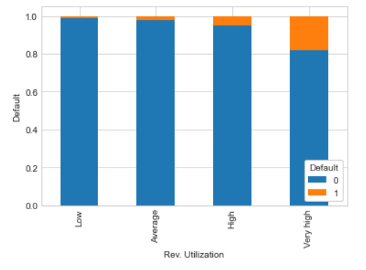
Findings – Revolving debt
Slightly significant

Slide 10
Next
ML model(s) to predict default

