Slide 1
Brother, can you spare a dime?
José Enrique García Verdes
Dec 2020

Slide 2
Content
Problem
Challenges
Results
Next

Slide 3
Problem
Predict probability of default within the next two years
Classification: Yes / No
Metric: Area Under Receiver Operating Characteristic Curve (

Slide 4
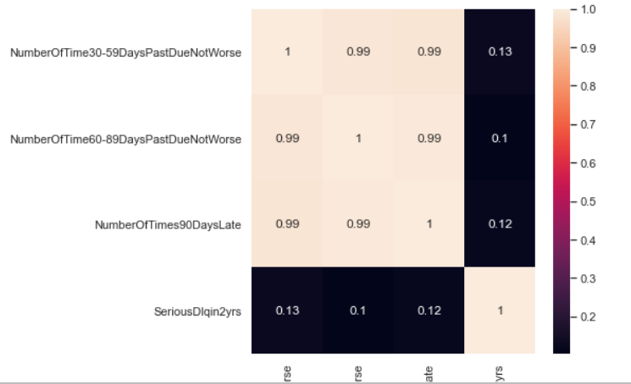
Challenges
Multicollinearity
Used Pearson / VIF
Remove variables
Create combined variable

Slide 5
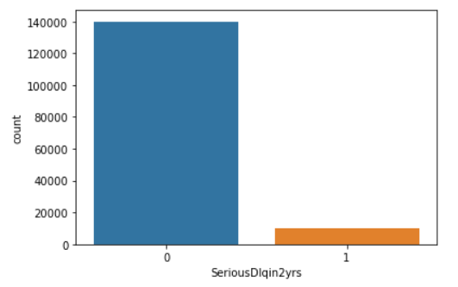
Challenges
Target distribution
Under Sampling
Over sampling
SMOTE
Combination SMOTE / US

Slide 6
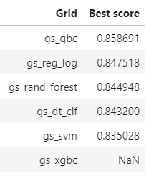
Results
Tested:
Logistic regression
Decision tree
Support Vector Machine
Random forest
Gradient boost classifier
XGBoost classifier

Slide 7
Next
Further investigate and test
hyper-parameters
Deep learning
Use kaggle for testing / get a new laptop

