Slide 1
CASALS
Jiageng Zhong
2026

Slide 2
CASALS
Current Data Products
L0: Raw LiDAR data in TDMS format.
L1A: Structured HDF5 data.
L1B: Geolocated reference height and full transmit/receive waveforms.
Future Level-2 Products
Potential products may include:
3D multi-return point clouds derived from waveform decomposition and geolocation.
Point classification: Ground, vegetation, buildings, water, and noise.
DSM / DTM: Surface and terrain elevation models.
Vegetation metrics: Canopy height and vertical structure.
Applications
Vegetation: Full waveforms can reveal multiple canopy layers and potentially ground beneath vegetation.
Water: Near-infrared light is strongly absorbed by water, limiting bathymetric applications.
Buildings: Measurements generally provide less additional benefit than for vegetation.
Terrain: Ground elevation and topographic mapping, especially where vegetation obscures the surface.
Notes:
Source: notebooks/07_georeferencing_geometry.ipynb, section ECEF geometry and H1/H2 mapping; research/geolocation/bin_georeferencing_audit/run_audit.py::bin_to_xyz. The displayed H2 bin-center interpolation is research-supported. The closure shown is internal consistency, not independent absolute accuracy.

Slide 3
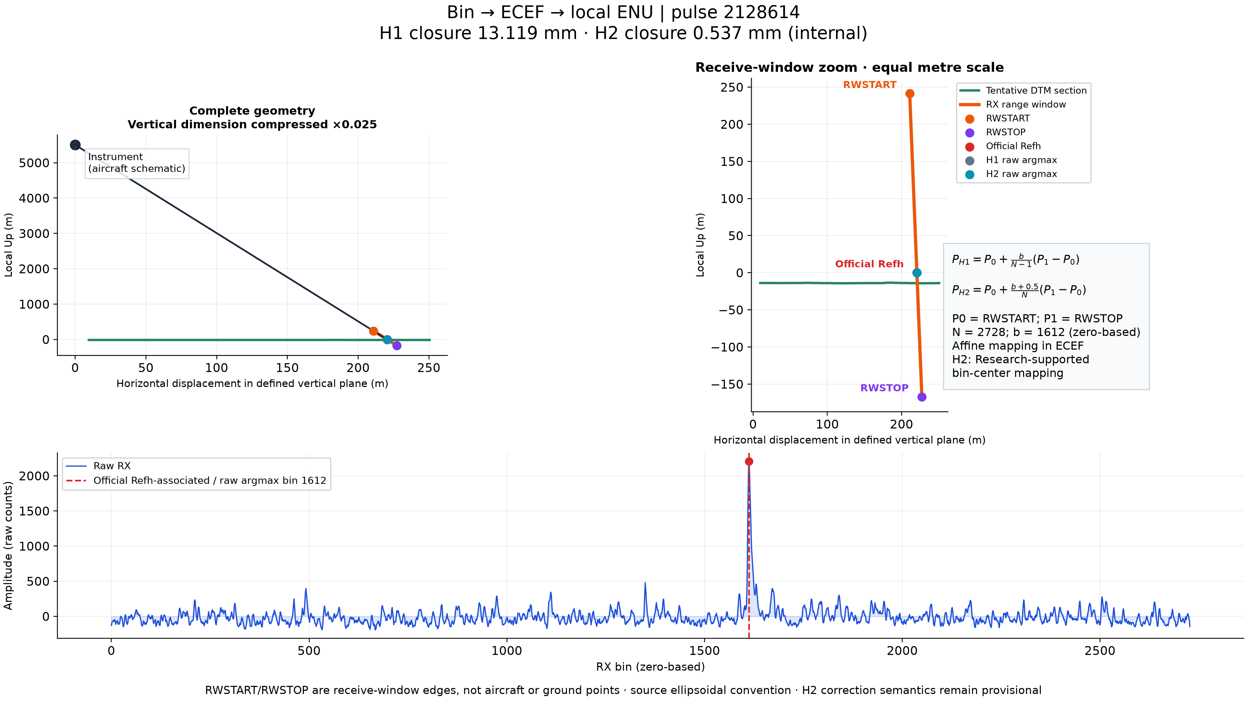
RX bin mapping
Notes:
Source: notebooks/07_georeferencing_geometry.ipynb, section ECEF geometry and H1/H2 mapping; research/geolocation/bin_georeferencing_audit/run_audit.py::bin_to_xyz. The displayed H2 bin-center interpolation is research-supported. The closure shown is internal consistency, not independent absolute accuracy.

Slide 4
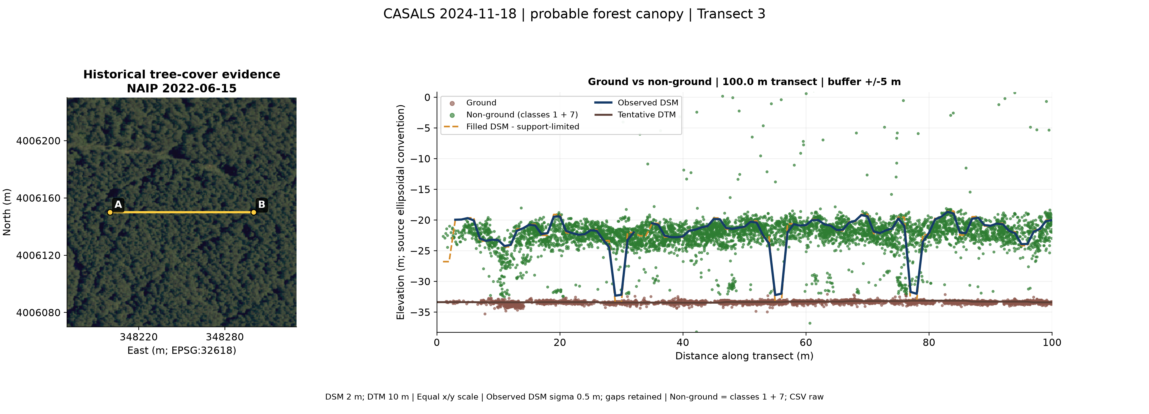
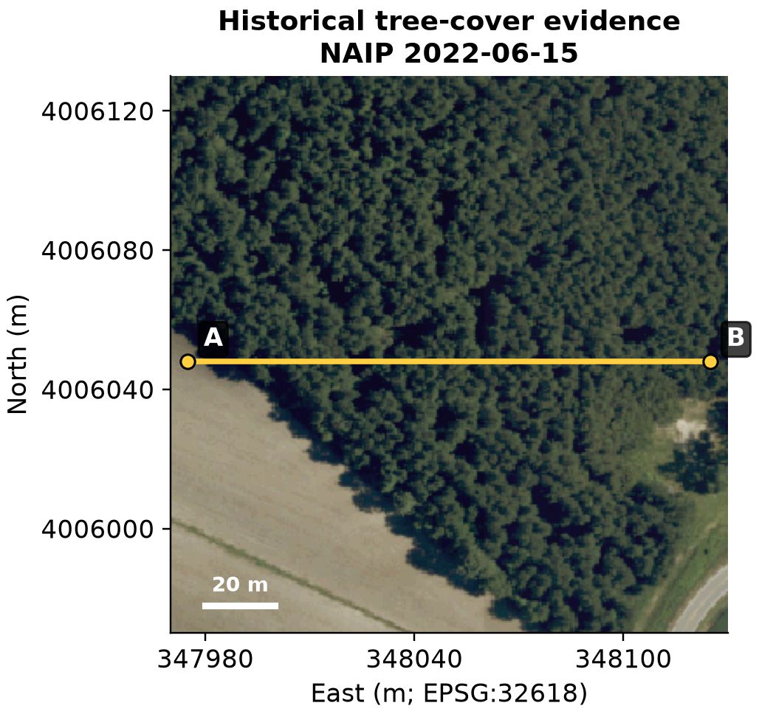
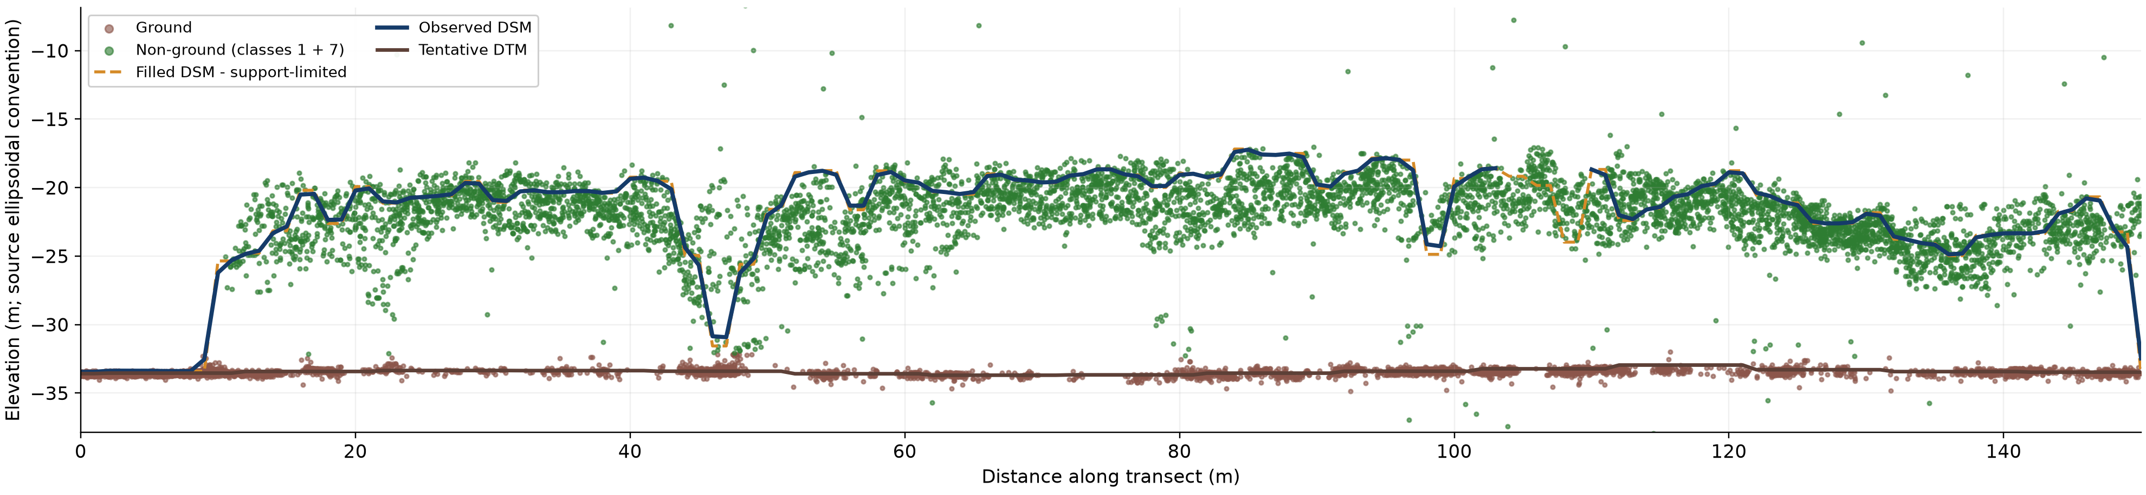
Sweep

Slide 5
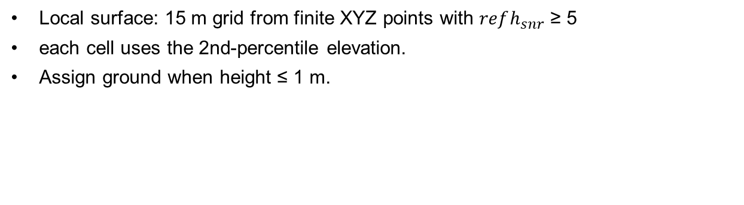
Classification
GROUND
Local surface: 15 m grid from finite XYZ points with $refh_{snr}$ ≥ 5
each cell uses the 2nd-percentile elevation.
Assign ground when height ≤ 1 m.
NOISE
Height < −1 m or > 30 m; or 5 m local point density < 0.02 pts/m³ among remaining points.
Notes:
Sources: notebooks/02_refh_classification.ipynb (H5-only prediction flow); casals_l1b/classification.py (DEFAULT_CONFIG, build_ground_grid, sample_ground_grid_idw, classify_points_baseline, compute_group_robust_z, compute_scanline_features); outputs/classification/full_20261009/casals_l1b_20241118T171757_001_02/casals_l1b_20241118T171757_001_02_run_metadata.json (actual run settings and counts for the H5 shown on the preceding slide).
This specific H5 run uses rule_combined_v1, with no reference supplied; metadata records evaluation.status = not_run. Counts: class 1 = 893,771; class 2 = 2,346,855; class 7 = 363,854 (3,604,480 pulses total).
Ground support candidates require finite XYZ and refh_snr >= 5. A 15 m grid stores the 2nd-percentile elevation per cell. Missing cell estimates use inverse distance weighting from up to 12 cells, power 2, within 30 m. HAG = refh elevation minus sampled local ground. Class 2 is assigned when |HAG| <= 1.5 m.
Class 7 baseline rules: HAG below the ground band (< -1.5 m), HAG > 30 m, or 5 m neighborhood density < 0.02 points/m3 among points remaining after height rules. The local density is the number of points in a 5 m 3D-radius sphere divided by that sphere volume. Non-finite HAG with a valid DTM is also class 7. The enabled scanline rule flags remaining class-1 points with per-track robust HAG z 35–55, HAG 8–15 m, and 5 m density >=2 points/m3; tracks need >=30 points. Robust z uses absolute deviation from track median divided by scaled median absolute deviation. Sweep z is disabled.
Class 1 includes no-usable-DTM points and valid-HAG points left after the ground/noise rules. It is a residual LAS class, not a land-cover label. Near-ground guard, signal/density noise, below-ground refinement, and DTM-support confidence are disabled in this run. These deterministic rules are not independent ground truth or an absolute-accuracy certification.

Slide 6
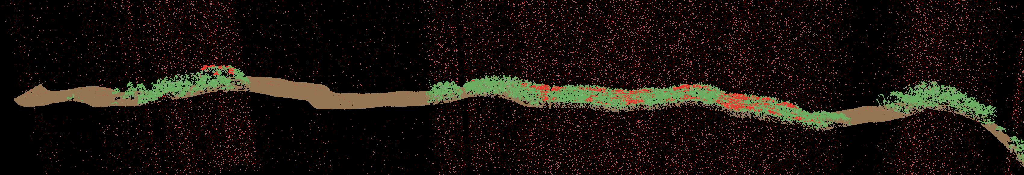
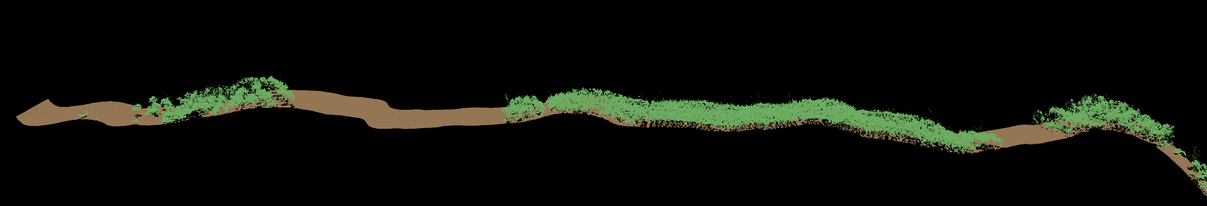
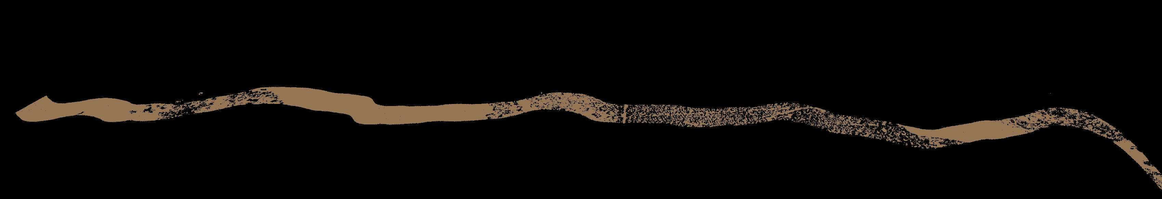
Classification
Data: casals_l1b_20241118T171757_001_02
Full Points
Filtered Points
Ground Points

Slide 7
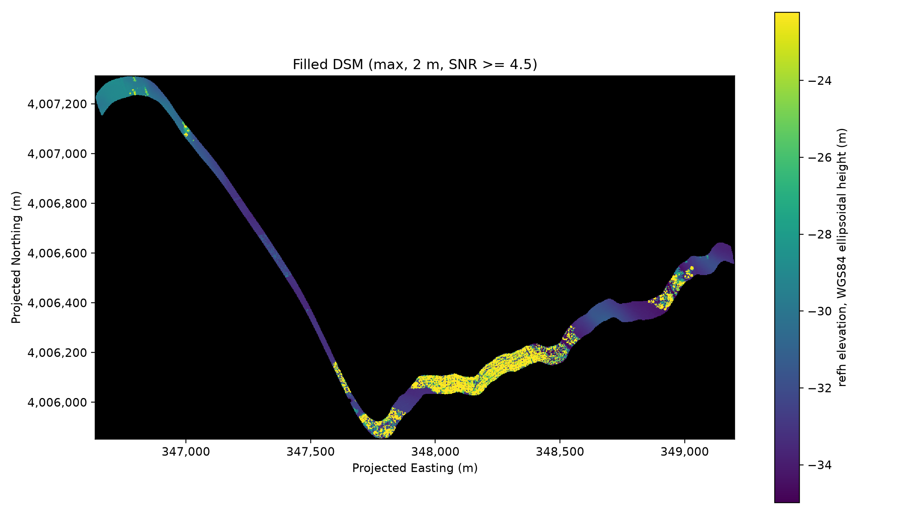
DSM
casals_l1b_20241118T171757_001_02
DSM is generated using points whose SNR>=4.5.

