Slide 1
CASALS
Jiageng Zhong
2026

Slide 2
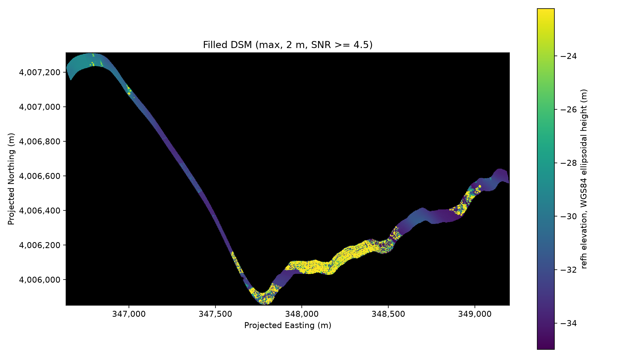
DSM
DSM is generated using points whose SNR>=4.5.

Slide 3
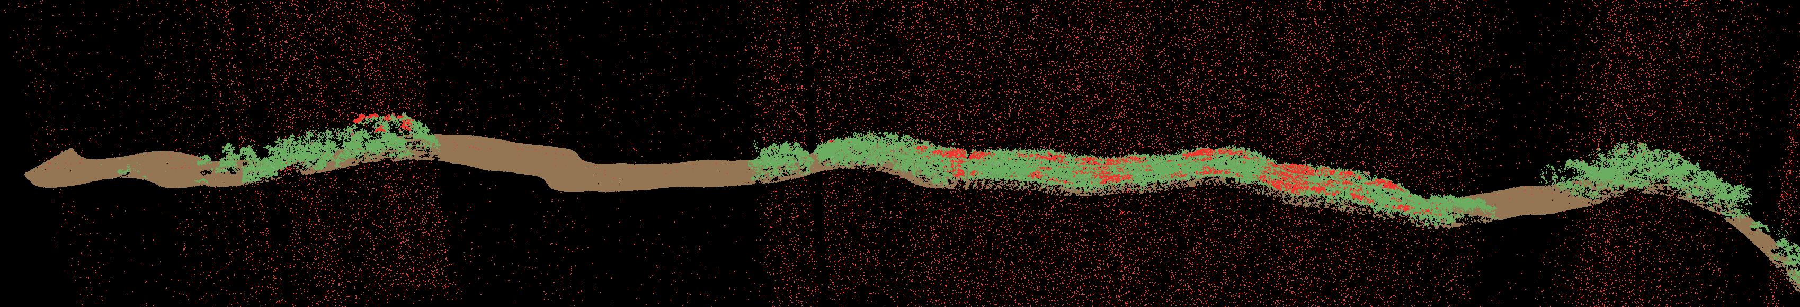
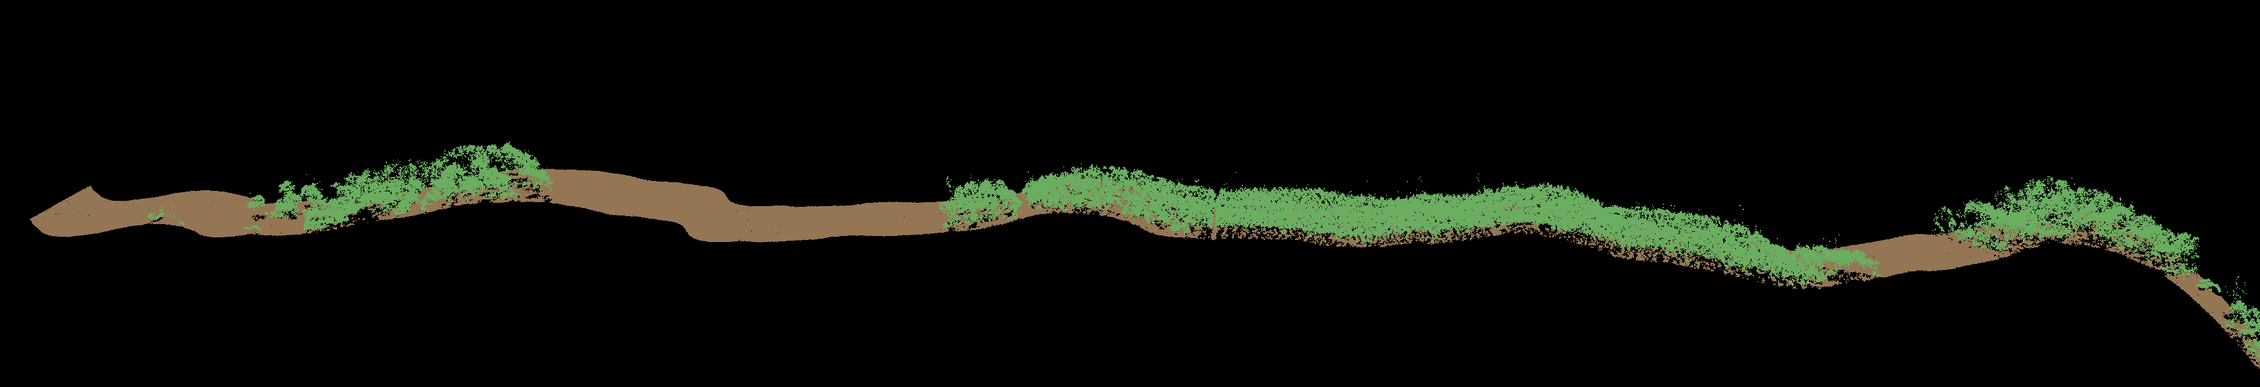
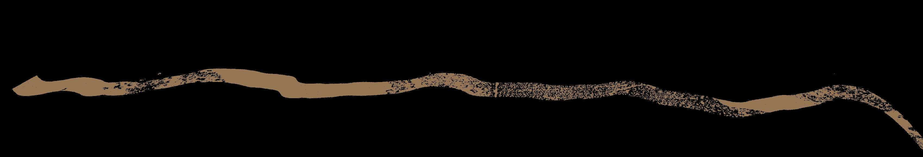
Classification
Data: casals_l1b_20241118T171757_001_02
Full Points
Filtered Points
Ground Points

Slide 4
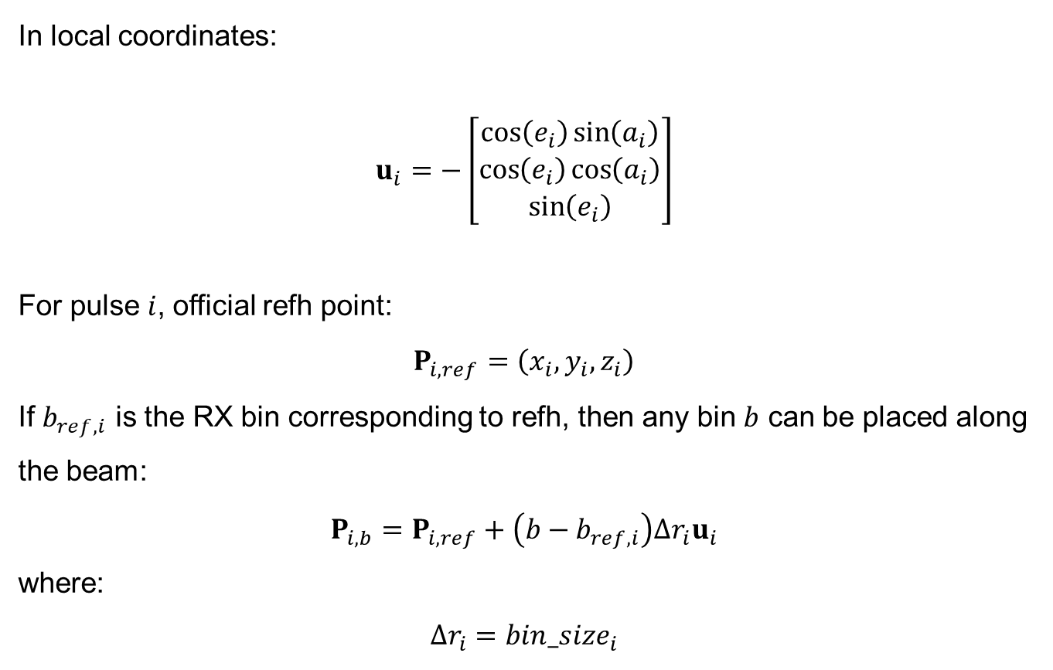
Georeference
In local coordinates:
$$u_{i}=−\left[\begin{matrix}\cos\left(e_{i}\right)\sin\left(a_{i}\right) \\ \cos\left(e_{i}\right)\cos\left(a_{i}\right) \\ \sin\left(e_{i}\right)\end{matrix}\right]$$
For pulse $i$, official refh point:
$$P_{i,ref}=\left(x_{i},y_{i},z_{i}\right)$$
If $b_{ref,i}$ is the RX bin corresponding to refh, then any bin $b$ can be placed along the beam:
$$P_{i,b}=P_{i,ref}+\left(b−b_{ref,i}\right)Δr_{i}u_{i}$$
where:
$$Δr_{i}=bin_size_{i}$$
Official reference point
refh_longitude
refh_latitude
refh
Sensor position
instrument_longitude
instrument_latitude
instrument_altitude
Beam direction
local_beam_azimuth
local_beam_elevation

Slide 5
Georeference

Slide 6
Georeference

Slide 7
Georeference

