Slide 1
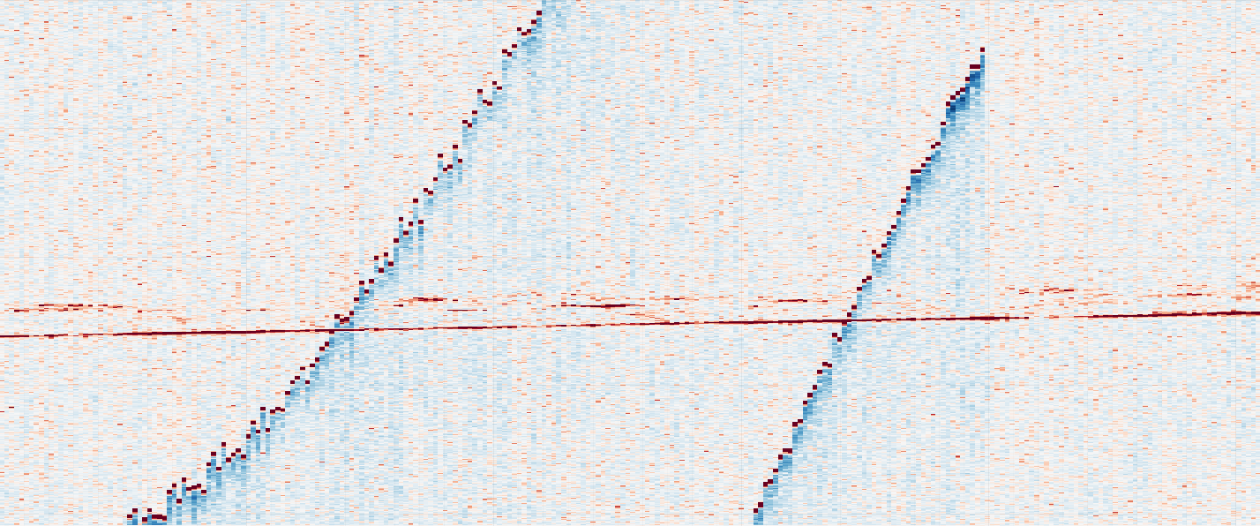
Data
CASALS L1B is a calibrated/geolocated sensor-level HDF5 product. In the current analysis, we use the refh reference-return fields as a Level-A point representation, together with signal attributes such as amplitude, background statistics, and SNR.
H5 file:
refh_longitude refh_latitude refh_height refh_snr refh_amp refh_thres good_snr track_num sweep_num
bg_mean bg_std
……
Range (m) →
Track Index

Slide 2
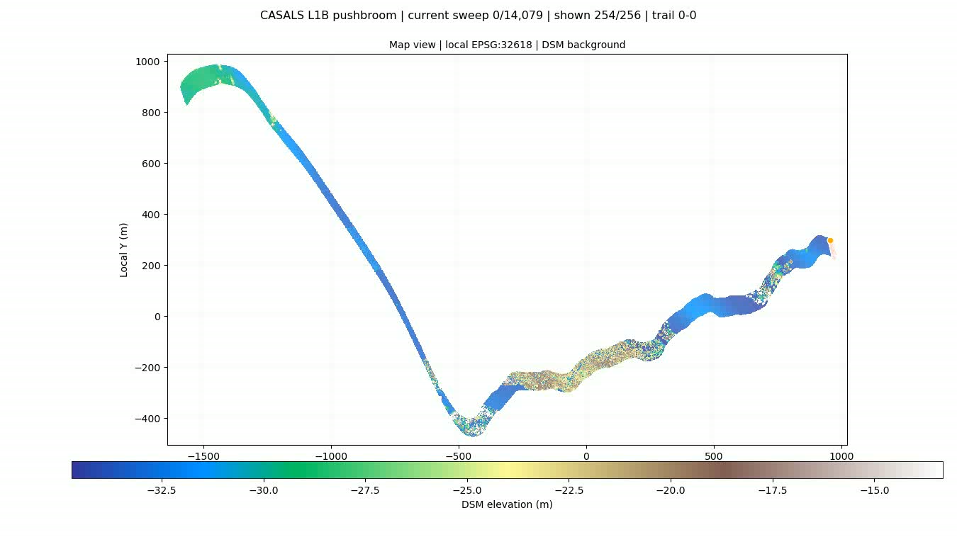
Data

Slide 3
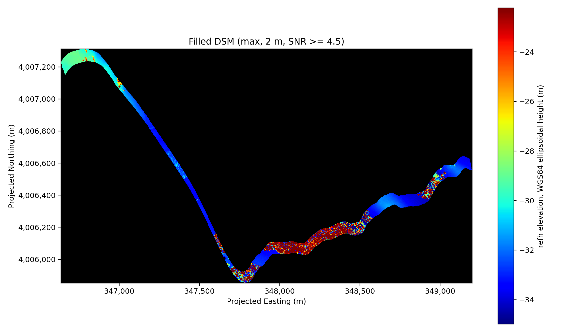
DSM
DSM is generated using points whose SNR>=4.5.

Slide 4
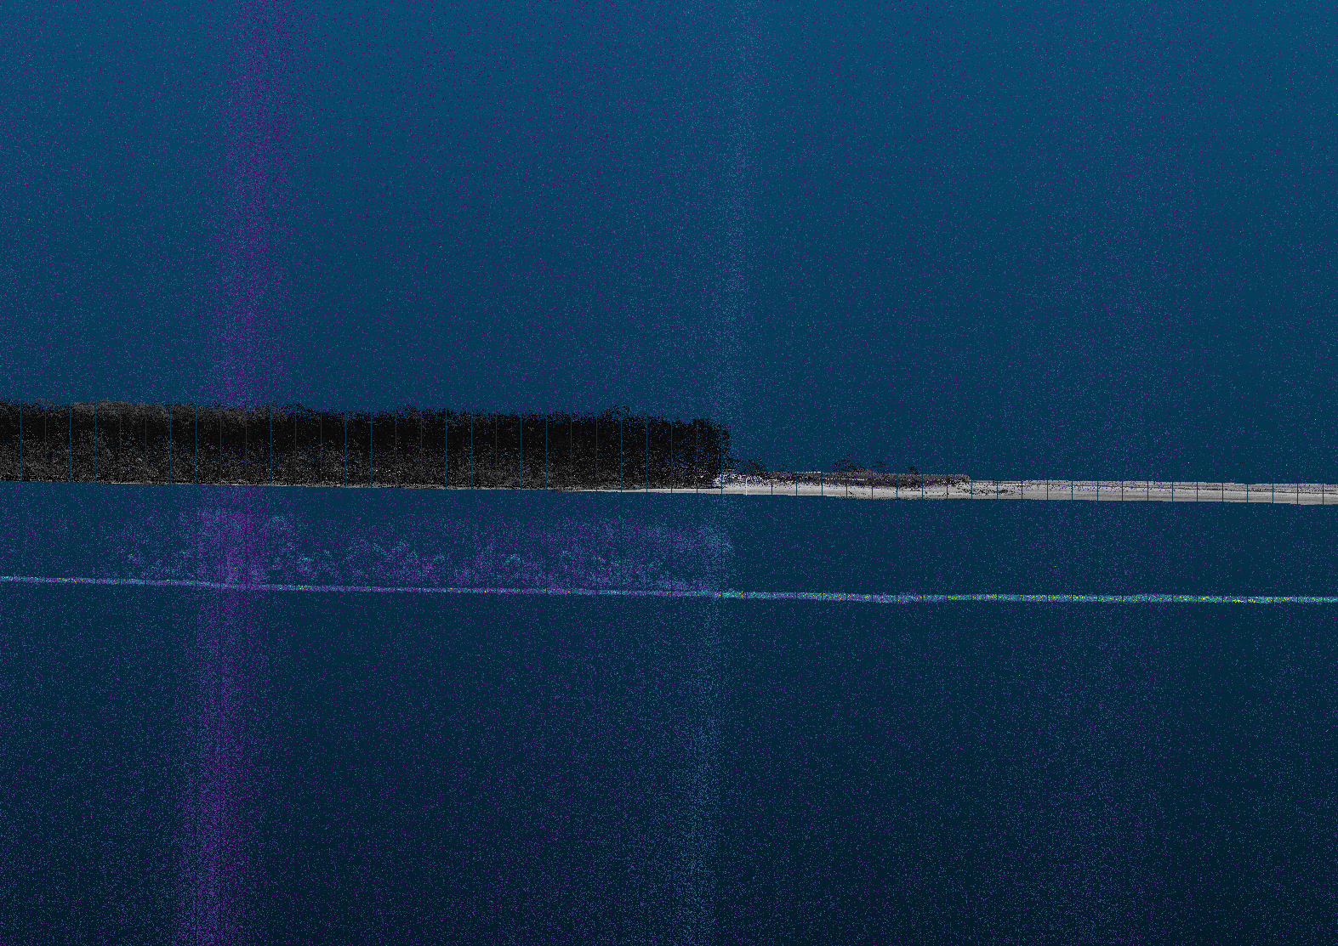
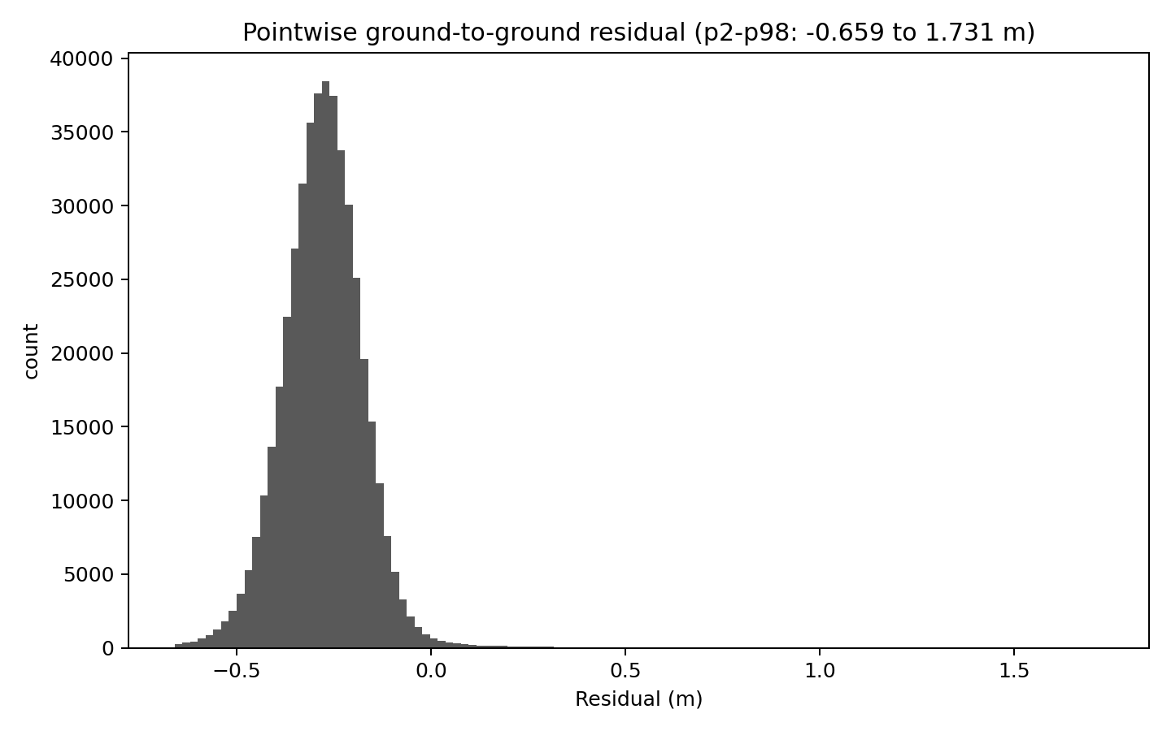
Elevation
Histogram of residuals after transformation
Raw CASALS–3DEP height difference is large and stable, about −37.6 to −38.0 m, mainly reflecting a mixed height-system difference rather than same-datum ground error.
CASALS is treated as WGS84 ellipsoidal height, while 3DEP is treated as NAD83(2011) + NAVD88 orthometric height.
Full WGS84 3D transformation gives a shift of about −37.1 to −37.7 m and reduces the ground-to-ground residual to −0.28 to −0.52 m.

Slide 5
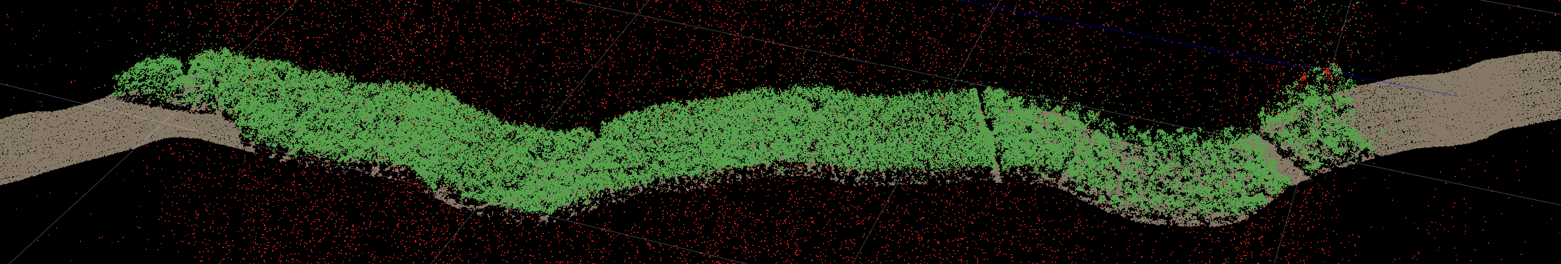
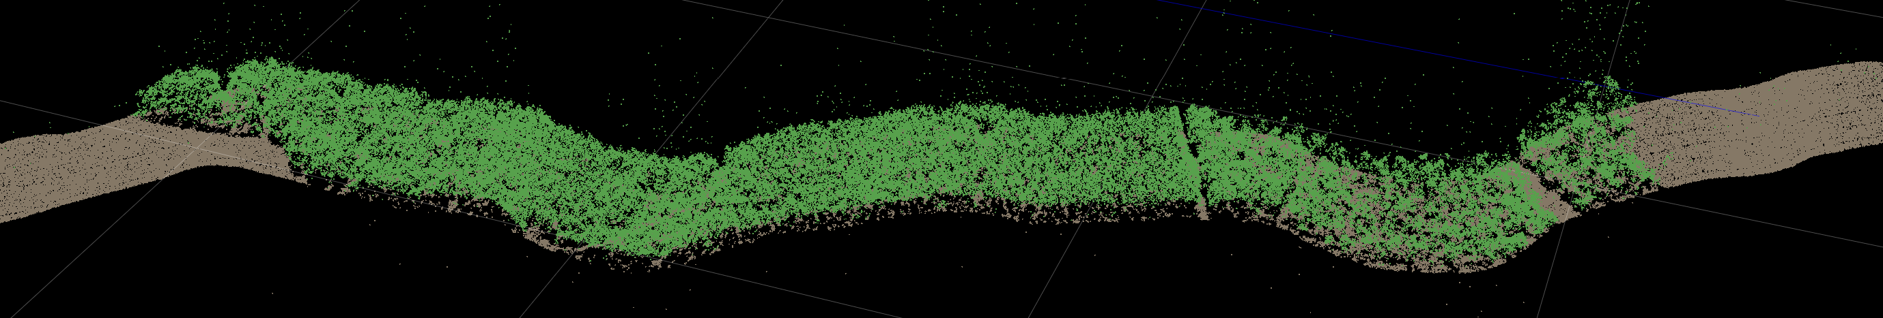
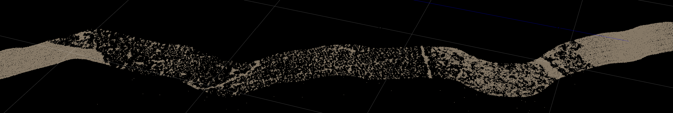
Classification
Data: casals_l1b_20241118T171757_001_02
Red points for noise
Full Points
Green points for surface cover
Filtered Points
Grey points for ground
Ground Points

Slide 6
Understanding & Suggestion
CASALS L1B is a geolocated waveform product, not a multi-return point-cloud product. It stores full Tx/Rx waveforms and one main geolocated reference return per pulse.
refh is the geolocated reference height. It is the WGS84 ellipsoidal height of the receive-waveform bin with maximum amplitude. Therefore, refh represents one selected waveform bin per pulse, not all waveform peaks.
The L1B file has one refh point per pulse. There is no confirmed stored geolocation for other waveform peaks. We should not assume that non-reference peaks from waveform decomposition already have lon/lat/height.
Beam-angle fields exist and are meaningful. L1B includes local_beam_azimuth and local_beam_elevation, plus range-window fields such as rwstart/rwstop, bin_size, and timing/correction fields. However, beam angle alone is not enough. It gives a ray direction, but not the position of another peak along that ray. To geolocate another peak, we also need a validated mapping from waveform bin offset to physical range offset.
Since CASALS L1B currently provides full waveforms and one geolocated reference height per pulse, it would be very useful to also preserve more complete georeferencing information for the waveform/range dimension.
Ideally, the product should include either explicit geolocation, or a fully documented beam/range model that allows users to derive coordinates for any waveform bin or decomposed peak.
At minimum, the documentation should clearly define all parameters, e.g: whether the beam vector points sensor-to-surface or surface-to-sensor. This would allow waveform decomposition results to be converted into scientifically defensible derived returns, rather than being limited to relative waveform-shape analysis.

