Slide 1
CASALS
Jiageng Zhong
2026

Slide 2
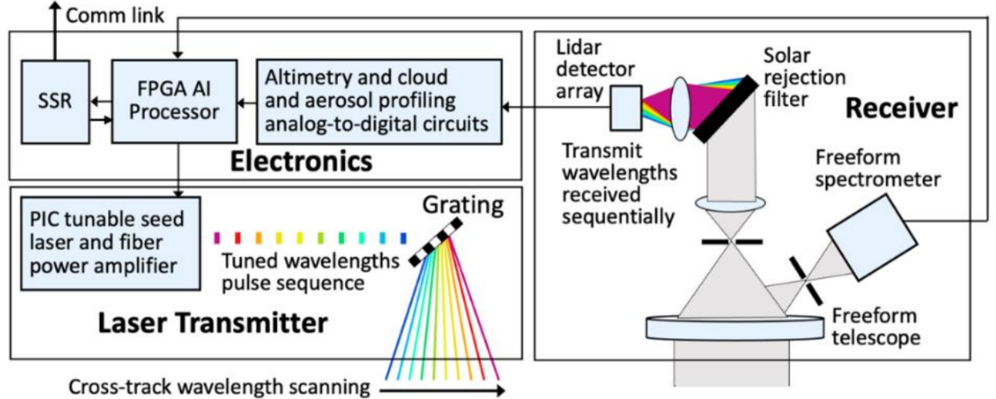
CASALS architecture
CASALS (Concurrent Artificially-intelligent Spectrometry and Adaptive LiDAR System) is designed to acquire co-registered structure (range/waveform) and reflectance information over the same ground swath.
Primary CASALS LiDAR
Laser transmitter: wavelength-tuned pulsed emission (swath encoding)
Dispersive scan optics: λ→θ beam steering (cross-track swath, no scanner)
Receiver + detector: multi-channel, grating-filtered return capture
Electronics/FPGA + digitizer: time-tagging + full-waveform acquisition (range-gated)
Airborne demo / measurement suite
GNSS/INS (Applanix): pose/time for geotagging and georeferencing
Co-aligned hyperspectral imager (Headwall): VNIR–SWIR reflectance over the LiDAR swath
Look-ahead cameras (concept/flight suite): context imaging for real-time targeting decisions

Slide 3
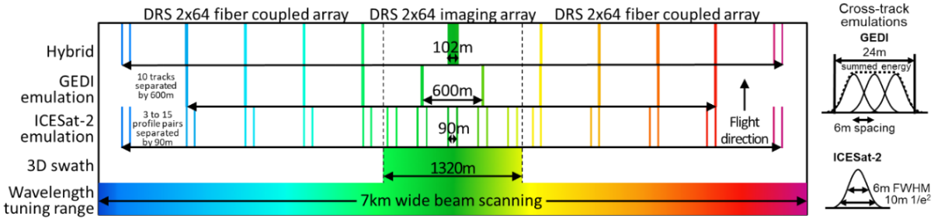
Observation principle
How CASALS forms a swath
Single beam, many footprints: CASALS sweeps laser wavelength, and a grating maps wavelength to cross-track angle, creating a dense footprint set across the swath.
Track concept: a sweep visits many cross-track footprint locations; successive sweeps can “fill” the swath (SCBI waveforms note).
Full-waveform LiDAR: each footprint returns a digitized analog waveform (vs. photon list), supporting canopy/ground separation and complex scenes.

Slide 4
CASALS specifications
Spaceflight concept / targets (scalable track count)
Wavelength-to-angle swath mapping: fast wavelength tuning + dispersive grating in the telescope (no mechanical scanner).
Cross-track capacity (concept): a 30-nm tuning range can form ~1,200 resolvable cross-track spots over 0.825° (~7.2 km swath from 500-km orbit); any subset can be selected by wavelength switching.
Key implication: “track count” is a design degree of freedom (up to ~1,200 resolvable spots in the cited concept), not inherently fixed at 256.
Airborne prototype / datasets (256-track implementation)
Operating wavelength (prototype for Earth science): 1040 nm.
Channelization: 256 tuned wavelengths across ~13 nm; 2-ns pulse carved at each wavelength; amplified up to 3 kW peak power (design).
Receiver filtering/detection: grating-spectrometer receiver with ~0.8-nm passband per footprint; HgCdTe APD array; signals time-division multiplexed to two high-speed ADCs; range-gated digitization to reduce data volume.
Airborne geometry @ 8.5 km: 0.67° total scan angle using 256 tuned wavelengths; ~110 m swath width; ~0.7 m overlapping footprints; ~0.43 m cross-track and ~0.24 m along-track spacing; waveform per footprint with ~20 detected photons (reported).
Airborne geometry @ ~5 km (SCBI note): 0.75° full-width scan; 32 footprints per sweep and 8 sweeps fill the swath to 256 overlapping footprints; ~0.24 m cross-track spacing; ~0.17 m along-track spacing at 80 m/s; ~65 m swath (and “equivalent” ~6.5 km from 500 km orbit).

Slide 5
Georeference
Time-tagged LiDAR data (Tx start time + Rx samples) + platform navigation (position/attitude). Airborne demo explicitly uses Applanix POS AVX 510 and reports ~1 m footprint geolocation accuracy (1σ) from 8.5 km, with over-water maneuvers to estimate pointing biases.
Steps:
Time alignment: synchronize LiDAR row/footprint timestamps to GNSS/INS time.
Range retrieval: estimate range to scattering surfaces from waveform timing relative to start pulse (Tx) and Rx gate.
Pointing model: convert wavelength channel → cross-track angle (calibrated wavelength-to-angle map) + apply attitude (roll/pitch/yaw) + boresight.
Ray–surface intersection: intersect LOS with Earth ellipsoid/DEM (or use waveform-derived range to solve 3D point along the LOS).
Calibration/refinement: solve residual biases (boresight, lever-arm, timing) using dedicated maneuvers / control surfaces; propagate uncertainties to products.

Slide 6
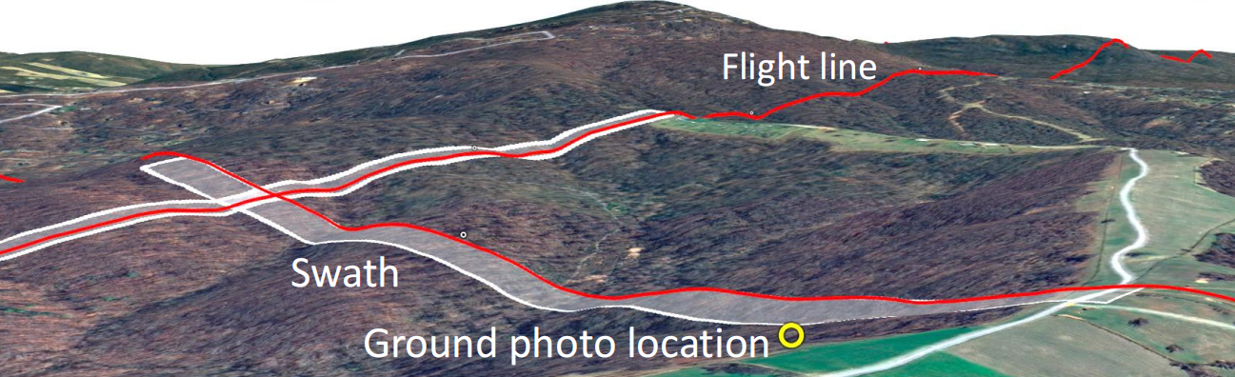
Airborne / UAV observation mode
Cross-track steering: 256 tuned wavelengths spanning 0.67° total scan angle, yielding ~110 m swath from 8.5 km altitude.
Footprint geometry (demo): ~0.7 m diameter overlapping footprints; ~0.43 m cross-track and ~0.24 m along-track spacing.
Co-boresighted passive sensors: Headwall VNIR–SWIR pushbroom + frame cameras; frame cameras point ~7° ahead to give ~8 s for onboard analysis/retargeting.

Slide 7
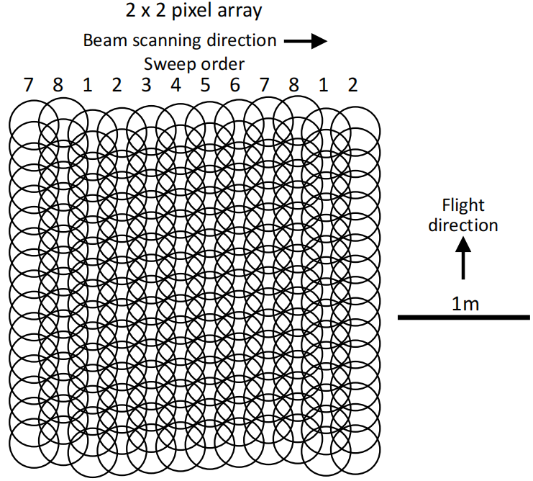
Airborne / UAV observation mode
Wavelength-tuning points the laser beam cross-track over a full-width angle of 0.75° (0.013rad).
One tuning sweep targets 32 footprint locations distributed with equal spacing across the swath and 8 sweeps fill in the swath cross-track with 256 overlapping footprints.
The cross-track footprint spacing is 0.24m at 5km ranging distance, equal to the FWHM diameter, forming a 65m wide swath (equivalent to 6.5km swath in 500km satellite orbit).
The along-track footprint spacing is 0.17m at 80m/s aircraft ground speed, forming 256 parallel tracks.
12 of 256 Wavelength-tuned Tracks
Across the Airborne CASALS Lidar Swath

Slide 8
Airborne / UAV observation mode - TDMS
What the file represents (pushbroom waveform LiDAR)
A TDMS file stores many along-track advances called rows.
Each row contains the full cross-track swath as 256 waveform footprints (parallel tracks).
Each footprint is a 1D int16 waveform sampled in time/range.
Key acquisition parameters (from TDMS group properties)
# WVLSteps/Sweep = steps per sweep (typically 32)
# Sweeps/ShiftCycle = sweeps per cycle (typically 8)
Sweeps/File = rows per file (number of pushbroom advances)
Derived: footprints_per_row = steps_per_sweep × sweeps_per_cycle = 32 × 8 = 256
Sweep vs Step (the critical definitions)
Step (k): one discrete cross-track pointing/position within a wavelength-tuning sweep (k = 0..31).
Sweep (j): one pass through all steps (j = 0..7 within a shift cycle).
Why 8 sweeps? Interleaving/fill-in across sweeps densifies cross-track sampling so one row becomes 256 footprints.
Channel naming and meaning (how data is stored)
TDMS contains 256 channels named Sweep{j}Step{k} for all (j,k) pairs.
Each channel corresponds to a fixed footprint index across the entire file (same cross-track position pattern).
Each channel is stored as one long 1D stream made by concatenating all rows:
channel = [row0 waveform][row1 waveform] ... [rowN-1 waveform]

Slide 9
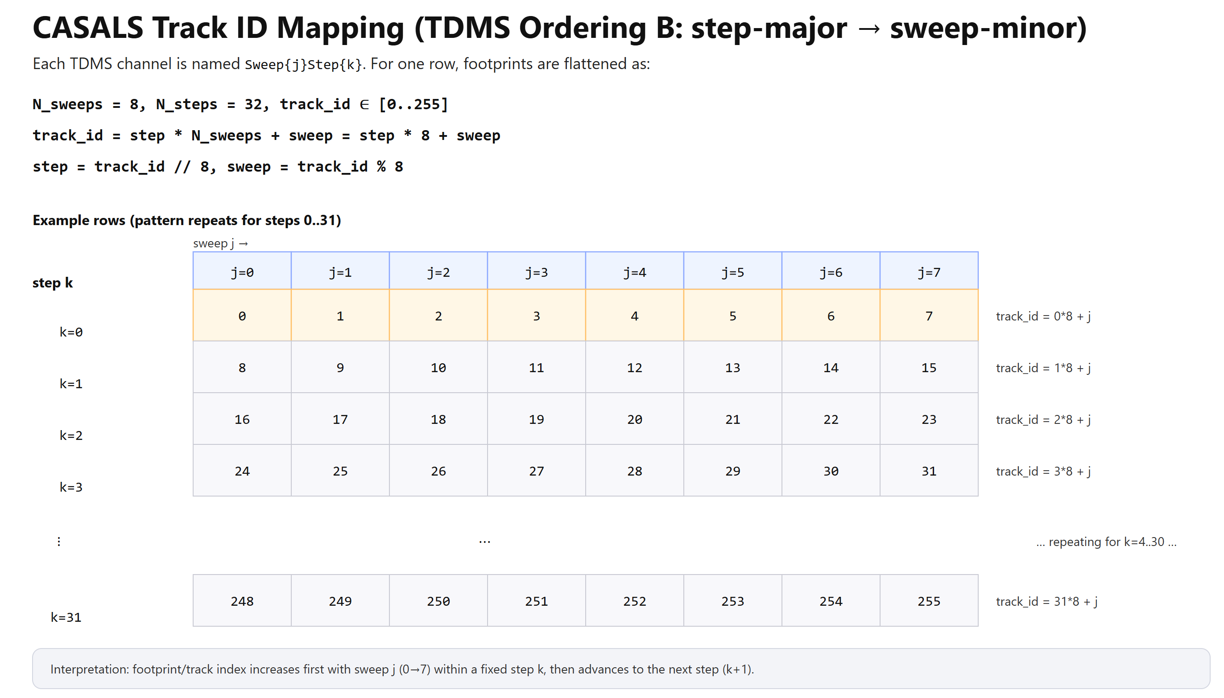
Airborne / UAV observation mode - TDMS

Slide 10
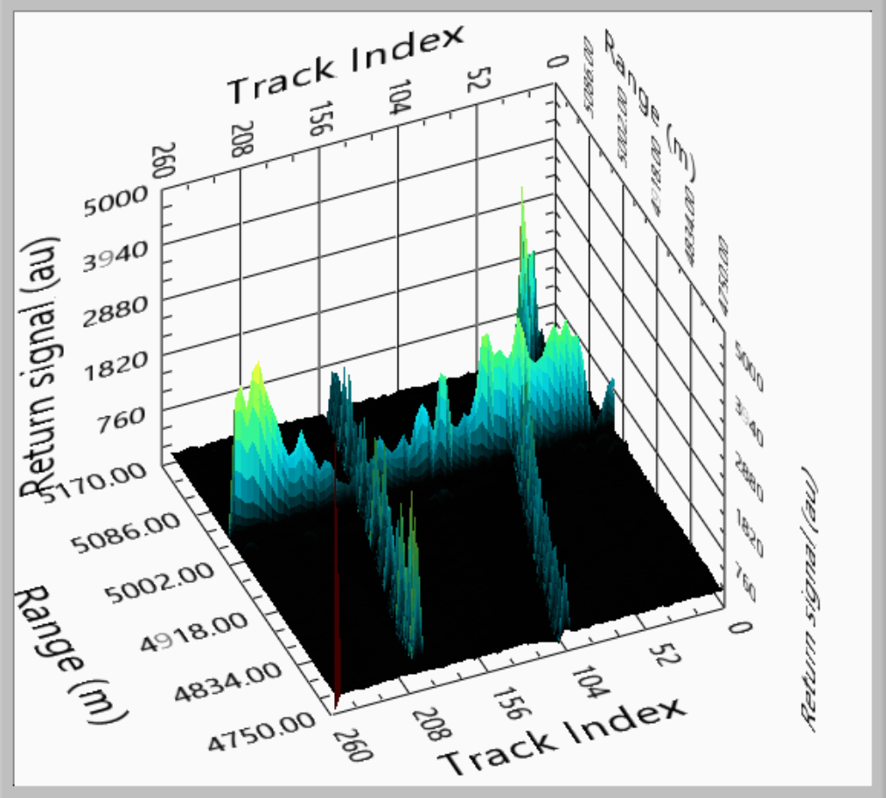
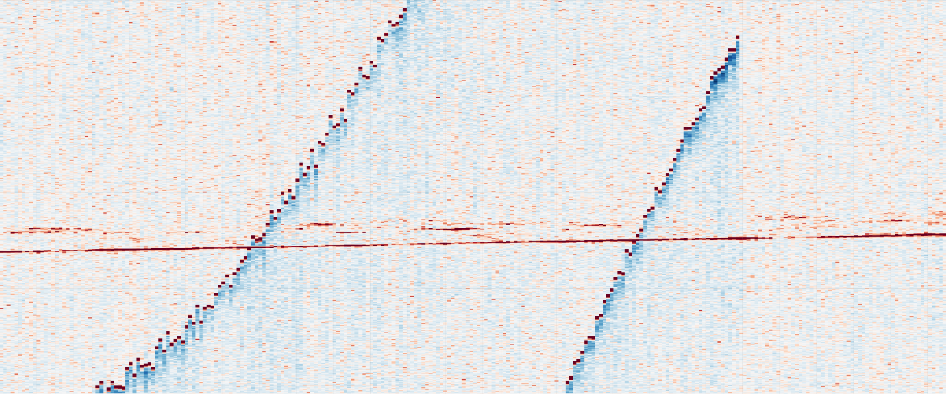
Nadir-port window reflections
A “nadir-port window” is a protective optical window in the nadir viewing path. A small fraction of the laser pulse can reflect off that window surface(s) and re-enter the receiver path, creating a strong instrumental ghost (non-geophysical) at a consistent range/time.
Possible ways to detect:
fixed range bin / early-time consistency
abnormal amplitude
weak dependence on scene
track-localized behavior
Range (m) →
Track Index

Slide 11
06.18

Slide 12
Data
CASALS L1B is a calibrated/geolocated sensor-level HDF5 product. In the current analysis, we use the refh reference-return fields as a Level-A point representation, together with signal attributes such as amplitude, background statistics, and SNR.
H5 file:
refh_longitude refh_latitude refh_height refh_snr refh_amp refh_thres good_snr track_num sweep_num
bg_mean bg_std
……
Range (m) →
Track Index

Slide 13
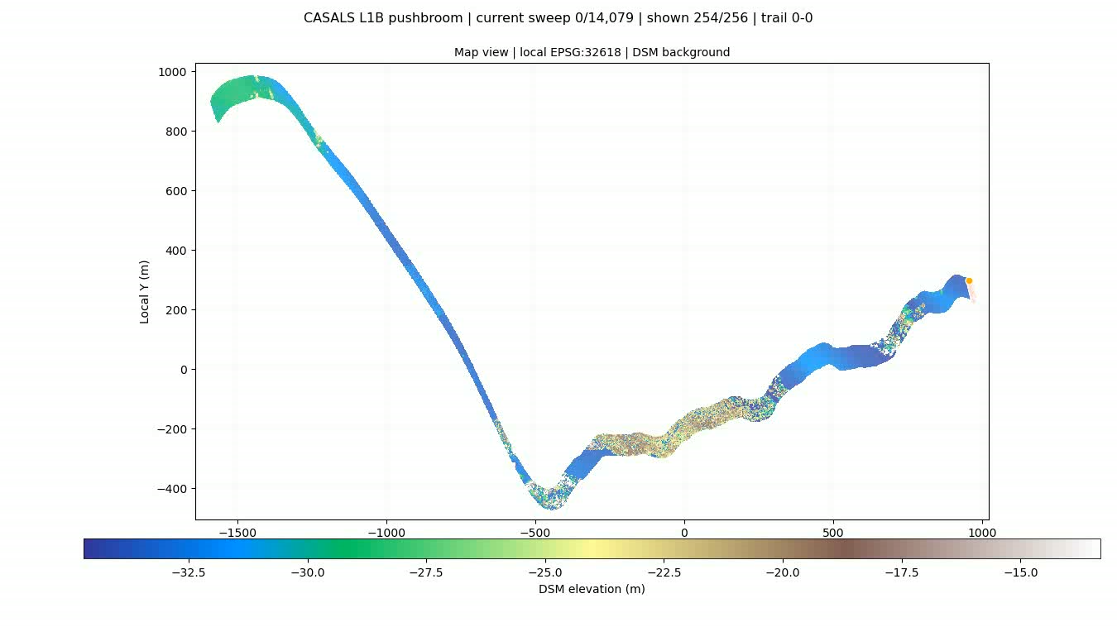
Data

Slide 14
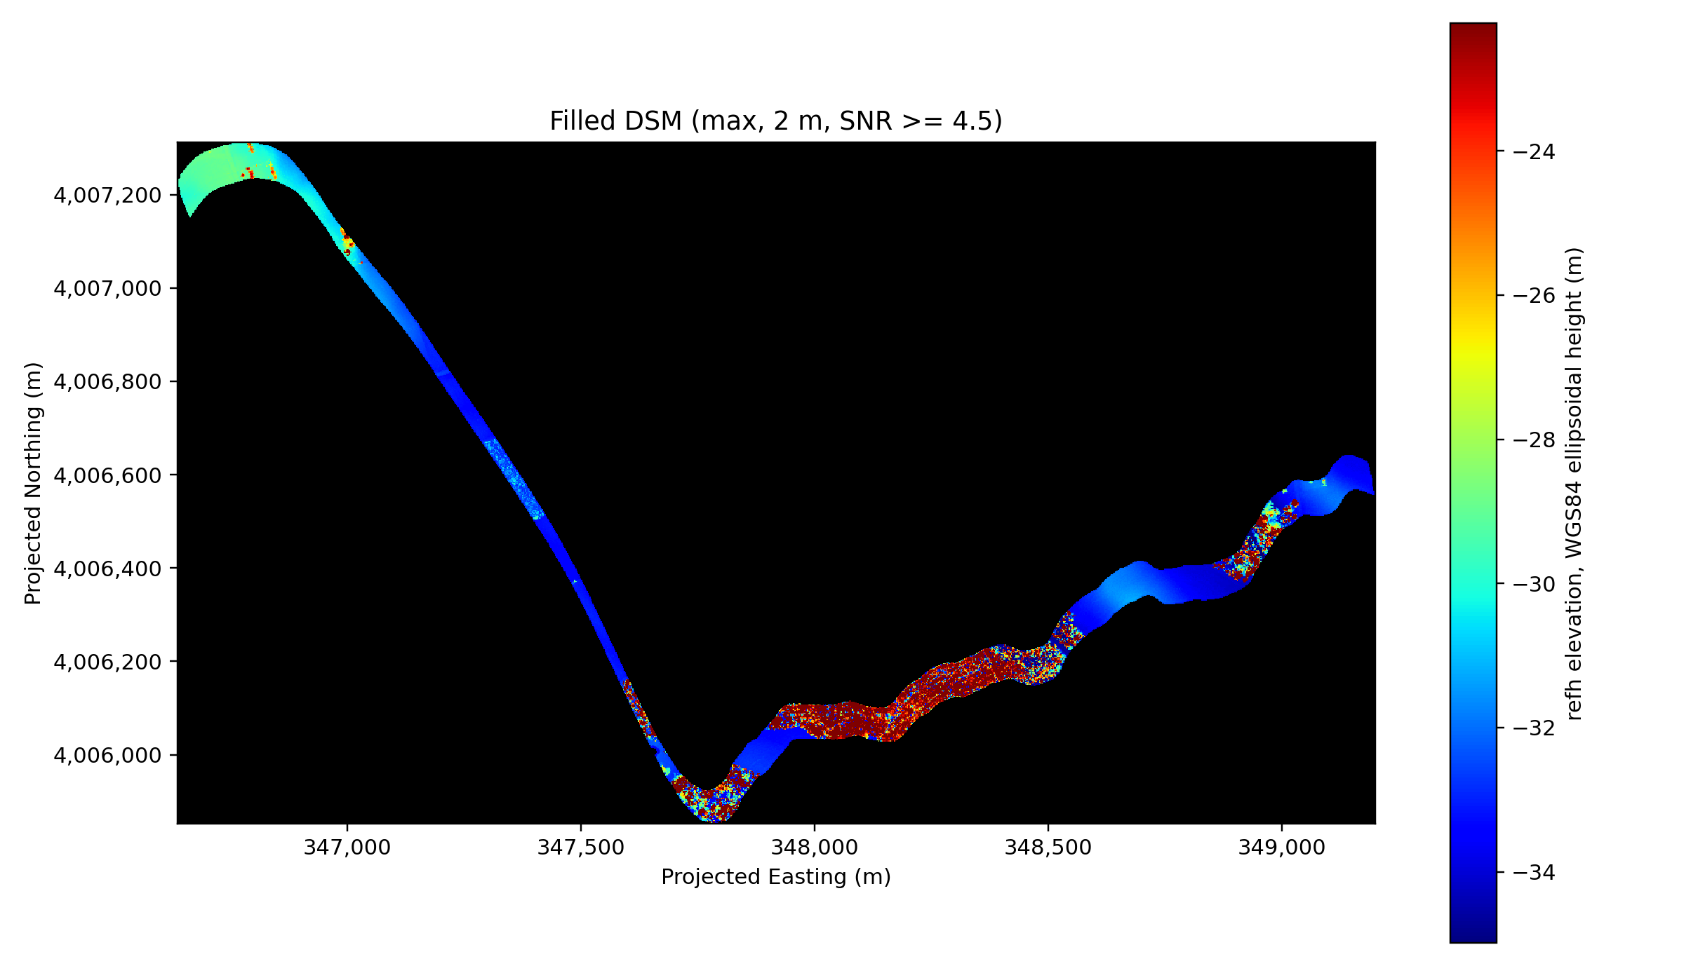
DSM
DSM is generated using points whose SNR>=4.5.

Slide 15
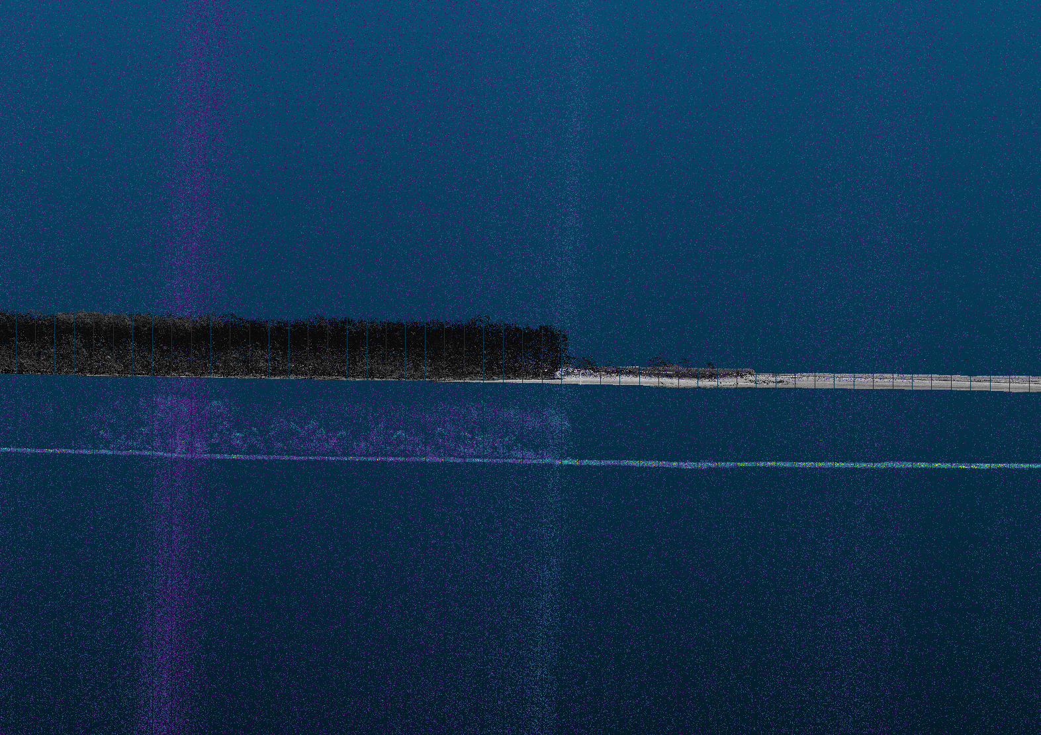
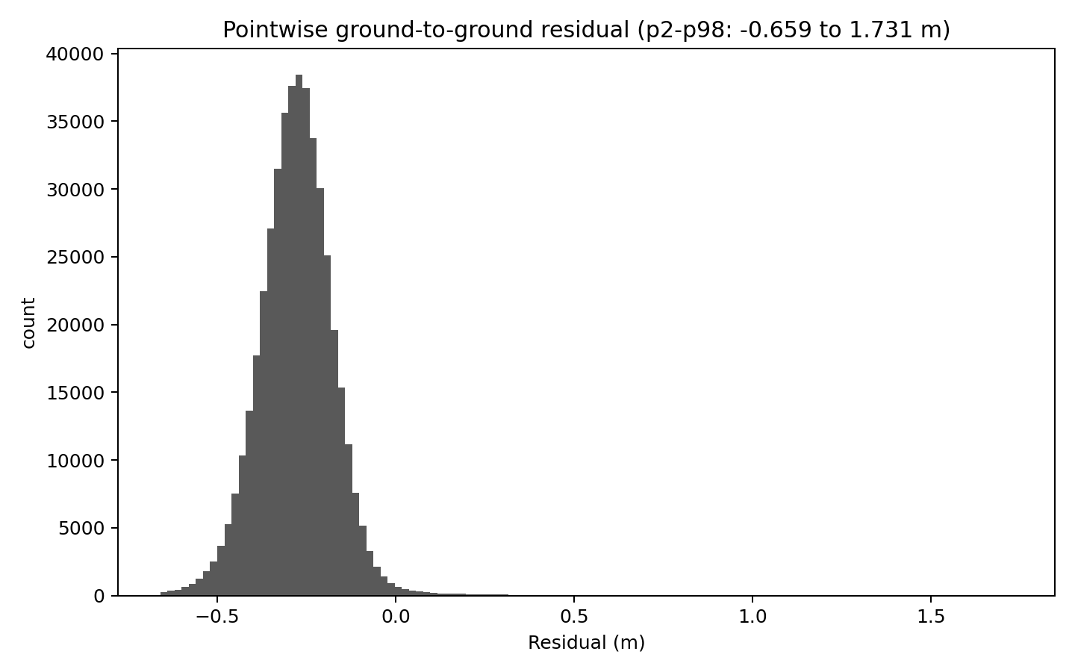
Elevation
Histogram of residuals after transformation
Raw CASALS–3DEP height difference is large and stable, about −37.6 to −38.0 m, mainly reflecting a mixed height-system difference rather than same-datum ground error.
CASALS is treated as WGS84 ellipsoidal height, while 3DEP is treated as NAD83(2011) + NAVD88 orthometric height.
Full WGS84 3D transformation gives a shift of about −37.1 to −37.7 m and reduces the ground-to-ground residual to −0.28 to −0.52 m.

Slide 16
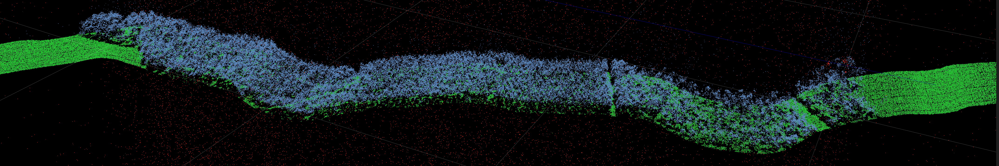
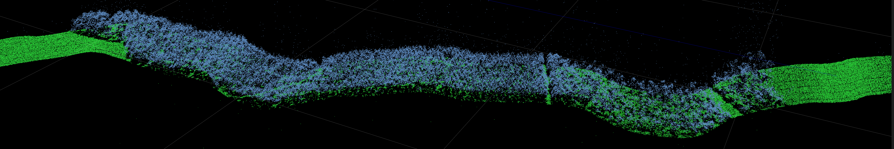
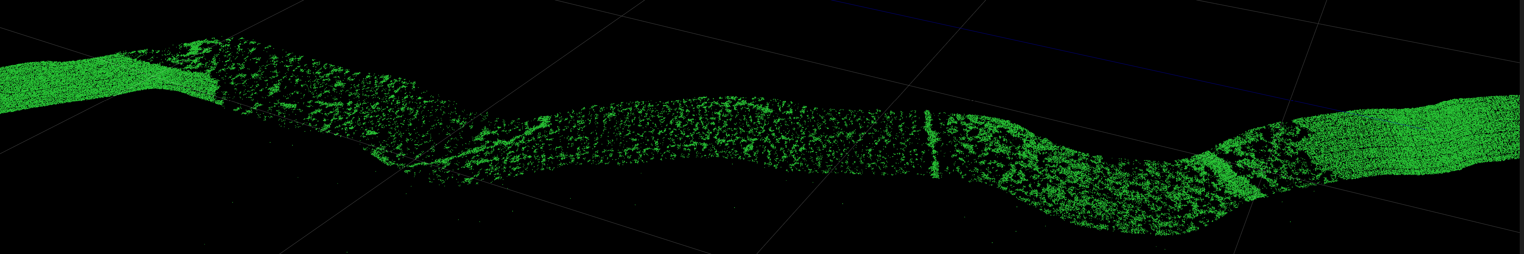
Classification
Data: casals_l1b_20241118T171757_001_02
Full Points
Filtered Points
Ground Points

Slide 17
Understanding & Suggestion
CASALS L1B is a geolocated waveform product, not a multi-return point-cloud product. It stores full Tx/Rx waveforms and one main geolocated reference return per pulse.
refh is the geolocated reference height. It is the WGS84 ellipsoidal height of the receive-waveform bin with maximum amplitude. Therefore, refh represents one selected waveform bin per pulse, not all waveform peaks.
The L1B file has one refh point per pulse. There is no confirmed stored geolocation for other waveform peaks. We should not assume that non-reference peaks from waveform decomposition already have lon/lat/height.
Beam-angle fields exist and are meaningful. L1B includes local_beam_azimuth and local_beam_elevation, plus range-window fields such as rwstart/rwstop, bin_size, and timing/correction fields. However, beam angle alone is not enough. It gives a ray direction, but not the position of another peak along that ray. To geolocate another peak, we also need a validated mapping from waveform bin offset to physical range offset.
Since CASALS L1B currently provides full waveforms and one geolocated reference height per pulse, it would be very useful to also preserve more complete georeferencing information for the waveform/range dimension.
Ideally, the product should include either explicit geolocation, or a fully documented beam/range model that allows users to derive coordinates for any waveform bin or decomposed peak.
At minimum, the documentation should clearly define all parameters, e.g: whether the beam vector points sensor-to-surface or surface-to-sensor. This would allow waveform decomposition results to be converted into scientifically defensible derived returns, rather than being limited to relative waveform-shape analysis.

